Slide 1


The measurement of non-photonic electrons in STAR
Olga Hájková for the STAR Collaboration
Faculty of Nuclear Sciences and Physical Engineering
Czech Technical University in Prague
Hard Probes 2012
27th May – 1st June 2012, Cagliary, Italy

Slide 2
Outline
Motivation.
NPE analysis methods.
NPE spectrum in p+p collisions at 200 GeV.
NPE – hadron correlations in p+p collisions at 200GeV and 500GeV.
NPE spectrum in Au+Au collisions.
NPE – hadron correlation in Au+Au collisions.
NPE elliptic flow in Au+Au collisions.
Future – measurement with HFT and MTD.

Slide 3
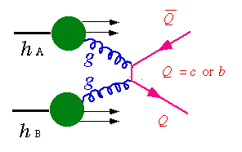
NPE measurement as a proxy to the heavy flavor
K+
e-/μ-
Due to their large masses heavy quarks are produces mainly during initial parton-parton interactions at RHIC, and they are good probes to study the QCD matter.
Study of heavy flavor production in nucleon+nucleon collisions is a test of the validity of the pQCD.
Measurement in p+p collisions can be use as a baseline to study effect of hot and cold nuclear matter to production of heavy flavor quarks in ion-ion and ion-nucleon collisions.
νl
K-
D0
π
D0
Open heavy flavor
e-/μ-
e+/μ+
Heavy quarkonia
Today 17:30 (Room T3): Anthony KESICH - Measurements of Upsilon Production and Nuclear Modification Factor at STAR.

Slide 4
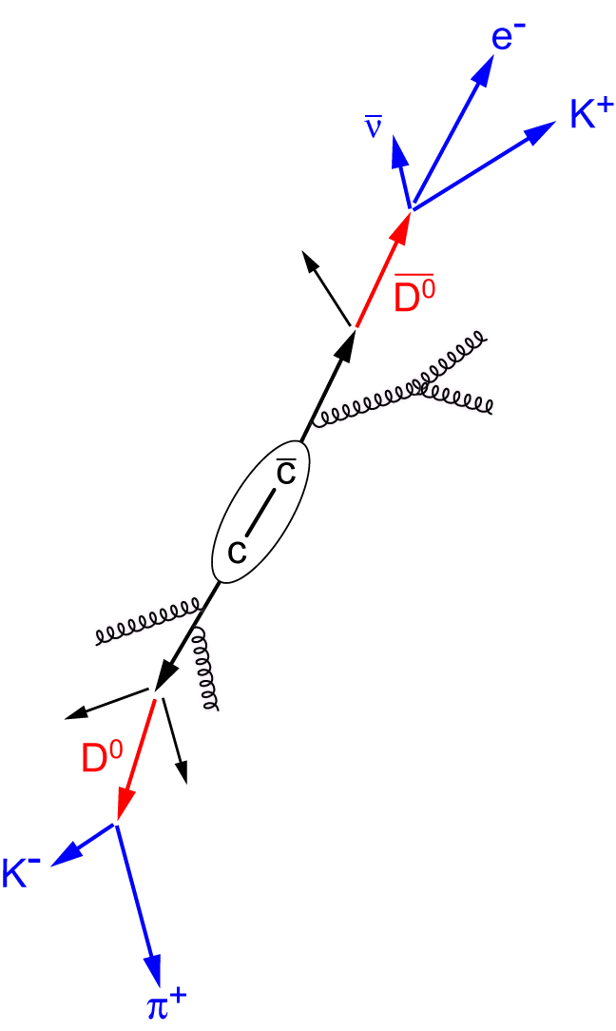
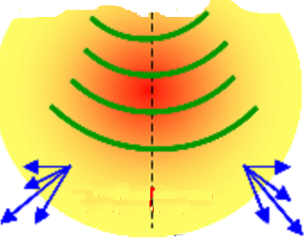
NPE measurement as a proxy to
the heavy flavor production
Study of non-photonic electrons is a good way to measure production of bottom and charm hadrons via semi-leptonic decays.
Main background in this measurement comes from photonic electrons.
→ Dalitz decay: π0 → γ+e++e- (BR: ~1.2%)
→ Gamma conversions: γ → e++e- (Decay
prob: 7/9*Radiation Length)
Away side heavy quark medium modifications – study via correlation.

Slide 5
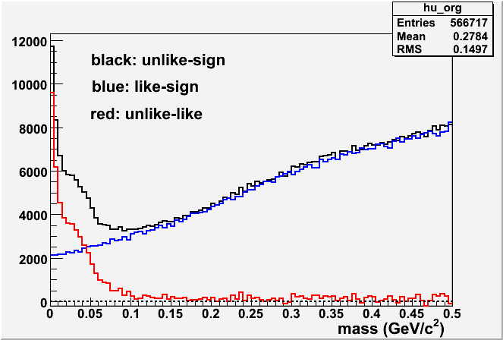
NPE analysis method
Inclusive electrons – pass electron identification cuts.
Photonic electrons – identify via small invariant mass cut and spectrum is reconstructed statistically unlike-sign minus like-sign.
Purity – from Inclusive electrons sample.
A fraction of electrons from pairs cannot be tracked in the TPC → Photonic electron efficiency = reconstructed photonic electrons over all photonic (i.e. reconstructed and non-reconstructed).
Same way as yield could be calculated others variables (elliptic flow).
p+p 200 GeV
STAR preliminary

Slide 6
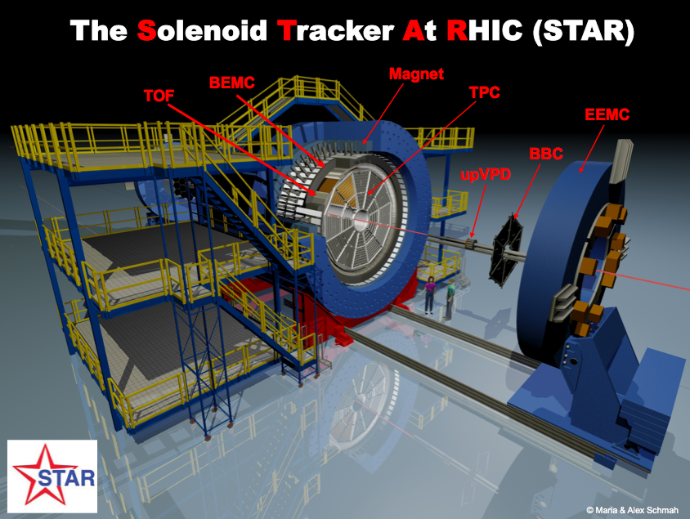
STAR detector at RHIC
Large acceptance:
|η|<1, 0<φ<2π
Time Projection Chamber (TPC) – tracking, particle identification, momentum
Time of Flight detector (ToF) – particle identification
BEMC – electron identification, triggering
BSMD – electron identification at high pT

Slide 7
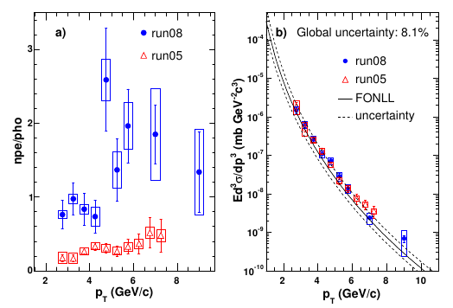
NPE spectrum in p+p collisions at √s=200GeV
Different material thickness in years 2005 and 2008 (⁓10 times more material in run05 because of silicon detectors presence).
→ much more gama conversion background in run05.
→leads to the different NPE/PHE ratio.
→ despite of analysis sensitivity to the amount of photonic background, results from years 2005 and 2008 agree with each other well for pT > 3 GeV.
STAR Phys. Rev. D 83 (2011) 052006

Slide 8
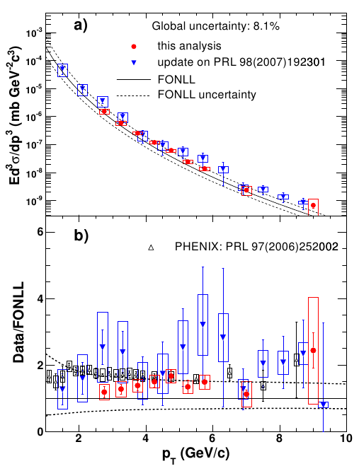
NPE spectrum in p+p collisions at √s=200GeV
Results from years 2005 and 2008 were combined.
Combined results are consistent with PHENIX results, and with FONLL calculations as well.
STAR Phys. Rev. D 83 (2011) 052006

Slide 9
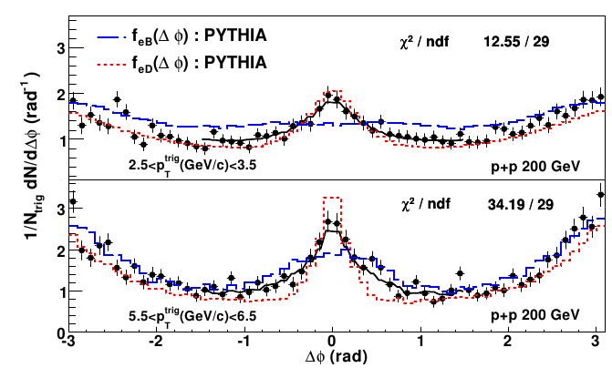
NPE – hadron azimuthal
correlation
Radiative energy loss depends on the quark matter → theoretical prediction of the non-photonic electron suppression rely on the B/D ratio.
Study of NPE- hadron azimuthal correlations allows determine the B/D ratio of NPE.
Bottom and charm contributions to the total NPE yields are obtained by the comparision of data with PYTHIA.
STAR: PRL 105, 202301 (2010)

Slide 10
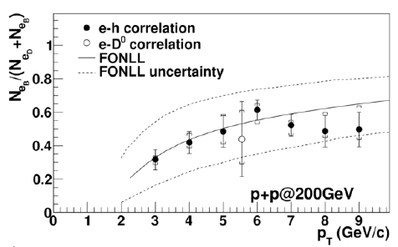
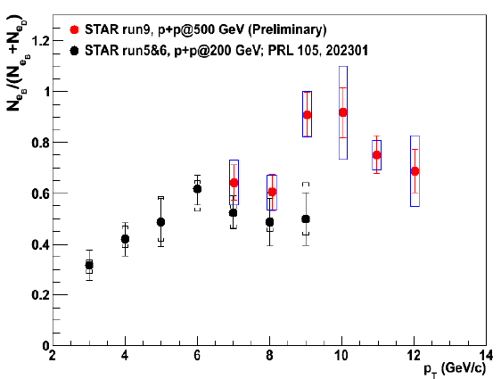
Bottom contribution to the NPE
in p+p at 200GeV and 500GeV
STAR: PRL 105, 202301 (2010)
Contribution of the B mesons decay at 200GeV to the NPE spectra increase with pT. and its comparable to the contribution from D mesons decay at pT>5GeV.
B contribution to the NPE is about 60% for p+p collisions at 500GeV at high pT.
Bottom contribution to the NPE increasing with energy.

Slide 11
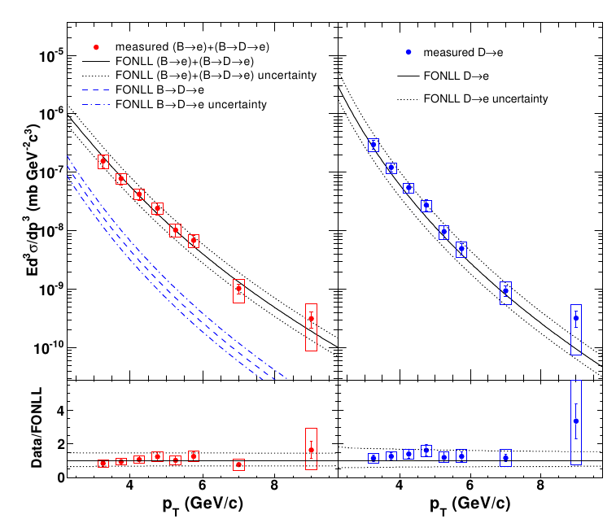
Bottom and charm contributions to the NPE at 200 GeV
Measurement of NPE from bottom decays is consistent with the central value of FONLL, NPE from charm decays are between the central value and upper limit of the FONLL calculation.
After extrapolating the results to the full kinematics region total bottom production is:
Results uncertainties are 12.5%(stat.) and 27.5%(syst.)
Both results are consistent with FONLL calculation.
STAR Phys. Rev. D 83 (2011) 052006

Slide 12
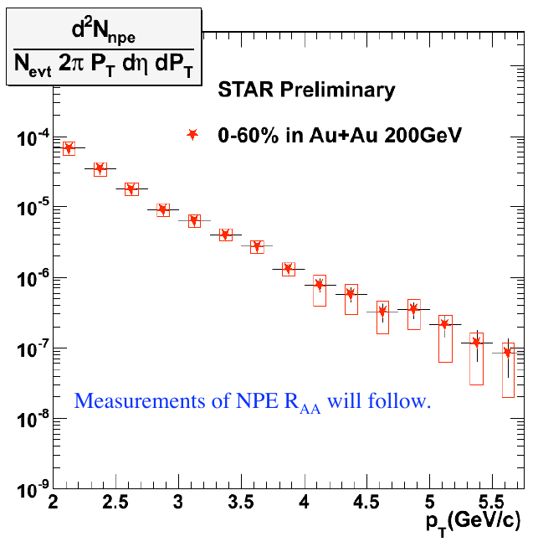
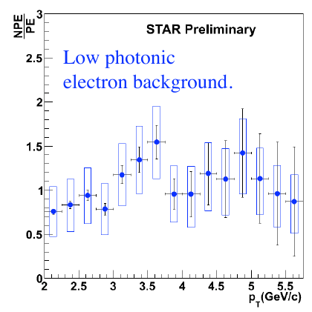
NPE in Au+Au collisions at √sNN=200GeV
NPE spectrum in central and semi-central collisions in Au+Au at 200GeV (run10) - Minimum bias events.
Part of a data sample.

Slide 13
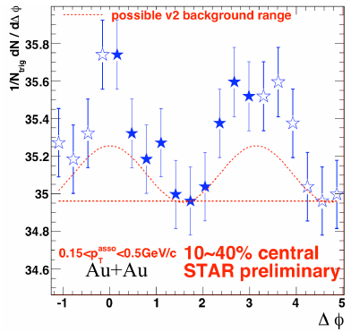
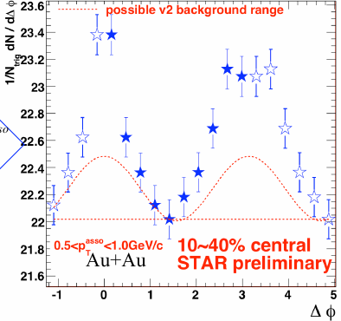
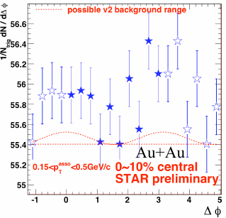
NPE-hadron correlation in
Au+Au collisions at 200 GeV
Semi-central collisions for associated track pT 0.15-0.5GeV and 0.5-1.0GeV.
Central collisons for association track pT 0.15-0.5GeV
We observed both – near side and away side correlations.

Slide 14
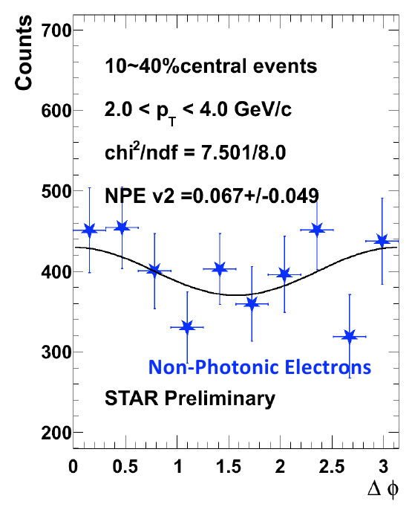
NPE elliptic flow
Electron-event plane correlations → NPE elliptic flow v2.
Finite v2 for 10-40% central events was observed.

Slide 15
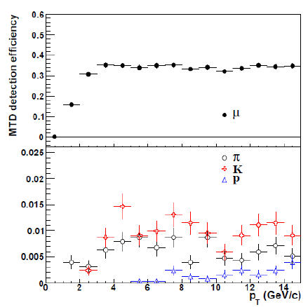
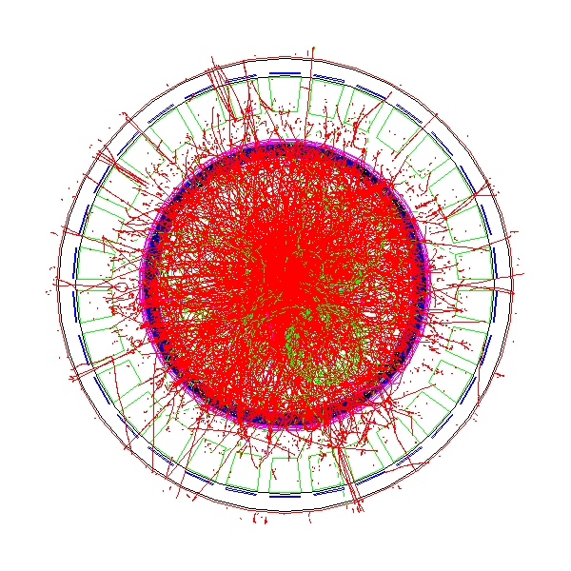
Muon Telescope Detector
MTD (MRPC): Multi-gap Resistive Plate Chamber. Gas detector.
Advantages for open heavy flavor measurements:
→ No gamma conversion and much less Dalitz decay contribution → very low photonic background.
→ High muon efficiency.
→ Muon to pion (hadron) ratio enhancement by factor ⁓ 50-100 (100-1000) → less hadron contamination.
→ e-muon correlation could help distinguish heavy flavor production from initial lepton pair production.
→ no bremsstrahlung for muon-muon.
→ 43% in run 2013, and complete in run 2014.
L. Ruan et al., Journal of Physics G: Nucl. Part. Phys. 36 (2009) 095001

Slide 16
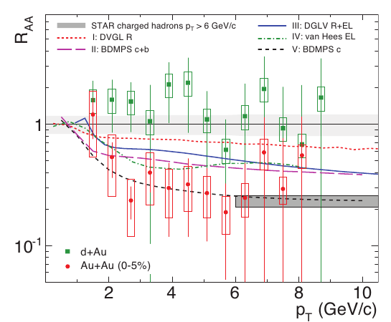
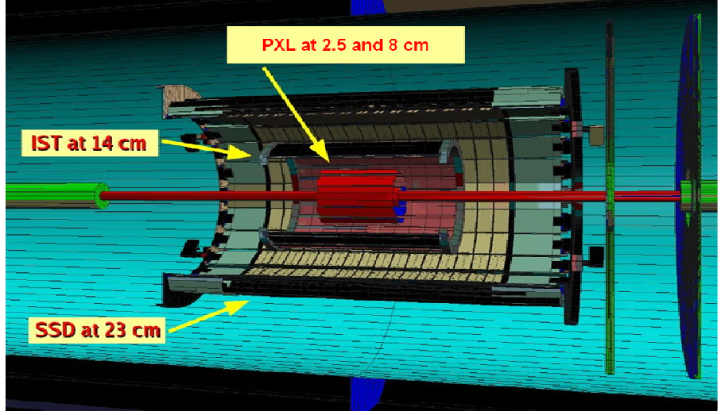
Heavy flavor tracker (HFT)
Phys.Rev.Lett.98:192301,2007; Erratum-ibid.106:159902,2011
Heavy Flavor Tracker (HFT) - Prototype Year 2013 and complete run in Year 2014.
NPE RAA in central Au+Au collisions shows similar suppresion as that of light spectra. Precise calculation of charm and bottom contribution to the NPE is crutial to interpret these results.
HFT will allow measurement of B → e spectrum separately (Current method via NPE-hadron correlation has large systematics uncertainties).

Slide 17
Conclusions
Non-photonic spectrum in p+p collisons at 200 GeV was presented. Results are in agreement with FONLL calculations.
All RHIC measurements in p+p collisons at 200 GeV are consistent with each other.
Bottom and charm contribution to the NPE in p+p collisions at 200 GeV and 500 GeV was estimated. B meson to the D meson ratio is increasing with pT. Results are in an good agreement with FONLL calculations.
Preliminary results in Au+Au collisions at 200 GeV was presented. Finite elliptic flow for 10-40% central events was observed.
HFT and MTD upgrades extend the area of heavy flavor measurements.

Slide 18
Thank you! :-)

