Slide 1
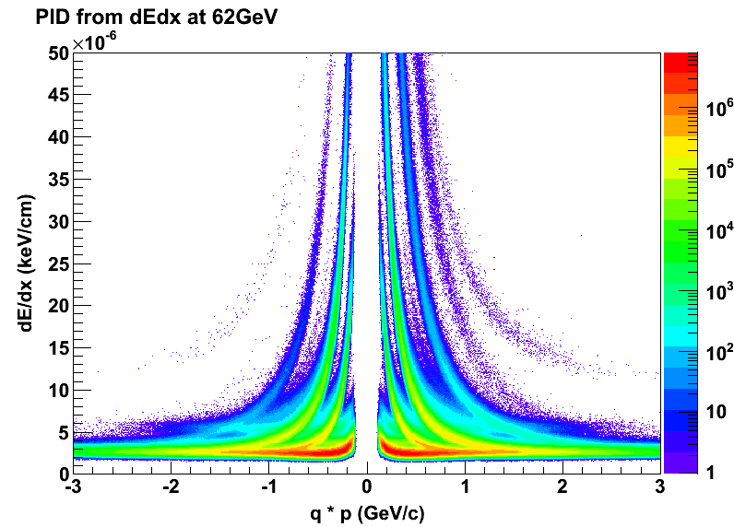
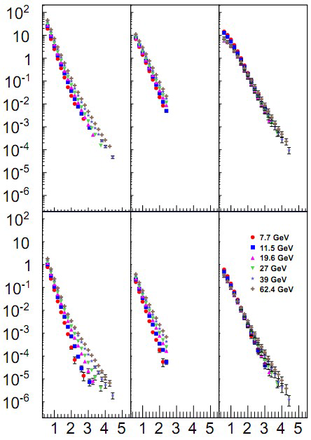
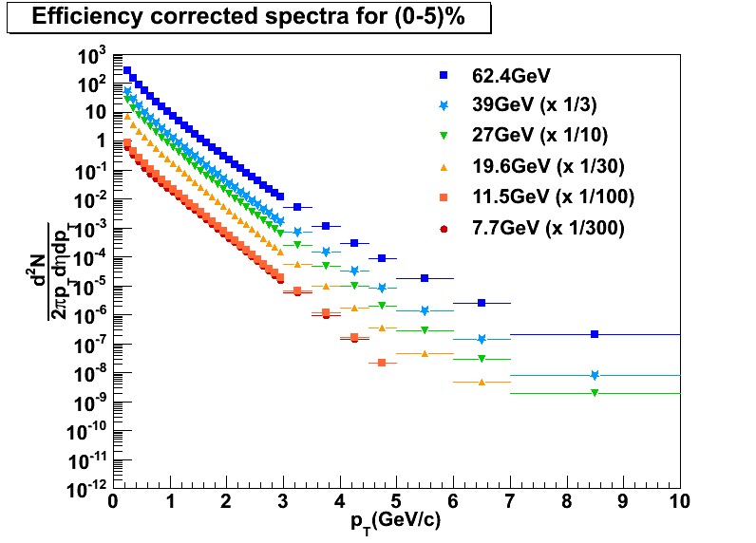
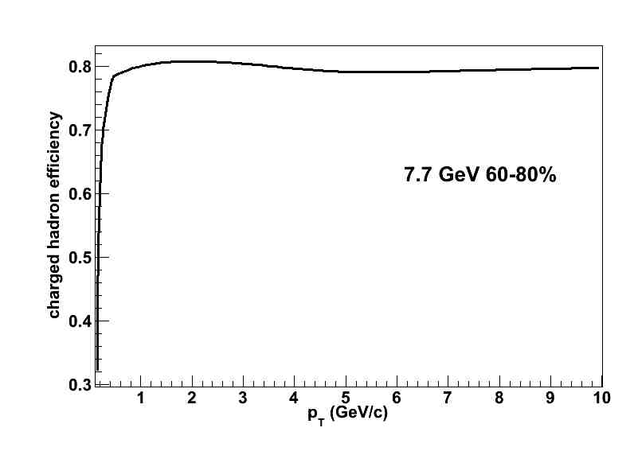
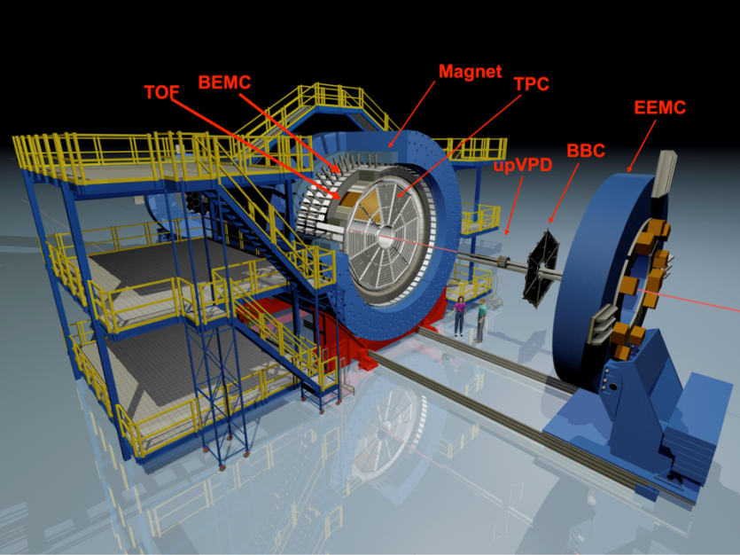
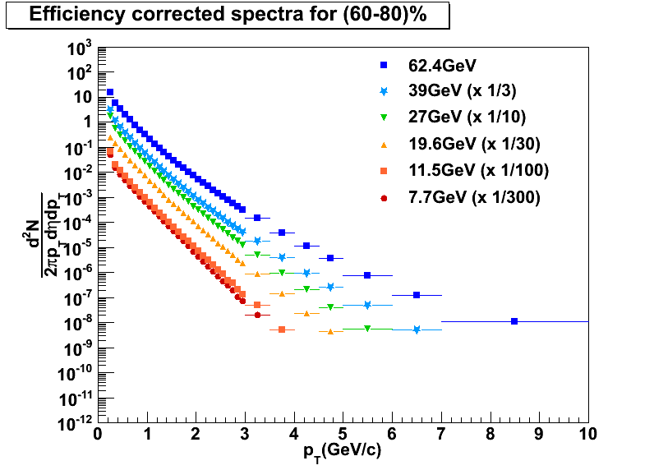
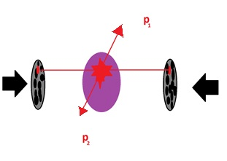
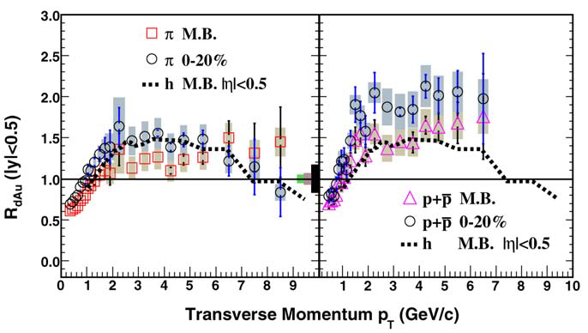
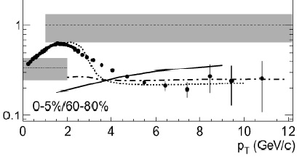
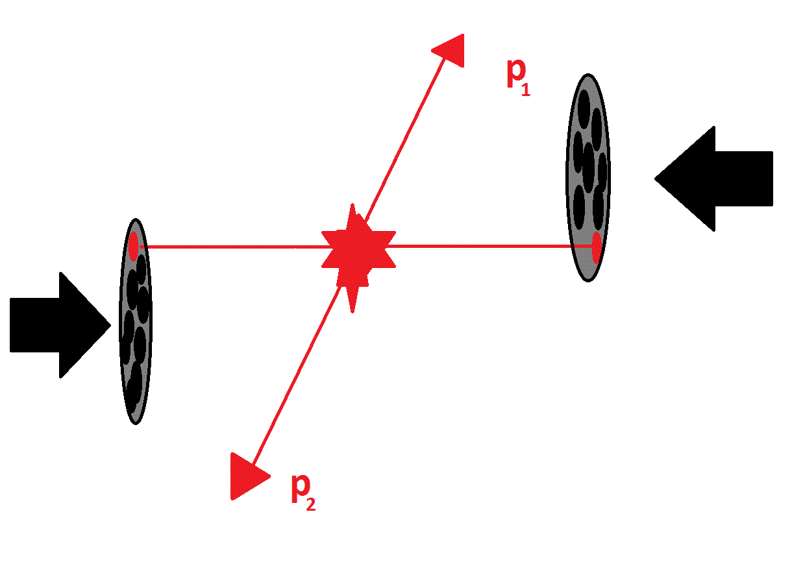
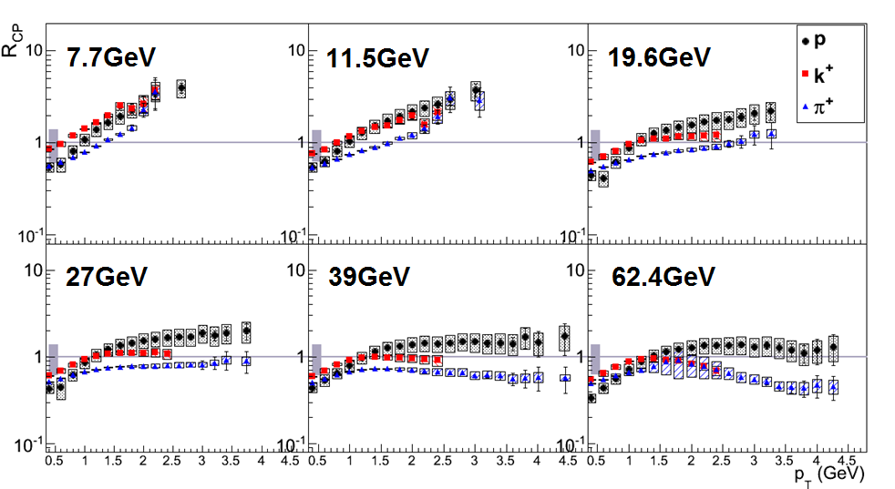
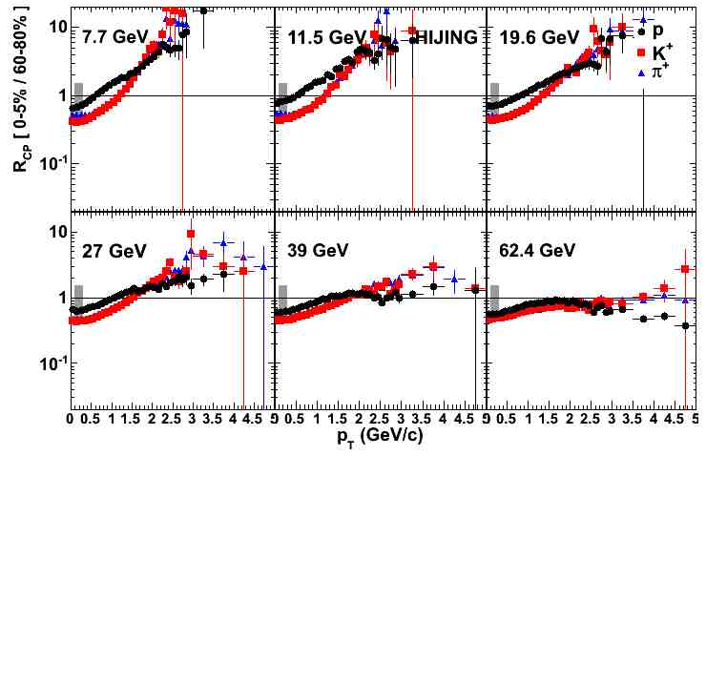
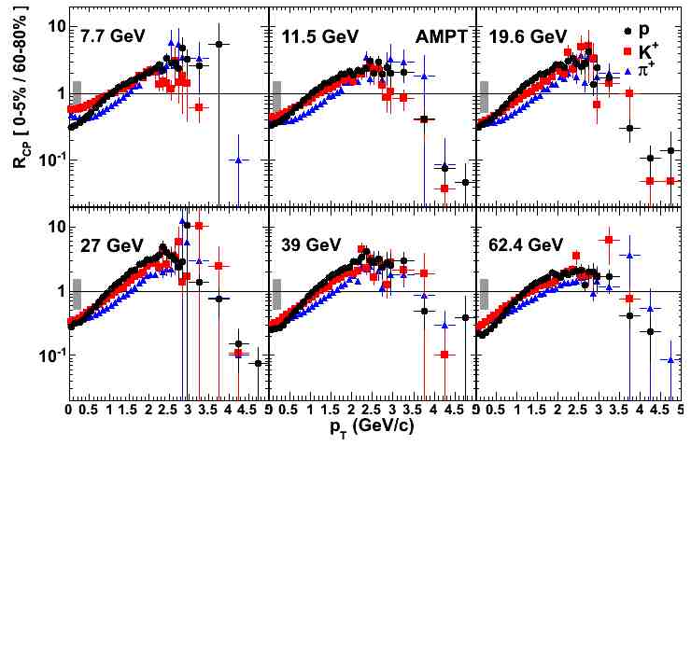
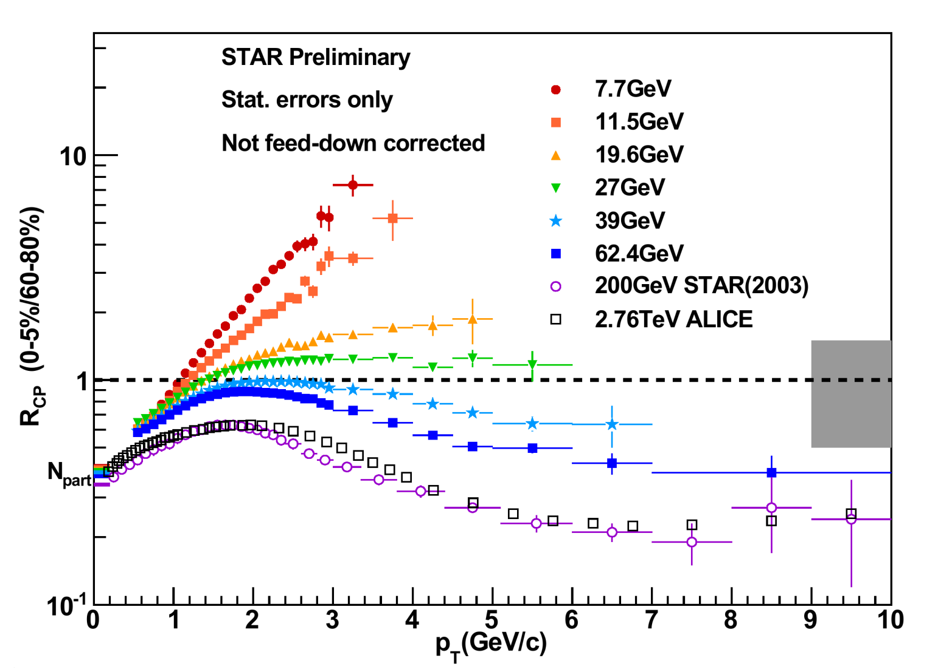
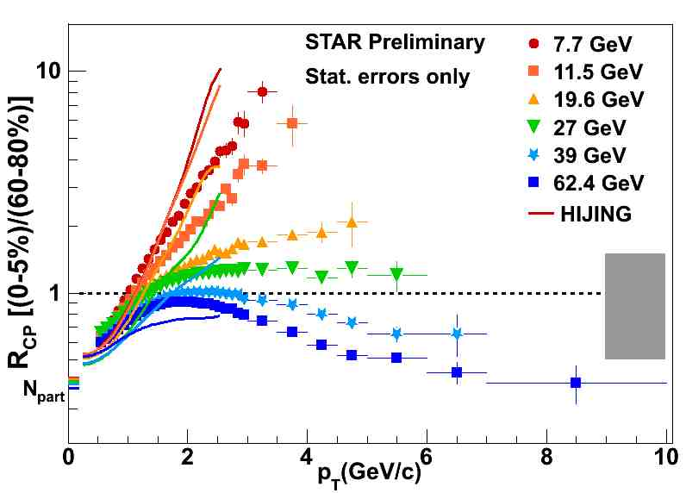
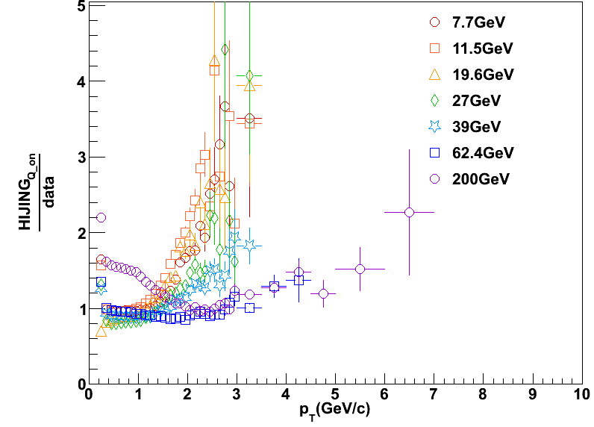
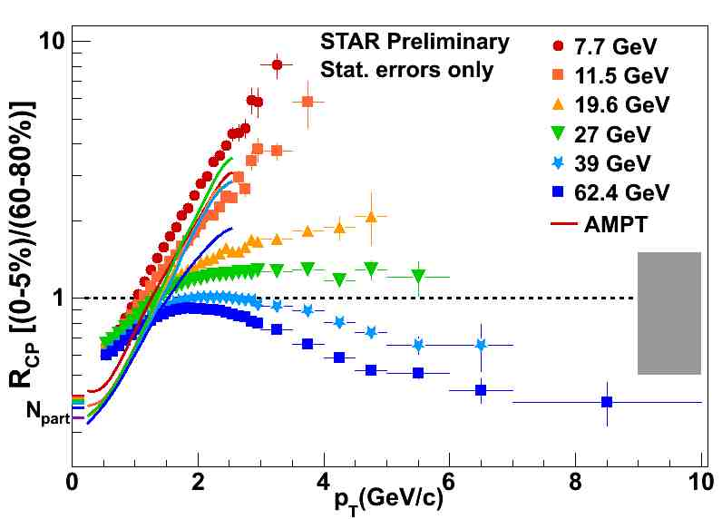
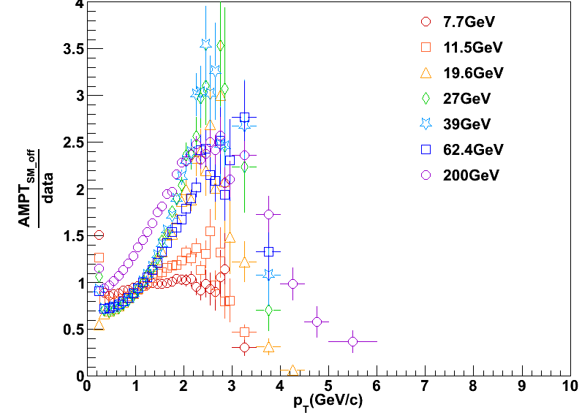
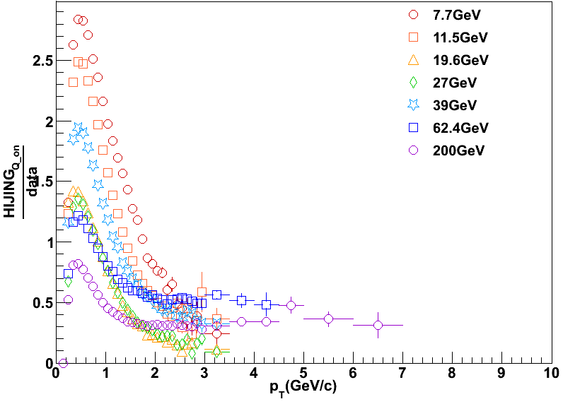
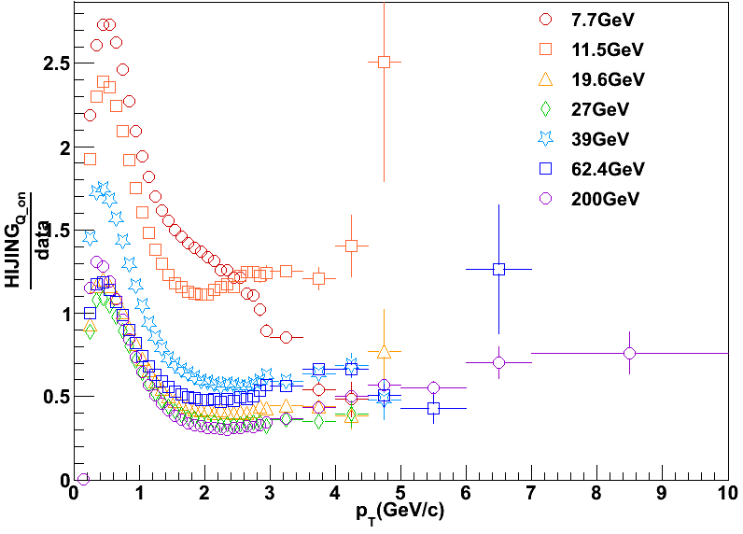
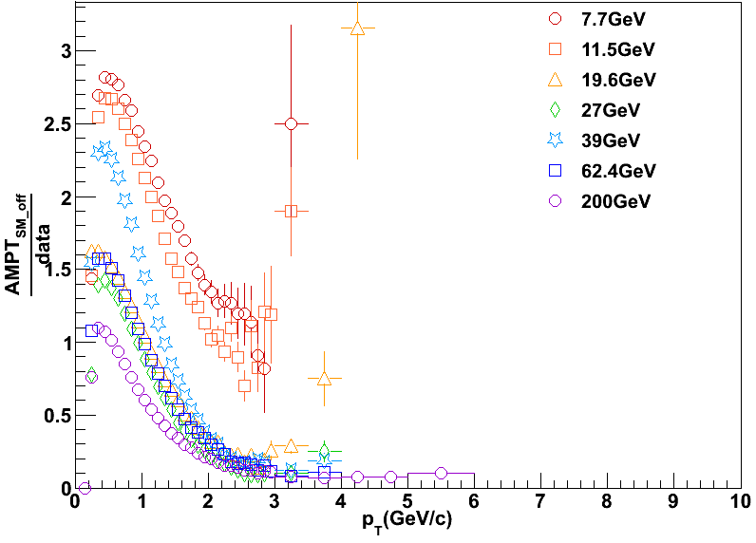
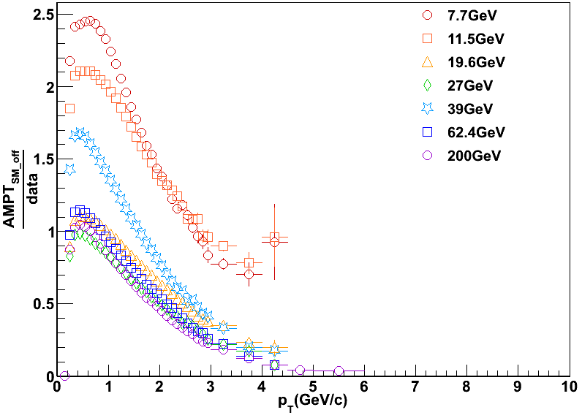
Charged particle transverse momentum spectra measured
at mid-rapidity by STAR in the RHIC Beam Energy Scan
Stephen Horvat (for the STAR Collaboration)
Abstract
Suppression of high transverse momentum (p_{T}) charged hadrons can be measured by the nuclear modification factor, which compares binary collision-scaled p_{T} spectra from central heavy-ion collisions to a reference spectrum, either proton-proton (R_{AA}) or peripheral heavy-ion collisions (R_{CP}). At $\sqrt{s_{NN}}$ = 62.4 GeV the nuclear modification factor at high p_{T} is consistent with medium induced quenching. Measurements by STAR of charged hadron R_{CP}($\sqrt{s_{NN}}$, p_{T}) in Au+Au collisions for $\sqrt{s_{NN}}$ = 7.7 – 200 GeV show a smooth transition from strong enhancement of high-p_{T} charged hadrons at $\sqrt{s_{NN}}$ = 7.7 GeV to strong suppression at $\sqrt{s_{NN}}$ = 200 GeV. These data will be compared with the event generators HIJING and AMPT.
Motivation
Method
Spectra
Proving that the QGP is formed at top RHIC and LHC energies requires that signatures for its existence vanish as collision energies are reduced
Colliding energies were varied from 200 GeV down to 7.7 GeV in the RHIC beam energy scan, and this range may be extended to even lower energies with the fixed target program proposed by STAR
Cold nuclear matter effects were shown to compete with the mechanisms leading to suppression through d + Au collisions
Models employing different physical mechanisms can be tested against the data in an effort to model the relative contributions from these competing effects
Two models are shown here; HIJING and AMPT
HIJING is a QCD-based Monte Carlo event generator
AMPT is similar, but adds transport to the partonic and hadronic phases
Charged tracks are taken in |η|<0.5
Particle identification from dE/dx and time-of-flight
Single particle tracking efficiencies corrected
TOF matching efficiency corrected
Trigger efficiency corrected
Spectra are obtained as a function of centrality for each $\sqrt{s_{NN}}$
Default versions of the models were run
Centrality was determined, for both the models and the data, by counting the number of charged tracks in |η|<0.5
π⁺
0-5%
p
K⁺
($\frac{1}{{GeV}^{2}})$
STAR Preliminary
Statistical errors only
STAR Preliminary
Statistical errors only
π⁺
K⁺
p
STAR Preliminary
($\frac{1}{{GeV}^{2}})$
Phys. Lett. B 637 (2006) 161
Au + Au
Central
60-80%
STAR Preliminary
Statistical errors only
dAu200
Protons
AuAu200
$$R_{CP}= \frac{{\left(N_{Bin}\right)}_{P}}{{\left(N_{Bin}\right)}_{C}}×\frac{{\left(\frac{d^{2}N}{{2πp}_{T}dp_{T}dη}\right)}_{C}}{{\left(\frac{d^{2}N}{{2πp}_{T}dp_{T}dη}\right)}_{P}}$$
p_{T} (GeV/c)
R_{CP}
Kaons and pions show a stronger energy dependence than protons
Less energy dependence for central than for peripheral collisions
The inclusive measurement has a higher p_{T} reach, while the identified measurement enables the study of species dependence in R_{CP}, as well as particle ratios and related measurements
Pions
Au + Au
Peripheral
Phys. Rev. Lett. 91 (2003) 172302
N_{Bin} ≡ number of binary collisions (from a Glauber MC model)
R_{CP}
Ann. Rev. of Nucl. and Part. Sci. 57, 205 (2007)
HIJING 1.383
AMPT 1.21
K⁺
STAR Preliminary
p_{T} (GeV/c)
HIJING employs a Glauber Monte Carlo to determine participating nucleons
pQCD is used to describe jet production above a cutoff parameter in momentum
Low-p_{T} multistring interactions are described by phenomenology whose parameters are tuned using p + p data from $\sqrt{s_{NN}}$ = 5 - 2000 GeV
Details can be found in Gyulassy M. and Wang X. 1991 Phys. Rev. D 44 3501
The identified R_{CP} for π, K, and p fails to describe the species dependence of R_{CP} seen in data, although it qualitatively captures the $\sqrt{s_{NN}}$ dependence
The default version of HIJING overestimates R_{CP} for lower energies
HIJING fails to reproduce the data at the level of the spectra
AMPT uses HIJING to generate its initial conditions
It adds Zhang's Parton Cascade for describing partonic scatterings and A Relativistic Transport model for hadronic scatterings
Although Lund fragmentation is used for hadronization in both HIJING and AMPT, AMPT’s Lund parameters were further tuned to NA49 data
Additional details can be found in Zi-Wei Lin et al. 2005 Phys. Rev. C 72 064901
The default version of AMPT fails to reproduce the energy dependence of R_{CP} but does qualitatively capture the species dependence
AMPT does not reproduce the spectra from data
Phys. Rev. Lett. 91 (2003) 172302
Nucl. Part. Phys. 38 (2011) 124080
Protons exhibit the least energy dependence with no significant suppression, even at $\sqrt{s_{NN}}$ = 62 GeV
High-p_{T} kaons also show no significant suppression
Pions vary from strong enhancement at low energies to suppression at high RHIC energies
Inclusive charged particles show a strong energy dependence, with the RHIC beam energy scan perfectly spanning the region of interest
Measurements of charged hadron R_{CP} at LHC energies have been largely consistent with $\sqrt{s_{NN}}$ = 200 GeV measurements at RHIC
R_{CP} HIJING
_____________________
R_{CP} Data
R_{CP} AMPT
____________________
R_{CP} Data
ratio of charged particle spectra from HIJING to that from data in 60-80% centrality
ratio of charged particle spectra from HIJING to that from data in 0-5% centrality
ratio of charged particle spectra from AMPT to that from data in 60-80% centrality
ratio of charged particle spectra from AMPT to that from data in 0-5% centrality
Gyulassy M. and Wang X. 1994 Comput. Phys. Commun. 83 307
Zhang B. et al. 2000 Phys. Rev. C 61 067901
Conclusions
Suppression of high-p_{T} particles at top RHIC and LHC energies smoothly and monotonically evolves into strong enhancement as $\sqrt{s_{NN}}$ decreases
The strong enhancement observed at lower collision energies complicates the interpretation of results; in particular, there may still be a QGP at collision energies that exhibit no suppression, but this signal of jet quenching is overwhelmed at these lower energies by the observed enhancement
The default tunes of AMPT and HIJING are unable to reproduce the spectra and R_{CP} seen in data well enough to use the models to predict at what energy quenching ‘turns off’
Either these models need additional tuning or some of the their model assumptions do not hold
Conclusions

