Slide 1
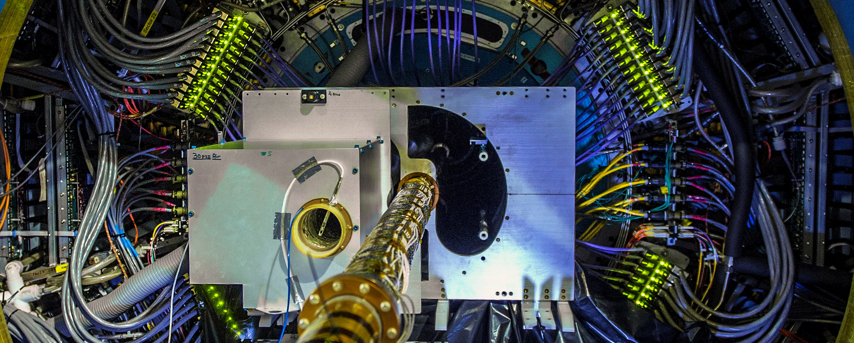


Measurements of open charm hadrons at the STAR experiment
Miroslav Simko
for the STAR Collaboration
Nuclear Physics Institute,
The Czech Academy of Sciences

Slide 2
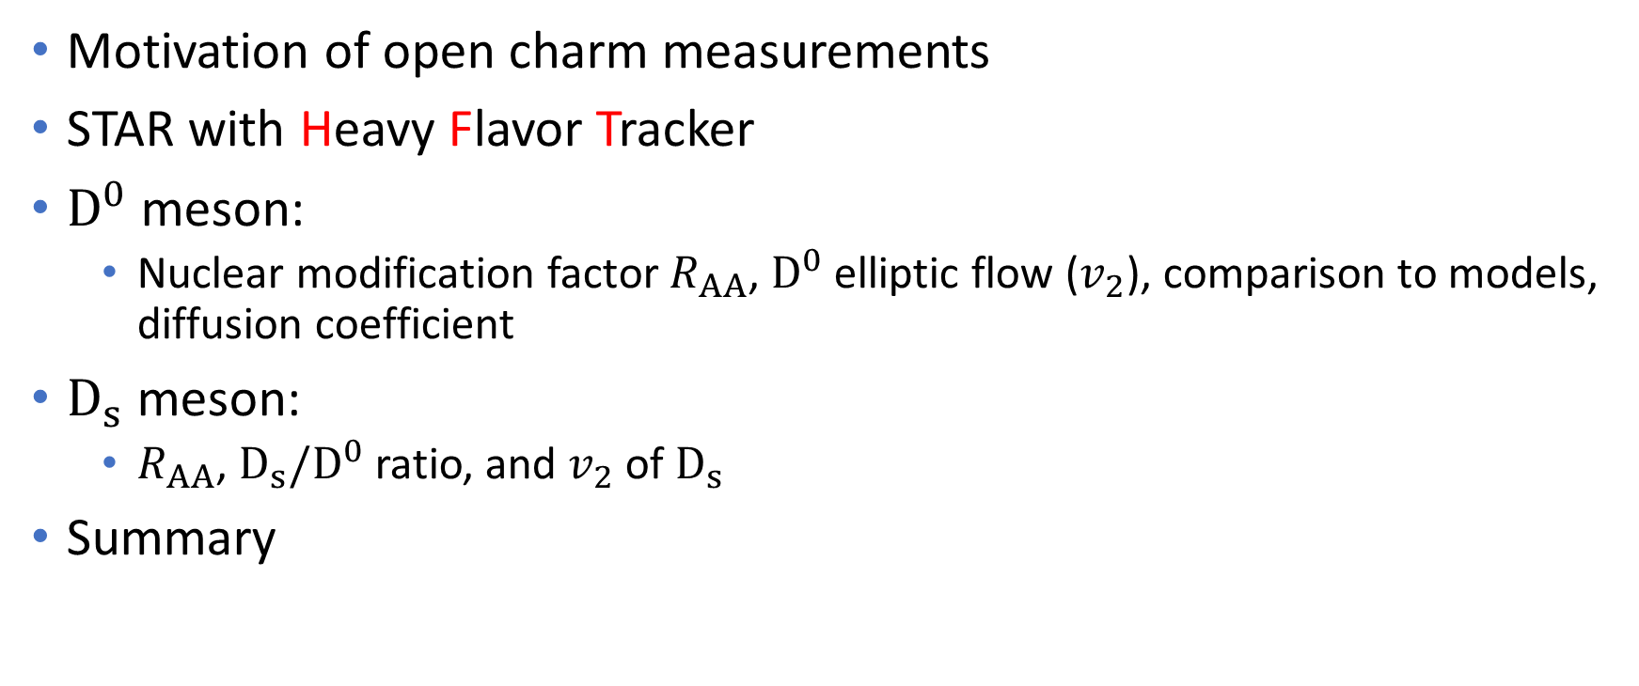
Outline
Motivation of open charm measurements
STAR with Heavy Flavor Tracker
$D^{0}$ meson:
  Nuclear modification factor $R_{AA}$, $D^{0}$ elliptic flow ($v_{2}$), comparison to models, diffusion coefficient
$D_{s}$ meson:
  $R_{AA}$, $D_{s}/D^{0}$ ratio, and $v_{2}$ of $D_{s}$
Summary

Slide 3
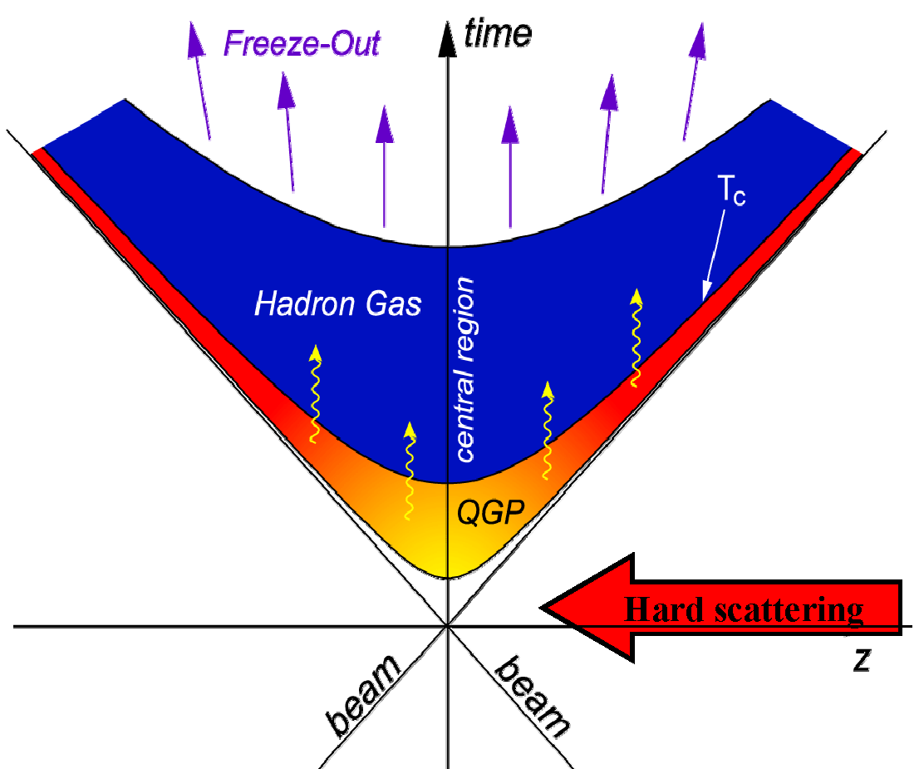
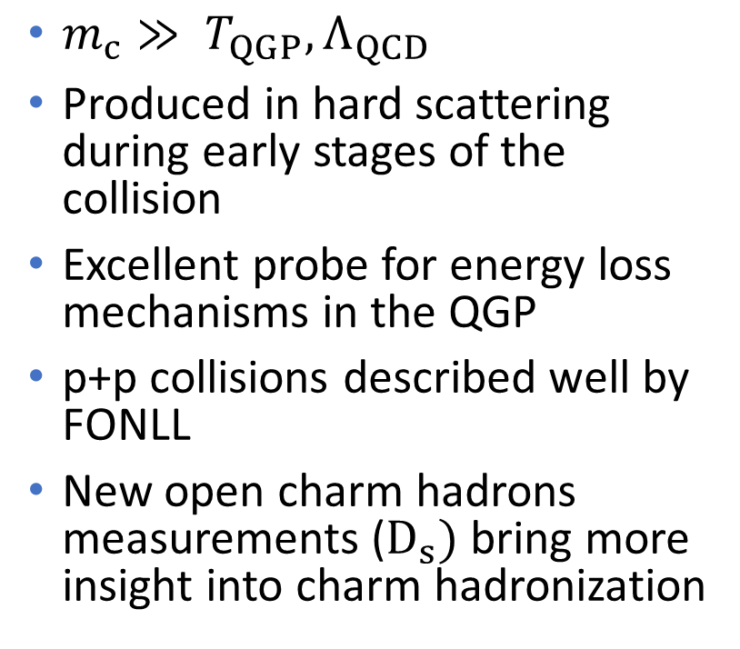


Studying QGP with open charm
$$π$$
$$K$$
$m_{c}≫ T_{QGP}, Λ_{QCD}$
Produced in hard scattering during early stages of the collision
Excellent probe for energy loss mechanisms in the QGP
p+p collisions described well by FONLL
New open charm hadrons measurements ($D_{s})$ bring more insight into charm hadronization
D-meson
c-quark
[STAR: PRD 86 (2012) 072013, NPA 931 (2014) 520;
CDF: PRL 91 (2003) 241804; ALICE: JHEP01 (2012) 128;
FONLL: PRL 95 (2005) 122001]

Slide 4

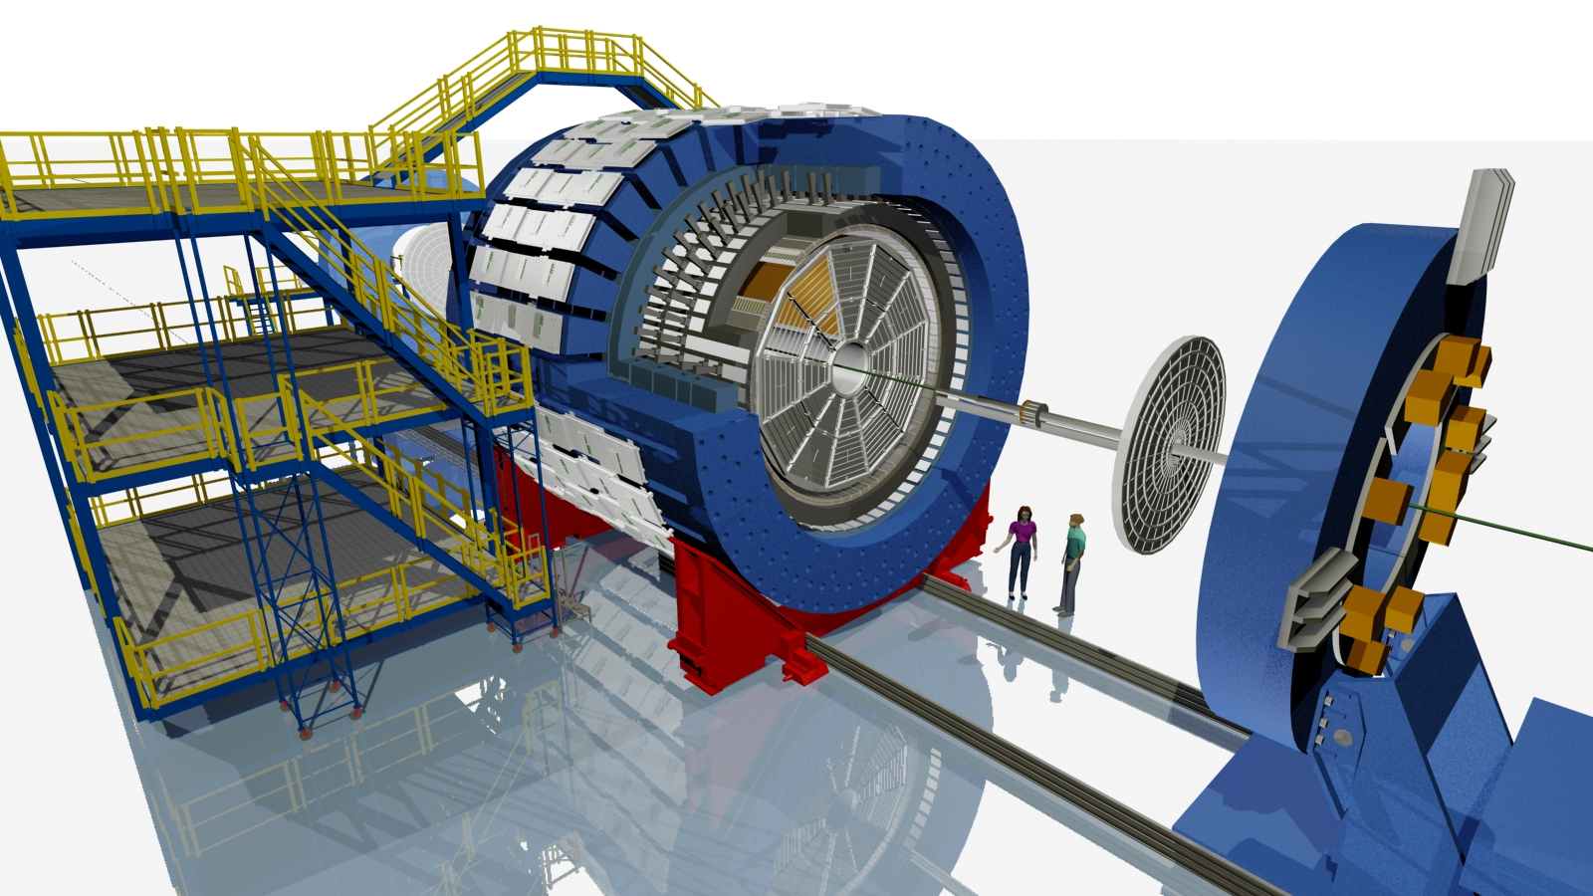





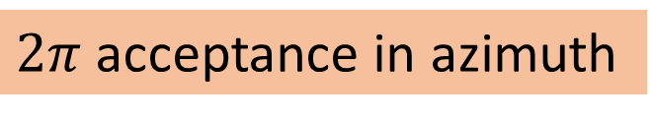

STAR detector
$2π$ acceptance in azimuth
$→$
TOF:
1/$β$(PID)
$$−1<η<1$$
TPC: Tracking
dE/dx (PID)
$←$ $−1<η<1$
HFT:
$←$ SSD
$←$ IST
$←$PXL
Silicon vertex detector
$$−1<η<1$$

Slide 5
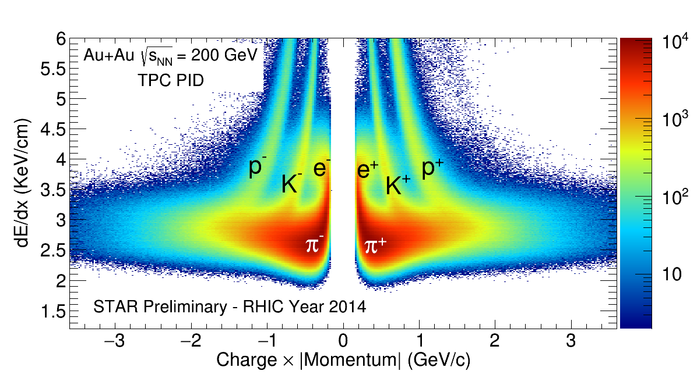
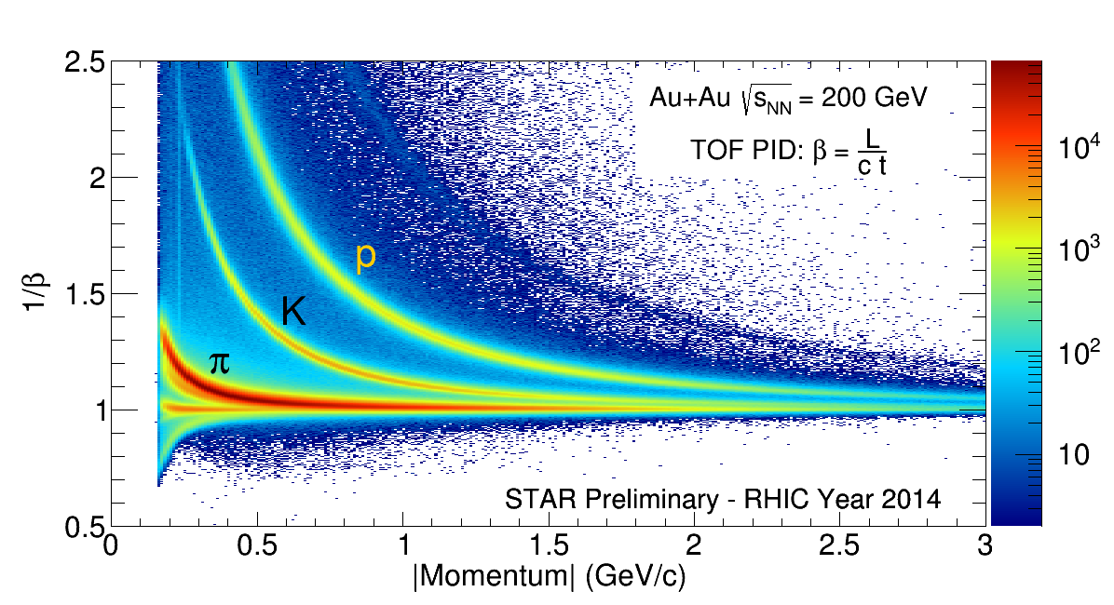

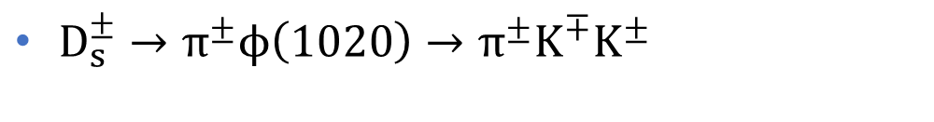
Particle Identification in TPC and TOF
Clear separation for long-lived hadrons
$D^{0}\left(\overline{D^{0}}\right)→π^{±}K^{∓}$
$D^{±}→π^{±}π^{±}K^{∓}$
$D_{s}^{±}→π^{±}ϕ\left(1020\right)→π^{±}K^{∓}K^{±}$

Slide 6
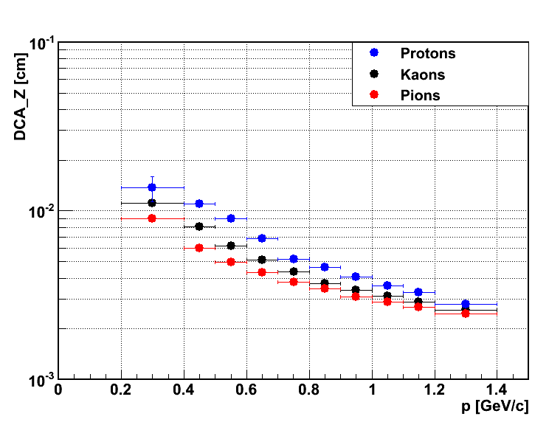
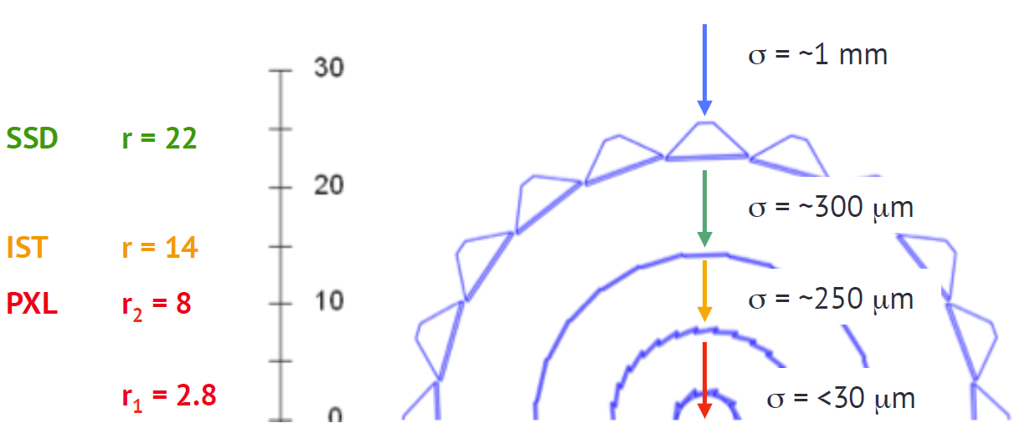

STAR Heavy Flavor Tracker
The Pixel detector: First MAPS technology in a collider experiment
Pointing resolution: $∼$30 $μ$m at high $p_{T}$ (exceeds the requirement of 55 $μ$m for 750 MeV/$c$ kaons)
Radiation length 0.4 % $X_{0}$ for the 1st layer of pixel
Recorded $\sim$ 3.2 B good Au+Au events in 2014 and 2016
750 M events shown in this talk
STAR Preliminary
46 µm
cm
cm
cm
cm

Slide 7
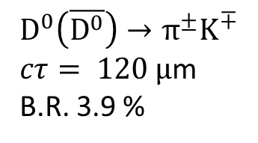

Topological reconstruction
Combinatorial background suppressed by 4 orders of magnitude
Highly improved signal-to-background ratio
$$D^{0}$$
$$D^{0}\left(\overline{D^{0}}\right)→π^{±}K^{∓}$$
$cτ= 120 μ$m
B.R. 3.9 %

Slide 8



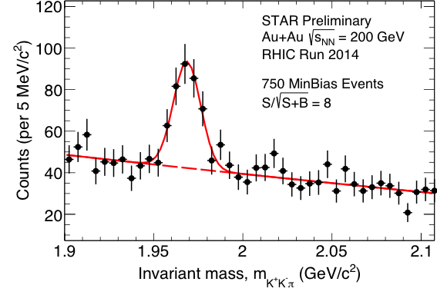

Three body decays
$D^{±}→π^{±}π^{±}K^{∓}$ $cτ=312 μ$m B.R. 9.46 %
$D_{s}^{±}→π^{±}ϕ\left(1020\right)→π^{±}K^{±}K^{∓} cτ=150 μ$m B.R. 2.32 %
$$D^{±}$$
$$D_{s}$$
STAR Preliminary
RHIC Run 2014
Invariant mass $m_{K^{−}π^{+}π^{+}}$ (GeV/c²)

Slide 9
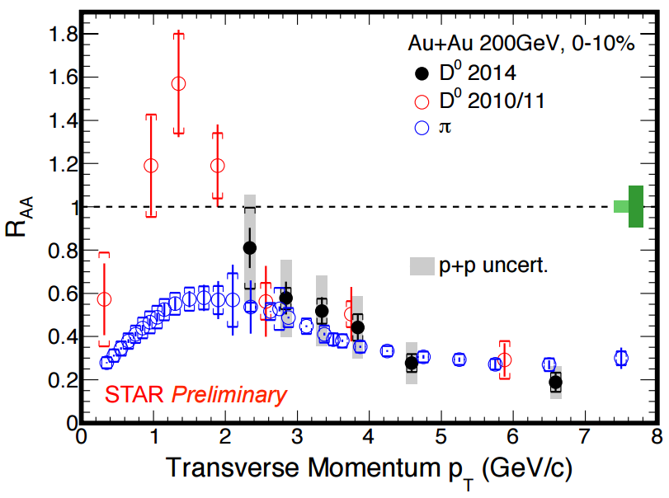

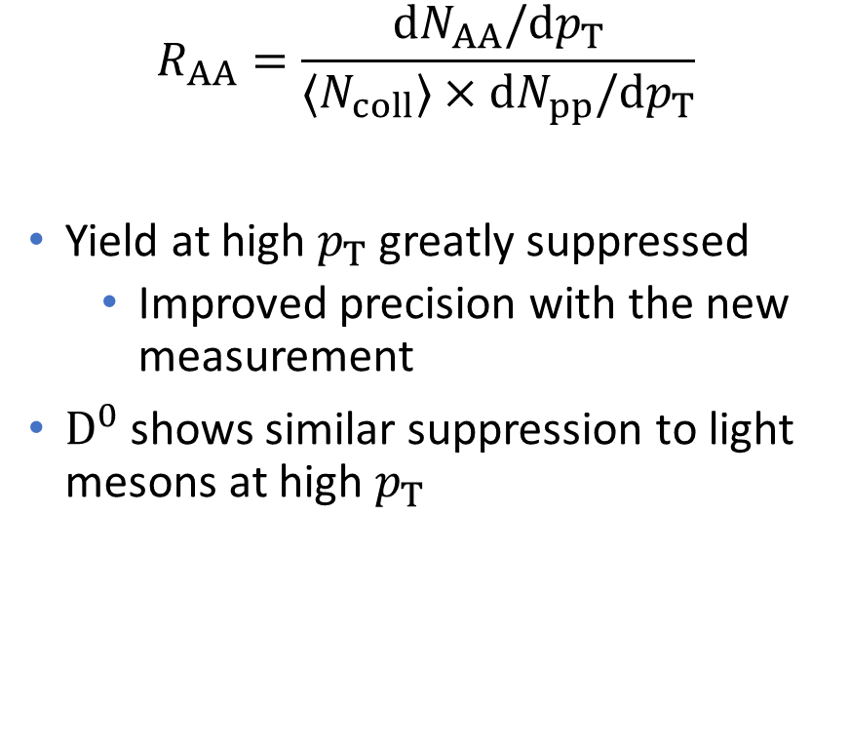
$R_{AA}$ of $D^{0}$
$$R_{AA}=\frac{dN_{AA}/dp_{T}}{〈N_{coll}〉×dN_{pp}/dp_{T}}$$
Yield at high $p_{T}$ greatly suppressed
  Improved precision with the new measurement
$D^{0}$ shows similar suppression to light mesons at high $p_{T}$
[STAR: PRL 113 (2014) 142301
PLB 655 (2007) 104]

Slide 10
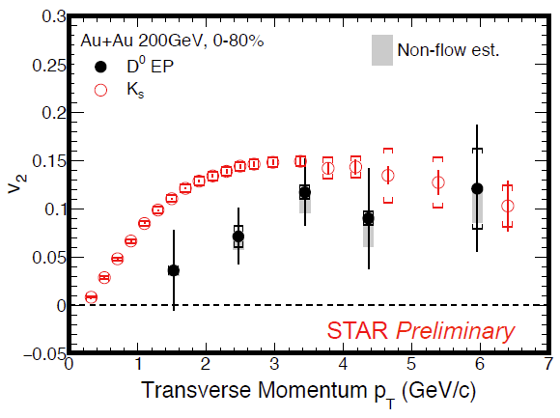
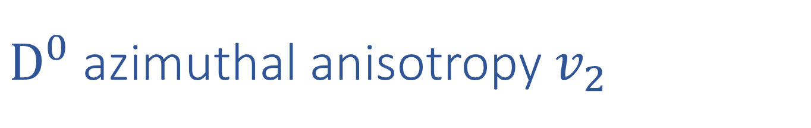
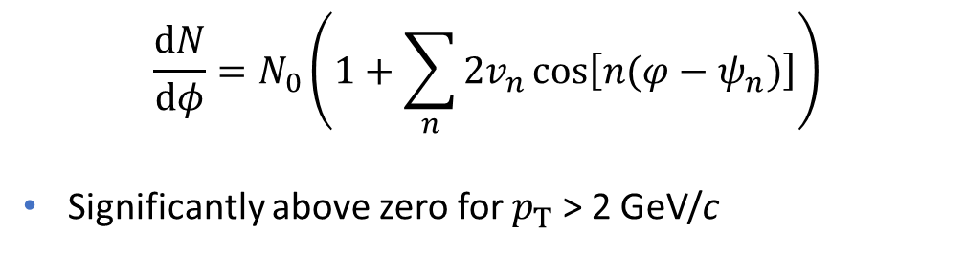

$D^{0}$ azimuthal anisotropy $v_{2}$
$$\frac{dN}{dφ}=N_{0}\left(1+\sum_{n}{2v_{n}\cos\left[n(φ−ψ_{n})\right]}\right)$$
Significantly above zero for $p_{T}$ > 2 GeV/c
$m_{T}^{2}=m^{2}+ p_{T}^{2}$
${ v}_{2}$ is slightly below lighter hadrons
  Higher statistics will enable a comparison in finer centrality bins
STAR Preliminary
[STAR:PRC 77 (2008) 54901
PRL 116 (2016) 62301]

Slide 11
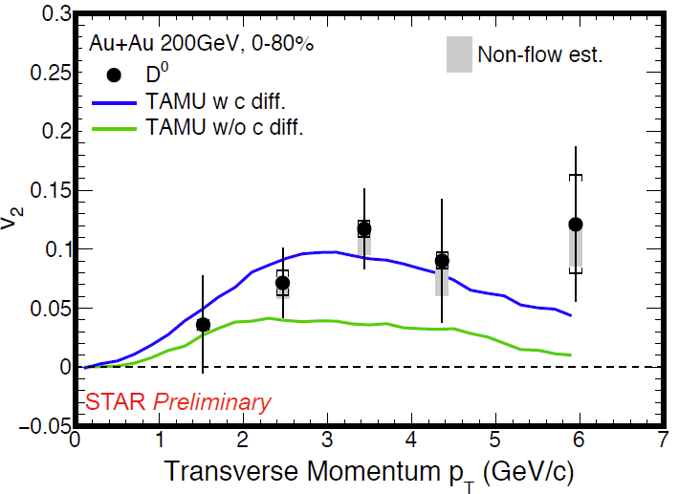
Charm quark diffusion
TAMU: non-perturbative T-matrix approach
The model with charm diffusion in the medium is favored by data
[Theory: arXiv:1506.03981 (2015) & private comm. ]

Slide 12
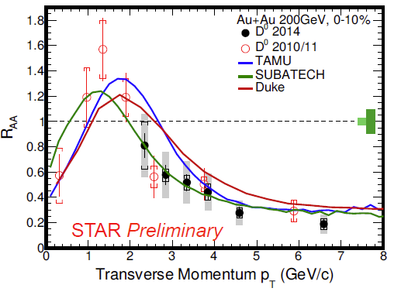
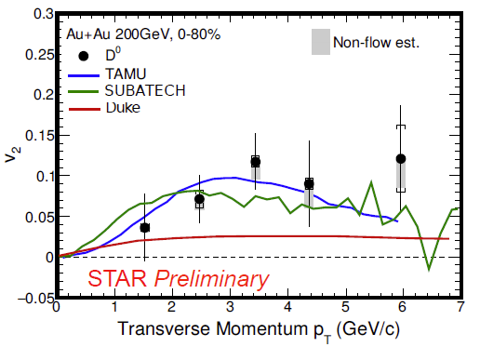
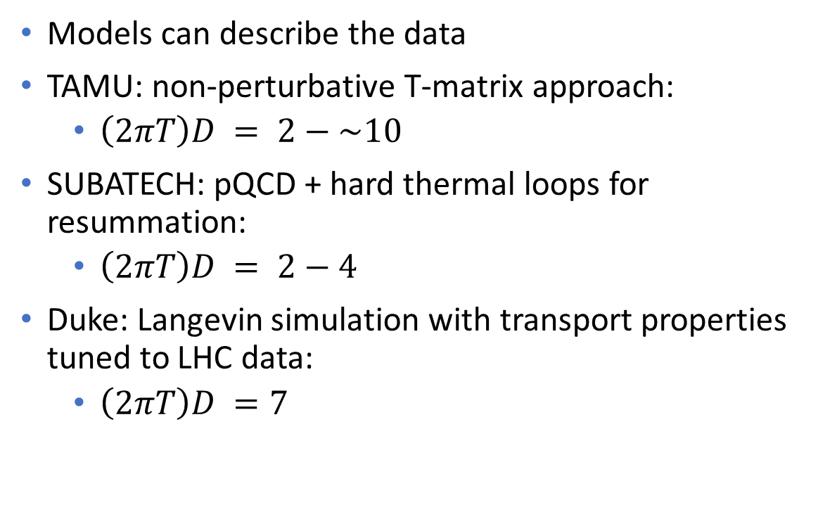
Comparison to models with charm diffusion
Models can describe the data
TAMU: non-perturbative T-matrix approach:
  $\left(2πT\right)D = 2−\sim 10$
SUBATECH: pQCD + hard thermal loops for resummation:
  $\left(2πT\right)D = 2−4$
Duke: Langevin simulation with transport properties tuned to LHC data:
  $\left(2πT\right)D =7$
[Theory: PRC 92(2015) 024907
arXiv:1506.03981 (2015)
& private comm.]
[STAR 2010/11: PRL 113 (2014) 142301]

Slide 13
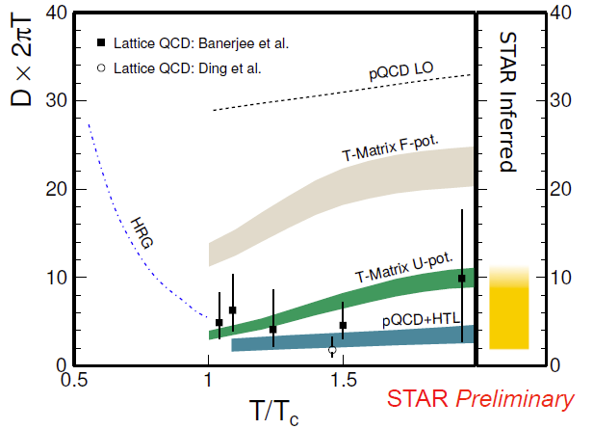

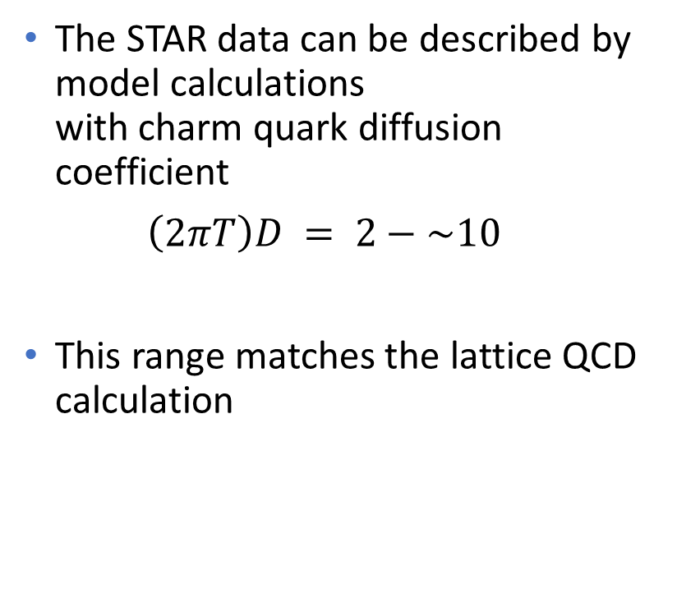
Diffusion coefficient $\left(2πT\right)D$
  The STAR data can be described by model calculations
  with charm quark diffusion coefficient
  $\left(2πT\right)D = 2−\sim 10$
This range matches the lattice QCD calculation

Slide 14


$D_{s}$ reconstruction
$D_{s}^{±}→π^{±}φ\left(1020\right)→π^{±}K^{±}K^{∓}$
$cτ=150 μ$m
B.R. 2.32 %
Mass 1968.47 MeV/$c^{2}$
First measurement of $D_{s}$ at RHIC
Courtesy, Peter Filip

Slide 15
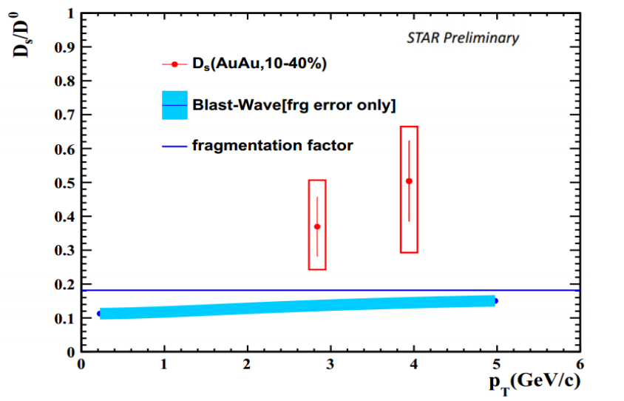

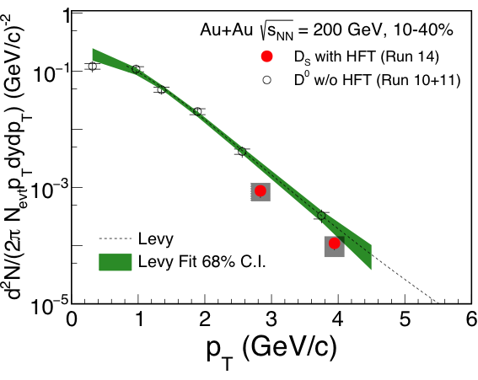

$D_{s}$ yield and $D_{s}/D_{0}$ratio
STAR Preliminary
[STAR: PRL 113 (2014) 142301]
Fragmentation factor from charm to $D_{s}$ is 0.9 $±$ 0.1
Hint of $D_{s}$ enhancement compared to $D^{0}$
[H1 Collaboration, Eur.Phys.J.C38(2005)447] [ZEUS Collaboration, Eur.Phys.J.C44(2005)351]

Slide 16
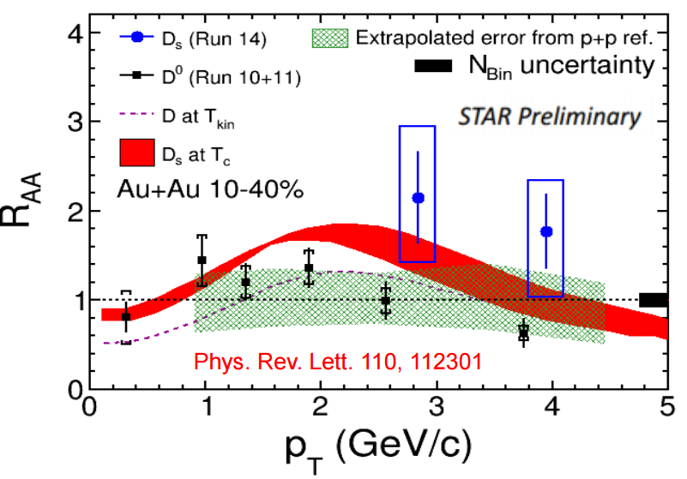

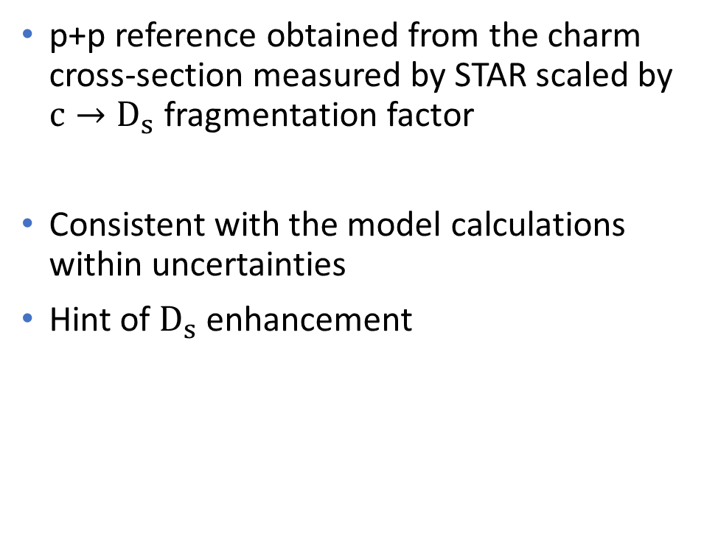
$R_{AA}$ compared to a model calculation
p+p reference obtained from the charm cross-section measured by STAR scaled by $c→D_{s}$ fragmentation factor
Consistent with the model calculations within uncertainties
Hint of $D_{s}$ enhancement
[H1 Collaboration, Eur.Phys.J.C38(2005)447] [ZEUS Collaboration, Eur.Phys.J.C44(2005)351]
(2014)
[Phys.Rev.Lett.113(2014) 142301]

Slide 17
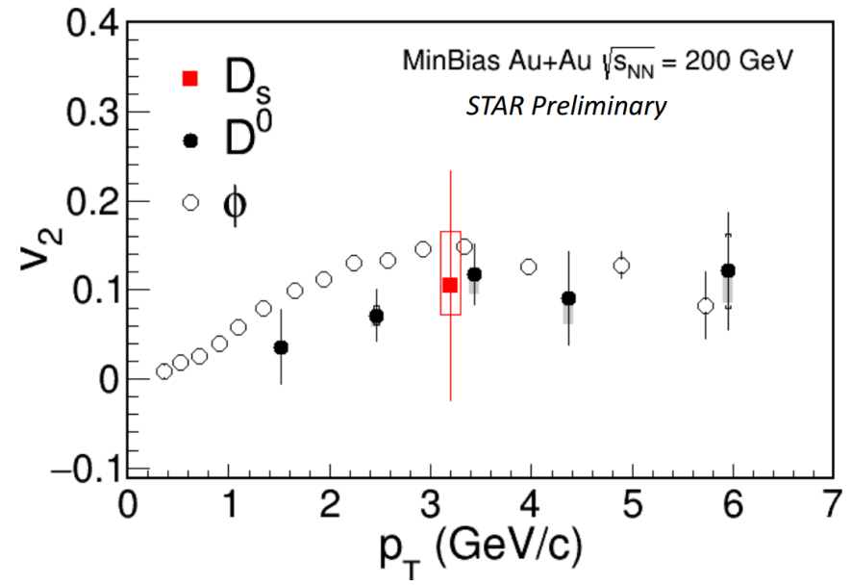

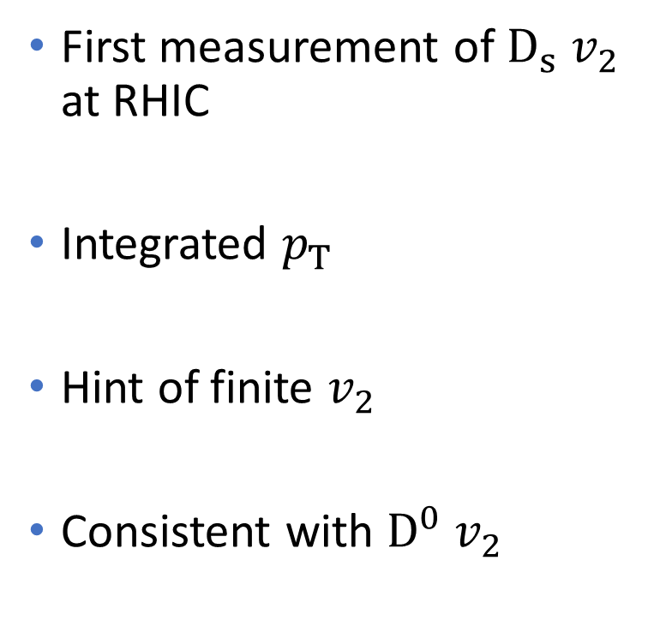
$D_{s}$ azimuthal anisotropy $v_{2}$
  First measurement of $D_{s}{ v}_{2}$ at RHIC
  Integrated $p_{T}$
Hint of finite $v_{2}$
Consistent with $D^{0}$ $v_{2}$

Slide 18
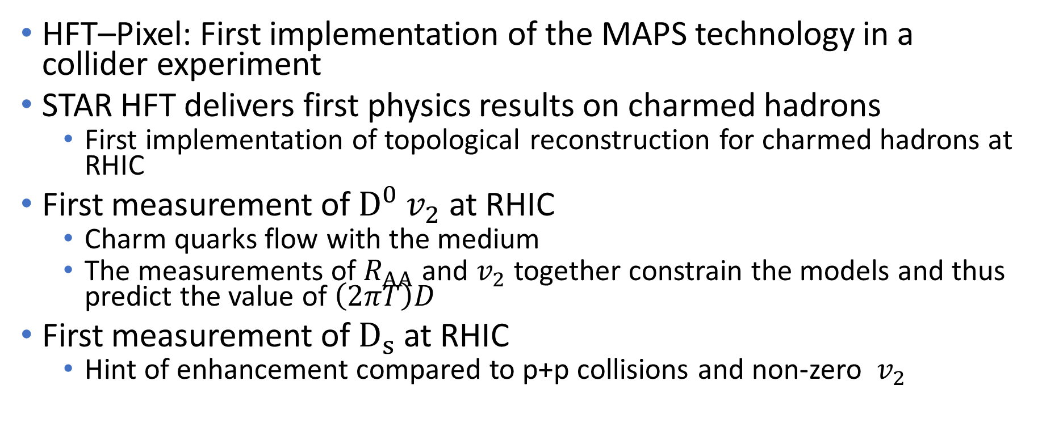
Summary
HFT–Pixel: First implementation of the MAPS technology in a collider experiment
STAR HFT delivers first physics results on charmed hadrons
  First implementation of topological reconstruction for charmed hadrons at RHIC
First measurement of $D^{0}$ $v_{2}$ at RHIC
  Charm quarks flow with the medium
  The measurements of $R_{AA}$ and $v_{2}$ together constrain the models and thus predict the value of $\left(2πT\right)D$
First measurement of $D_{s}$ at RHIC
  Hint of enhancement compared to p+p collisions and non-zero ${ v}_{2}$

Slide 19
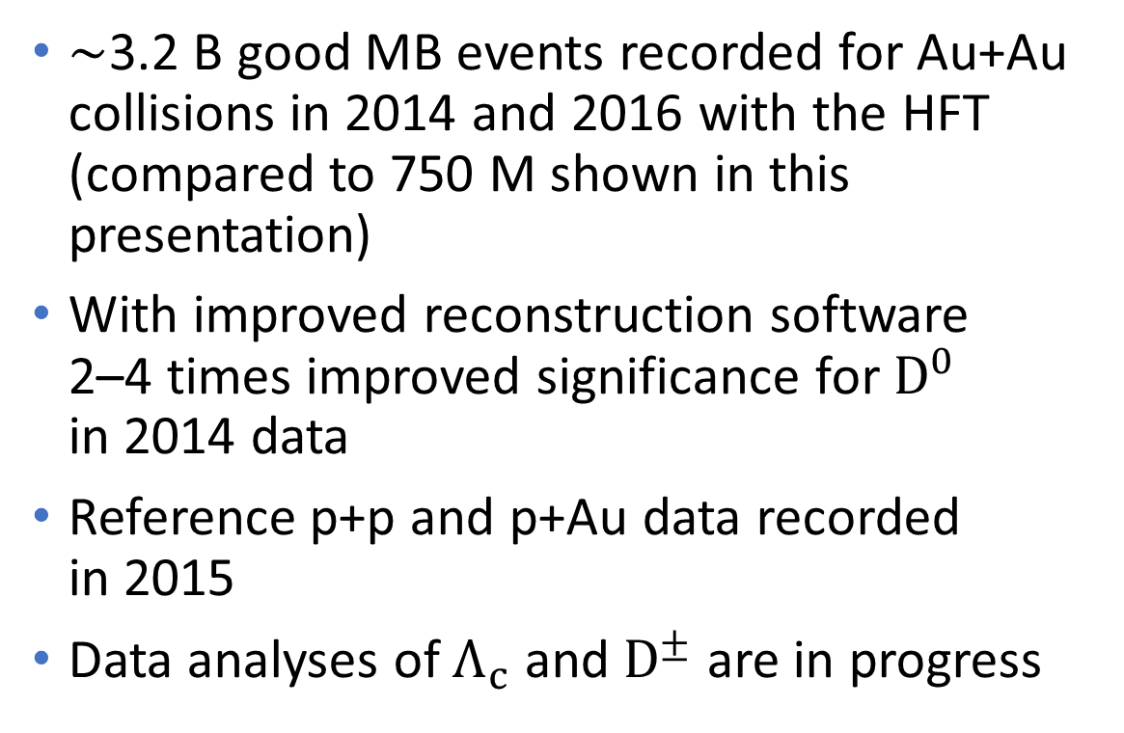
Outlook
$∼$3.2 B good MB events recorded for Au+Au collisions in 2014 and 2016 with the HFT (compared to 750 M shown in this presentation)
With improved reconstruction software 2–4 times improved significance for $D^{0}$ in 2014 data
Reference p+p and p+Au data recorded in 2015
Data analyses of $Λ_{c}$ and $D^{±}$ are in progress

Slide 20
Thank you for your attention

Slide 21
Backup

Slide 22
Silicon Strip Detector (SSD)

Slide 23
SSD readout refurbishment
Upgrade from 200 Hz to 1 kHz
New
  40 ladder cards on detector
  5 RDO cards
  5 Fiber-to-LVDS boards
Fiber-to-LVDS
RDO board – adapted from PXL
Ladder cards

Slide 24
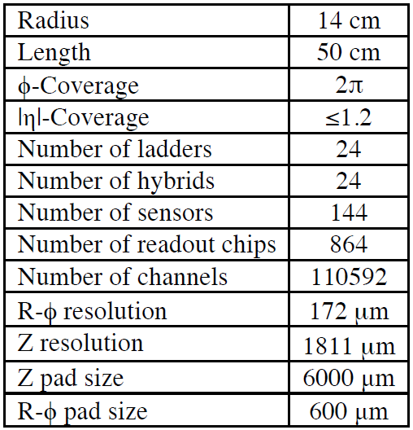
Intermediate Silicon Tracker (IST)

Slide 25
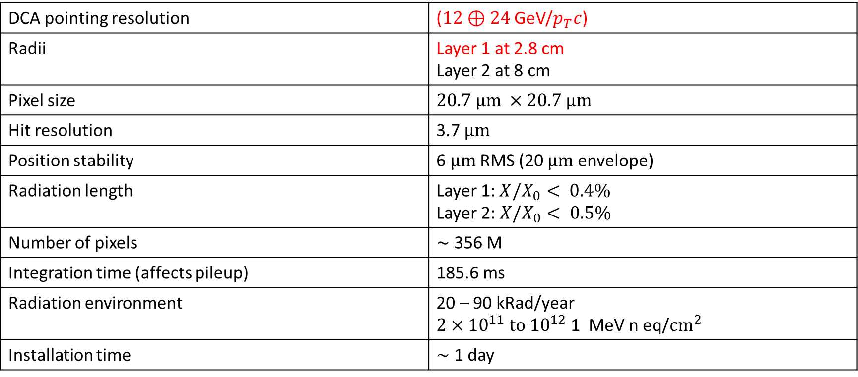
Pixel detector (PXL)
DCA pointing resolution | ($12⊕24$ GeV/$p_{T}c$)
Radii | Layer 1 at 2.8 cm Layer 2 at 8 cm
Pixel size | $$20.7 μm ×20.7 μm$$
Hit resolution | 3.7 $μm$
Position stability | 6 $μm$ RMS (20 $μm$ envelope)
Radiation length | Layer 1:$X/X_{0}< 0.4\%$ Layer 2: $X/X_{0}< 0.5\%$
Number of pixels | $∼$ 356 M
Integration time (affects pileup) | 185.6 ms
Radiation environment | 20 – 90 kRad/year $2×{10}^{11} to {10}^{12}$ 1 MeV n eq/$cm^{2}$
Installation time | $∼$ 1 day

