Slide 1
Probing the QCD phase diagram with Measurements of strange hadron elliptic flow in STAR
ICPAQGP 2015, Kolkata
Md. Nasim
University of California, Los Angeles
(for the STAR Collaboration)

Slide 2
Content
Introduction & Motivation
STAR detector and Particle Identification
Results & Discussions
- 200 GeV
- BES –Phase I
Summary

Slide 3
Motivation
QCD phase diagram:
A phase diagram of strongly interacting matter.
Theory predict:
A cross-over at μ_{Β} ~0
At high μ_{Β}, the transition is first order
Critical point: where first order transition ends
Goals of the STAR Experiment
Top RHIC Energy
Study the properties of QGP
Beam Energy Scan (BES)
M. M. Aggarwal (STAR collaboration)
arXiv:1007.2613
Search for phase boundary
Search for QCD Critical point

Slide 4
Elliptic Flow
y
p_{y}
x
p_{x}
y
z
x
Non-central collisions: azimuthal anisotropy in coordinate-space
Interactions anisotropy in momentum-space
Sensitive to early times in the evolution of the system
Sensitive to the equation of state
P. Klob, U. W. Heinz, Nucl. Phys. A715, (2003) 653c

Slide 5
Why Strange Hadrons ?
Strange-hadrons (Ω, φ)
Freeze-out
- at higher
temperature T_{fo}~T_{ch}
- with lower
collective
velocity ⟨β_{T}⟩
Hadronic interaction cross-section with non-strange hadrons is expected to be small
Sensitive to information of early stage
STAR: Nucl. Phys. A 757, 101 (2005)
STAR: Phys. Rev. Lett. 99, 112301 (2007)
A. Shor, Phys. Rev. Lett. 54, 1122 (1985)
Md. Nasim et.all Phys. Rev. C 87,014903 (2013)

Slide 6
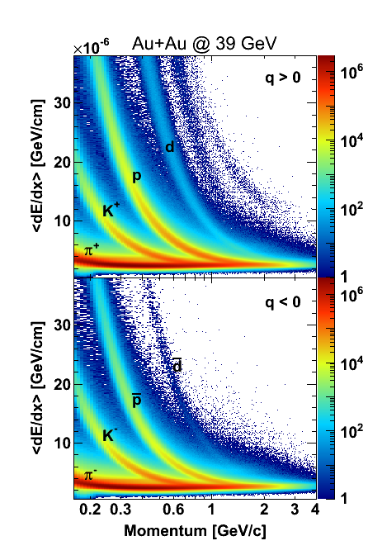
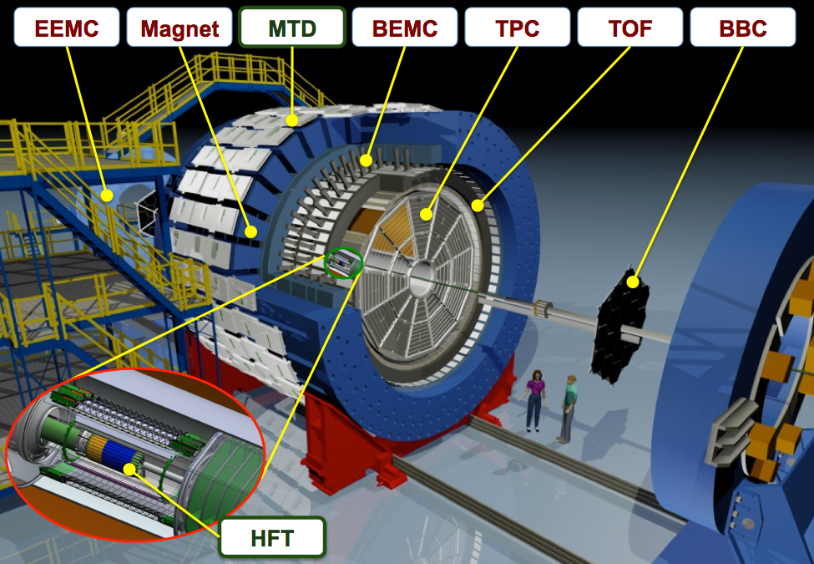
STAR Detector & Particle Identification
TPC
Uniform Acceptance
Full Azimuth Coverage
Excellent PID
Data sets: Au+Au
7.7, 11.5, 19.6, 27, 39, 62.4 and 200 GeV
Time Projection Chamber (TPC)
& Time of Flight (TOF)
for particle identification

Slide 7
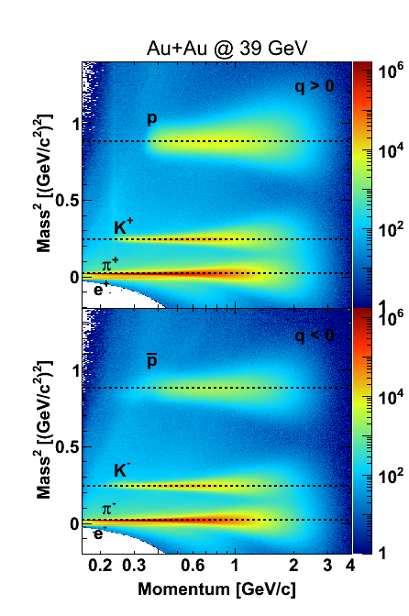
STAR Detector & Particle Identification
ToF
Uniform Acceptance
Full Azimuth Coverage
Excellent PID
Data sets: Au+Au
7.7, 11.5, 19.6, 27, 39, 62.4 and 200 GeV
Time Projection Chamber (TPC)
& Time of Flight (TOF)
for particle identification

Slide 8
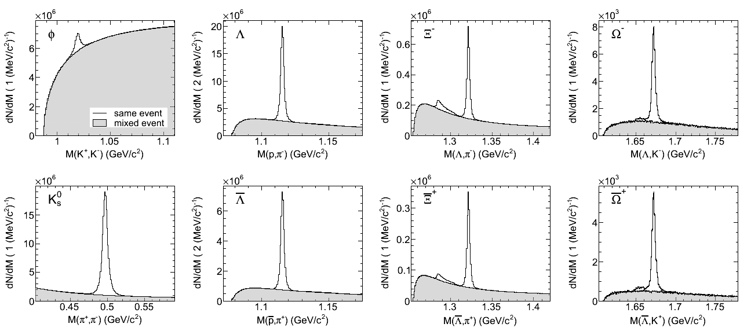
Reconstructed Strange Hadrons
Particle | Mass (GeV/c²) | Decay mode | Branching ratio
K_{S}⁰ | 0.498 | π⁺ + π⁻ | 69.20 ± 0.05
φ | 1.019 | K⁺ + K⁻ | 48.9 ± 0.5
Λ⁰ | 1.116 | p + π⁻ | 63.9 ± 0.5
Ξ | 1.322 | Λ⁰ + π | 99.89 ± 0.04
Ω | 1.672 | Λ⁰ + K | 67.8 ± 0.7
Au+Au 39 GeV

Slide 9
Top RHIC Energy: partonic collecivity
Au+Au 200 GeV
STAR Preliminary
Baryon-meson separation (particle-type dependent)
for p_{T}> 2.0 GeV.
Also v₂(φ)~v₂(π) and v₂(Ω)~v₂(p)
Clear evidence for partonic collectivity

Slide 10
Top RHIC Energy: NCQ Scaling vs Centrality
Au+Au 200 GeV
STAR Preliminary
Scaling hold within the limit of 10% for both 0-30% and
30-80% centrality for (m_{T}-m₀)/n_{q} > 0.8 GeV/c²,
except for pions.

Slide 11
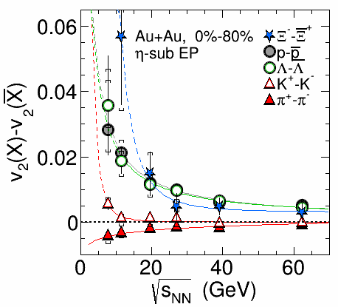
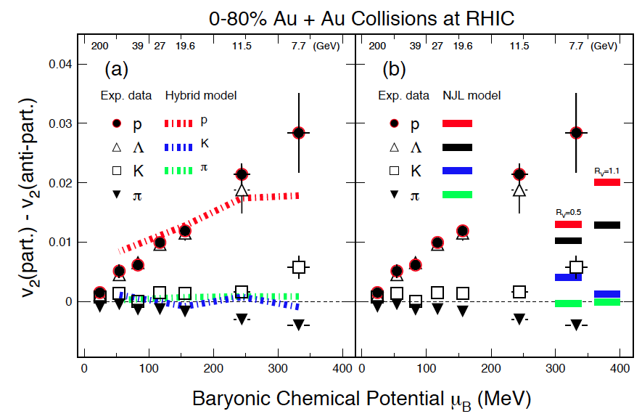
BES-I: Particle vs Anti-particle
Minimum Bias Au+Au
NJL: Acta Phys.Polon.Supp. 7 (2014) 1, 183
STAR: Phys. Rev. Lett. 110, 142301 (2013)
Hybrid: Phys. Rev. C 86, 044903 (2012))
Hydro model: Hybrid model (UrQMD + hydro) with baryon stopping
Nambu-Jona-Lasinio (NJL): Using vector mean-field potential, repulsive
for quarks, attractive for anti-quarks
Good agreement between data and hybrid-hydro model
calculation with baryon stopping.

Slide 12
BES-I: Particle vs Anti-particle
Centrality Dependence
STAR Preliminary
STAR Preliminary
Relative difference between particle and anti-particle v₂
is larger in central collisions than in peripheral.

Slide 13
BES-I: Baryon-Meson Separation
Minimum Bias Au+Au
STAR: Phys. Rev. Lett. 110, 142301 (2013)
Baryon-meson splitting separation disappears at √s_{NN} ≤ 11.5 GeV
Hadronic interaction might play an important role for √s_{NN} ≤ 11.5 GeV

Slide 14
BES-I: Baryon-Meson Separation
Minimum Bias Au+Au
STAR: Phys. Rev. Lett. 110, 142301 (2013)
Baryon-meson splitting separation disappears at √s_{NN} ≤ 11.5 GeV
Hadronic interaction might play an important role for √s_{NN} ≤ 11.5 GeV

Slide 15
BES-I: Baryon-Meson Separation
Centrality Dependence
v₂
STAR Preliminary
Baryon-meson splitting separation disappears at √s_{NN} ≤ 11.5 GeV
Hadronic interaction might play an important role for √s_{NN} ≤ 11.5 GeV

Slide 16
φ-meson v₂ vs beam energy
<v₂> (φ) for √s_{NN} ≥ 19.6 GeV
can be described by AMPT-SM
by varying parton-parton cross
section from 3 mb to 10 mb.
√s_{NN} > 19.6 GeV : v₂(φ) ~ v₂(p)
√s_{NN} ≤ 19.6 GeV: v₂(φ) < v₂(p)
STAR Preliminary
Contribution to the collectivity from partonic phase
decreases with decreasing beam energy.
Need More Statistics for φ-meson !

Slide 17
Summary
200 GeV:
We established clear evidence of partonic collectivity with the high precision measurement of Ω and φ-meson v₂ .
BES –I :
The observed difference in v₂ of particle and anti-particle becomes larger at lower collision energies.
This observation is consistent with the scenario where more stopped quarks compared to that of pairly produced quarks in lower energy collisions.
The baryon-meson separation disappears at √s_{NN} ≤ 11.5 GeV.
Measured φ-meson v₂ indicates less partonic collectivity at √s_{NN} ≤ 11.5 GeV. More statistics needed to confirm .

Slide 18
Plan for BES-II
RHIC - electron cooling for luminosity increase.
STAR iTPC upgrade - for tracking and PID improvement.
Event Plane Detector at forward rapidity.
RHIC plan for BES-II : run 2018-19
Estimated error on φ-meson v₂ :

Slide 19
Back-up

Slide 21
Top RHIC Energy: partonic collecivity
Au+Au 200 GeV
STAR Preliminary
Baryon-meson separation (particle-type dependent)
for p_{T}> 2.0 GeV.
Also v₂(φ)~v₂(K) and v₂(Ω)~v₂(p)
Clear evidence for partonic collectivity

