Slide 1


Recent STAR Results
Zhangbu Xu
BNL
For the STAR Collaboration
Recent Highlights
  Heavy Flavor
  Electromagnetic probe
  Chiral Magnetic Observables
Programs in next 2 years
BES I/II Program
Looking forward (upgrade)
Longer Term and Summary

Slide 2



STAR Detector System
EEMC
Magnet
MTD
BEMC
TPC
TOF
BBC
HFT
X10³ increases in DAQ rate since 2000

Slide 3
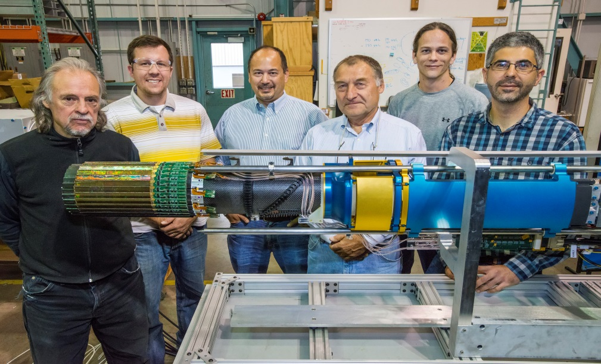
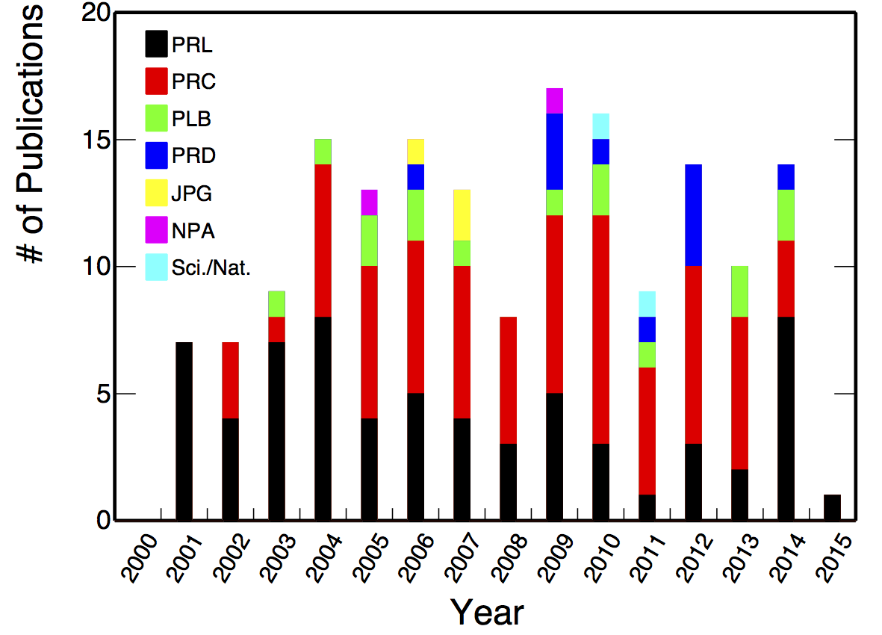
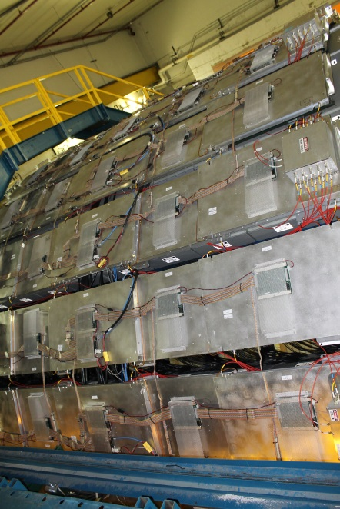
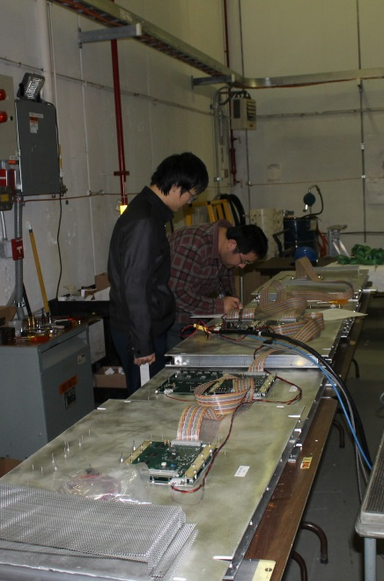
Results, technologies and
people who made it happen
Experimental talks focusing on STAR
Higher Harmonic flow of φ meson
in STAR at RHIC.
SHARMA, Mukesh Kumar
Measurement of azimuthal anisotropy of
light nuclei produced in heavy-ion
collisions at RHIC.
HAQUE, Rihan
Dynamical net charge fluctuations
at RHIC energies in STAR.
SHARMA, Bhanu
Jet Measurements at STAR
Jan Rusnak (STAR invited)
Probing the QCD phase diagram
with the measurements of strange hadron
elliptic flow in STAR
Md. Nasim
Heavy Flavor Tracker at the STAR Experiment.
SIMKO, Miroslav
Direct-photon+hadron correlations for the study of
parton energy loss at the top RHIC energy.
SAHOO, Nihar Ranjan
Exploring QCD Phase Diagram with
the RHIC Beam Energy Scan Program
Bedanga Mohanty (STAR invited)
New insights on the QCD phase diagram
Roy Lacey
Heavy flavor production at RHIC
Sonia Kabana
https://drupal.star.bnl.gov/STAR/presentations

Slide 4

QGP properties and QCD Phase Diagram
space coordinate
mass scale
penetrating thermal scale
high momentum scale
causality time scale
Initial Geometry
  U+U shape and density➔v₂ and Strangeness
  Asymmetric systems (d+Au, Cu+Au, ³He+Au, p+Au)
Free Quarks
  Flow of heavy quarks
  Color Screening of Heavy Quarkonia
Excited Vacuum
  Dileptons as tool to systematically study Chiral Symmetry Restoration
  What are the procedures to achieve that?
Properties of QGP
  Jet
  Long-Range Correlations
Projections from STAR Upgrades
  Heavy-Flavor Tracker (HFT)
  Muon Telescope Detector (dimuon and e-μ)

Slide 5
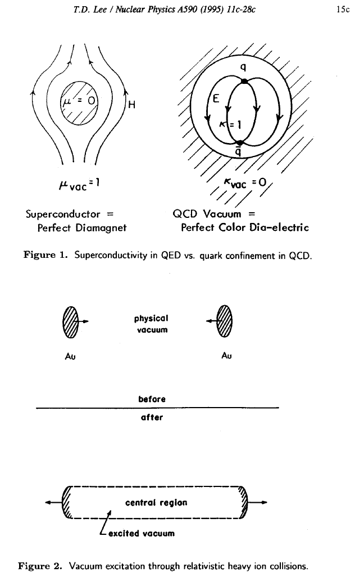
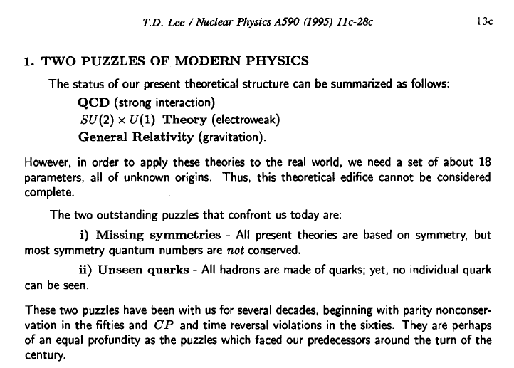
Free Quarks
Excited Vacuum
Quark Matter 1995
Color Screening of Quarkonia, Charm Quark Flow
In-medium ρ spectral function, thermal radiation, Chiral Magnetic Effect

Slide 6
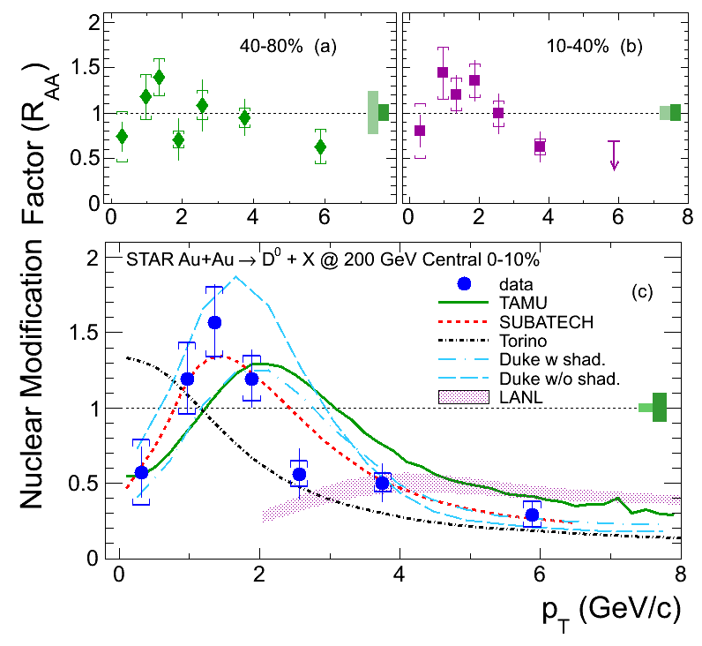
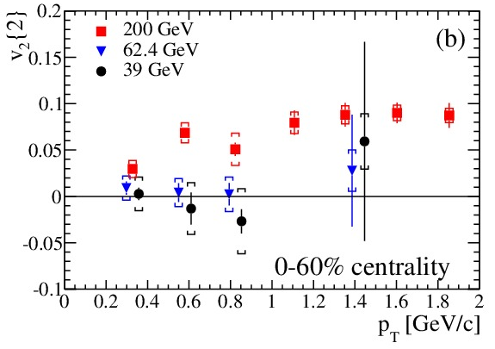
Flow and Quenching of Heavy Quarks
Elliptic flow of
Electrons from heavy-flavor hadrons
Finite v₂ at low p_{T}
Jet contribution at high p_{T}
Difference at lower energies
arXiv: 1405.6348
First measurement of directly reconstructed
Charmed hadron radial flow at RHIC
PRL 113 (2014)142301
HFT Crucial to moving forward the Program

Slide 7
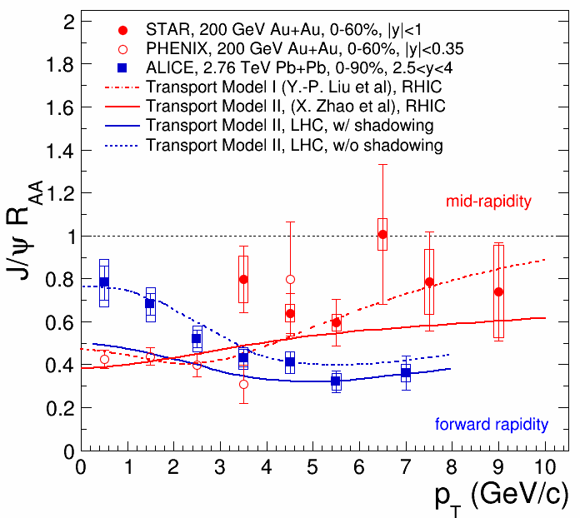
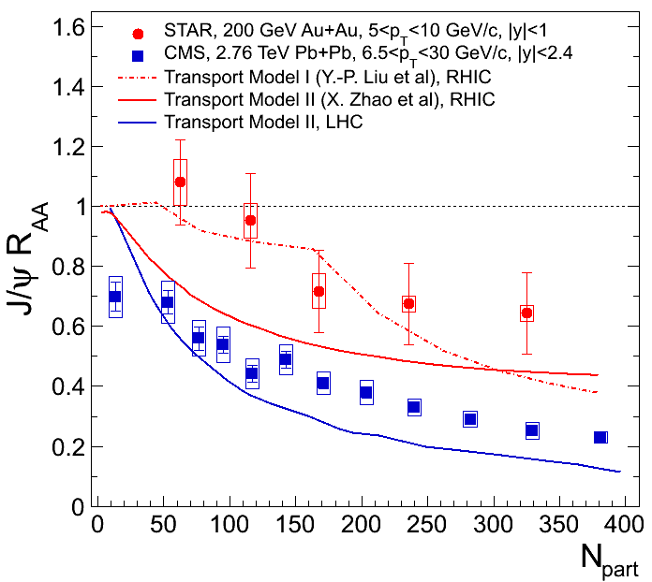
J/ψ p_{T} dependence in A+A
PHENIX: PRL98(2007)232301;
STAR: arXiv: 1208.2736, PLB (2013)
J/ψ R_{AA} decreases from low to high p_{T} at LHC.
J/ψ R_{AA} increases from low to high p_{T} at RHIC.
J/ψ R_{dA} reach unity at p_{T}>4GeV/c (PHENIX).
At high p_{T}, J/ψ more suppressed at LHC.
Substantial interaction (not just cold nuclear effect)
Notes:
7

Slide 8
J/ψ Suppression without flow
RHIC:
large suppression, zero flow
LHC:
less suppression, hints of flow
Phys. Rev. Lett. 111 (2013) 52301
Color Screening and quark coalescence
STAR low-p_{T} Phys. Rev. C 90, 024906 ; high-p_{T} : Phys.Lett. B722 (2013)
Most distinct features in all the particles
Interaction and suppression
Neither radial nor elliptic flow
Open charm suppression and flow

Slide 9
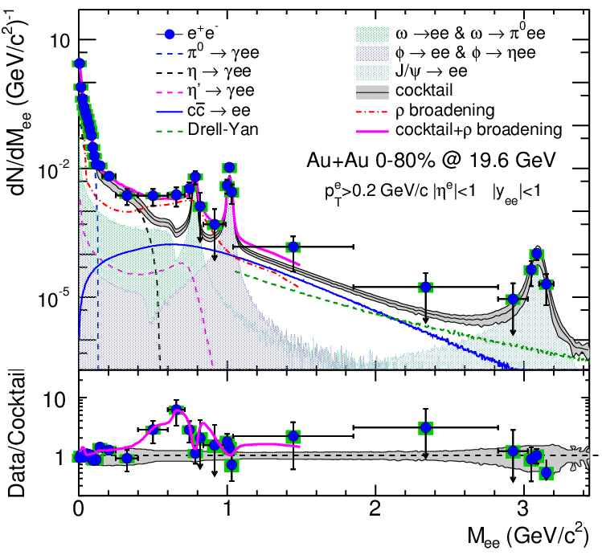
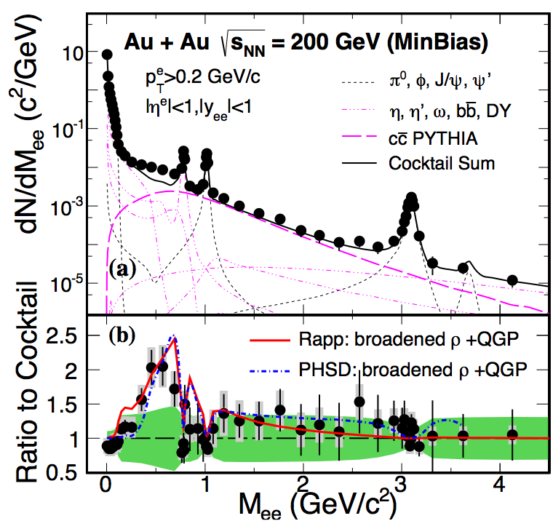
Dilepton In-medium Effect
Practical way of observing chiral symmetry restoration from dileptons:
disappearance of hadronic structure (vector meson peaks)
dissolve into continuous thermal distribution from LMR to IMR
Subtract charm contributions at IMR
New Results on 19.6GeV Au+Au
arXiv:1501.05341
one week of data in 2011 at 19.6GeV
LMR
ρ→e⁺e⁻
πηφω
IMR
q‾q→l⁺l⁻
c→l
arXiv:1312.7397, PRL 113 (2014) 022301
HMR
J/Ψ, DY, ϒ(1,2,3)

Slide 10
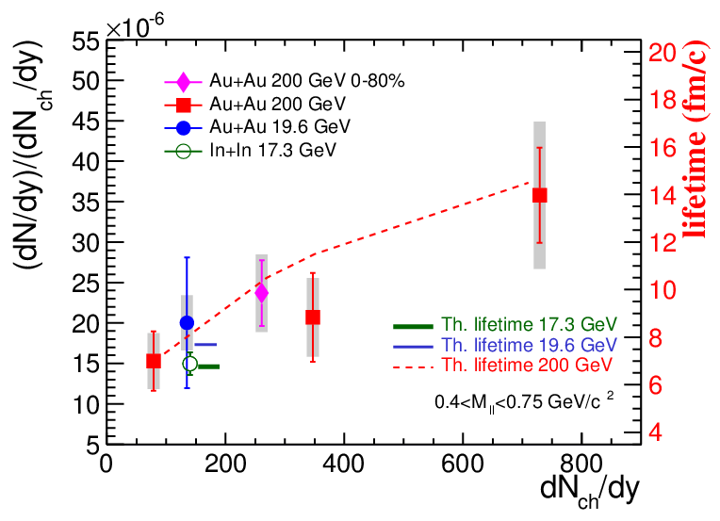
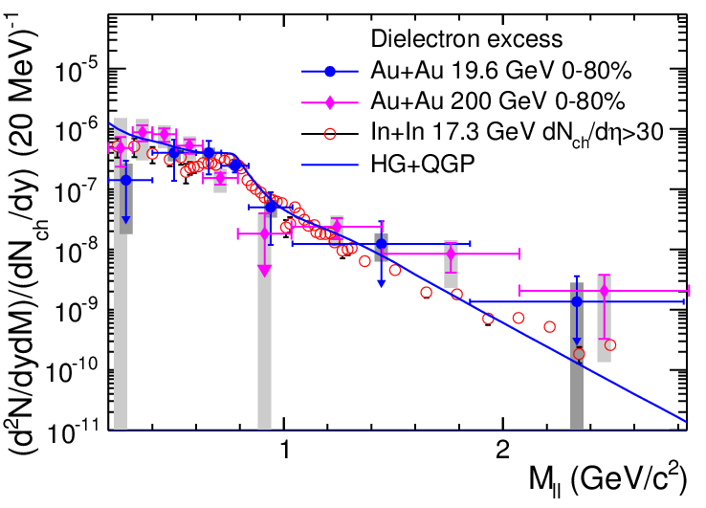
Energy Dependence of Dilepton Excess
arXiv:1501.05341 one week of data in 2011 at 19.6GeV
19.6GeV consistent with SPS results
Excess shape at low mass
described by rho in-medium broadening
Excess yields (after detector correction)
are sensitive to early system lifetime:
integrated over duration at the high temperature

Slide 11
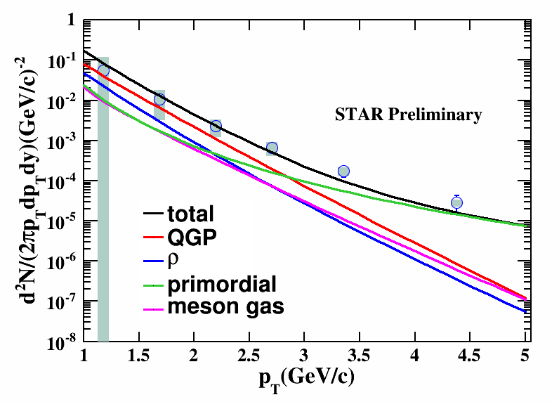
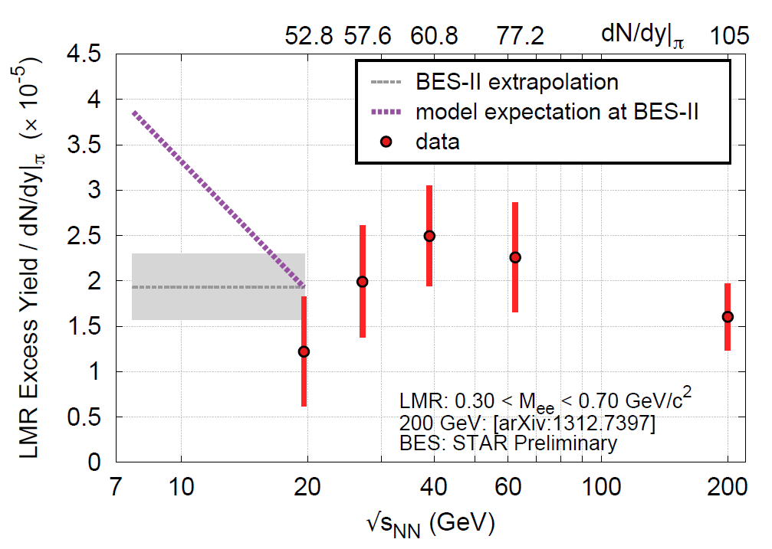
Quantify the spectral function
Temperature dependence of rho spectral function
Beam energy range where final state is similar
Initial state and temperature evolution different
Density dependence by Azimuthal dependence (v₂)
Use centrality dependence as another knob
Direct photon results should match with extrapolation
Baryon dependence of rho spectral function
1. LMR excess expected to be consistent with total baryon density increase
Direct virtual photons
QM14: Chi Yang, Patrick Huck

Slide 12
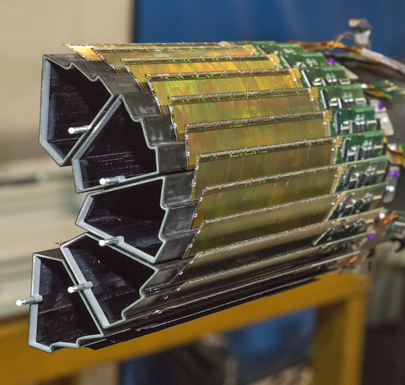
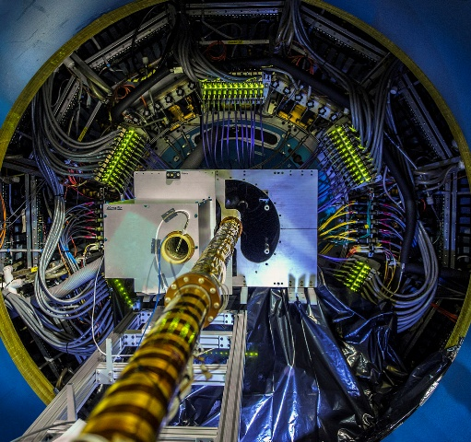
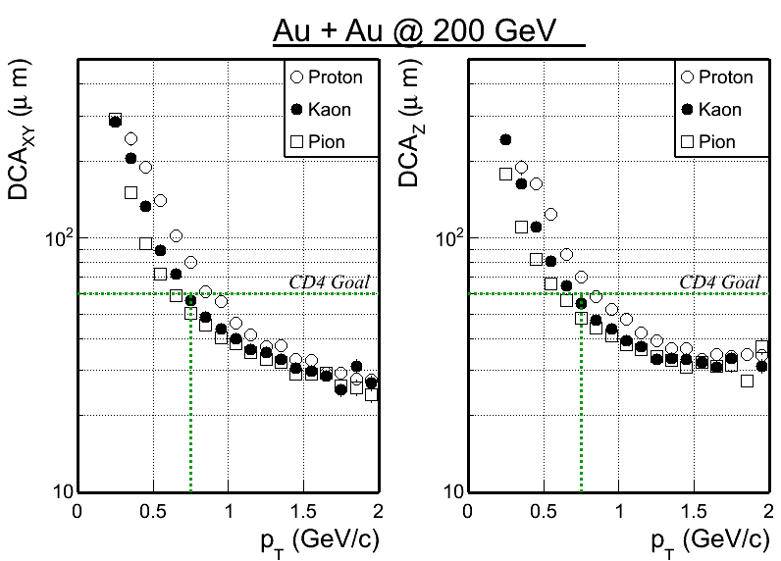
Status: Heavy Flavor Tracker
Heavy Flavor Tracker (HFT) Full reconstruction of charm
hadron with displaced vertex
Physics goal: Precision measurement of heavy quark hadron production in heavy ion collisions
All 3 sub-detectors (PXL, IST, SSD) were completed, installed prior to Run14
PXL – heart of the HFT: state-of-art detector, MAPS technology, first time used at a collider experiment.
Taking data with STAR detector system,
Dataset production and analyses on the way
Reach Performance Requirement Goal:
With survey and preliminary alignment, Kaons at 750 MeV/c: DCA < 60μm
√s_{NN} = 200GeV Au+Au Collisions

Slide 13
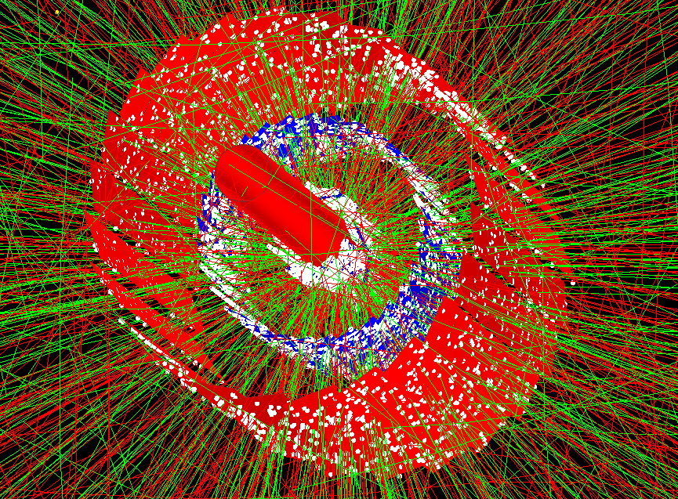
16cm

Slide 14

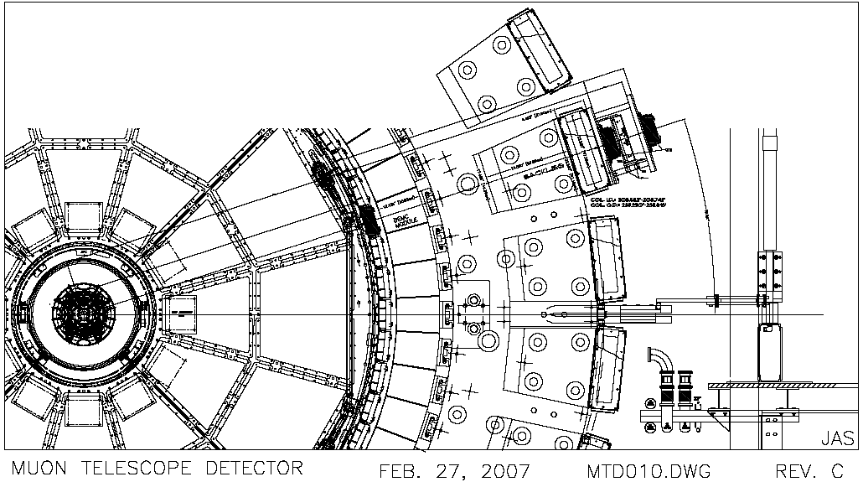
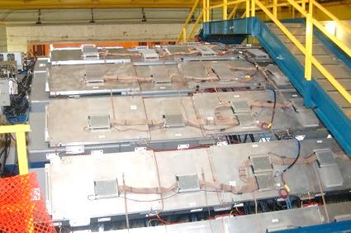
Status: Muon Telescope Detector
Beam pipe
HFT
TPC
TOF
EMC
Magnet
MTD
Muon Telescope Detector (MTD):
Physics goal: Heavy Quarkonia
MRPC technology; covers ~45%
azimuthally and |y| < 0.5
3) Fully installed in Run14:
sampling >10nb⁻¹ in 200GeV Au+Au
for quarkonium physics
4) VECC/USTC/Tsinghua/US joint project

Slide 15
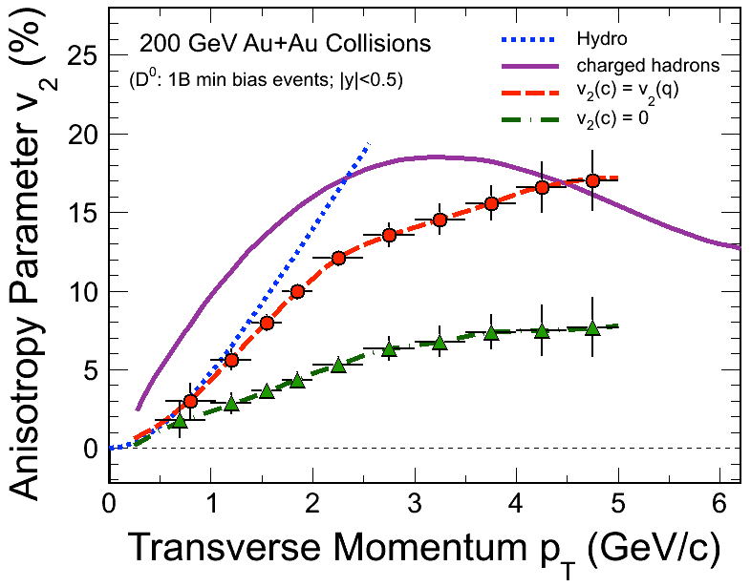
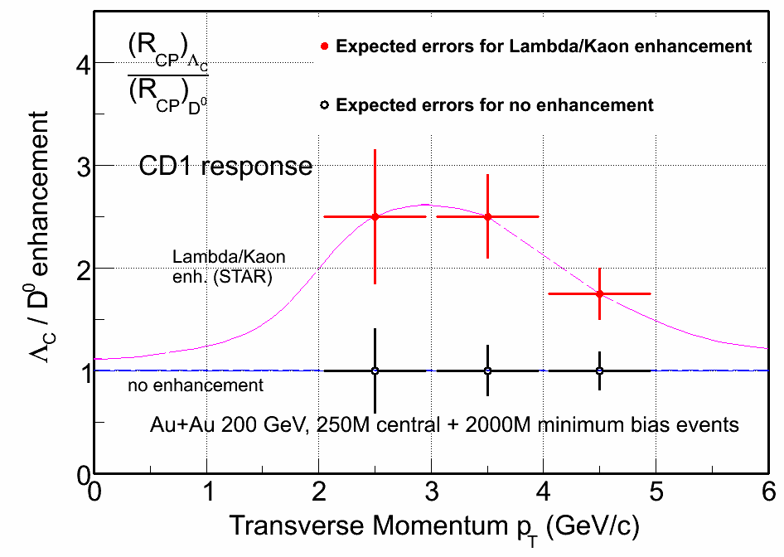
Open charm flow and coalescence
HFT Projection for Au+Au run14 + run16
Quantify charm quark flow and coalescence
with high-luminosity and high-statistics datasets

Slide 16
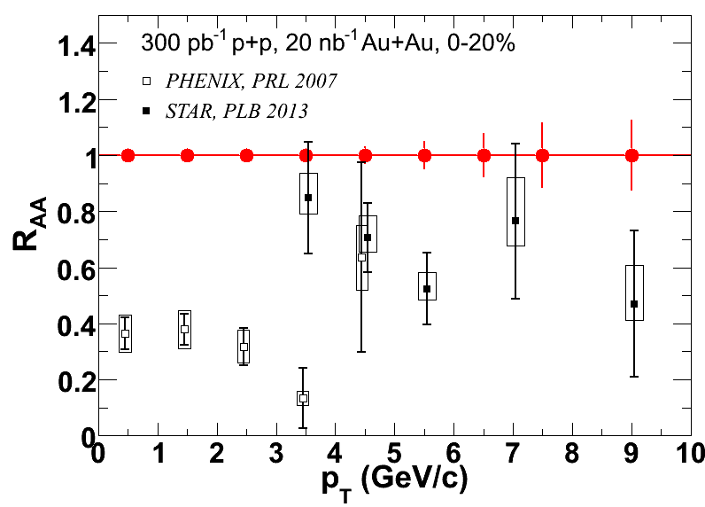
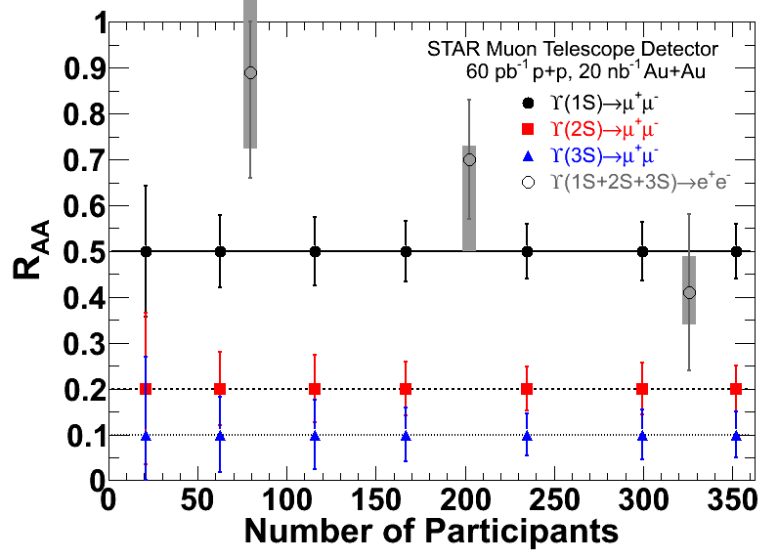
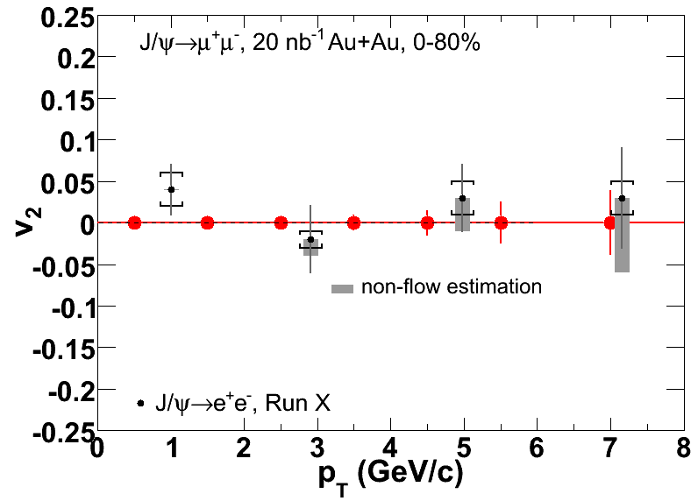
Run14+16 Quarkonium Measurements
Phys. Lett. B 735 (2014) 127
MTD: Improves statistical uncertainty
As well as systematic uncertainty
Separate Upsilon states
MTD+HFT: B→J/ψ, …

Slide 17
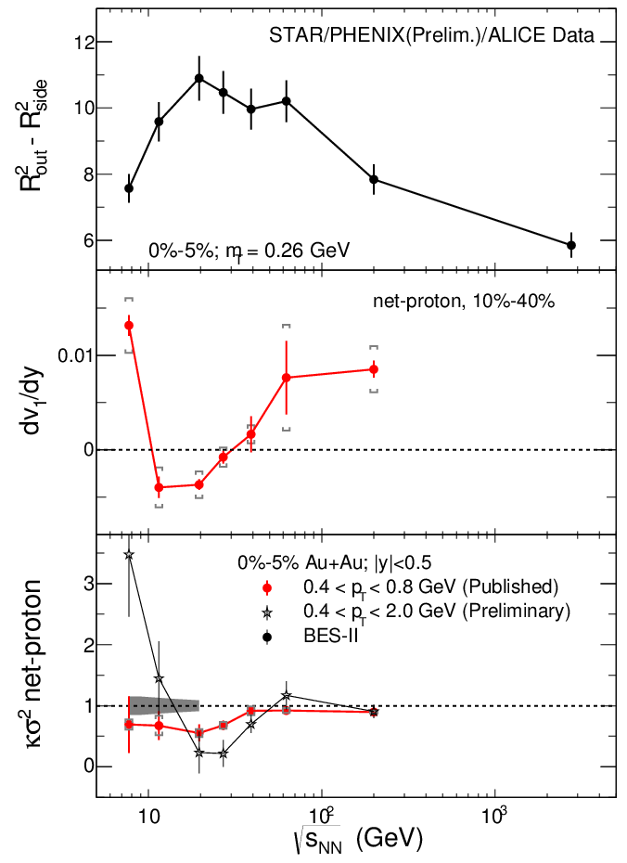
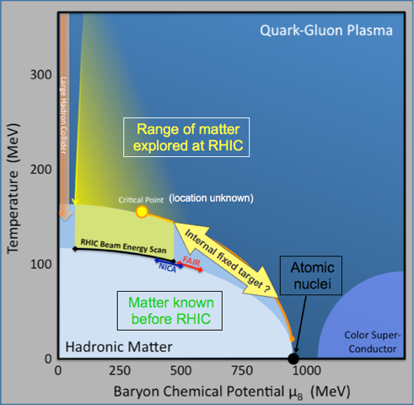
Mapping the QCD Phase Diagram
RHIC uniquely suited to map the QCD phase diagram at finite baryon density
The predicted QCD critical point
a landmark
anchoring the crossover transition to the sQGP at low baryon density
first order phase boundary and quarkyonic matter at high baryon density.
Roy Lacey
Talk
Hints of new behavior in first Beam Energy Scan
Beam Energy Scan Phase 2 (BES II):
from hints to quantitative understanding
Bedanga Mohanty
Talk

Slide 18
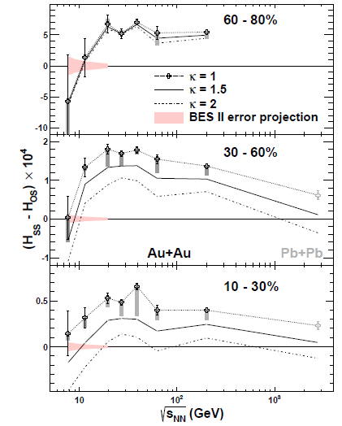
Chiral Magnetic Effects
All present Theories are based on symmetry
Charge separation with respect to the reaction plane. Non-zero separation at high energies with a decreasing trend toward low energy
Quarks (chiral) interact with gluonic fields (topologic change); produce such a charge separate with external magnetic field
BES II determines if the effect disappears at low energy
Similar effect with magnetic wave (CMW) and baryon vortical Effect (CVE)
STAR: 5 papers on related effects
Phys. Rev. Lett. 113 (2014) 52302
QCD Chirality Workshop 2015
UCLA, January 21-23, 2015

Slide 19
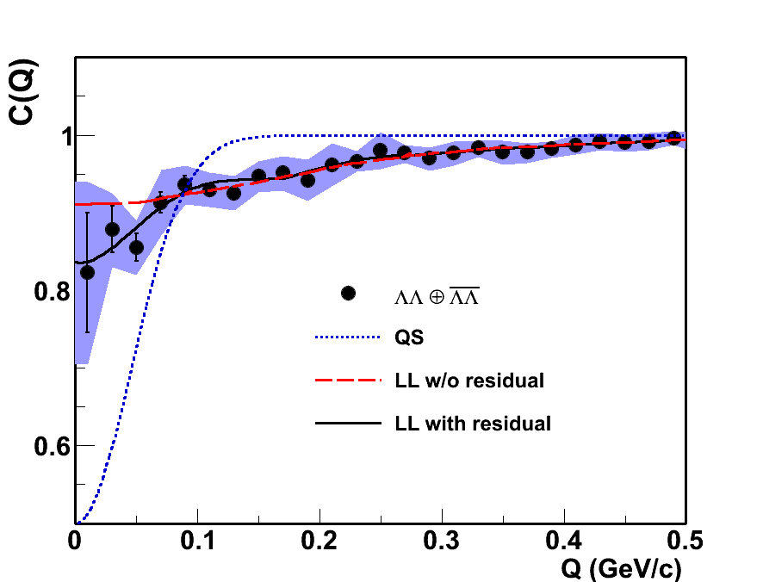

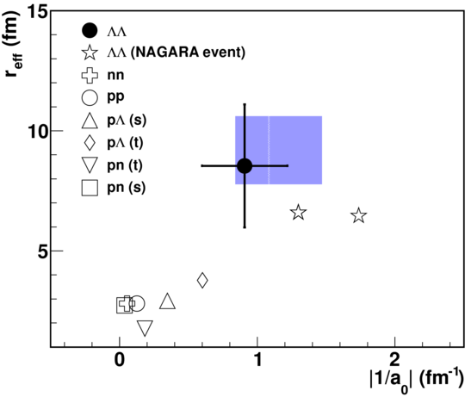
ΛΛ correlation function and H-dibaryon Search
Likely ΛΛ Attractive interaction
No ΛΛ resonant states
Discovery of antimatter hypertriton (Science 2010)
Discovery of antimatter Helium4 (Nature 2011)

Slide 20
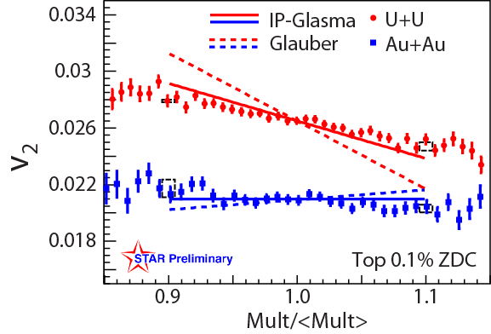
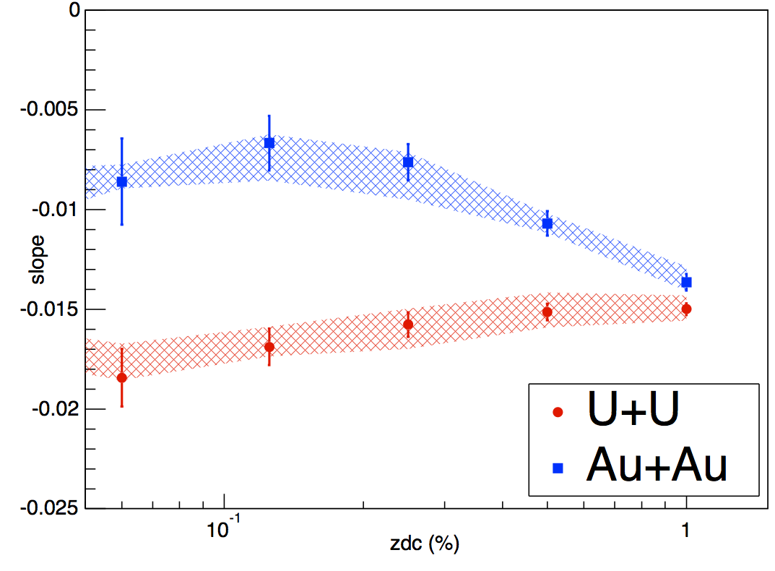


Extreme Geometries: U+U Collisions
STAR Preliminary
v₂ Slope
Collision centrality (ZDC)
Hui Wang (for the STAR Collaboration)
Quark Matter 2014
U+U collisions recorded to study possible effects due to geometry. Expected 20% increase in energy density in very central collisions
Tip-tip and body-body enhanced samples selected via forward neutrons (ZDC) and multiplicity in TPC
IP-Glasma model consistent with the observation: implying Gluon-Saturation type of initial condition at RHIC
- Bjoern Schenke, et al. arXiv:1403.2232
- Maciej Rybczyński, et. al. PRC87,044908(13)

Slide 21
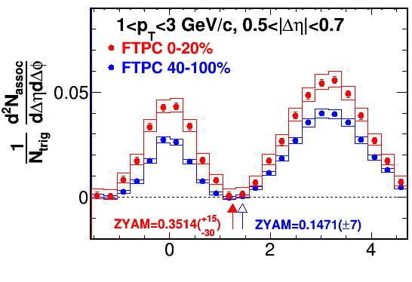
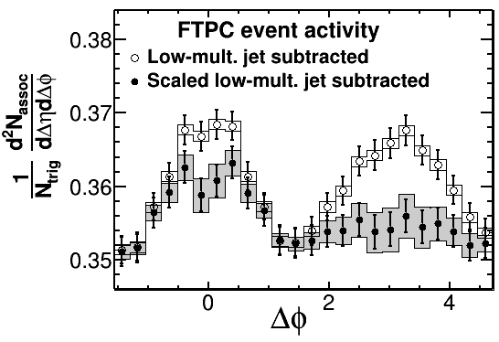
Extreme Geometry: d+Au Collisions
diharon in close Pseudo-rapidity range
d+Au@200 GeV
STAR Collaboration, arXiv: 1412.8437
p_{T} : [1,3]x[1,3] GeV/c
FTPC Multiplicity
STAR Preliminary
STAR Preliminary
Δφ
High-mult. (before ZYAM) – jet in low-mult.
→ Double Ridge
High-mult. (before ZYAM)– scaled jet in low-mult.
→ Away-side diminished

Slide 22
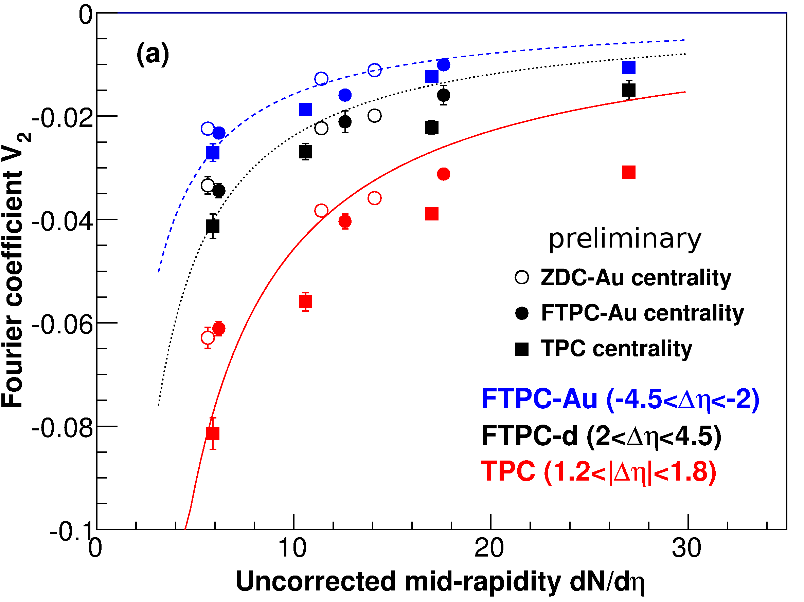
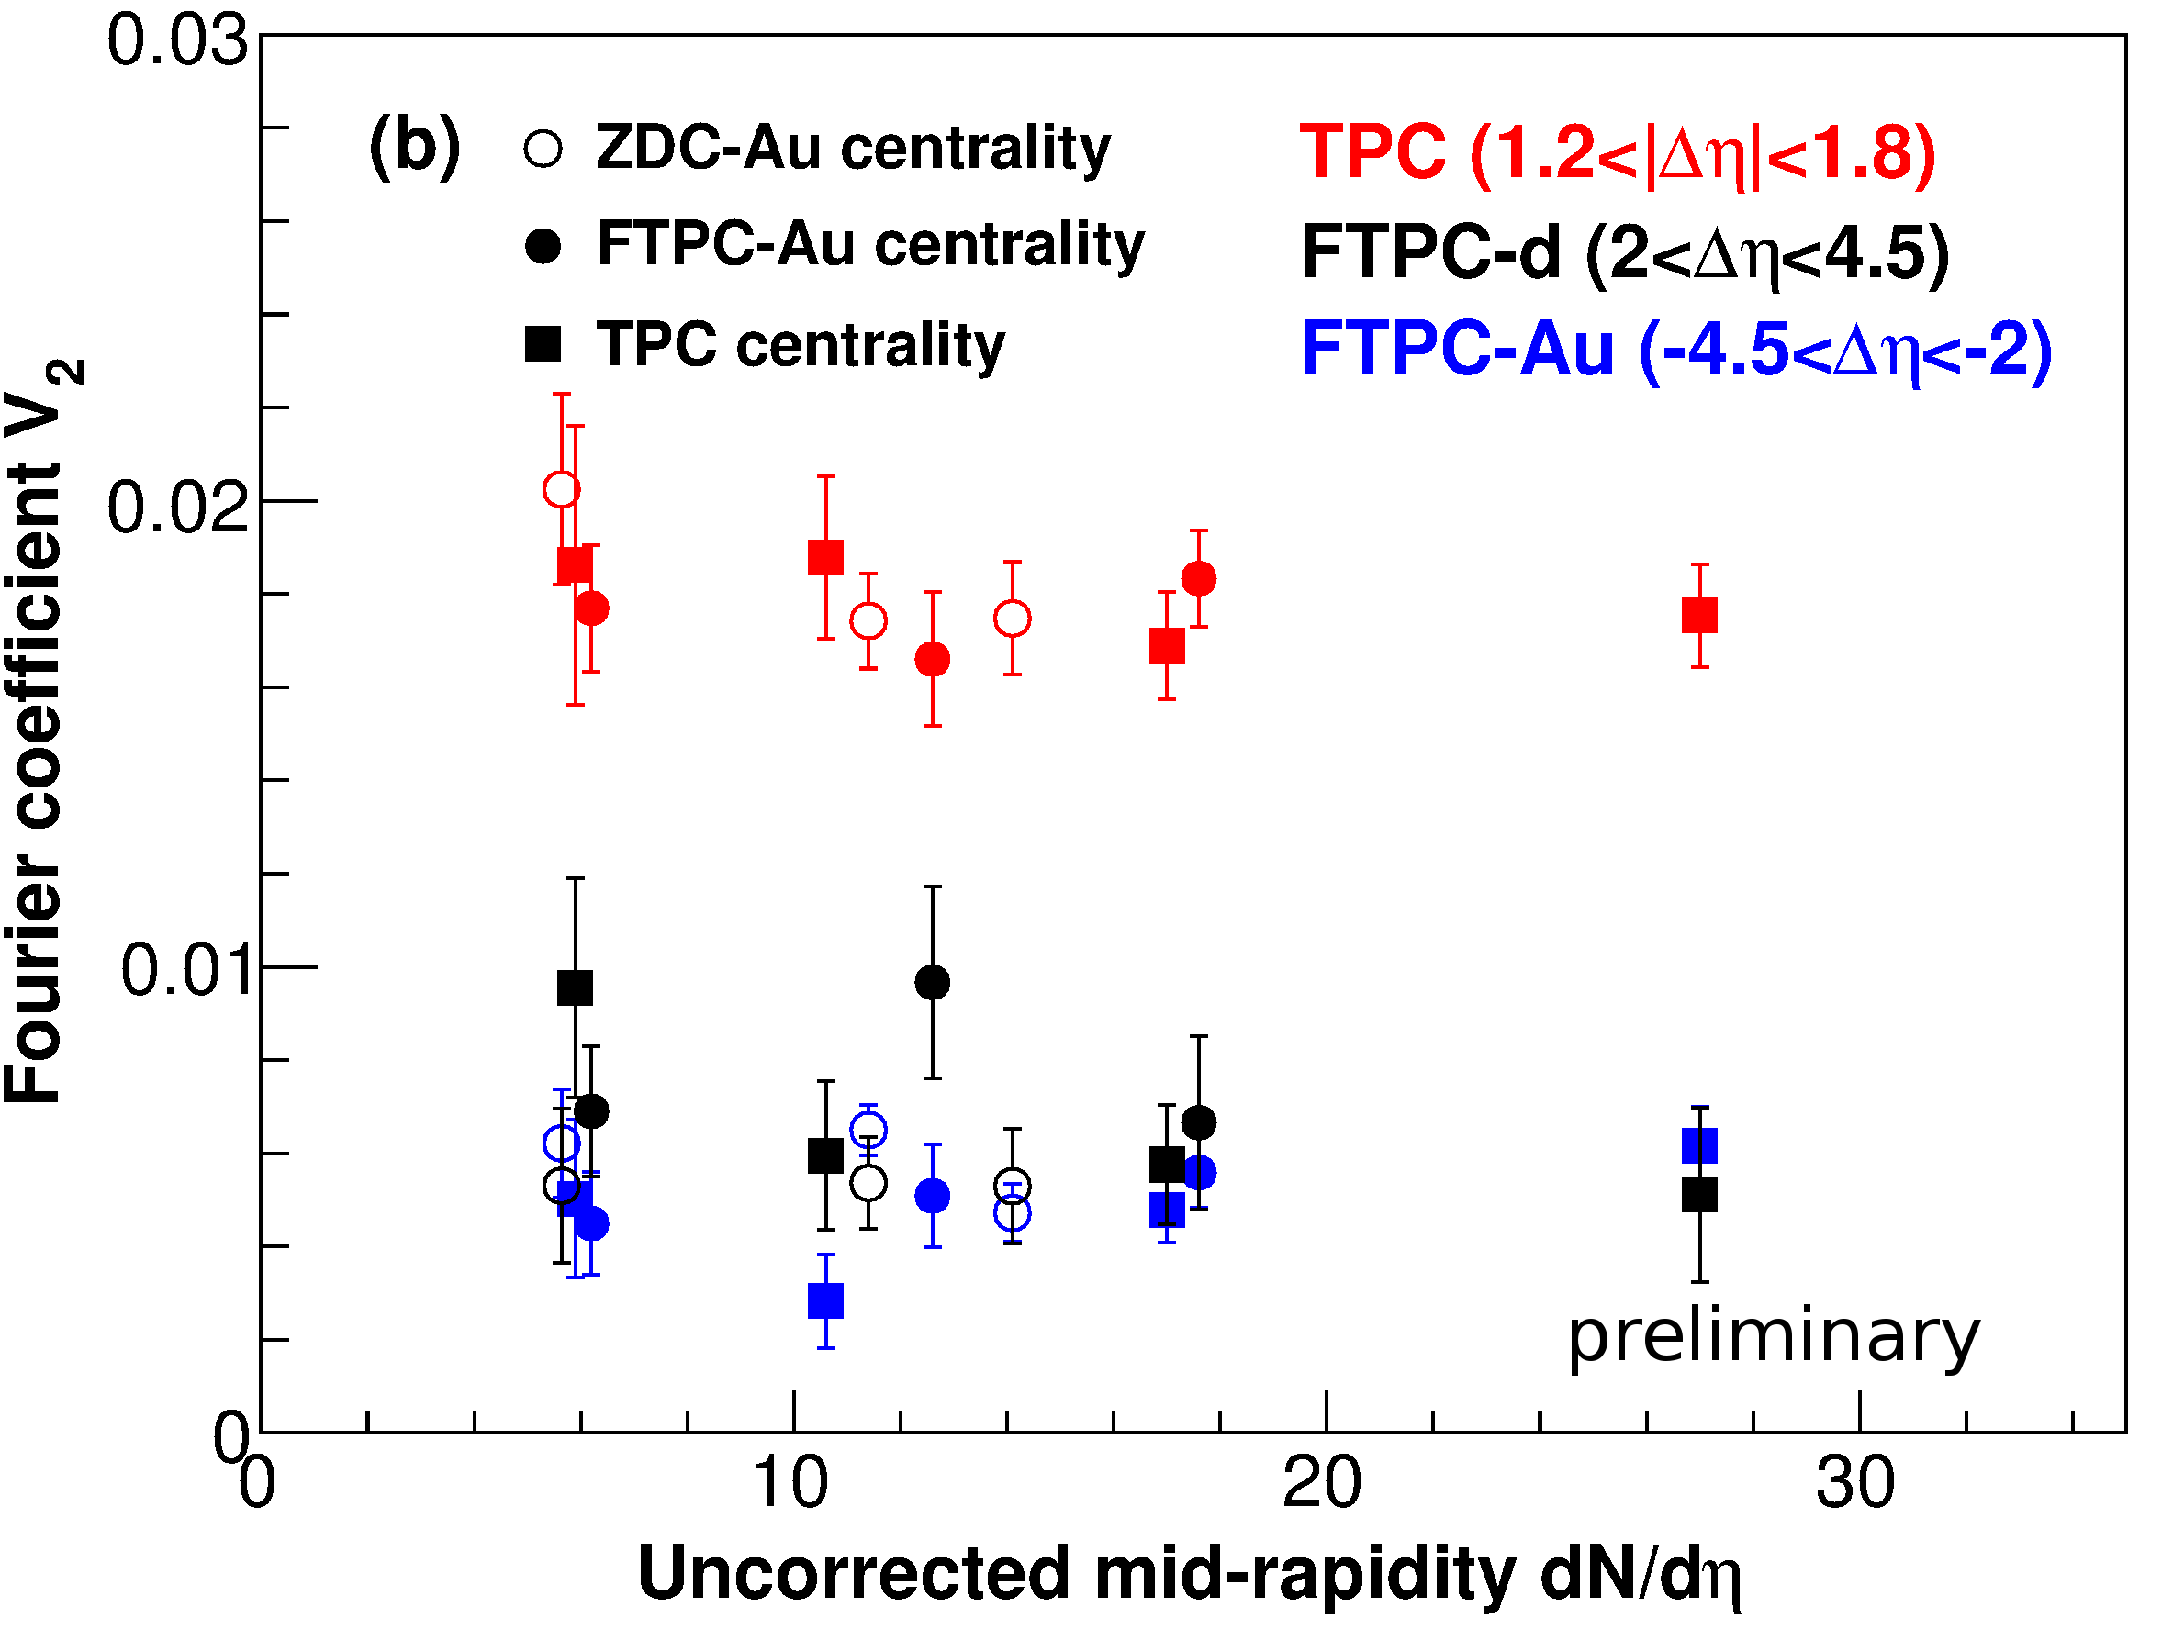
Fourier Coefficients vs. Multiplicity
diharon in large Pseudo-rapidity range
V₁=⟨cos( Δ φ)⟩ V ₂=⟨ cos( 2 Δ φ)⟩
STAR Preliminary
STAR Preliminary
Larger negative V₁ in low-mult. hides the V₂ shape
V₂ are same in high-mult. and low-mult. collisions

Slide 23
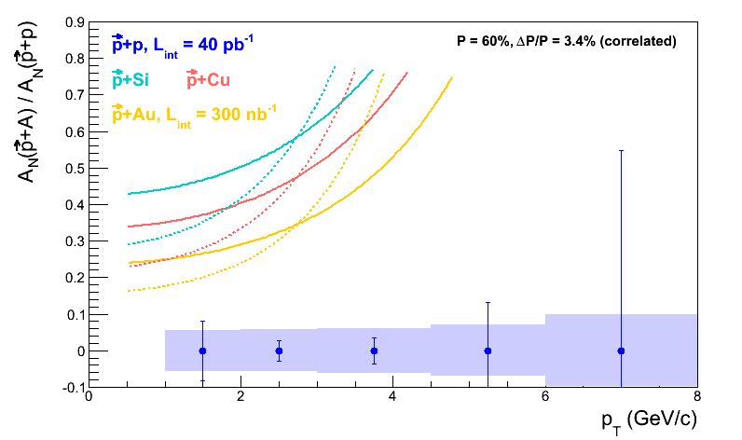
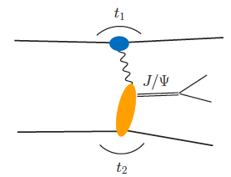
Heavy-Ion meets Spin (run15)
5 weeks
Polarized p+Au
L=300nb⁻¹
Saturation physics,
pA-ridge
Cold Nuclear Effect
GPD gluon (pre-EIC)
π⁰
Au
Au’
Upgrades for run15:
Roman-Pot Phase II
(move RP closer)
Refurbish FMS
FMS pre-shower
Forward Instrumentation (proton in BLUE)
p
p’
Other Extreme Geometry: Cu+Au, ³He+Au

Slide 24
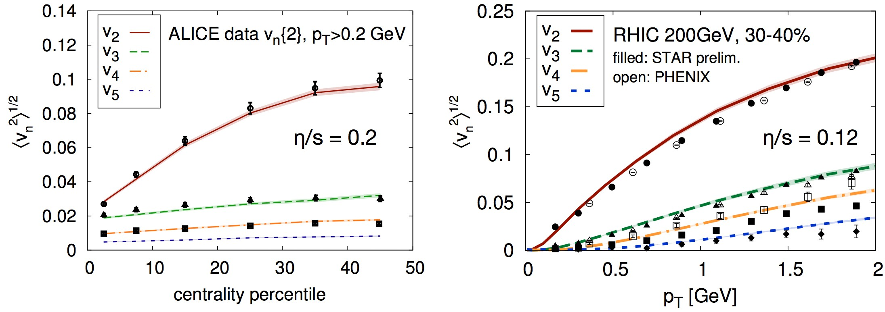
Quantifying a Complete Picture
1
 Experimental error bar no-longer the limiting factors on the eta/s
C. Gale et al., PRL 110 (2013) 012302
 Measurement aim to provide a picture that is as complete as possible.
 Event-by-event flow observables→ Initial fluctuation & flow correlation
 Event shape engineer & engen-mode ana.→ Geometry model & hydro. response
 Longitudinal fluctuations→ particle production & early time dynamics
 Medium response→ relaxation mechanism for local perturbation
 PID vn hadronization and hadronic transport
J. Jia et al, Hot QCD White paper for NSAC

Slide 25
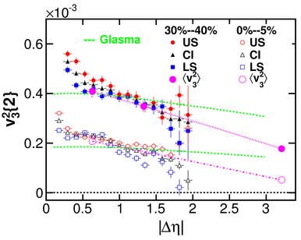
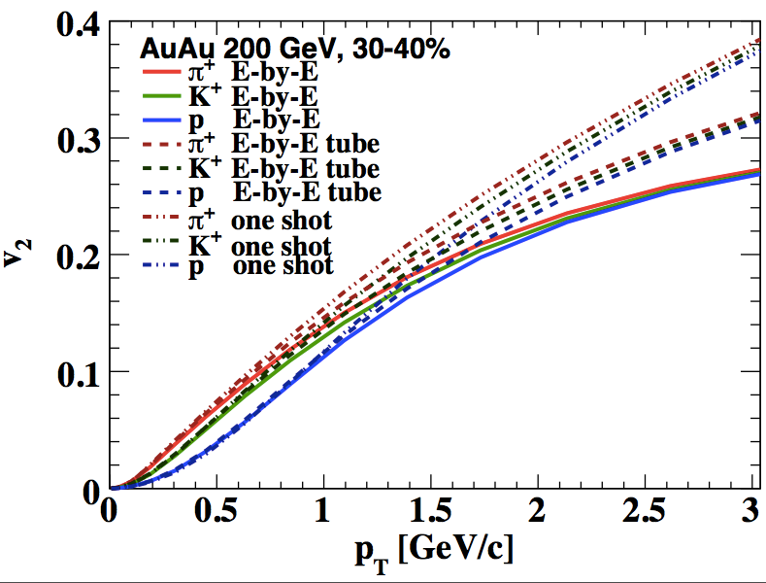
Effect of longitudinal fluctuation on constraining η/s
Pang, Wang, XN Wang PRC (2012)
STAR, PRC (2013)
Extracting reliable eta/s value from v2 measurement at mid-rapidity
Depends on how well we understand the initial condition or longitudinal dynamics
Need measurements at RHIC in longitudinal direction

Slide 26
Longitudinal Flow Decorrelations
L.G. Pang et al., arXiv: 1410.8690; X.N Wang, G.L. Ma, private communications
Forward Upgrade for A+A

Slide 27
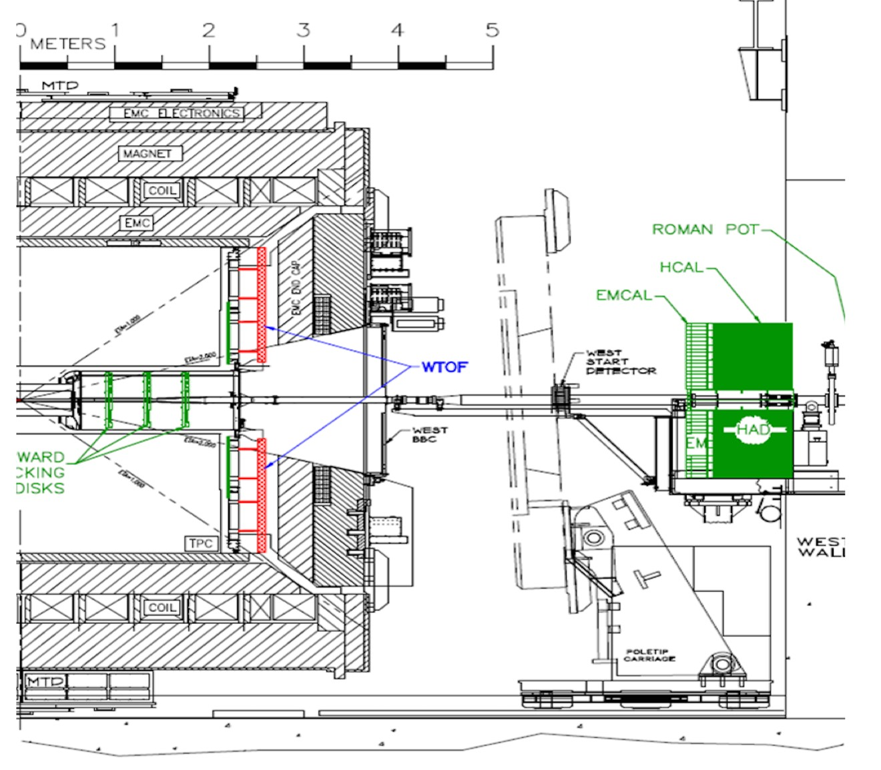
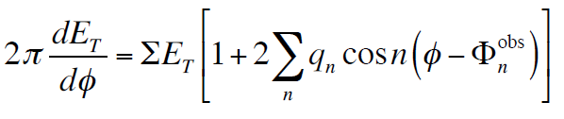
STAR Forward Upgrade:
Tracking and Calorimetry
Fourier expansion of FCal ET distribution:
(ATLAS, CMS method)
Event shape selection
0th order event-shape selection: Centrality by ΣE_{T} (system size)
2nd order event-shape selection: ellipticity by q2 (system shape)
3rd order event-shape selection: triangularity by q3 (system shape)

Slide 28
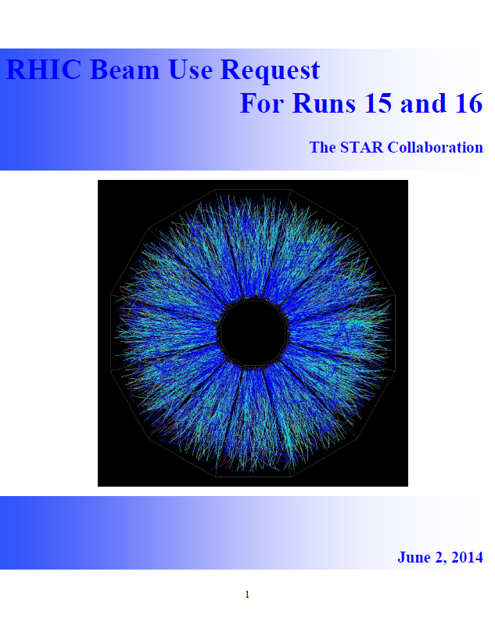
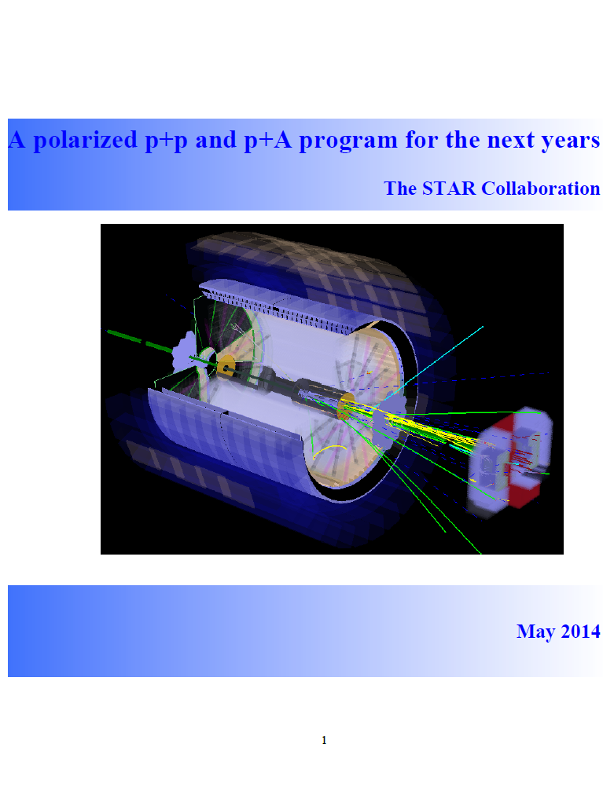
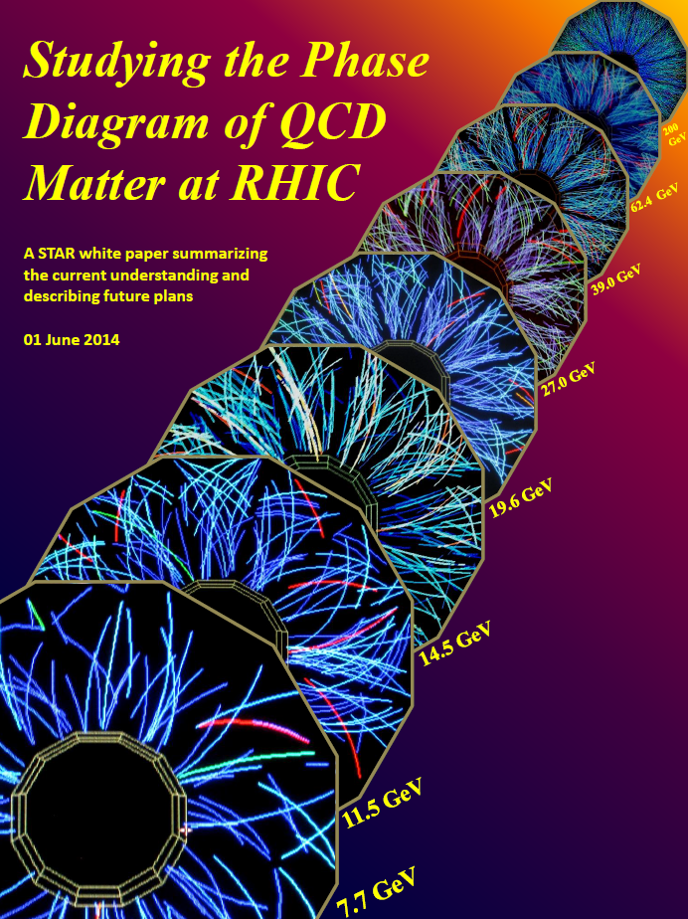
STAR Plan on BUR, BES II and pp/pA LoI
Committee co-chairs:
Bedanga Mohanty (NISER)
Dan Cebra (UC Davis)
Committee co-chairs:
Elke Aschenauer (BNL)
Ernst Sichtermann (LBL)
Huan Huang (UCLA)
https://drupal.star.bnl.gov/STAR/starnotes/public/sn0605
https://drupal.star.bnl.gov/STAR/starnotes/public/sn0598
https://drupal.star.bnl.gov/STAR/starnotes/public/sn0606

Slide 29
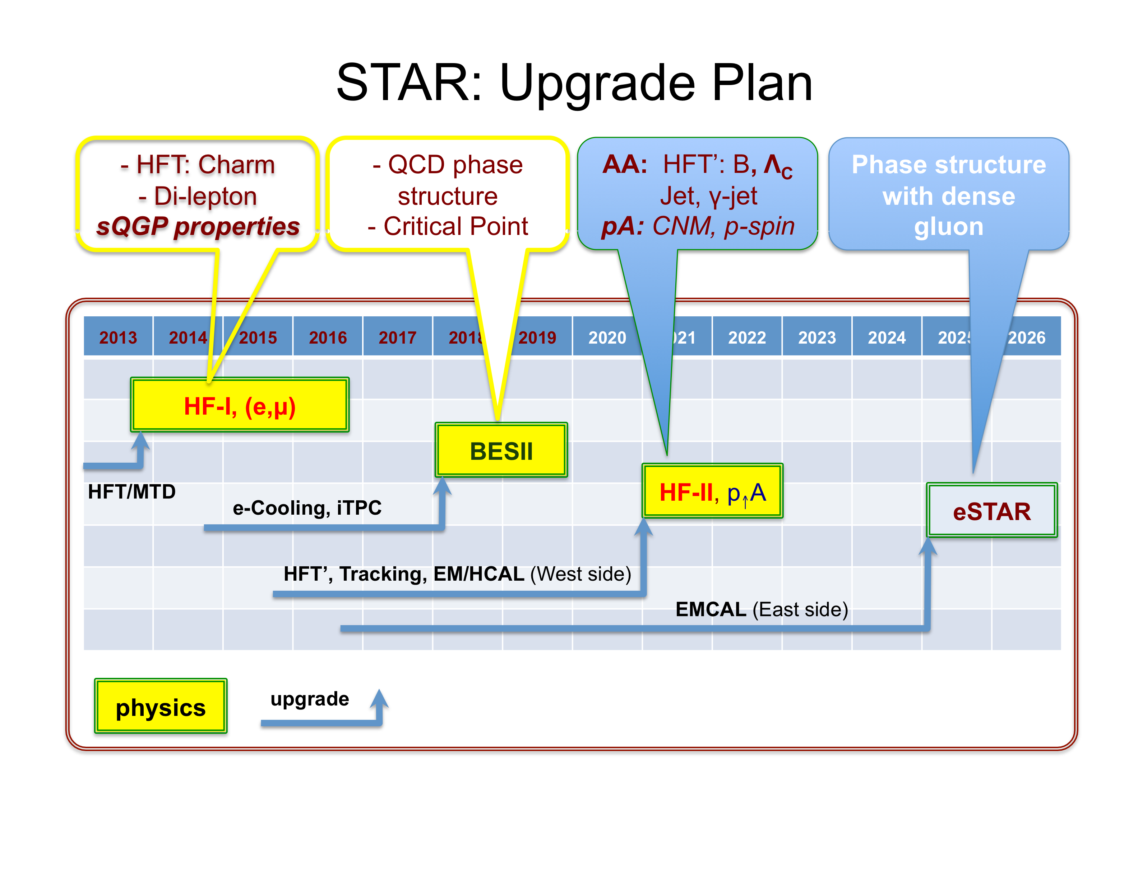
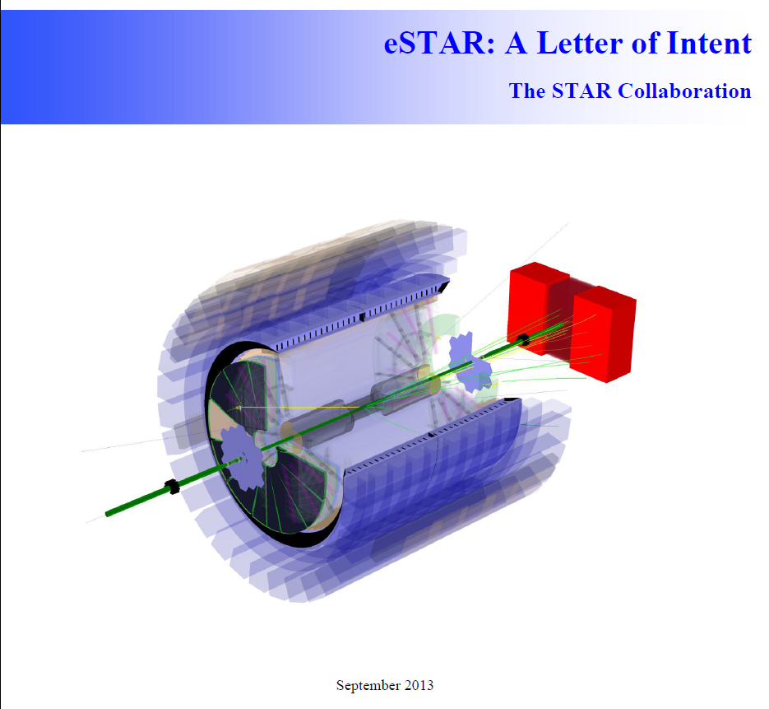

STAR Long-Term Plan
https://drupal.star.bnl.gov/STAR/starnotes/public/sn0592

Slide 30
Summary I
STAR/RHIC high-impact science with state-of-the-art detectors and ever-increasing luminosity and machine versatility.
Successful Upgrades and Plans to address key questions and physics milestones in the field
Run 15:
  crucial references in p+p and p+Au for HI
  Transversity and Gluon Spin Contribution
  Novel probe of saturation using Uniquely polarized p+Au
Run 16:
  Quantify heavy-flavor flow, thermalization, energy loss and color screening.
  Explore potential discovery of QCD predicted A_{N} relation between p+p and DIS.
Incremental Detector Upgrades:
Run15:
Refurbishing FMS
FMS Pre-shower
Roman Pot Phase II*
HFT PXL with Al Cable
Run16:
VPD with new Online QT
Forward Calorimeter Options

Slide 31
Summary II
Exciting results from BES I narrowing regime of search window for turn-off QGP signals; first-order phase transition; critical point
proposes BES II to answer compelling questions about the phase structure of QCD matter;
provide precision data for quantitative comparison with models on EOS at high-baryon density
Effective use of penetrating probes (heavy-flavor, jet and dileptons) to study the properties of QCD
Quantifying behavior of free heavy-quarks in-medium
The role of color screen in quarkonium production
Energy loss of energetic partons and quantifying medium properties
Degree of Chiral Symmetry Restoration impacts on hadron spectral function
Position ourselves in frontiers of nuclear science
Plan on transition to electron-ion physics
Understanding the parton distribution at low-x in proton and nuclei:
the glue that binds us all!

Slide 32





Detector Upgrades: iTPC
Replace inner Sectors
Progresses on R&D
1. strongback produced at UT Austin
2. New padplane design at BNL
3. New ALICE TPC FEE
4. Wire chamber at SDU
5. Proposal and management plan to
BNL next month

