Slide 1
Directed flow of identified particles from Beam Energy Scan Au+Au collisions
Subhash Singha
(on behalf of STAR Collaboration)
INT Program INT-16-3
Exploring the QCD Phase Diagram through Energy Scans
September 19-October 14, 2016

Slide 2
Outline
Directed flow in heavy-ion collisions
Beam energy scan (BES) program at RHIC
STAR detector at RHIC
Measurements at lower energies (AGS/SPS)
Results from STAR
Comparison of data with available models
Summary and outlook

Slide 3
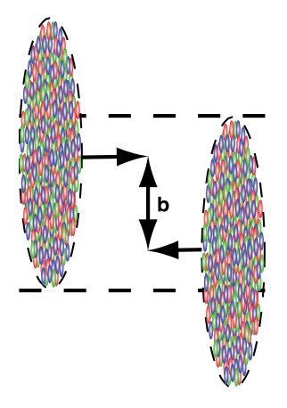
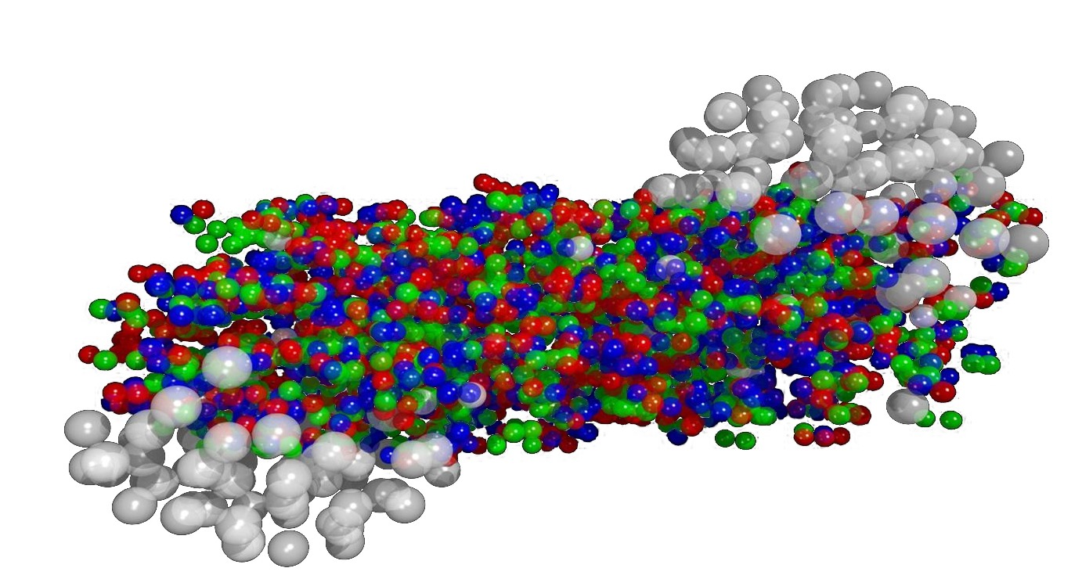
Directed flow in heavy-ion collisions
directed flow
elliptic flow
or
y
Nuclear passage time: 2R/γ ~ 0.1 fm/c
Probes early stages of collisions
H. Sorge,Phys Rev. Lett 78, 2309 (1997)
N. Herrmann et al, Annu. Rev. Nucl Part Sci 49, 581 (1999)

Slide 4
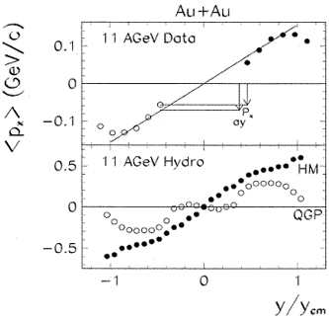
Rapidity dependence of directed flow
L. P. Csernai et al., Phys. Lett. B458, 454 (1999)
Models with QGP predicted a “wiggle”/ flat v1 at
mid-rapidity due to a 1st order phase transition

Slide 5
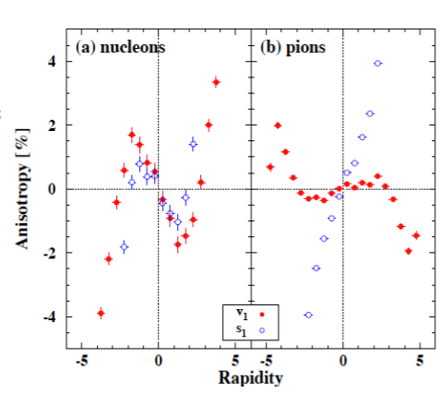
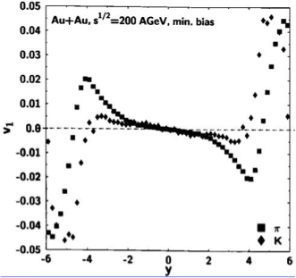
Rapidity dependence of directed flow
L. P. Csernai et al., Phys. Lett. B458, 454 (1999)
R. Snellings et al., Phys. Rev. Lett. 84, 2803 (2000)
M. Bleicher et al., Phys. Lett .B526, 309 (2002)
Models with QGP predicted a “wiggle”/ flat v1 at
mid-rapidity due to a 1st order phase transition
Models without QGP may also give a “wiggle” structure
e.g., Baryon stopping + positive space-momentum correlation

Slide 6
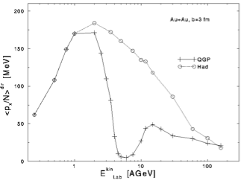
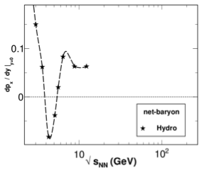
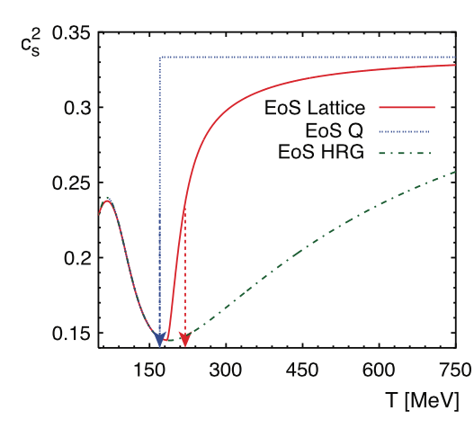
Directed flow and phase transition
D. Rischke et al, Heavy Ion Phys 1, 309 (1995)
H. Stocker Nucl. Phys. A750, 121 (2005)
R. Snellings, New J of Phys 13, 055008 (2011)
P. Huovinen et al, Nucl Phys A837, 26 (2010)
Model calculations indicated that v1-slope
(specially for baryons) at mid-rapidity is
sensitive to the EoS of the system

Slide 7
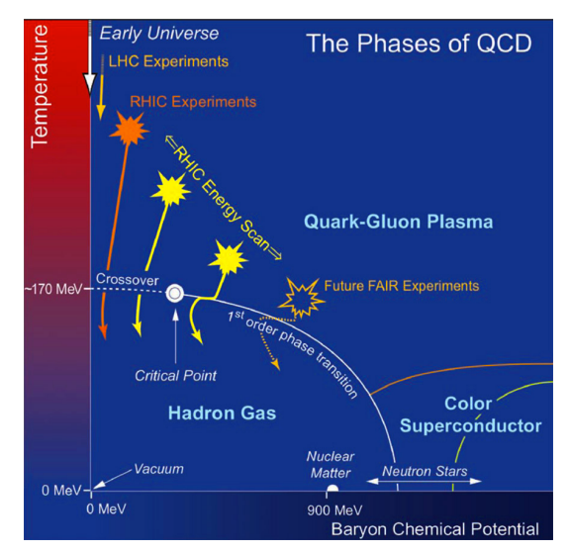
BES-I at RHIC
J. Cleymans et al PRC 73, 034905 (2006)
Energy(GeV) | Events (M) | T (MeV) | muB(MeV)
7.7 | 4 | 140 | 422
11.5 | 12 | 152 | 316
14.5 | 18 | 156 | 264
19.6 | 36 | 160 | 206
27 | 70 | 162 | 156
39 | 130 | 164 | 112
62.4 | 67 | 165 | 73
200 | 350 | 166 | 25
BES program: To explore QCD phase
diagram by varying beam energy
Map turn-off of QGP signatures
Search for Critical Point
Search for First-Order Phase Transition
https://drupal.star.bnl.gov/STAR/starnotes/public/sn0598
Directed flow (v1) is a key observable to search for the signature
of a 1st order phase transition

Slide 8
BES-I at RHIC
R. Snellings, New J of Phys 13, 055008 (2011)
P. Huovinen et al, Nucl Phys A837, 26 (2010)
https://drupal.star.bnl.gov/STAR/starnotes/public/sn0598
Large softening signature First-Order Phase Transition
Smaller softening signature Could have other explanations
(e.g., crossover)

Slide 9
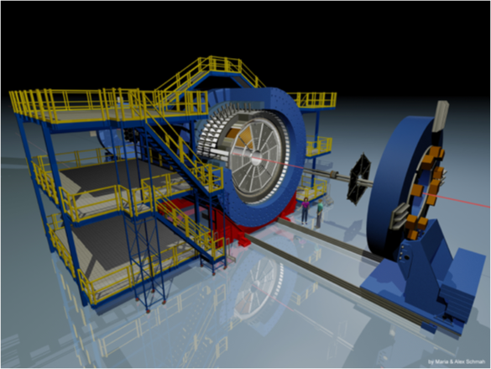
STAR Detector
STAR Detector
Uniform acceptance
Full azimuthal coverage
|η| < 1
Excellent PID capability

Slide 10
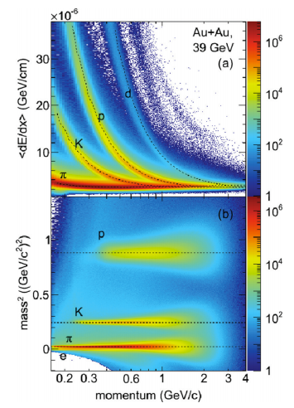
STAR Detector
STAR Detector
TPC
TOF
Uniform acceptance
Full azimuthal coverage
|η| < 1
Excellent PID capability

Slide 11
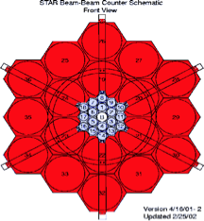
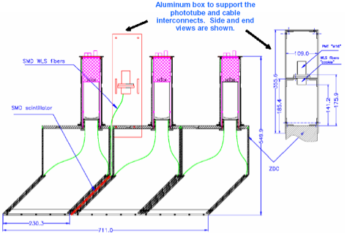
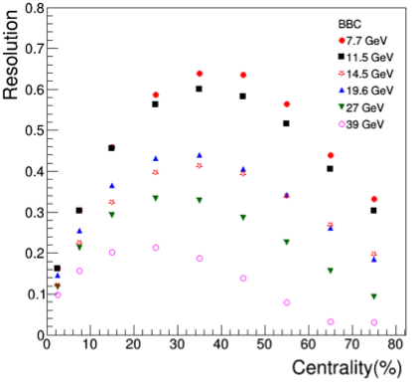
STAR Detector
BBC
z = 3.7 m
2.1 > | η| < 5
ZDC-SMD
z = 18.25 m
< 2 mrad
STAR Preliminary
1st order event plane estimated using
BBC (7.7 - 39 GeV)
ZDC (62.4, 200 GeV)
v1 signal significant at forward rapidity
Large η gap with TPC reduces non-flow
effects
increasing energy

Slide 12
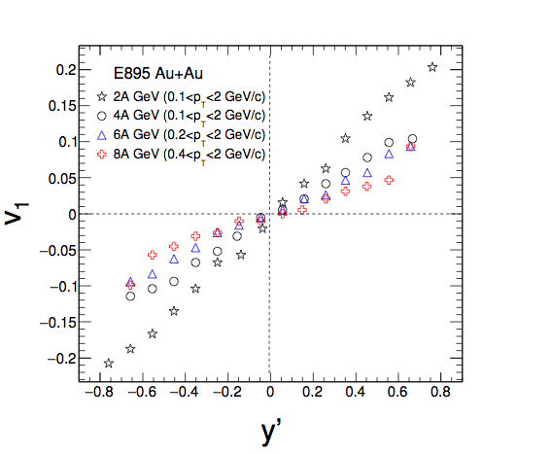
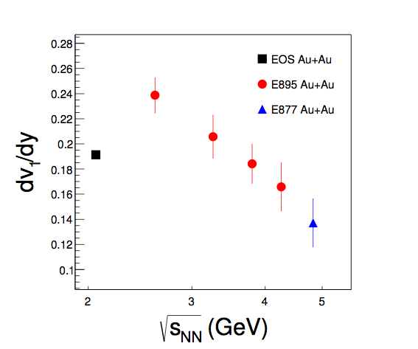
Results from AGS
PRL 84, 162301 (2014) (E895 Coll)
PRL 85, 162301 (2014) (E895 Coll)
PRL 86, 162301 (2014) (E895 Coll)
positive dv1/dy of protons for all energies
no dip observed at AGS around √sNN ~ 3.5 GeV

Slide 13
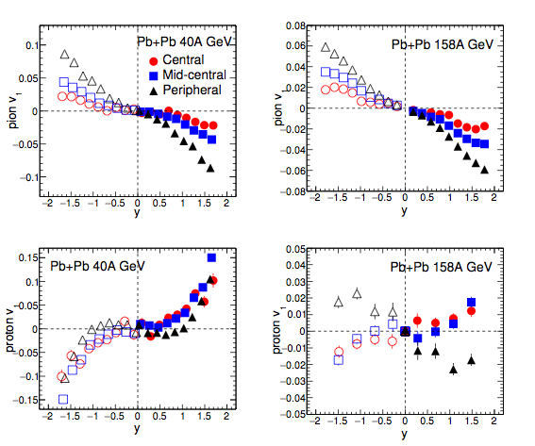
Results from SPS
Phy Rev C 68, 034903 (2003) (NA49 Coll)
pion
(dv1/dy)pion ~negative
for 40A, 158A GeV
(dv1/dy)proton ~positive
40A GeV, all centrality
158A GeV, central/mid
central
(dv1/dy)proton ~negative
158A GeV, peripheral
proton
Shadowing effect from spectators in peripheral collisions

Slide 14
Results from RHIC

Slide 15
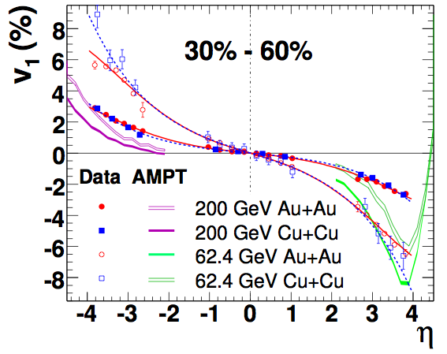
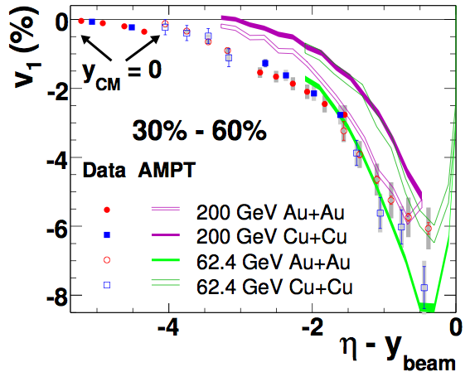
Charged hadron v1
PRL 108, 162301 (2014) (STAR Coll)
v1 is independent of system size (Au+Au ~ Cu+Cu)
v1 shows limiting fragmentation behavior
System size behavior can be explained by Hydro+tilted source
P. Bozek et al PRC 81, 054902 (2010)

Slide 16
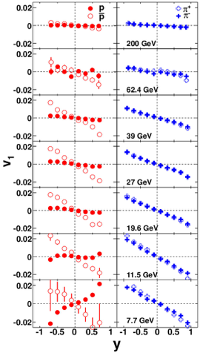
Energy dependence of proton and pion v1
PRL 112, 162301 (2014) (STAR Coll)
(dv1/dy)pion ~negative
for √sNN =7.7-200 GeV
(dv1/dy)proton ~negative
√sNN >=11.5 GeV
changes sign at √sNN =7.7 GeV
(dv1/dy)antiproton ~negative
for √sNN =7.7-200 GeV
v1-slope extracted by fitting a cubic function

Slide 17
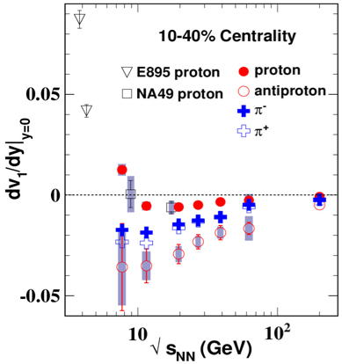
Energy dependence of proton and pion v1
PRL 112, 162301 (2014) (STAR Coll)
Trend observed by STAR inline with NA49
and E895 data

Slide 18
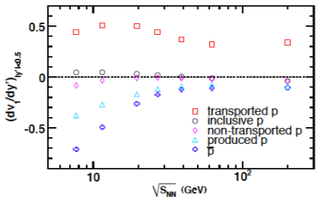
Energy dependence of proton and pion v1(y)
Y. Guo et. al, Phys. Rev. C 86, 044901 (2012)
PRL 112, 162301 (2014) (STAR Coll)
AMPT
Observed proton v1 has contributions
from produced and transported quarks
To disentangle these contributions,
we define
Fp = r1 Fanti-p + (1-r1) Fnet-p
F=dv1/dy, r1(y)=anti-p/p
proxy for transported protons

Slide 19
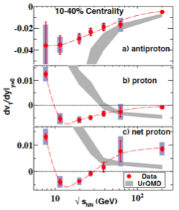
Energy dependence dv1/dy
PRL 112, 162301 (2014) (STAR Coll)
Fp = r1 Fanti-p + (1-r1) Fnet-p
F=dv1/dy, r1(y)=anti-p/p

Slide 20
Energy dependence dv1/dy
PRL 112, 162301 (2014) (STAR Coll)
Qualitative resemblance to
3-fluid hydro calculations
with 1st order PT
Minimum in net-proton dv1/dy with
double sign change
Softening of EoS (?)

Slide 21
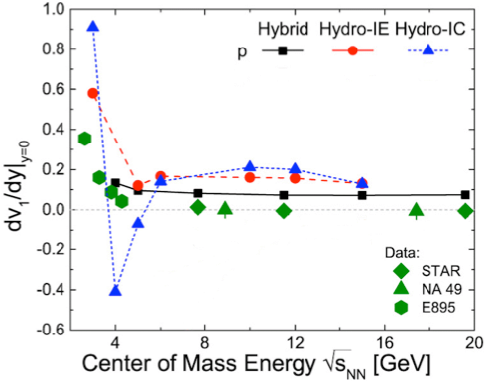
Energy dependence dv1/dy with models
Frankfurt hybrid: J. Steinheimer et al., PRC 89, 054913 (2014)

Slide 22
Energy dependence dv1/dy with models
Frankfurt hybrid: J. Steinheimer et al., PRC 89, 054913 (2014)
“All models severely underestimate the data”

Slide 23
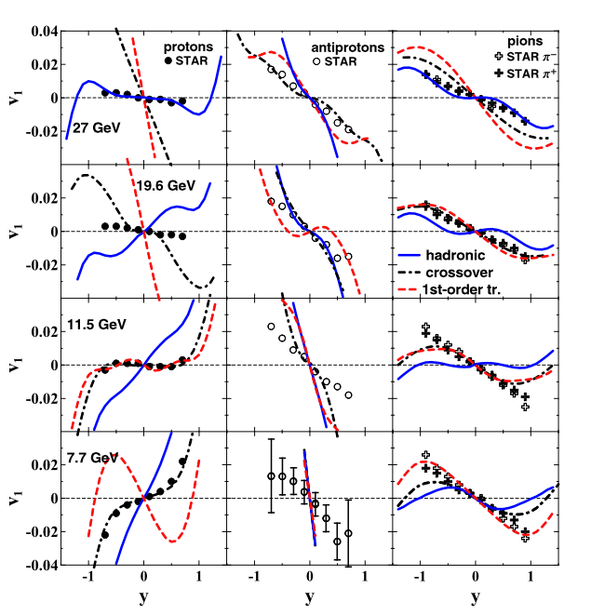
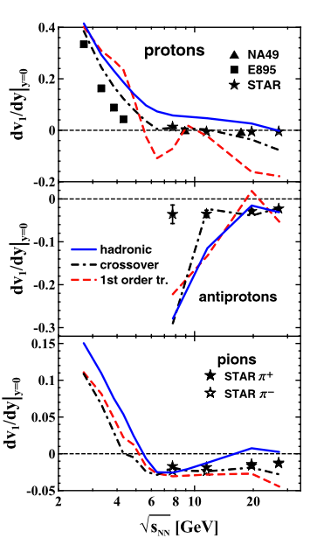
Energy dependence dv1/dy with models
3 FD: Y. Ivanov et al., PRC 91, 024915 (2015)

Slide 24
Energy dependence dv1/dy with models
3 FD: Y. Ivanov et al., PRC 91, 024915 (2015)
“However, predictions of the crossover and first-order-transition scenarios looked very similar so far. Only a slight preference could be given to the crossover EoS … best overall reproduction of the STAR data is achieved with the crossover EoS.”

Slide 25
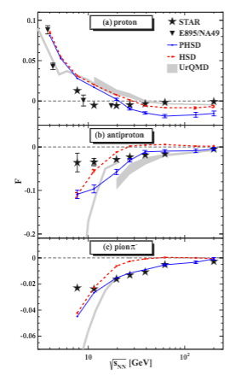
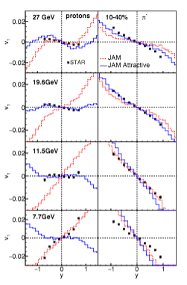
Energy dependence dv1/dy with models
PHSD: V. Konchakovski et al., PRC 90, 014903 (2014)
HSD: W. Cassing et al, arXiv: 1408.4313
UrQMD: S. Bass et al, Prog. Part. Nucl. Phys 41, 255, (1998)
JAM: Y. Nara et al., arxiv: 1601.07692

Slide 26
Energy dependence dv1/dy with models
PHSD: V. Konchakovski et al., PRC 90, 014903 (2014)
HSD: W. Cassing et al, arXiv: 1408.4313
UrQMD: S. Bass et al, Prog. Part. Nucl. Phys 41, 255, (1998)
JAM: Y. Nara et al., arxiv: 1601.07692
“More detailed systematic studies are needed by using a fully baryon density dependent EoS, in order to draw a conclusion that minimum of dv1/dy is a result of the softening of the EoS which may be caused by a first-order phase transition.”
“Still sizable discrepancies with experimental measurements in the directed flow …. Our flow analysis shows no indication of a first-order transition.”

Slide 27
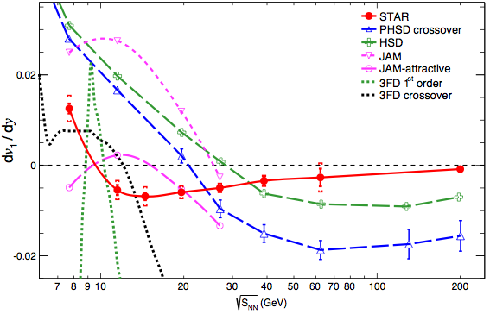
Energy dependence dv1/dy with models
(proton)
None of the models explains the data
Systematics associated with the models is quite large

Slide 28
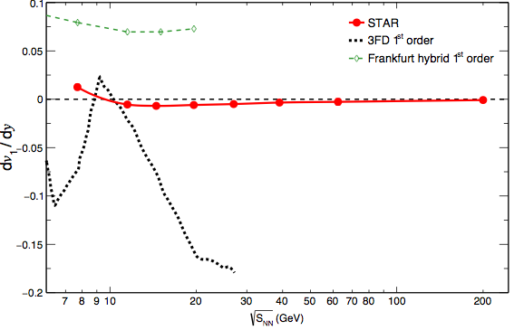
Energy dependence dv1/dy with models
(proton)
None of the models explains the data
Systematics associated with the models is quite large
(~ 2 orders of magnitude bigger than experimental errors!)

Slide 29
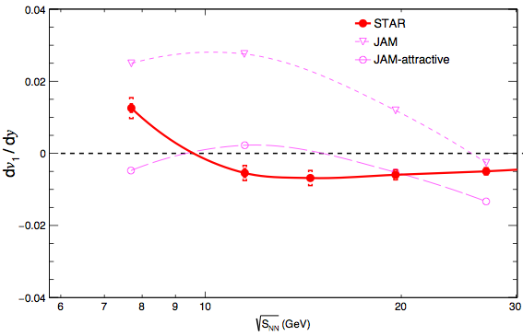
Energy dependence dv1/dy with models
JAM: Y. Nara et al., arxiv: 1601.07692
(proton)
Standard JAM: Close to data at 7.7 GeV (hadronic description)
Overestimate data at 11.5 and 19.6 GeV
JAM attractive: Close to data at 11.5 and 19.6 GeV

Slide 30
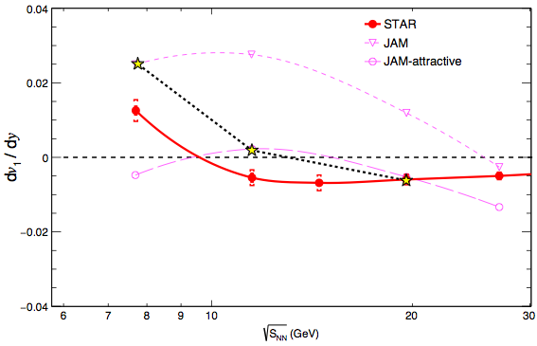
Energy dependence dv1/dy with models
JAM: Y. Nara et al., arxiv: 1601.07692
(proton)
Evidence for softening of EoS (?)
Standard JAM: Close to data at 7.7 GeV (hadronic description)
Overestimate data at 11.5 and 19.6 GeV
JAM attractive: Close to data at 11.5 and 19.6 GeV

Slide 31
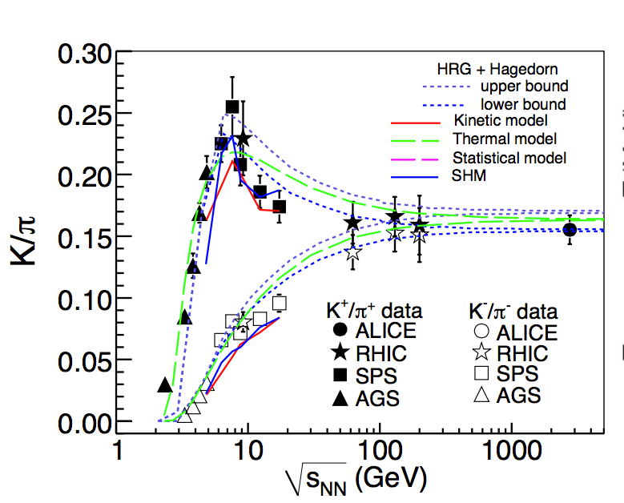
Energy dependence dv1/dy with models
R Singh et. al, arXiv:1304.2969
Acta Phys Pol B, 30, 2705, (1999)
(proton)
The peak indicates that the system
reaches maximum baryonic density
at around 10 GeV
Pair production dominant at higher
energies.
Evidence for softening of EoS (?)
J Randrup et. al, PRC 74, 047901 (2006)
At high baryon (net-baryon) density, one might expect a repulsive force

Slide 32
Strange hadron v1 at RHIC
New measurements
 | quark content
Λ | uds
K± | us
Ks⁰ | (ds -sd)/ 2
φ | ss
Complimentary to p data
Probe kaon-nucleon potential
Mass close to p, but it is a
vector meson
Minimally affected by late-stage
hadronic interactions
We can address
Role of produced quarks in HIC
Test hypothesis about transport of initial-state quarks

Slide 33
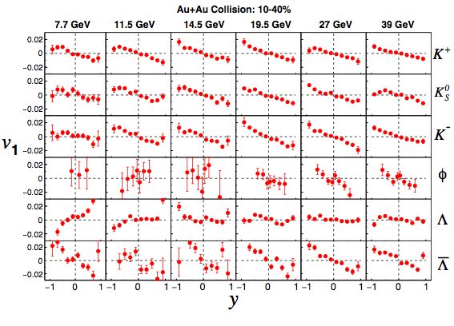
Rapidity dependence of v1
STAR Preliminary
19.6
v1-slope extracted by linear fitting (|y| < 0.8)
poor statistics for particles (e.g. Λ,φ) does not allow stable cubic fit
QM 2015: .P Shanmuganathan (for STAR Collaboration), arXiv:1512.09009

Slide 34
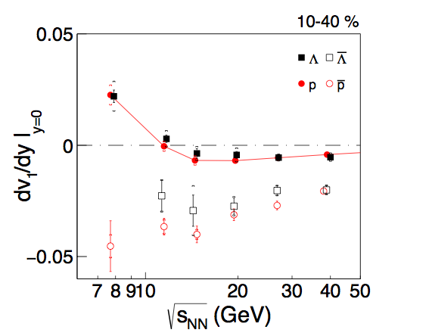
Energy dependence of dv1/dy
STAR Preliminary
line to guide the eye
(dv1/dy)p ~ (dv1/dy)Λ
(dv1/dy)p, Λ ~ negative
(dv1/dy)p ~ (dv1/dy)Λ

Slide 35
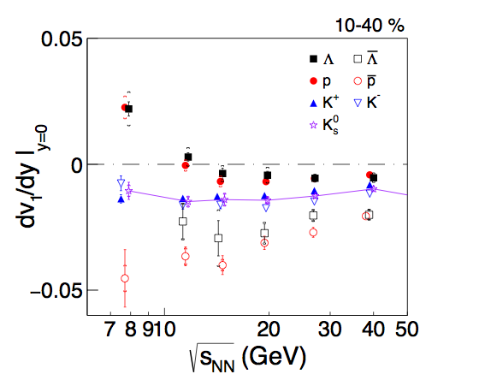
Energy dependence of dv1/dy
STAR Preliminary
line to guide the eye
(dv1/dy)K± ~ negative
(dv1/dy)Ks⁰ lies in
between K±

Slide 36
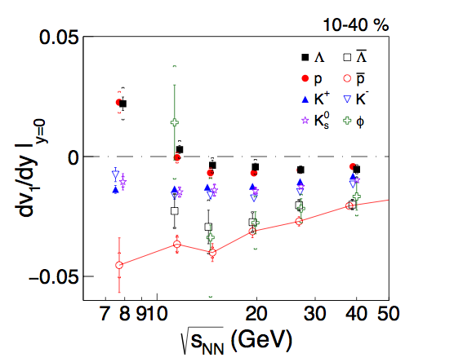
Energy dependence of dv1/dy
STAR Preliminary
line to guide the eye
(dv1/dy)Λ,p ~ (dv1/dy)φ
for energies above
14.5 GeV
(dv1/dy)φ~ 0 at
11.5 GeV with large
stat. uncertainty

Slide 37
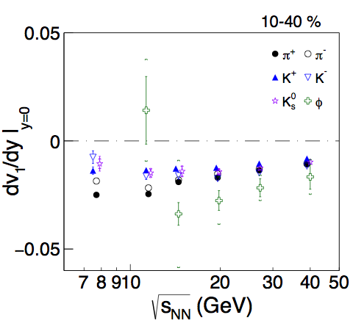
Energy dependence of dv1/dy
STAR Preliminary
(dv1/dy)K < (dv1/dy)φ
for energies above
14.5 GeV
(dv1/dy)φ~ 0 at
11.5 GeV with large
stat. uncertainty
Among the mesons, the particle (e.g. φ) with more produced quarks have larger magnitude of v1-slope.

Slide 38
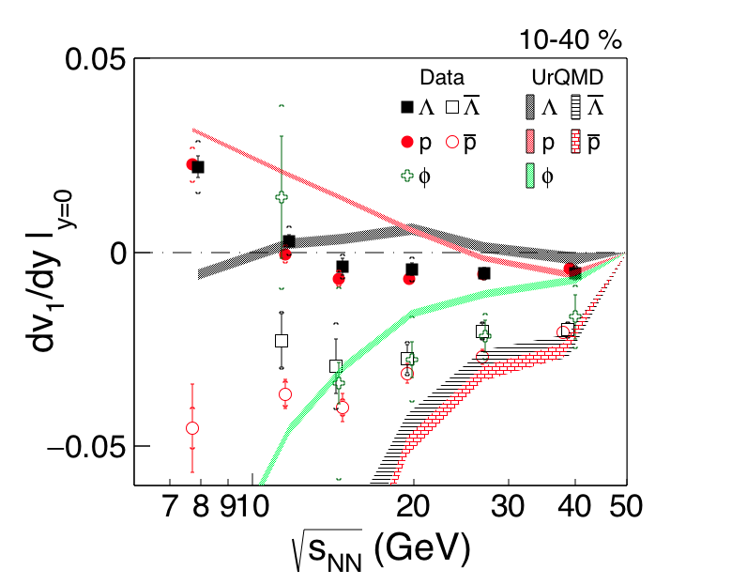
Energy dependence of dv1/dy
UrQMD: S. Bass et al, Prog. Part. Nucl. Phys 41, 255, (1998)
STAR Preliminary
(dv1/dy)UrQMD-Λ,φ:
deviate from data
below19.6 GeV
(dv1/dy)UrQMD-Λ, φ:
qualitatively similar
trend to data for
higher energies

Slide 39
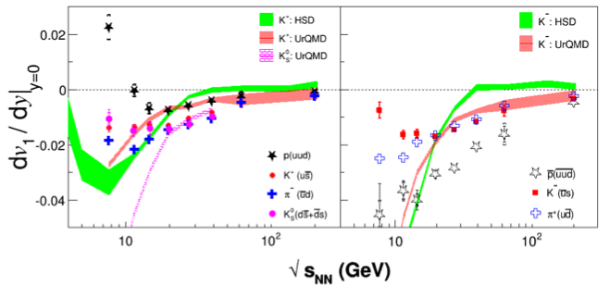
Energy dependence of dv1/dy
HSD: W. Cassing et al, arXiv: 1408.4313
UrQMD: S. Bass et al, Prog. Part. Nucl. Phys 41, 255, (1998)
STAR Preliminary
Particles in left panel expected have more stopped initial-state
nucleons than the anti-particles in right panel
dv1/dy(K±, Ks⁰) from UrQMD/HSD model can not explain data

Slide 40
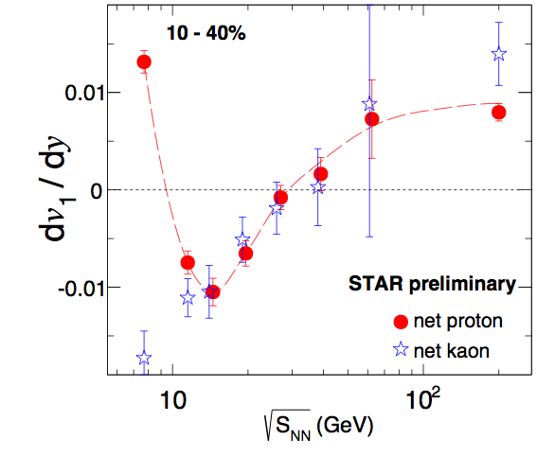
Energy dependence of net-particle v1
To disentangle contributions from
produced quarks & transported
quarks
Fp = r1 Fanti-p + (1-r1) Fnet-p
FK⁺ = r2 FK⁻ + (1-r2) Fnet-K
F=dv1/dy, r1(y)=anti-p/p
r2(y)=K⁻/K⁺
(dv1/dy)net-K ~ (dv1/dy)net-p at and above 14.5 GeV
but they deviate at lower energies

Slide 41
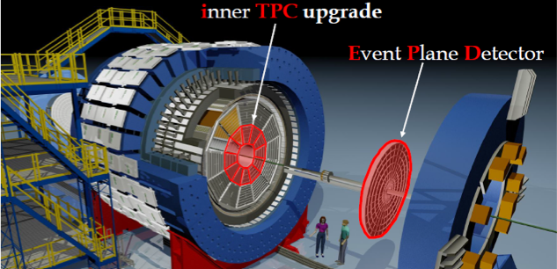
BES-II at RHIC
iTPC (-1.7 < |η| < 1.7)
EPD (2.1< |η| < 5.1)
extended coverage
better dE/dx
improved EP resolution
TPC independent centrality estimation

Slide 42
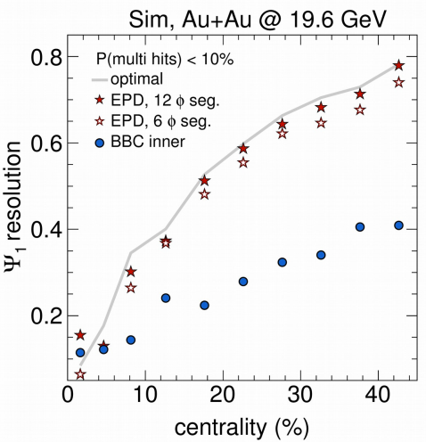
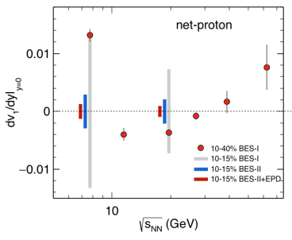
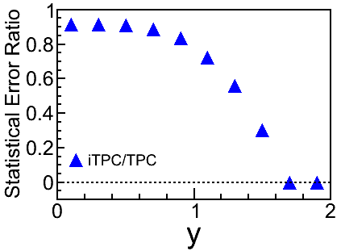
BES-II at RHIC
improvement in EP resolution
reduction in statistical uncertainty

Slide 43
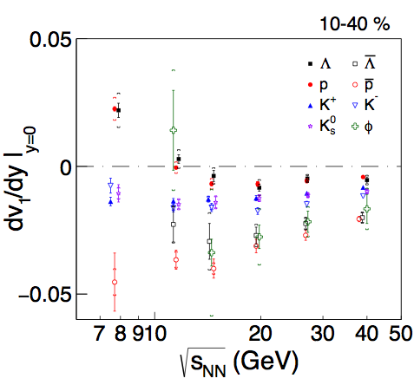
Summary and outlook
STAR published results show a minimum in dv1/dy for proton and
net-protons and a double sign-change in net-proton dv1/dy
New preliminary results:
➢ dv1/dy(p) ~ dv1/dy(Λ) and both show
sign-change √sNN < 14.5 GeV
➢ dv1/dy(anti-Λ,anti-p) ~ dv1/dy(ɸ)
for √sNN > 11.5 GeV
➢ dv1/dy(net-p) ~ dv1/dy(net-K) for
√sNN > 14.5 GeV: quark transport
while dv1/dy(net-K) stays negative for
√sNN < 14.5 GeV
STAR Preliminary

Slide 44
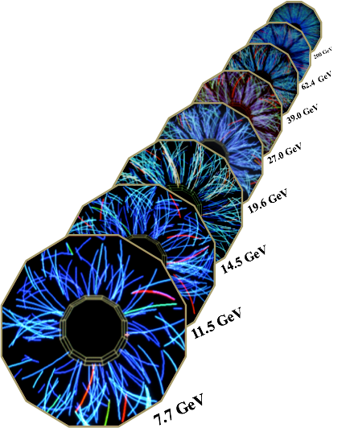
Summary and outlook
Present models can not explain main features of data
New set of results from STAR will put stringent constraint
on theoretical models
More theoretical progress needed for a clear interpretation
of data
Data from BES-II with more statistics and upgraded detectors
will provide results with more precision

Slide 45
Thank you

Slide 46
Interpretation of STAR dv1/dy data by different models
Frankfurt hybrid
”…we find that essentially all models, including the standard hadronic transport UrQMD, cannot even describe the qualitative behavior, observed by experiment, of the proton directed flow. All models severely overestimate the data, even though other observables, like the radial or elliptic flow, are usually well described within these models.”
3FD
“… with available data indicated a definite advantage of the deconfinement (crossover and first-order) scenarios over the purely hadronic one, especially at high (RHIC) collision energies. However, predictions of the crossover and first-order-transition scenarios looked very similar so far. Only a slight preference could be given to the crossover EoS. In the case of the directed flow we can definitely conclude that the best overall reproduction of the STAR data is achieved with the crossover EoS. The first-order-transition scenario gives results which strongly differ from those in the crossover scenario, especially for the proton v1.”
PHSD/HSD
“… Still sizable discrepancies with experimental measurements in the directed flow characteristics are found .............. Our flow analysis shows no indication of a first-order transition. However, we have found further strong evidence that the dynamics of heavy-ion reactions at lower SPS and AGS energies is far from being understood especially on the hadronic level.”
JAM:
““More detailed systematic studies are needed by using a fully baryon density dependent EoS, in order to draw a conclusion that minimum of dv1/dy is a result of the softening of the EoS which may be caused by a first-order phase transition. … It seems obvious to infer a softening of the EoS from the experimentally observed collapse of net-proton flow when the c.m. energy is increased from 7 to 11 GeV. However, the statement of a discovery of the ”softening” of the EoS from the net-proton v1 data shows even more convincing evidence for the ”phase transition” as we observe the re-bound at higher energies, namely STAR observed second change of sign of the v1 values of the net-protons at √ sNN ≈ 40 GeV back to positive v1 at higher energies [1]. This shows that the soft region is overcome, and the directed flow picks up steam again, due to the re-hardening of the EoS at considerably larger energy densities.”

Slide 47
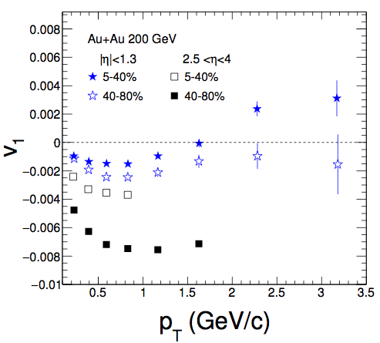
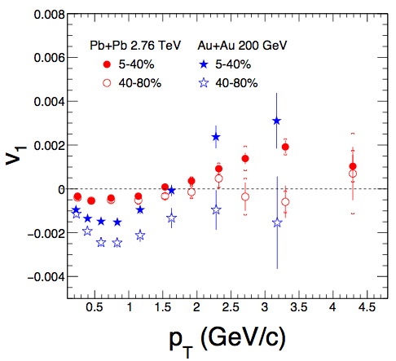
Results from RHIC and LHC

Slide 48
Baryon Density

Slide 49
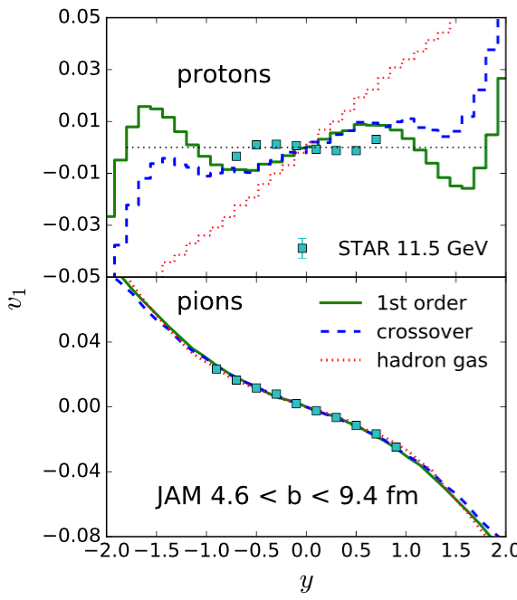
JAM Calculation

Slide 50
BES at RHIC

Slide 51
Cartoon made by Mike Lisa

