Slide 1


Measurements of v₂ and v₃ in p/d/³He+Au Collisions
Shengli Huang
For STAR Collaboration
Outline:
Physical Motivations
Analysis Results
Comparison to models and other measurements
Summary

Slide 2
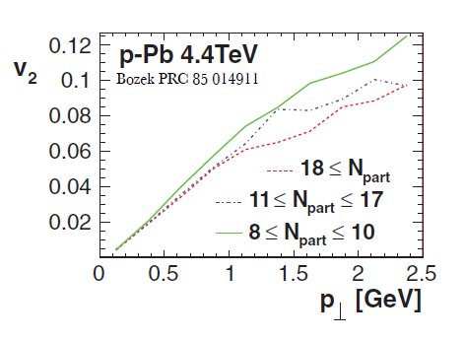
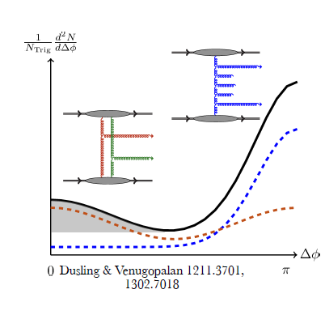
Anisotropy in small system
The origin of anisotropy in small system is under debate
Final state interaction: Hydrodynamics?
Initial momentum correlation: CGC?

Slide 3
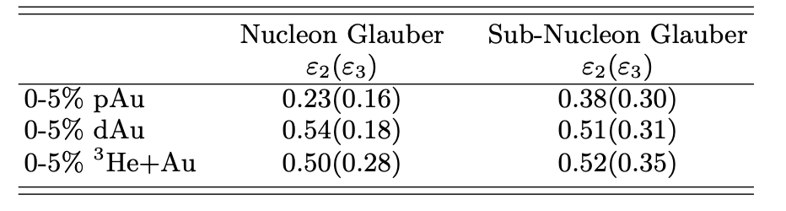
Anisotropy in small system
The origin of anisotropy in small system is under debate
Final state interaction: Hydrodynamics?
Initial momentum correlation: CGC?
Initial geometry in small system
Nucleonic vs Sub-Nucleonic fluctuations
Nucleon Glauber: J. L. Nagle, PRL 113, 112301 331 (2014).
Sub-Nucleon: K. Welsh, J. Singer, and U. Heinz, PRC 94, 334 024919 (2016).

Slide 4
Anisotropy in small system
The origin of anisotropy in small system is under debate
Final state interaction: Hydrodynamics?
Initial momentum correlation: CGC?
Initial geometry in small system
Nucleonic vs Sub-Nucleonic fluctuations
Nucleon Glauber: J. L. Nagle, PRL 113, 112301 331 (2014).
Sub-Nucleon: K. Welsh, J. Singer, and U. Heinz, PRC 94, 334 024919 (2016).

Slide 5
Data Analyses
Measurements for p/d/³He+Au collisions @ 200 GeV
STAR Experiment at RHIC
Centrality:
i) Number of tracks in TPC 0.2<p_{T}<3.0 GeV/c, | 𝜂 |<0.9
ii) BBC charge in Au-going direction -5.0<𝜂<-3.3
Two-particle correlation functions constructed for
trigger and associated particles with 0.2 <p_{T} < 2.0 GeV/c
| 𝜂 |<0.9 and |∆𝜂| > 1.0
  v₂{2}(p_{T}), v₃{2}(p_{T}) extracted from correlation functions following non-flow subtraction
  Comparison to v₂{4}

Slide 6
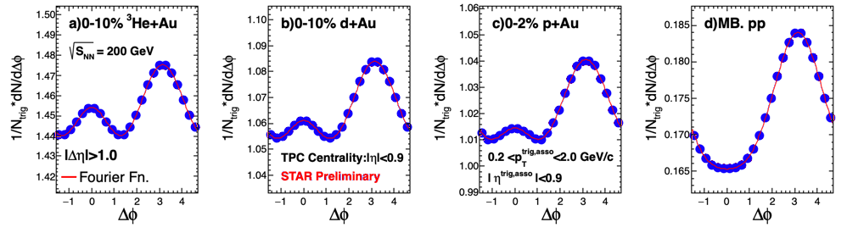
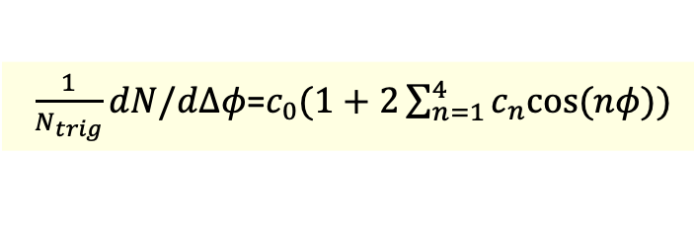
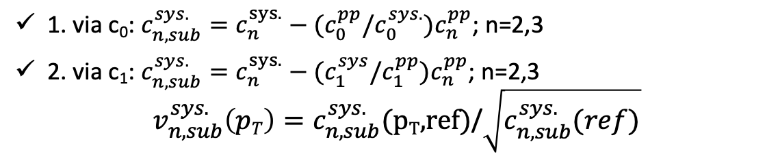
Long-range two-particle correlators and v_{n} extraction (I)
Three methods are employed for non-flow subtraction by using min-bias pp as a reference!
$\frac{1}{N_{trig}}dN/d∆φ$=$c_{0}(1+2\sum_{n=1}^{4}{c_{n}cos⁡(nφ)})$
1. via c₀: $c_{n,sub}^{sys.}=c_{n}^{sys.}−{(c}_{0}^{pp}/c_{0}^{sys.})c_{n}^{pp}$; n=2,3
2. via c₁: $c_{n,sub}^{sys.}=c_{n}^{sys.}−{(c}_{1}^{sys}/c_{1}^{pp})c_{n}^{pp}$; n=2,3
$${ v}_{n,sub}^{sys.}\left(pT\right)=c_{n,sub}^{sys.}\text{(}\text{pT}\text{,}\text{ref}\text{)}\text{/}\sqrt{c_{n,sub}^{sys.}(ref)}$$

Slide 7
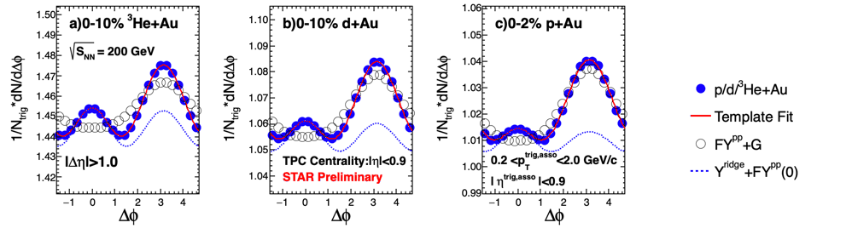
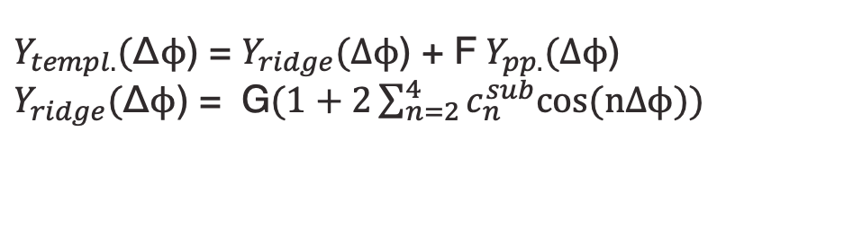
Long-range two-particle correlators and v_{n} extraction (II)
3. Template Fit
(ATLAS, PRL 116, 172301 (2016))
$Y_{templ.}($Δϕ) = $Y_{ridge}(\text{Δϕ}$) + F $Y_{pp.}(\text{Δϕ}$)
$Y_{ridge}($Δϕ) = G$(1+2\sum_{n=2}^{4}{c_{n}^{sub}cos⁡(\text{n}\text{Δϕ}))}$
“F” represents the modification for the long-range
away-side jet between p/d/³He+Au and p+p

Slide 8
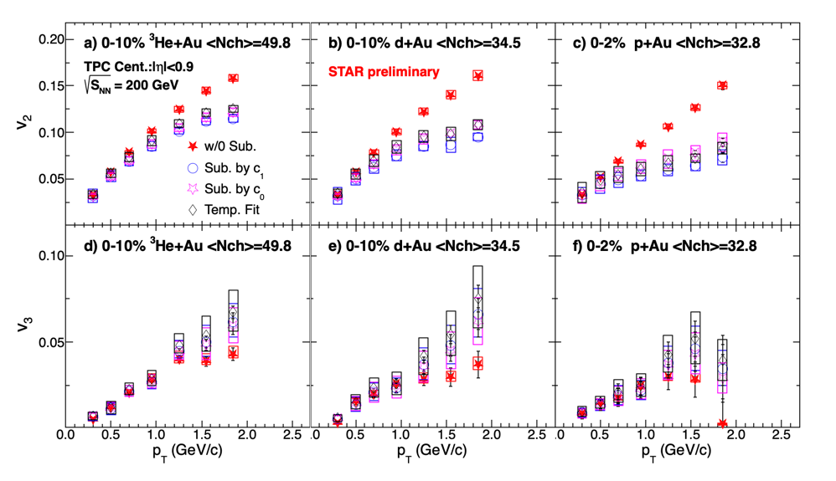
STAR differential v_{n} measurements for p/d/³He+Au
  Non-flow subtracted v₂ and v₃ are method-independent

Slide 9
STAR differential v_{n} measurements for p/d/³He+Au
  Non-flow subtracted v₂ and v₃ are method-independent
  Non-flow flow subtractions decrease v₂ and increase v₃

Slide 10
Non-flow in STAR
v₂
v₃
Non-flow contributions in both v₂ and v₃ increase with p_{T}
The away-side jet or dipole gives a positive contributions on v₂ while negative contributions on v₃
Notes:
We quantify this by taking the ratio

Slide 11
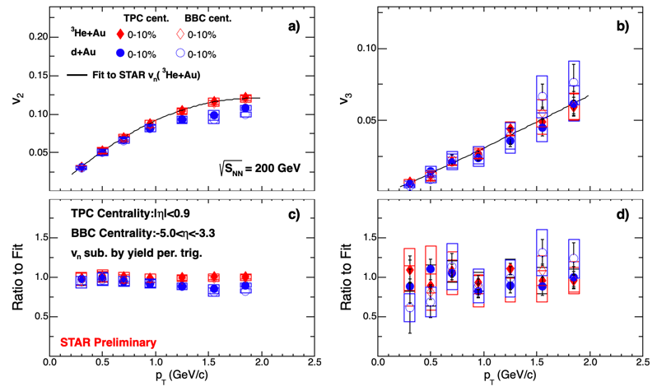
Differential v₂ and v₃ measurements for different centrality definitions
TPC centrality: Centrality and 2p correlation measured in same rapidity
BBC centrality: Centrality and 2p correlations measured in different rapidity, avoid auto-correlation
Results are consistent between two kinds of different centrality definitions with mid and backward rapidity regions

Slide 12
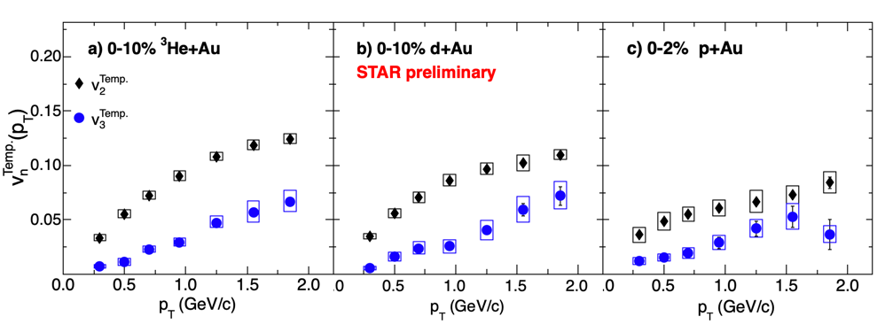
Comparison to model
Notes:
IP+Glasma initial momentum correlation and sub-nuclei fluctuations

Slide 13
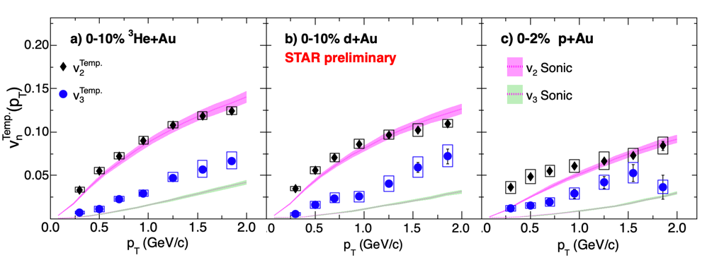
Comparison to model
(Super)Sonic: P. Romatschke, arXiv:1502.04745 [nucl-th].
IP-Glasma+Hydro: B. Schenke, C. Shen, and P. Tribedy, arXiv:2005.14682 [nucl-th].
Sonic model with initial geometry eccentricity from Nucleon Glauber under-predicts v₃ in all systems
How about Sub-nucleonic Glauber?
Notes:
IP+Glasma initial momentum correlation and sub-nuclei fluctuations

Slide 14
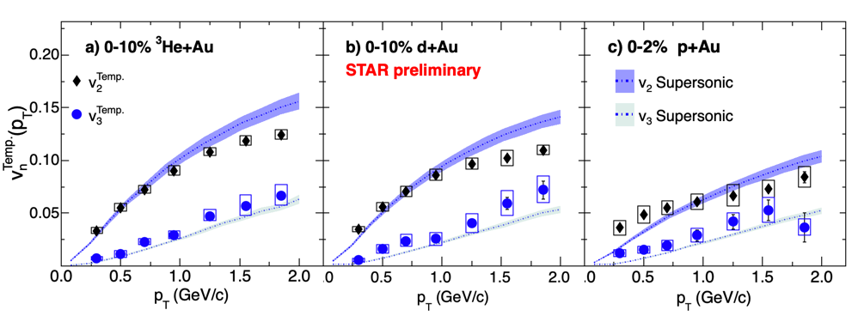
Comparison to model
(Super)Sonic: P. Romatschke, arXiv:1502.04745 [nucl-th].
IP-Glasma+Hydro: B. Schenke, C. Shen, and P. Tribedy, arXiv:2005.14682 [nucl-th].
Sonic model with initial geometry eccentricity from Nucleon Glauber under-predicts v₃ in all systems
How about Sub-nucleonic Glauber?
Supersonic model can match the v₂ and v₃ better by including the “pre-flow”
Notes:
IP+Glasma initial momentum correlation and sub-nuclei fluctuations

Slide 15
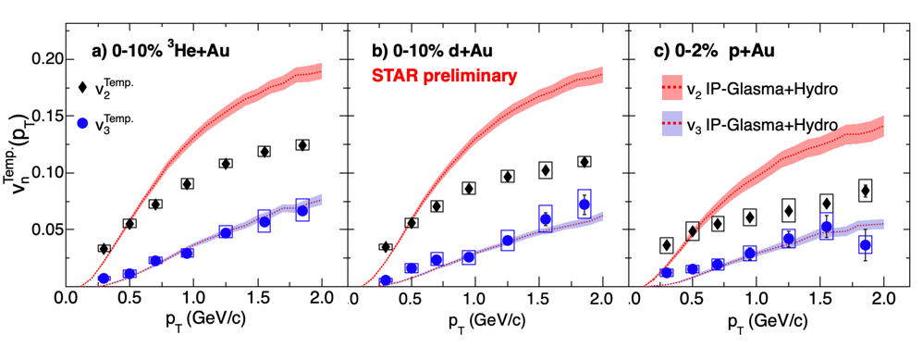
Comparison to model
(Super)Sonic: P. Romatschke, arXiv:1502.04745 [nucl-th].
IP-Glasma+Hydro: B. Schenke, C. Shen, and P. Tribedy, arXiv:2005.14682 [nucl-th].
Sonic model with initial geometry eccentricity from Nucleon Glauber under-predicts v₃ in all systems
How about Sub-nucleonic Glauber?
Supersonic model can match the v₂ and v₃ better by including the “pre-flow”
IP-Glasma+Hydro that includes sub-nucleonic fluctuations + initial momentum correlation over predicts v₂ but reproduces v₃
Notes:
IP+Glasma initial momentum correlation and sub-nuclei fluctuations

Slide 16
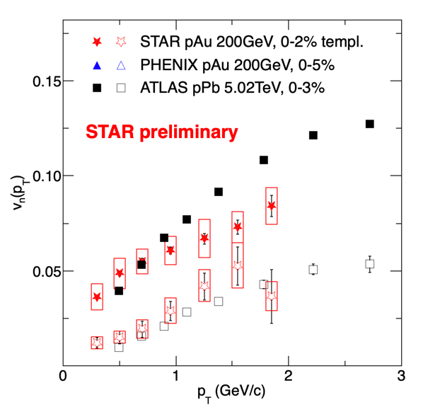
Comparisons to LHC
Measurements of both v₂ and v₃ from STAR are similar with that from LHC
ATLAS: Phys. Rev. C 90, 044906 (2014)
PHNEIX: Nature Phys. 15, 214 (2019)

Slide 17
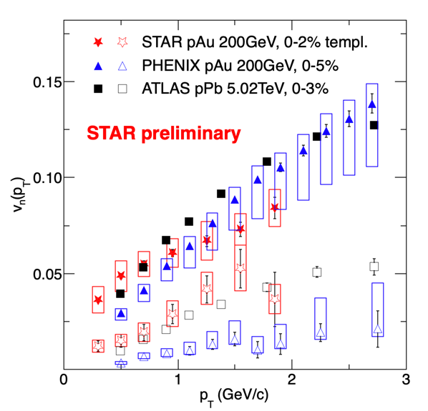
Comparisons to LHC
Measurements of both v₂ and v₃ from STAR are similar with that from LHC
Significant difference between STAR and PHENIX for v₃
ATLAS: Phys. Rev. C 90, 044906 (2014)
PHNEIX: Nature Phys. 15, 214 (2019)

Slide 18
Detail Comparisons to PHENIX
Notes:
We can look difference more detail

Slide 19
Detail Comparisons to PHENIX
The STAR and PHENIX v₂ and v₃ for ³He+Au, show reasonable agreement
Notes:
We can look difference more detail

Slide 20
Detail Comparisons to PHENIX
The STAR and PHENIX v₂ and v₃ for ³He+Au, show reasonable agreement
The STAR and PHENIX measurements for v₂ are also in reasonable agreement for p/d+Au
  Some difference(~25%) for p_{T}>1 GeV/c in d+Au and p_{T}<1 GeV/c in p+Au
Notes:
We can look difference more detail

Slide 21
Detail Comparisons to PHENIX
The STAR and PHENIX v₂ and v₃ for ³He+Au, show reasonable agreement
The STAR and PHENIX measurements for v₂ are also in reasonable agreement for p/d+Au
  Some difference(~25%) for p_{T}>1 GeV/c in d+Au and p_{T}<1 GeV/c in p+Au
The STAR and PHENIX v₃ for p/d+Au, show similar pT-dependence
  But magnitudes differ by a factor of 3
    System-independent STAR v₃
    System-dependent PHENIX v₃
Notes:
We can look difference more detail

Slide 22


Cross Checks done by STAR
Checks |  | Consistent results (within uncertainties) |  | Difference between measurements
Different techniques for flow extraction |  | Good agreement between different methods
Flow extraction with different centrality definition |  | Good agreement between measurements with different centrality definition
Independent analyses of v_{n} for d+Au |  | Good agreement between measurements from independent groups
Peripheral subtraction vs. pp subtraction |  |  |  | Peripheral subtraction is an underestimate
“A cross-experiment Small systems Advisory Committee” has been formed by BNL managements recently to understand the difference between STAR and PHENIX
Notes:
Add task force discuss is

Slide 23
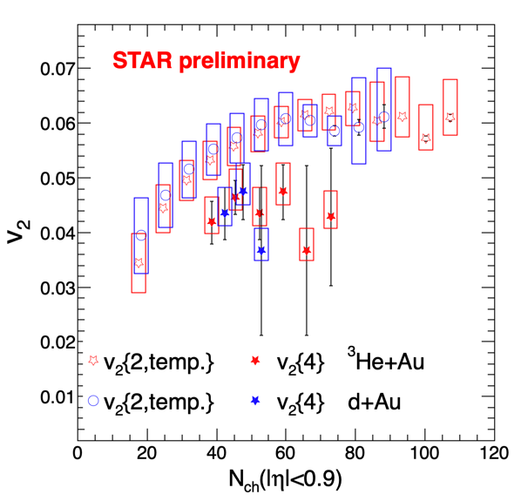
V₂{2} vs. v₂{4}
A positive v₂{4} is first observed at mid-rapidity by STAR in d+Au and ³He+Au collisions
The v₂{2} from template fit are larger than v₂{4} due to fluctuations

Slide 24
Outlook: O+O@RHIC 2021
TPC: |𝜂|<1.0
EPD:
-5.1<𝜂<-2.1
iTPC: |𝜂|<1.5
EPD:
2.1<𝜂<5.1
STAR proposal one week O+O run in 2021, which is supported by PAC
Large rapidity coverage due to new upgrade
Trigger HM event at both middle or forward rapidity

Slide 25
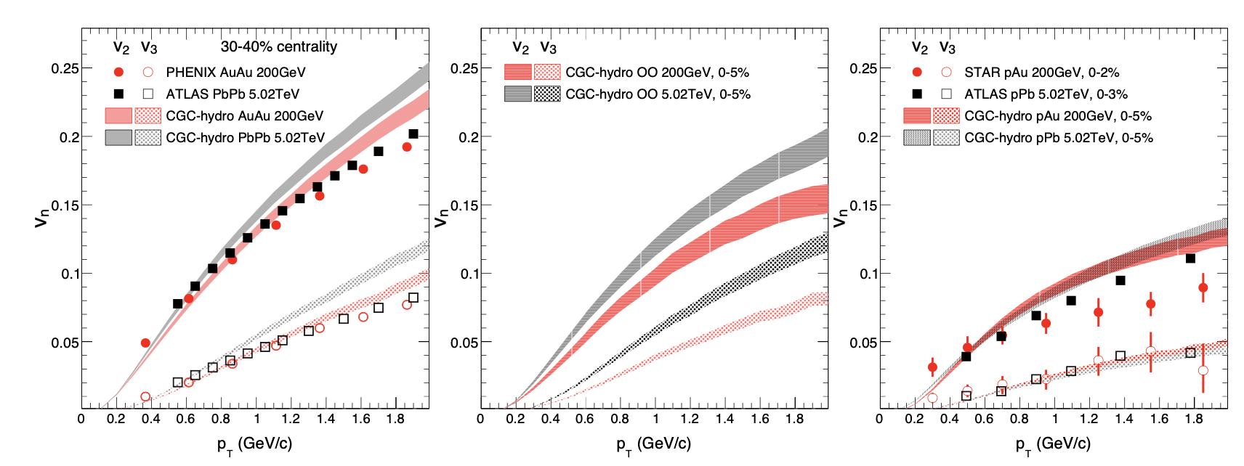
Outlook: O+O@RHIC 2021
TPC: |𝜂|<1.0
EPD:
-5.1<𝜂<-2.1
iTPC: |𝜂|<1.5
EPD:
2.1<𝜂<5.1
STAR proposal one week O+O run in 2021, which is supported by PAC
Large rapidity coverage due to new upgrade
Trigger HM event at both middle or forward rapidity
  First comparison between RHIC & LHC with ~identical Glauber geometry but different sub-nucleon fluctuation (Q_{s}) for a factor of 10 difference in energy
STAR: BUR2020
S.Huang , Z. Chen, J. Jia, W. Li: PhysRevC.101.021901

Slide 26
Summary
STAR measured v₂ and v₃ as a function of p_{T} and multiplicity. The extracted flow signals are found to be consistent from different non-flow subtraction methods

Slide 27
Summary
STAR measured v₂ and v₃ as a function of p_{T} and multiplicity. The extracted flow signals are found to be consistent from different non-flow subtraction methods
A system independent v₃ has been found
Initial geometry may be dominated by sub-nucleon fluctuations
“Pre-flow” or initial momentum correlation from initial state?

Slide 28
Summary
STAR measured v₂ and v₃ as a function of p_{T} and multiplicity. The extracted flow signals are found to be consistent from different non-flow subtraction methods
A system independent v₃ has been found
Initial geometry may be dominated by sub-nucleon fluctuations
“Pre-flow” or initial momentum correlation from initial state?
STAR is working closely with advisory committee to understand the difference with PHENIX

Slide 29
Summary
STAR measured v₂ and v₃ as a function of p_{T} and multiplicity. The extracted flow signals are found to be consistent from different non-flow subtraction methods
A system independent v₃ has been found
Initial geometry may be dominated by sub-nucleon fluctuations
“Pre-flow” or initial momentum correlation from initial state?
STAR is working closely with advisory committee to understand the difference with PHENIX
Thanks!

Slide 31
Backup

Slide 32
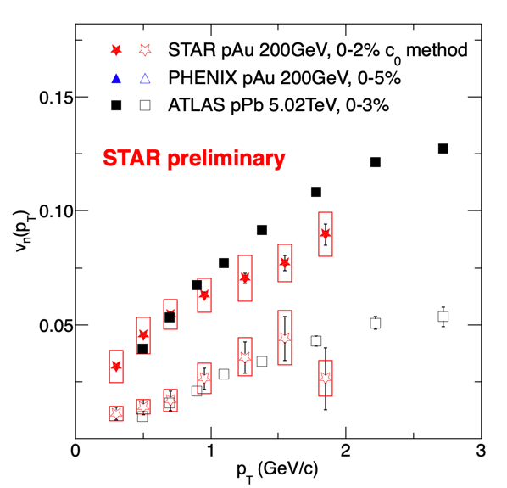
Backup

