Slide 1


Measurements of v₂,v₃ at mid-rapidity in p+Au, d+Au and ³He+Au collisions at 200 GeV
Shengli Huang
Outline:
Introductions and Motivations
Two-particle correlations at mid-rapidity
Model Comparison and Discussion
Summary

Slide 2
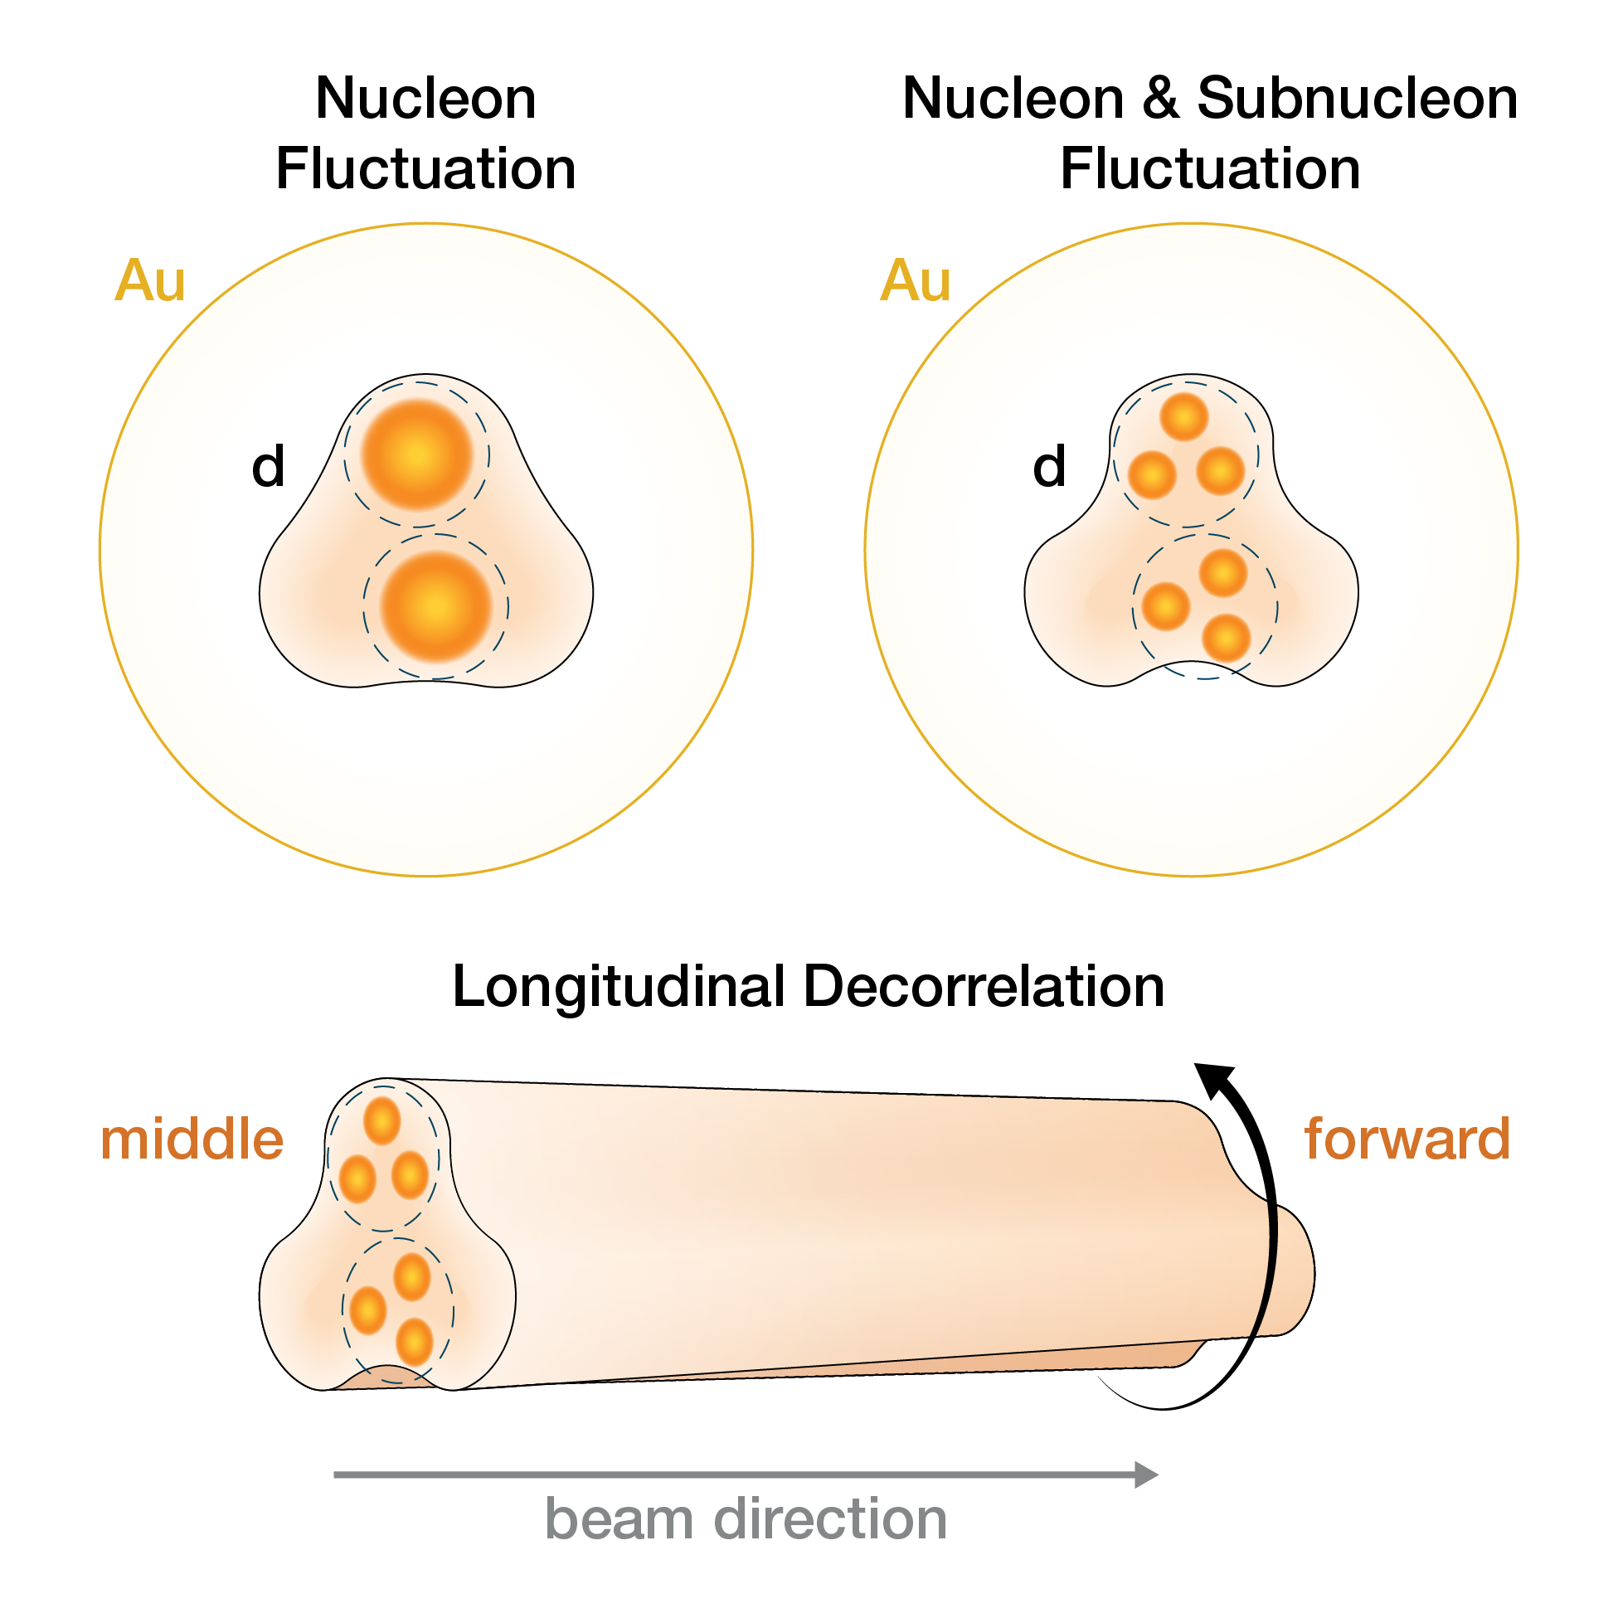
Initial Geometry in small system
Interplay between three possible sources:
1) Fluctuations in nucleon position
2) Fluctuations in nucleon position and its quark and gluon constituents
3) Fluctuation of overlap geometry along the beam direction
𝛆₃
𝛆₃

Slide 3
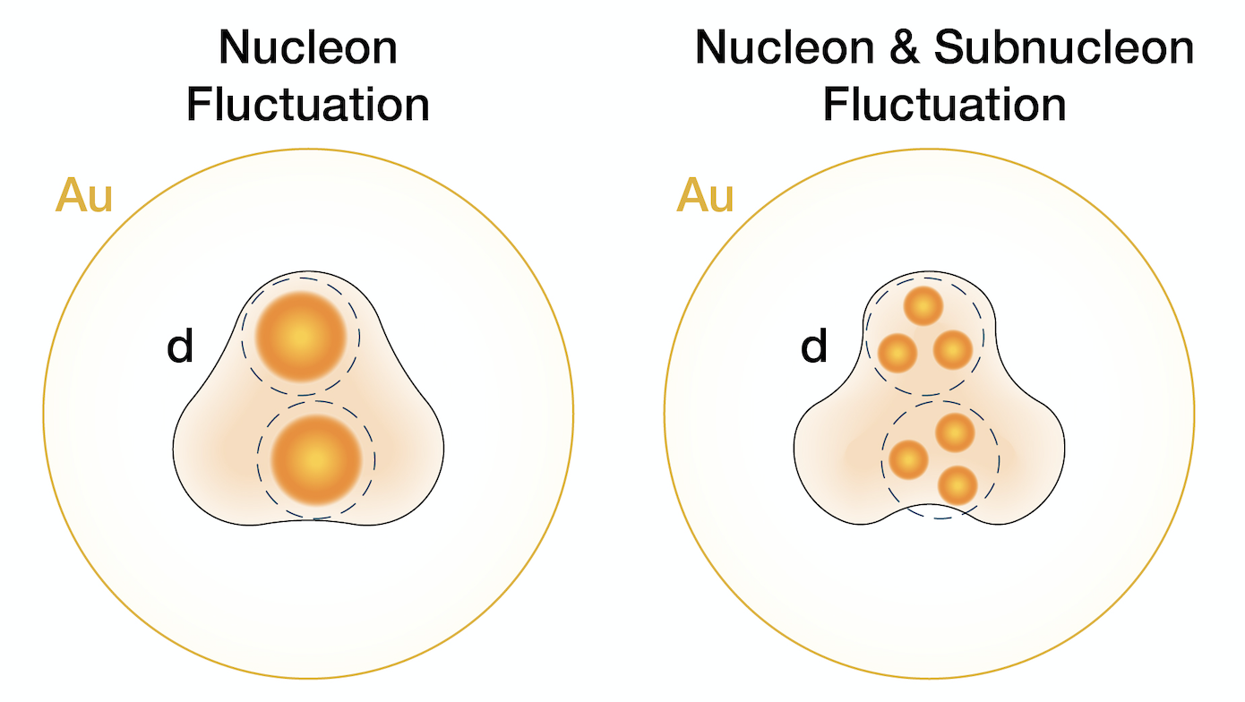
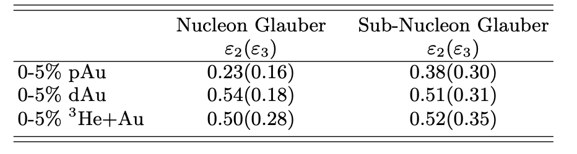
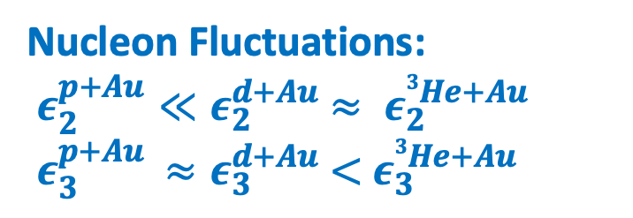
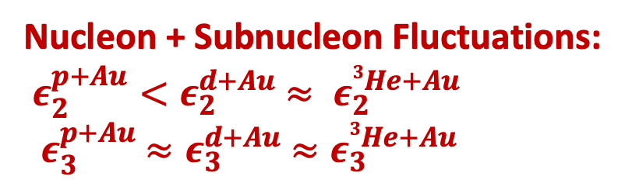
Nucleon vs. sub-nucleon fluctuation
Nucleon Fluctuations:
$ε_{2}^{p+Au}≪ε_{2}^{d+Au}$ $≈ ε_{2}^{3He+Au}$
${ ε}_{3}^{p+Au} ≈ε_{3}^{d+Au}$ $<$ $ε_{3}^{3He+Au}$
𝛆₃
𝛆₃
Nucleon + Subnucleon Fluctuations:
$ε_{2}^{p+Au}<ε_{2}^{d+Au}$ $≈ ε_{2}^{3He+Au}$
${ ε}_{3}^{p+Au} ≈ε_{3}^{d+Au}$ $≈ε_{3}^{3He+Au}$
The eccentricity hierarchy is smeared by sub-nucleon fluctuation
Nucleon Glauber: J. L. Nagle, PRL 113, 112301 331 (2014).
Sub-Nucleon: K. Welsh, J. Singer, and U. Heinz, PRC 94, 334 024919 (2016).

Slide 4
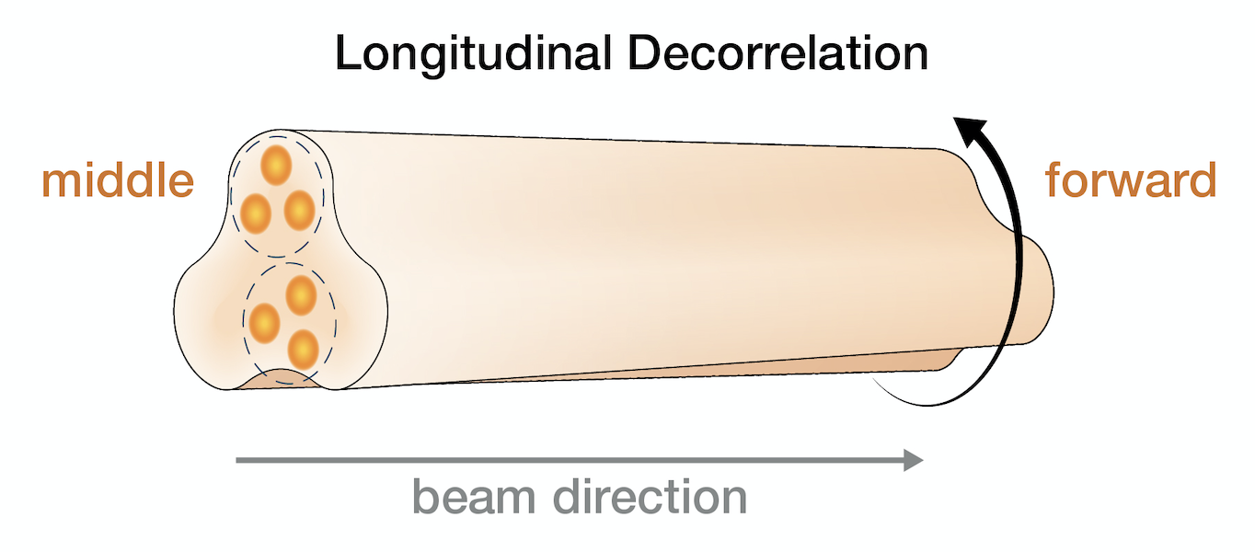
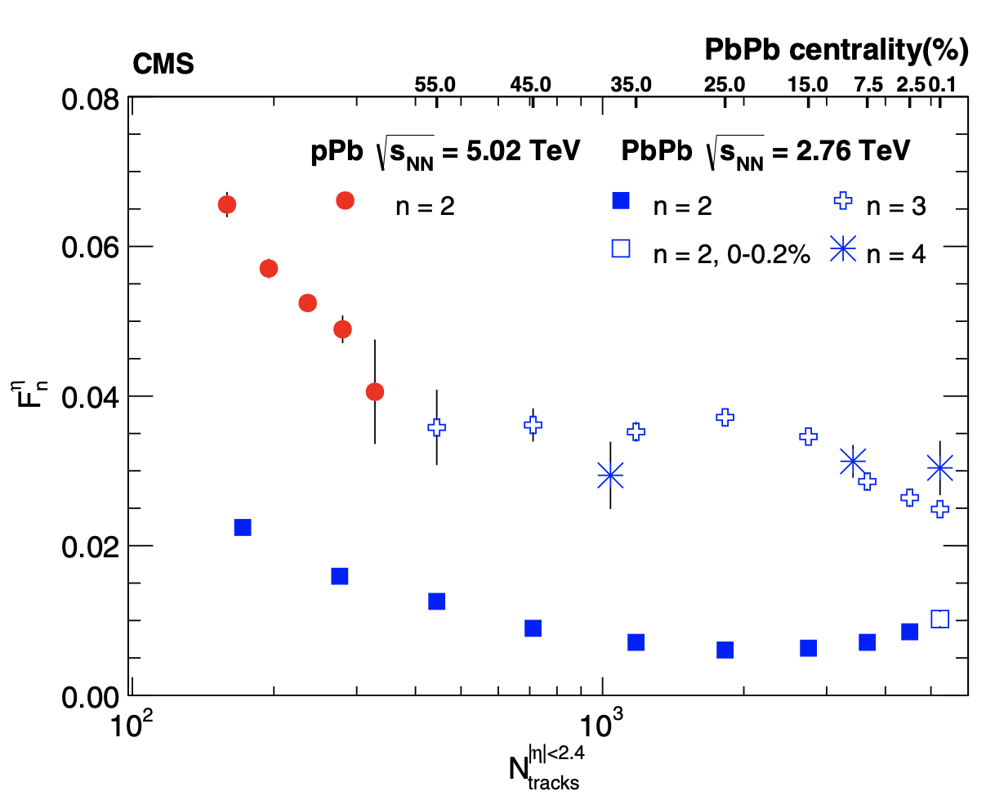
Longitudinal Decorrelation
CMS:PRC 92, 034911 (2015)
The longitudinal decorrelation from mid to forward rapidity complicates the
inference of the true initial geometry
Decorrelation is stronger for asymmetric systems (pPb > PbPb) and higher order anisotropy coefficients (for v₃ > for v₂)
Decorrelation poses challenges for all
boost-invariant hydro model-to-data comparisons

Slide 5
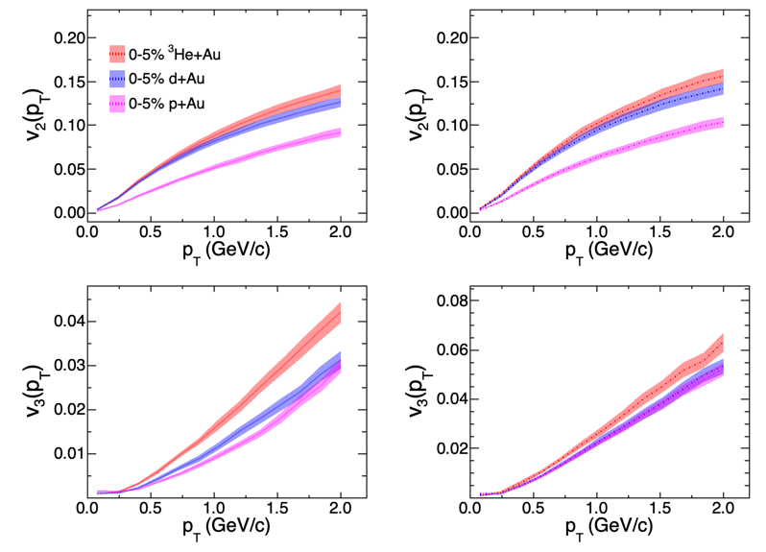
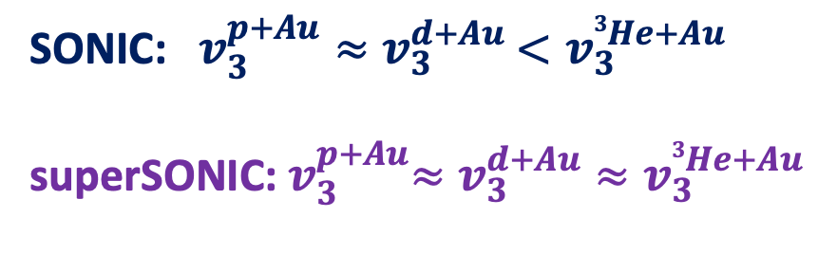
Pre-Flow Effect
SONIC
superSONIC
SONIC: Nucleon Fluctuation
superSONIC: Nucleon Fluctuation + Pre-Flow
SONIC: $v_{3}^{p+Au}≈v_{3}^{d+Au}$ $<v_{3}^{3He+Au}$
superSONIC:${ v}_{3}^{p+Au}≈v_{3}^{d+Au}≈v_{3}^{3He+Au}$
Pre-Flow effect will change the v₃ magnitude and dilute system
hierarchy
(super)SONIC: P. Romatschke Eur. Phys.J.C 75, 305 (2015)

Slide 6
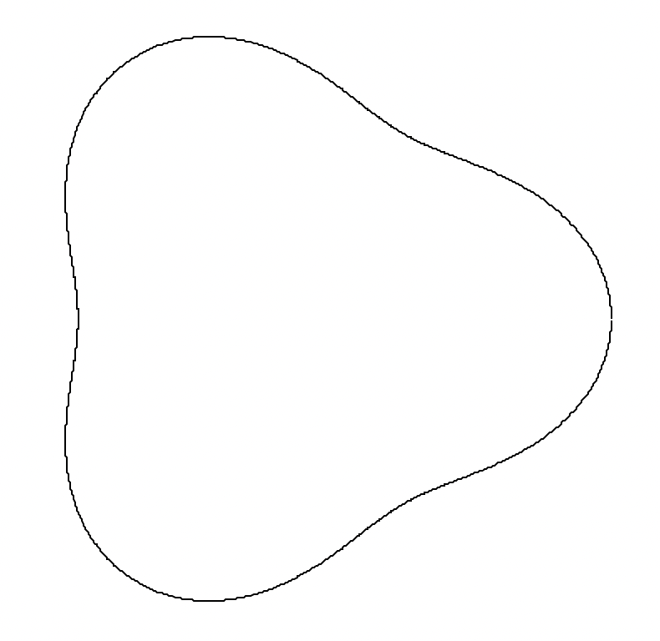
Differences in STAR-PHENIX Measurement
STAR: Mid-mid rapidity correlation
PHENIX: Mid-backward rapidity correlation
STAR:
1.|∆𝜂| > 1.0 to suppress the near-side nonflow
2.Small longitudinal decorrelation is expected,
boost invariant models can be directly
compared
3.Four types of nonflow subtraction methods
implemented
4.Centrlity:Two types of selections, activity in
|𝜂|<0.9 or -5.0<𝜂<-3.3
PHENIX:
1.|∆𝜂| > 2.75 to suppress the near-side nonflow
2.Large longitudinal decorrelation is expected
3.Nonflow estimated using multiplicity scaling of
p+p v_{n}
4.Centrality: activity in -3.9<𝜂<-3.1
He+Au(2014)
d+Au(2016)
p+Au(2015)
Au
Au
Au
³He
d
p
STAR
Phys. Rev. Lett. 130, 242301
-0.9<𝜂<0.9
PHENIX
Nature Phys. 15, 214 (2019)
-3.9<𝜂<-3.1
-0.35<𝜂<0.35

Slide 7
Correlation Function and Away-side Nonflow Subtraction
Correlation function in p+p indicates
nonflow is dominated by the away-side
jet-like correlation
Four nonflow subtraction methods have been employed using p+p as reference
c₀ method: scaled with per trigger yield
Near-side method: scaled with near-side jet yield
c₁ method: scaled by v₁ from momentum conservation
Template Fit method: scaled with away-side jet
STAR, Phys. Rev. Lett. 130, 242301

Slide 8
STAR differential v_{n} measurements for p/d/3He+Au
Au
  Non-flow subtraction will only decrease v₂ and increase v₃
³He
Au
d
  Non-flow subtracted v₂ and v₃ show minimal method dependence
Au
p
STAR, Phys. Rev. Lett. 130, 242301

Slide 9
Vn for Different Centrality Selection
|𝜂 |< 0.9
-5.0<𝜂 <-3.3
(c₁ subtraction)
Results agree well for both centrality definitions using activity from mid
and backward rapidity regions

Slide 10
Role of Pre-Flow
SONIC model , which incorporates initial geometry eccentricity from nucleon position but does not consider sub-nucleon fluctuations, under-predicts the observed v₃ in all systems.
(super)SONIC: P. Romatschke Eur. Phys.J.C 75, 305 (2015)

Slide 11
Role of Pre-Flow
SONIC model , which incorporates initial geometry eccentricity from nucleon position but does not consider sub-nucleon fluctuations, under-predicts the observed v₃ in all systems.
SuperSONIC mode, which include initial geometry eccentricity from nucleon position and the “pre-flow” can provide better description of v₃
(super)SONIC: P. Romatschke Eur. Phys.J.C 75, 305 (2015)

Slide 12
The system dependence
The final state contributions are expected to be largely canceled out when comparing similar multiplicity events
Studying the ratios of flow will be helpful to understand the initial spatial geometry and the contribution from the preflow
V₂(HeAu) ≈ v₂(dAu) > v₂(pAu)
V₃(HeAu) ≈ v₃(dAu) ≈ v₃(pAu)
STAR, Phys. Rev. Lett. 130, 242301

Slide 13
The system dependence
The final state contributions are expected to be largely canceled out when comparing similar multiplicity events
Studying the ratios of flow will be helpful to understand the initial spatial geometry and the contribution from the preflow
V₂(HeAu) ≈ v₂(dAu) > v₂(pAu)
V₃(HeAu) ≈ v₃(dAu) ≈ v₃(pAu)
Midrapidity v₃ implies no difference in triangular fluid shape between systems
STAR, Phys. Rev. Lett. 130, 242301

Slide 14
The system dependence
The final state contributions are expected to be largely canceled out when comparing similar multiplicity events
Studying the ratios of flow will be helpful to understand the initial spatial geometry and the contribution from the preflow
V₂(HeAu) ≈ v₂(dAu) > v₂(pAu)
V₃(HeAu) ≈ v₃(dAu) ≈ v₃(pAu)
Two Base Lines: eccentricity ratios
Eccentricity with nucleon fluctuation
STAR, Phys. Rev. Lett. 130, 242301

Slide 15
The system dependence
The final state contributions are expected to be largely canceled out when comparing similar multiplicity events
Studying the ratios of flow will be helpful to understand the initial spatial geometry and the contribution from the preflow
V₂(HeAu) ≈ v₂(dAu) > v₂(pAu)
V₃(HeAu) ≈ v₃(dAu) ≈ v₃(pAu)
Two Base Lines: eccentricity ratios
Eccentricity with nucleon fluctuation
Eccentricity with nucleon+sub-nucleon
STAR, Phys. Rev. Lett. 130, 242301

Slide 16
The system dependence
The final state contributions are expected to be largely canceled out when comparing similar multiplicity events
Studying the ratios of flow will be helpful to understand the initial spatial geometry and the contribution from the preflow
V₂(HeAu) ≈ v₂(dAu) > v₂(pAu)
V₃(HeAu) ≈ v₃(dAu) ≈ v₃(pAu)
Two Base Lines: eccentricity ratios
Eccentricity with nucleon fluctuation
Eccentricity with nucleon+sub-nucleon
Sub-nucleon fluctuation?
or
Pre-flow?
STAR, Phys. Rev. Lett. 130, 242301

Slide 17
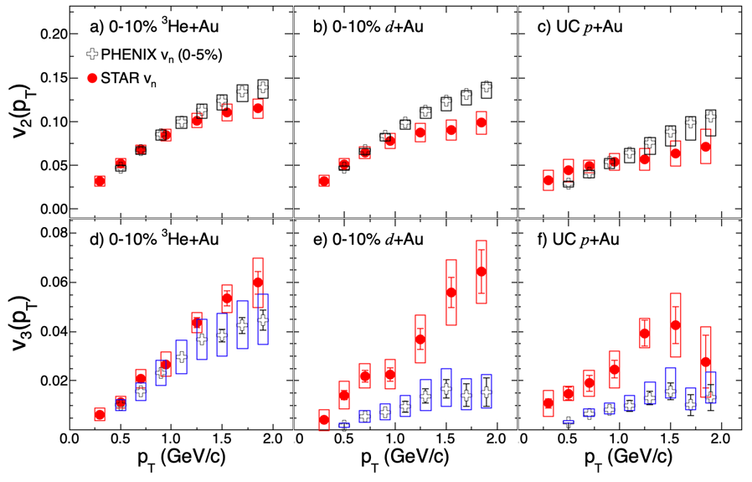
Role of longitudinal decorrelation:
3D-Glauber model
The STAR and PHENIX v₃ for p/d+Au, show similar p_{T} dependence
  But magnitudes differ by a large factor
    System-independent STAR v₃
    System-dependent PHENIX v₃
X. Zhao && C. Shen PRC.107.014904

Slide 18
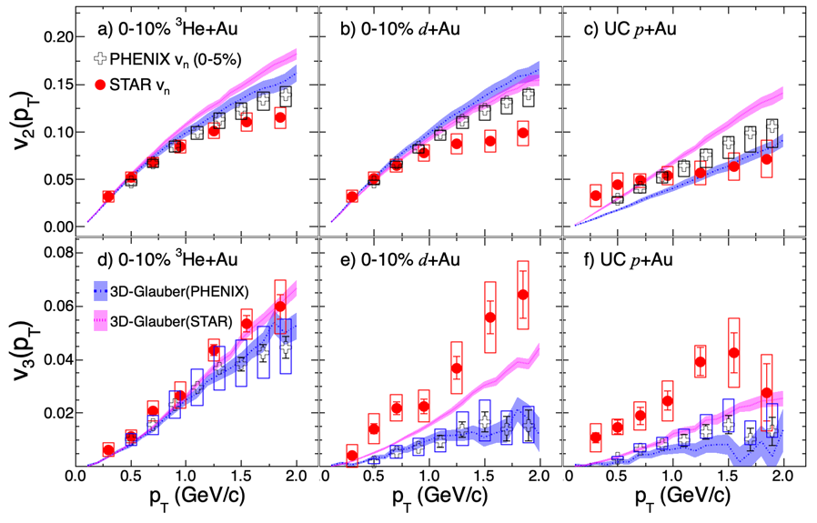
Role of longitudinal decorrelation:
3D-Glauber+MUSIC
The STAR and PHENIX v₃ for p/d+Au, show similar p_{T} dependence
  But magnitudes differ by a large factor
    System-independent STAR v₃
    System-dependent PHENIX v₃
3D Glauber + MUISC indicates there are significant de-correlations in PHENIX v₃ measurements
Model underestimates STAR and PHENIX v₃ measurements in p+Au
X. Zhao && C. Shen PRC.107.014904

Slide 19
New d+Au Data 2021
TPC: |𝜂|<1.0
EPD:
-5.1<𝜂<-2.1
iTPC: |𝜂|<1.5
EPD:
2.1<𝜂<5.1
100M MB and 100M HM(0-5% selected by EPD) triggered events have been taken by STAR in 2021
Improved acceptance: iTPC (|η|<1.5) + EPD(2.1<|η|<5.1)
Simultaneously measuring the mid-mid and mid-backward rapidity correlations
Further investigate the longitudinal decorrelation in small-sized system

Slide 20
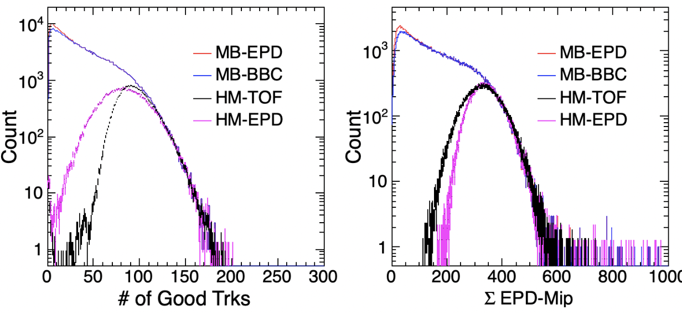
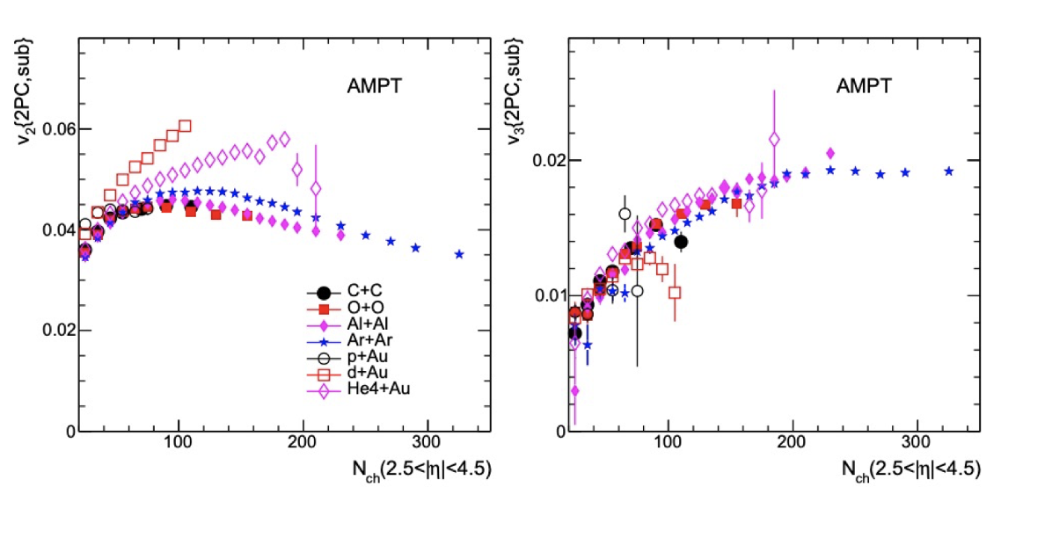
O+O@RHIC 2021
STAR has taken 600M MB and 200M HM O+O events in 2021
Large rapidity coverage due to iTPC |𝜂|<1.5 and EPD(2.1<|𝜂|<5.0 )
Trigger on HM event at both middle and forward rapidity regions
Different flow behaviors between symmetric and asymmetric collision systems
Disentangle the impact of the subnucleon fluctuations from the nuclear shape
S.Huang , Z. Chen, J. Jia, W. Li: PhysRevC.101.021901

Slide 21
Summary
The STAR experiment conducted measurements of v₂ and v₃ as a function of p_{T} in central p+Au, d+Au and ³He+Au collisions. The extracted flow signals were found to be consistent across four different non-flow subtraction methods.
The observed v₃ is system independent, suggesting a significant influence of sub-nucleon gluon field fluctuations on the initial geometry of small-sized systems. Although, longitudinal decorrelation and pre-flow effects need to be further investigated
In the future, the availability of new d+Au and O+O data will provide additional information for studying the sub-nucleon structure, pre-flow and longitudinal decorrelations.
Thanks!

Slide 22
Backup

Slide 23
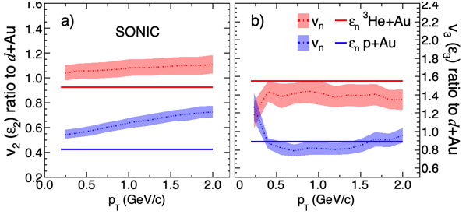
SONIC Hydro.
SONIC: P. Romatschke Eur. Phys.J.C 75, 305 (2015)
V_{n}∝𝜀_{n} approximately holds for v₃
On the other hand, the ratio v₂(pAu)/v₂(dAu) may be affected by different viscous correction functions or other dynamical effects
Studying v_{n} in p/d/³He+Au collisions and their ratios can provide valuable insights into the initial spatial geometry and pre-equilibrium dynamics during the initial stage of the collision

Slide 24
HIJING pp vs. 𝜂 Gap

Slide 25
Detail Comparisons to PHENIX
The STAR and PHENIX v₂ and v₃ for ³He+Au, show reasonable agreement
The STAR and PHENIX measurements for v₂ are also in reasonable agreement for p/d+Au
  Some difference(~25%) for p_{T}>1 GeV/c in d+Au and p_{T}<1 GeV/c in p+Au
The STAR and PHENIX v₃ for p/d+Au, show similar p_{T} dependence
  But magnitudes differ by a factor of 3
    System-independent STAR v₃
    System-dependent PHENIX v₃
Longitudinal decorrelation effect?
PHENIX: Nature Phys. 15, 214 (2019)
STAR: 2210.11352
Notes:
We can look difference more detail

Slide 26
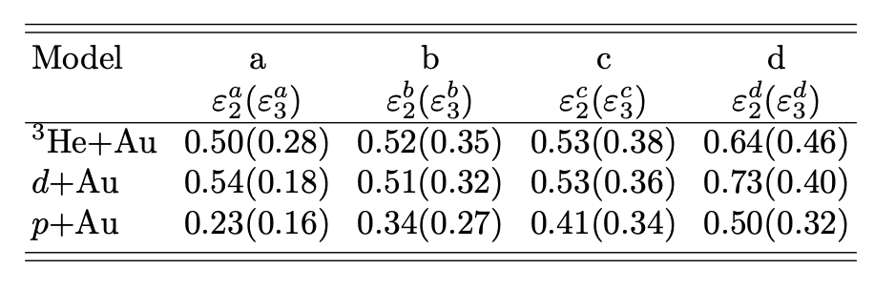
Comparison to IP-Glasma
IP-Glasma+Hydro includes sub-nucleonic gluon field fluctuations + initial momentum correlation + pre-flow.
It is tuned to describe the data for large-sized systems and then extrapolated to small-sized systems
It overpredicts v₂ but reproduces v₃ . Larger 𝛆₂ or strong pre-flow from IP-Glasma model ?
STAR measurements provide useful constraints on model tuning in future
IP-Glasma+Hydro: Phys. Lett. B 803, 135322 (2020)
Notes:
IP+Glasma initial momentum correlation and sub-nuclei fluctuations

Slide 27
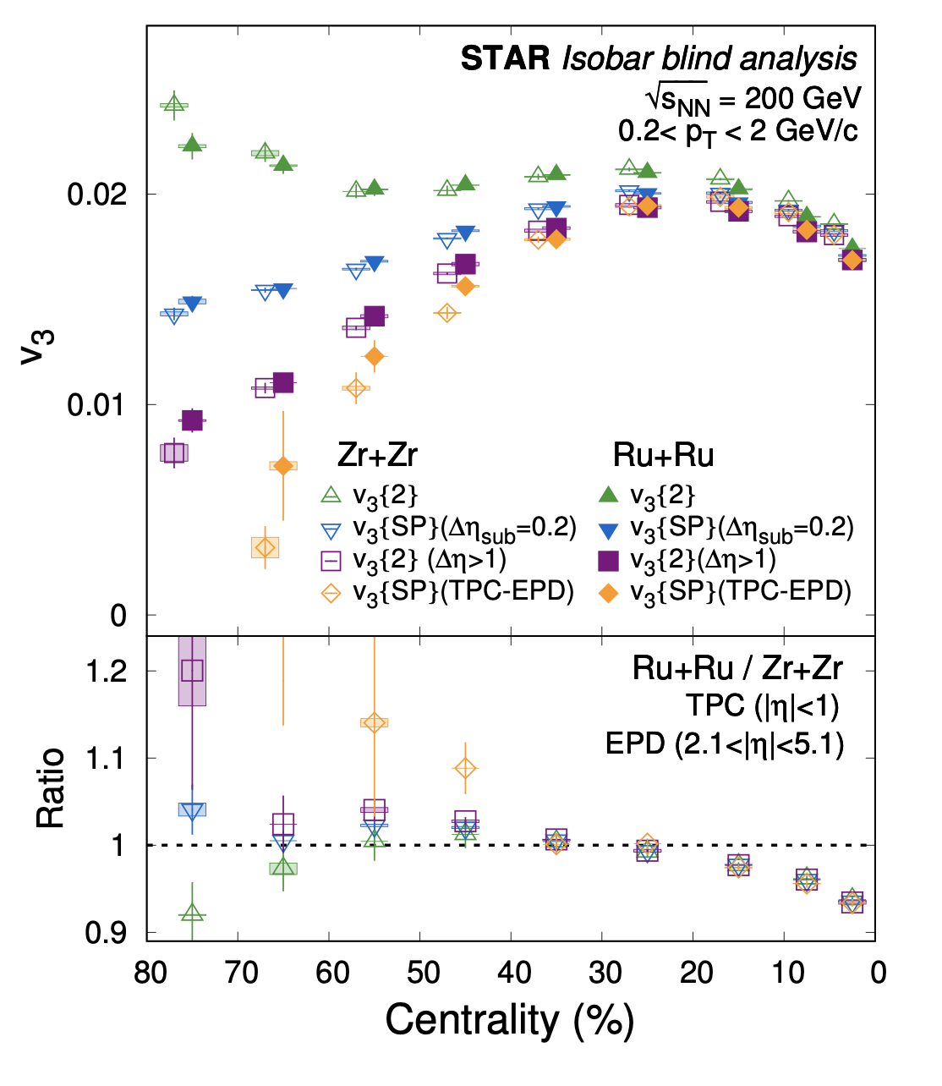
Isobar Vn

