Slide 1


Exploring the deformation of nuclei with v_{n}-<p_{T}> correlation from STAR
Supported in part by
Shengli Huang
Outline:
Physics motivations
Correlation between v_{n} and <p_{T}>
Model comparisons
Summary

Slide 2
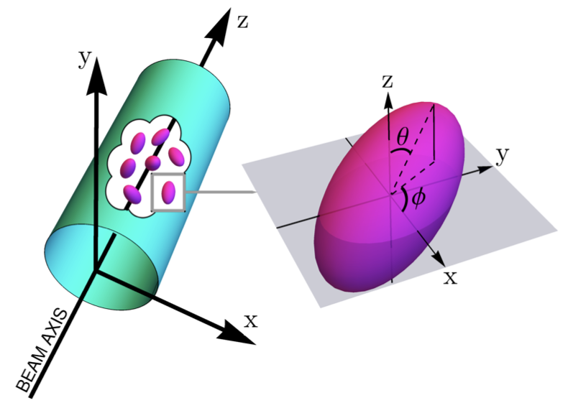
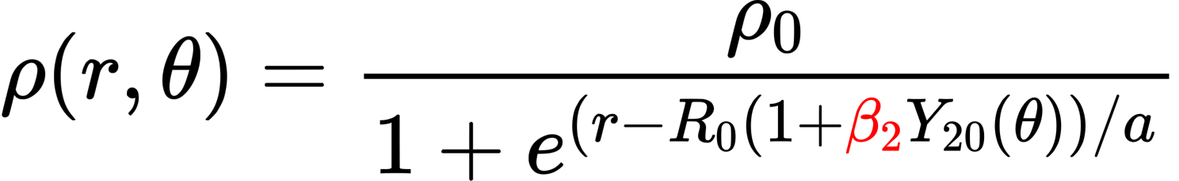
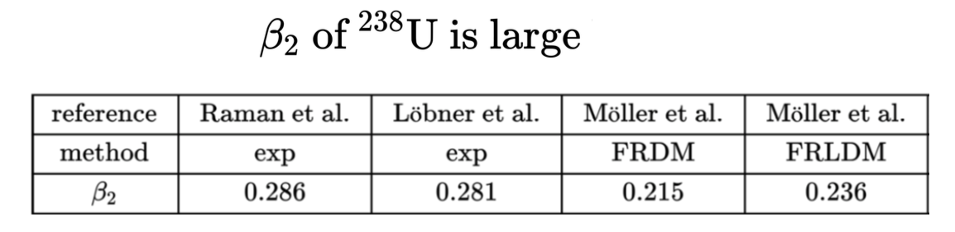
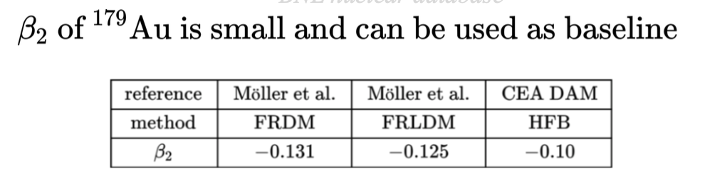
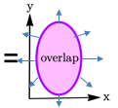
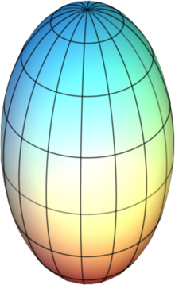
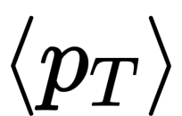
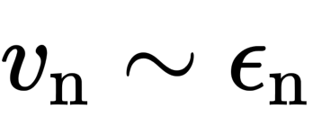

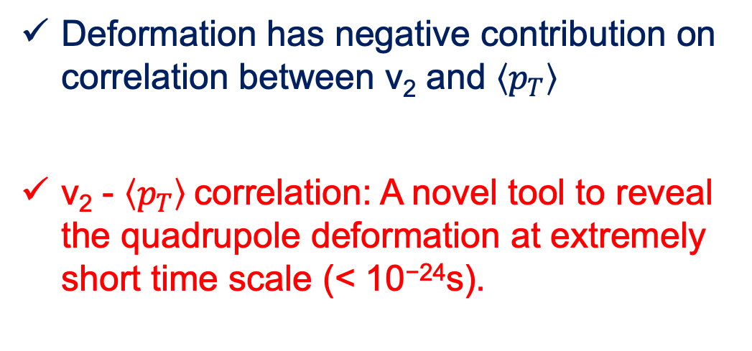

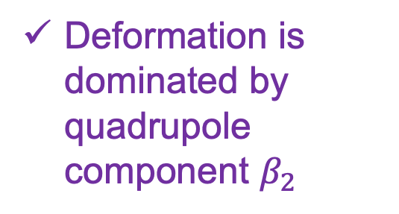
Deformation and v₂- $\left\langle p_{T}\right\rangle$ correlation
Nuclear density:
Deformation is dominated by quadrupole component $β_{2}$
G. Giacalone, PRL124, 202301(2020)
Body-Body
Deformation has negative contribution on correlation between v₂ and $\left\langle p_{T}\right\rangle$
v₂ - $\left\langle p_{T}\right\rangle$correlation: A novel tool to reveal the quadrupole deformation at extremely short time scale (< 10⁻²⁴s).
large R, small
large 𝛆₂, large v₂
Tip-Tip
small R, large
small 𝛆₂, small v₂

Slide 3
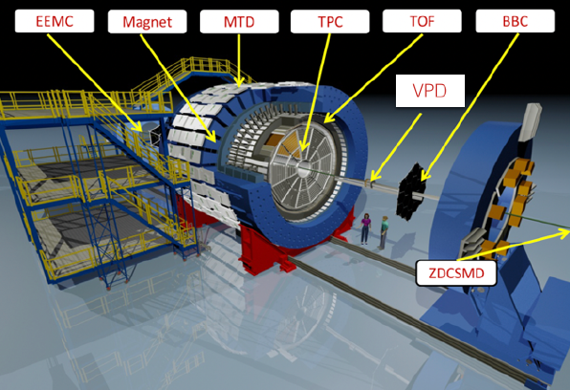
The STAR detector
<p_{T}> and v_{n} are measured within 0.2<p_{T}<2.0 GeV/c and |𝜂|<1.0
Multiplicity are measured within 0.2<p_{T}<2.0 GeV/c and |𝜂|<0.5
Track efficiency is corrected from embedding data
Large, Uniform Acceptance at Mid-rapidity

Slide 4
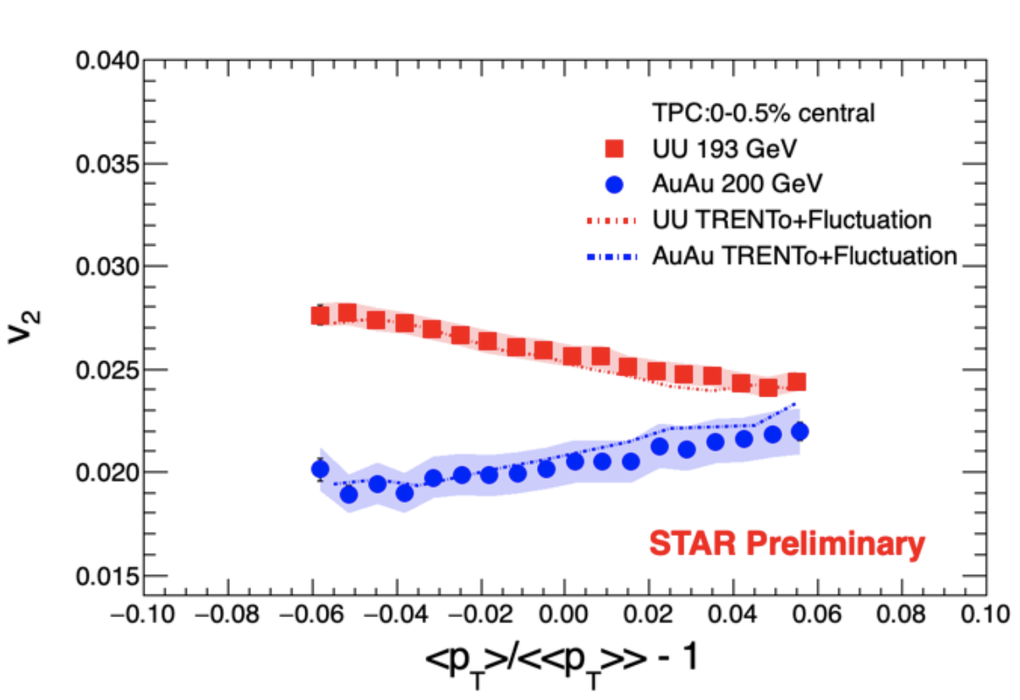
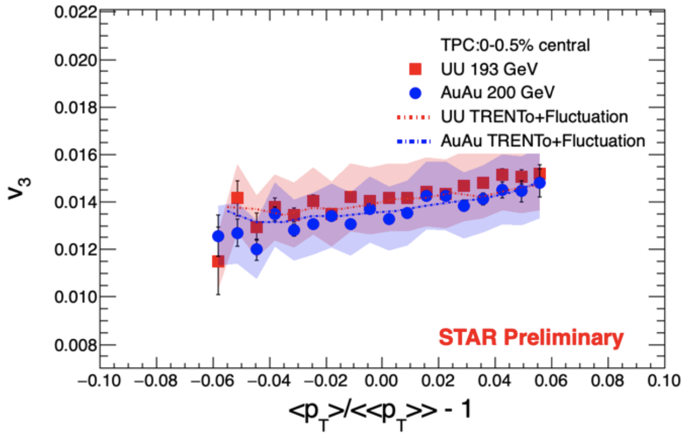
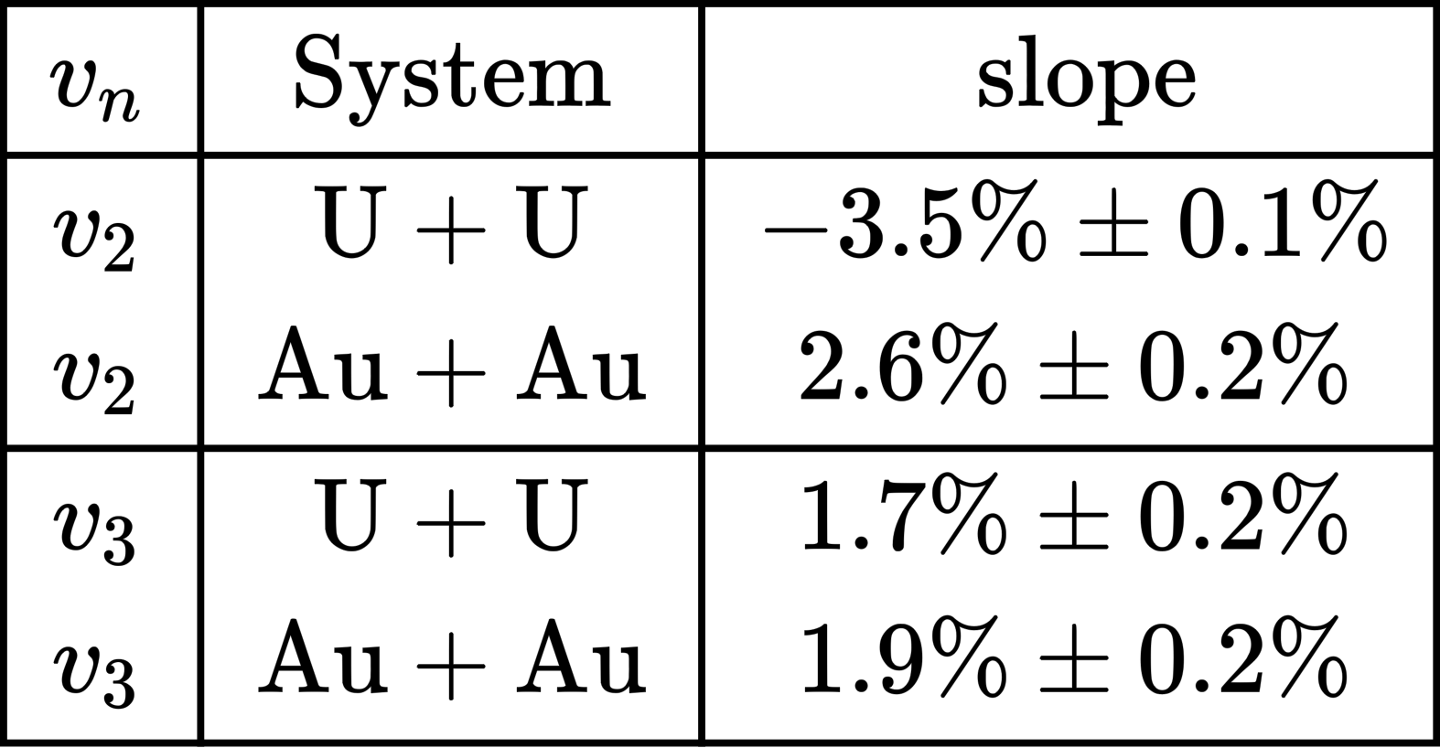
Event-by-event $v_{n}$ vs. $\left\langle p_{T}\right\rangle$ in ultra central (0-0.5%) collisions
Negative correlation is observed between $v_{2}$ and $\left\langle p_{T}\right\rangle$ in central U+U collisions while not in Au+Au
large deformation in U+U
$v_{3}−\left\langle p_{T}\right\rangle$ correlations are positive and similar between Au+Au and U+U
After implementing the statistical fluctuation (due to finite multiplicity), TRENTo model can reproduce the data quantitatively.

Slide 5
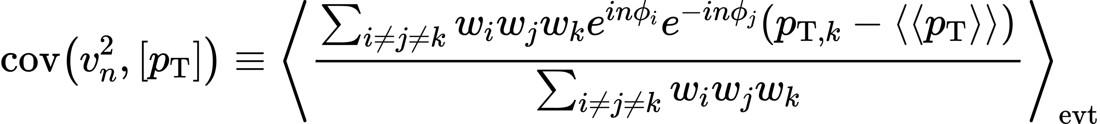
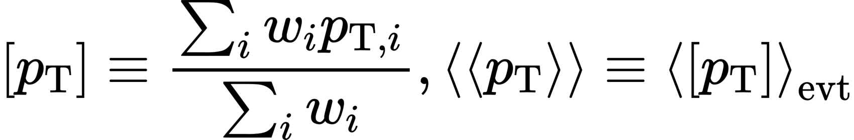
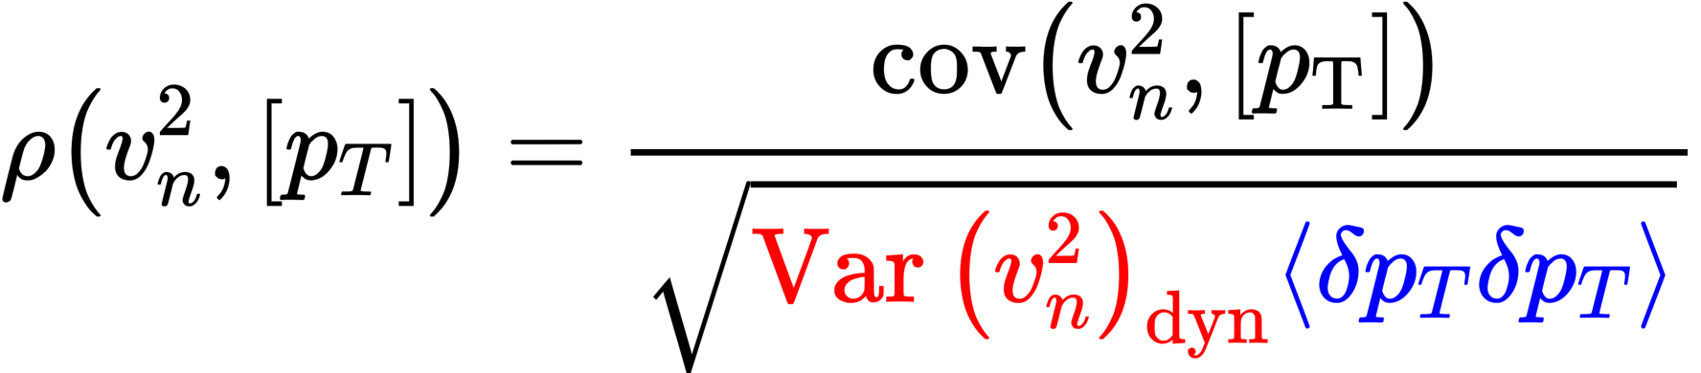
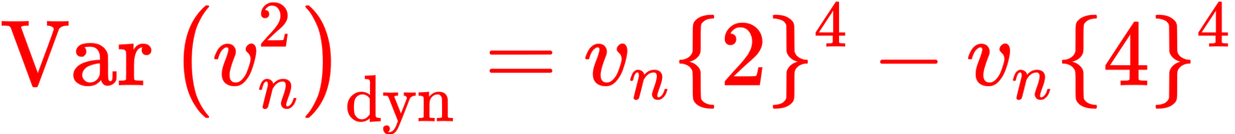
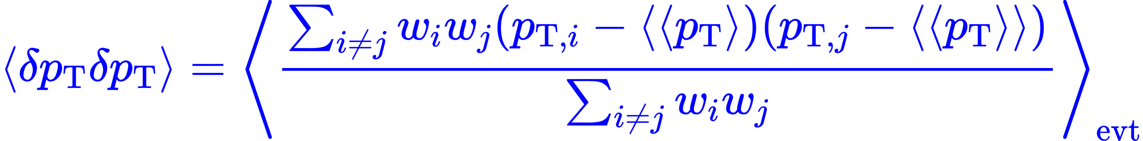
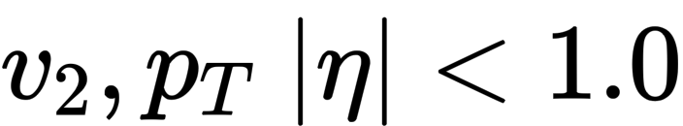
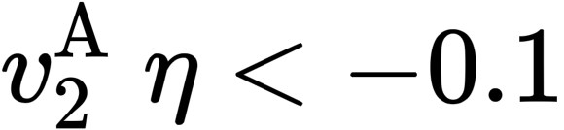
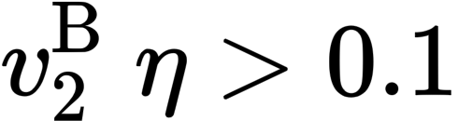
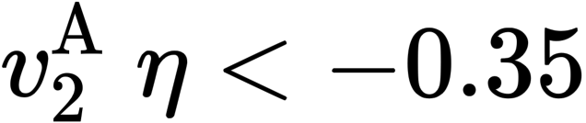
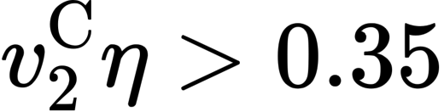
Pearson coefficient
Pearson coefficient: designed to measure dynamical fluctuations
P. Bozek, PRC93, 044908(2016); B. Schenke et al., PRC102, 034905(2020); G. Giacalone, PRC102, 024901(2020), PRL124, 202301(2020), arXiv:2006.15721;
F.G. Gardim et al., PLB809, 135749(2020) ; ATLAS EPJC79, 985(2019)
w_{i} is track weight
Nonflow effect: sub-event method
Standard
2-subevent
3-subevent
<p_{T}> |𝜂|<0.35
<p_{T}> |𝜂|<1.0

Slide 6
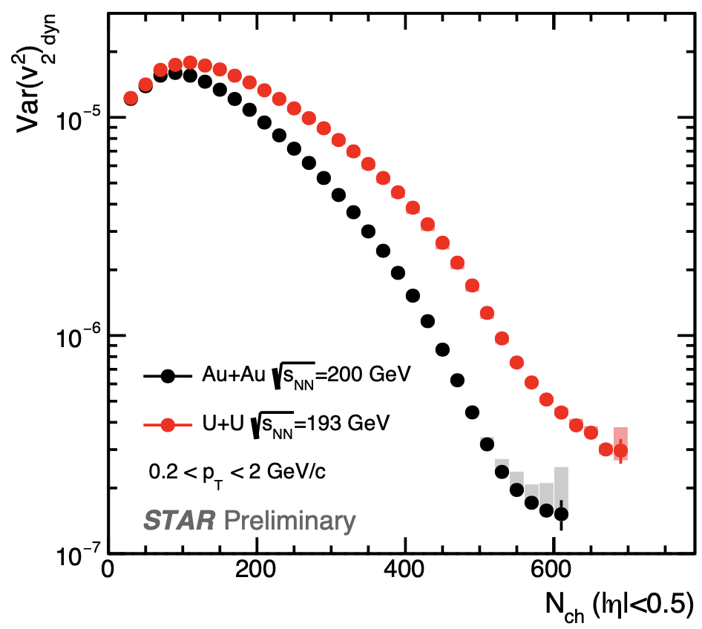
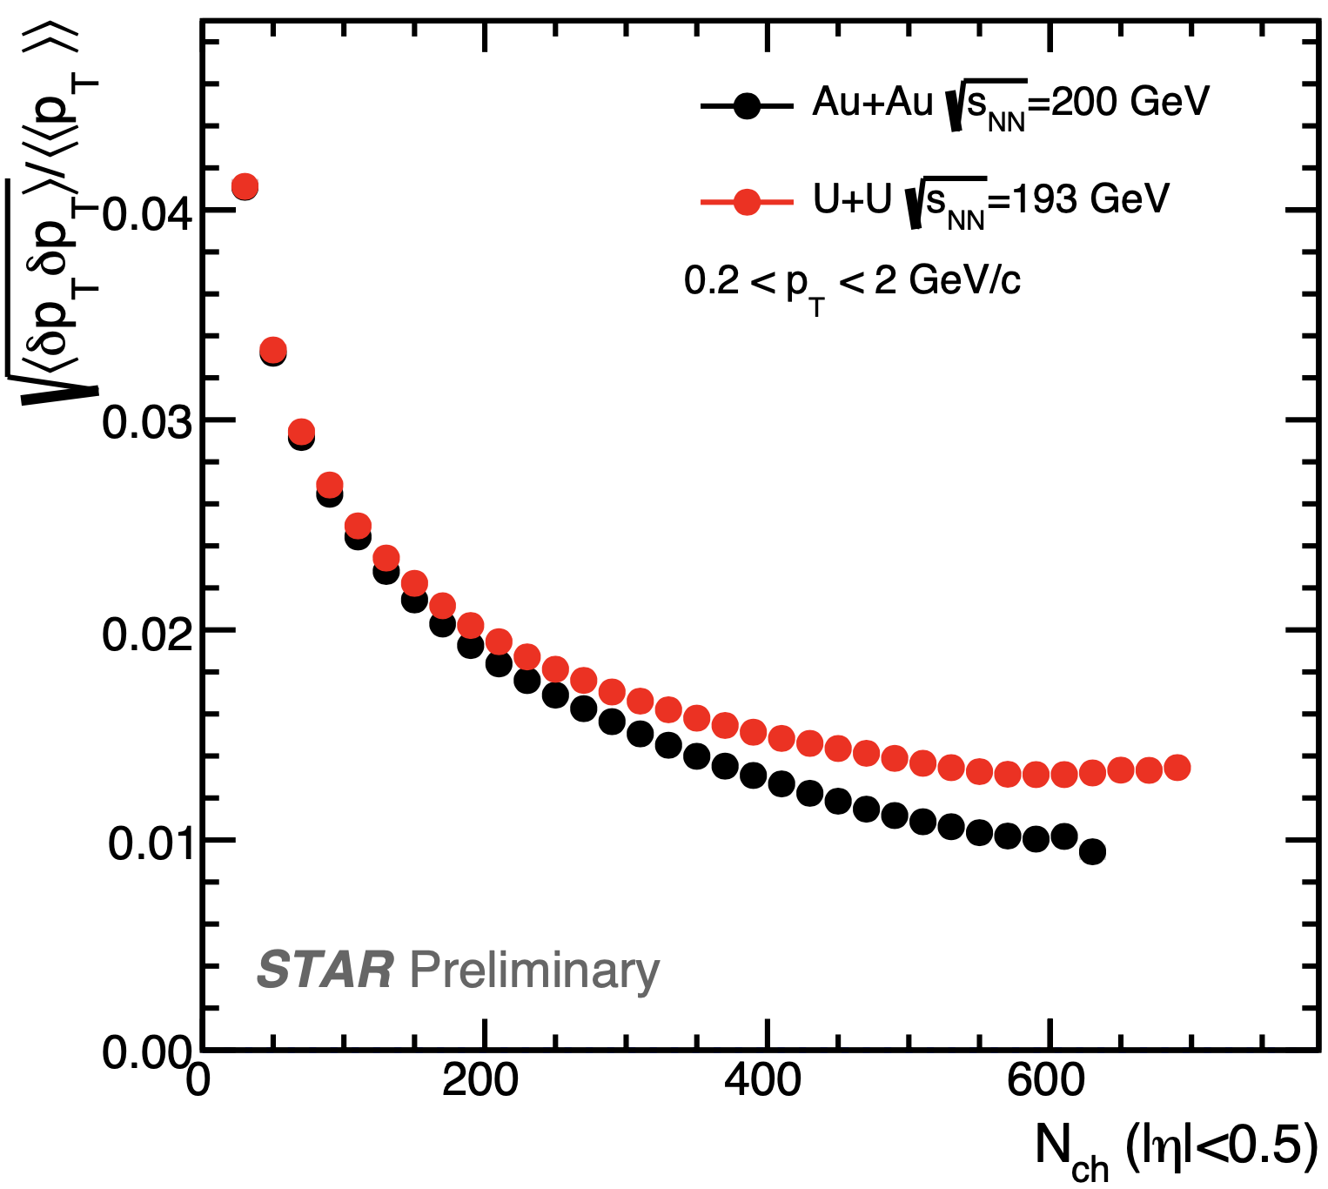

Dynamical $v_{n}^{2}$ variance and $\left\langle p_{T}\right\rangle$ fluctuations
Both flow and $\left\langle p_{T}\right\rangle$ fluctuations affected by nuclear deformation

Slide 7
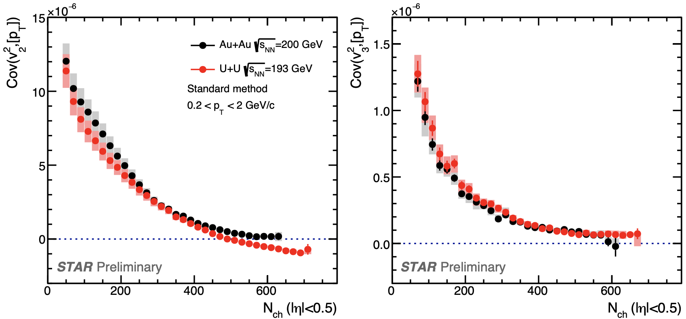
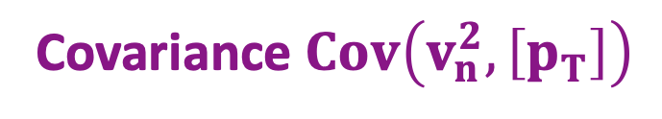
Covariance $Cov\left(v_{n}^{2},\left[p_{T}\right]\right)$
n=2
n=3
Sign-change for c$ov\left(v_{2}^{2},\left[p_{T}\right]\right)$in central U+U as expected from deformation

Slide 8
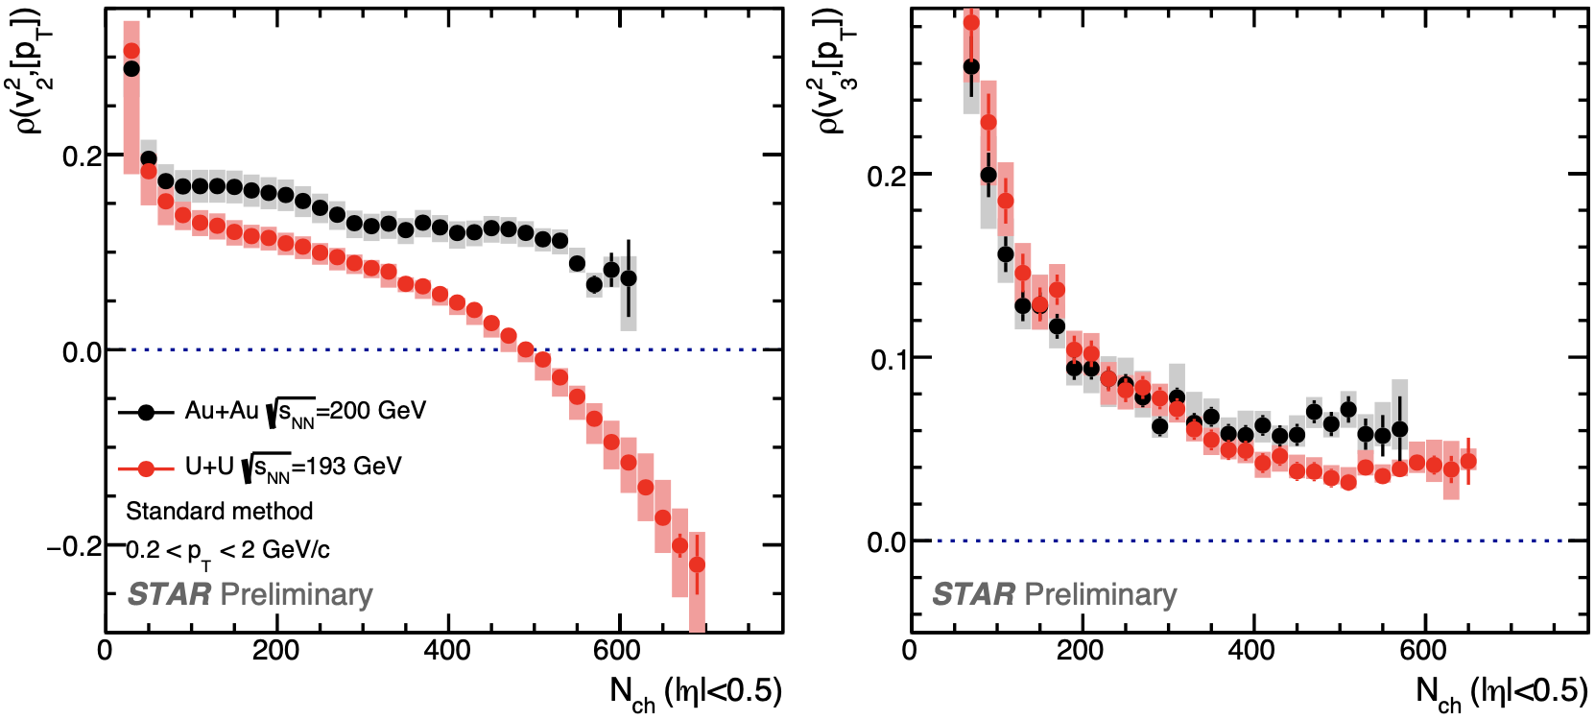
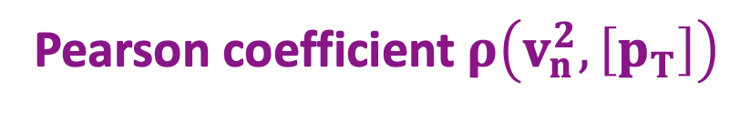
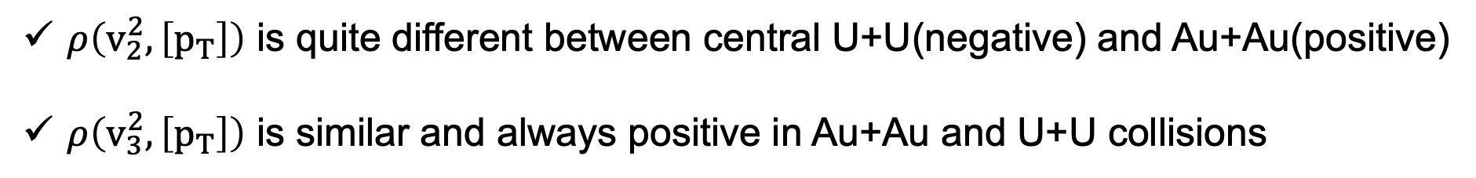
Pearson coefficient $ρ\left(v_{n}^{2},\left[p_{T}\right]\right)$
$ρ\left(v_{2}^{2},\left[p_{T}\right]\right)$ is quite different between central U+U(negative) and Au+Au(positive)
$ρ\left(v_{3}^{2},\left[p_{T}\right]\right)$ is similar and always positive in Au+Au and U+U collisions

Slide 9
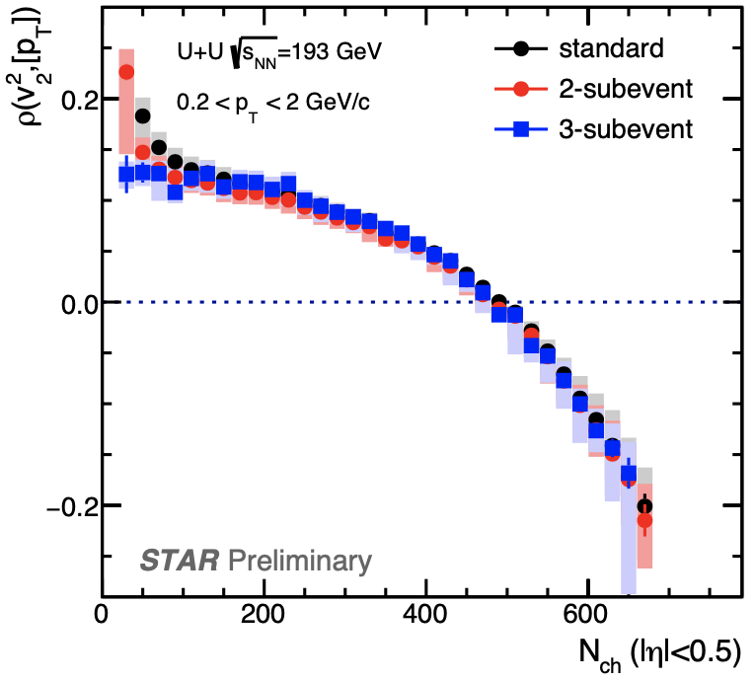
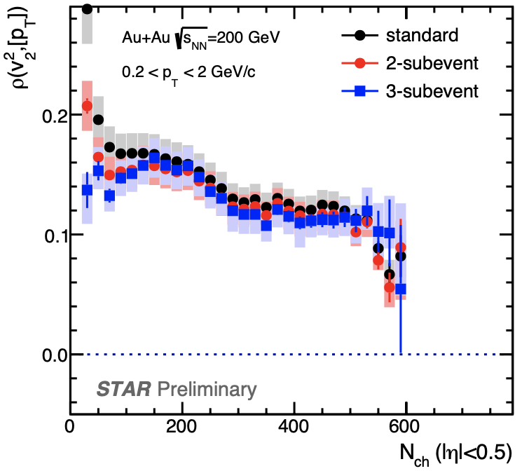
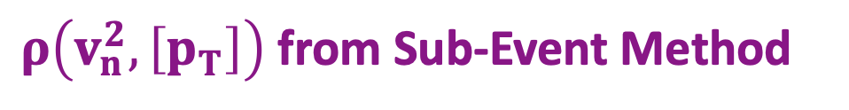
$ρ\left(v_{n}^{2},\left[p_{T}\right]\right)$ from Sub-Event Method
Sub-event methods indicate non-flow effect is negligible in central AA collisions

Slide 10
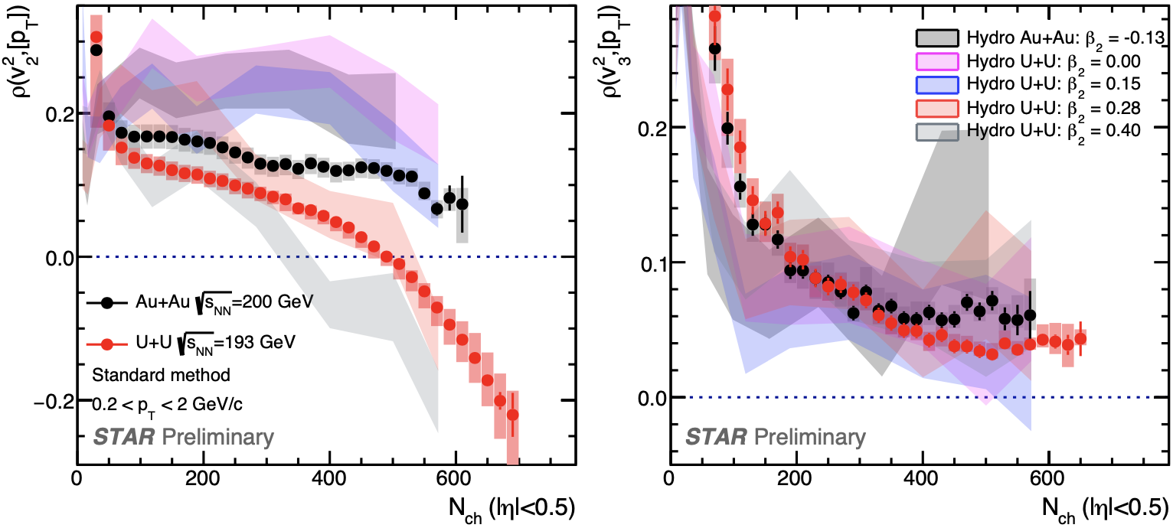
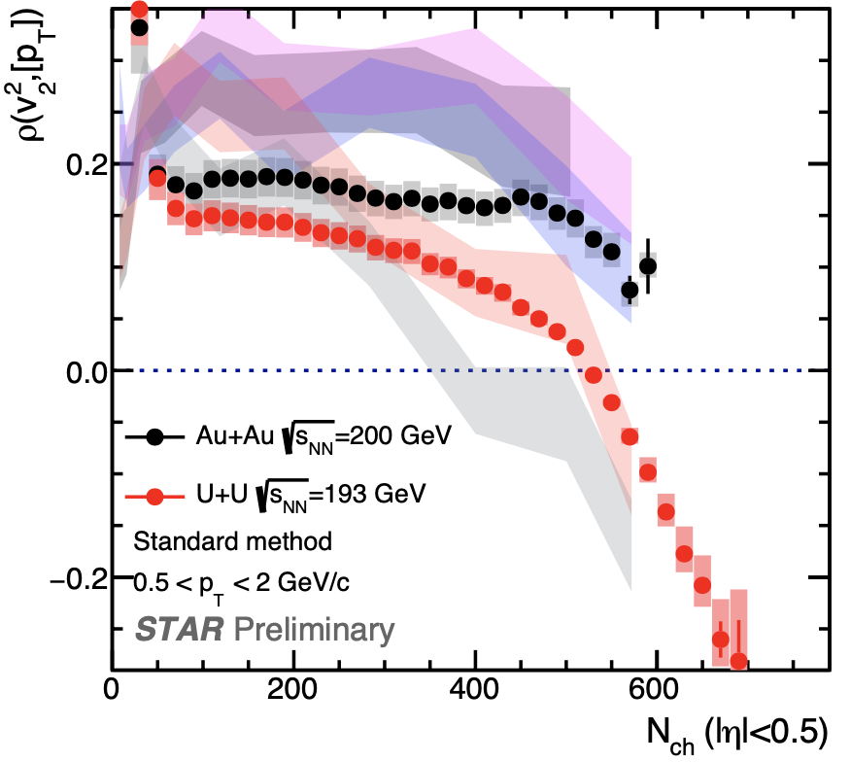
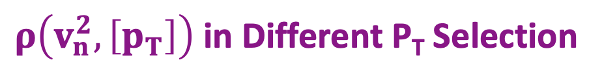
$ρ\left(v_{n}^{2},\left[p_{T}\right]\right)$ in Different P_{T} Selection
IP-Glasma+Hydro: private calculation provided by Bjoern Schenke (based on B. Schenke, C. Shen, P. Tribedy, PRC102, 044905(2020))
0.2< p_{T} < 2 GeV/c
0.5< p_{T} < 2 GeV/c
Features for 0.5<p_{T}<2 GeV/c are same as 0.2<p_{T}<2 GeV/c.

Slide 11
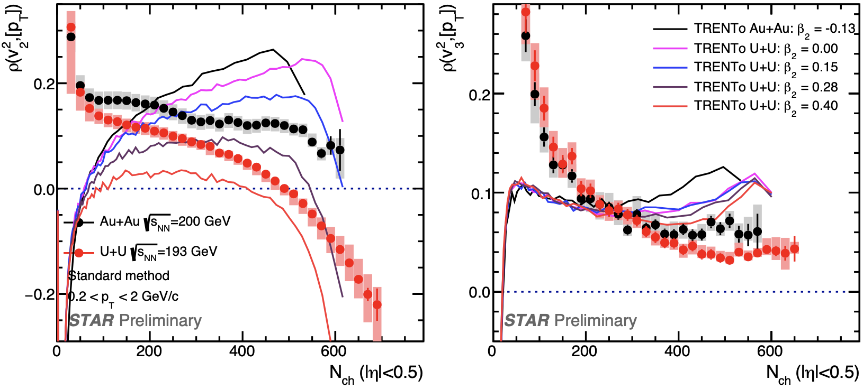
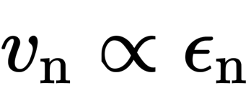
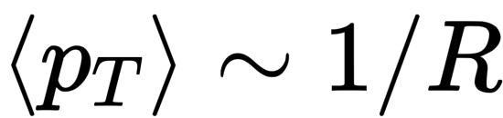
Comparison with TRENTo Model
TRENTo: private calculation provided by Giuliano Giacalone(based on PRC102, 024901(2020), PRL124, 202301(2020) )
Au+Au -0.13
0.00
TRENTo: assuming
0.15
0.28
0.40
TRENTo fails to describe the STAR data but shows a hierarchical $β_{2}$ dependence in U+U collisions.
TRENTo suggests this sign-change in the central collisions could be due to deformation effect.
TRENTo prefers the $β_{2}$ value between 0.28 to 0.4 for Uranium

Slide 12
Comparison with IP-Glasma+Hydro
IP-Glasma+Hydro: private calculation provided by Bjoern Schenke (based on B. Schenke, C. Shen, P. Tribedy, PRC102, 044905(2020))
A hierarchical $β_{2}$ dependence for $ρ\left(v_{2}^{2},\left[p_{T}\right]\right)$while not for $ρ\left(v_{3}^{2},\left[p_{T}\right]\right)$in U+U in IP-Glasma
$$\text{Data} \text{comparable} \text{to} β\text{2}\text{\sim 0.28 }\text{with} \text{IP}\text{-}\text{Glasma} \text{but} \text{with} \text{large} \text{uncertainty}$$

Slide 13
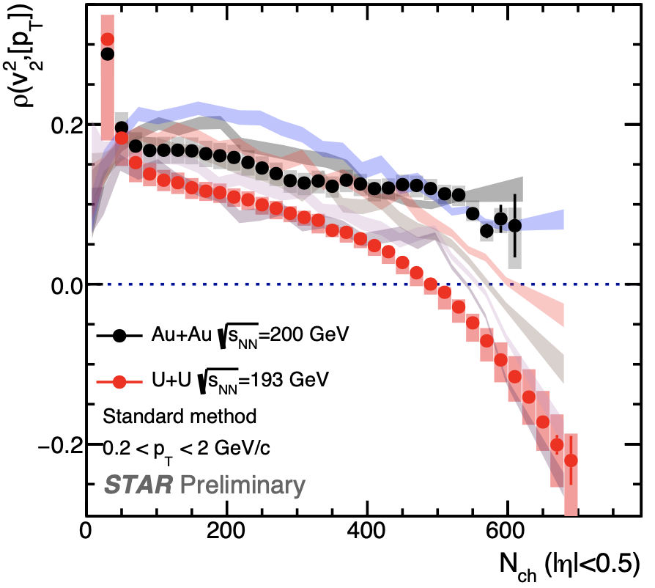
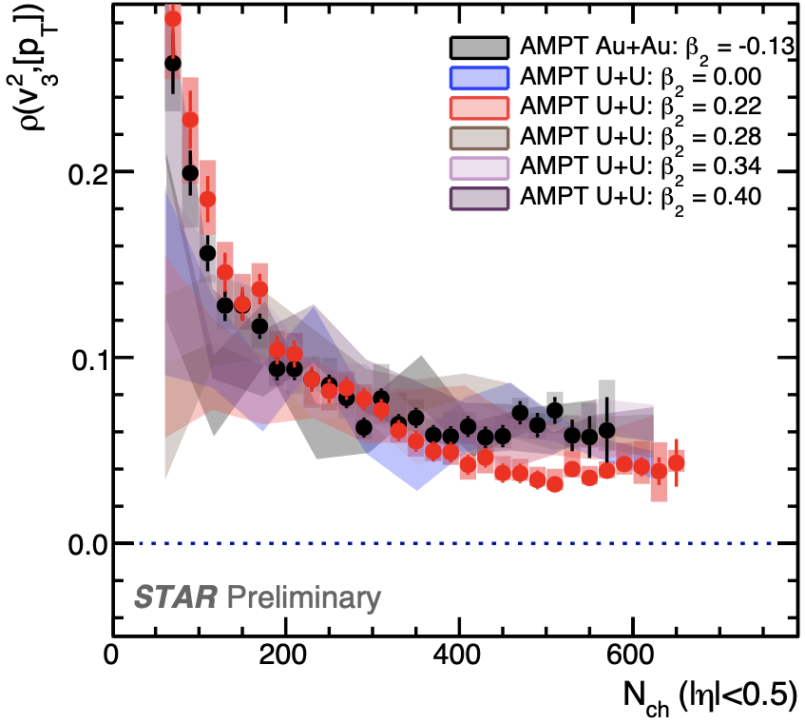
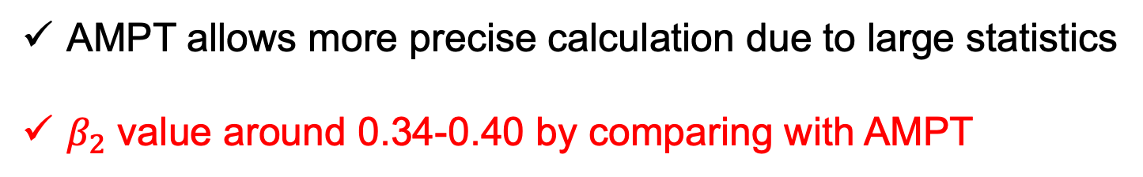
Comparison with AMPT Model
AMPT-SM: Chunjian Zhang, Jiangyong Jia et al., arXiv:2105.05713
Au+Au -0.13
String melting v2.26t5
Parton cross section: 3mb
0.00
0.22
0.28
0.34
0.40
AMPT allows more precise calculation due to large statistics
$β_{2}$ value around 0.34-0.40 by comparing with AMPT

Slide 14
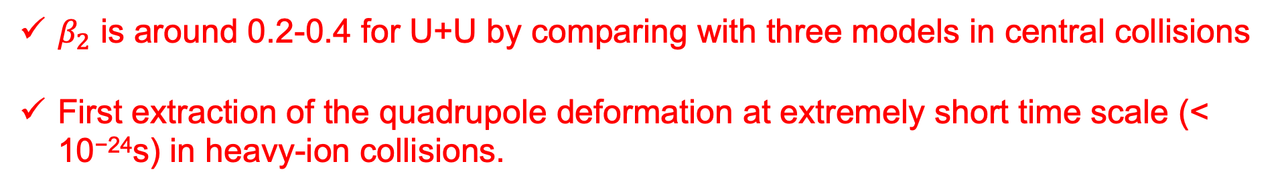
Comparison with Model in Central UU
U+U@193GeV
$β_{2}$ is around 0.2-0.4 for U+U by comparing with three models in central collisions
First extraction of the quadrupole deformation at extremely short time scale (< 10⁻²⁴s) in heavy-ion collisions.

Slide 15
Summary
A sign change of v₂-p_{T} correlation is observed in central U+U while not in Au+Au collisions
Nonflow has been studied via sub-event methods and found to be negligible in central collisions
Comparison with several model calculations constrains β₂ in the range of 0.2-0.4 for Uranium
First constraints on quadrupole deformation at extremely short time scale (< 10⁻²⁴s) accessible through heavy-ion collisions.

