Slide 1



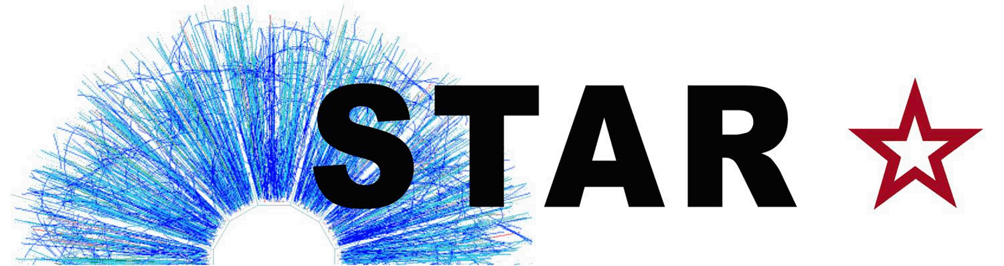


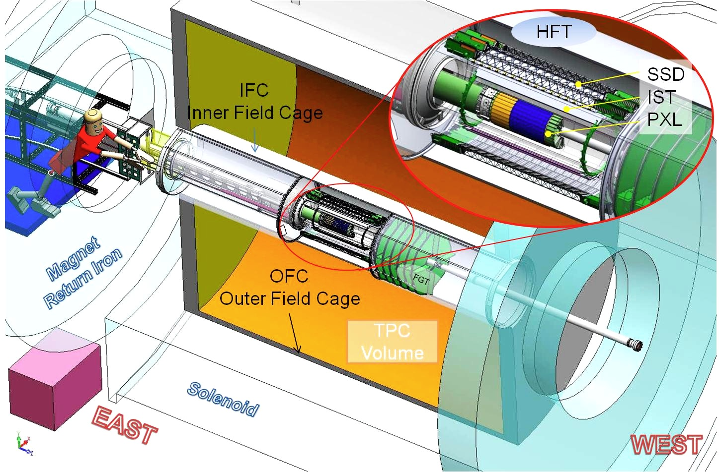
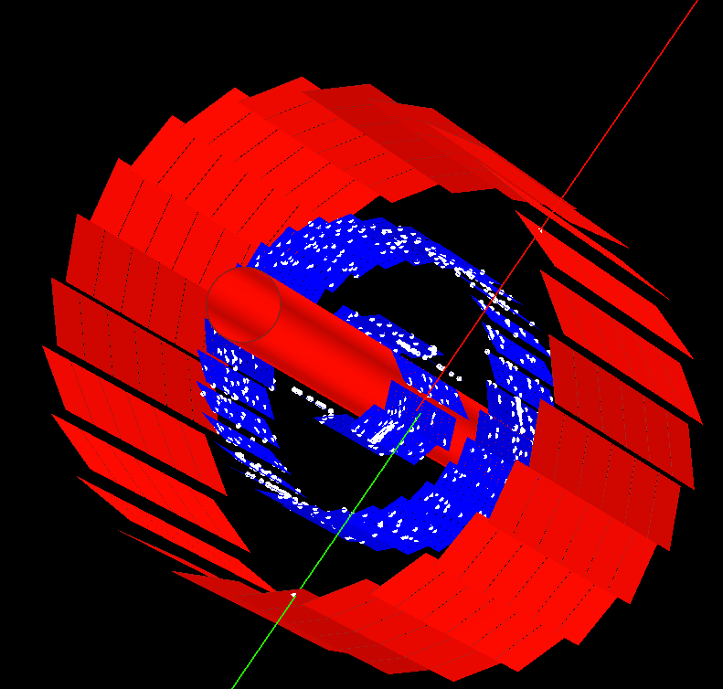
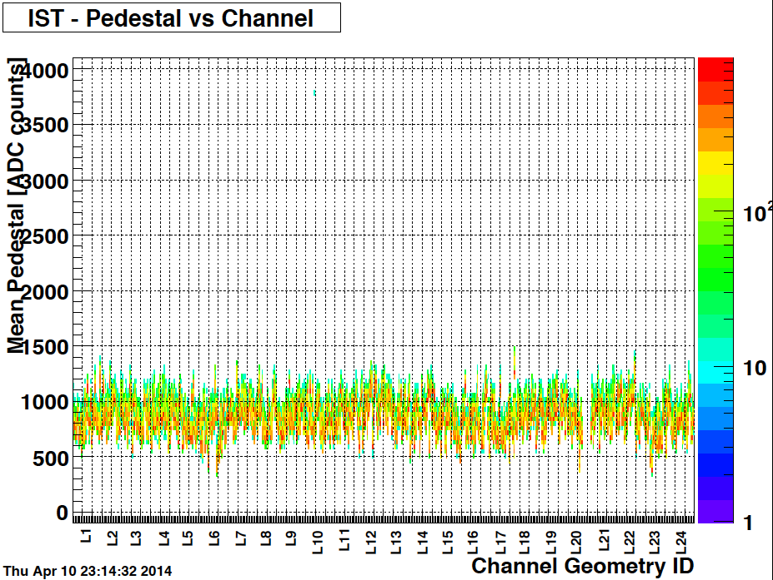
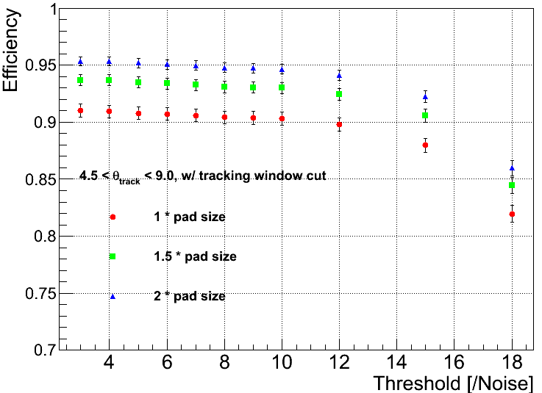
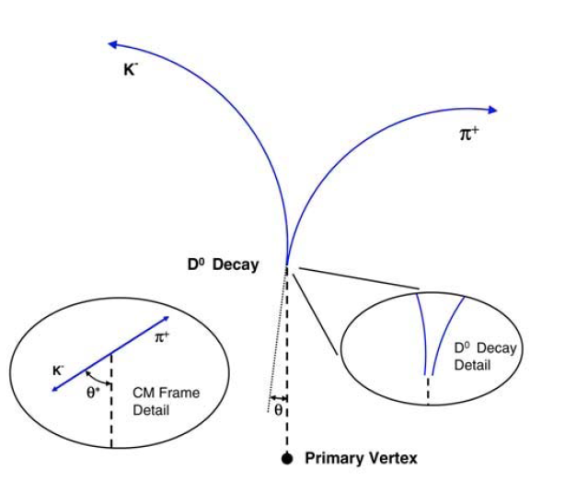
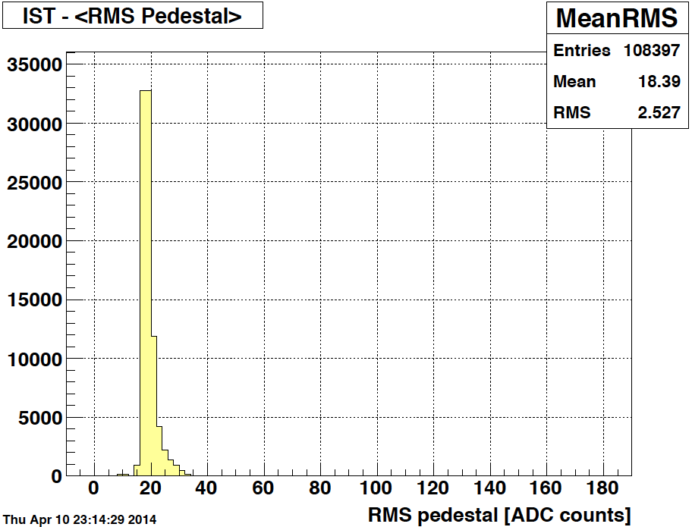
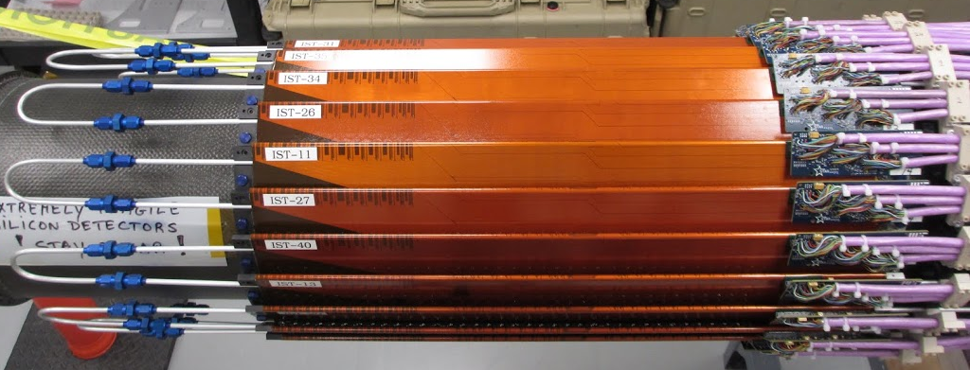
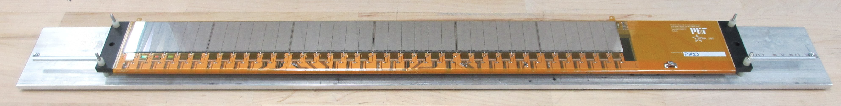
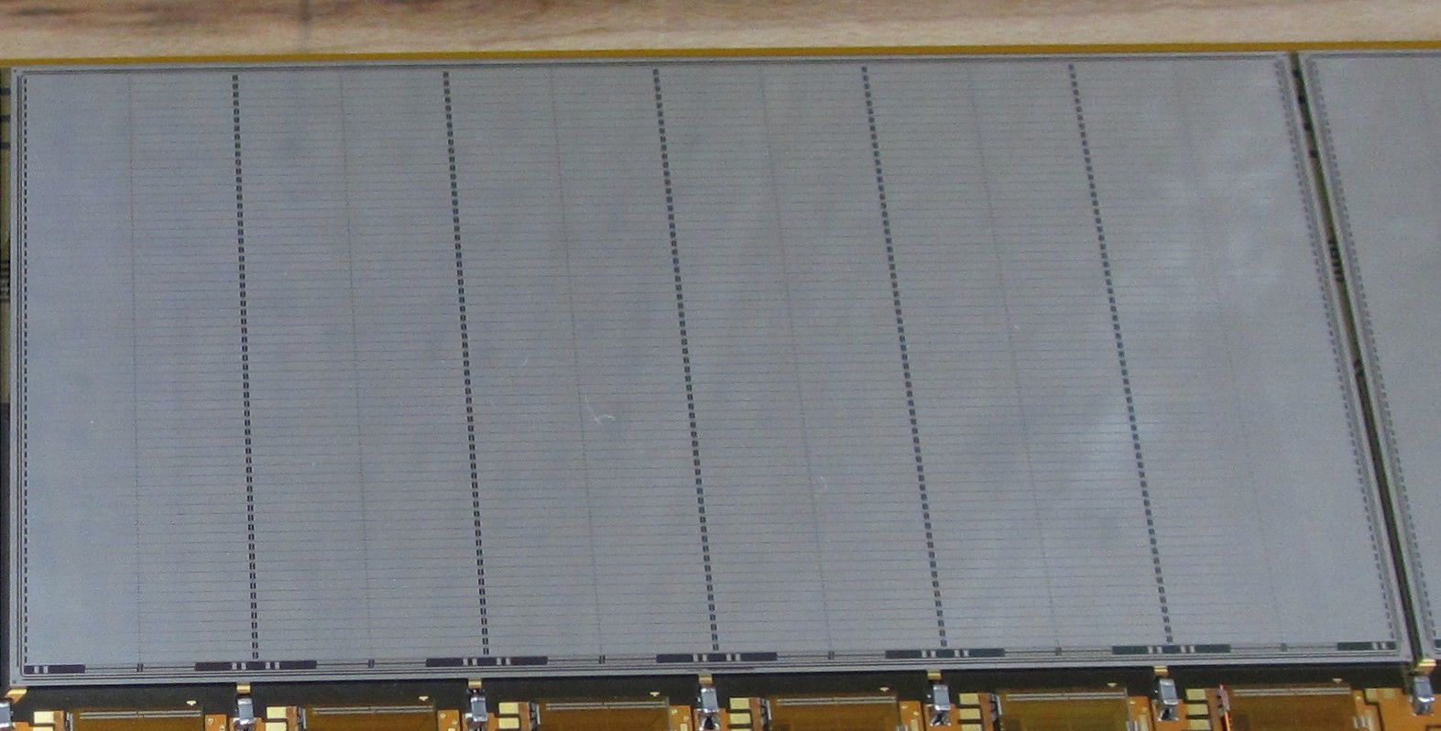
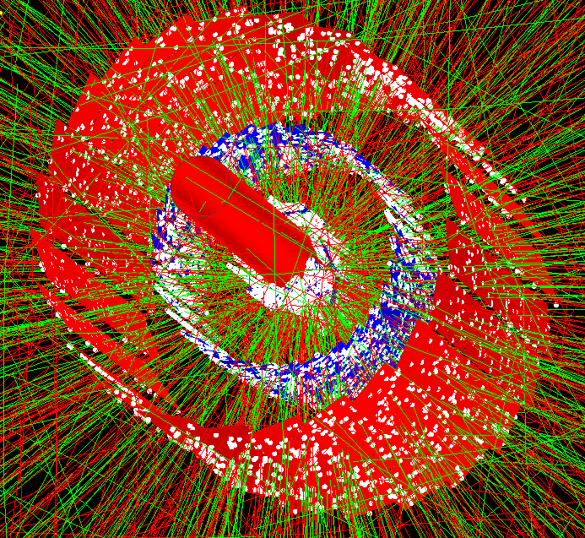
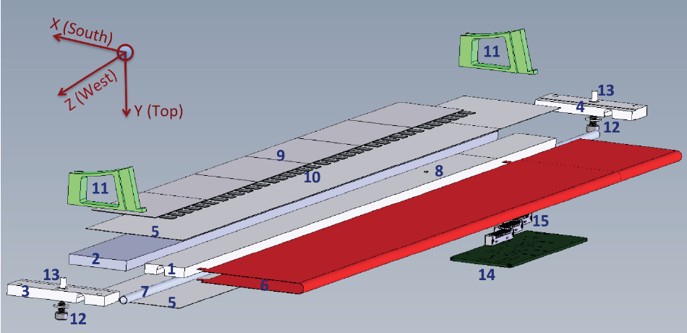
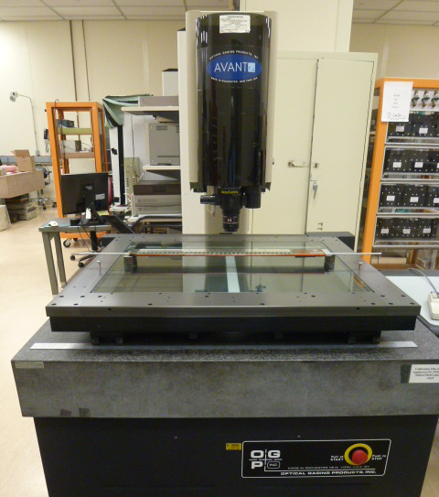
Intermediate Silicon Tracker For STAR HFT Upgrade
Yaping Wang^{1, 3}, Gerrit J. van Nieuwenhuizen², Zhenyu Ye^{1, 3}
for the STAR Collaboration
¹ University of Illinois at Chicago, ² Massachusetts Institute of Technology, ³ Central China Normal University
Abstract
The Heavy Flavor Tracker (HFT) has been installed in the STAR experiment at the Relativistic Heavy Ion Collider since January 2014. It greatly enhances the capability for heavy flavor studies by measurements of displaced vertices and direct topological reconstruction of open charm hadrons. The HFT consists of two inner layers of silicon pixel detectors, an intermediate layer of silicon pad detector and an outer layer of silicon strip detector. The Intermediate Silicon Tracker (IST) is the third layer made of silicon pad sensors, which have a position resolution of about 170 (1800) microns in the r-ϕ (z) direction. In this poster, we will present the design of the IST detector system, and its performance in the cosmic ray tests and ongoing physics data taking in Au-Au collisions.
1. Physics Motivation
4. Performance of IST in Cosmic Run and Au+Au 200 GeV Collisions
Detector | Radius (cm) | Hit Resolution R/ϕ - Z (μm - μm) | Radiation length
SSD | 22 | 20 / 740 | 1% X₀
IST | 14 | 170 / 1800 | <1.5% X₀
PIXEL | 8 | 12/ 12 | ~0.6% X₀
 | 2.9 | 12 / 12 | ~0.4% X₀
IST: red layer PXL: blue layers
IST hit finding efficiency decrease versus channel offline threshold, ~95% with 2*pad size cut
Residual resolution matches design goal (Straight line projection to IST by 2 PXL hits, 2 back-to-back PXL tracks required each event. Survey data were used for IST ladder and PXL sector, and alignment data for others of top level)
Signal-to-Noise ratio (typical value after track angle correction): 23:1
IST (Intermediate Silicon Tracker)
1 layer of silicon pad sensors
Guiding tracks from the SSD to the PIXEL
Fast readout detector (40 MHz sampling rate, 4 μs analogue pipeline)
Event display
Heavy Flavor Tracker (HFT) will greatly enhance the capability of STAR for heavy flavor studies (energy loss mechanism and partonic thermalization), allowing identification of displaced vertices and direct topological reconstruction of open charm hadrons.
RMS noise
Pedestal
D⁰ → K⁻ π⁺ , cτ ~ 120 μm
Channel Threshold [/Noise]
2. Technical Design
ϕ-Coverage | 2π
|η|-Coverage | ≤1.2
Number of Staves | 24
Number of hybrids | 24
Number of sensors | 144
Number of readout chips | 864
Number of channels | 110592
r-ϕ resolution | 172 μm
Z resolution | 1811 μm
R-ϕ pad size | 594 μm
Z pad size | 6275 μm
σ = 0.0200±0.0002 cm
σ = 0.1828±0.0014 cm
MPV ~ 440 ADCs
~ 50 cm
5. Performance of IST in Au+Au@200 GeV
IST stave = Carbon fiber ladder
+ Kapton flex hybrid
+ Passive components
+ 6 silicon pad sensors
+ 3 x 12 APV25-S1 readout chips
+ Aluminium cooling tube
+ Liquid coolant (3M Novec 7200)
300 μm Hamamatsu sensor
( 64 × 12 pads)
The HFT has been collecting data in the RHIC Au+Au 200 GeV run. The IST performance is stable and good. Main performance is summarized below:
Stable pedestal and RMS level over all channels (96.4% good chips, and 96% good channels)
Reasonable Residual resolution (Helix projection to IST by TPC track reconstructed with 2 PXL hits included; Survey data were used for IST/PXL ladders and sensors, and alignment data for others of top level. – See details in Michael Lomnitz’s poster
IST staves were assembled/tested/surveyed at UIC/FNAL and MIT/BNL sites (18 staves produced at each site).
3. IST Geometry, Production and Survey
1) carbon foam 2) carbon honeycomb 3) west carbon end-cap 4) east Al end-cap 5) carbon fiber skins 6) Kapton hybrid 7) Al cooling tube with cooling liquid inside 8) thermal sensor 9) silicon sensors 10) APV chips 11) support blocks 12) screws with washers 13) spacers 14) transition board 15) readout connectors.
Event display
σ = 0.0187±0.0001 cm
σ = 0.0226±0.0001 cm
σ = 0.2265±0.0009 cm
6. Summary
Optical Gaging Products Avant 600 (Automated video measuring system with ~0.5 micron XYZ resolution)
Two reproducible survey data sets for each stave with difference ≤ 3 (10) microns in X-Z (Y)
HFT is designed to enhance STAR’s capability for heavy flavor studies.
IST is a sub-detector of HFT: (1) based on silicon micro-strip technology; (2) Fast readout and reasonable position resolution; (3) Performance of the IST meets design goals; (4) Data taking for Au+Au@200 GeV in 2014.

