Slide 1

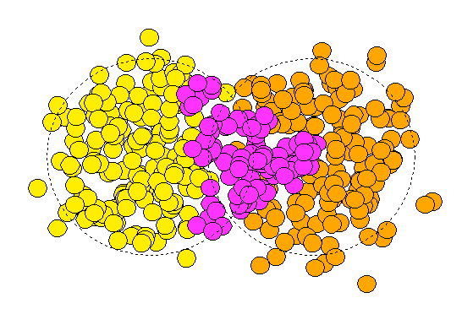
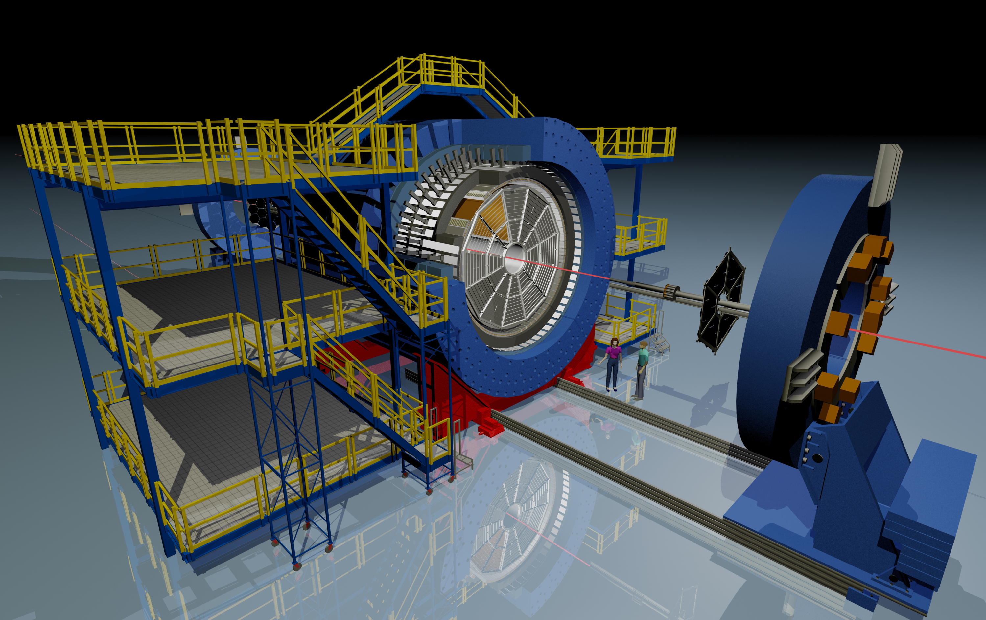




Triangular Flow of Identified Hadrons in Au+Au Collisions at √s_{NN} = 39 & 200 GeV
Xu Sun^{(1,2)} for the STAR Collaboration
Initial Condition and Collectivity in high-energy nuclear collisions
ψ₃
ToF
TPC
Harbin Institute of Technology, Harbin, China
Lawrence Berkeley National Laboratory, Berkeley, USA

Slide 2
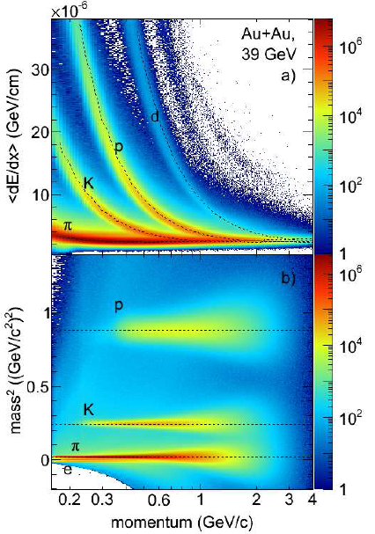
Particle Identification and p_{T} Dependence
Au+Au, 200 GeV,00-80%
Au+Au, 39 GeV,00-80%
39 GeV
STAR Preliminary
Mass ordering of v₃ for 200 and 39 GeV → radial flow
The collectivity is stronger in 200GeV collisions

Slide 3
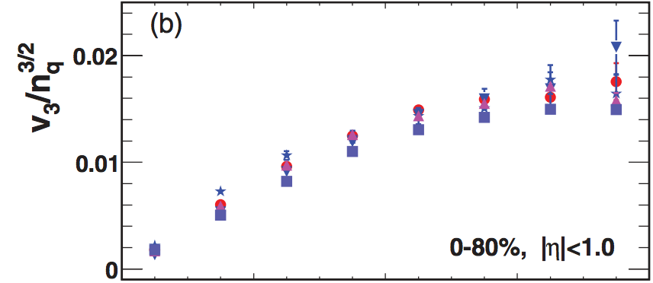
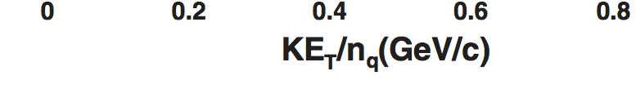

Number-of-Constituent Quark Scaling
R. Lacey, J. Phys. G: Nucl. Part. Phys. 38 (2011) 124048
AMPT: PRC 84, 064907 (2011)
Harri Niemi, QM14, Friday
200 GeV
39 GeV
Collective behavior for v₃ at 39 and 200 GeV
  Mass ordering at low p_{T}, similar to v₂
  v₂/v₃ > 1: v₂ geometry +fluctuation
        v₃ fluctuation
More energies (19.6, 27,…) and particle species
(K⁰_{s},Λ,…) coming soon
Au+Au 200 GeV
STAR Preliminary
STAR Preliminary

