Slide 1
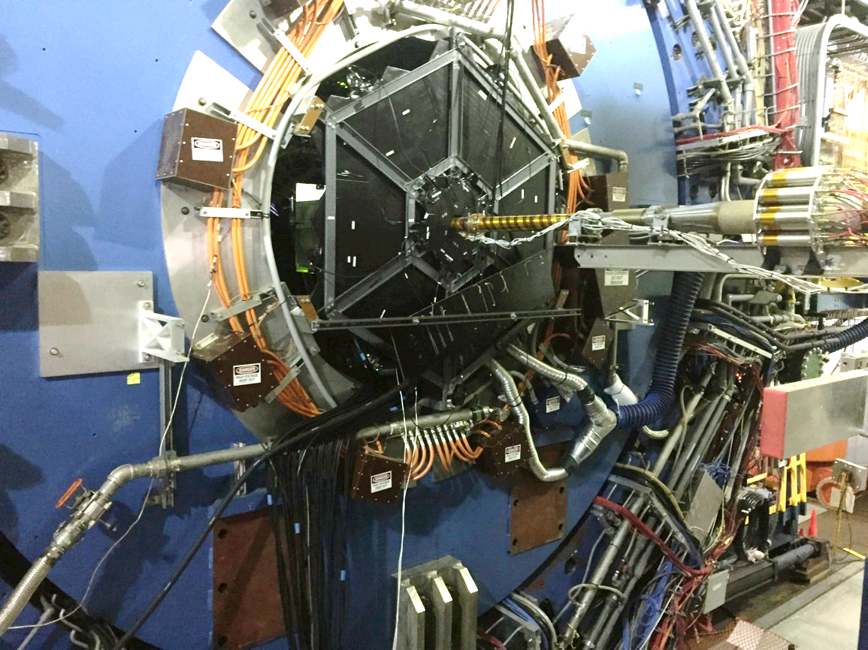
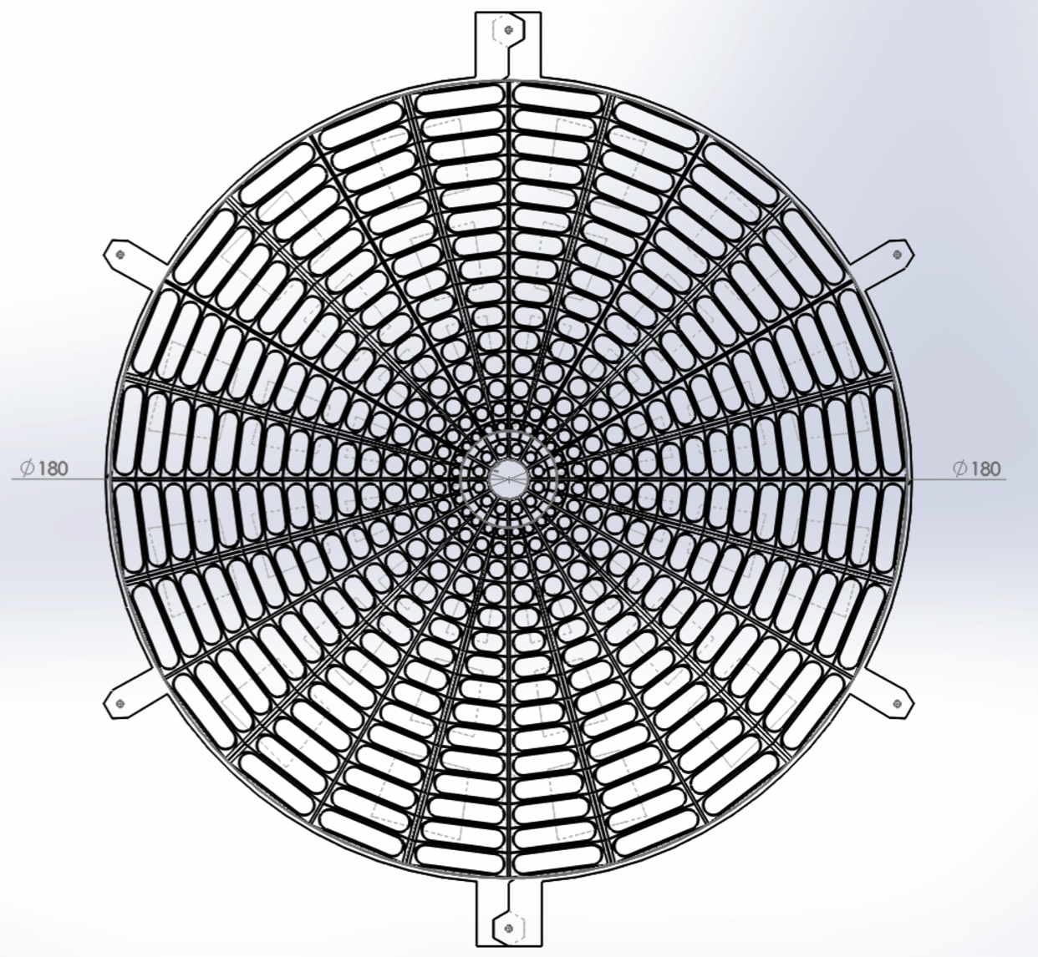
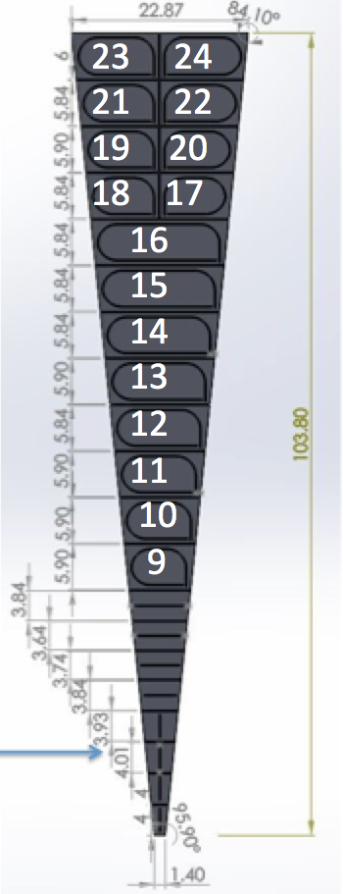
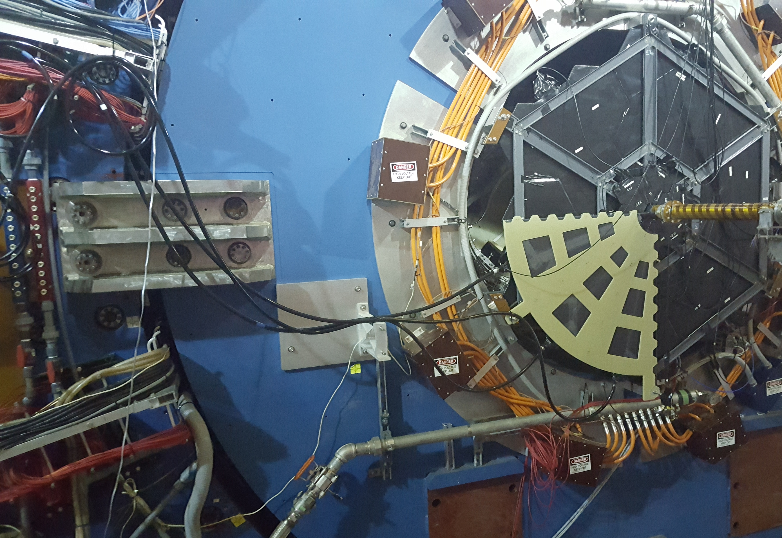
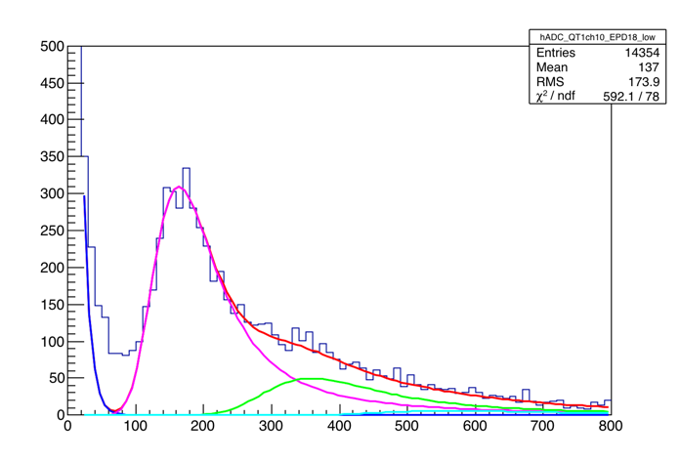
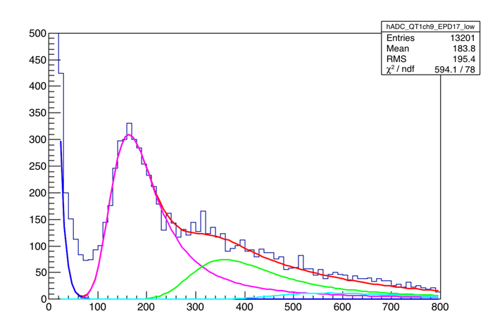
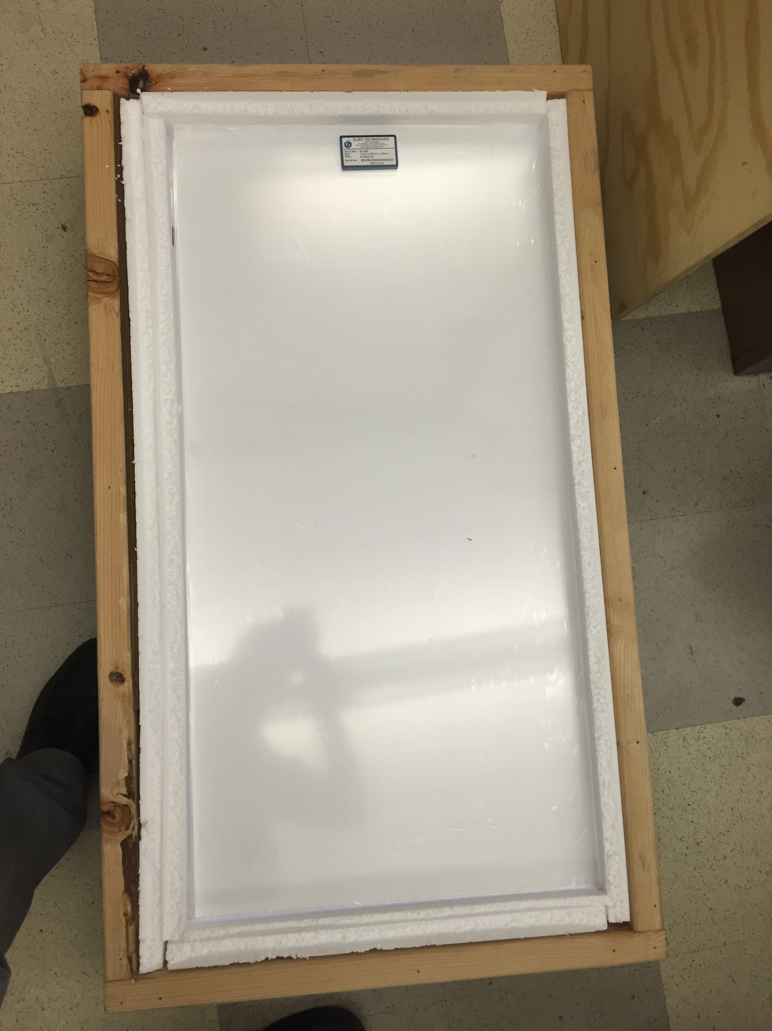
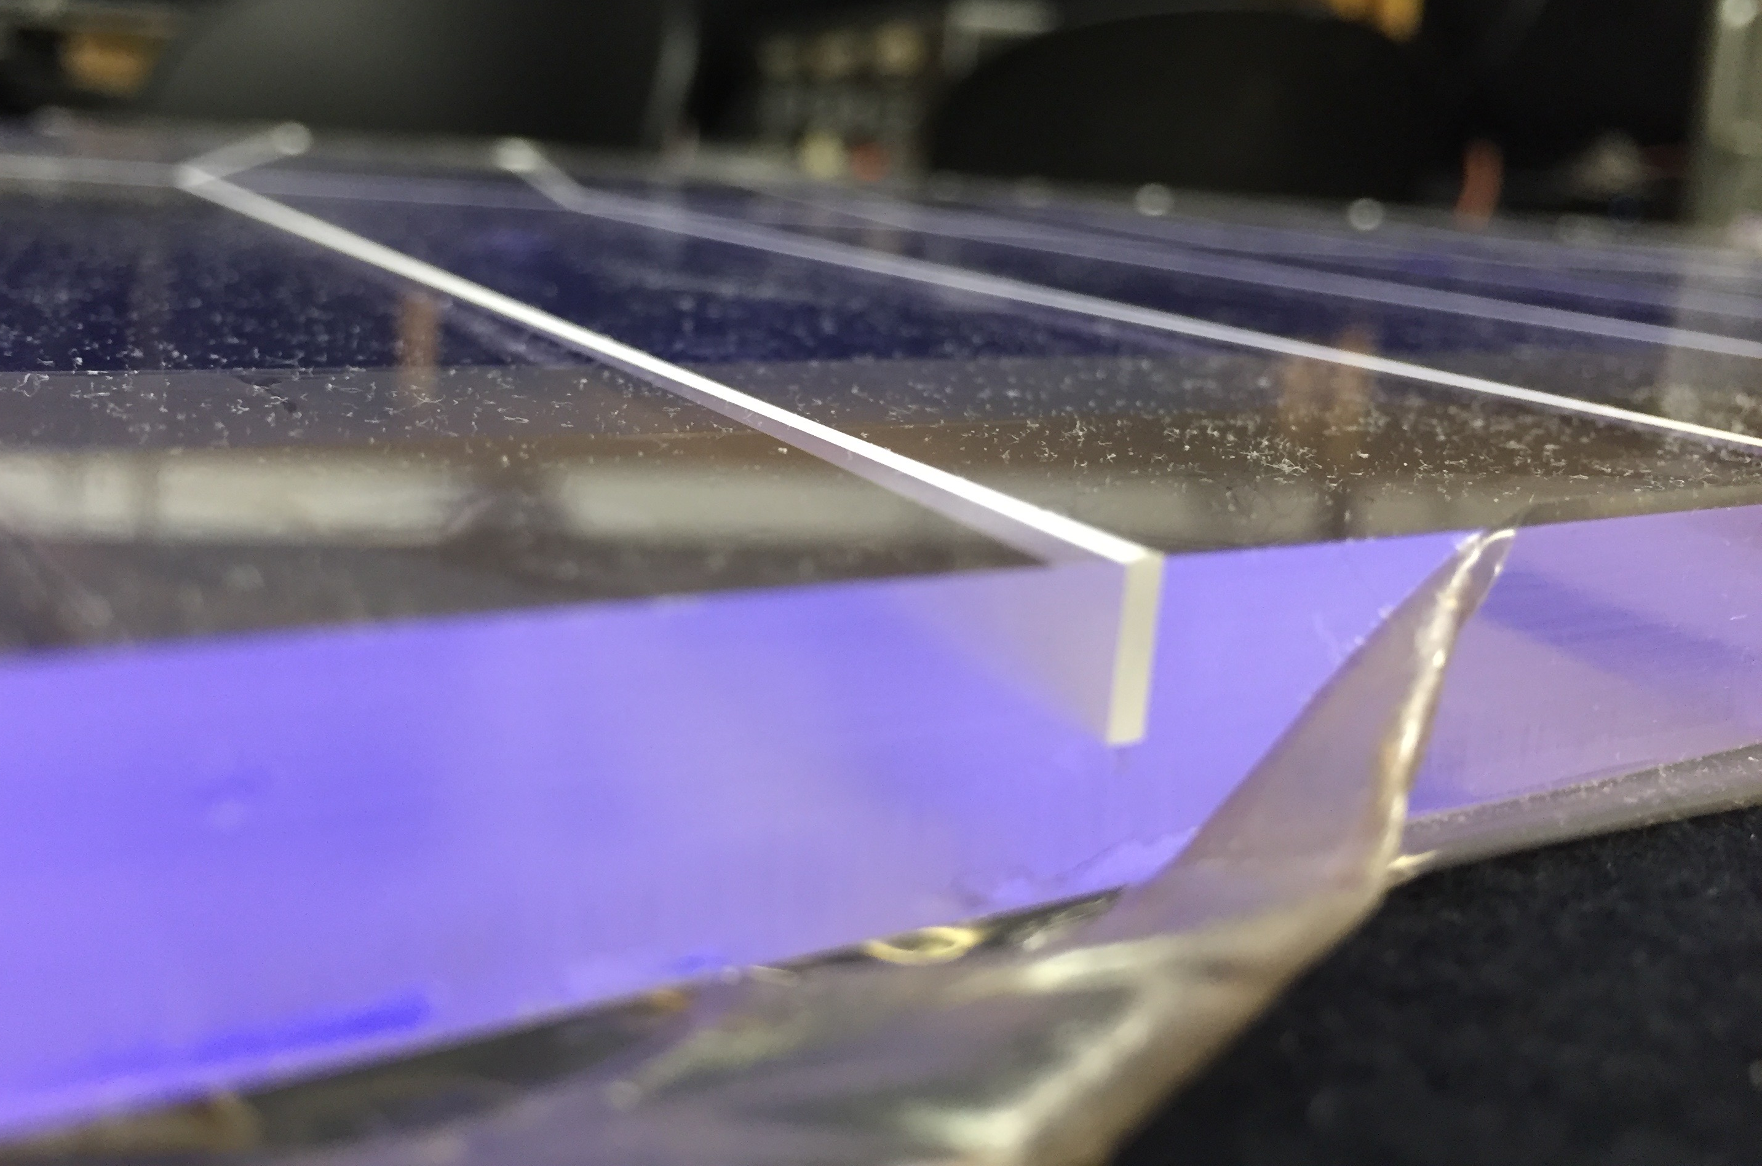
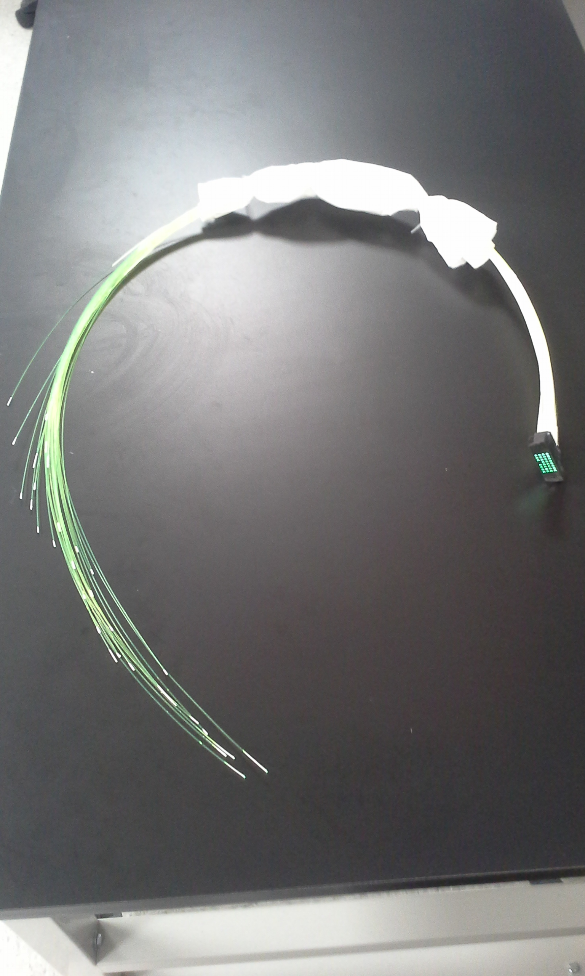
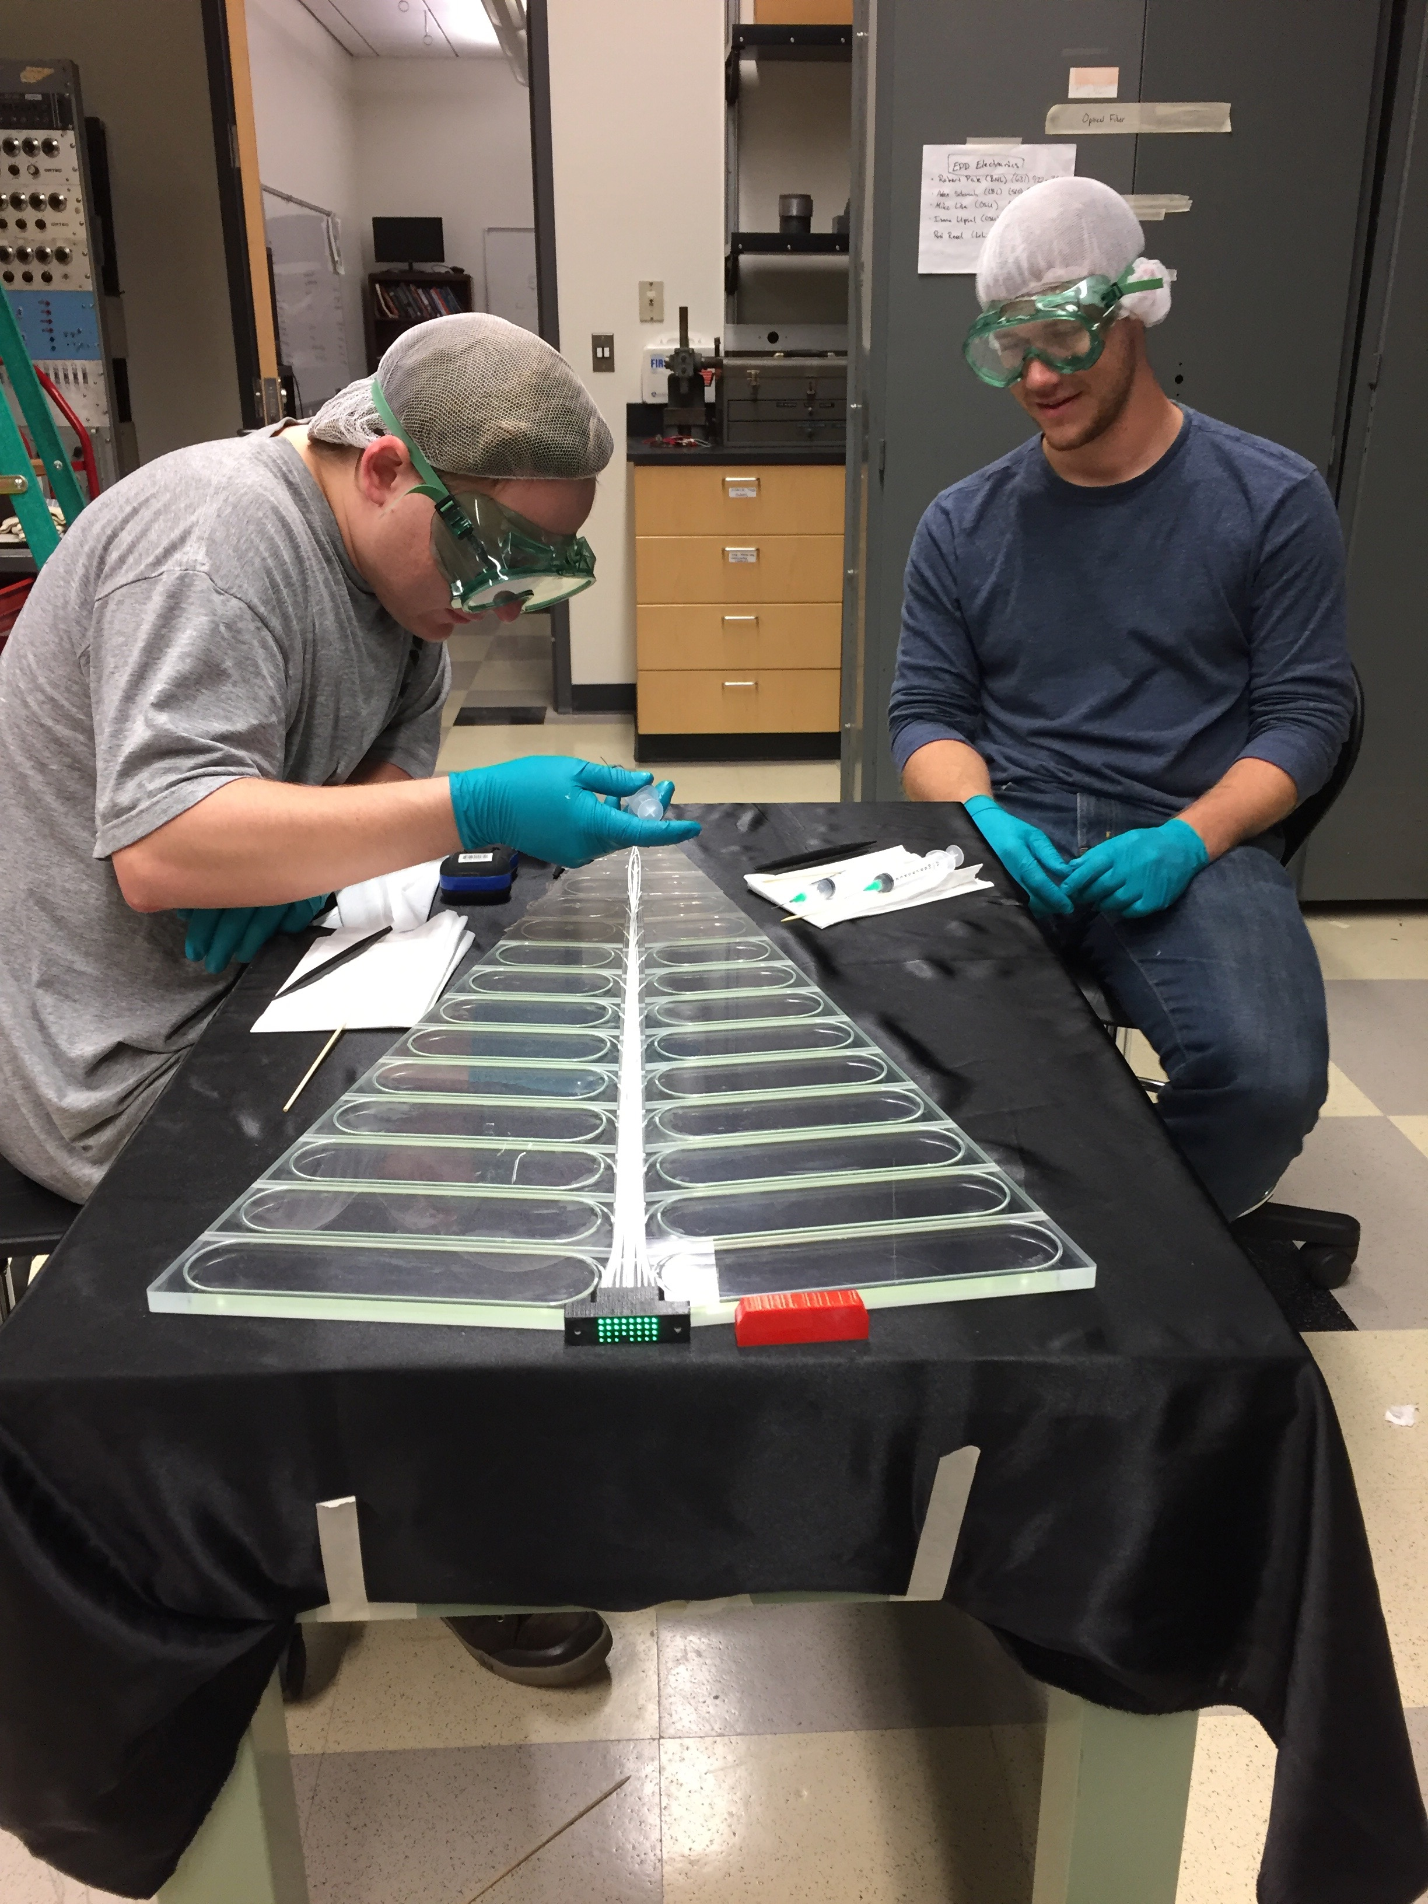
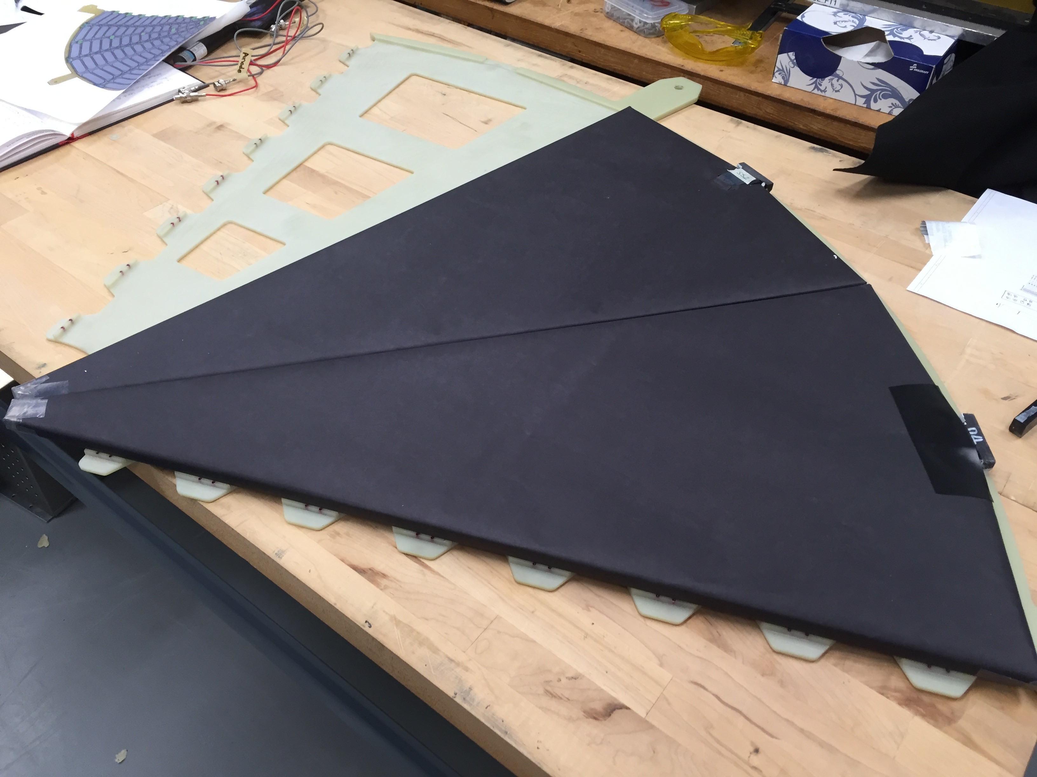
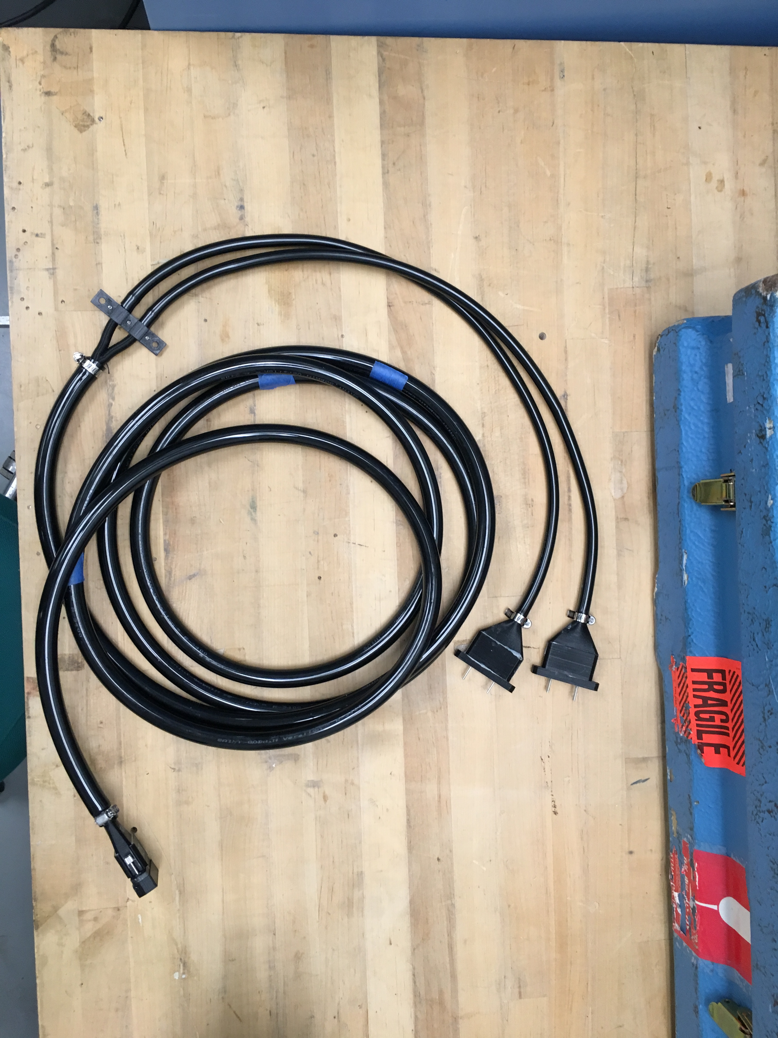
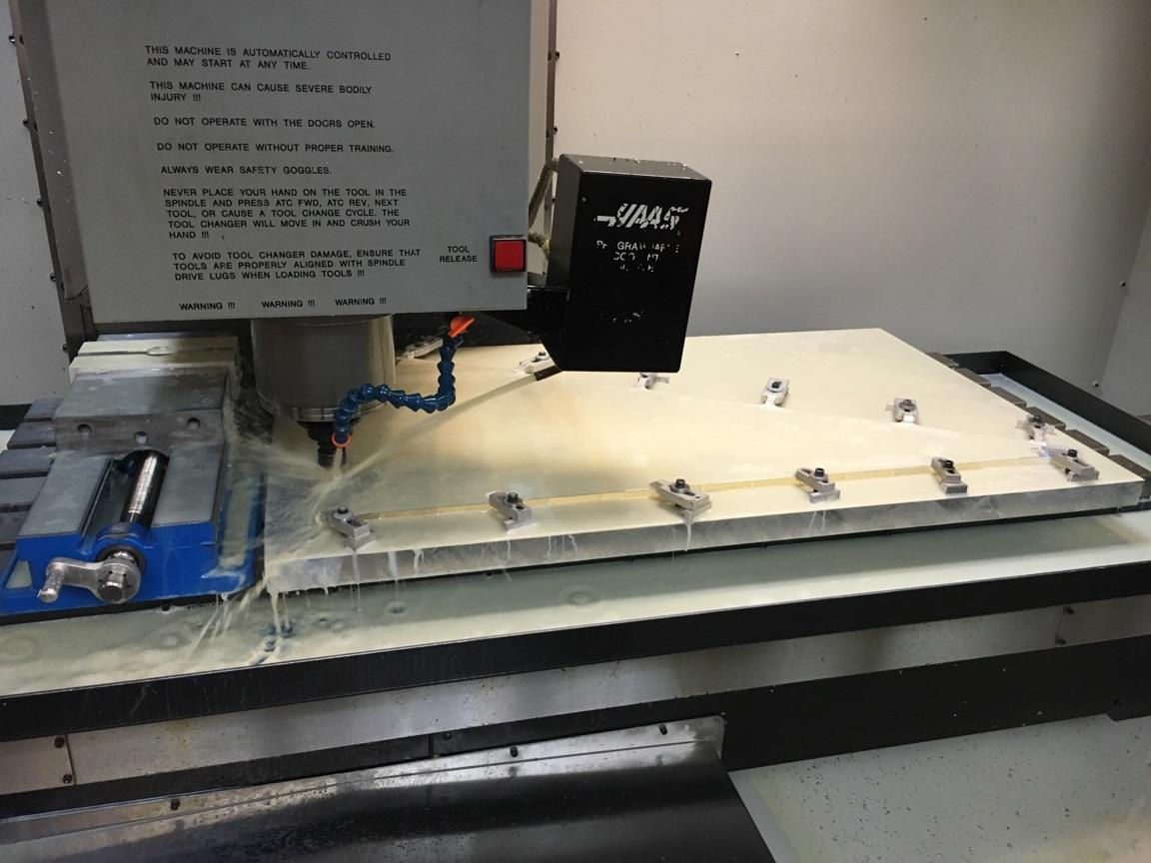
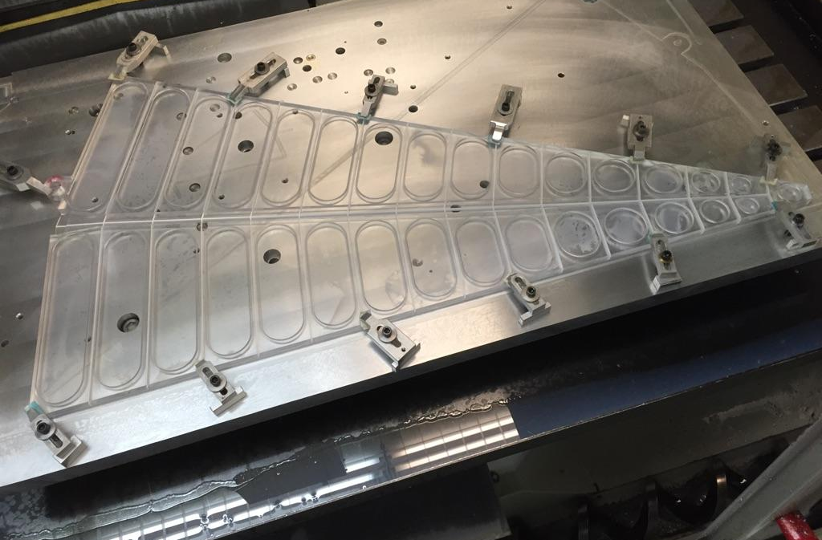
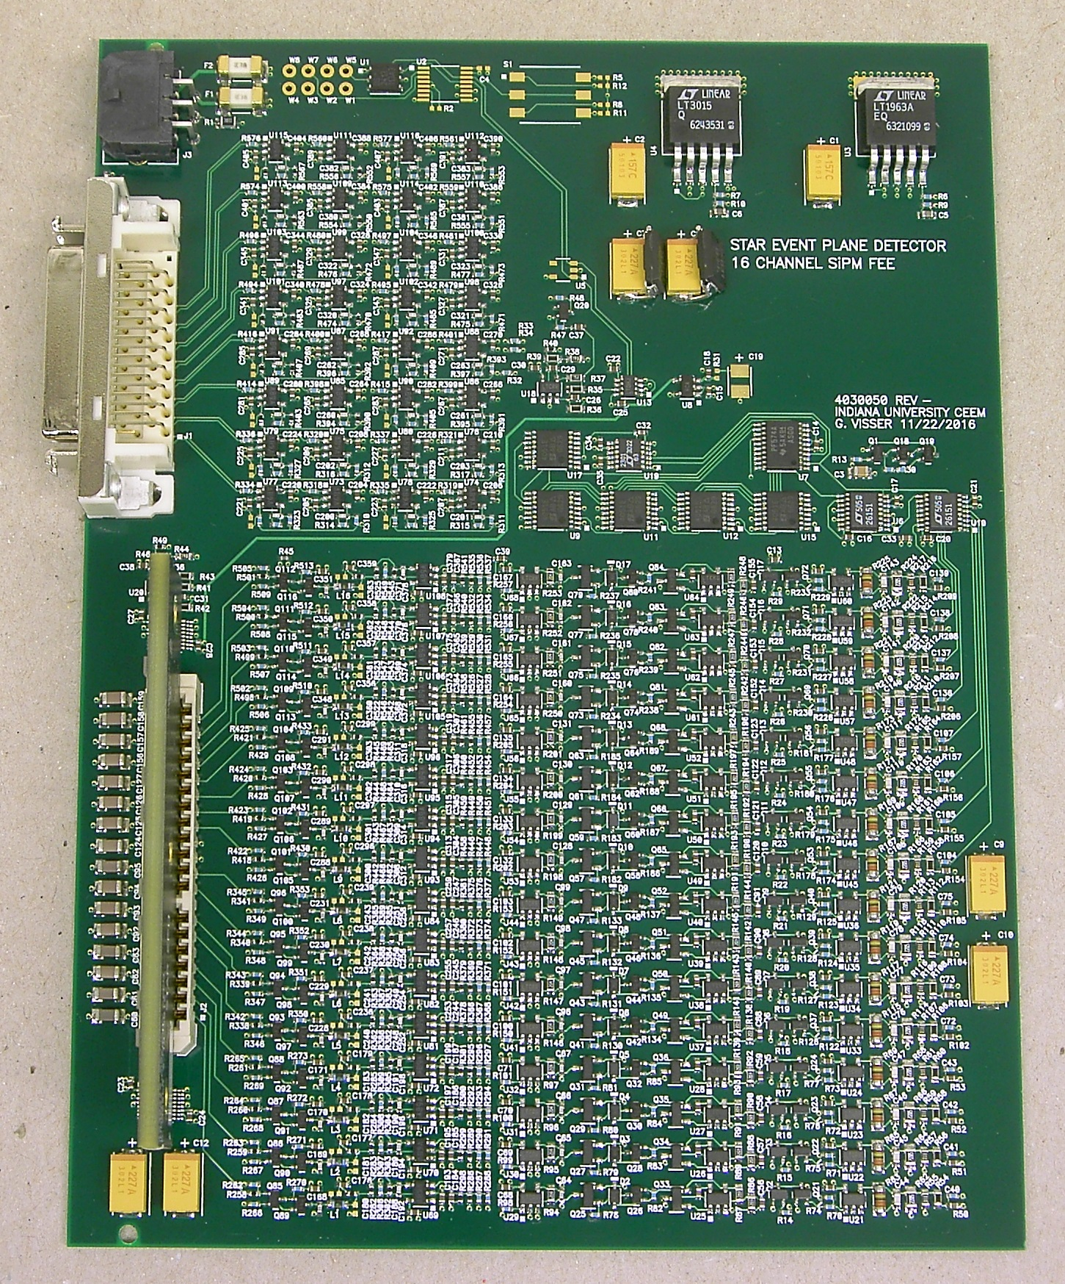
An Improved Event Plane Detector for the STAR Experiment
J. Ewigleben, for the STAR Collaboration
Abstract
The Beam Energy Scan (BES) program at the Relativistic Heavy-Ion Collider has shown hints of a critical point and first order phase transition at the BES energies. Key measurements for locating the critical point and determining the first order phase transition are limited by poor event plane resolution, limited statistics and a TPC-only centrality determination. Therefore, phase II of the BES program was proposed to take data with upgraded detectors and increased statistics for the further investigation. A new event plane and collision centrality detector (EPD) is planned to replace the existing detector, the Beam-Beam Counter (BBC), with higher granularity and acceptance. The design of the EPD consists of two scintillator discs at z= ± 3.75m from the center of STAR, covering 2.2 < η < 5.1, the same as the BBC. The detector will be read out by silicon photomultipliers (SiPM) - an inexpensive and magnetic field insensitive replacement for the traditional phototube. A prototype of the detector, consisting of a single sector was integrated into STAR during the 2016 run, the results of which will be shown. The geometry and segmentation of the design optimizes event-plane resolution, centrality determination and flow harmonic measurements. We will discuss the plans to install one quarter of a disc into STAR for the 2017 run.
EPD Specifications
The EPD is a replacement for the existing BBC detector at STAR.
Comprised of 2 wheels of 12 supersectors each.
Each supersector is made up of 31 optically
isolated channels, for a total of 744 channels,
compared to the BBCs 72 channels total.
Each channel is embedded with wavelength
shifting (WLS) optical fiber wound 3 times within
the tile. This is coupled to clear optical fiber which
is then coupled to SiPMs and finally read out by
STAR FEEs/QTs.
Each wheel has a diameter of 1.8 meters, and
will be placed at z= ± 3.75m inside the pole tip.
Prototype Build and Results
A prototype of an EPD supersector was placed in front of the BBC and tested during RHIC operations at STAR in 2016.
The purpose of the prototype was to test the ability of the EPD to act as a trigger for STAR, dimensions of channels and embedded WLS fiber, and the reliability of materials used.
The tile and embedded fiber design differed from the final design, with the goal being to test many different designs under run conditions at once.
An average of around 50 photons per minimum ionizing particle (MIP) was observed, with similarly sized tiles having similar average photon counts.
Plots show clear 1 and 2 MIP bumps, with tiles closer to the beam pipe showing more multi-MIP events, which is as expected.
As a Trigger and Detector for BES-II
The EPD will be a key upgrade for measurements related to BES-II, removing
the TPC dependent centrality determination and increasing event plane
determination.
Increased spatial and timing
resolution (~1ns) over BBC, as well as
slightly increased coverage in η.
Will serve as the trigger detector for
STAR.
One quarter wheel is in place for 2017
run, with the full 2 wheels to be finished
and installed at STAR for the 2018 run.
Timeline
Tile 18
Tile 17
1 MIP
1 MIP
2 MIPs
2 MIPs
c
Construction
1
3
4
5
6
2
Scintillator plastic comes as rectangular tiles.
Each tile is machined into 2 separate supersectors.
Each tile is machined halfway through, the cuts are filled with a reflective epoxy, flipped over and machined the rest of the way, then again filled with reflective epoxy. This optically isolates each channel.
In parallel, the WLS embedded fiber and clear fiber 3D printed connectors are assembled, with the clear fiber routed through rubber tubing and the WLS fiber partially painted with reflective paint to reduce cross-talk.
The fibers are routed in the channels around the tiles 3 times, and then the channels are filled with an optical grade epoxy.
The supersectors are wrapped first in Tyvek, and then in 2 layers of black paper. The mounting frame is broken up into quadrants, with 3 supersectors held in each quadrant. The SiPM cards and FEEs are prepared separately.
1
2
3
4
5
6
The STAR Collaboration
drupal.star.bnl.gov/STAR/presentations

