Slide 1


Jet Reconstruction in Heavy Ion Collisions
Alán Dávila for the STAR Collaboration
WWND February, 8, 2011

Slide 2
Outline
Heavy ion collisions’ prior probes
Jet finding algorithms used at STAR
STAR preliminary jet measurements in central Au+Au collisions
Recent background fluctuations studies
Conclusions

Slide 3
Correlations
Per final state charged hadron 2D particle correlations
Same side model includes a 2D Gaussian
Un-triggered correlations see broadening but only in direction.
Glauber Linear Superposition
The width increases with centrality
The decreases…
Peak
Amplitude
Peak η
Width
Peak φ Width
3
Notes:
Note, centrality -> transverse particle density for the 60 and 100 GeV plots to scale.
The 0,0 bin is suppressed to mask out the electron pairs (understood, not important correlation)

Slide 4
High Pt probes
Parton kinematics are not directly measureable
Use high PT particles as an approximation of the parton kinematics
4
Notes:
The transient character of the medium created in HI collisions (~few fm/c) pushes physicists to look for probes created in the collisions themselves.
Suppression established at: J. Adams et al. (STAR), Phys. Rev. Lett. 97, 162301
(2006), nucl-ex/0604018
Plot: Horizontal bars are systematic, others area statistical. Leftmost points are d+Au, 8 < Pt_trigger < 15 GeV/c. d+Au and Au+Au at 200 GeV sqrt(s_NN)
Enhancement establised at: J. Adams et al. (STAR), Phys. Rev. Lett. 95, 152301
(2005), nucl-ex/0501016
*Hard scattered partons (high Q^2) can serve the purpose of probes. Since experiments cannot directly measure partons, high Pt particles are used as an approximation for the parton Pt.
*Using these probes STAR has established :
-Suppression of high Pt yield for particles opposite in azimuth from a triggered high Pt particle
-Enhancement of low Pt multiplicity and Pt sum for particles in the away side.
*These observations could be explained by a softening of the jet fragments if the parton is interacting with the dense medium
Plot: Away side is |deltaphi|>1.0, |deltaEta|<1.0, Nch, and Pt are the values obtained by integrating the per trigger distribution on that (for away) region of deltaphi, deltaEta. Both pp and AuAu collisions are at 200 GeV sqrt(s_NN). 0.15 < Pt < 4 GeV/c

Slide 5
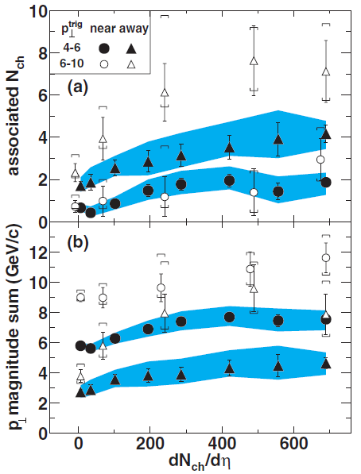
High Pt probes
Parton kinematics are not directly measureable
Use high PT particles as an approximation of the parton kinematics
Recoil low PT multiplicity and PT sum enhancement
0.15 GeV/c < < 4GeV/c
Au+Au
pp
J. Adams et al. (STAR), Phys. Rev. Lett. 95, 152301 (2005)
4
Notes:
The transient character of the medium created in HI collisions (~few fm/c) pushes physicists to look for probes created in the collisions themselves.
Suppression established at: J. Adams et al. (STAR), Phys. Rev. Lett. 97, 162301
(2006), nucl-ex/0604018
Plot: Horizontal bars are systematic, others area statistical. Leftmost points are d+Au, 8 < Pt_trigger < 15 GeV/c. d+Au and Au+Au at 200 GeV sqrt(s_NN)
Enhancement establised at: J. Adams et al. (STAR), Phys. Rev. Lett. 95, 152301
(2005), nucl-ex/0501016
*Hard scattered partons (high Q^2) can serve the purpose of probes. Since experiments cannot directly measure partons, high Pt particles are used as an approximation for the parton Pt.
*Using these probes STAR has established :
-Suppression of high Pt yield for particles opposite in azimuth from a triggered high Pt particle
-Enhancement of low Pt multiplicity and Pt sum for particles in the away side.
*These observations could be explained by a softening of the jet fragments if the parton is interacting with the dense medium
Plot: Away side is |deltaphi|>1.0, |deltaEta|<1.0, Nch, and Pt are the values obtained by integrating the per trigger distribution on that (for away) region of deltaphi, deltaEta. Both pp and AuAu collisions are at 200 GeV sqrt(s_NN). 0.15 < Pt < 4 GeV/c

Slide 6
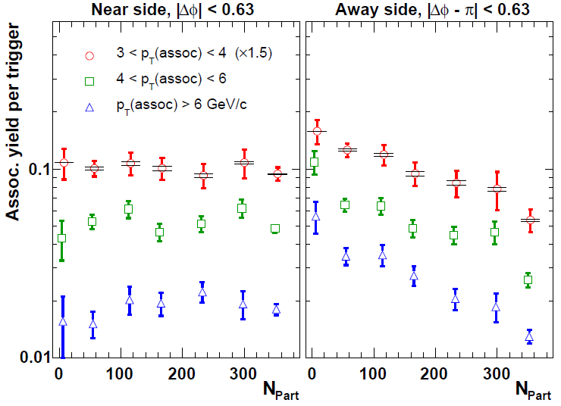
High Pt probes
Parton kinematics are not directly measureable
Use high PT particles as an approximation of the parton kinematics
Recoil low PT multiplicity and PT sum enhancement
J. Adams et al. (STAR), Phys. Rev. Lett. 97, 162301 (2006)
0.15 GeV/c < < 4GeV/c
Au+Au
dAu
pp
Recoil high PT yield suppression
Possible explanation: softening of jet fragments
J. Adams et al. (STAR), Phys. Rev. Lett. 95, 152301 (2005)
4
Notes:
The transient character of the medium created in HI collisions (~few fm/c) pushes physicists to look for probes created in the collisions themselves.
Suppression established at: J. Adams et al. (STAR), Phys. Rev. Lett. 97, 162301
(2006), nucl-ex/0604018
Plot: Horizontal bars are systematic, others area statistical. Leftmost points are d+Au, 8 < Pt_trigger < 15 GeV/c. d+Au and Au+Au at 200 GeV sqrt(s_NN)
Enhancement establised at: J. Adams et al. (STAR), Phys. Rev. Lett. 95, 152301
(2005), nucl-ex/0501016
*Hard scattered partons (high Q^2) can serve the purpose of probes. Since experiments cannot directly measure partons, high Pt particles are used as an approximation for the parton Pt.
*Using these probes STAR has established :
-Suppression of high Pt yield for particles opposite in azimuth from a triggered high Pt particle
-Enhancement of low Pt multiplicity and Pt sum for particles in the away side.
*These observations could be explained by a softening of the jet fragments if the parton is interacting with the dense medium
Plot: Away side is |deltaphi|>1.0, |deltaEta|<1.0, Nch, and Pt are the values obtained by integrating the per trigger distribution on that (for away) region of deltaphi, deltaEta. Both pp and AuAu collisions are at 200 GeV sqrt(s_NN). 0.15 < Pt < 4 GeV/c

Slide 7
Alternative probes of Heavy Ion collisions
A) Triggering in high PT hadrons produces a surface bias (hadrons coming from partons that interact least with the medium)
Hadron
Quark
Gluon
Gamma
Jet
A
5
Notes:
More generic in the sense that we can tag b jets for ex.

Slide 8
Alternative probes of Heavy Ion collisions
A) Triggering in high PT hadrons produces a surface bias (hadrons coming from partons that interact least with the medium)
B) Gamma- jets do not suffer such bias as the photon gets the original parton kinematics but they suffer of limited statistics.
Hadron
Quark
Gluon
Gamma
Jet
A
B
5
Notes:
More generic in the sense that we can tag b jets for ex.

Slide 9
Alternative probes of Heavy Ion collisions
A) Triggering in high PT hadrons produces a surface bias (hadrons coming from partons that interact least with the medium)
B) Gamma- jets do not suffer such bias as the photon gets the original parton kinematics but they suffer of limited statistics.
C) A more generic way to probe the medium is to try to recover the original parton kinematics by full jet reconstruction.
Hadron
Quark
Gluon
Gamma
Jet
A
B
C
5
Notes:
More generic in the sense that we can tag b jets for ex.

Slide 10
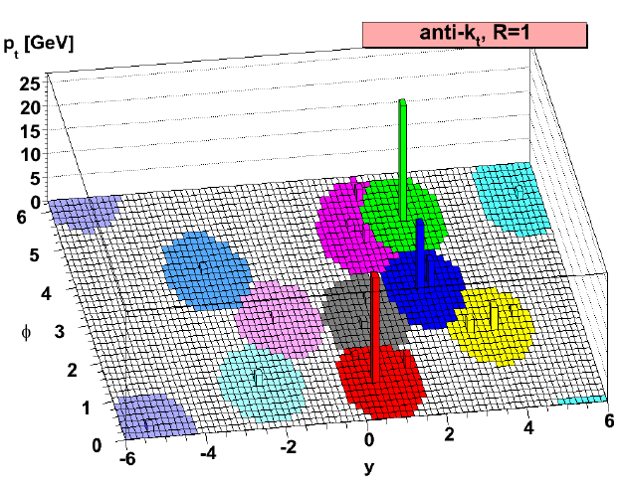
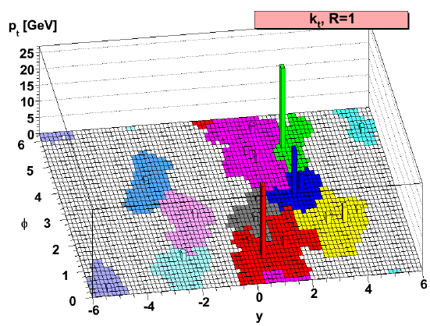
Jet Finding Algorithms
kt and anti-kt: sequential recombination algorithms
Give a jet area measure (important for Au+Au background estimations)
collinear and infrared safe
NlnN time ( secs for ~ 1000 particles)
STAR: kt , anti-kt from FASTJET package
JHEP 0804 (2008) 063
6
Notes:
There are several Jet Finding algorithms found in the literature: Cone algorithms, Sequential recombination, Gaussian filtering
A completely defined Jet Finding Algorithm consist on a clustering algorithm and the parameters of it and recombination scheme
The kt and anti-kt sequential recombination algorithms included in the FASJET package are used at STAR to reconstruct jets in Au+Au collisions
Gavin Salam: arXiv:0801.0070v1 [hep-ph]
Yue Shi: ….
Time Phys. Lett. B 641 (2006) 57 [hep-ph/0512210]
Picture from : JHEP 0804 (2008) 063 [arXiv:0802.1189]

Slide 11
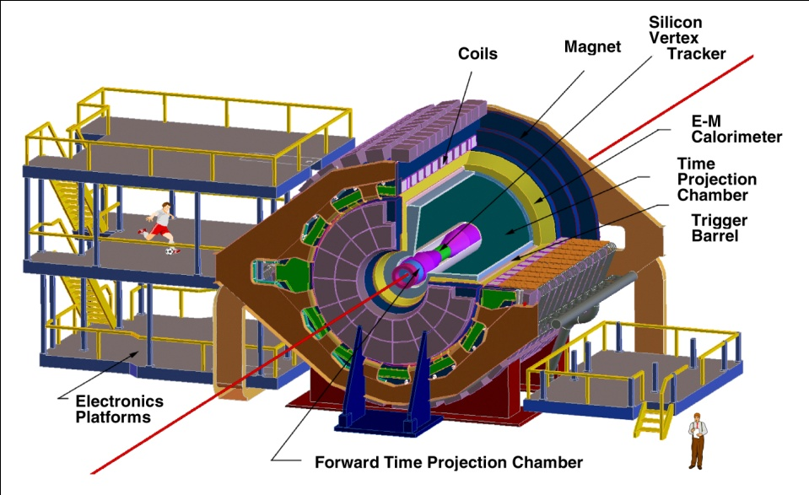
Jet reconstruction at STAR
Charged particles from the TPC (protons, pions, kaons, e, …)
Neutral particles from EMCAL ( , gamma)
No , neutrons, detected (<10% effect)
Note: not at scale
Triggers used
:
Jet Patch (P+P)
High Tower
Towers’ matched tracks are subtracted to avoid double counting
TPC
BEMC
We apply a PT cut of 0.2 GeV/c
In track and towers
: (-1.2,1.2)
7
Notes:
B field or 0.5 Tesla, 4800 EMCAL towers, TPC tracking efficiency ~80%,central AuAu (Pt>2.0). Minimum Pt for this configuration ~150 MeV/c (120?)
Pt track resolution = 0.0045pt + 0.0052 (AuAu)
BEMC calibration uncertainty ~5%

Slide 12
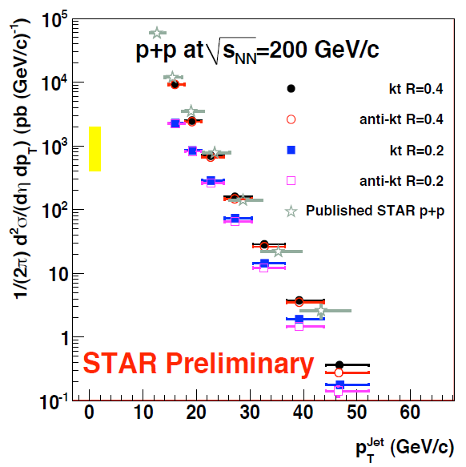
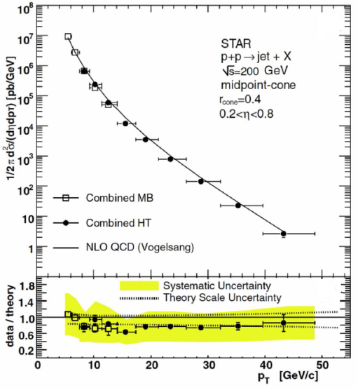
Jets in pp collisions
Jets produced at STAR are well described by pQCD over several orders of magnitude.
kt and anti-kt algorithms consistent with published STAR results with midpoint cone algorithm.
B. I. Abelev et al. (STAR Collaboration), Phys. Rev .Lett. 97, 252001 (2006)
8

Slide 13
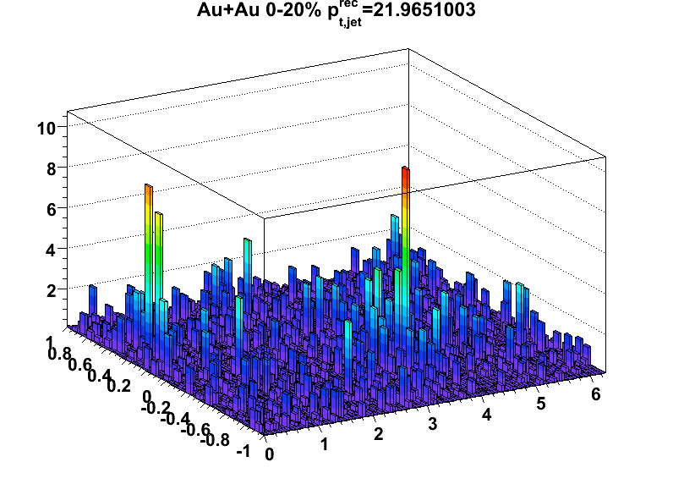
Going to Heavy Ions
200 GeV central Au+Au collisions: Underlying event interferes with the jet reconstruction. Per event background estimations and jet areas (FASTJET)are used to subtract the background at STAR.
Active area : number of clustered soft particles within a jet over density of particles
Event background:
Irresolution
Non-gaussian
Background in HI collision is not uniform.
9
Notes:
Area: JHEP 0804 (2008) 005 [arXiv:0802.1188]
The Active area of a jet is obtained by populating the event with a density of very soft particles and counting the number of particles clustered in a jet
Bkg fluctuations severely affect the steeply falling spectra o jets

Slide 14
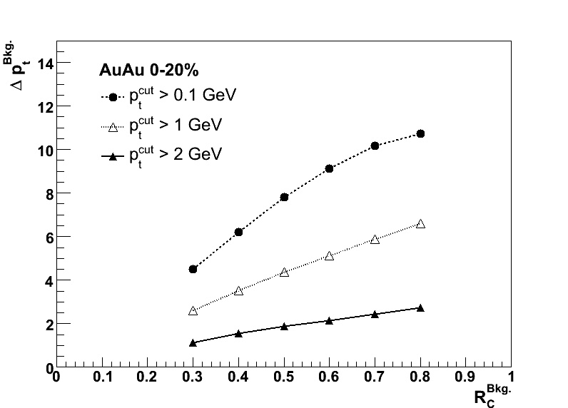
Going to Heavy Ions
200 GeV central Au+Au collisions: Underlying event interferes with the jet reconstruction. Per event background estimations and jet areas (FASTJET)are used to subtract the background at STAR.
Active area : number of clustered soft particles within a jet over density of particles
Event background:
Irresolution
Non-gaussian
Background in HI collision is not uniform.
First look: Background fluctuations assuming Gaussian distribution (Incorrect assumption)
9
Notes:
Area: JHEP 0804 (2008) 005 [arXiv:0802.1188]
The Active area of a jet is obtained by populating the event with a density of very soft particles and counting the number of particles clustered in a jet
Bkg fluctuations severely affect the steeply falling spectra o jets

Slide 15
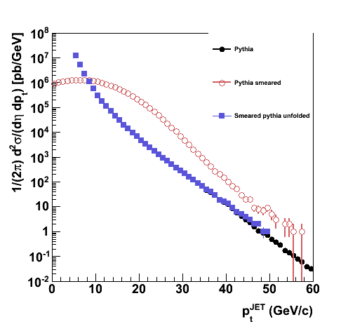
Jet Spectrum in AuAu collisions at RHIC
background corrected jet PT:
Pythia
Event region to region fluctuations
Pythia smeared
The measured yield is convoluted with the irresolution function f:
Pythia unfolded
unfolding
simulation
To obtain the real distribution requires deconvolution (unfolding).
10
Notes:
Systematic uncertainty bands come from UE fluctuations
Note: for QM09 gaussian was used, we now know this is not appropiate, therefore the studies on slide on Bkg fluctuations
Nuclear Physics A 830 (2009) 255c–258c

Slide 16
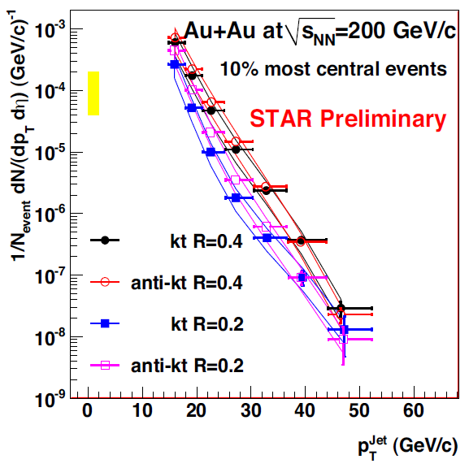
Jet Spectrum in AuAu collisions at RHIC
Full reconstructed jets yield at central AuAu collisions at STAR
False jet yield estimated with Au+Au events randomized in azimuth (no jet-leading particles present)
Background fluctuations approximated by Gaussian
New progress on these points in succeeding slides
kt and anti-kt give similar results.
Smaller resolution -> smaller yield
Increased kinematics wrt single/di-hadron measurements!
11
Notes:
Systematic uncertainty bands come from UE fluctuations
Note: for QM09 gaussian was used, we now know this is not appropiate, therefore the studies on slide on Bkg fluctuations
Nuclear Physics A 830 (2009) 255c–258c

Slide 17
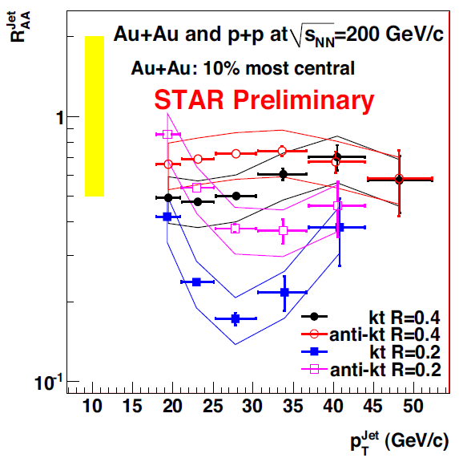
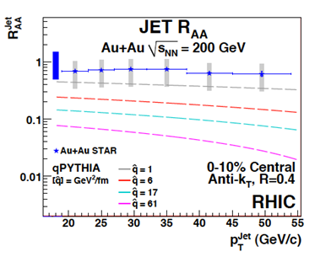
RAA
For Nbin scaling, RAA = 1.
RAA value is consistent with one for R = 0.4, but smaller for R = 0.2.
The jet spectrum is not completely recovered.
Note: RAA -> 0.2
in the limit R -> 0.0
(single hadrons)
12
Notes:
Jets come from hard scatterings and should scale with Nbin (at the Pt range shown)
qPythia predicts more suppression than observed
qPythia with vacum setting reproduced jets and pi0 cross section in pp . RAA for pion0 does not do so well at small <3 GeV/c or big pt >10 GeV/c
I. Vitev et al. arXiv:0910.1090v1 [hep--‐ph]

Slide 18
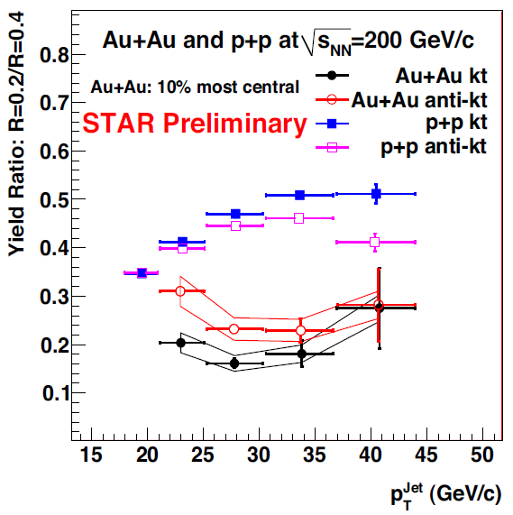
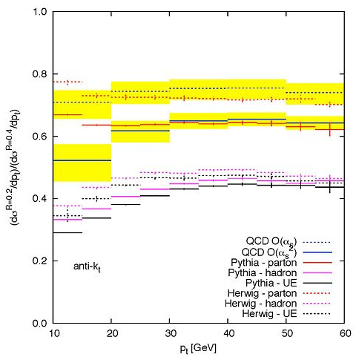
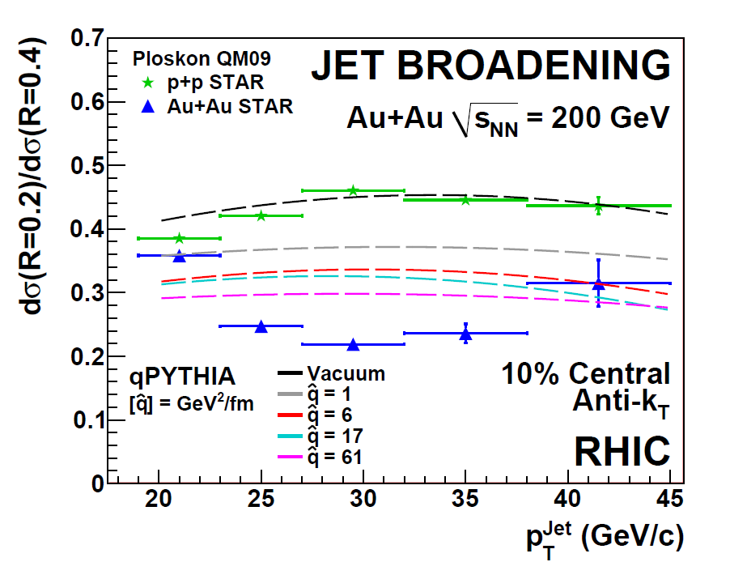
R(0.2)/R(0.4)
G. Soyez, Private Communication
p+p
√s=200 GeV
Increasing jet PT increases the ratio. Jets get more collimated in pp
Ratio of R = 0.4/R = 0.2 shows an increased suppression in AuAu compared to pp. This is suggestive of a broadening of jets in AuAu collisions.
13
Notes:
Higher order corrections and hadronization seem to be the reason of broadening in pp (G Soyez, private communication , Mateusz)
qPythia predicts less broadening than observed

Slide 19
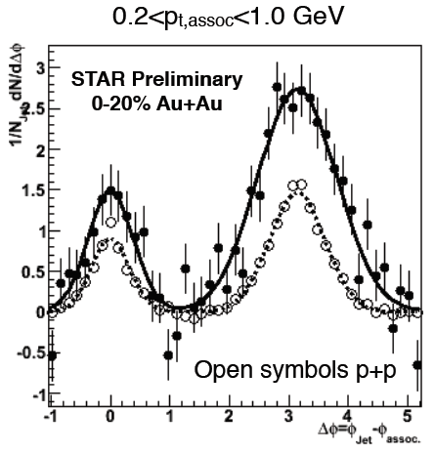
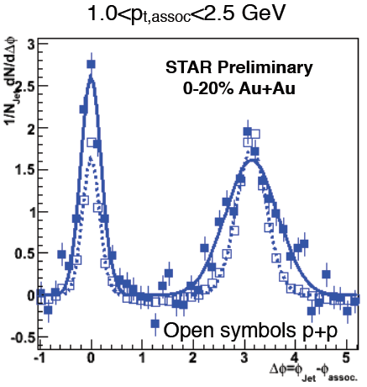
Jet-hadron correlations
AuAu Jet-hadron correlations show broadening on the away side.
HT trigger jet axis
Anti-kt
R = 0.4
PT Jet trigger> 20 GeV/c
PT cut > 2 GeV/c
For more on Jet-hadron correlations see A. Ohlson’s talk next
14
Notes:
Lower left: Dijet coincidence rate is also suppressed in AuAu collisions. Can it be explained by broadening? ->
Lower right: R = 0.2 / R = 0.4 ratio is also suppressed.
arXiv:1010.3184v1 [nucl-ex]

Slide 20
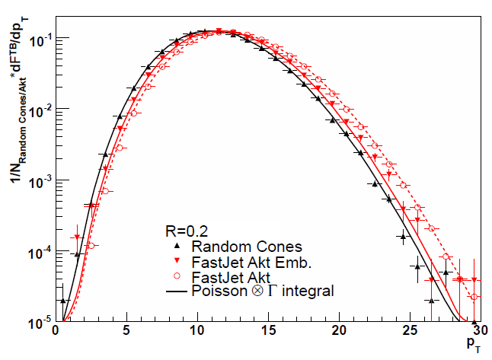
New progress on background Fluctuations
Toy model
Thermal distribution (no signal)
Random in ,
The statistical distributions describe fluctuations as expected
Clustered in a cone of R = 0.2
15
Notes:
The gamma function comes from a model of several independent emission sources, (fit gives 370).
The deltaPt dist gives the prob that a jet gets an extra contribution to its background corrected Pt due to backg fluctuations equal to deltaPt
Note, the outliers in fragmentation pattern plot come from 2 (out of 30) qPythia jets
arXiv:1012.2406v2 [nucl-ex]
In random cones the embed particle refers to 10 GeV Pt,
Joern Putschke Note

Slide 21
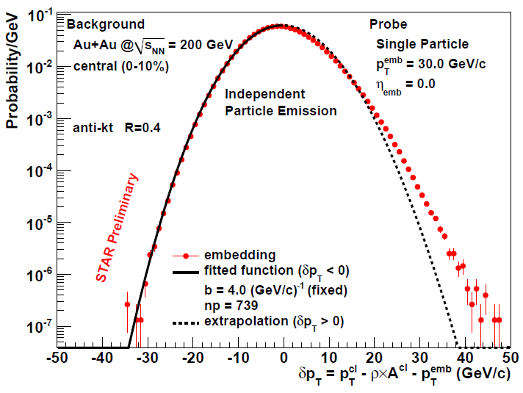
New progress on background Fluctuations
Generalized probe embedding
Embed a known probe in a AuAu central event
Reconstruct the jet that contains the probe in it
Calculate irresolution:
Toy model
Thermal distribution (no signal)
Random in ,
The statistical distributions describe fluctuations as expected
High Pt tails
fitted with a gamma function
Clustered in a cone of R = 0.2
15
Notes:
The gamma function comes from a model of several independent emission sources, (fit gives 370).
The deltaPt dist gives the prob that a jet gets an extra contribution to its background corrected Pt due to backg fluctuations equal to deltaPt
Note, the outliers in fragmentation pattern plot come from 2 (out of 30) qPythia jets
arXiv:1012.2406v2 [nucl-ex]
In random cones the embed particle refers to 10 GeV Pt,
Joern Putschke Note

Slide 22
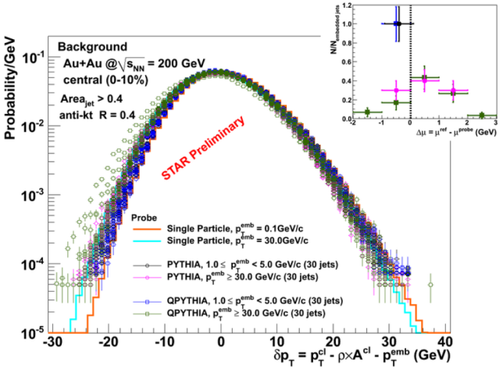
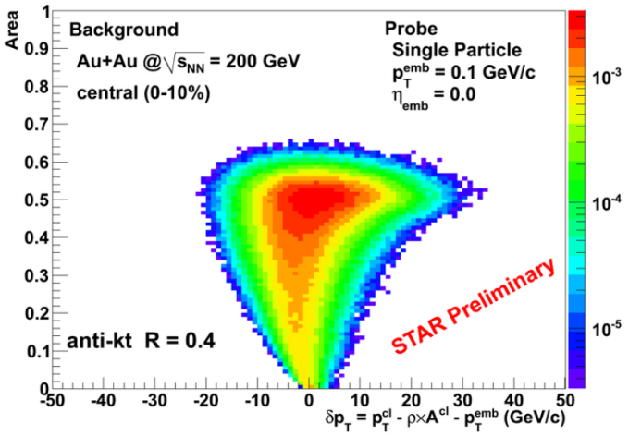
Background Fluctuations
does vary with jet area.
is independent of fragmentation pattern
Better understanding of background fluctuations
Irresolution independent on fragmentation pattern
16
Notes:
Probes with different fragmentation patterns are embedded to se how the JFA and background subtraction distorts (or not) the above defined irresolution

Slide 23
Jet Shapes background
Differential jet shape: Average rate of change of PT at distance r from the jet axis
Integrated Jet Shape
Differential Jet Shape
Single jet…
Average over many jets …
Jet Axis
R
r
17

Slide 24
Jet Shapes background
Differential jet shape: Average rate of change of PT at distance r from the jet axis
Integrated Jet Shape
Differential Jet Shape
Single jet…
Average over many jets …
Particles from the HI collision will contribute to PT(r), they will also move the jet axis: This effectively changes PT(r) too
Jet Axis
R
r
Blue jet particles
Red HI background
Not distinguishable in a jet by jet basis
17

Slide 25
Jet Shapes background
Differential jet shape: Average rate of change of PT at distance r from the jet axis
Integrated Jet Shape
Differential Jet Shape
Single jet…
Average over many jets …
Particles from the HI collision will contribute to PT(r), they will also move the jet axis: This effectively changes PT(r) too
Jet Axis
R
r
Background subtraction
Ring PT
Blue jet particles
Red HI background
Not distinguishable in a jet by jet basis
Jet PT
17

Slide 26
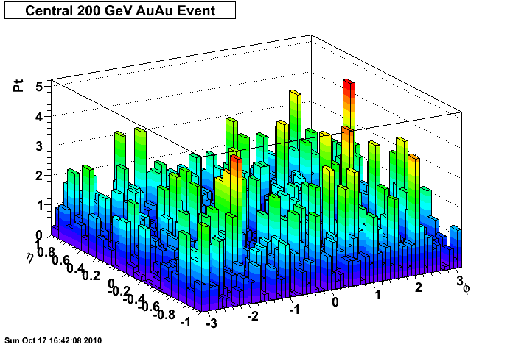
Jet Shapes background
Use generalized probe embedding to characterize the fluctuations
Charged Particles Only !
Embed Single 30 GeV/c pion in AuAu event
this represents our truth signal
Run JFA and extract jet with embedded pion
this is our measurement
Subtract background
Jet area in denominator
Ring area in numerator
Get the fluctuations in jet shape measurement
18

Slide 27
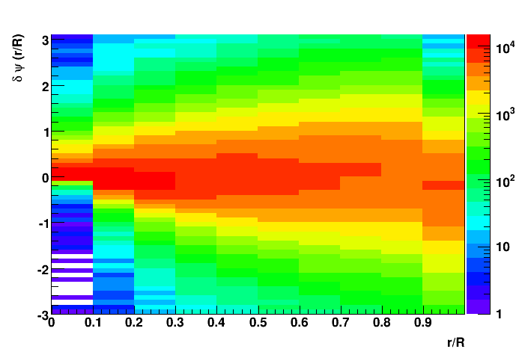
Jet Shapes background
Use generalized probe embedding to characterize the fluctuations
Charged Particles Only !
Single 30 GeV/c pions embedded
= 0.1
area | 0.08 | 0.15 | 0.23 | 0.30 | 0.38
Relative distance from jet axis
Fluctuations increase with increased ring area
19

Slide 28
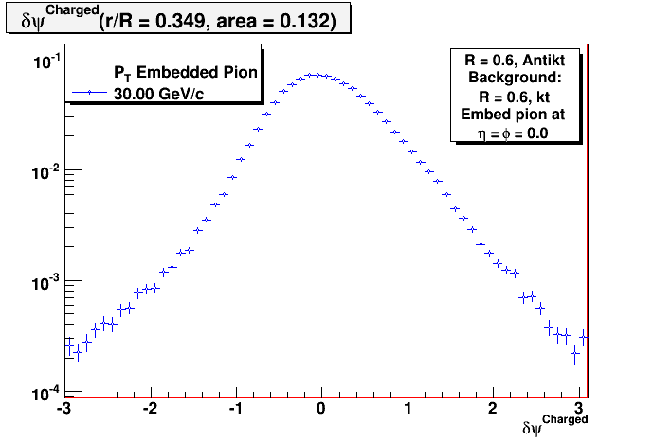
Jet Shapes background
Use generalized probe embedding to characterize the fluctuations
Charged Particles Only !
Single 30 GeV/c pions embedded
r/R = 0.349 projection
= 0.1
STAR Preliminary
area | 0.08 | 0.15 | 0.23 | 0.30 | 0.38
Relative distance from jet axis
Fluctuations increase with increased ring area
Truth signal
19

Slide 29
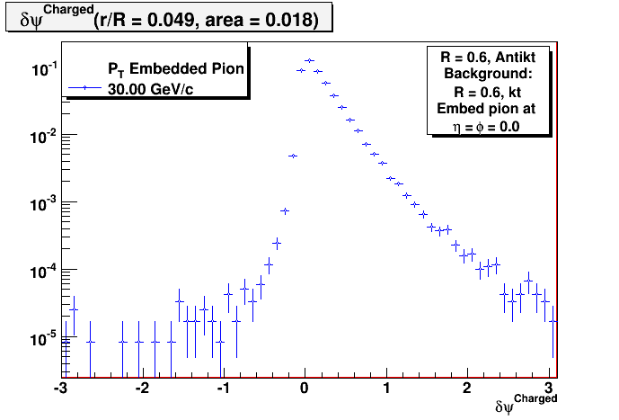
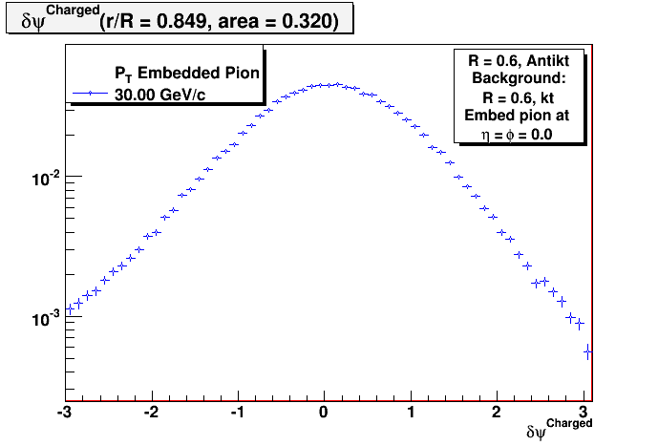
Jet Shapes background
Fluctuations of the jet shape measurement close to the axis (small area) and close to the edge (bigger area)
STAR Preliminary
STAR Preliminary
There is a clear dependence of the shape of the fluctuations on r. This is consistent with previous studies of fluctuations dependencies on jet area
20

Slide 30
Conclusions
Preliminary jet measurements at STAR indicate jet profile broadening in 10% most central Au+Au collisions.
The event region to region background fluctuations in central Au+Au events calculated by the generalized probe embedding are mostly independent of jet fragmentation pattern (single particle, quenched, unquenched).
On the verge of applying all this knowledge in intra jet measurements (jet shapes, JT, intra jet momentum flow)
Jets are a calibrated probe that can be used to expand current studies of the medium created in heavy ion collisions at RHIC

Slide 31
Backup
collinear and infrared safe
NlnN time ( secs for ~ 1000 particles)
STAR: kt , anti-kt from FASTJET package
In an event define and compute distances between particles and the beam
Find minimum of the distances, if it is set as jet, otherwise merge i,j.
Repeat
kt -> p = 1
anti-kt -> p = -1
At STAR
E-Scheme
Notes:
There are several Jet Finding algorithms found in the literature: Cone algorithms, Sequential recombination, Gaussian filtering
A completely defined Jet Finding Algorithm consist on a clustering algorithm and the parameters of it and recombination scheme
The kt and anti-kt sequential recombination algorithms included in the FASJET package are used at STAR to reconstruct jets in Au+Au collisions
Gavin Salam: arXiv:0801.0070v1 [hep-ph]
Yue Shi: ….
Time Phys. Lett. B 641 (2006) 57 [hep-ph/0512210]
Picture from : JHEP 0804 (2008) 063 [arXiv:0802.1189]

Slide 32
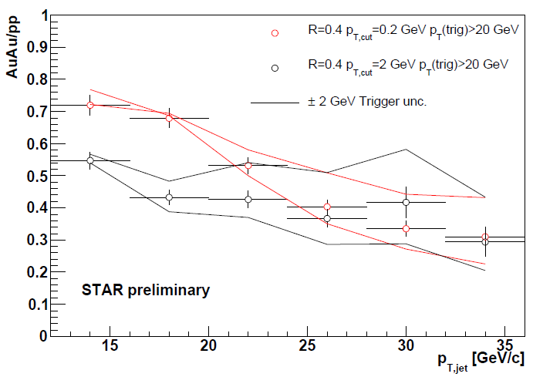
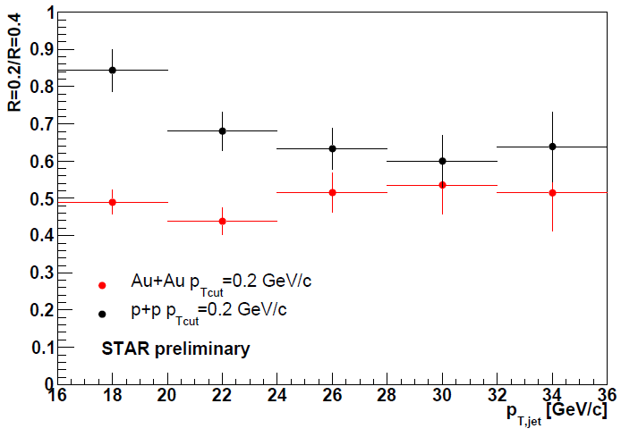
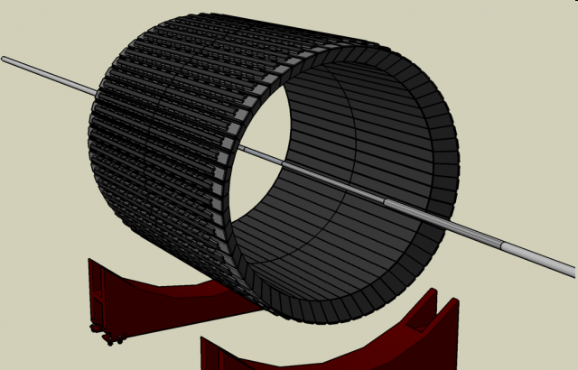
Di jet yields comparison
Di-jet rates Au+Au/ p+p
Trigger Jet Pt> 20 GeV/c
Di –jet: trigger jet + recoil jet
Deposition of Energy fires High Tower trigger
PT cut of 0.2, 2.0 GeV/c on tracks/towers for the recoil jets
PT cut of 2.0 GeV/c for the trigger jets
Bkg estimated from spectrum at azimuth wrt dijet axis
R = 0.2/R = 0.4 ratio shows higher suppression than in the pp system.
Measurements agree with the jet broadening scenario
Recoil Jet
Notes:
Lower left: Dijet coincidence rate is also suppressed in AuAu collisions. Can it be explained by broadening? ->
Lower right: R = 0.2 / R = 0.4 ratio is also suppressed.
arXiv:1010.3184v1 [nucl-ex]

