Slide 1



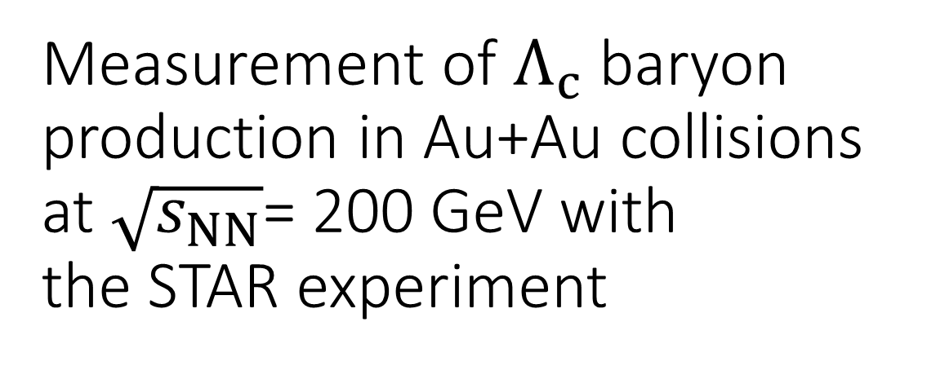
Measurement of $Λ_{c}$baryon production in Au+Au collisions at $\sqrt{s_{NN}}$= 200 GeV with the STAR experiment
Miroslav Šimko
for the STAR Collaboration
Nuclear Physics Institute
of the Czech Academy of Sciences

Slide 2
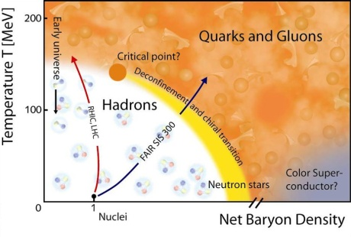
Quark-gluon Plasma (QGP)
Phase diagram of strongly interacting matter
New state of matter composed of deconfined quarks and gluons
Expected to exist in neutron stars and in the early Universe
More on QGP in the talk on Wednesday at 10:00 am by Jana Bielčíková

Slide 3



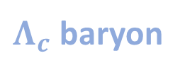
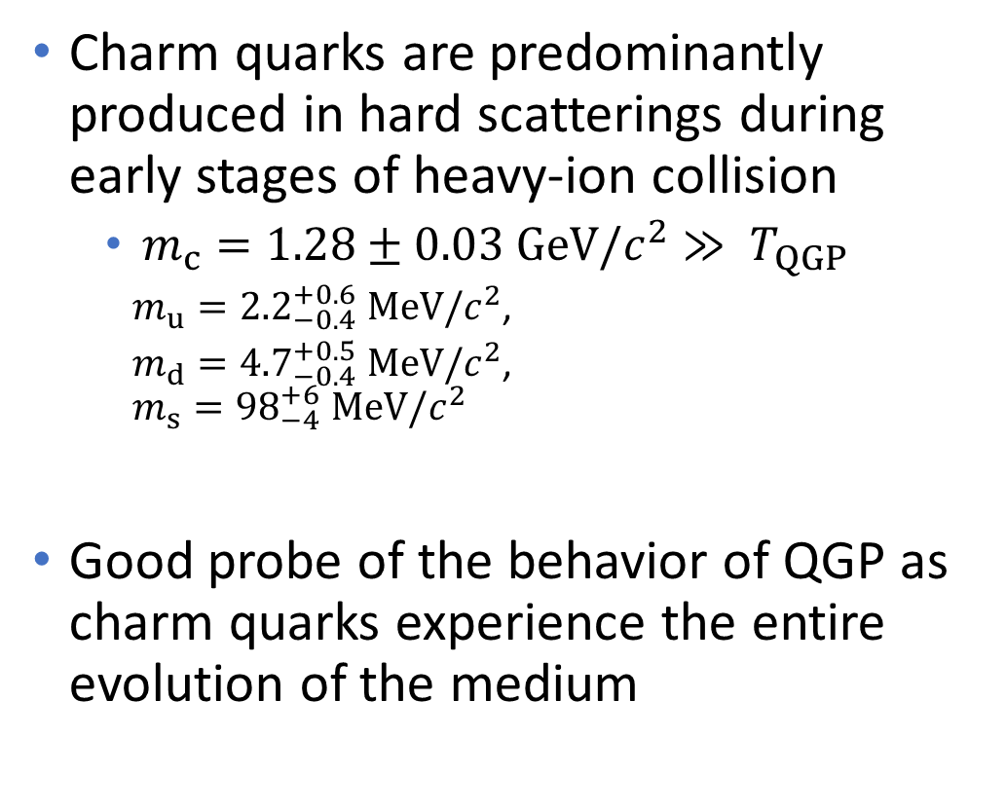
Use charm quarks to probe QGP
$$K$$
$$π$$
$$p$$
Charm quarks are predominantly produced in hard scatterings during early stages of heavy-ion collision
  $m_{c}=1.28±0.03 GeV/c^{2}≫ T_{QGP}$
    $m_{u}={2.2}_{−0.4}^{+0.6} MeV/c^{2}$,
    $m_{d}={4.7}_{−0.4}^{+0.5} MeV/c^{2}$,
    $$m_{s}={98}_{−4}^{+6} MeV/c^{2}$$
Good probe of the behavior of QGP as charm quarks experience the entire evolution of the medium
$Λ_{c}$ baryon
c-quark
[Chin. Phys. C, 40, 100001 (2016) and 2017 update ]
More on charm meson measurements in the talk on Wednesday at 12:15 by Lukáš Kramárik

Slide 4

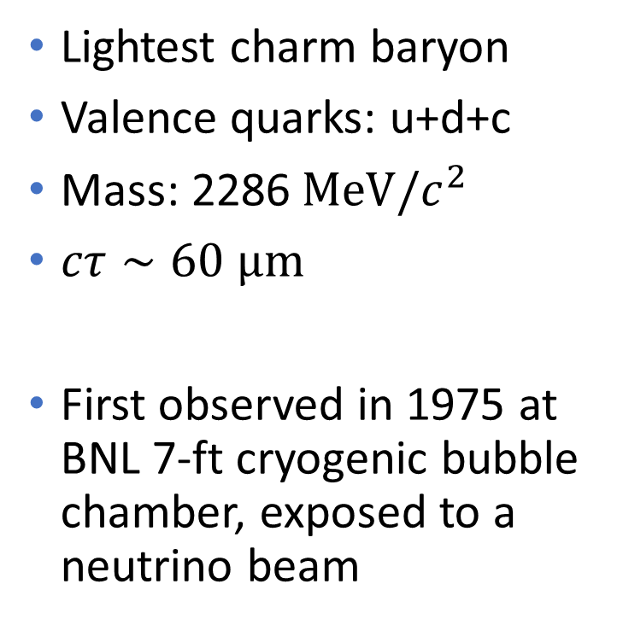
$Λ_{c}$ baryon
Lightest charm baryon
Valence quarks: u+d+c
Mass: 2286$MeV/c^{2}$
$cτ∼60 μm$
First observed in 1975 at BNL 7-ft cryogenic bubble chamber, exposed to a neutrino beam
[Cazzioli et al. PRL 34 (1975) 1125]

Slide 5
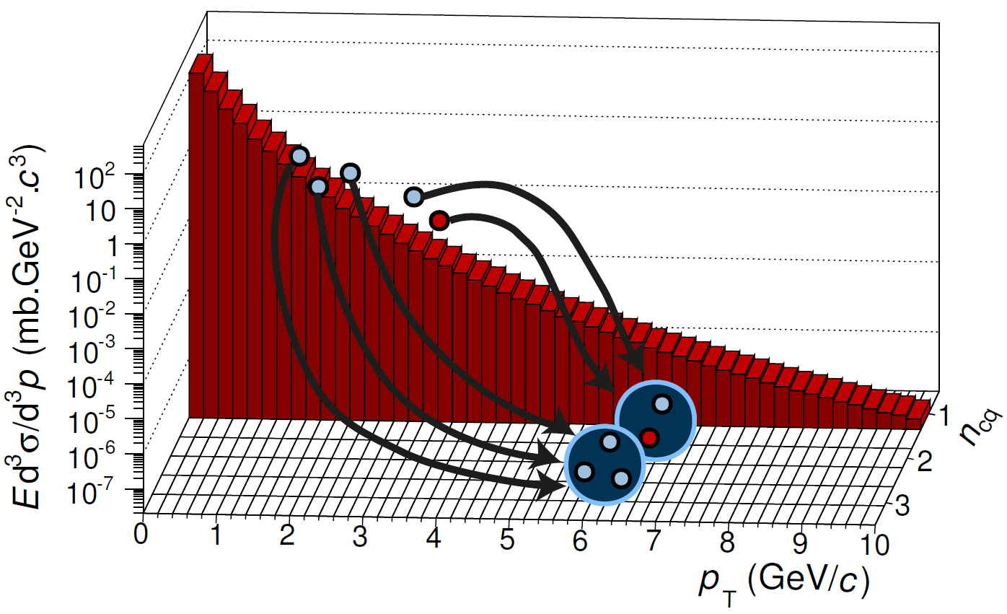
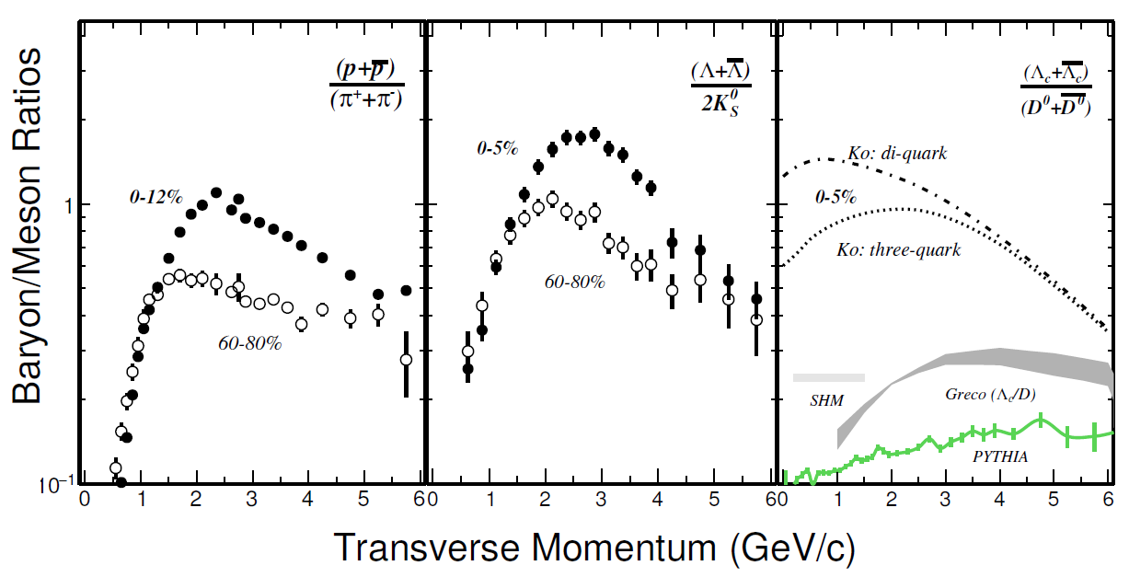
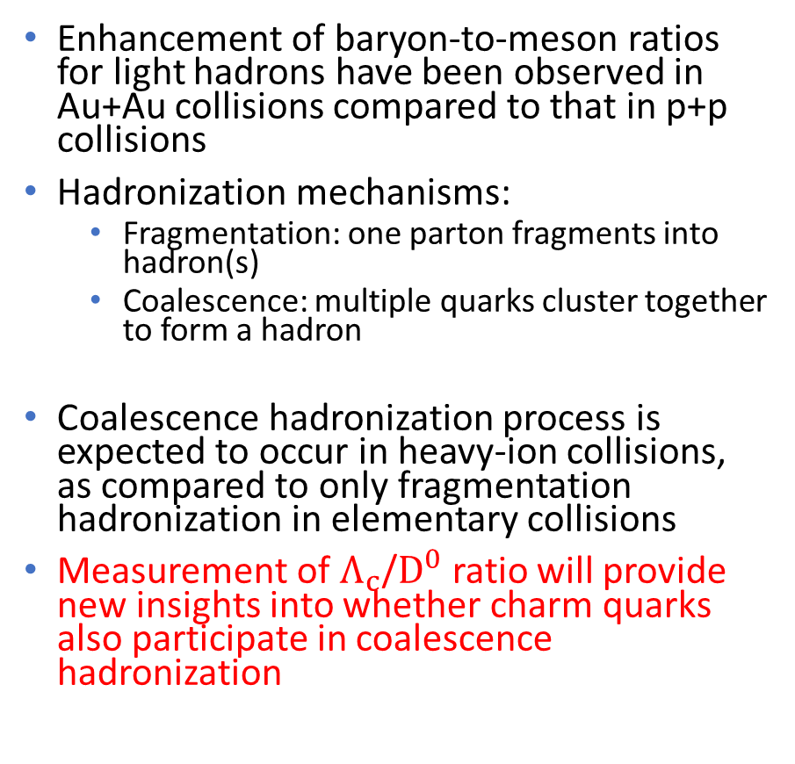
Quark coalescence
Enhancement of baryon-to-meson ratios for light hadrons have been observed in Au+Au collisions compared to that in p+p collisions
Hadronization mechanisms:
  Fragmentation: one parton fragments into hadron(s)
  Coalescence: multiple quarks cluster together to form a hadron
Coalescence hadronization process is expected to occur in heavy-ion collisions, as compared to only fragmentation hadronization in elementary collisions
Measurement of $Λ_{c}$/$D^{0}$ratio will provide new insights into whether charm quarks also participate in coalescence
hadronization
[STAR: PRL 108 (2012) 072301]
[Theory:
SHM: PLB 659 (2008) 149];
Greco: PRD 90 (2014) 054018;
Ko: PRL 100 (2008) 222301]

Slide 6
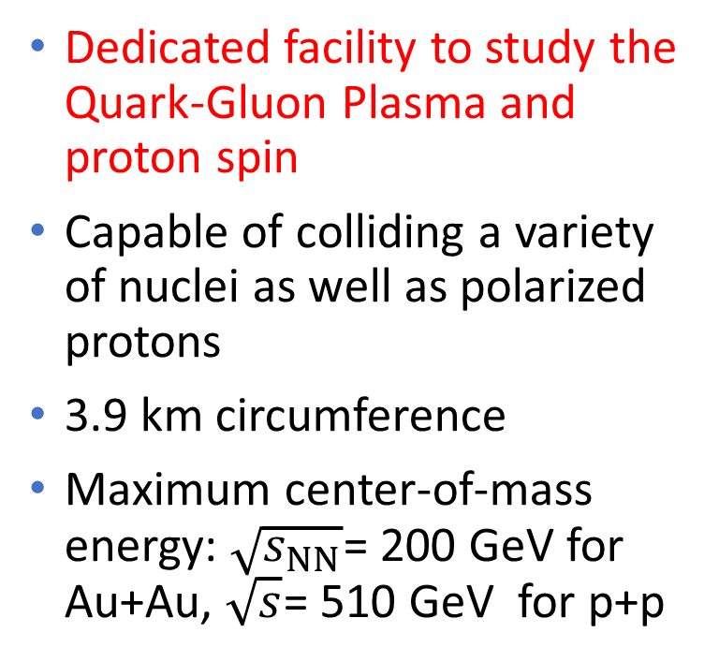
The Relativistic Heavy-Ion Collider at Brookhaven National Laboratory
Dedicated facility to study the Quark-Gluon Plasma and proton spin
Capable of colliding a variety of nuclei as well as polarized protons
3.9 km circumference
Maximum center-of-mass energy: $\sqrt{s_{NN}}$= 200 GeV for Au+Au, $\sqrt{s}$= 510 GeV for p+p

Slide 7
The Solenoidal Tracker at RHIC (STAR)
Multipurpose particle detector
Excellent tracking and identification of charged particles with full azimuthal coverage at midrapidity
Mostly inside of a 0.5T solenoid magnet

Slide 8
The Solenoidal Tracker at RHIC (STAR)
Multipurpose particle detector
Excellent tracking and identification of charged particles with full azimuthal coverage at midrapidity
Mostly inside of a 0.5T solenoid magnet
Time-Projection Chamber (TPC)
Large-volume gaseous detector
Tracking and particle identification via energy-loss measurement

Slide 9
The Solenoidal Tracker at RHIC (STAR)
Multipurpose particle detector
Excellent tracking and identification of charged particles with full azimuthal coverage at midrapidity
Mostly inside of a 0.5T solenoid magnet
Time-Of-Flight detector (TOF)
MRPC
Particle identification via measurement of the time of flight

Slide 10
The Solenoidal Tracker at RHIC (STAR)
Multipurpose particle detector
Excellent tracking and identification of charged particles with full azimuthal coverage at midrapidity
Mostly inside of a 0.5T solenoid magnet
Heavy Flavor Tracker (HFT)
Installed in 2014 – 2016
4 layers of silicon detectors
Precise vertexing detector

Slide 11
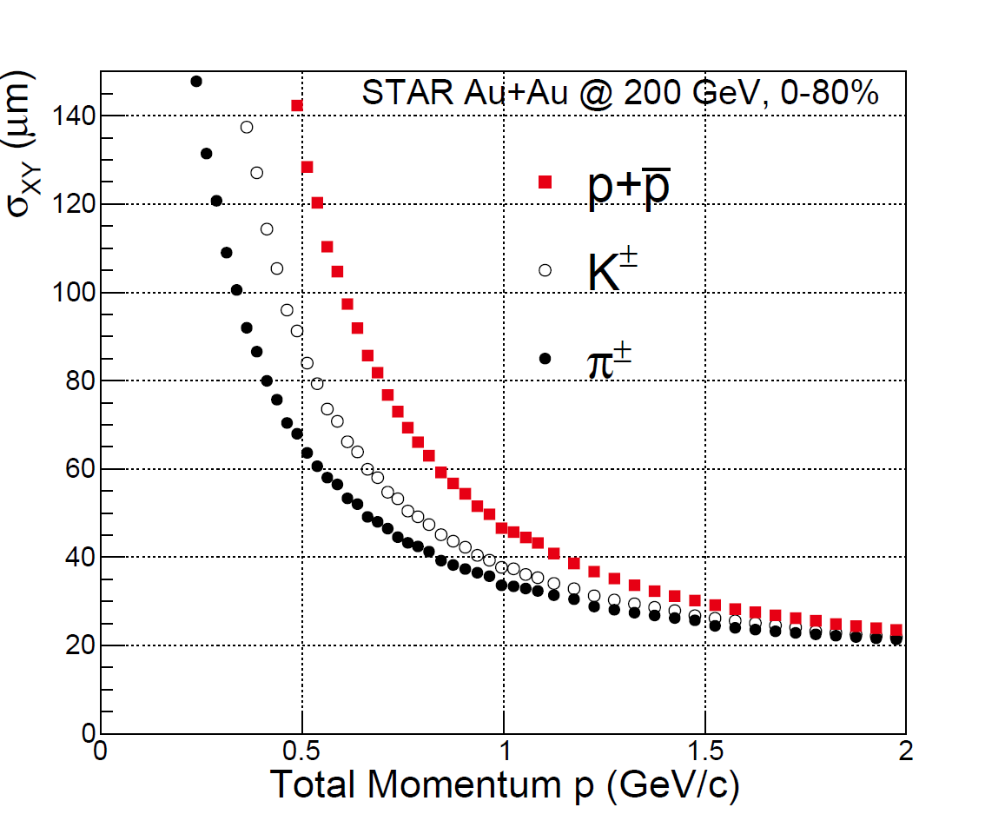
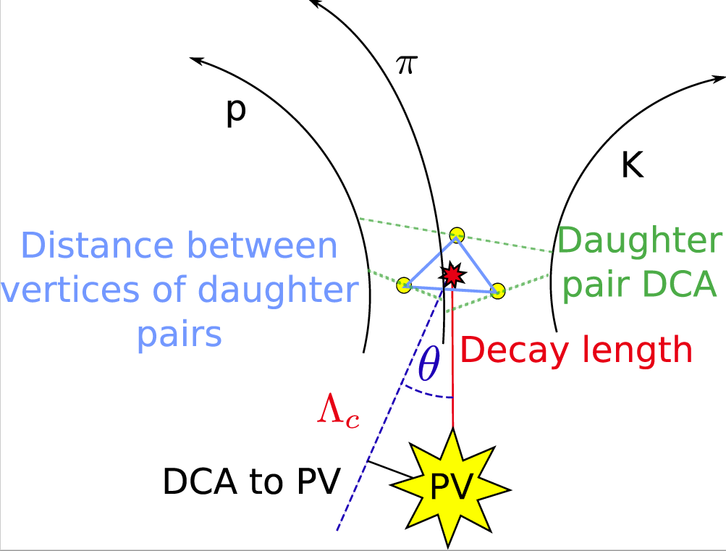
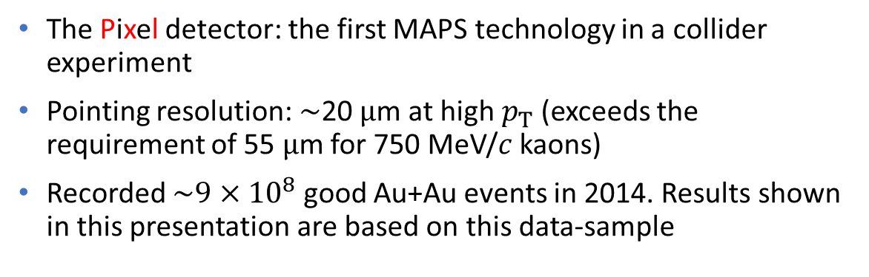
STAR Heavy Flavor Tracker
The Pixel detector: the first MAPS technology in a collider experiment
Pointing resolution: $∼$20 $μ$m at high $p_{T}$ (exceeds the requirement of 55 $μ$m for 750 MeV/$c$ kaons)
Recorded $\sim {9×10}^{8}$ good Au+Au events in 2014. Results shown in this presentation are based on this data-sample
[STAR: PRL 118 (2017) 212301]

Slide 12
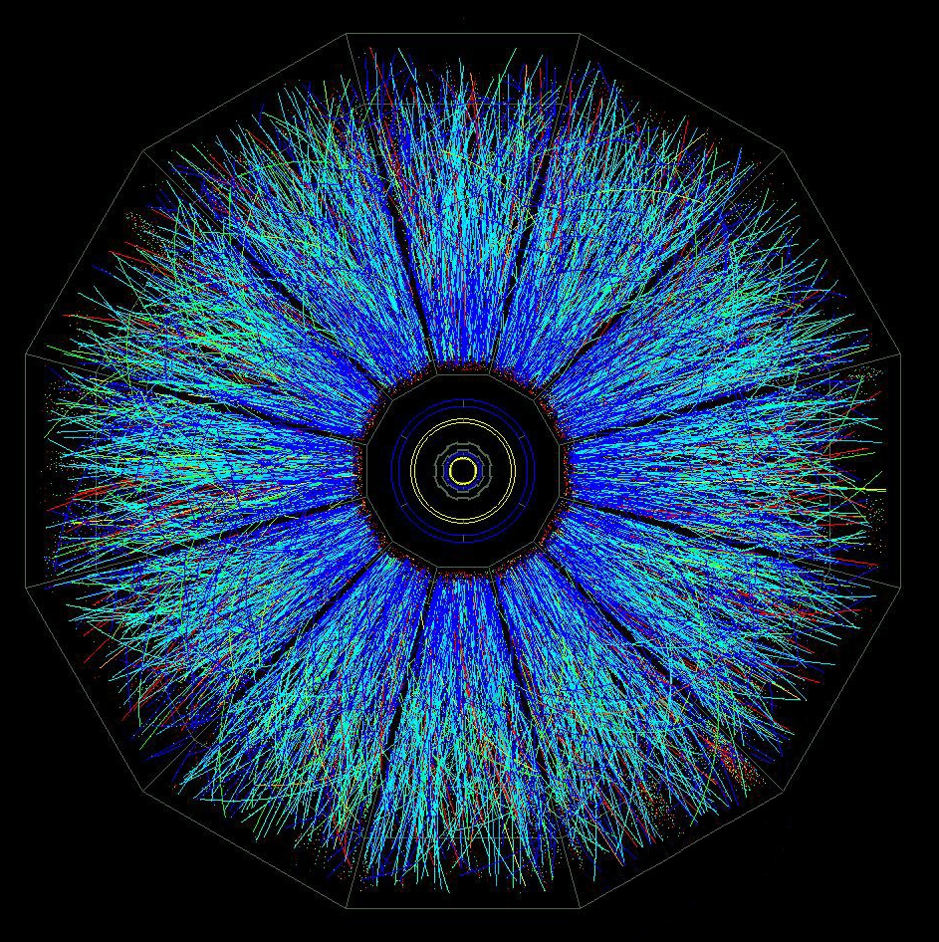

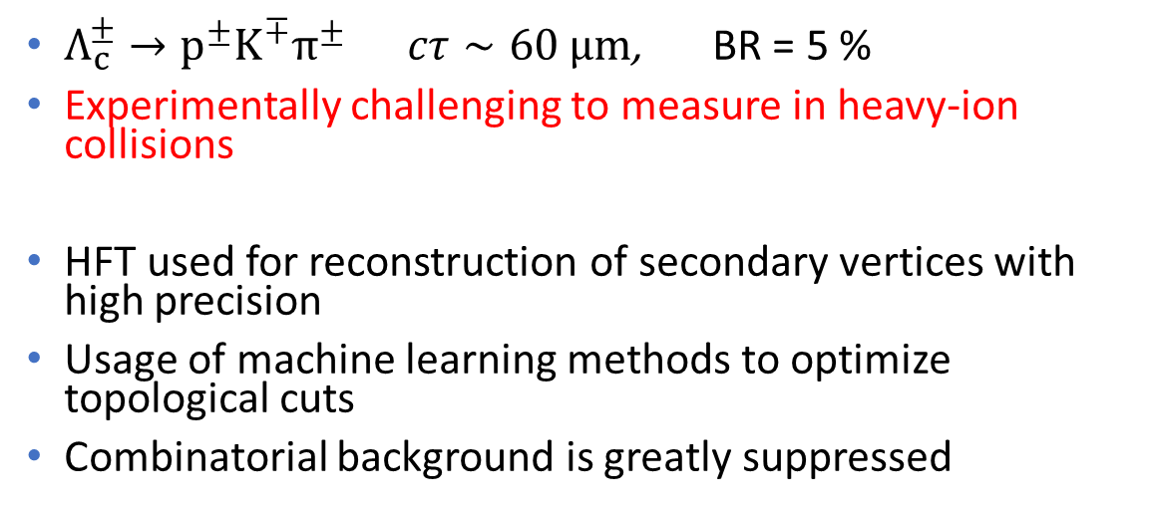
Topological reconstruction of $Λ_{c}$ with the HFT
$Λ_{c}^{±}→p^{±}K^{∓}π^{±}$ $cτ∼60 μm$, BR = 5 %
Experimentally challenging to measure in heavy-ion collisions
HFT used for reconstruction of secondary vertices with high precision
Usage of machine learning methods to optimize topological cuts
Combinatorial background is greatly suppressed

Slide 13
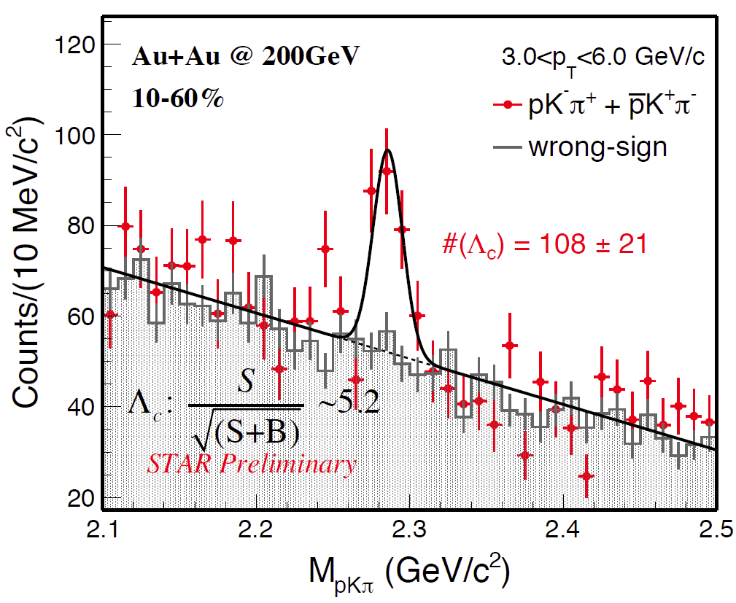

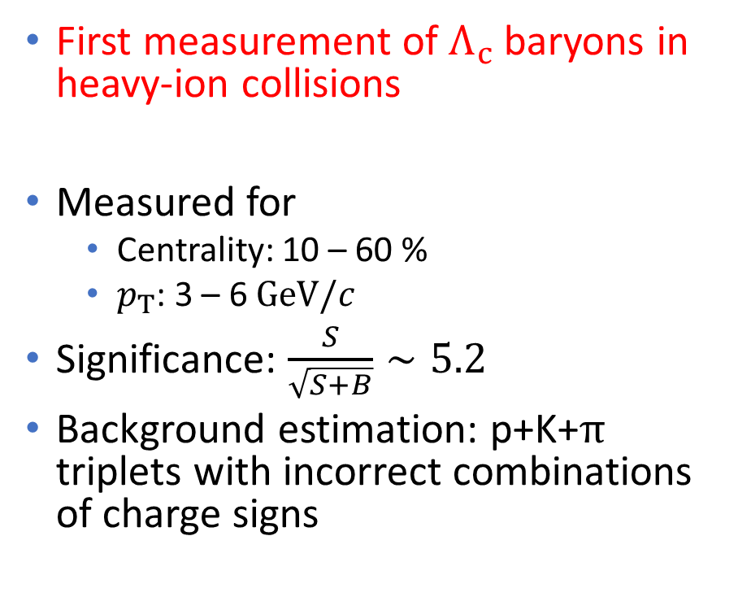
p+K+$π$ invariant mass spectrum
First measurement of $Λ_{c}$ baryons in heavy-ion collisions
Measured for
  Centrality: 10 – 60 %
  $p_{T}$: 3 – 6 $GeV/c$
Significance: $\frac{S}{\sqrt{S+B}}∼5.2$
Background estimation: p+K+$π$ triplets with incorrect combinations of charge signs

Slide 14
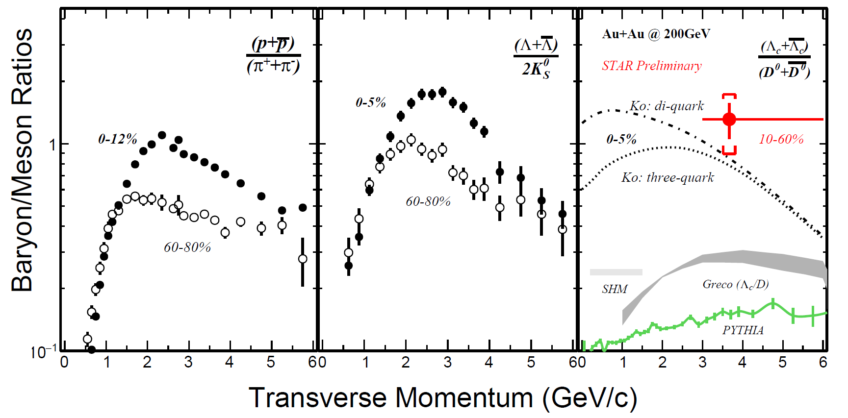

$Λ_{c}$/$D^{0}$ yield ratio
[STAR: PRL 108 (2012) 072301]
[Theory:
SHM: PLB 659 (2008) 149];
Greco: PRD 90 (2014) 054018;
Ko: PRL 100 (2008) 222301]
Clear enhancement observed compared to the fragmentation scenario predicted by PYTHIA
Compatible with baryon-to-meson ratios of light hadrons
Ko model (0-5%), including coalescence of thermalized charm quarks, is consistent with the data for both di-quark + 1 quark, and three-quark scenarios

Slide 15
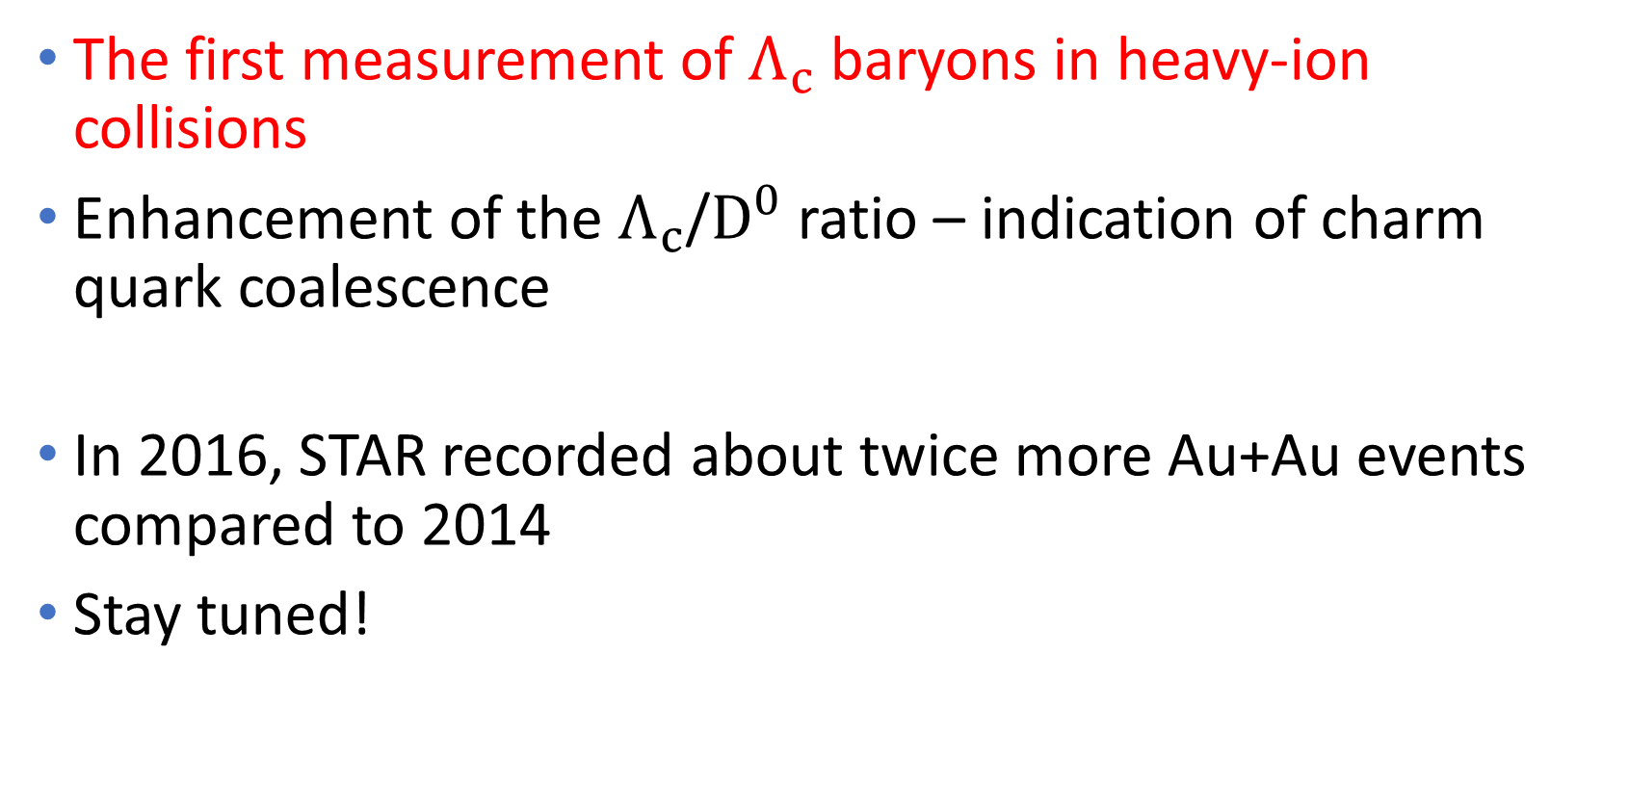
Summary
The first measurement of $Λ_{c}$ baryons in heavy-ion collisions
Enhancement of the $Λ_{c}$/$D^{0}$ ratio – indication of charm quark coalescence
In 2016, STAR recorded about twice more Au+Au events compared to 2014
Stay tuned!

Slide 16
Thank you for your attention

Slide 17
Backup

Slide 18
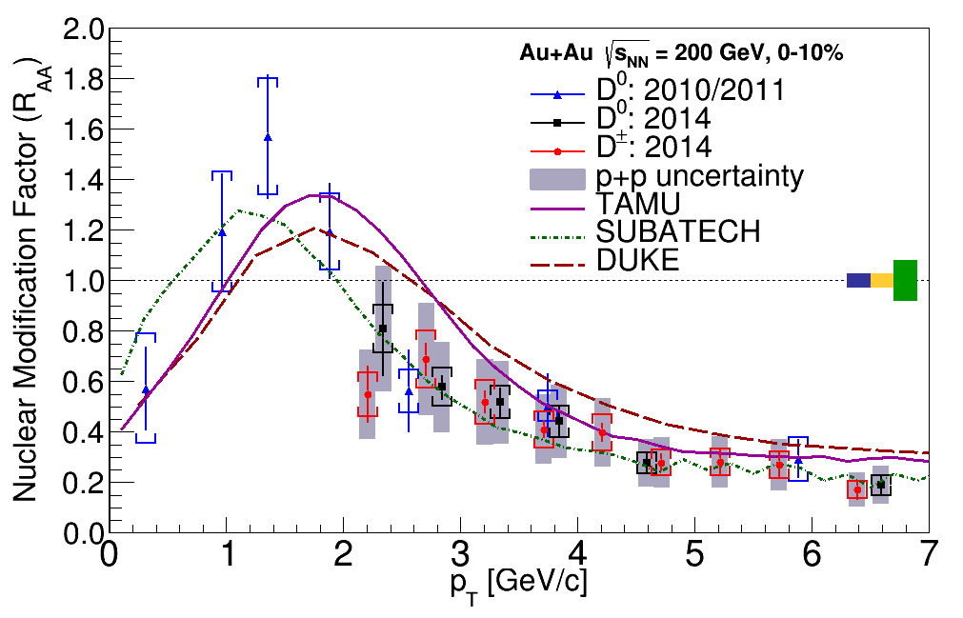
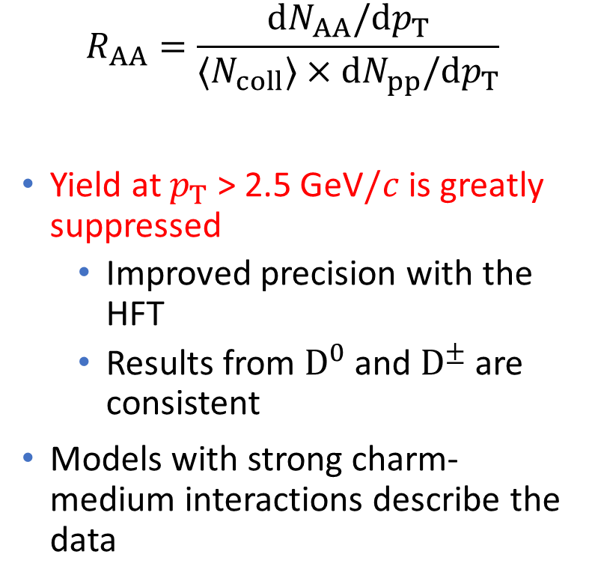

Nuclear modification factor $R_{AA}$ of $D^{0}$ and $D^{±}$
$$R_{AA}=\frac{dN_{AA}/dp_{T}}{〈N_{coll}〉×dN_{pp}/dp_{T}}$$
Yield at $p_{T}$ > 2.5 GeV$/c$ is greatly suppressed
  Improved precision with the HFT
  Results from $D^{0}$ and $D^{±}$ are consistent
Models with strong charm-medium interactions describe the data
N_{col} uncert.
σ_{pp} uncert.
STAR preliminary
[STAR: PRL 113 (2014) 142301]
[Theory:
TAMU: Eur. Phys. J. C (2016) 76: 107 & private comm.;
SUBATECH: PRC 91(2015) 054902 & private comm.;
Duke: PRC 92(2015) 024907 & private comm]

Slide 19
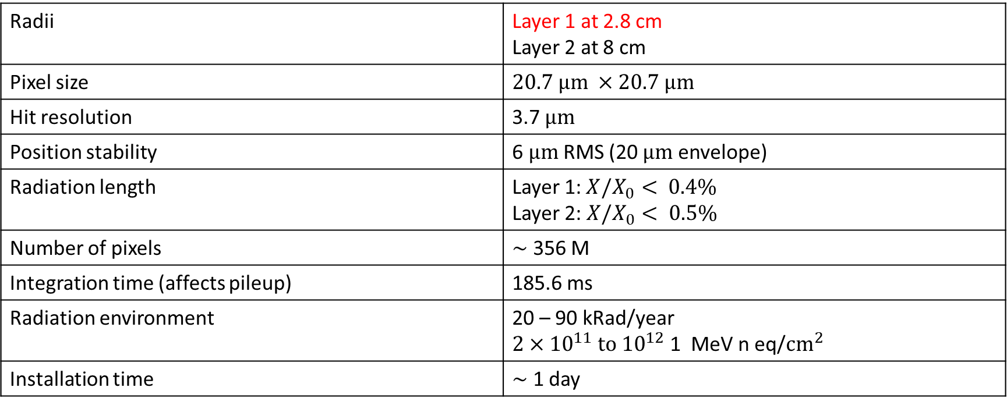
Pixel detector (PXL)
Radii | Layer 1 at 2.8 cm Layer 2 at 8 cm
Pixel size | $$20.7 μm ×20.7 μm$$
Hit resolution | 3.7 $μm$
Position stability | 6 $μm$ RMS (20 $μm$ envelope)
Radiation length | Layer 1:$X/X_{0}< 0.4\%$ Layer 2: $X/X_{0}< 0.5\%$
Number of pixels | $∼$ 356 M
Integration time (affects pileup) | 185.6 ms
Radiation environment | 20 – 90 kRad/year $2×{10}^{11} to {10}^{12}$ 1 MeV n eq/$cm^{2}$
Installation time | $∼$ 1 day

