Slide 1
What Can be Learned from Identifying Leading Hadrons of Jets in STAR?
Kolja Kauder for the STAR Collaboration

Slide 2
Outline
Introduction / Motivation
Quark Gluon Plasma
Experimental Setup
Jets as Probes via 2D Correlation Analyses
Identifying Trigger Particles to Study Particle Production
Particle Identification Method
Results
Jet Cone Dilution by Background Triggers
Ridge (and Away-Side): Higher Harmonics
Summary and Outlook

Slide 3
Stages of a Heavy Ion Collision
~400 nucleons
Measured
Quark Gluon Plasma:
Hot
Liquid
Strongly Interacting
Quark & Gluon DOF
Notes:
Lorentz Contraction

Slide 4
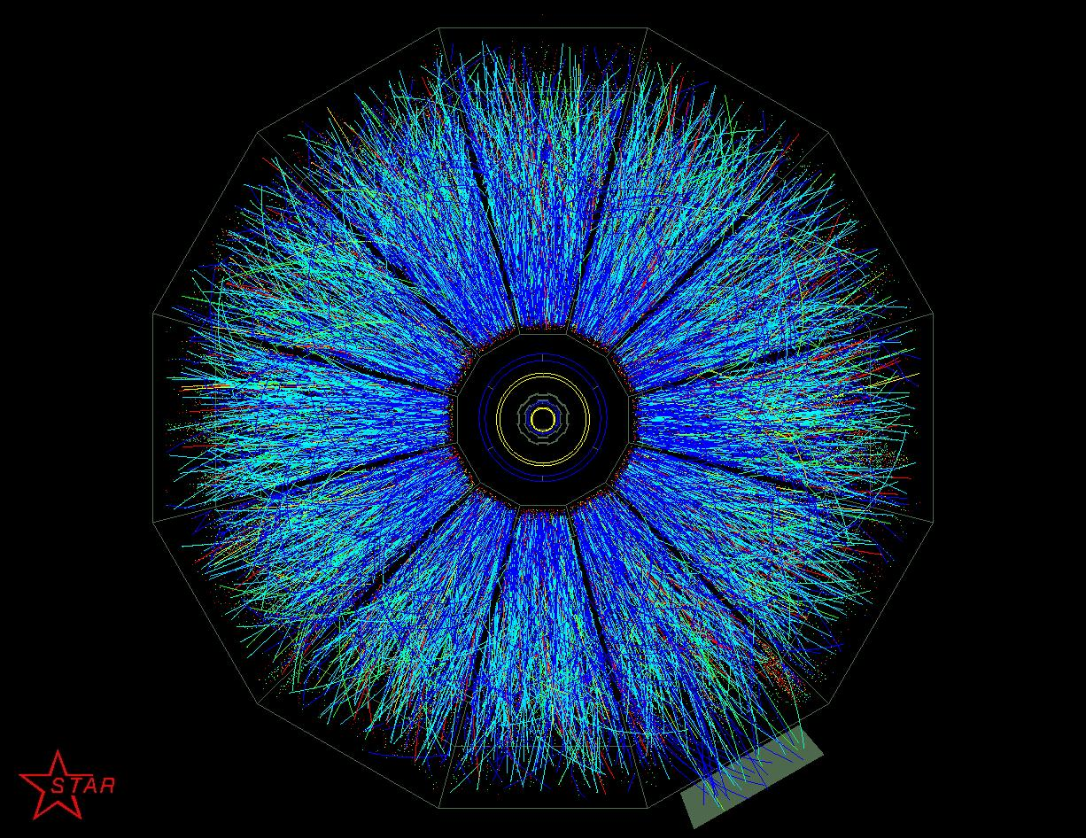
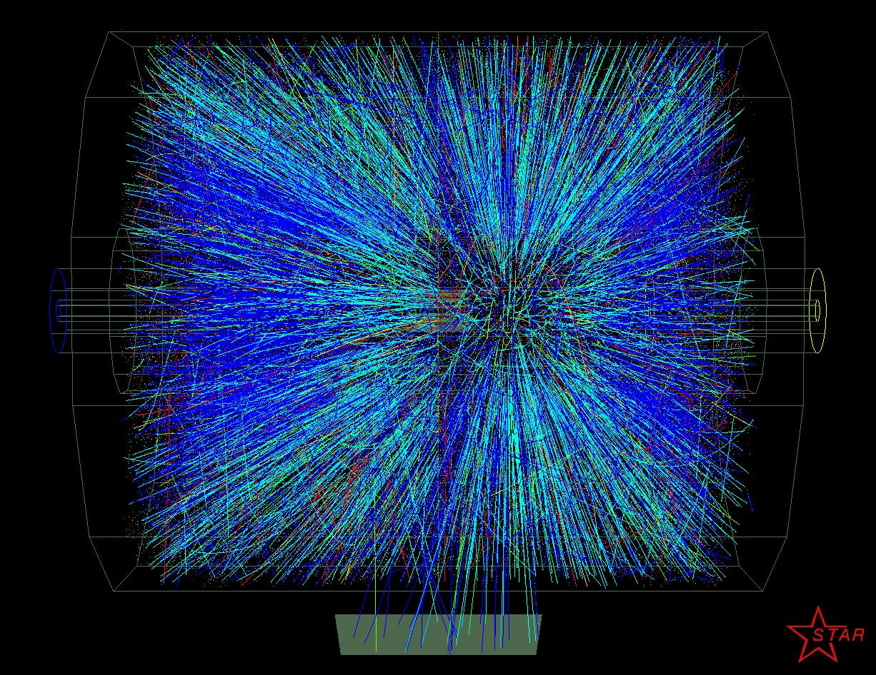
The STAR Detector
Full azimuthal acceptance
Pseudorapidity acceptance |η|<1.8
Particle Identification
Au+Au, 200 GeV
Notes:
No pileup, single event!

Slide 5
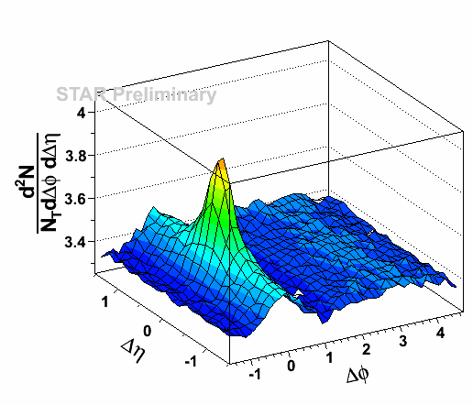
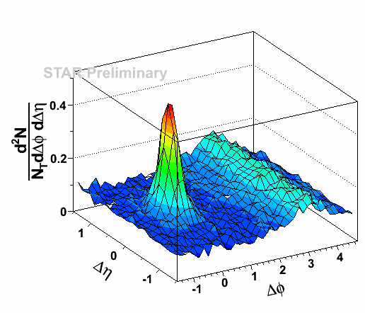
Tomography
4 < p_{T}^{trig} < 6 GeV/c
2 < p_{T}^{assc} < p_{T,trig}
STAR, PRL 91 (2003) 072304
Dihadron Correlation
associates
associates
Trigger
associates
d+Au
4 < p_{T,trig} < 5 GeV/c
1.5 < p_{T,ssc} < 4 GeV/c
0-10% central
4 < p_{T,trig} < 5 GeV/c
1.5 < p_{T,ssc} < 4 GeV/c
0-10% central
4 < p_{T}^{trig} < 5 GeV/c
1.5 < p_{T}^{assc} < 4 GeV/c
Selecting Trigger ID:
Jet Cone
“Ridge”
Away-Side
Notes:
Hard – separable from medium
preferrably colored

Slide 6
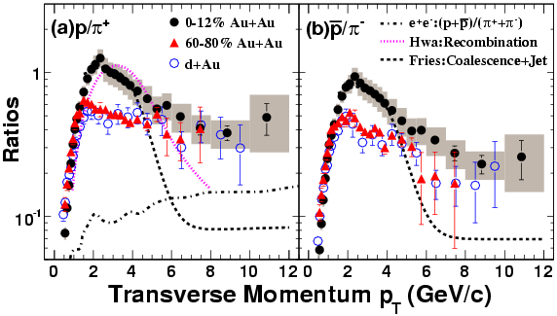
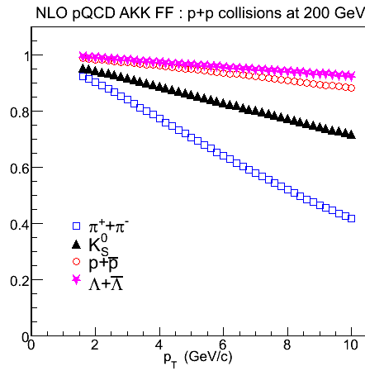
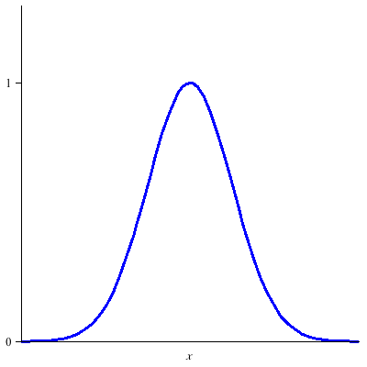
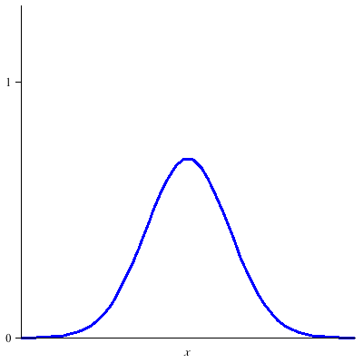
Baryon vs. Meson Trigger
STAR, PRL 97 (2006) 152301
STAR, PLB 637 (2006) 161
Gluon contribution factor
Albino et al.
NPB 725 (2005) 181
Between 1.5~5 GeV: Enhanced relative baryon yield
Well captured by recombination/ coalescence
Baryon trigger: Stronger Dilution?
AKK NLO FFs describe data well
At high p_{T}:
Mesons bias toward q jets?
Color charge effect on energy loss?
Fragmentation + Recombination
a. u.
Δφ=0
Notes:
thermal thermal, shower thermal, shower shower

Slide 7
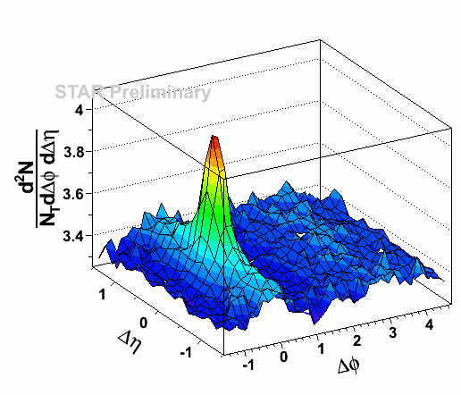
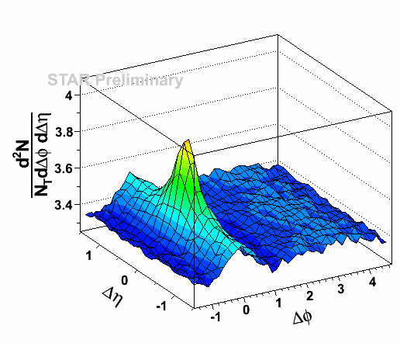
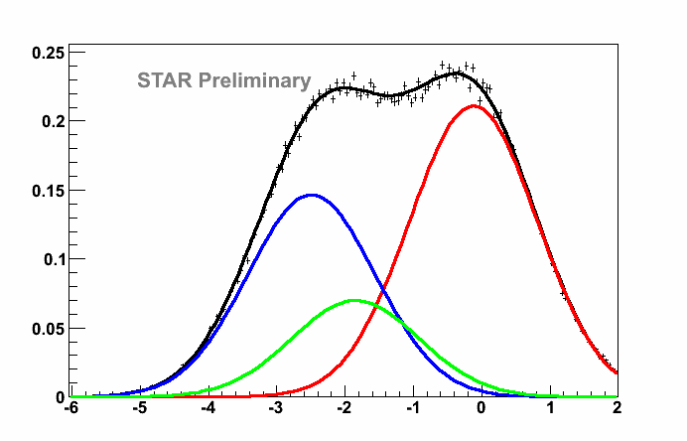
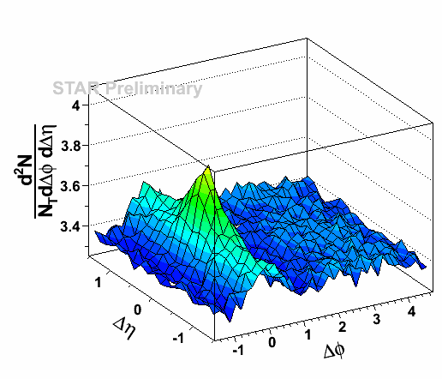
Statistical Separation in Two Steps
n_{σ}^{π} > 0.
97% purity
pion sample
Inclusive, raw
n_{σ}^{π} < 0,
pion-depleted sample
n_{σ}^{π} = (dE/dx - π prediction) /resolution
π
K
P
n_{σ}^{π} < 0, cleaned
pure p+K sample
n_{σ}^{π}
0-10% central
4 < p_{T}^{trig} < 5 GeV/c
1.5 < p_{T}^{assc} < 4 GeV/c

Slide 8
2D Correlation
π± trigger
(P±+K±) trigger
Big difference immediately visible with the naked eye:
Pion triggers: Small Ridge Large Cone
P+K triggers: Large Ridge Small Cone
Dilution? Need d+Au

Slide 9
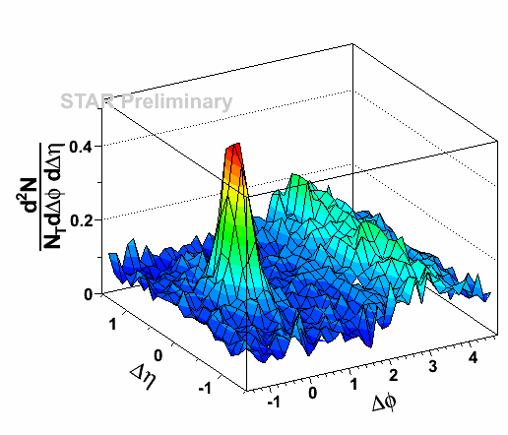
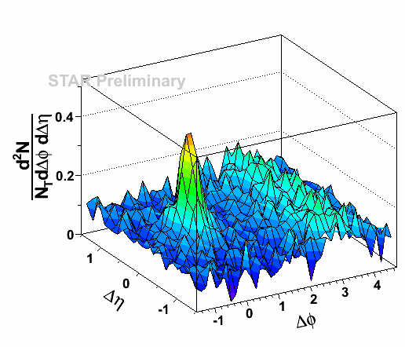
2D Correlation – d+Au
π± trigger
(P±+K±) trigger
No appreciable ridge
Cone is similar in d+Au
Signs of dilution are there, but subtle

Slide 10
2D Correlation
π± trigger
(P±+K±) trigger
Jet Cone Yield: π : d+Au  Au+Au ~25% P+K: d+Au ~ Au+Au
π increase instead of P decrease

Slide 11
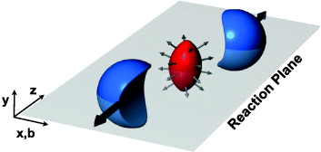
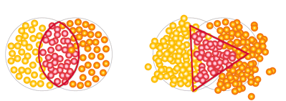
Source of the Ridge
Multitude of Ridge models
Radiation + Jet Quenching
Radiation + Longitudinal Flow
Phantom Jet
Turbulent Color Fields
Momentum Kick
Medium Heating and Parton Recombination
...
Front runner:
Hydro: Initial State Anisotropy → Final State
Ridge: Odd harmonics not negligible

Slide 12
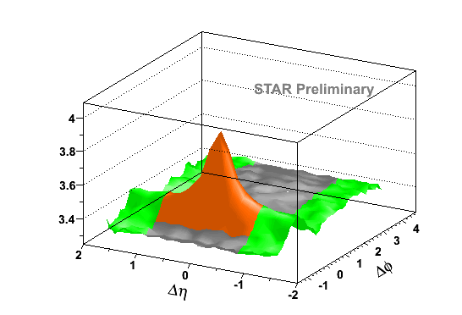
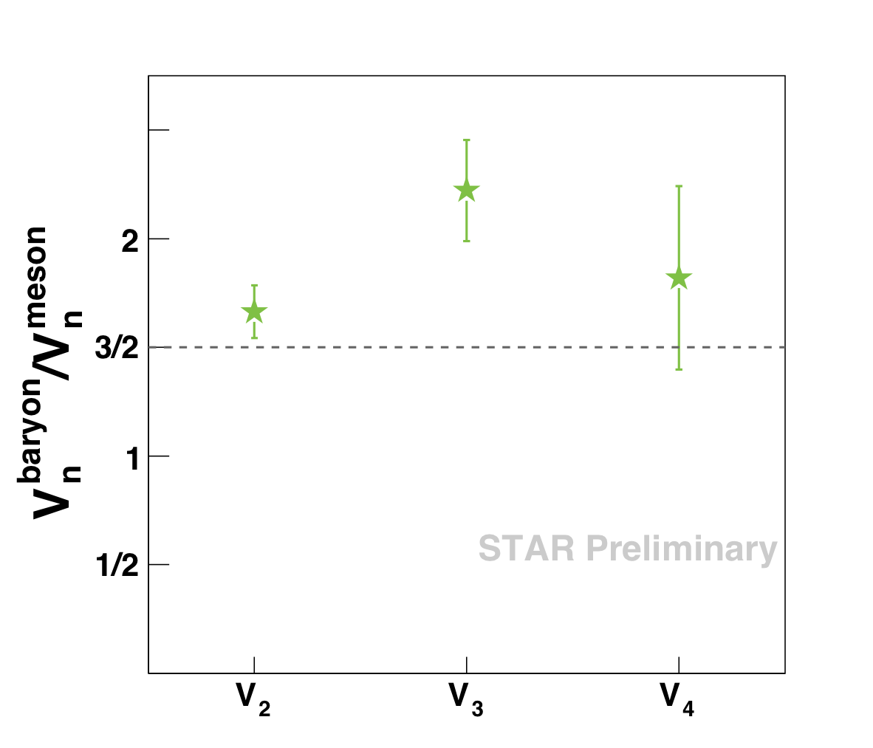
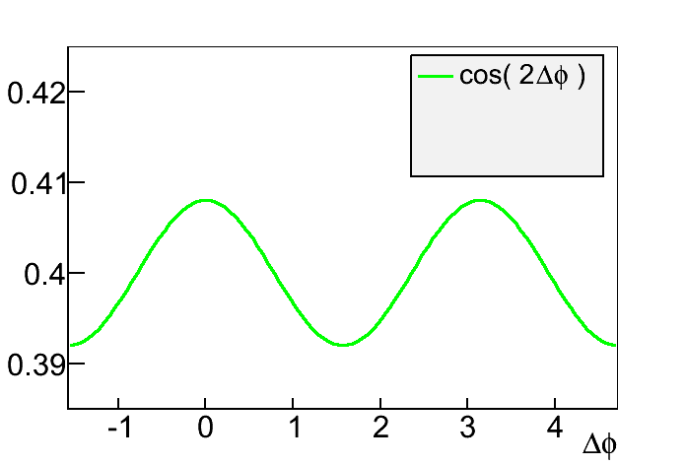
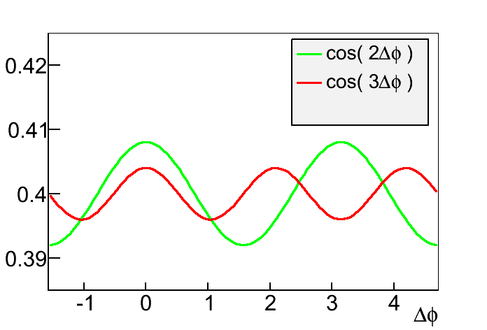
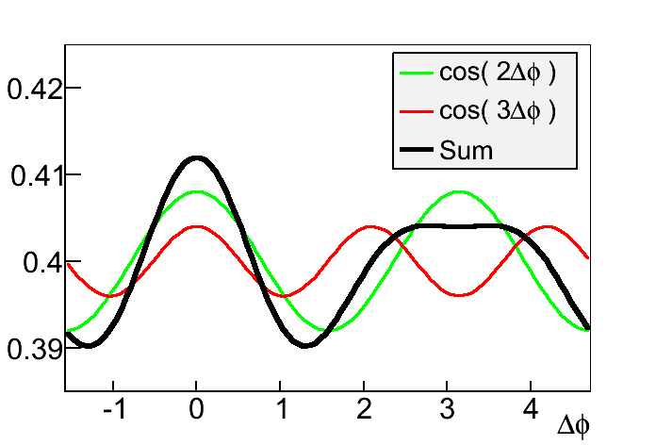
Scaling of Fourier Coefficients
0-10% central
4 < p_{T,trig} < 5 GeV/c
Expect flow-like harmonics to scale with quark number
Non-Pions: P / K ratio also measured.
Statistical errors only
Indications that V₂ and V₃ scale differently

Slide 13
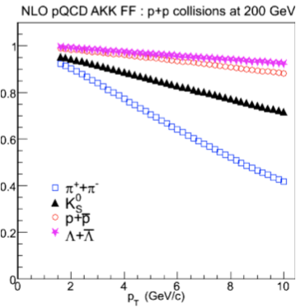
Summary
Identified Triggers
Jet Cone: Associated yield much larger for pion than proton+kaon triggers.
Signs of enhancement compared to d+Au
Ridge: Associated yield smaller for pions. Scaling behavior constrains models
Outlook:
Quantify comparison to ReCo
Proton-Kaon separation
Quark vs. Gluon Jets?
Gluon contribution factor
Albino et al.
NPB 725 (2005) 181

