Slide 1
Leading Hadron PID Effects in Di-hadron Angular Correlations in STAR
Kolja Kauder for the STAR Collaboration

Slide 2
Overview
Motivation
Baryon/Meson puzzle and correlations
Technique
Particle identification in the TPC
Di-hadron correlation, statistical separation
Results
Jet cone
Ridge
Summary and Outlook

Slide 3
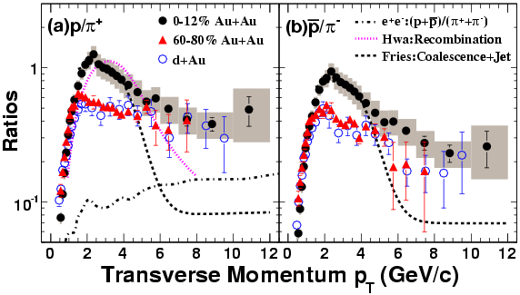
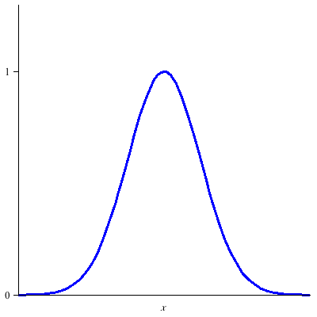
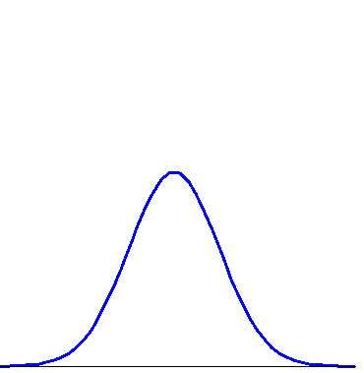
Baryon/Meson Puzzle
STAR, PRL 97 (2006) 152301
Enhanced relative yield of baryons to mesons, compared to d+Au, well captured by recombination
Fragmentation + Recombination
Fragmentation
From simplistic recombination:
Stronger trigger dilution for baryons → Lower associated yield per hadron trigger
a. u.
a. u.
Δφ=0
Δφ=0

Slide 4
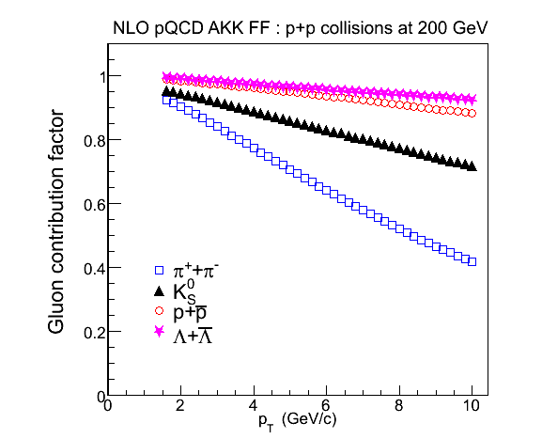
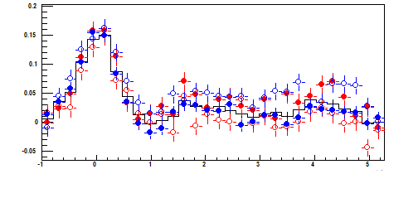
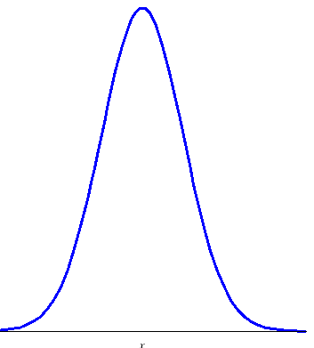
Early Result
Possible explanation
J. Ulery, QM 2005
STAR, PLB 637 (2006) 161
Gluon contribution factor
3<P_{T}Trig<4 GeV/c
50% P
50% Pbar
95% π+
95% π-
Charged
Δφ
Albino et al.
NPB 725 (2005) 181
STAR Preliminary
Δφ
p_{T}
p_{T}
AKK NLO FFs describe STAR data well
Expected near-side effect: Baryon triggers come from gluon jets,
→ higher energy loss, higher cone yield
Au+Au 0-5%
2.0<P_{T}Assoc<3.0 GeV/c
Δφ
a. u.
a. u.
Azimuthal correlation:
Identical cone yield for P and π triggers
No dilution, contrary to simplistic recombination scenario
Δφ=0
Δφ=0

Slide 5
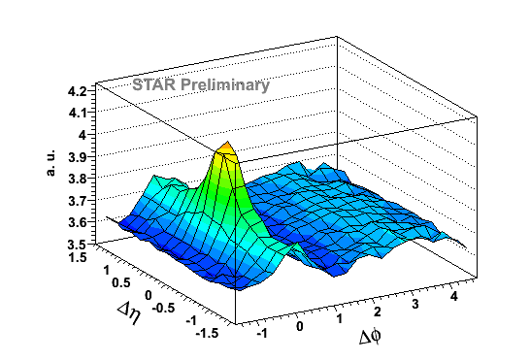
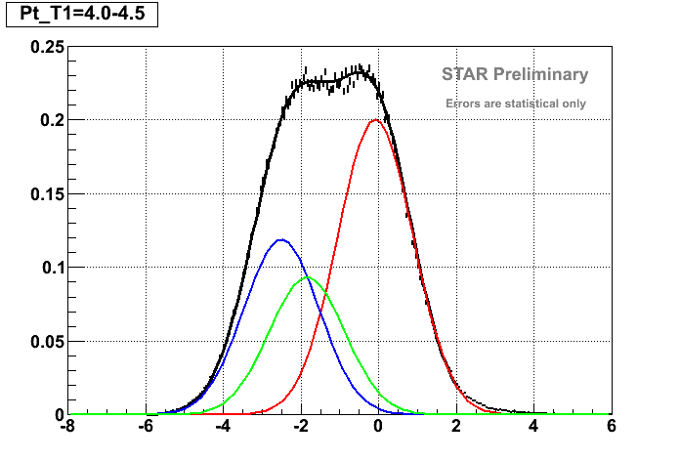
Second Dimension
e
π
K
P
Log dE/dx
0-10% central
4 < p_{T,trigger} < 6 GeV/c
p_{t,assoc.} > 1.5 GeV/c
Year ‘10 Au+Au
√S_{NN}=200 GeV
|V_{z}|<25 cm, |dca|<3cm
nFit>25, nFit/nFitMax>51%
Trigger is highest p_{T} track
Log p_{T}
Explore additional structures in PID-triggered correlations with high statistics 2010 data set
a. u.
π
K
P
PID:
Relativistic rise of ionization energy loss (dE/dx)
n_{σ}^{π} = (dE/dx - π prediction) /resolution
Fit with Gaussians in 500 MeV slices
PID the same way as e.g. in PRL 97 (2006) 152301
n_{σ}^{π}
Statistical separation of particle species

Slide 6
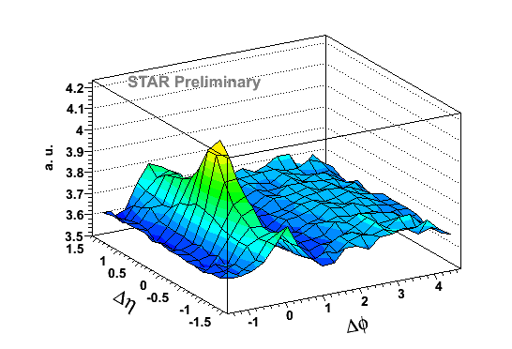
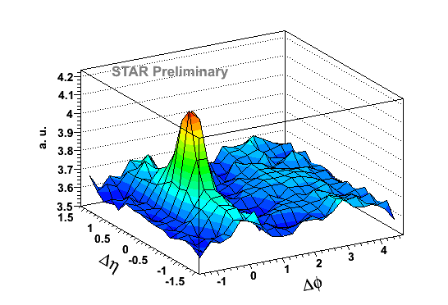
Biased Trigger Sets
Inclusive, raw
n_{σ}^{π} < C_{π,}
pion-depleted sample
n_{σ}^{π} > C_{π,} 95%
pure pion sample
a. u.
π
K
P
Au+Au
4 < p_{T,trigger} < 6 GeV/c
p_{t,assoc.} > 1.5 GeV/c
0-10% central, Trigger is highest p_{T} track

Slide 7
Further statistical separation
Know pure π-triggered correlation
Know number of remaining π triggers in the “non-pion”-triggered correlation (other half of the gaussian)
→ Subtract pion contribution
pion-depleted sample
“–”
pure pion sample
a. u.
π
K
P
Au+Au
→ True P+K triggered correlation

Slide 8
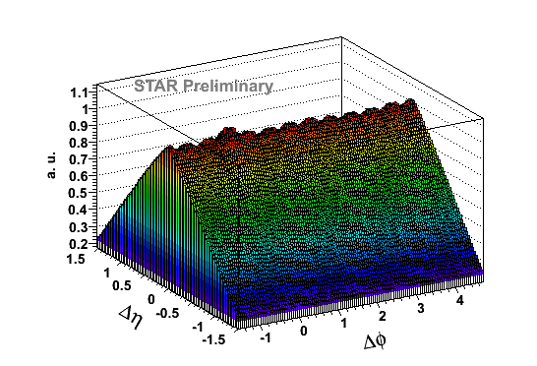
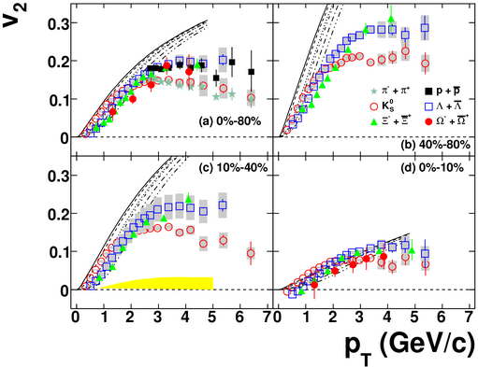
Di-Hadron Analysis
Background Subtraction:
Mixed MB events for combinatoric background
Background level from ZYAM assumption
Elliptic flow at high p_{T}:
PRC 77 (2008) 54901
Use K⁰ v₂ for mesons (π, K±)
Use Λ v₂ for baryons (protons)
PRC 72 (2005) 014904
Use charged hadron v₂ for associated particles
Notes:
Composition from fits:
Non-pions ≈ 60% Protons + 40% Kaons

Slide 9
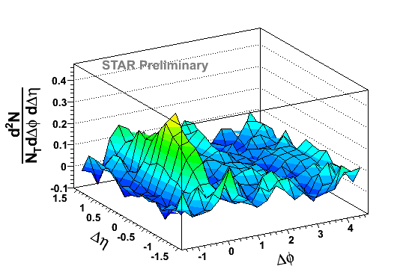
Di-Hadron Correlation with PID triggers
π± trigger
Large jet-like cone, small ridge from pion triggers
Smaller cone, large ridge from P+K triggers
(P±+K±) trigger
Au+Au
4 < p_{T,trigger} < 6 GeV/c
p_{t,assoc.} > 1.5 GeV/c

Slide 10
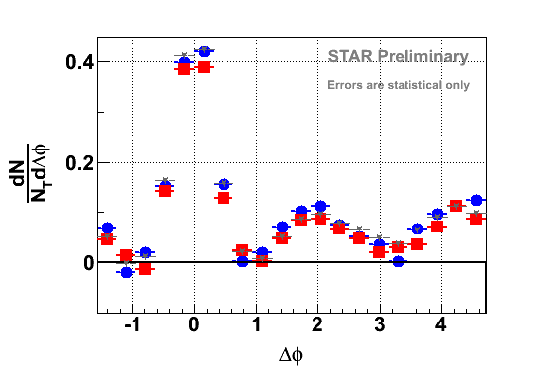
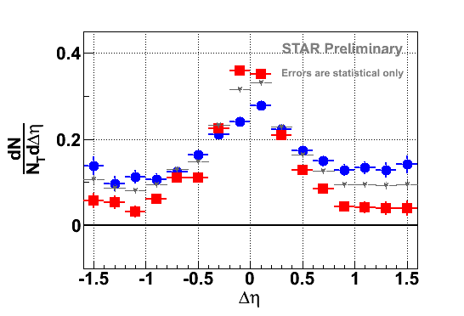
Projections – Au+Au
|Δη|<1.0
Trigger:
π± (P±+K±)
Charged h
|Δφ|<0.73
Consistent with previous results – but that is a function of projection range!
Does not reveal entire structure
Δη reveals rich trigger PID dependent structure:
Higher jet-like amplitude for pions
Ridge predominantly contributed by non-pion-triggered events
Au+Au
4 < p_{T,trigger} < 6 GeV/c
p_{t,assoc.} > 1.5 GeV/c

Slide 11
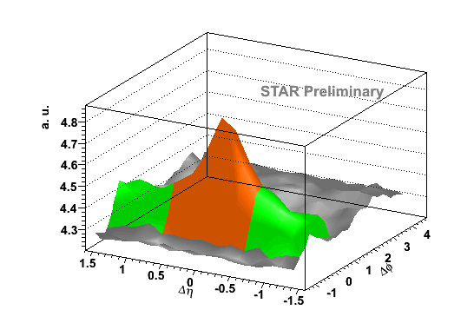
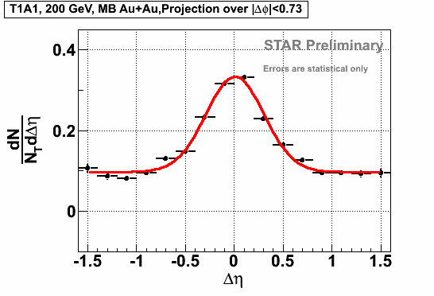
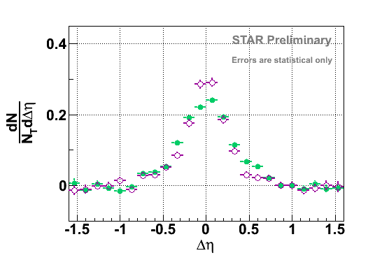
Yields in Au+Au
Jet cone: Get background + flow + ridge from raw signal at 0.7<|Δη|<1.5
→ Drastically reduced systematic uncertainties
Ridge:
Use zyam alone
Fit Gaussian+pedestal
to |Δη| projection
Au+Au
Pure Cone:
Au+Au
d+Au
Illustrations on this slide from Charged–h

Slide 12
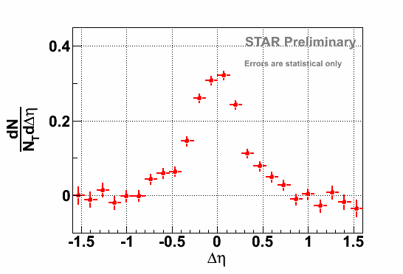
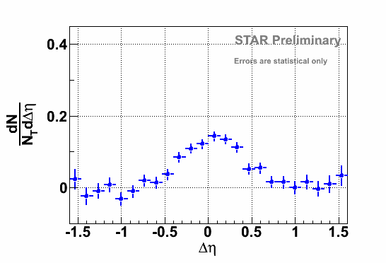
Pure Cone
π± trigger
(P±+K±) trigger
Large difference in Jet-like amplitude
Au+Au
4 < p_{T,trigger} < 6 GeV/c
p_{t,assoc.} > 1.5 GeV/c

Slide 13
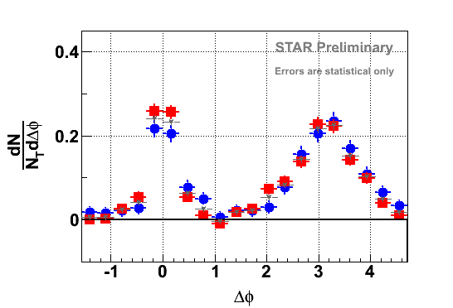
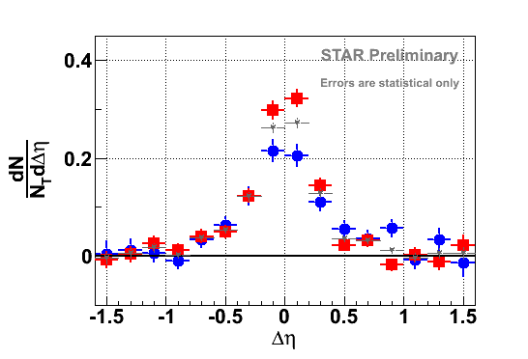
Projections – d+Au
|Δη|<1.0
Trigger:
π± (P±+K±)
Charged h
|Δφ|<0.73
Difference in Jet-like amplitude persists
d+Au MB
4 < p_{T,trigger} < 6 GeV/c
p_{t,assoc.} > 1.5 GeV/c

Slide 14
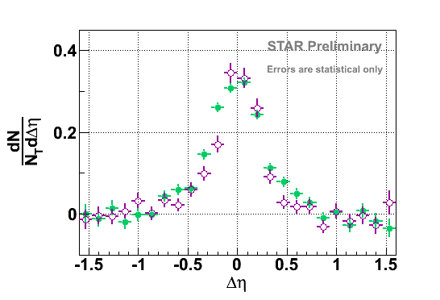
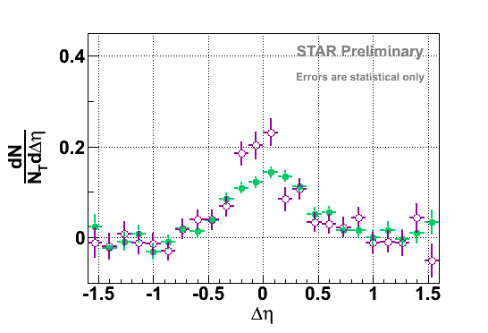
Jet Cone Yield and Width
Pure Cone:
Au+Au
d+Au
Au+Au
d+Au
Au+Au
d+Au
Trigger PID | Pure cone yield | Pure cone yield | σ | σ
π± trigger | 0.22 ± 0.01 | 0.19 ± 0.01 | 0.34 ± 0.03 | 0.28 ± 0.03
(P±+K±) trigger | 0.12 ± 0.01 | 0.14 ± 0.02 | 0.27 ± 0.01 | 0.22 ± 0.01
Charged hadron | 0.173 ± 0.005 | 0.168 ± 0.007 | 0.30 ± 0.01 | 0.23 ± 0.01
All errors statistical only!
Similar associated hadron yields between d+Au and Au+Au for each type of trigger
Larger pure cone yield for pion than P+K triggers

Slide 15
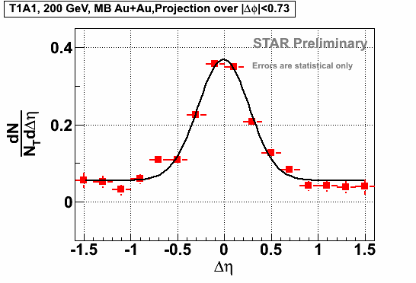
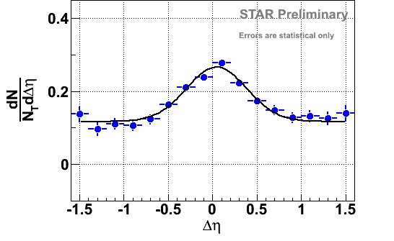
Ridge Yield
Au+Au
Trigger PID | Ridge yield per unit Δη
π± trigger | 0.057 ± 0.005
(P±+K±) trigger | 0.118 ± 0.007
Charged hadron | 0.097 ± 0.003
All errors statistical only!
Higher Ridge yield for P+K triggers than for pion triggers
Need theory input
Radiation (from gluon jets)?
Momentum kick, jet flavor conversion, …?
Higher order Fourier harmonics?

Slide 16
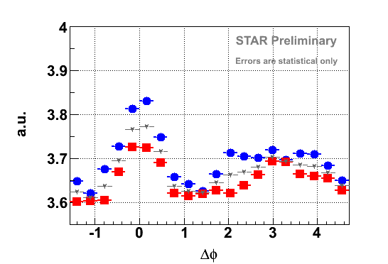
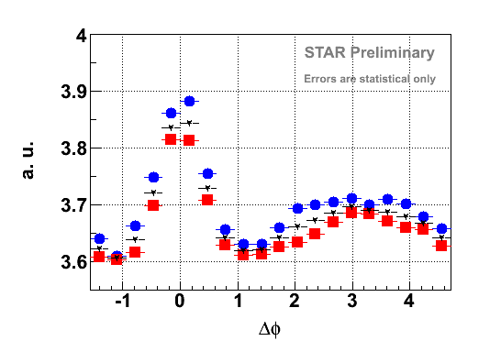
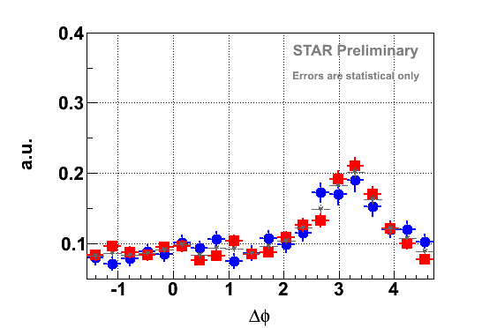
Raw Correlation
4 < p_{T,trigger} < 6 GeV/c
p_{t,assoc.} > 1.5 GeV/c
Large Δη : Ridge difference evident in raw correlation.
Not reconcilable with symmetric backgrounds.
Before background subtraction
Full Δη range: Difference in away-side structures.
Au+Au
0.7<|Δη|<1.5
Trigger:
π± (P±+K±)
Charged h
d+Au MB
Au+Au
0 <|Δη|<1.5

Slide 17
Summary
Cone:
Pion triggers: High associated jet-like yield
P+K triggers: Lower jet yield
Similar to d+Au - consistent with no dilution of the near side
Ridge
Pion triggers: small Ridge
P+K triggers: larger Ridge contribution
Further theory input needed
Away-Side:
Shape differences for pion and P+K triggers
To do:
Finalize systematics
Separate kaons from protons

Slide 18
Backup

Slide 19
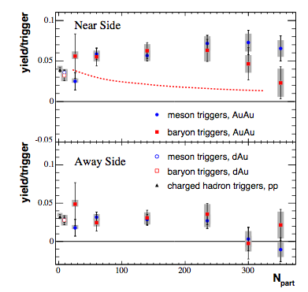
Previous PHENIX measurement
PRC 71, 051902 (2005)
Within |η|<0.35: Lower baryon-triggered yield in central collisions
2.5 < p_{T,trigger} < 4 GeV/c
1.7 < p_{t,assoc.} < 2.5 GeV/c

Slide 20
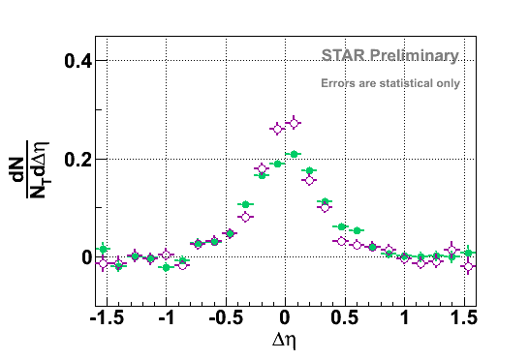
Pure Cone Projections
Charged–h
(P±+K±)–h
Au+Au
d+Au
(P±+K±+some π±)–h
(before π± subtraction)
π±–h

Slide 21
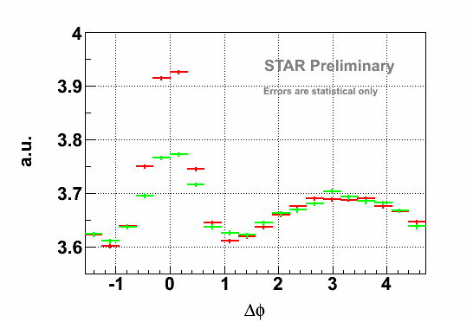
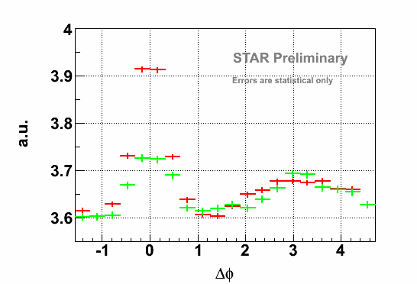
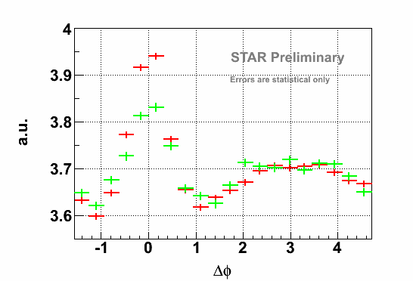
Raw Ridge vs. Raw Cone
Charged–h
Before Flow subtraction
Raw Ridge at 0.7<|Δη|<1.5 vs.
Raw Cone with |Δη|<0.7
Au+Au
π±–h
(P±+K±)–h

Slide 22
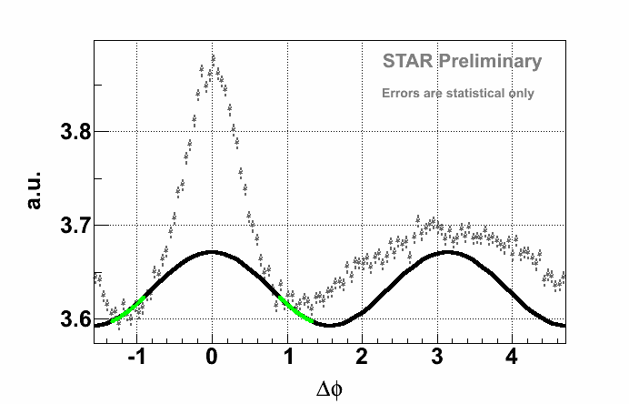
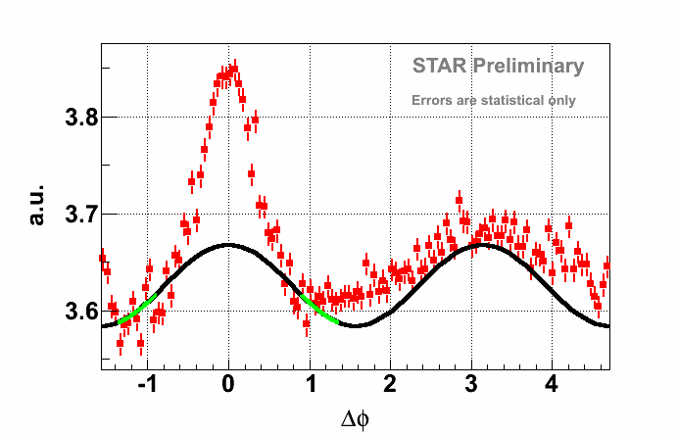
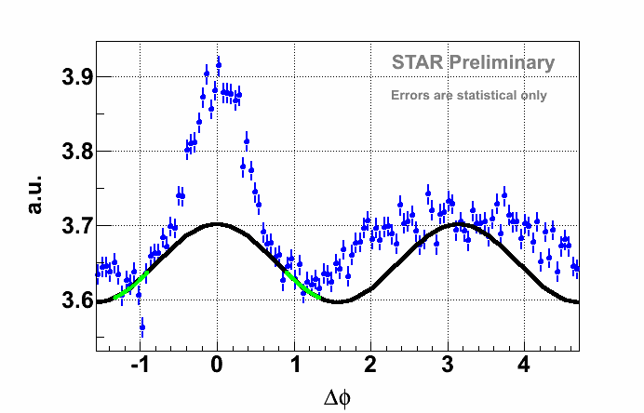
Zyam
Charged–h
Fit range:
|Δη|<1 0.8<|Δφ|<1.34
Au+Au
π±–h
(P±+K±)–h

