Slide 1
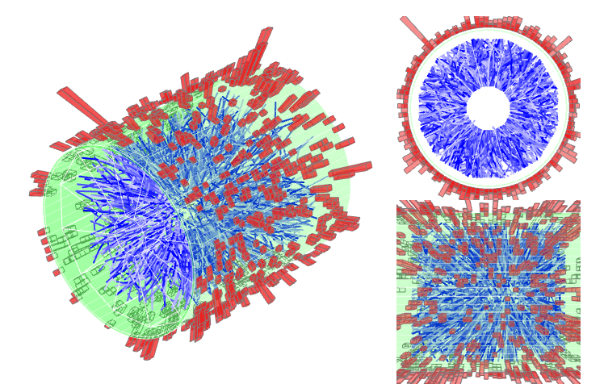


Di-Jet Imbalance Measurements in
Central Au+Au Collisions at √s_{NN}=200 GeV from STAR
Kolja Kauder for the STAR Collaboration
July 02, 2015

Slide 2
Overview
Motivation
Data Analysis
  Data Selection and Jet Reconstruction
  Method
Results
Summary

Slide 3
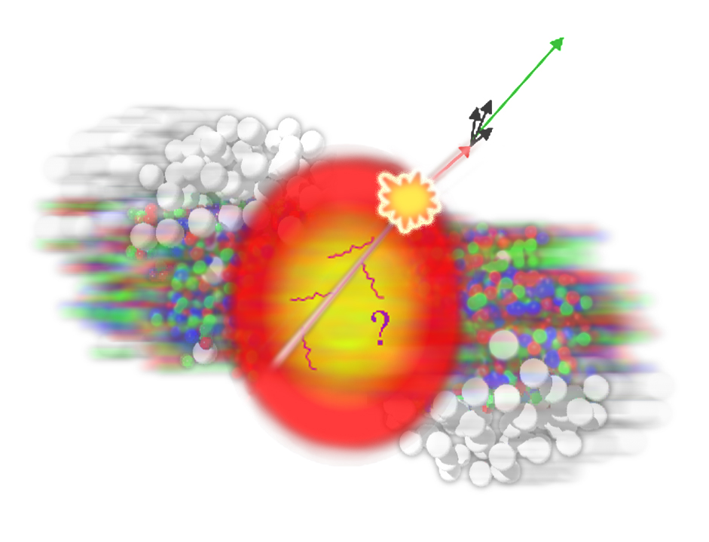
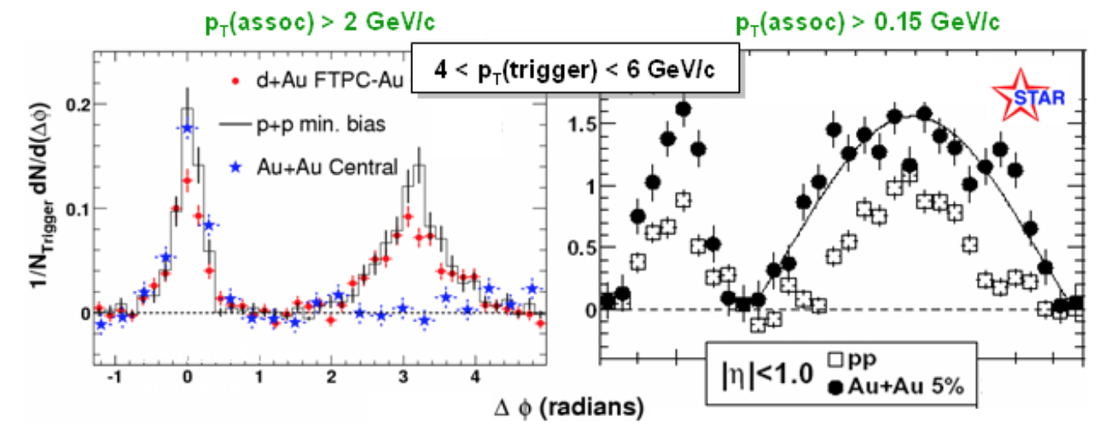
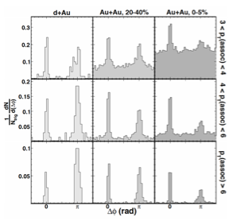
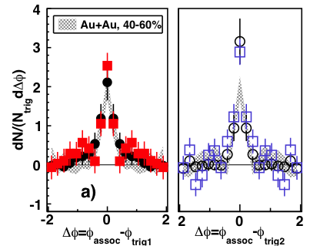
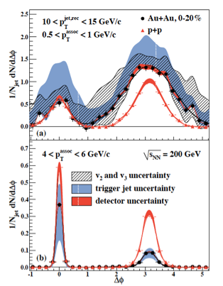
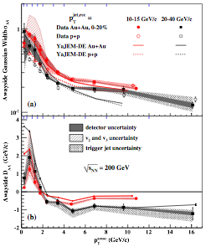
A Decade+ of Jet Quenching in STAR
Di-hadron
STAR, PRL 91, 072304 (2003)
STAR, PRL 95,152301 (2005)
Di-Jets
STAR, PRL 97, 162301 (2006)
2+1
STAR, PRC 83, 061901 (2011)
Jet-hadron
STAR, PRL 112, 122301 (2014)
Ensemble-based
  hard trigger → small modification
  Suppression at high p_{T}
  Enhancement at low p_{T}
  Broadening in Δφ
Goal: jet-by-jet E-loss
→Di-jet Imbalance A_{J}

Slide 4
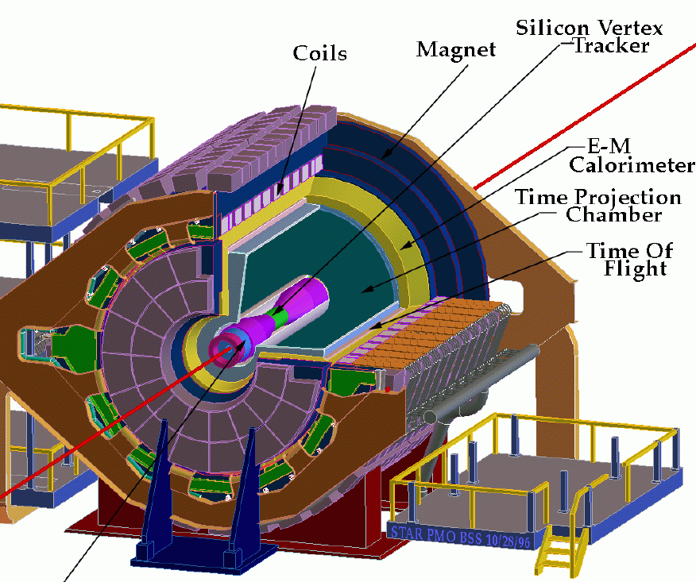
The Solenoidal Tracker At RHIC (STAR)
Tracking (charged) and EMC (neutral) in 2π (azimuth) × ±1 (η)
High Tower (HT) trigger:
E_{T}>5.5 GeV in one tower
AuAu 2007: cut to 0-12% central
pp from 2006: Embed into 0-12% central Au+Au
Efficiency difference and systematic uncertainty assessed in embedded pp
Jet-Finding:
FastJet3
M. Cacciari and G. Salam
Phys. Lett. B 641, 57 (2006)
Anti-k_{T}, R=0.4 (0.2)
Background: k_{T}, same R

Slide 5
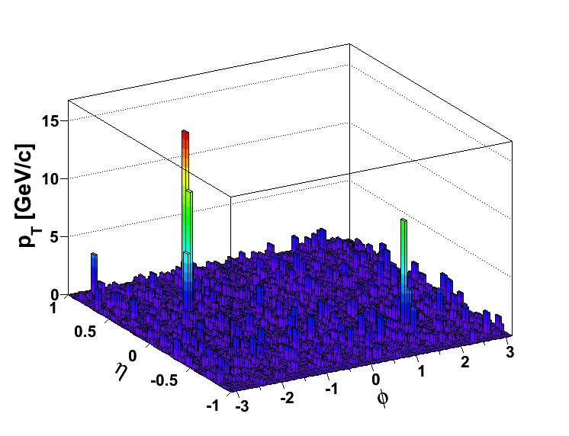
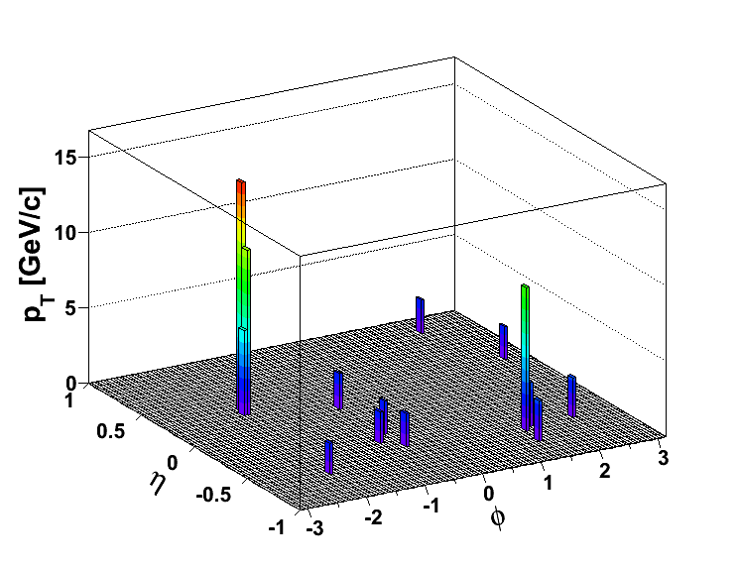
(Biased) Di-Jet Selection
Constituent pT^{Cut} = 0.2 GeV/c
Constituent pT^{Cut} = 2 GeV/c
→ Reduce BG
→ Reduce combinatorial jets
Di-jet Selection:
Jet pT^{Lead}>20 GeV/c
Jet pT^{SubLead}>10 GeV/c
|Δφ-π|<0.4
ATLAS, PRL 105, 252303
CMS, PRC 84, 024906 (2011)

Slide 6
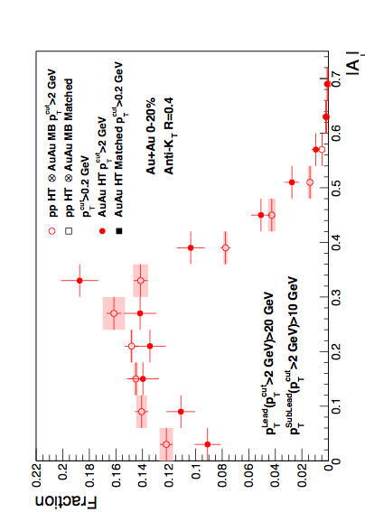
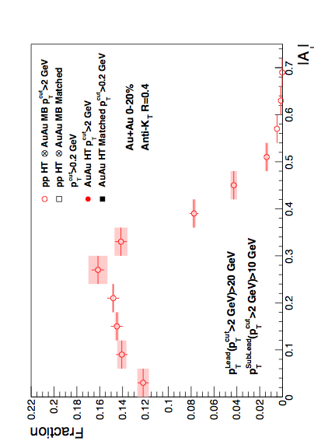

Di-Jet Imbalance AJ
Central Au+Au, R=0.4
Anti-kT R=0.4, pT^{Lead}>20 GeV & pT^{SubLead}>10 GeV with pT^{cut}>2 GeV/c
Event Fraction
p-value < 10⁻⁴
(stat. error only)
Sys. Uncertainties:
- tracking eff. 6%
- tower energy
scale 2%
Central Au+Au
anti-k_{T}, R=0.4
Preliminary
Pearson’s χ²-test of
“The two histograms sample the same distribution”
N.D. Gagunashvili,
arXiv:physics/0605123
|AJ|
Au+Au di-jets more imbalanced than p+p for pT^{cut}>2 GeV/c
Can the balance be restored?

Slide 7
Matched Di-jets w/o Constituent p_{T} Cut
pT^{Cut}=2 GeV/c
pT^{Lead}>20 GeV/c
pT^{SubLead}>10 GeV/c
|Δφ-π|<0.4
pT^{Cut}=0.2 GeV/c
pT^{Lead}>20 GeV/c (pT^{Cut}=2 GeV/c)
pT^{SubLead}>10 GeV/c (pT^{Cut}=2 GeV/c)
Rerun jet-finding algorithm
anti-kT on these events
Geom. matching
Geom. matching
Keep this jet selection
Calculate “matched” |AJ| with constituent pT,cut>0.2 GeV/c.
Geom. matching: ΔR<0.4

Slide 8
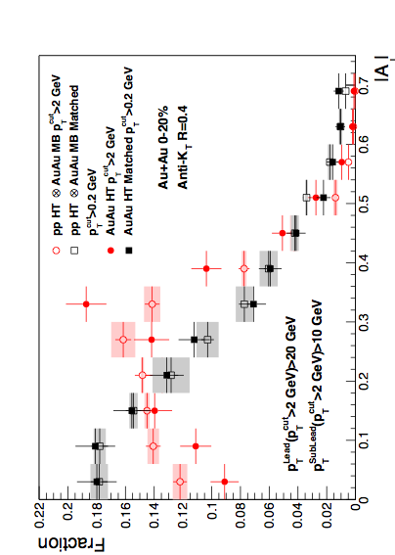
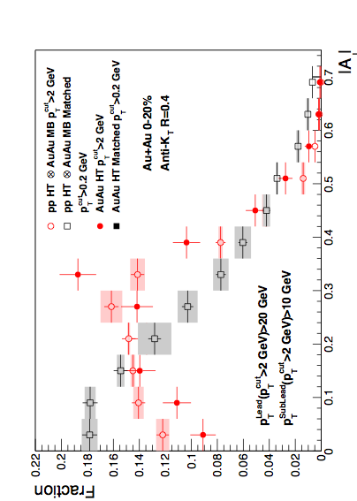
Di-Jet Imbalance AJ
Central Au+Au, R=0.4
Anti-kT R=0.4, pT^{Lead}>20 GeV & pT^{SubLead}>10 GeV with pT^{cut}>2 GeV/c
Event Fraction
p-value < 10⁻⁴
(stat. error only)
Sys. Uncertainties:
- tracking eff. 6%
- tower energy
scale 2%
Central Au+Au
anti-k_{T}, R=0.4
p-value = 0.8
(stat. error only)
Preliminary
|AJ|
Au+Au di-jets more imbalanced than p+p for pT^{cut}>2 GeV/c
Au+Au AJ ~ p+p AJ for matched di-jets (R=0.4)

Slide 9
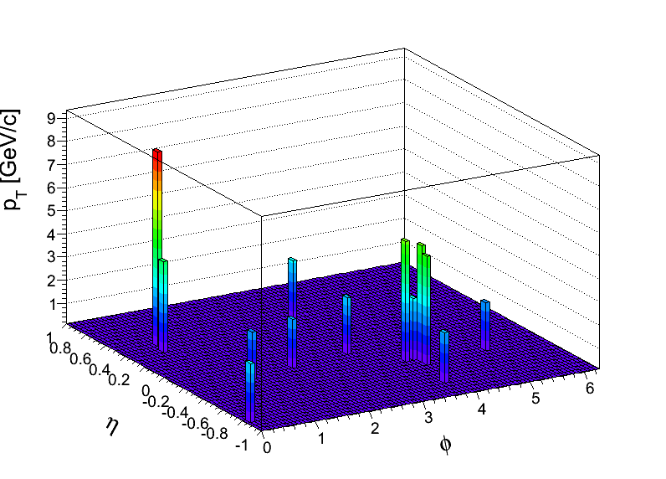
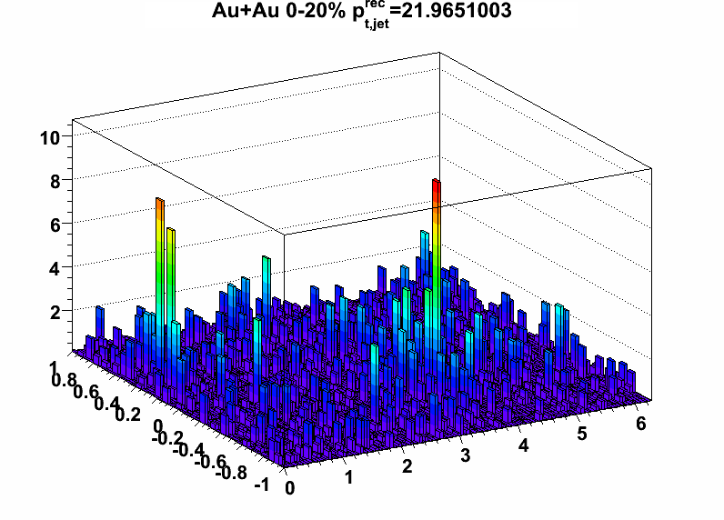
Null-Hypothesis:
Balance Restored by Uncorrelated BG?
Method 1: Random Cone (RC):
Take di-jet pair pT^{Cut}>2 GeV/c (w/o low pT)
pT^{Cut}=2 GeV/c
pT^{Lead}>20 GeV
pT^{SubLead}>10 GeV
Embed randomly
Calculate |AJ| with pT^{Cut}>0.2 GeV/c
using cone of R
the 2 Jet vectors
into a central
Au+Au MB event
pT [GeV/c]
Embed the two Jet
vectors into a Au+Au HT
event, 2R away from
reconstructed di-jet
pair in that event
Method 2: EtaCone (EC):
Take di-jet pair
pT^{Cut}>2 GeV/c (w/o low pT)
η
ϕ

Slide 10
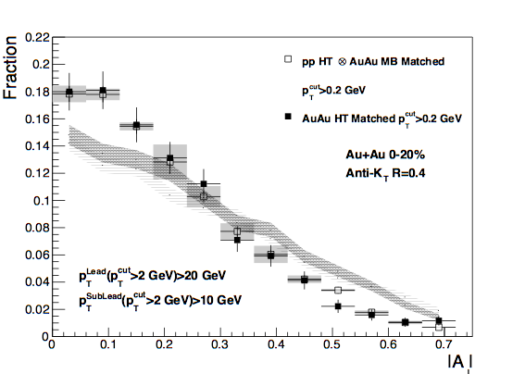
Effect of Background Fluctuations
Anti-kT R=0.4, pT^{Lead}>20 GeV & pT^{SubLead}>10 GeV with pT^{cut}>2 GeV/c
Event Fraction
Sys. Uncertainties:
- tracking eff. 6%
- tower energy
scale 2%
Central Au+Au
anti-k_{T}, R=0.4
Preliminary
Method 2
(EC)
Method 1
(RC)
|AJ|
Balancing of Au+Au matched di-jets due to
correlated signal yield in a cone of R=0.4

Slide 11
Differential Measurements
R=0.2
Study Broadening
Jet Selection
R=0.4
Matched to
p_{T}^{Cut} > 0.2 GeV/c
R=0.4
Matched to
Study Softening
p_{T}^{Cut} > 2 GeV/c
Geom. matching: ΔR<0.4
p_{T}^{Cut} > 1 GeV/c

Slide 12
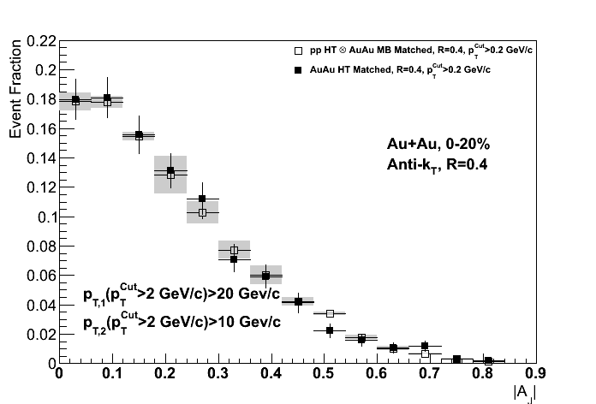
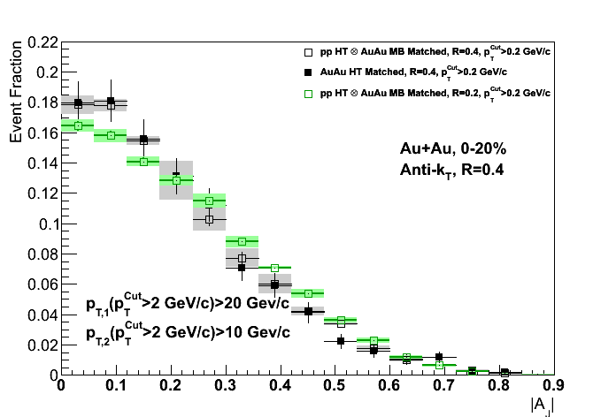
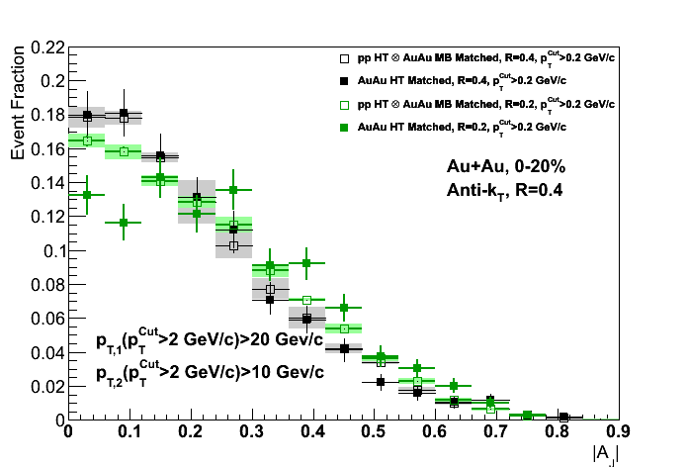
Jet Broadening – Match to
R=0.2
Anti-kT R=0.4 and 0.2, pT^{Lead}>20 GeV & pT^{SubLead}>10 GeV with pT^{cut}>2 GeV/c
Central Au+Au
anti-k_{T}, R=0.4
Sys. Uncertainties:
- tracking eff. 6%
- tower energy
scale 2%
p-value = 0.8
(stat. error only)
Preliminary
p-value = 2 × 10⁻⁴
(stat. error only)
For the same R=0.4, pT,1>20, pT,2>10 GeV Jets,
balance can not be restored within R=0.2 → Broadening

Slide 13
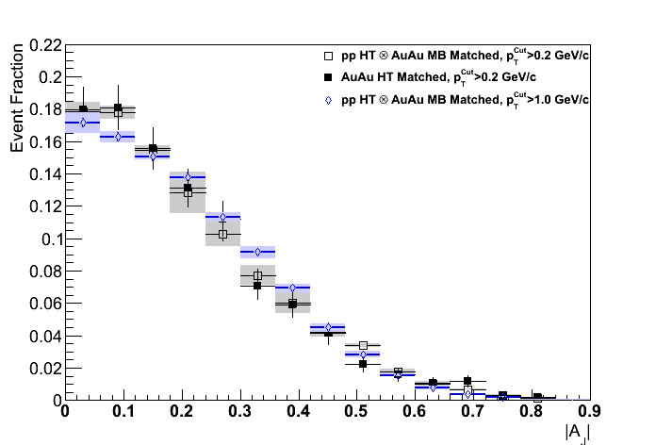
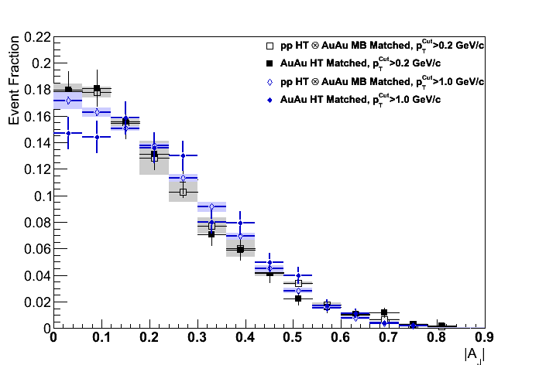
Jet Softening – Match to p_{T}^{Cut} = 1GeV/c
Anti-kT R=0.4 and 0.2, pT^{Lead}>20 GeV & pT^{SubLead}>10 GeV with pT^{cut}>2 GeV/c
Central Au+Au
anti-k_{T}, R=0.4
Sys. Uncertainties:
- tracking eff. 6%
- tower energy
scale 2%
p-value = 0.8
(stat. error only)
Preliminary
p-value =5-20%
(stat. error only)
p_{T}^{Cut} = 1GeV/c not sufficient to restore balance
→ signs of jet softening between 1 and 2 GeV/c

Slide 14
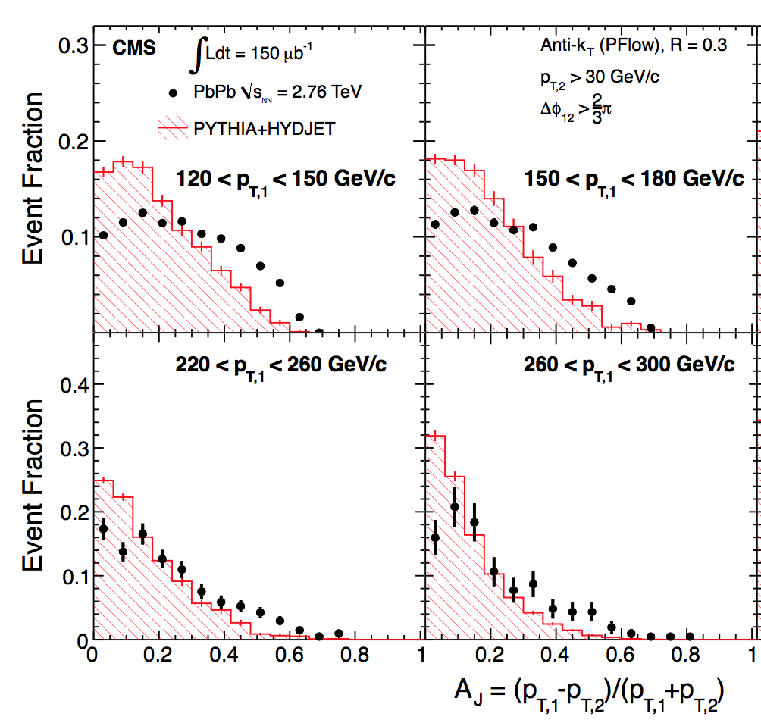
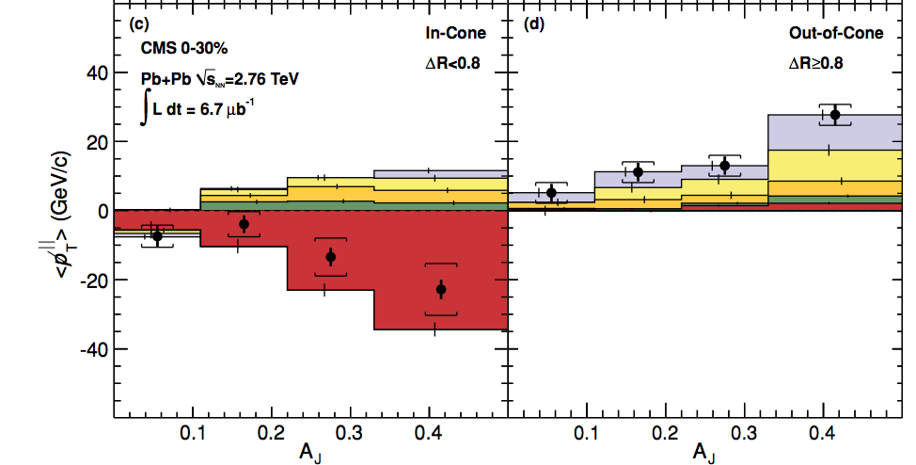
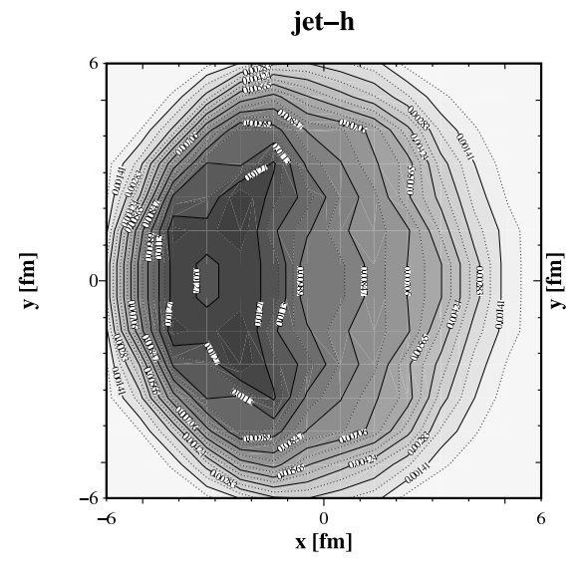
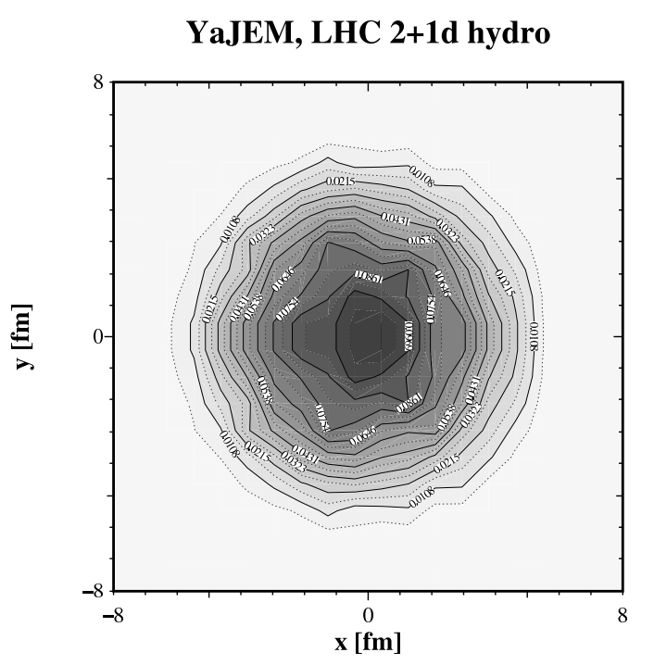
Discussion
For the first time: “Lost” energy of the dijets is recovered in a jet of R=0.4
for pT^{Cut} = 0.2 GeV/c
Interpretation:
(Constituent) pT^{Cut} = 2 GeV/c
+ High Tower
+ (Jet) pT^{Lead}>20 GeV/c
→ Surface Bias
+ (Recoil) pT^{SubLead}>10 GeV/c
→ Path Length Control
Contrast to LHC:
Large imbalance, balanced at large angles
“Unbiased” di-jet selection
→ longer path lengths
  & Larger energy loss at early times
→ more diffusion in medium
CMS, PRC 84,
024906 (2011)
STAR:
p_{T}^{lead}>15 GeV/c
pT^{cut}>2 GeV/c
T. Renk, PRC 87, 024905 (2013)
LHC:
A_{J} Dijet Trigger
T. Renk, PRC 85, 064908 (2012)

Slide 15
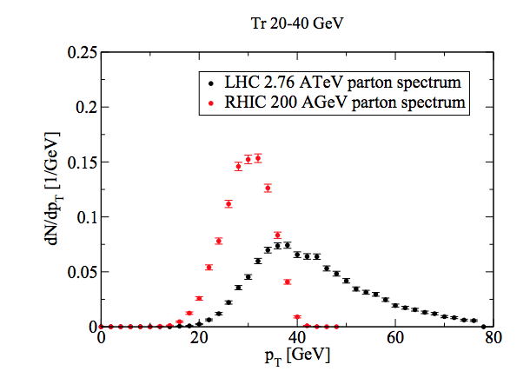
Unique Opportunity for Jet Geometry Engineering at RHIC
p_{T}^{SubLead} & Constituent p_{T} → systematically dial in the path length of the recoil jet
Dijet Imbalance = Recoil E-loss?
Found a “sweet spot”
Lost energy seems to be
contained within R=0.4
Matching: Differentially study
  Broadening – jet-by-jet
  Softening – jet-by-jet
  Future:
  Statistics × 7
  →Fragmentation function and
  radial profile of in-medium
  jet energy loss
RHIC Advantage:
Steeply falling spectrum
→ Good correlation between
jet and original energy
R=0.4,p_{T}^{Cut}>2 GeV/c
T. Renk, PRC 87, 024905 (2013)

Slide 16
Summary
Jet reconstruction of leading and recoil jet
→ Energy loss jet-by-jet instead of ensemble-based
A_{J}: Define a subset of imbalanced di-jets in Au+Au, that can be restored to pp balance
  “Lost” energy seems contained within R=0.4 and low p_{T}
  Imbalance remains for smaller cone or higher constituent cutoff
  → Observed Broadening and Softening jet-by-jet

Slide 17
Backup

Slide 18
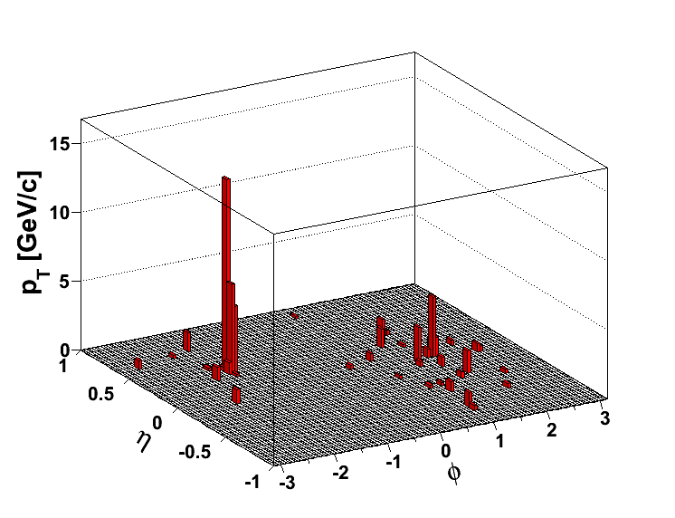
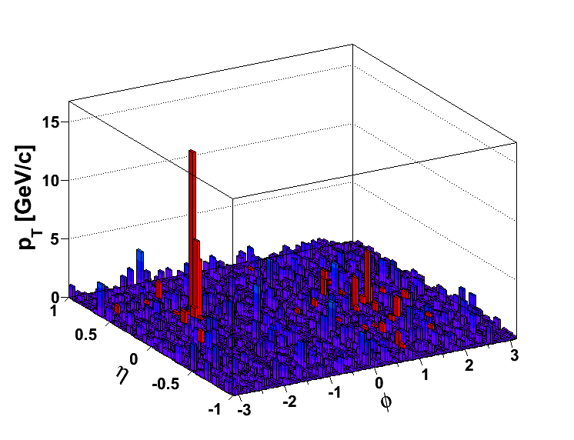
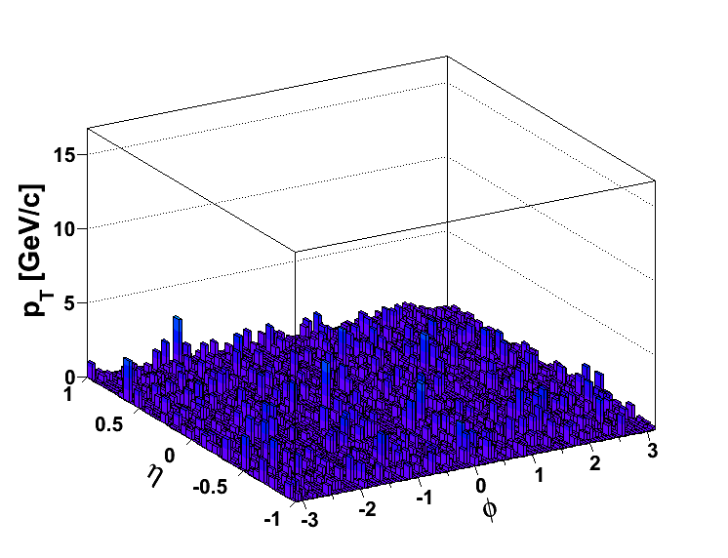
pp Reference
Au+Au HT
pp @ Au+Au
pp HT
Central Au+Au
Cannot compare
Compare
No correction to particle level. To compare on equal footing:
Embed full pp events into (unbiased) central events
Tower and efficiency uncertainty studied in pp

Slide 19
pp HT Reference and Systematic Errors
Reference:
pp HT ⊗ AuAu MB
Embed pp HT randomly
into AuAu 0-20% minimum
bias event, adjusted for
relative tracking efficiency
between pp HT Y06 and
AuAu HT Y07
Event Fraction
Preliminary
STAR, PRL 112, 122301 (2014)
Systematic Uncertainties (Analogous to Jet-Hadron Corr.)
- Tracking efficiency uncertainties 6%
- Relative Tower energy scale uncertainty 2%
- Background/vn: Null-Hypothesis Method1 vs. Method2
- Remaining uncertainties negligible

Slide 20
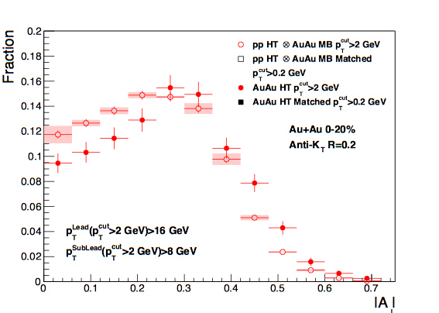
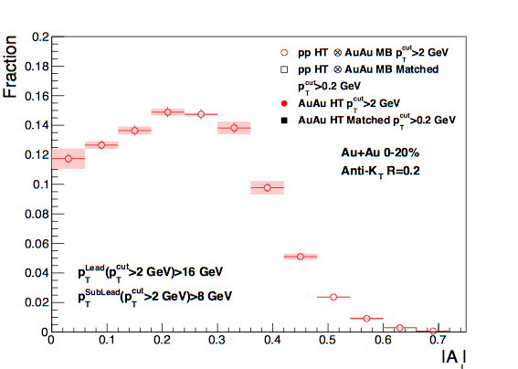
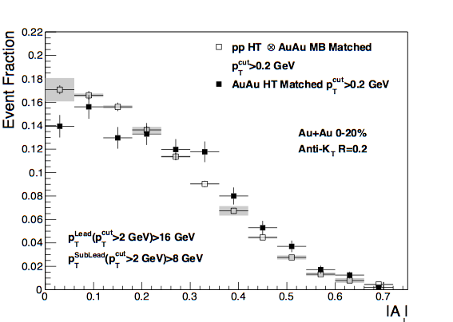
Di-Jet Imbalance AJ
Central Au+Au, R=0.2
Anti-kT R=0.2, pT^{Lead}>16 GeV & pT,^{SubLead}>8 GeV with pT^{cut}>2 GeV/c
Event Fraction
Sys. Uncertainties:
- tracking eff. 6%
- tower energy
scale 2%
p-value < 10⁻¹⁰
(stat. error only)
Central Au+Au
anti-k_{T}, R=0.2
p-value < 10⁻⁴
(stat. error only)
Preliminary
|AJ|
Matched Au+Au AJ ≠ p+p AJ for R=0.2
→ (recoil) Jet broadening in 0.2 − 0.4

Slide 21
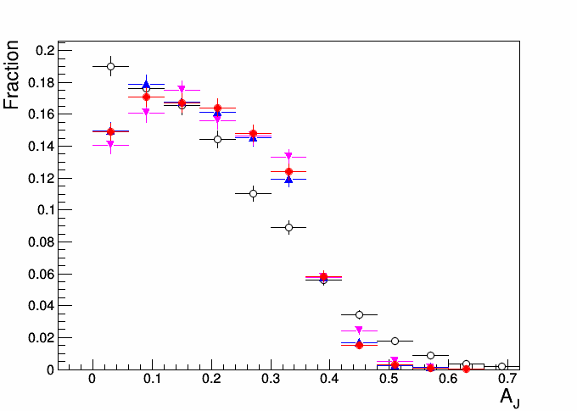
PYTHIA8 Particle Level (PL) and Toy Bkg. Model
Anti-kT R=0.4, pT,1>20 GeV & pT,2>10 GeV with pT^{cut}>2 GeV
Pythia8 PL
Pythia8 PL & Bkg
Pythia8 PL & Bkg (v2)
Pythia8 PL & Bkg
& track eff. Y07
Event Fraction

