Slide 1
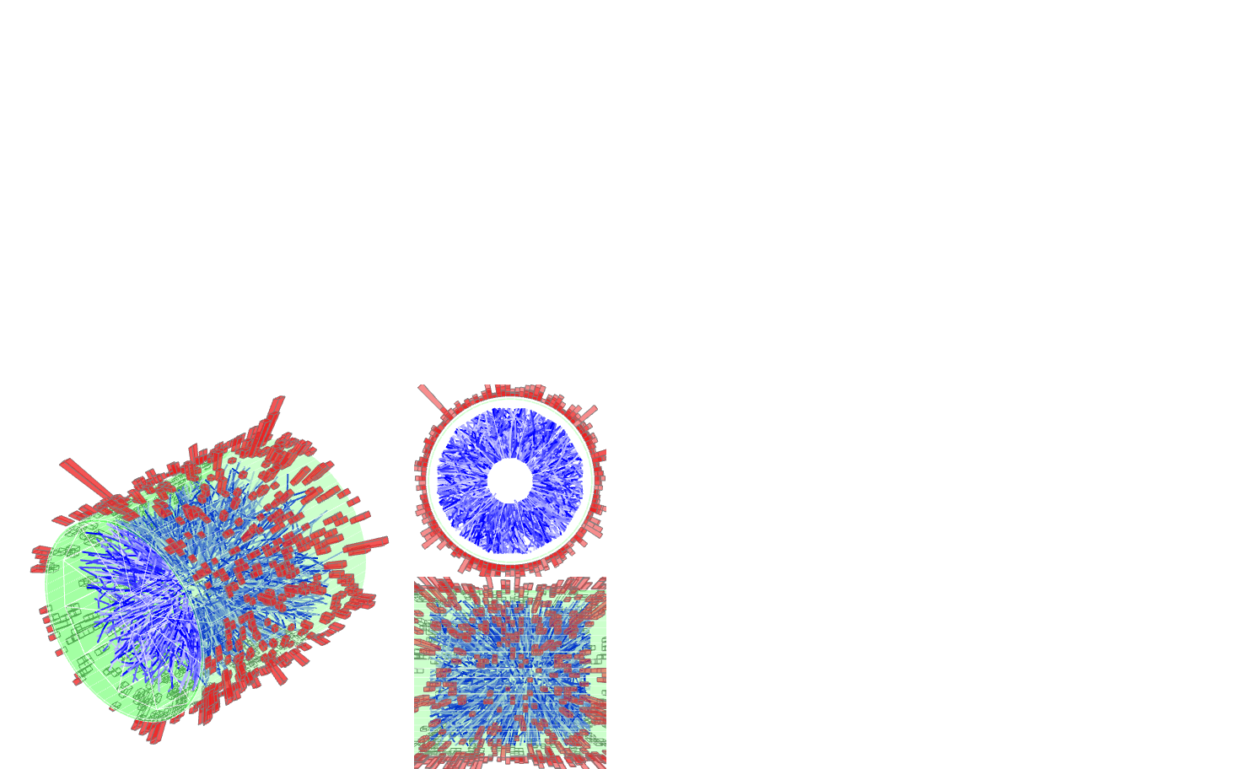


Di-Jet Imbalance Measurements in
Central Au+Au Collisions at √s_{NN}=200 GeV from STAR
Kolja Kauder for the STAR Collaboration
April 14, 2016

Slide 2
Overview
Motivation
Data Analysis
  Data Selection and Jet Reconstruction
  Method
Results
Summary

Slide 3
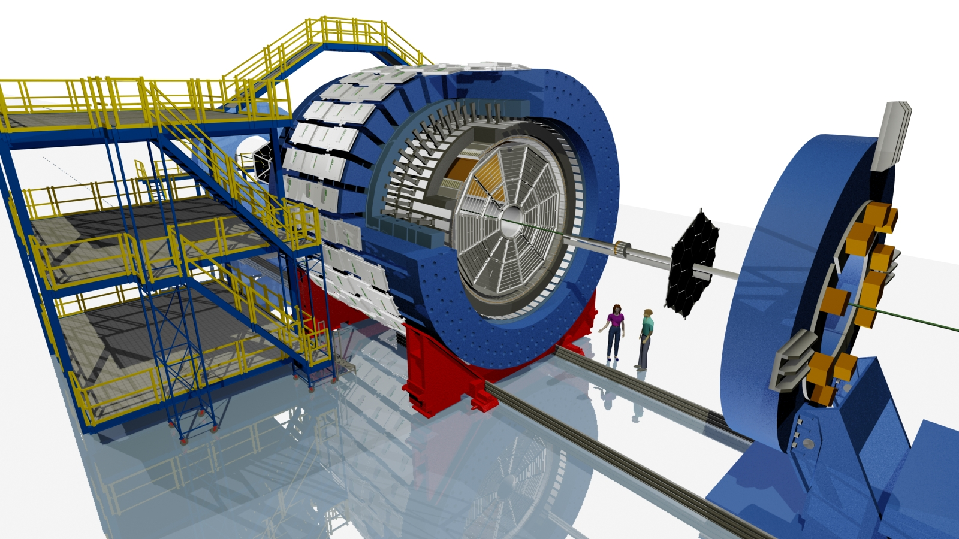
STAR
Charged and neutral particles:
Full azimuthal acceptance
Extended pseudorapidity acceptance |η|<1
Online Trigger
E_{T}> 5.4 GeV
in one tower
Δφ x Δη = 0.05 x 0.05
BEMC
Magnet
TPC
© Maria & Alex Schmah
Au+Au, 200 GeV

Slide 4
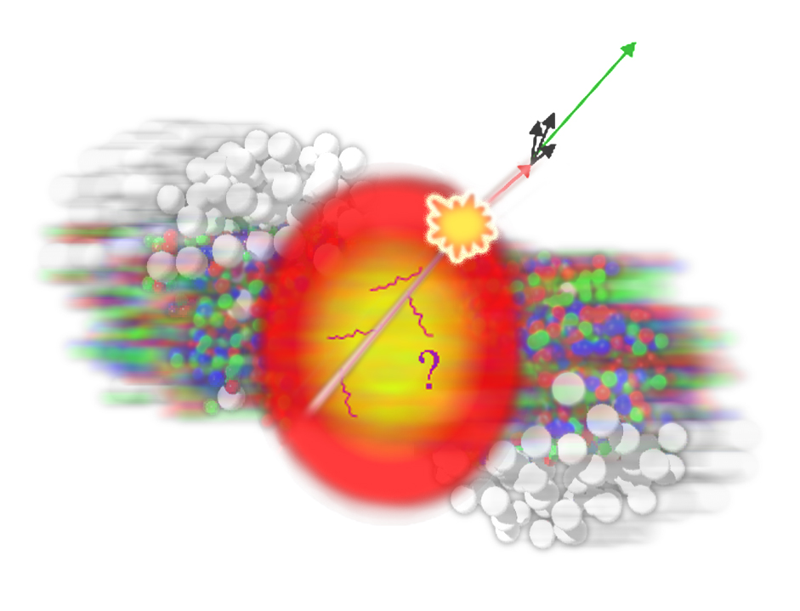
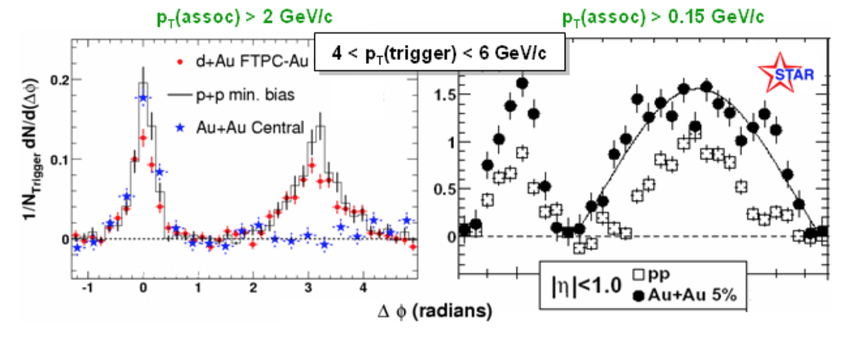
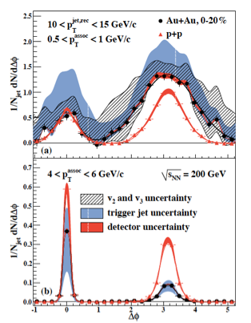
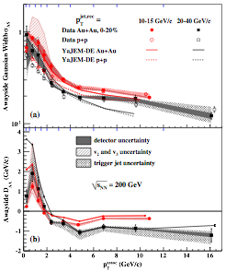
Jets Through Correlations
Di-hadron
STAR, PRL 91, 072304 (2003)
STAR, PRL 95,152301 (2005)
Suppression at high p_{T}
balanced by
Enhancement at low p_{T}
Broadening in Δφ
Jet-hadron
STAR, PRL 112, 122301 (2014)

Slide 5
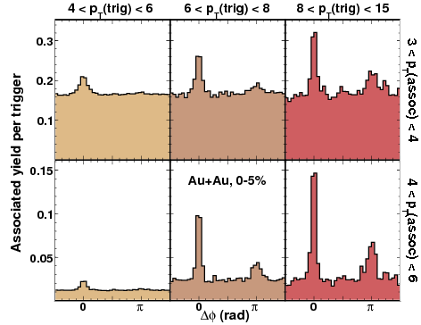
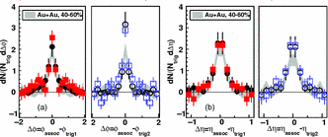
Di-Jets in Correlations
Di-Jets
STAR, PRL 97, 162301 (2006)
hard trigger → small modification
hard trigger on both sides
→ tangential bias
All Correlations: Ensemble-based
“jets lose x amount of energy on average”
Goal: reconstruct both sides of a hard scattering
→ jet-by-jet E-loss
“this di-jet pair has x amount of imbalance”
2+1
STAR, PRC 83, 061901 (2011)

Slide 6
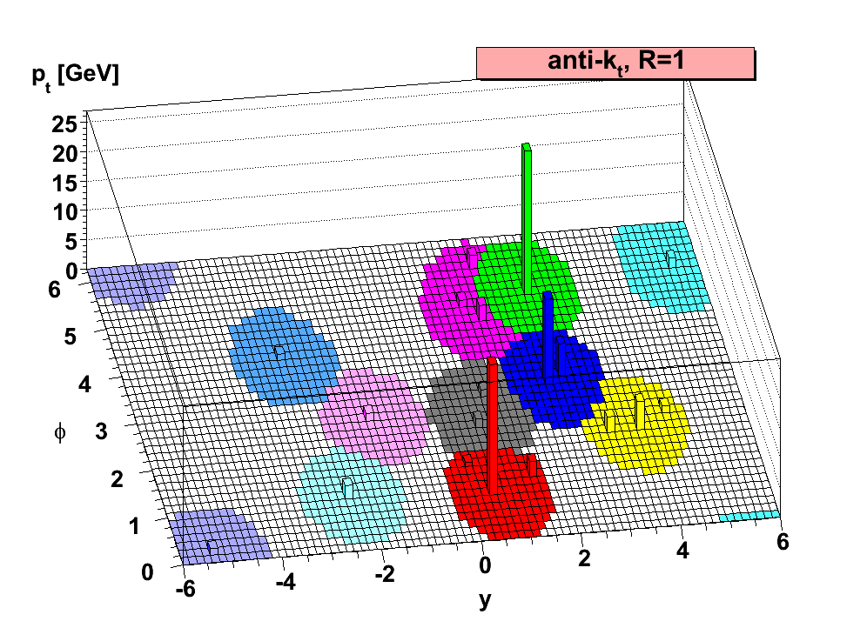
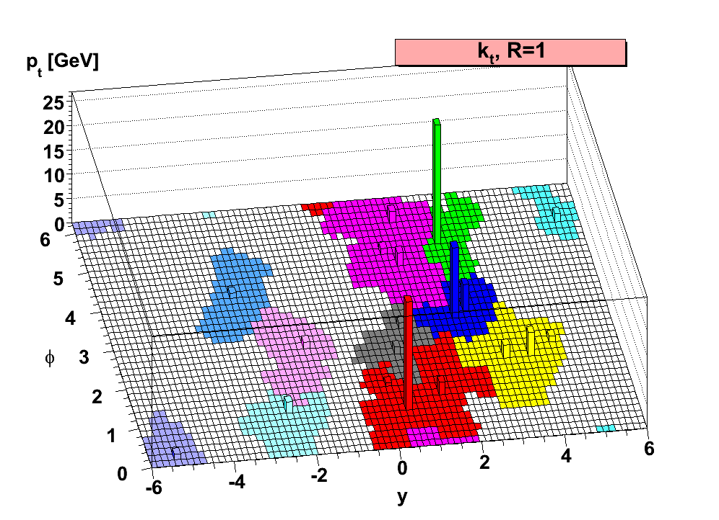
Jet Finding
Implementation:
FastJet3
M. Cacciari and G. Salam
Phys. Lett. B 641, 57 (2006)
Sequential Clustering:
anti-k_{T}, R=0.2—0.5
average energy density:
k_{T} algorithm, same R
Resulting clusters are jets.
  Operational definition. No unambiguous jet definition exists!
Advantages:
  Minimize sensitivity to hadronization:
  IR-safe and collinear-safe algorithm and instrumentation
  Measure energy flow: connect to dynamics of partons
  Comparison to QCD calculations beyond event generators

Slide 7
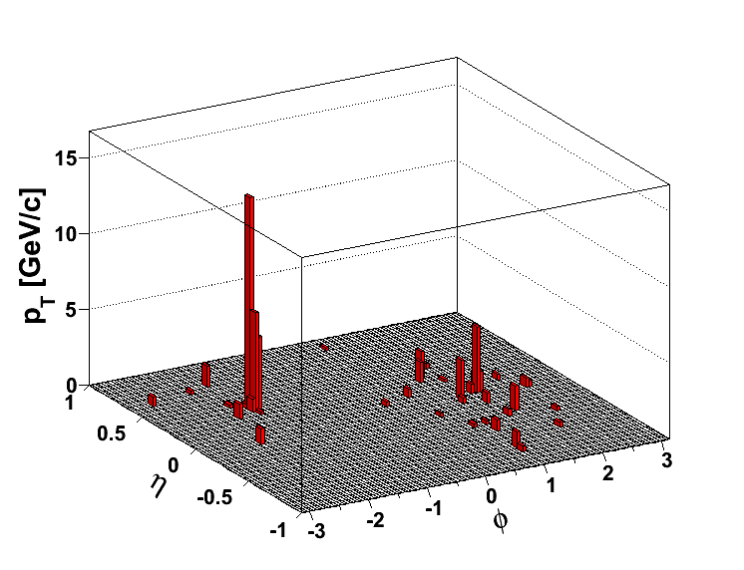
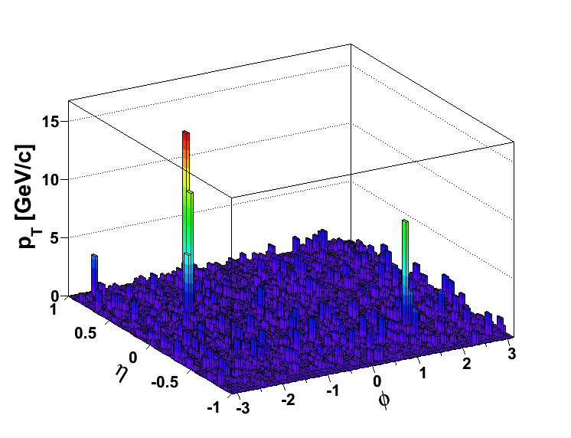
The Underlying Heavy Ion Event
pp
@200 GeV
Central Au+Au @ 200 GeV
< Σ p_{T} > in an R= 0.4 cone is on the order of ~25 GeV/c
Intra-event fluctuations: ~6 GeV/c
Can still find a “jet”, but does it come from a hard scattering?
And if so, how to determine the parton energy?

Slide 8
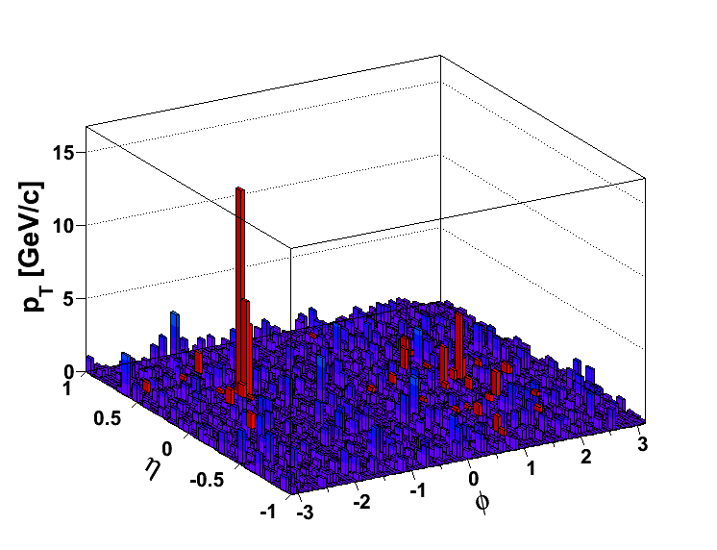
Background
Subtract average density:
Fluctuations and Detector Effects: Embed reference in AuAu
Compare on detector level
20 GeV fluctuations are rare (~3σ)
– but 20 GeV jets are rare as well
How to select hard scatters?
Focus on “coincidence” measurements
Di-Jet Asymmetry
pp @ Au+Au
ATLAS, PRL 105, 252303
CMS, PRC 84, 024906 (2011)

Slide 9
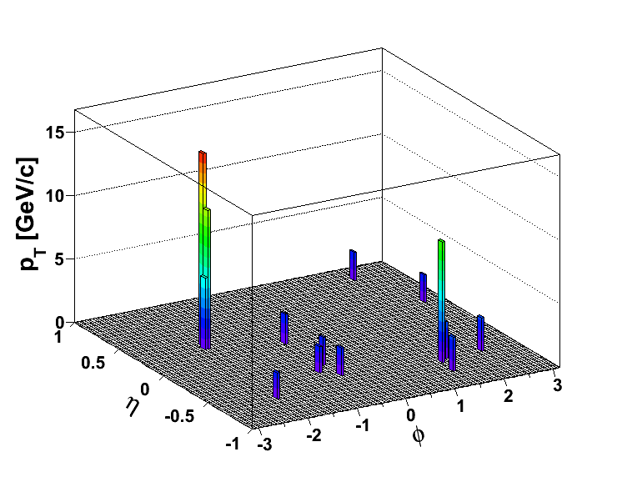
(Biased) Di-Jet Selection
Constituent pT^{Cut} = 0.2 GeV/c
Constituent pT^{Cut} = 2 GeV/c
→ Reduce BG
→ Reduce combinatorial jets
Di-jet Selection:
Jet pT^{Lead}>20 GeV/c
Jet pT^{SubLead}>10 GeV/c
|Δφ-π|<0.4

Slide 10
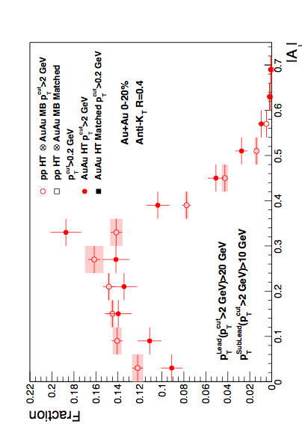
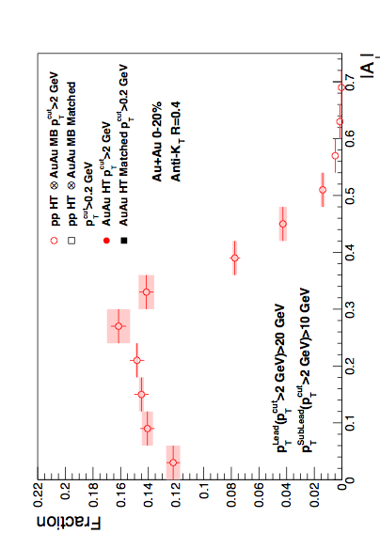

Di-Jet Imbalance AJ
Central Au+Au, R=0.4
Anti-kT R=0.4, pT^{Lead}>20 GeV & pT^{SubLead}>10 GeV with pT^{cut}>2 GeV/c
Event Fraction
Central Au+Au
anti-k_{T}, R=0.4
p-value < 10⁻⁴
(stat. error only)
Sys. Uncertainties:
- tracking eff. 6%
- tower energy
scale 2%
Preliminary
Pearson’s χ²-test
N.D. Gagunashvili,
arXiv:physics/0605123
|AJ|
Au+Au di-jets more imbalanced than p+p for pT^{cut}>2 GeV/c
Can the balance be restored?

Slide 11
Matched Di-jets w/o Constituent p_{T} Cut
pT^{Cut}=2 GeV/c
pT^{Lead}>20 GeV/c
pT^{SubLead}>10 GeV/c
|Δφ-π|<0.4
pT^{Cut}=0.2 GeV/c
pT^{Lead}>20 GeV/c (pT^{Cut}=2 GeV/c)
pT^{SubLead}>10 GeV/c (pT^{Cut}=2 GeV/c)
Rerun jet-finding algorithm
anti-kT on these events
Geom. matching
Geom. matching
Keep this jet selection
Calculate “matched” |AJ| with constituent pT,cut>0.2 GeV/c.
Geom. matching: ΔR<0.4

Slide 12
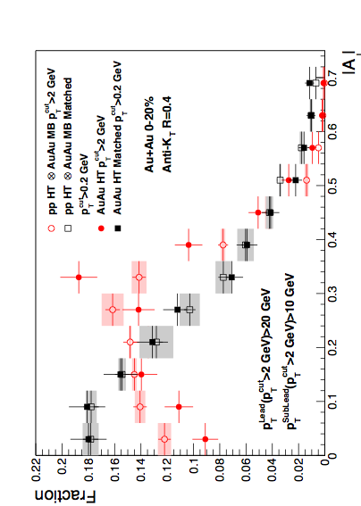
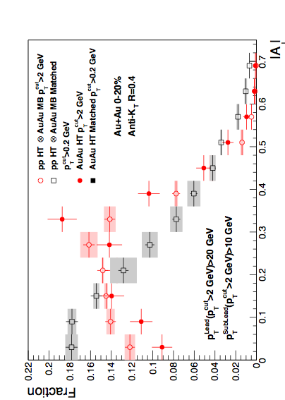
Di-Jet Imbalance AJ
Central Au+Au, R=0.4
Anti-kT R=0.4, pT^{Lead}>20 GeV & pT^{SubLead}>10 GeV with pT^{cut}>2 GeV/c
Event Fraction
p-value < 10⁻⁴
(stat. error only)
Sys. Uncertainties:
- tracking eff. 6%
- tower energy
scale 2%
Central Au+Au
anti-k_{T}, R=0.4
p-value = 0.8
(stat. error only)
Preliminary
|AJ|
Au+Au di-jets more imbalanced than p+p for pT^{cut}>2 GeV/c
Au+Au AJ ~ p+p AJ for matched di-jets (R=0.4)

Slide 13
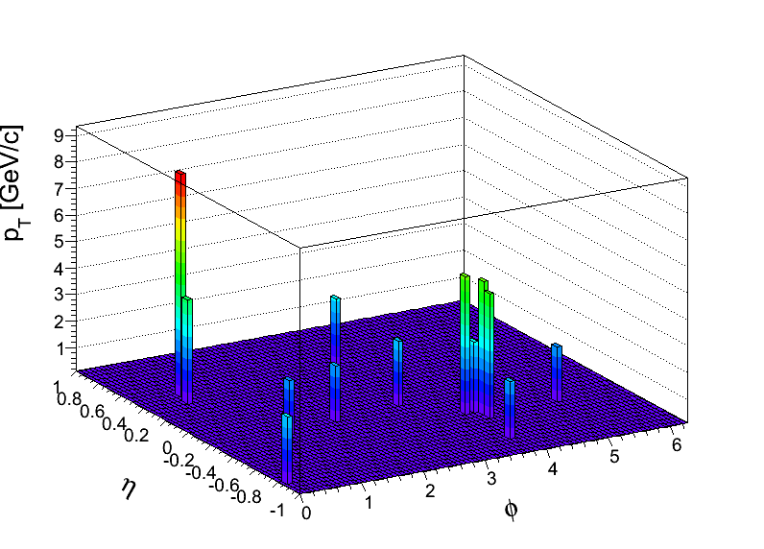
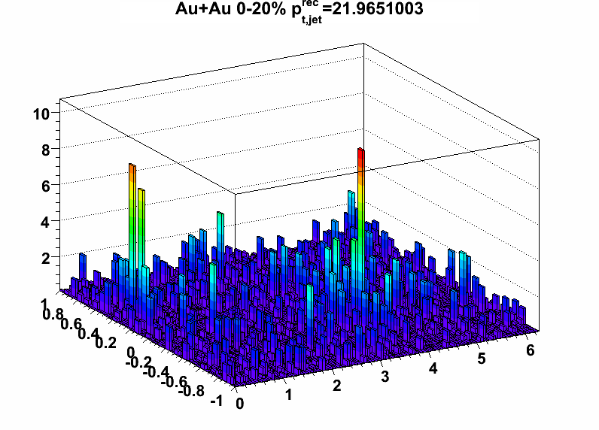
Null-Hypothesis:
Balance Restored by Uncorrelated BG?
Method 1: Random Cone (RC):
Take di-jet pair pT^{Cut}>2 GeV/c (w/o low pT)
pT^{Cut}=2 GeV/c
pT^{Lead}>20 GeV
pT^{SubLead}>10 GeV
Embed randomly
Calculate |AJ| with pT^{Cut}>0.2 GeV/c
using cone of R
the two Jet vectors
into a central
Au+Au MB event
pT [GeV/c]
Embed the two Jet
vectors into a Au+Au HT
event, 2R away from
reconstructed di-jet
pair in that event
Method 2: EtaCone (EC):
Take di-jet pair
pT^{Cut}>2 GeV/c (w/o low pT)
η
ϕ

Slide 14
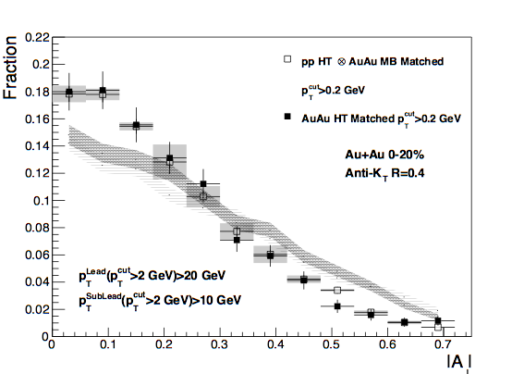
Effect of Background Fluctuations
Anti-kT R=0.4, pT^{Lead}>20 GeV & pT^{SubLead}>10 GeV with pT^{cut}>2 GeV/c
Event Fraction
Sys. Uncertainties:
- tracking eff. 6%
- tower energy
scale 2%
Central Au+Au
anti-k_{T}, R=0.4
Preliminary
Method 2
(EC)
Method 1
(RC)
|AJ|
Balancing of Au+Au matched di-jets due to
correlated signal yield in a cone of R=0.4

Slide 15
Differential Measurements
R=0.2
Study Broadening
Jet Selection
R=0.4
Matched to
p_{T}^{Cut} > 0.2 GeV/c
R=0.4
Matched to
Study Softening
p_{T}^{Cut} > 2 GeV/c
Geom. matching: ΔR<0.4
p_{T}^{Cut} > 1 GeV/c

Slide 16
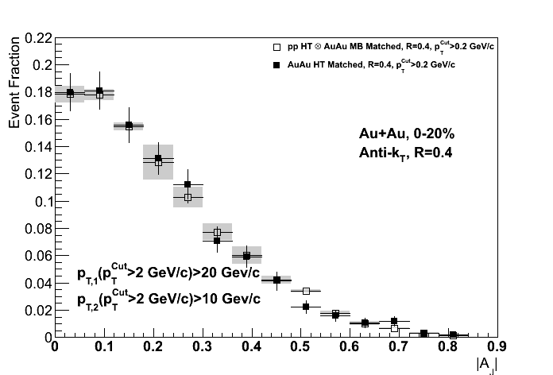
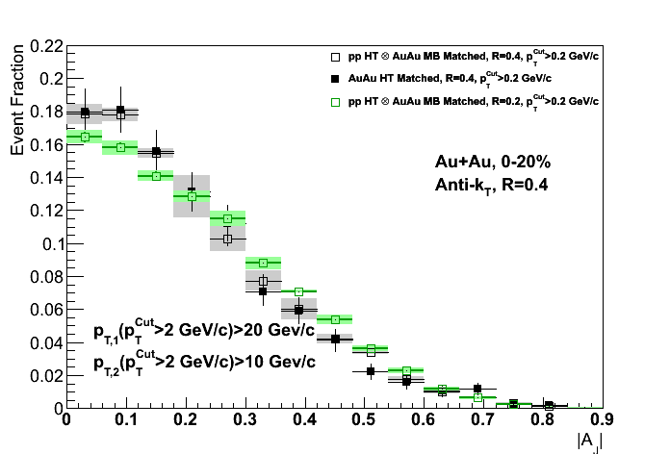
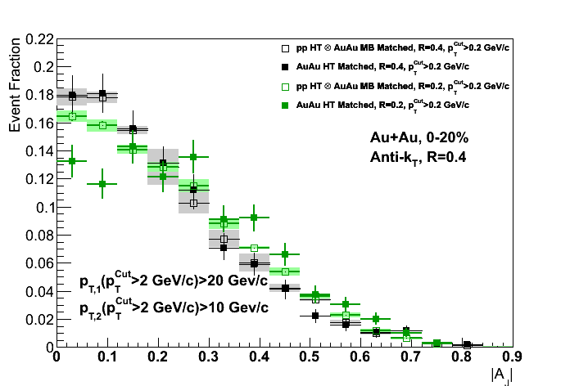
Jet Broadening – Match to
R=0.2
Anti-kT R=0.4 and 0.2, pT^{Lead}>20 GeV & pT^{SubLead}>10 GeV with pT^{cut}>2 GeV/c
Central Au+Au
anti-k_{T}, R=0.4
Sys. Uncertainties:
- tracking eff. 6%
- tower energy
scale 2%
p-value = 0.8
(stat. error only)
Preliminary
p-value = 2 × 10⁻⁴
(stat. error only)
For the same R=0.4, pT,1>20, pT,2>10 GeV Jets,
balance can not be restored within R=0.2 → Broadening

Slide 17
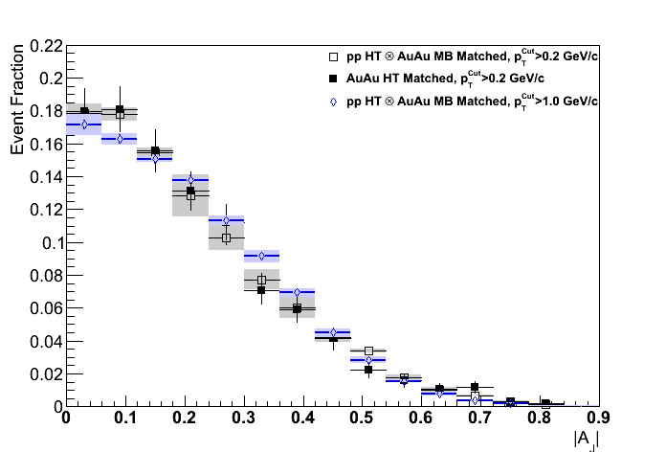
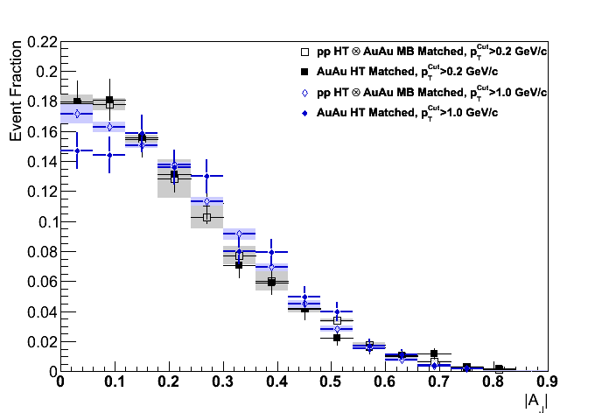
Jet Softening – Match to p_{T}^{Cut} = 1GeV/c
Anti-kT R=0.4 and 0.2, pT^{Lead}>20 GeV & pT^{SubLead}>10 GeV with pT^{cut}>2 GeV/c
Central Au+Au
anti-k_{T}, R=0.4
Sys. Uncertainties:
- tracking eff. 6%
- tower energy
scale 2%
p-value = 0.8
(stat. error only)
Preliminary
p-value =5-20%
(stat. error only)
p_{T}^{Cut} = 1GeV/c not sufficient to restore balance
→ signs of jet softening between 1 and 2 GeV/c

Slide 18
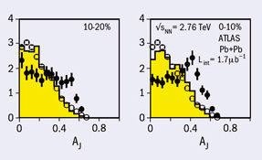
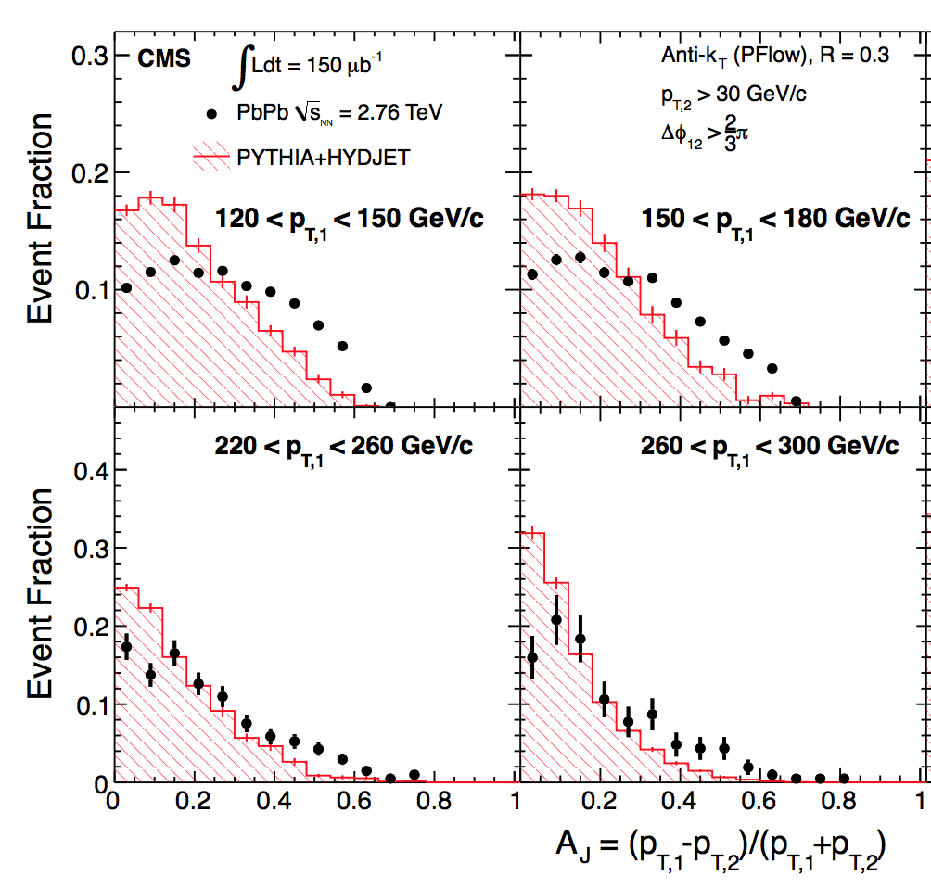
Contrast and Compare
Preliminary
“Hard Core”: Similar to LHC:
clear imbalance compared to pp
ATLAS, PRL 105, 252303
CMS, PRC 84, 024906 (2011)

Slide 19
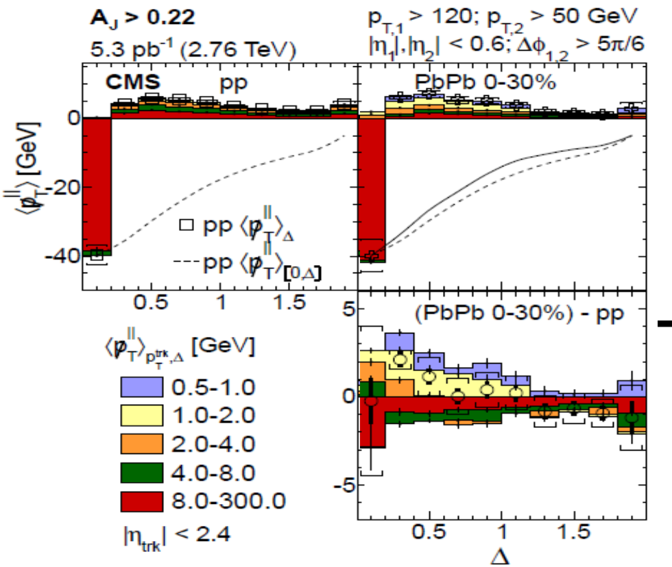
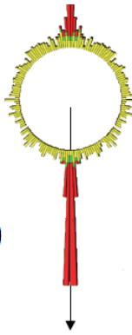

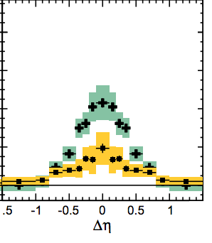

Contrast and Compare II
Missing Energy
LHC: Shifted to large angles
Preliminary
Jet-like yield
out to |ΔR|~1
RHIC: Contained in R=0.4
Shifted to lower p_{T}
CMS, JHEP 01 (2016) 006
CMS, JHEP 1602 (2016)

Slide 20
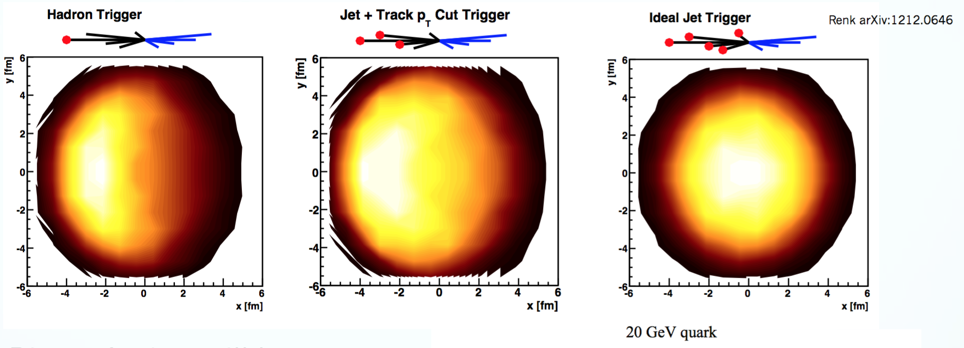
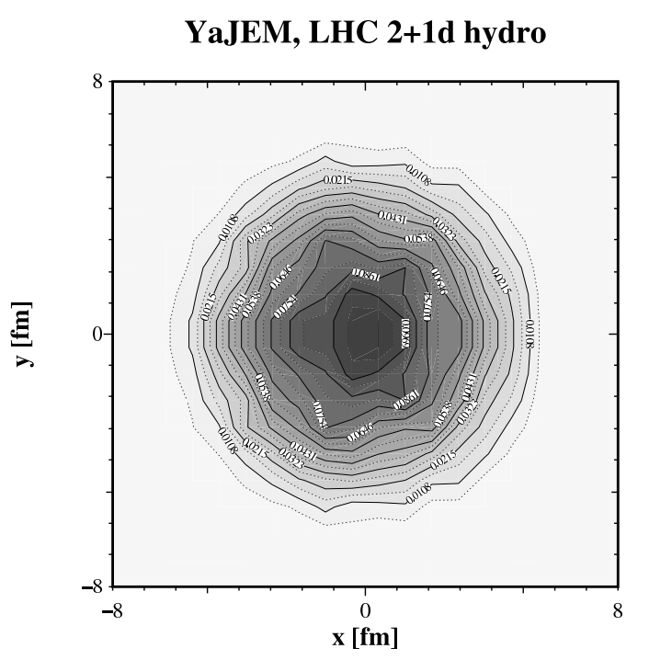
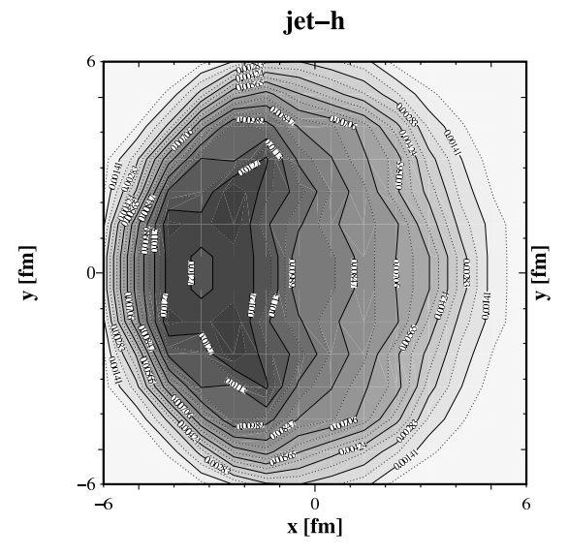
Geometric Biases
YaJEM, T. Renk
arXiv:1212.0646
PRC 85, 064908 (2012)
PRC 87, 024905 (2013)
STAR
LHC Dijets
hadron
jet
w/ cuts
ideal jet
dijet
STAR Interpretation:
(Constituent) pT^{Cut} = 2 GeV/c
+ High Tower
+ (Jet) pT^{Lead}>20 GeV/c
→ Surface Bias
+ (Recoil) pT^{SubLead}>10 GeV/c
→ Path Length Control
LHC:
“Unbiased” di-jet selection
longer path lengths & larger energy loss at early times
→ more diffusion in medium

Slide 21
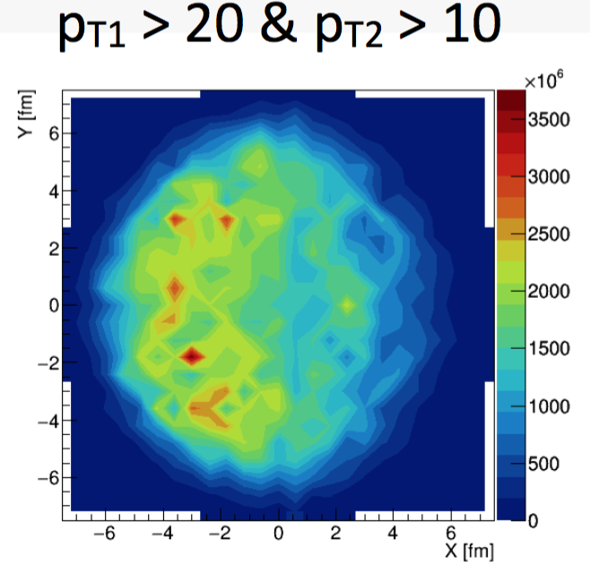
YaJEM Calculation for STAR Dijets
(First Look)
Courtesy of Kirill Lapidus
1D hydro
R = 0.4
constituent bias 2 GeV
5.5 hard track in either of two jets
back-to-back
Signs of creation hot spots shift by 2-4 fm
Needs further investigation
-- Be mindful of fluctuations and hydrodynamic expansion

Slide 22
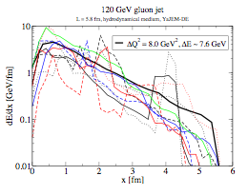
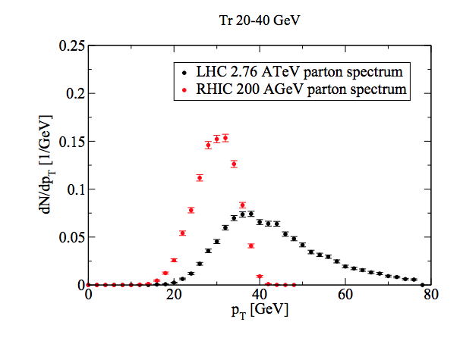
RHIC vs LHC
LHC:
Larger energy loss at early times
→ more diffusion in medium
→ larger angles
RHIC:
Quenched energy closer to initial
parton/jet direction. Can utilize biases
for systematic exploration.
→ (easier) to study soft gluon radiation
T. Renk, PRC 88, 044905 (2013)
RHIC Advantage:
Steeply falling spectrum
→ Good correlation between
jet and original energy
R=0.4,p_{T}^{Cut}>2 GeV/c
T. Renk, PRC 87, 024905 (2013)

Slide 23
Unique Opportunity for Jet Geometry Engineering at RHIC
p_{T}^{SubLead} & Constituent p_{T} → systematically dial in the path length of the recoil jet
Dijet Imbalance = Recoil E-loss?
Found a “sweet spot”
Lost energy seems to be
contained within R=0.4
Matching: Differentially study
  Broadening – jet-by-jet
  Softening – jet-by-jet
  Future:
  →Fragmentation function and
  radial profile of in-medium
  jet energy loss
Sampled Luminosity:
Run7 High Tower: 0.56 nb⁻¹
Run14 High Tower: 14 nb⁻¹
Statistics × 30

Slide 24
Summary
Jet reconstruction of leading and recoil jet
→ Energy loss jet-by-jet instead of ensemble-based
A_{J}: Define a subset of imbalanced di-jets in Au+Au, that can be restored to pp balance
  For the first time, “lost” energy seems contained within R=0.4 and low p_{T}
  Imbalance remains for smaller cone or higher constituent cutoff
  → Observed Broadening and Softening jet-by-jet

Slide 25
Backup

Slide 26
pp HT Reference and Systematic Errors
Reference:
pp HT ⊗ AuAu MB
Embed pp HT randomly
into AuAu 0-20% minimum
bias event, adjusted for
relative tracking efficiency
between pp HT Y06 and
AuAu HT Y07
Event Fraction
Preliminary
STAR, PRL 112, 122301 (2014)
Systematic Uncertainties (Analogous to Jet-Hadron Corr.)
- Tracking efficiency uncertainties 6%
- Relative Tower energy scale uncertainty 2%
- Background/vn: Null-Hypothesis Method1 vs. Method2
- Remaining uncertainties negligible

Slide 27
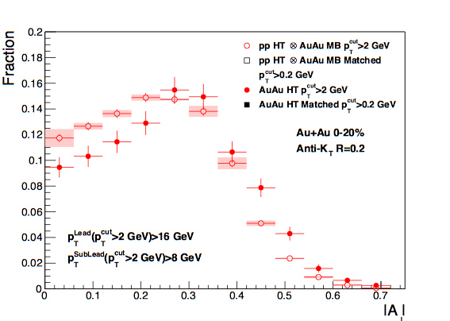
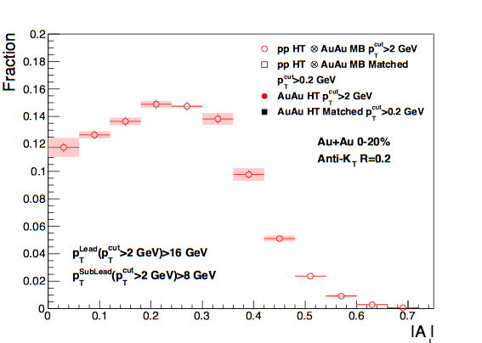
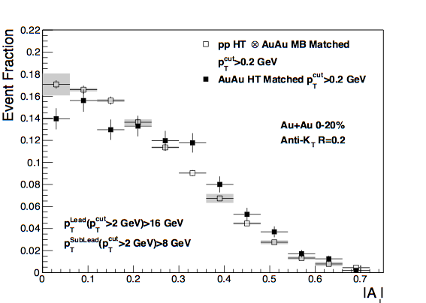
Di-Jet Imbalance AJ
Central Au+Au, R=0.2
Anti-kT R=0.2, pT^{Lead}>16 GeV & pT,^{SubLead}>8 GeV with pT^{cut}>2 GeV/c
Event Fraction
Sys. Uncertainties:
- tracking eff. 6%
- tower energy
scale 2%
p-value < 10⁻¹⁰
(stat. error only)
Central Au+Au
anti-k_{T}, R=0.2
p-value < 10⁻⁴
(stat. error only)
Preliminary
|AJ|
Matched Au+Au AJ ≠ p+p AJ for R=0.2
→ (recoil) Jet broadening in 0.2 − 0.4

Slide 28
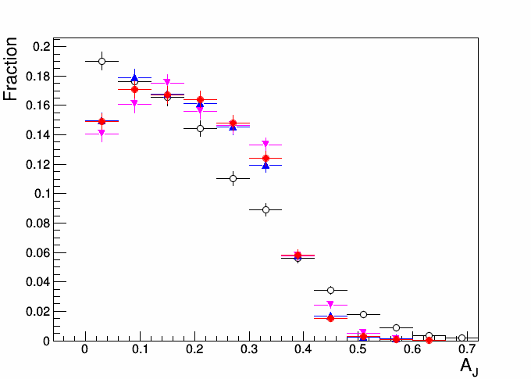
PYTHIA8 Particle Level (PL) and Toy Bkg. Model
Anti-kT R=0.4, pT,1>20 GeV & pT,2>10 GeV with pT^{cut}>2 GeV
Pythia8 PL
Pythia8 PL & Bkg
Pythia8 PL & Bkg (v2)
Pythia8 PL & Bkg
& track eff. Y07
Event Fraction

