Slide 1
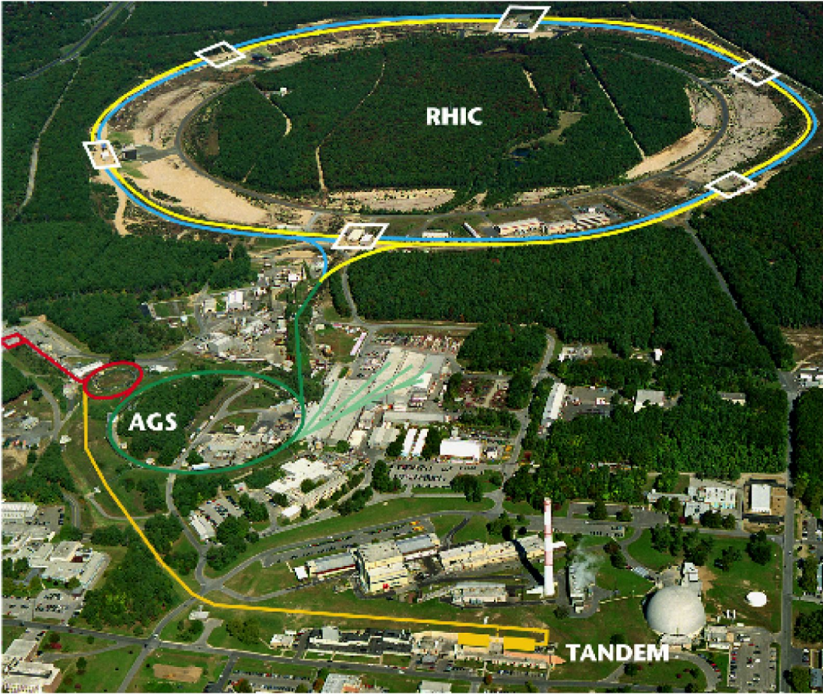
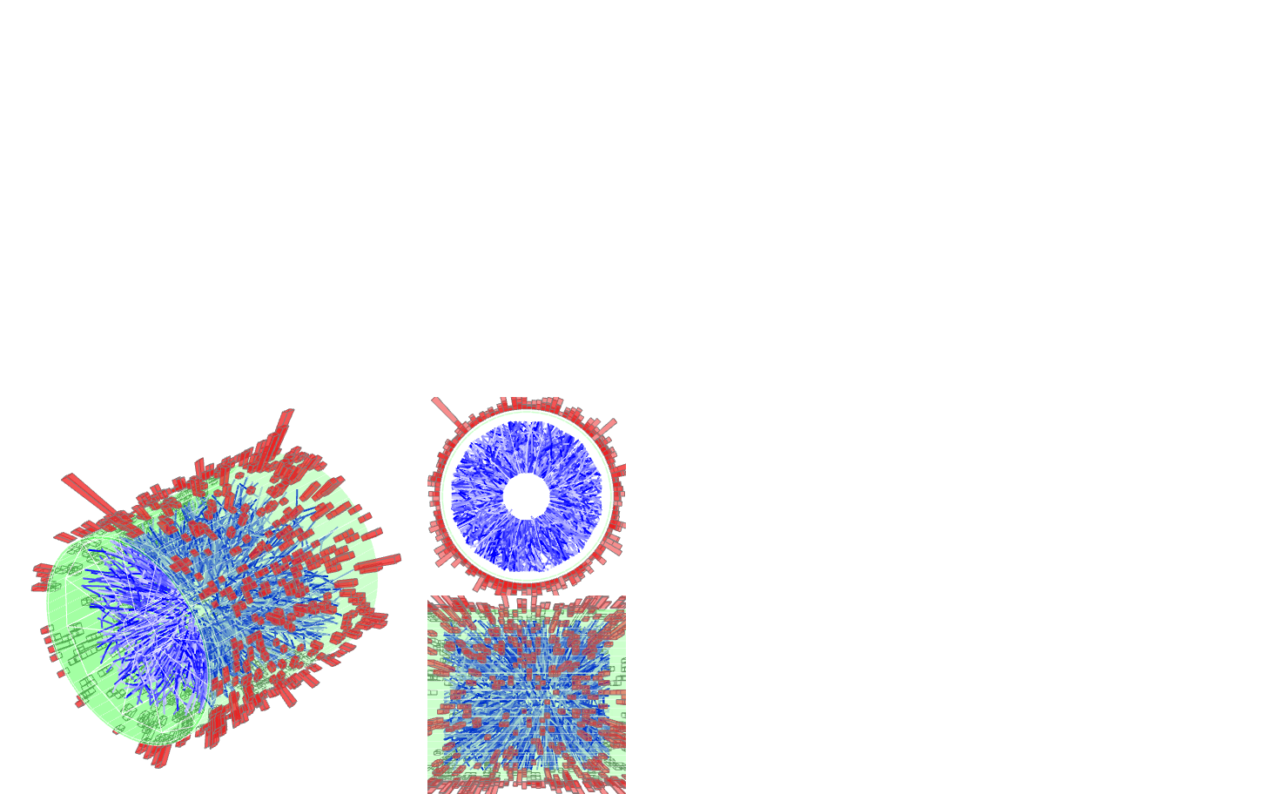


Jet Measurements with STAR with a focus on jet reconstruction
Kolja Kauder for the STAR Collaboration
June 8, 2016

Slide 2
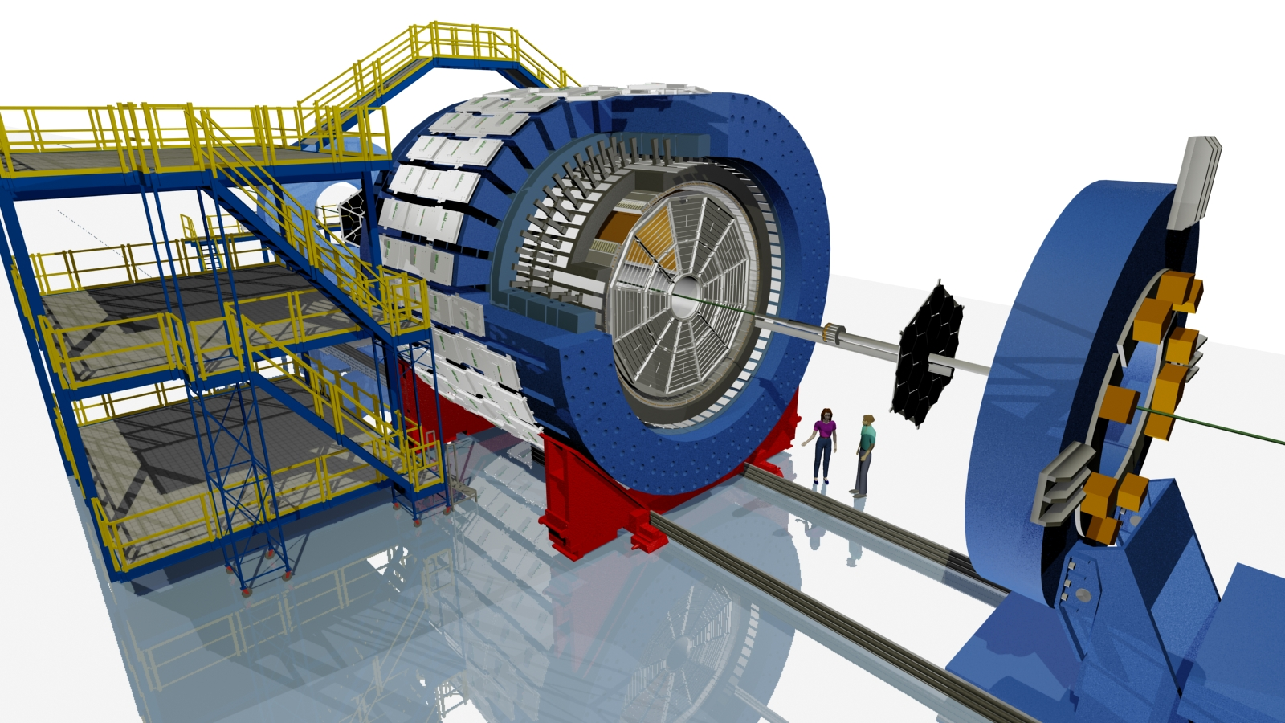
STAR
Charged and neutral particles:
Full azimuthal acceptance
Extended pseudorapidity acceptance |η|<1
High Tower: Online Trigger
E_{T}> 5.4 GeV
in one tower
Δφ x Δη = 0.05 x 0.05
BEMC
Magnet
TPC
© Maria & Alex Schmah
Au+Au, 200 GeV

Slide 3
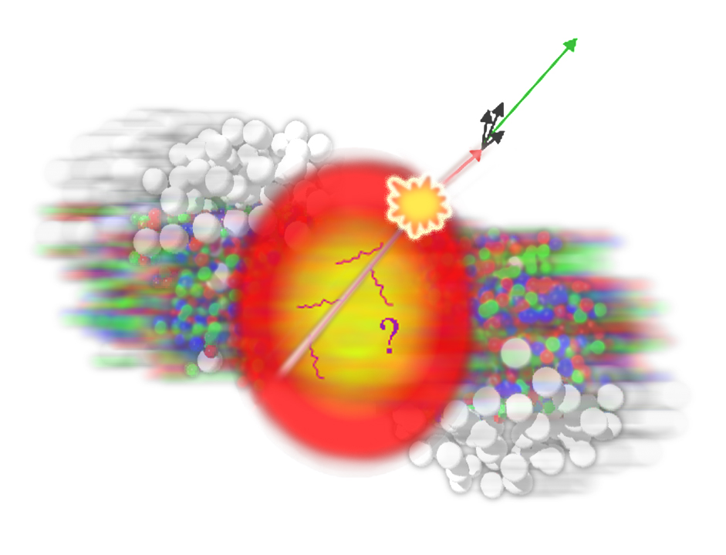
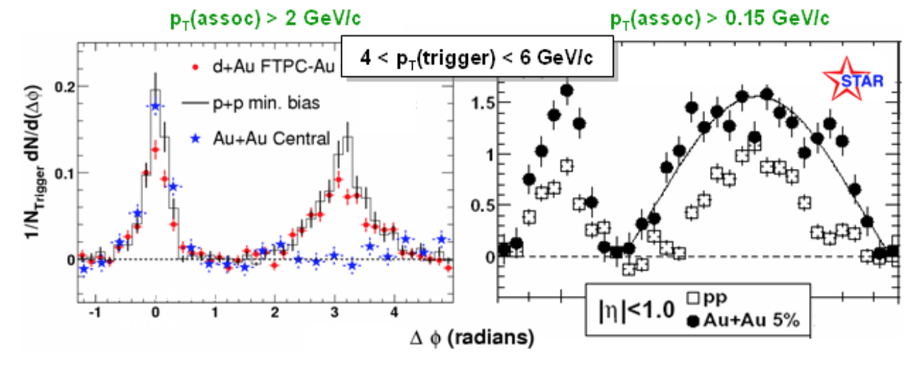
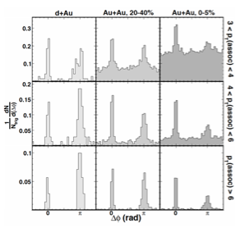
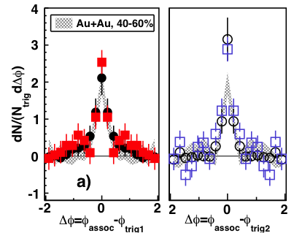
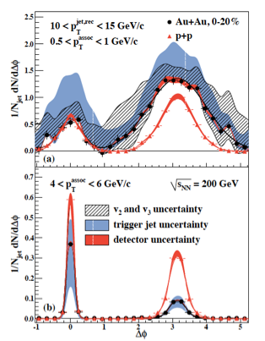
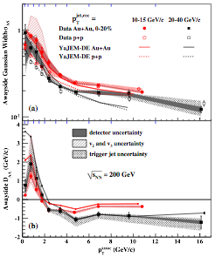
Correlations: Jet Quenching beyond R_{AA}
Di-hadron
STAR, PRL 91, 072304 (2003)
STAR, PRL 95,152301 (2005)
Di-Jets
STAR, PRL 97, 162301 (2006)
2+1
STAR, PRC 83, 061901 (2011)
Jet-hadron
STAR, PRL 112, 122301 (2014)
Hadron Correlations: Dependence on hadronization
Goal: partonic E-loss
All Correlations: Ensemble-based
“jets lose x amount of energy on average”
Goal: jet-by-jet E-loss
“this jet lost x amount of energy

Slide 4
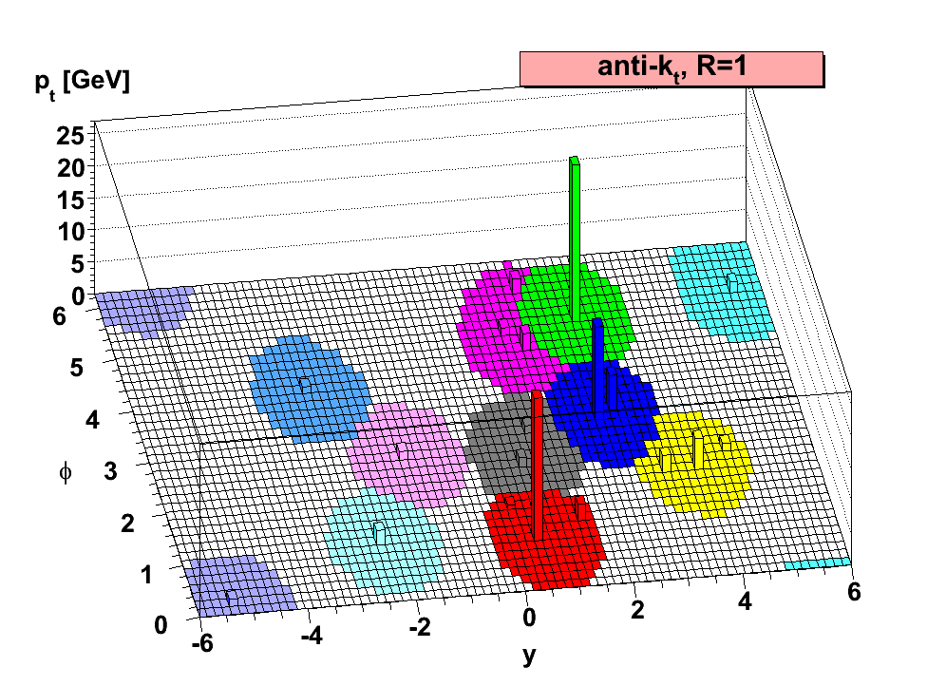
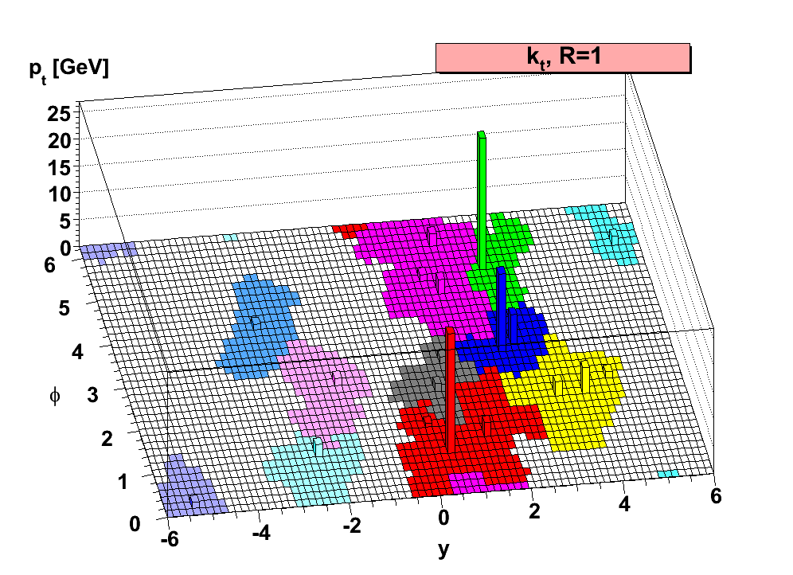
Jet Finding
Implementation:
FastJet3
M. Cacciari and G. Salam
Phys. Lett. B 641, 57 (2006)
Sequential Clustering:
anti-k_{T}, R=0.2—0.5
average energy density:
k_{T} algorithm, same R
Resulting clusters are jets.
  Operational definition. No unambiguous jet definition exists!
Advantages:
  Minimize sensitivity to hadronization:
  IR-safe and collinear-safe algorithm and instrumentation
  Measure energy flow: connect to dynamics of partons
  Comparison to QCD calculations beyond event generators

Slide 5
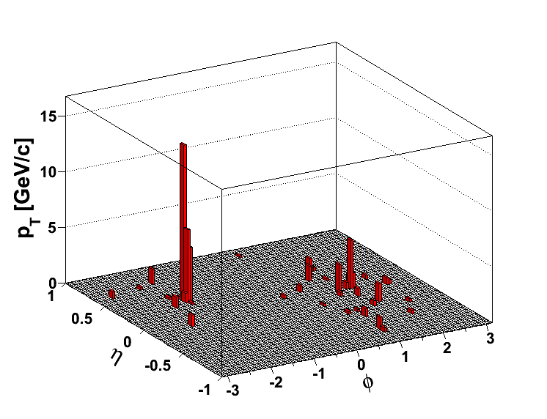
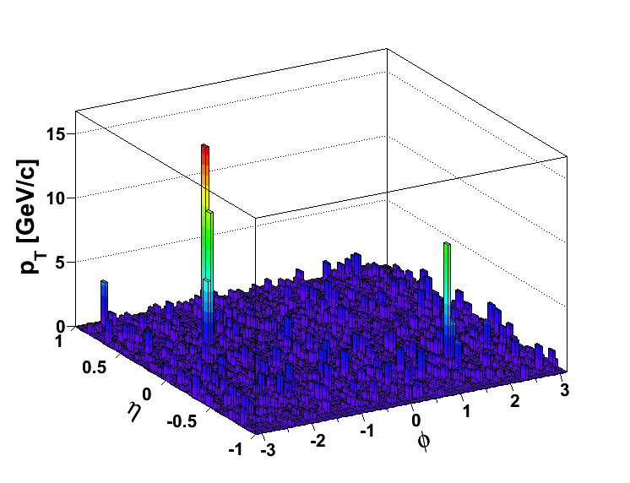
The Underlying Heavy Ion Event
pp
@200 GeV
Central Au+Au @ 200 GeV
< Σ p_{T} > in an R= 0.4 cone is on the order of ~25 GeV/c
Intra-event fluctuations: ~6 GeV/c
Can still find a “jet”, but does it come from a hard scattering?
And if so, how to determine the parton energy?

Slide 6
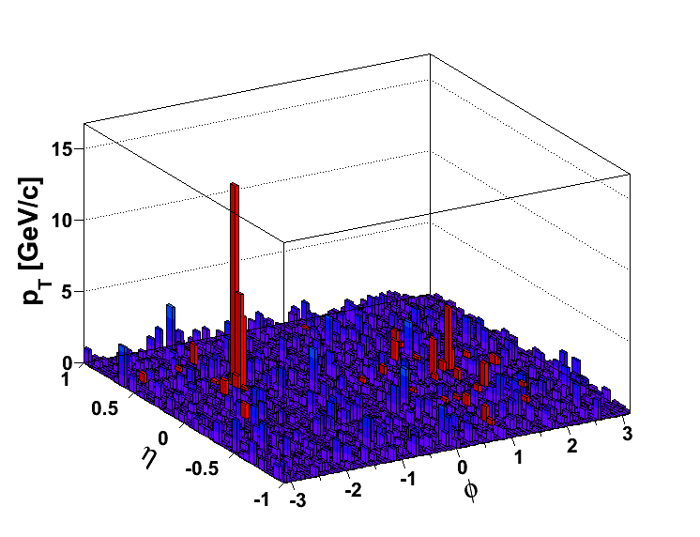
Background
Subtract average density:
Fluctuations and Detector Effects: Embed reference in AuAu
Compare on detector level
Or unfold response matrix
to particle level
20 GeV fluctuations are rare (~3σ)
– but 20 GeV jets are rare as well
How to select hard scatters?
Focus on “coincidence” measurements
Hadron-Jet correlations
Surface bias for trigger, but away- side is bias-free
Di-Jet Asymmetry
tangential bias
→ jet geometry engineering
Alternative: direct γ
→ see Nihar Sahoo’s talk
pp @ Au+Au

Slide 7
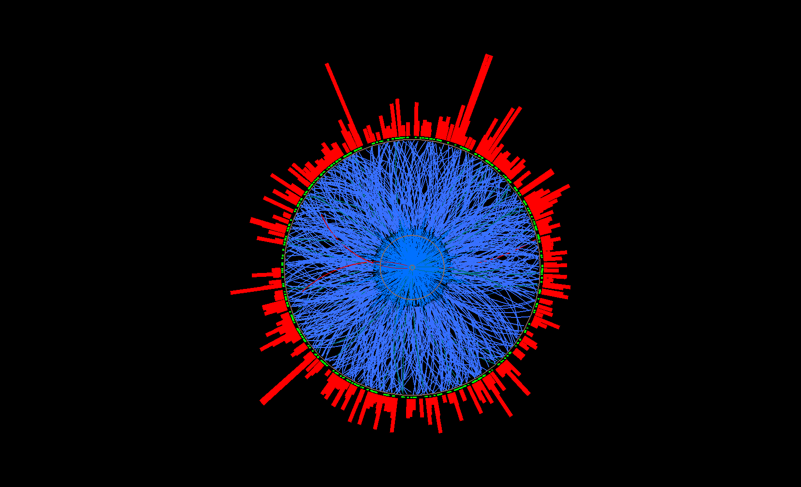
Semi-Inclusive Recoil Jets
Semi-Inclusive Recoil Jets
A. Schmah, HP 2015
Semi-inclusive yield of (charged) jets recoiling from a high-p_{T} hadron trigger
Recoil jet(s)
search area
Measured
Calculable in pQCD
Trigger
particle
Phys.Rev. D79 (2009) 114014
arXiv:0904.4402
- Trigger on high p_{T} hadron → Selection of a high p_{T} process
- Use all jet candidates on the other azimuthal hemisphere
within +/- 45 degrees → no fragmentation bias on recoil side!
- Combinatorial background determined via mixed events

Slide 8
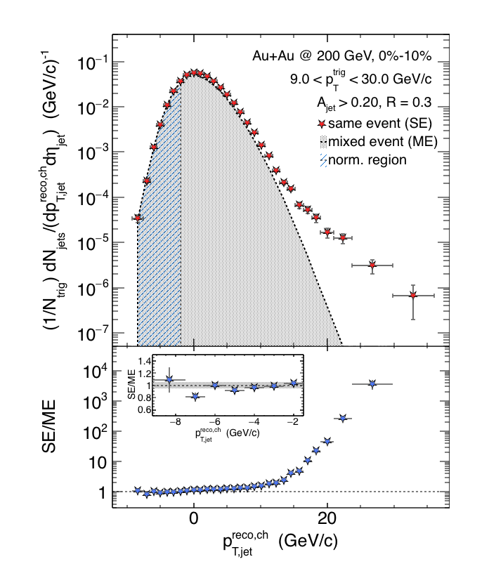
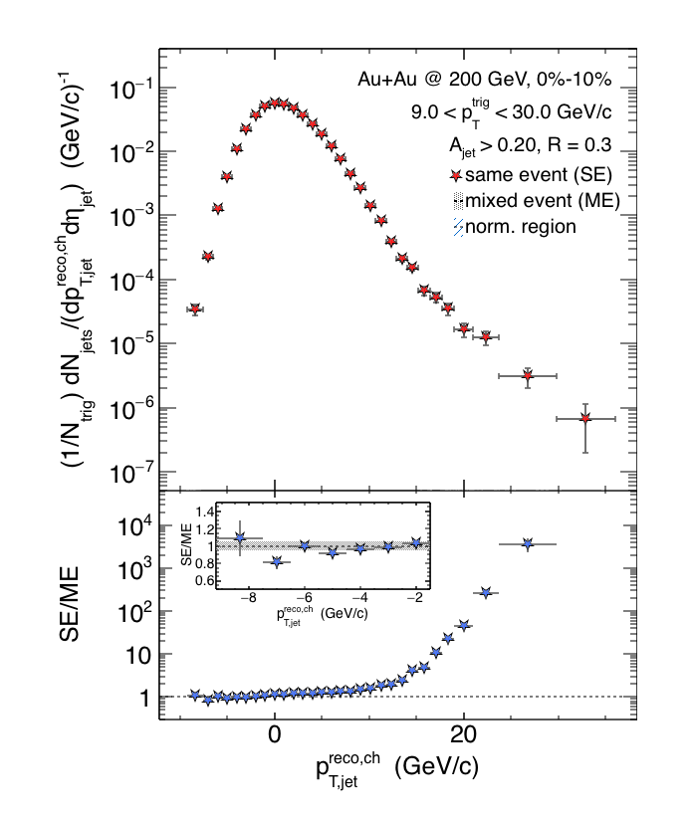

Charged Raw Recoil Jet Spectrum:
Central Au+Au
Central
- Excellent description of
low p_{T} SE spectrum with ME
- Normalization region varied
systematically
- Significant jet signal at
p_{T} - ρA > 10 GeV/c
Preliminary
Combinatorial jet background
statistically described by
mixed event technique

Slide 9
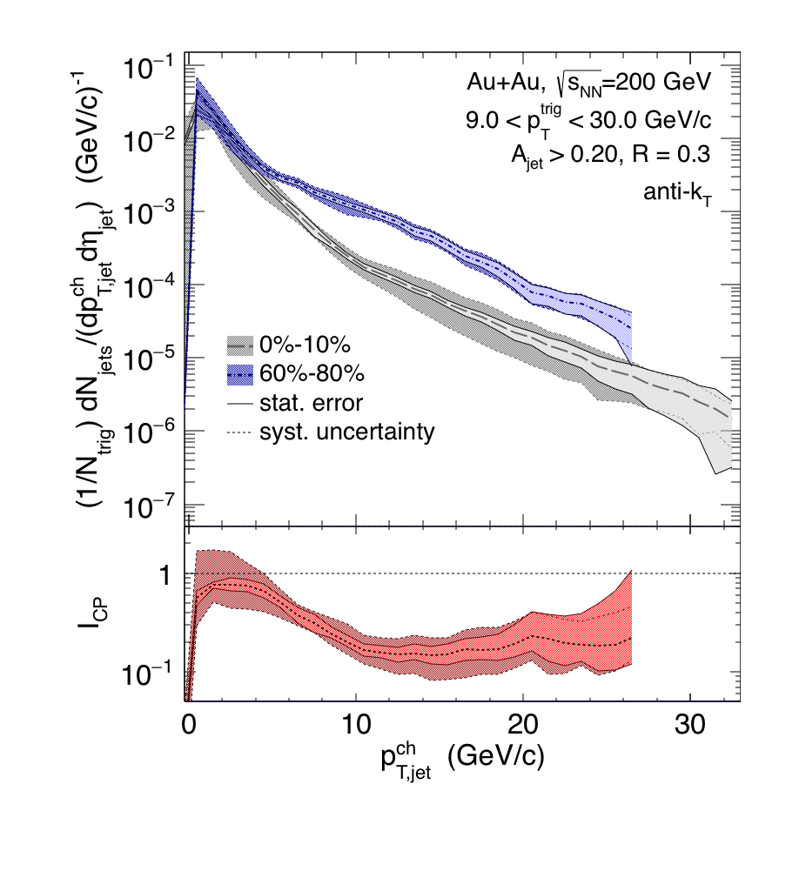
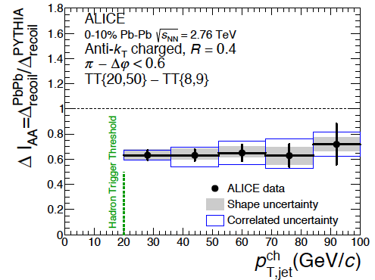
Comparison Central-Peripheral: I_{CP}
- Significant suppression (~0.2)
at p_{T} > 10 GeV/c, close to 1 at low p_{T}
- Larger suppression compared to
LHC energies! (caveat: different R)
Preliminary
ALICE
Errors show combined systematics
arXiv:1506.03984 [nucl-ex]

Slide 10
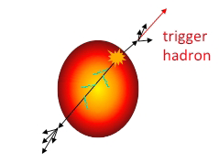
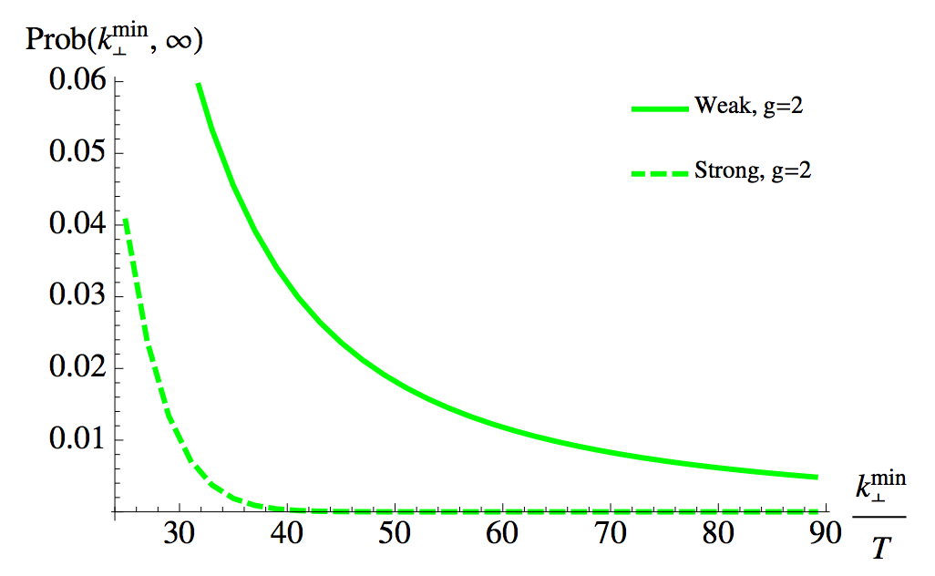
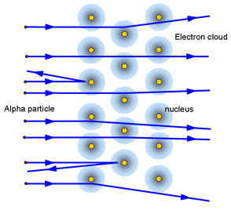
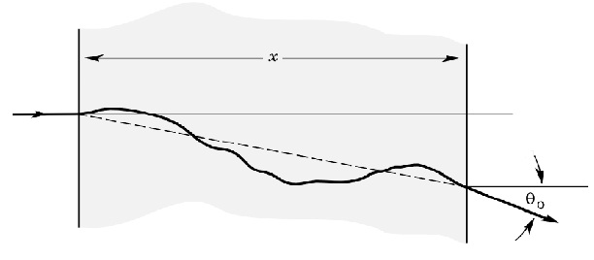
Large Angle Scattering off the QGP?
JHEP 1305 (2013) 031
Δφ
Discrete scattering centers or effectively continuous medium?
Scattering probability can give us
important information about coupling
→ strongly/weakly coupled QGP
→ quasiparticles?
“Weak”
multiple scattering
“Strong”
Continuous E-loss

Slide 11
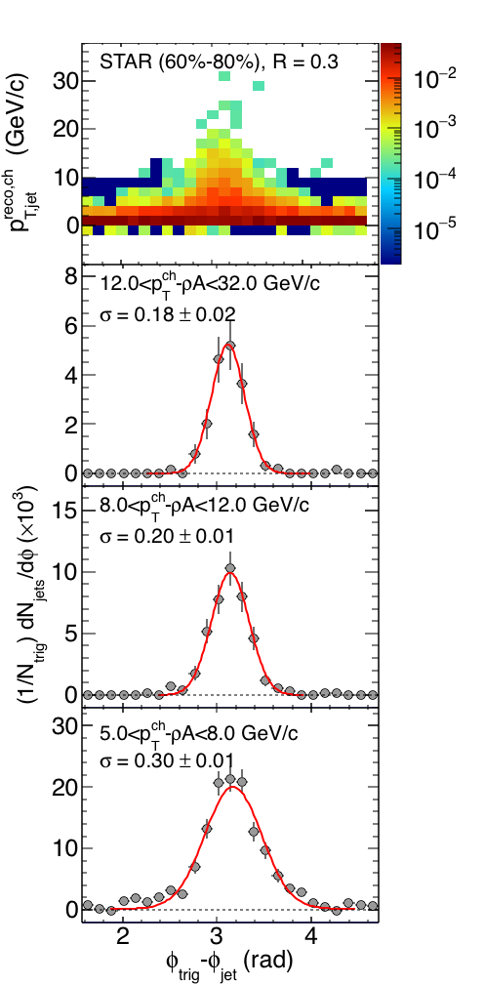
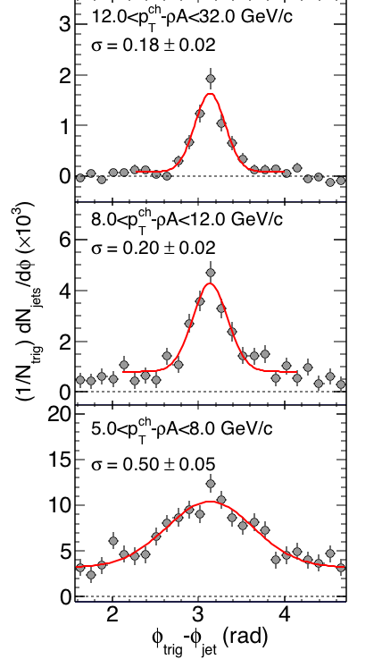
Δφ at R = 0.3
Peripheral
Central
High recoil jet p_{T:}
→ Same width for both centralities
12 < p_{T}-ρA < 20
Preliminary
Preliminary
8 < p_{T}-ρA < 12
5 < p_{T}-ρA < 8 GeV/c:
Significant difference
Normalization? BG? Flow?
→ More studies needed
5 < p_{T}-ρA < 8
Δφ = φ_{trig} – φ_{jet}
Δφ = φ_{trig} – φ_{jet}

Slide 12
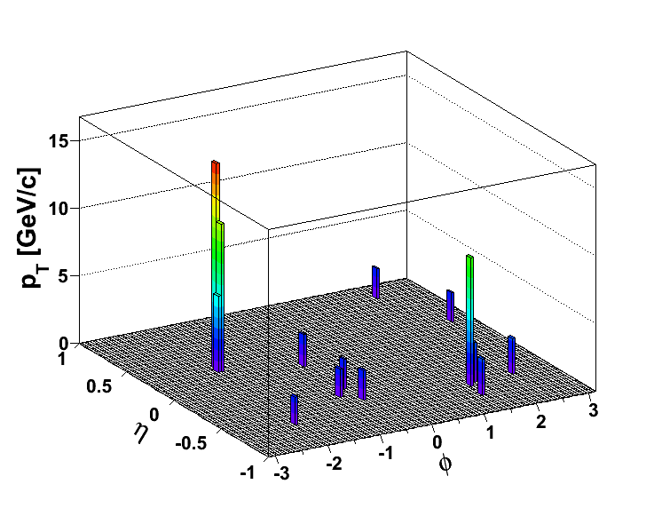
Trigger and Away-Side Jets
(Biased) Di-Jet Selection
Constituent pT^{Cut} = 0.2 GeV/c
Constituent pT^{Cut} = 2 GeV/c
→ Reduce BG
→ Reduce combinatorial jets
Di-jet Selection:
Jet pT^{Lead}>20 GeV/c
Jet pT^{SubLead}>10 GeV/c
|Δφ-π|<0.4
ATLAS, PRL 105, 252303
CMS, PRC 84, 024906 (2011)

Slide 13
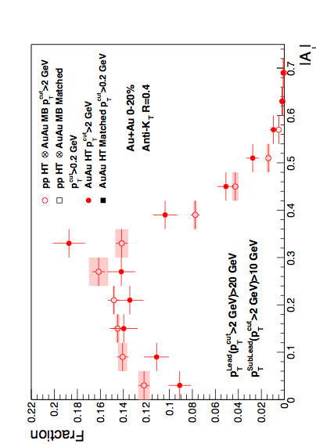
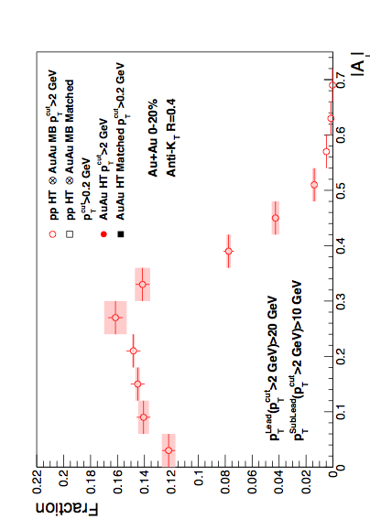
Di-Jet Imbalance AJ
Central Au+Au, R=0.4
KK, HP 2015
Anti-kT R=0.4, pT^{Lead}>20 GeV & pT^{SubLead}>10 GeV with pT^{cut}>2 GeV/c
Event Fraction
Central Au+Au
anti-k_{T}, R=0.4
p-value < 10⁻⁴
(stat. error only)
Sys. Uncertainties:
- tracking eff. 6%
- tower energy
scale 2%
Preliminary
Pearson’s χ²-test
N.D. Gagunashvili,
arXiv:physics/0605123
|AJ|
Au+Au di-jets more imbalanced than p+p for pT^{cut}>2 GeV/c
Can the balance be restored?

Slide 14
Matched Di-jets w/o Constituent p_{T} Cut
pT^{Cut}=2 GeV/c
pT^{Lead}>20 GeV/c
pT^{SubLead}>10 GeV/c
|Δφ-π|<0.4
pT^{Cut}=0.2 GeV/c
pT^{Lead}>20 GeV/c (pT^{Cut}=2 GeV/c)
pT^{SubLead}>10 GeV/c (pT^{Cut}=2 GeV/c)
Rerun jet-finding algorithm
anti-kT on these events
Geom. matching
Geom. matching
Keep this jet selection
Calculate “matched” |AJ| with constituent pT,cut>0.2 GeV/c.
Geom. matching: ΔR<0.4

Slide 15
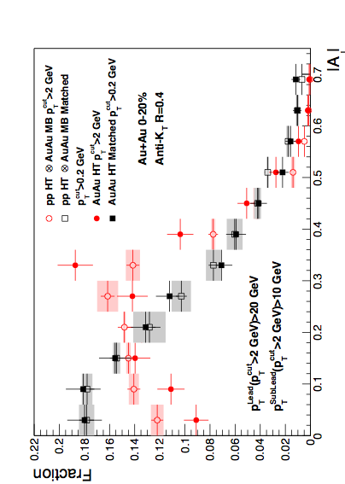
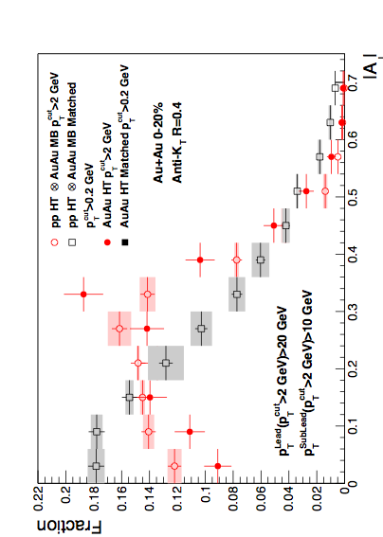
Di-Jet Imbalance AJ
Central Au+Au, R=0.4
Anti-kT R=0.4, pT^{Lead}>20 GeV & pT^{SubLead}>10 GeV with pT^{cut}>2 GeV/c
Event Fraction
p-value < 10⁻⁴
(stat. error only)
Sys. Uncertainties:
- tracking eff. 6%
- tower energy
scale 2%
Central Au+Au
anti-k_{T}, R=0.4
p-value = 0.8
(stat. error only)
Preliminary
|AJ|
Au+Au di-jets more imbalanced than p+p for pT^{cut}>2 GeV/c
Au+Au AJ ~ p+p AJ for matched di-jets (R=0.4)

Slide 16
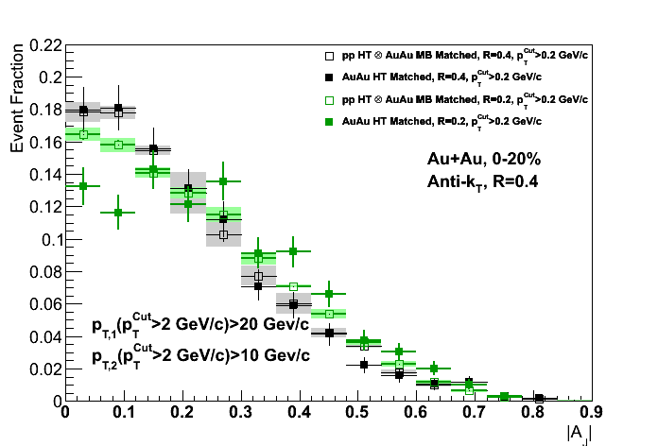
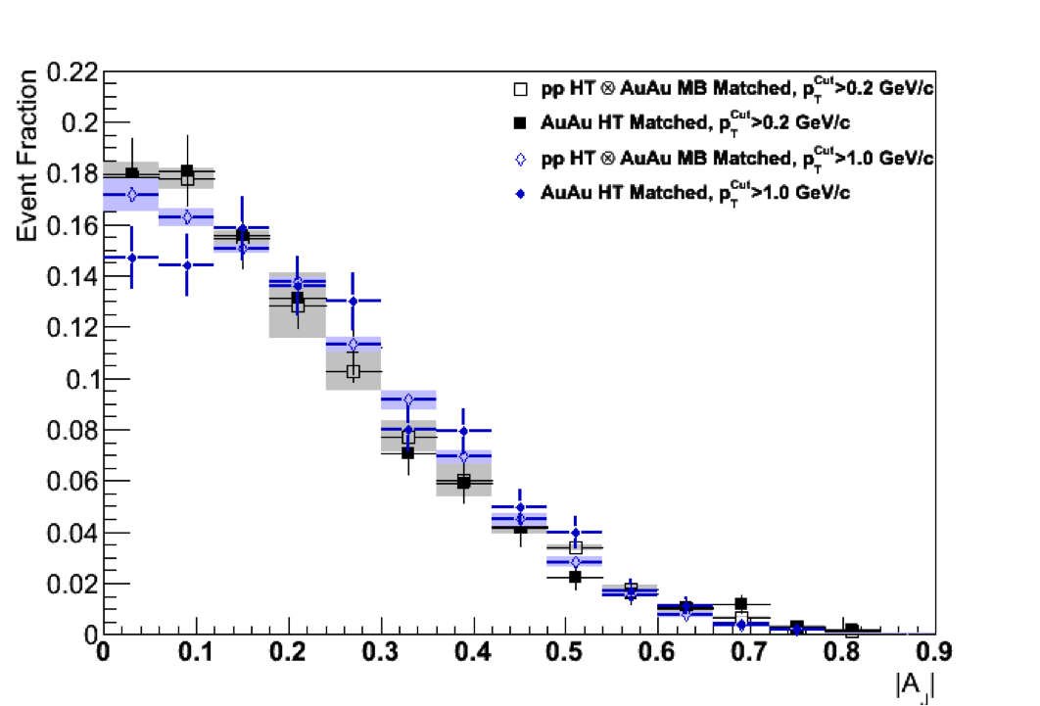
Differential Measurements
R=0.2
R=0.4
R=0.4
Matched to
Matched to
p_{T}^{Cut} > 0.2 GeV/c
p_{T}^{Cut} > 2 GeV/c
p_{T}^{Cut} > 1 GeV/c
Preliminary
Preliminary
Balance can not be recovered in smaller cone,
or harder constituents

Slide 17
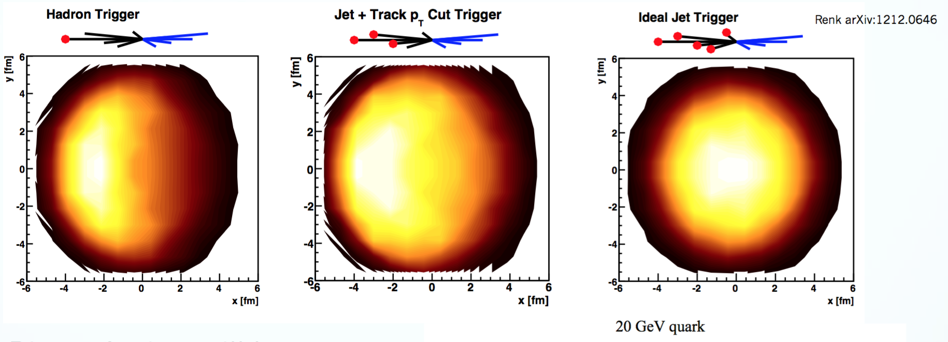
A Consistent (Qualitative) Picture
Focus on: Jet Softening
All measurements π⁰, h-jet, γ^{dir}, A_{J}, and jet-h consistent with suppression of high-z fragments
  Particularly jet-h and A_{J} suggest balancing at low-z
  Near-side is affected differently, but recoil always has long path length
  Need to compare at the same parton p_{T} and hadron z_{T}

Slide 18
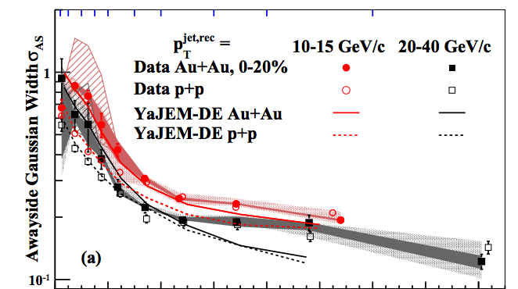
A Consistent (Qualitative) Picture
Focus on: Jet Broadening
h-Jet: Away-Side Jet cross section of narrow jets is suppressed
  Suggests broadening beyond R=0.3
Differential Di-Jet Imbalance: Broadening
Preliminary
PRL 112 (2014)
12, 122301

Slide 19
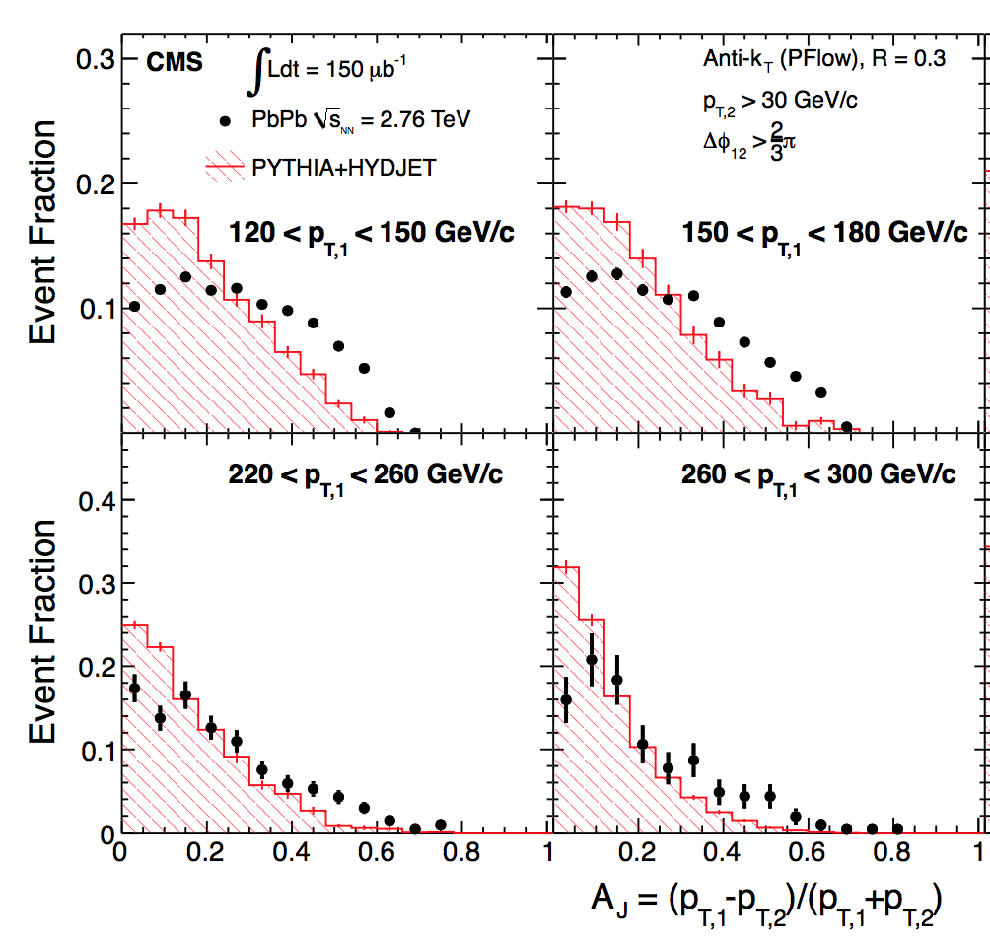
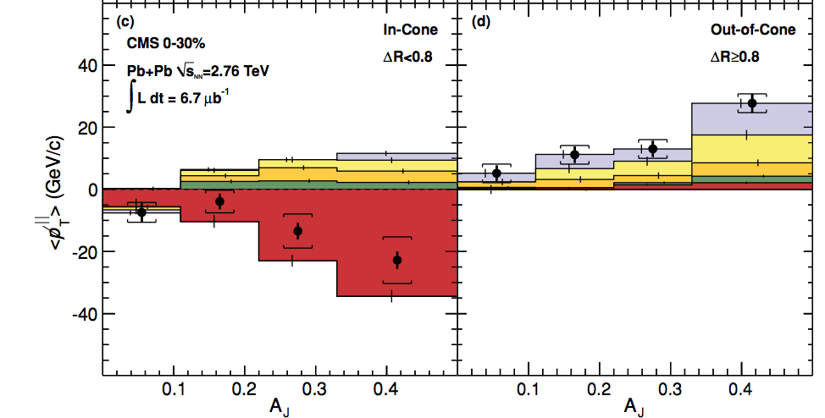
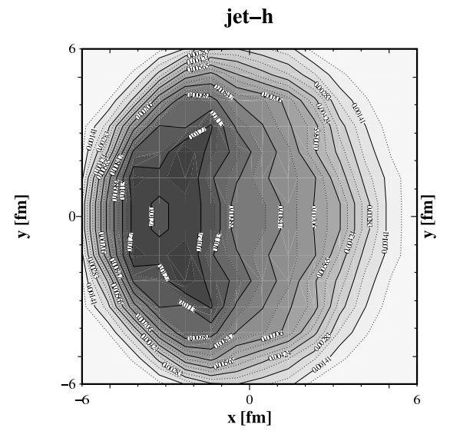
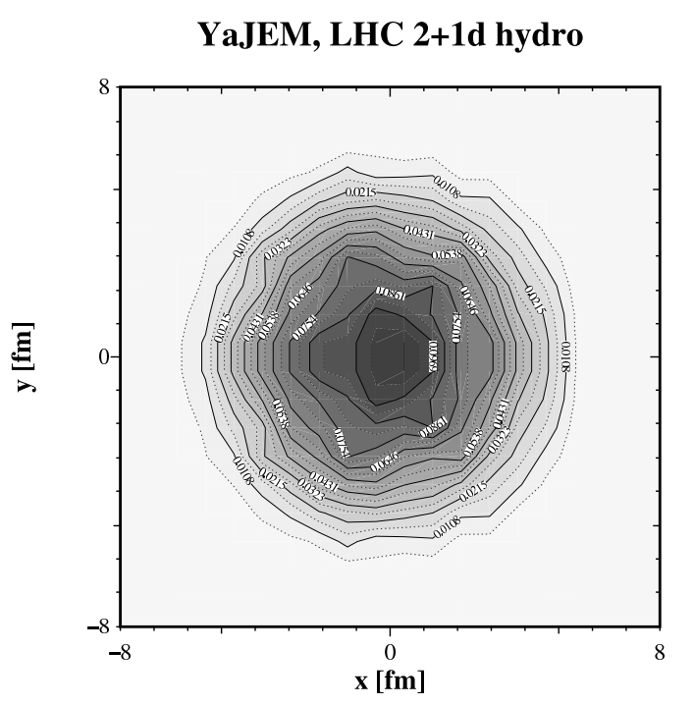
A Tool to Control Path Length
Biased Di-Jet A_{J}: “Lost” energy of the dijets is recovered in a jet of R=0.4
for pT^{Cut} = 0.2 GeV/c
Interpretation:
(Constituent) pT^{Cut} = 2 GeV/c
+ High Tower (5.5 GeV)
+ (Jet) pT^{Lead}>20 GeV/c
→ Surface Bias
+ (Recoil) pT^{SubLead}>10 GeV/c
→ Path Length Control
Contrast to LHC:
Large imbalance, balanced at large angles
“Unbiased” di-jet selection
→ longer path lengths
  & Larger energy loss at early times
→ more diffusion in medium
CMS, PRC 84,
024906 (2011)
STAR:
p_{T}^{lead}>15 GeV/c
pT^{cut}>2 GeV/c
T. Renk, PRC 87, 024905 (2013)
LHC:
A_{J} Dijet Trigger
T. Renk, PRC 85, 064908 (2012)

Slide 20
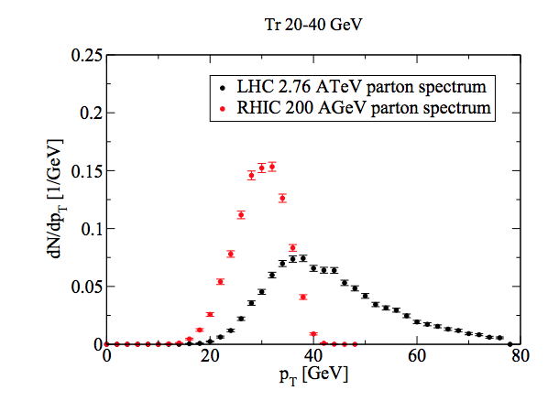
Unique Opportunity for
Jet Geometry Engineering at RHIC
p_{T}^{SubLead} & Constituent p_{T} → systematically dial in the path length of the recoil jet
R=0.4,p_{T}^{Cut}>2 GeV/c
T. Renk, PRC 87, 024905 (2013)
A RHIC Strength!
Good correlation between jet and parton energy for these jets

Slide 21
Summary
Hadron-Jet: Jet reconstruction of recoil jet
→ no fragmentation bias on recoil side
  Suppression at 20 GeV/c (~0.2) is larger compared to LHC energies (caveat: different R)
  Δφ shows no difference between central and peripheral,
  except for lowest p_{T} (interpretation needs more studies)
A_{J}: Jet reconstruction of leading and recoil jet
→ Energy loss jet-by-jet instead of ensemble-based
  “Lost” energy seems contained within R=0.4 and low p_{T}
  Imbalance remains for smaller cone or higher constituent cutoff
  → Observed Broadening and Softening jet-by-jet

Slide 22
Bonus Slides

Slide 23
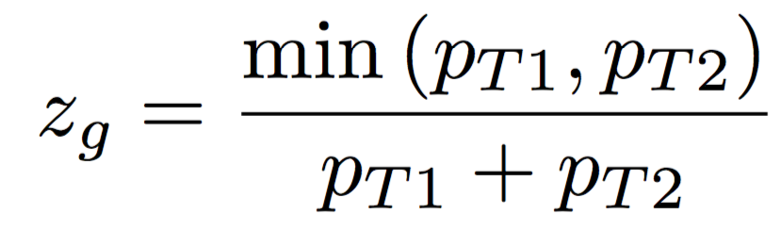
Bonus: Soft-Drop Grooming
Remove wide angle soft radiation
Interesting for:
groomed energy, groomed radius
pp, jet mass, …
Focus here:
“Groomed Momentum Sharing”
p_{T} fraction carried by smaller sub-jet after grooming
J. Thaler
ALICE Jet Workshop,Yale
Larkoski et al.,
Phys. Rev. D 91, 111501 (2015)

Slide 24
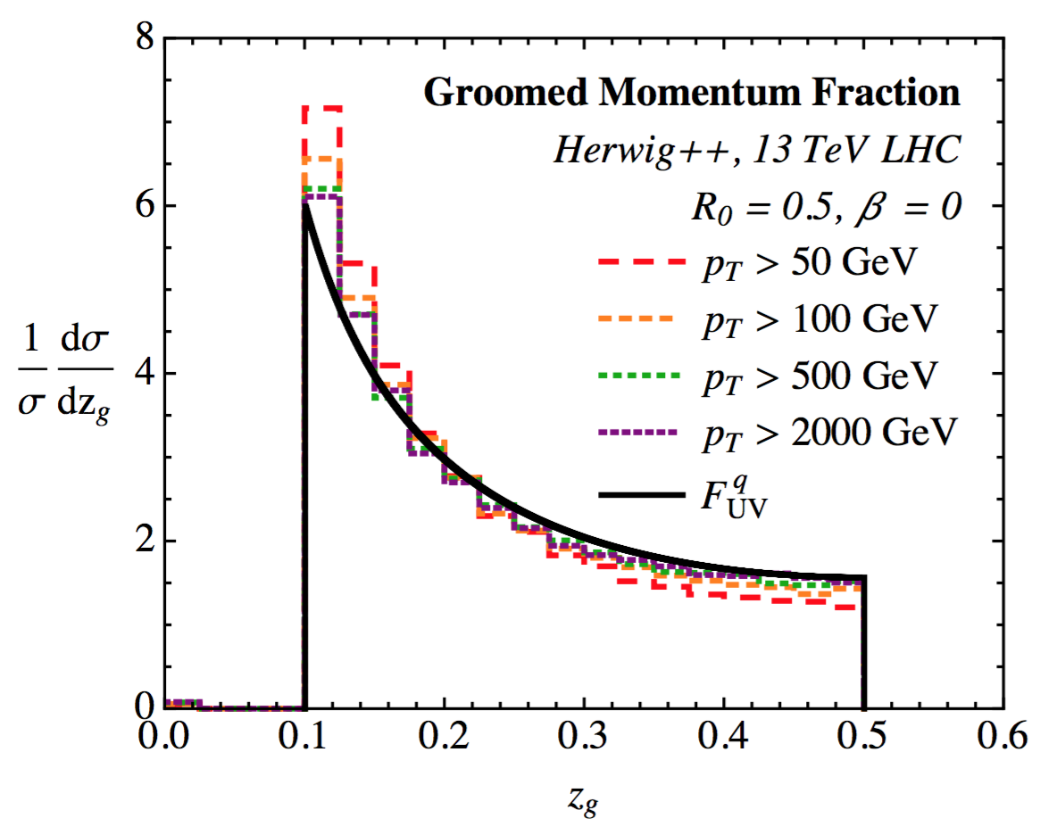
Measuring the AP Splitting Function
Role of β:
β>0 - IRC safe
β<0 - (IR)C unsafe
β=0 - IRC unsafe – but Sudakov-safe
P_{i}: Appropriate Altarelli-Parisi splitting function (symmetrized)
(q->qg, g->gg, g->qg)
~ independent of α_{s}
~ independent of p_{T} (in UV limit)
~ same for quarks and gluons
~ weak p_{T} dependence at RHIC

Slide 25
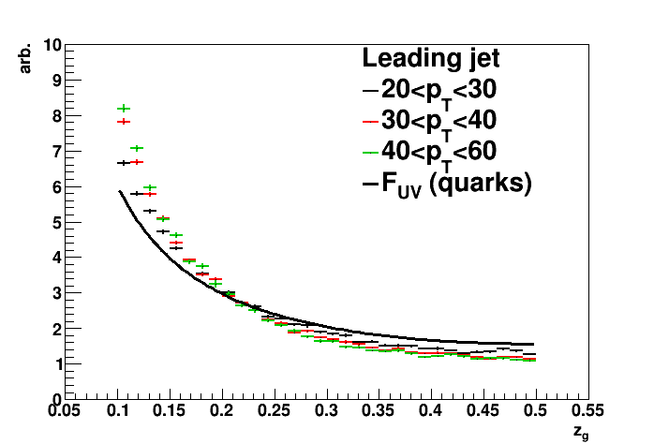
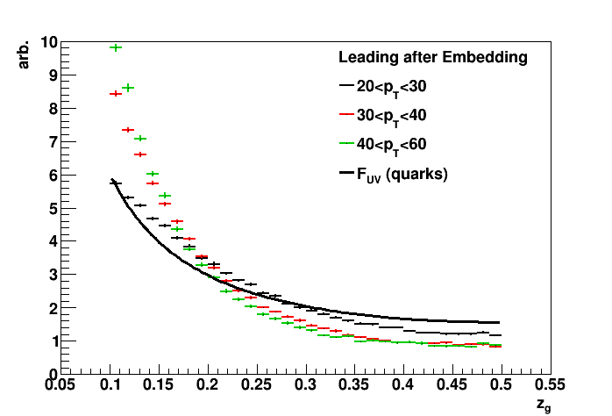
PYTHIA @ RHIC
PYTHIA8 pp at 200 GeV
Leading anti-k_{T} Jets, R=0.4
reclustered with C/A
- Some difference from theory
- maybe due to “small” R
- Z_{g} becomes p_{T}-indep. above 30 GeV
Same jets embedded
Fake Au+Au mocks up multiplicity, spectra, energy densiy
- Fairly benign background effect
- Shape and mild p_{T} dependence good for unfolding

Slide 26
Backup

Slide 27
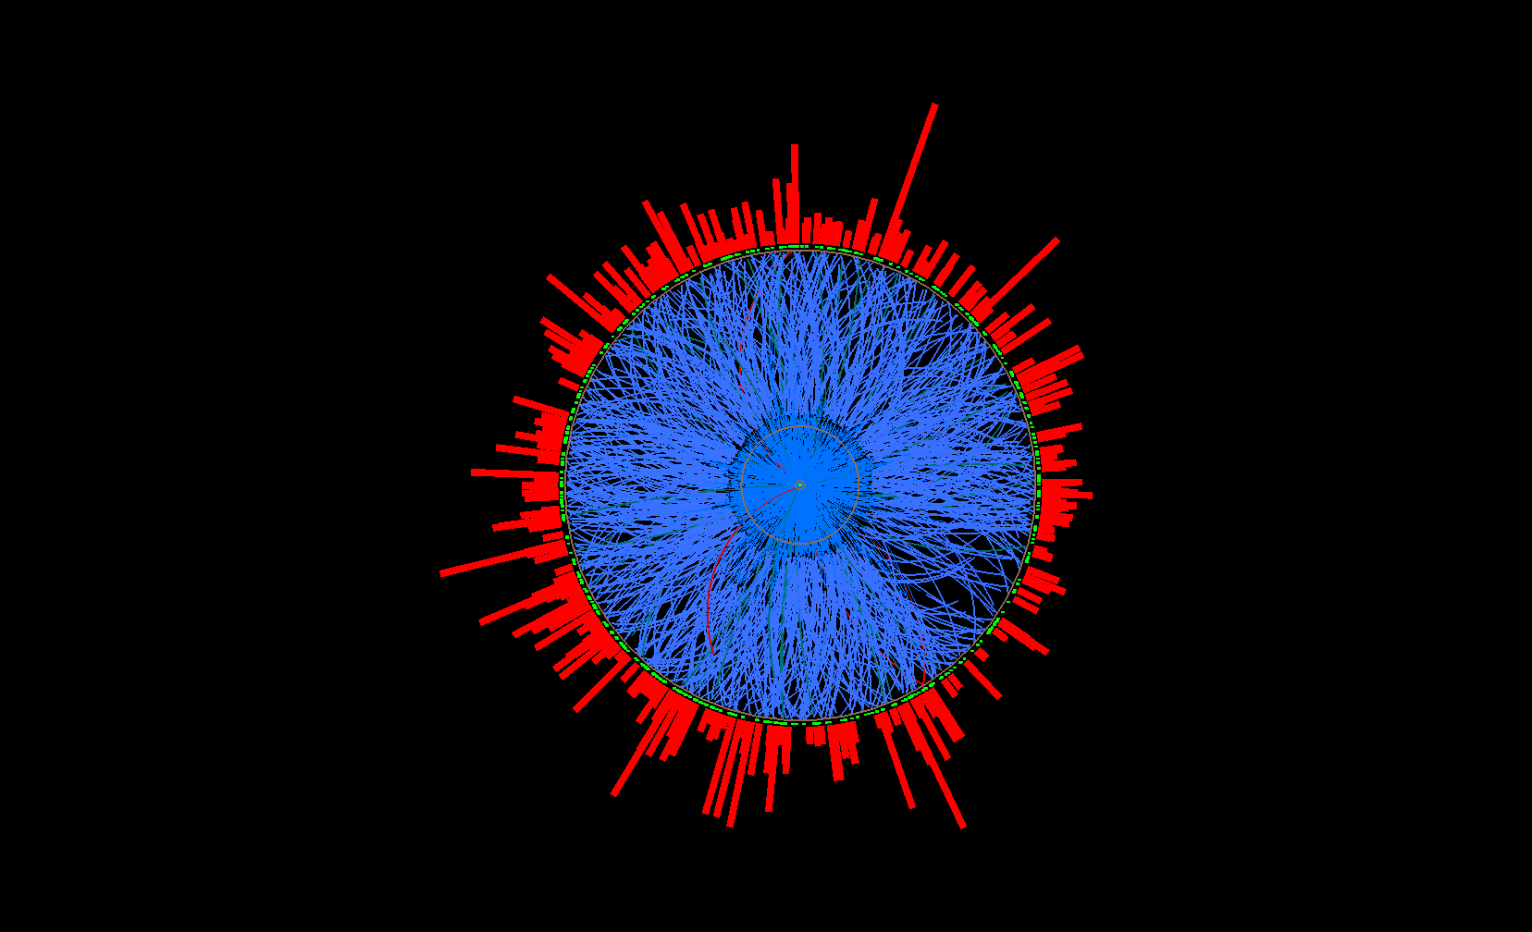
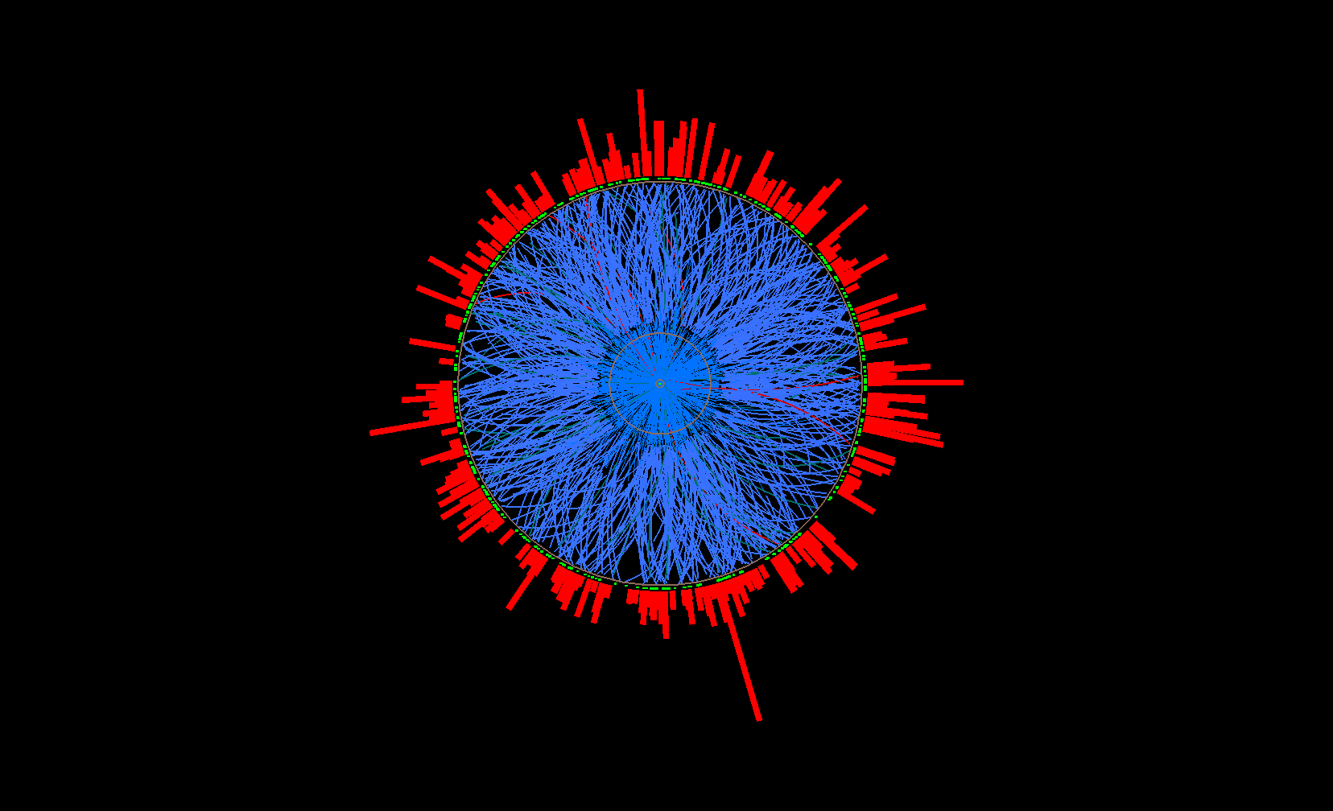
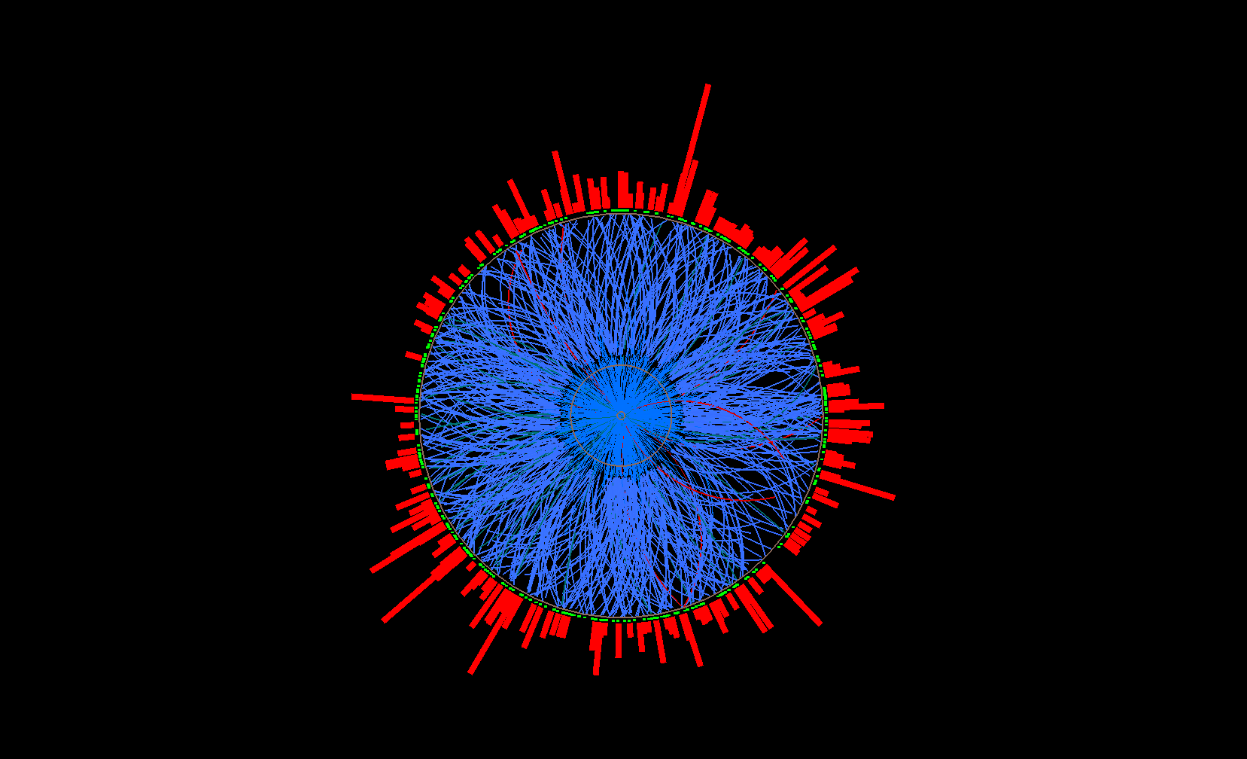
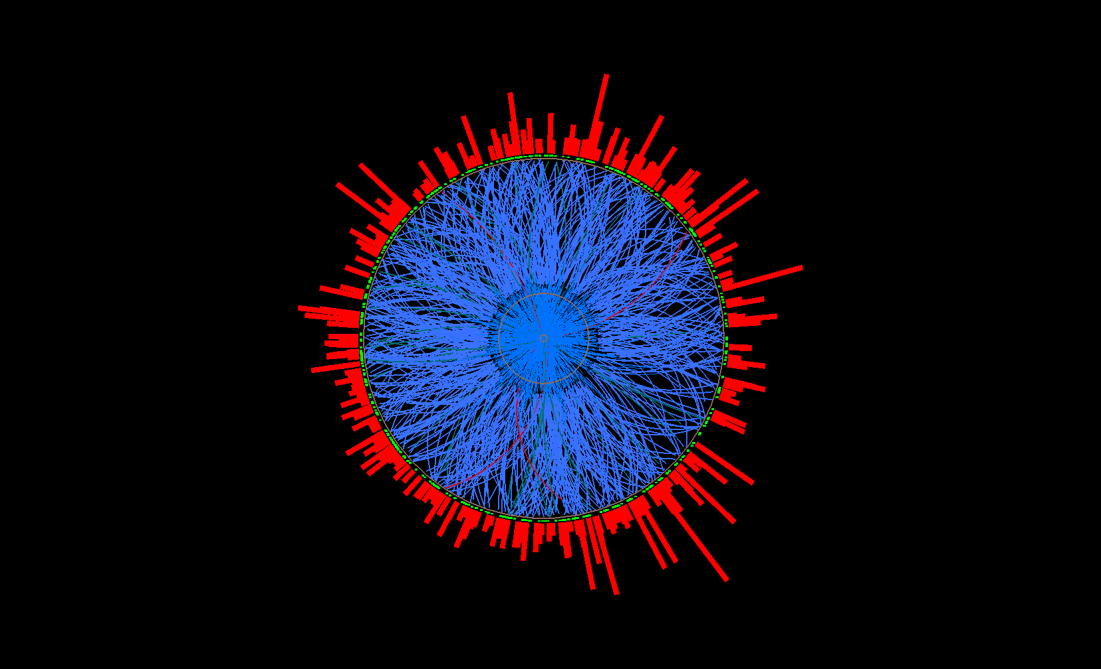
Mixed Event Generation for Jets
Mixed event
Mix only similar centrality, Ψ_{EP} ,
z-vertex position
Pick one random
track per real event
→ add to mixed
event
…
Real events
Ev. 1
Ev. 2
Ev. 3
Ev. 765

Slide 28
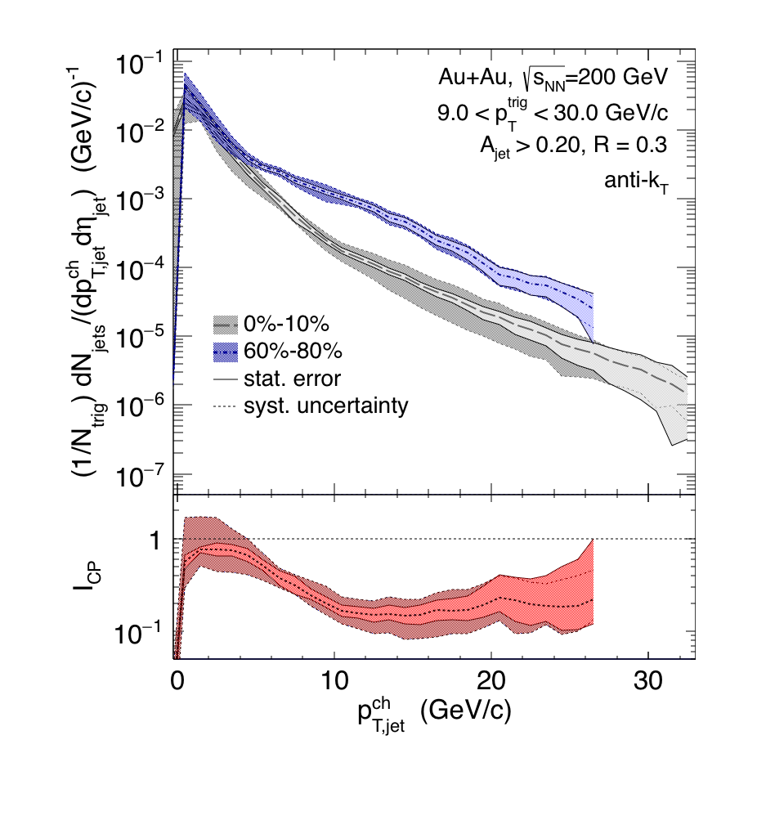
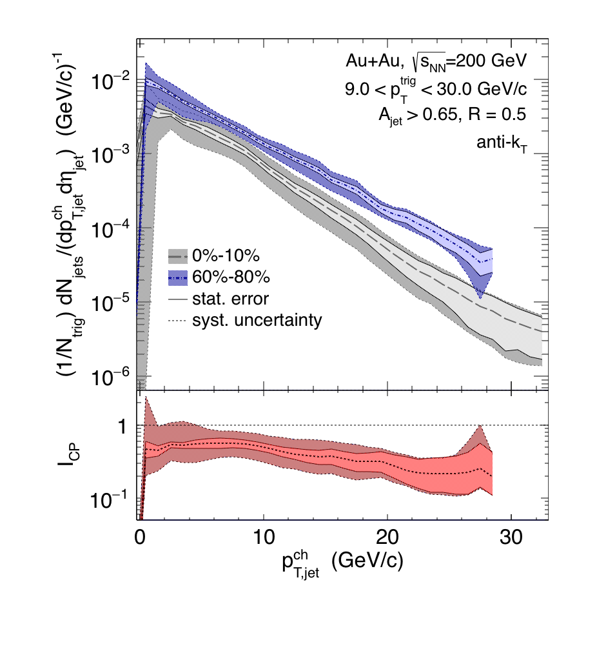
Recoil yield suppression
R=0.3
R=0.5
Preliminary
Preliminary
Calculate spectrum shift
requires distributions ~ exponential, ratio ~ flat
RHIC: smaller shift for larger R
R=0.5: smaller shift at RHIC than LHC
Out-of-cone energy transport ?
comparison requires similar trigger bias ➔ theory calculation
Spectrum Shift Periph/pp ➔Central
 | p^{ch}_{T,jet} range [GeV] | Shift R=0.3 [GeV] | Shift R=0.5 [GeV]
Au+Au @ 200 GeV | [10,20] | -6.3 ± 0.6 ± 0.8 | -3.8 ± 0.5 ± 1.8
Pb+Pb @ 2.76 TeV ALICE arXiv:1506.03984 | [60,100] |  | -8 ± 2

Slide 29
pp HT Reference and Systematic Errors
Reference:
pp HT ⊗ AuAu MB
Embed pp HT randomly
into AuAu 0-20% minimum
bias event, adjusted for
relative tracking efficiency
between pp HT Y06 and
AuAu HT Y07
Event Fraction
Preliminary
STAR, PRL 112, 122301 (2014)
Systematic Uncertainties (Analogous to Jet-Hadron Corr.)
- Tracking efficiency uncertainties 6%
- Relative Tower energy scale uncertainty 2%
- Background/vn: Null-Hypothesis Method1 vs. Method2
- Remaining uncertainties negligible

Slide 30
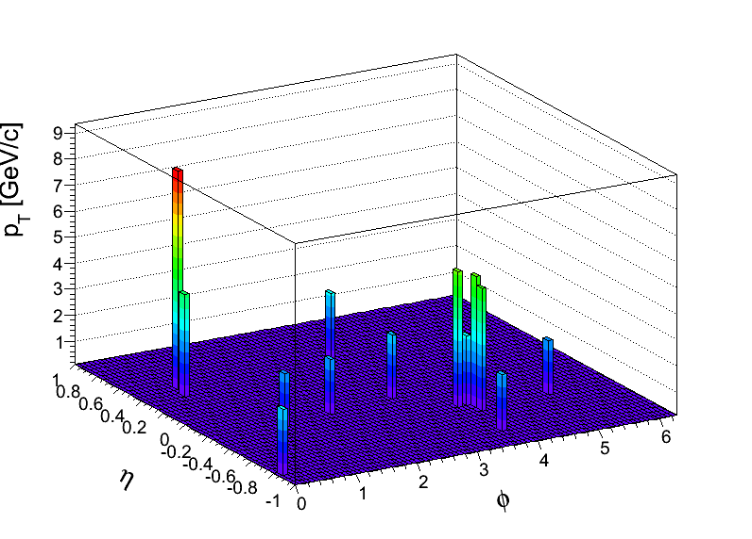

Null-Hypothesis:
Balance Restored by Uncorrelated BG?
Method 1: Random Cone (RC):
Take di-jet pair pT^{Cut}>2 GeV/c (w/o low pT)
pT^{Cut}=2 GeV/c
pT^{Lead}>20 GeV
pT^{SubLead}>10 GeV
Embed randomly
Calculate |AJ| with pT^{Cut}>0.2 GeV/c
using cone of R
the two Jet vectors
into a central
Au+Au MB event
pT [GeV/c]
Embed the two Jet
vectors into a Au+Au HT
event, 2R away from
reconstructed di-jet
pair in that event
Method 2: EtaCone (EC):
Take di-jet pair
pT^{Cut}>2 GeV/c (w/o low pT)
η
ϕ

Slide 31

Effect of Background Fluctuations
Anti-kT R=0.4, pT^{Lead}>20 GeV & pT^{SubLead}>10 GeV with pT^{cut}>2 GeV/c
Event Fraction
Sys. Uncertainties:
- tracking eff. 6%
- tower energy
scale 2%
Central Au+Au
anti-k_{T}, R=0.4
Preliminary
Method 2
(EC)
Method 1
(RC)
|AJ|
Balancing of Au+Au matched di-jets due to
correlated signal yield in a cone of R=0.4

Slide 32

Contrast and Compare
Preliminary
“Hard Core”: Similar to LHC:
clear imbalance compared to pp
ATLAS, PRL 105, 252303
CMS, PRC 84, 024906 (2011)

Slide 33





Contrast and Compare II
Missing Energy
LHC: Shifted to large angles
Preliminary
Jet-like yield
out to |ΔR|~1
RHIC: Contained in R=0.4
Shifted to lower p_{T}
CMS, JHEP 01 (2016) 006
CMS, JHEP 1602 (2016)

Slide 34
Geometric Biases
YaJEM, T. Renk
arXiv:1212.0646
PRC 85, 064908 (2012)
PRC 87, 024905 (2013)
STAR
LHC Dijets
hadron
jet
w/ cuts
ideal jet
dijet
STAR Interpretation:
(Constituent) pT^{Cut} = 2 GeV/c
+ High Tower
+ (Jet) pT^{Lead}>20 GeV/c
→ Surface Bias
+ (Recoil) pT^{SubLead}>10 GeV/c
→ Path Length Control
LHC:
“Unbiased” di-jet selection
longer path lengths & larger energy loss at early times
→ more diffusion in medium

Slide 35

YaJEM Calculation for STAR Dijets
(First Look)
Courtesy of Kirill Lapidus
1D hydro
R = 0.4
constituent bias 2 GeV
5.5 hard track in either of two jets
back-to-back
Signs of creation hot spots shift by 2-4 fm
Needs further investigation
-- Be mindful of fluctuations and hydrodynamic expansion

Slide 36

RHIC vs LHC
LHC:
Larger energy loss at early times
→ more diffusion in medium
→ larger angles
RHIC:
Quenched energy closer to initial
parton/jet direction. Can utilize biases
for systematic exploration.
→ (easier) to study soft gluon radiation
T. Renk, PRC 88, 044905 (2013)
RHIC Advantage:
Steeply falling spectrum
→ Good correlation between
jet and original energy
R=0.4,p_{T}^{Cut}>2 GeV/c
T. Renk, PRC 87, 024905 (2013)

Slide 37



Di-Jet Imbalance AJ
Central Au+Au, R=0.2
Anti-kT R=0.2, pT^{Lead}>16 GeV & pT,^{SubLead}>8 GeV with pT^{cut}>2 GeV/c
Event Fraction
Sys. Uncertainties:
- tracking eff. 6%
- tower energy
scale 2%
p-value < 10⁻¹⁰
(stat. error only)
Central Au+Au
anti-k_{T}, R=0.2
p-value < 10⁻⁴
(stat. error only)
Preliminary
|AJ|
Matched Au+Au AJ ≠ p+p AJ for R=0.2
→ (recoil) Jet broadening in 0.2 − 0.4

Slide 38

PYTHIA8 Particle Level (PL) and Toy Bkg. Model
Anti-kT R=0.4, pT,1>20 GeV & pT,2>10 GeV with pT^{cut}>2 GeV
Pythia8 PL
Pythia8 PL & Bkg
Pythia8 PL & Bkg (v2)
Pythia8 PL & Bkg
& track eff. Y07
Event Fraction

