Slide 1
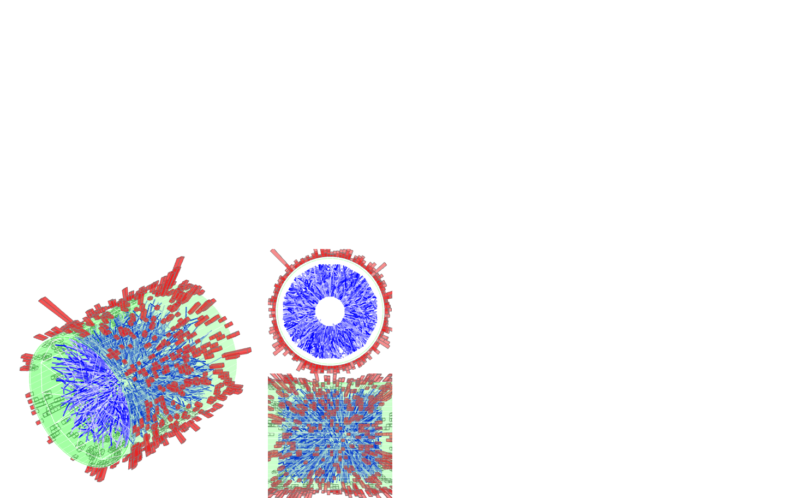
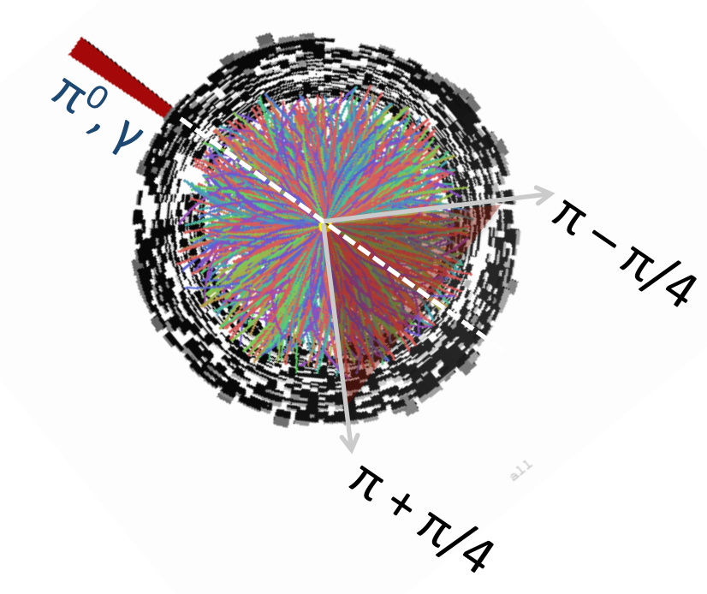


Recent Jet Results from STAR
h, π⁰ , γ
Kolja Kauder for the STAR Collaboration
March4, 2016

Slide 2
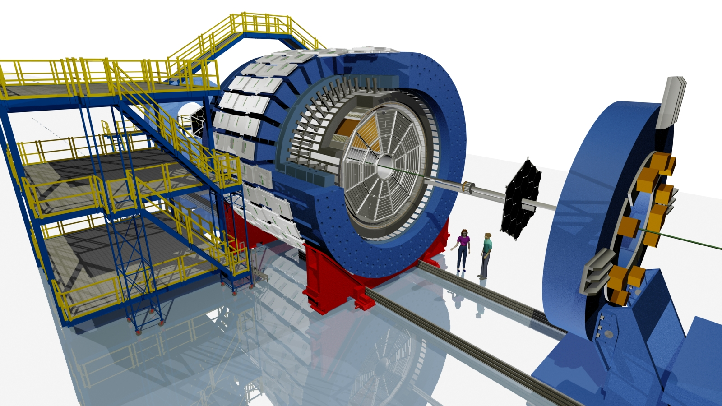
STAR
Charged and neutral particles:
Full azimuthal acceptance
Extended pseudorapidity acceptance |η|<1
BEMC
Magnet
TPC
Au+Au, 200 GeV
© Maria & Alex Schmah

Slide 3
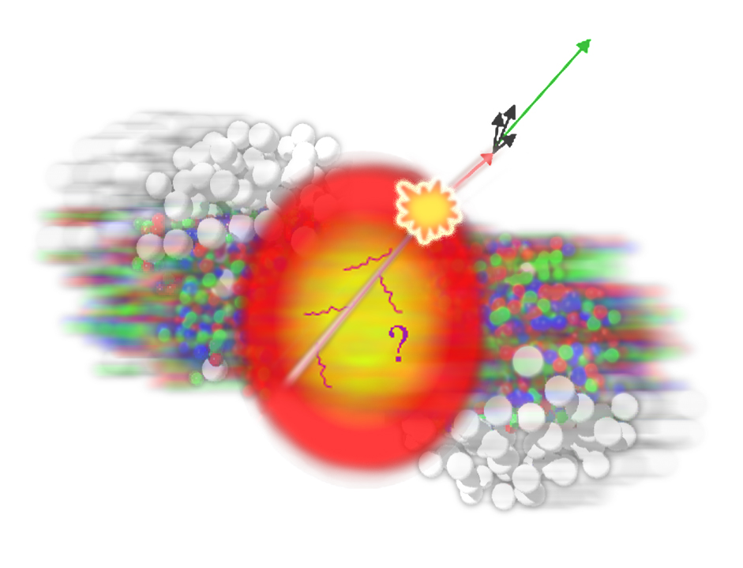
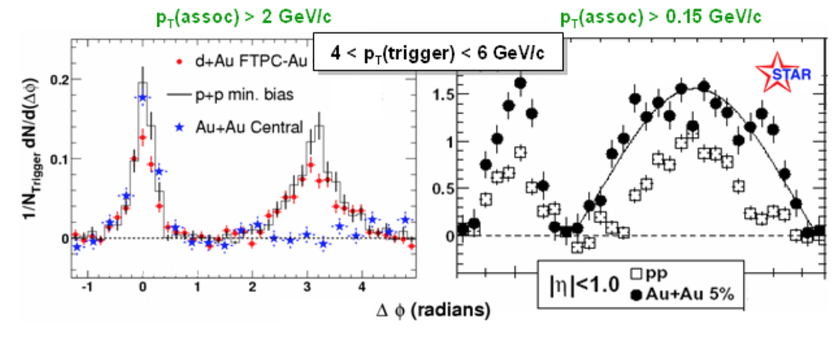
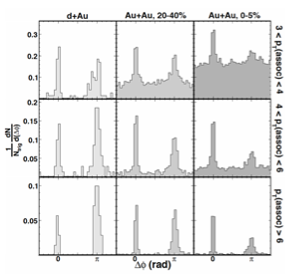
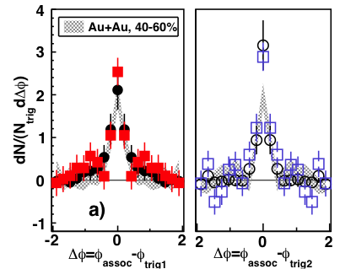
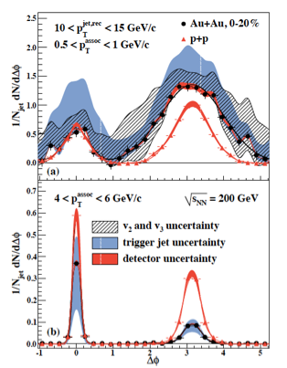
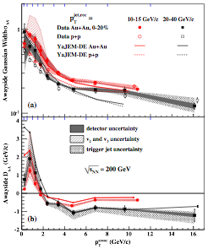
A Decade+ of Jet Quenching in STAR
Di-hadron
STAR, PRL 91, 072304 (2003)
STAR, PRL 95,152301 (2005)
Di-Jets
STAR, PRL 97, 162301 (2006)
2+1
STAR, PRC 83, 061901 (2011)
Jet-hadron
STAR, PRL 112, 122301 (2014)
Jets: Calculable pQCD probe,
well described in pp
What we know:
hard trigger = small modification
→ Surface Bias
Jet-associated particles:
  Suppression at high p_{T}
  Enhancement at low p_{T}
  Broadening in Δφ

Slide 4
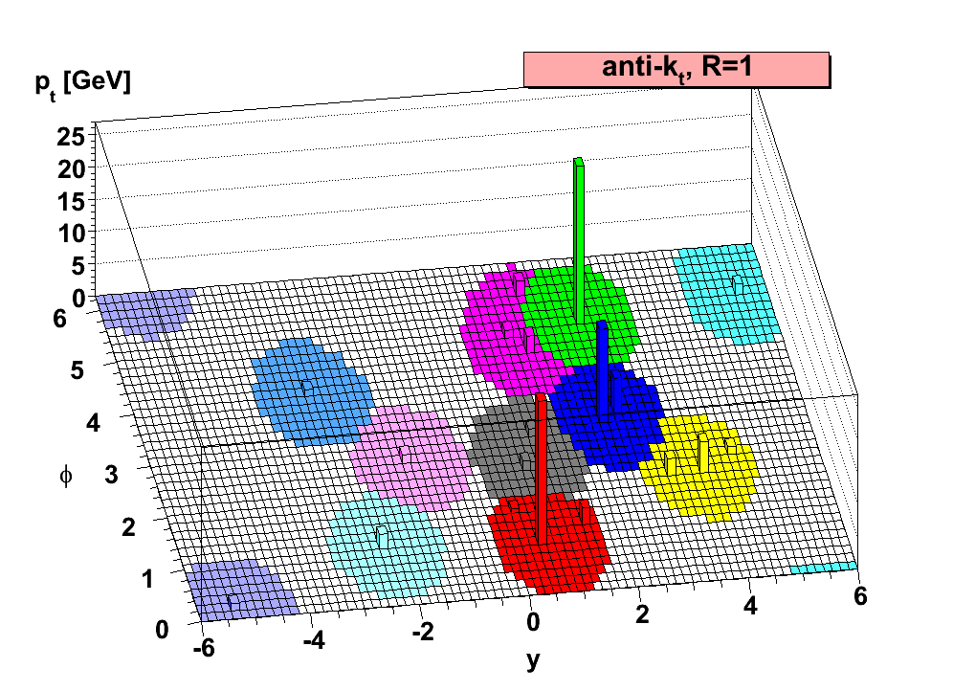
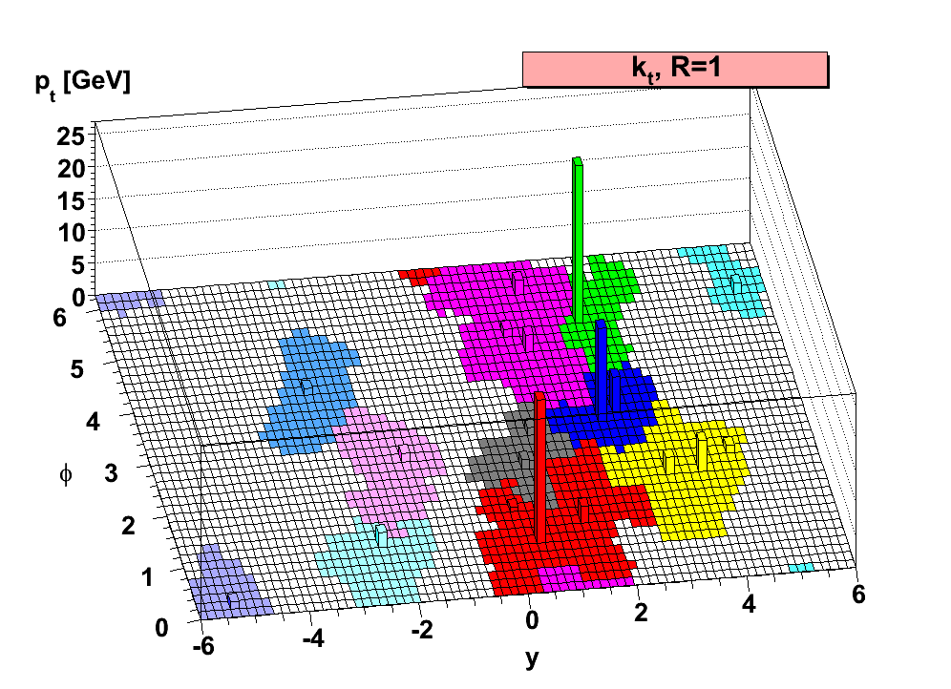
Jet Finding
Implementation:
FastJet3
M. Cacciari and G. Salam
Phys. Lett. B 641, 57 (2006)
Sequential Clustering:
anti-k_{T}, R=0.2—0.5
average energy density:
k_{T} algorithm, same R
Resulting clusters are jets.
  Operational definition. No unambiguous jet definition exists!
Advantages:
  Minimize sensitivity to hadronization:
  IR-safe and collinear-safe algorithm and instrumentation
  Measure energy flow: connect to dynamics of partons
  Comparison to QCD calculations beyond event generators

Slide 5
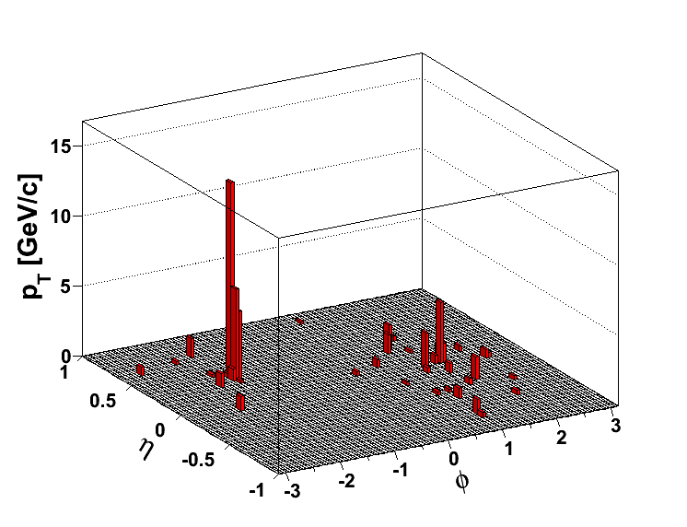
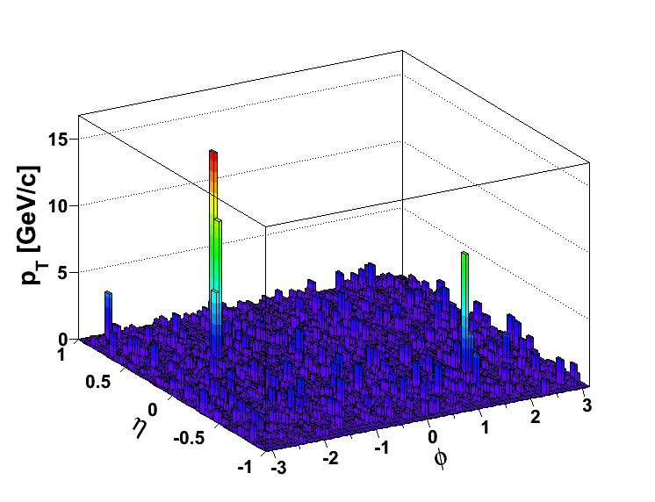
The Underlying Heavy Ion Event
pp
@200 GeV
Central Au+Au @ 200 GeV
<p_{T} density> in an R= 0.4 cone is on the order of
~25 GeV/c
… and intra-event fluctuations
~6 GeV/c
Can still find a “jet”, but does it come from a hard scattering?
And if so, how to determine the parton energy?

Slide 6
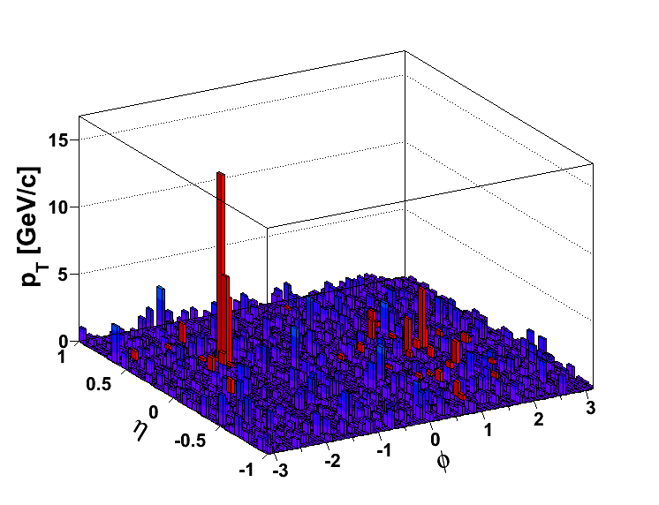
Background
Subtract average density:
Fluctuations and Detector Effects: Embed reference in AuAu
Compare on detector level
Or unfold response matrix
to particle level
20 GeV fluctuations are rare (~3σ)
– but 20 GeV jets are rare as well
How to select hard scatters?
Focus on “coincidence” measurements
γ-hadron correlations
minimal bias, but low cross-section
hadron-jet correlations
Surface bias for trigger, but away- side is bias-free
Di-Jet Asymmetry
tangential bias → jet geometry engineering
pp @ Au+Au

Slide 7
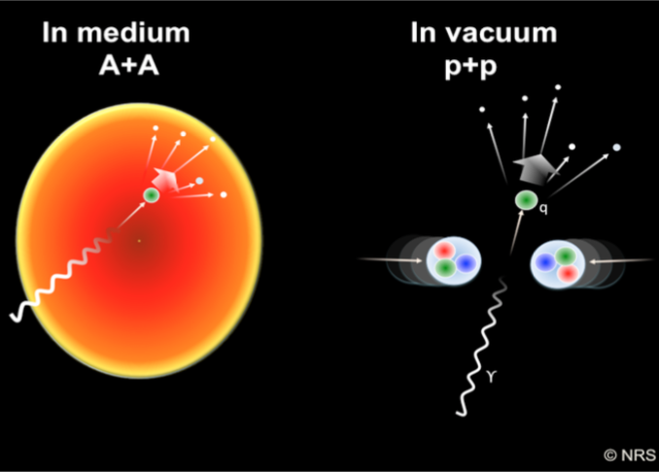
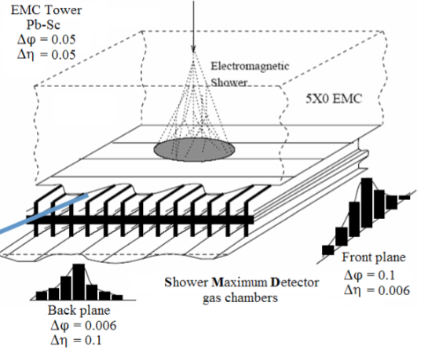
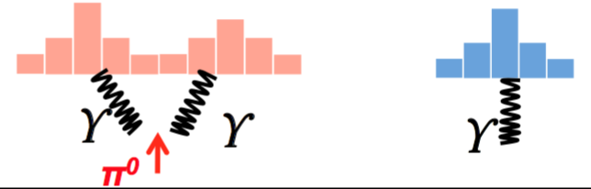
Access to Parton Energy without Jets:
Direct Photon Triggers
The “Golden Probe”
Does not interact
Volume emission
→ No surface bias
qg→qγ dominates
→ Fix flavor
γ energy strongly correlated to original parton
low cross-section
Separate high p_{T} π⁰→γγ from γ^{dir}
Barrel Shower Max
BSMD – inside tower
Transverse Shower Profile:

Slide 8
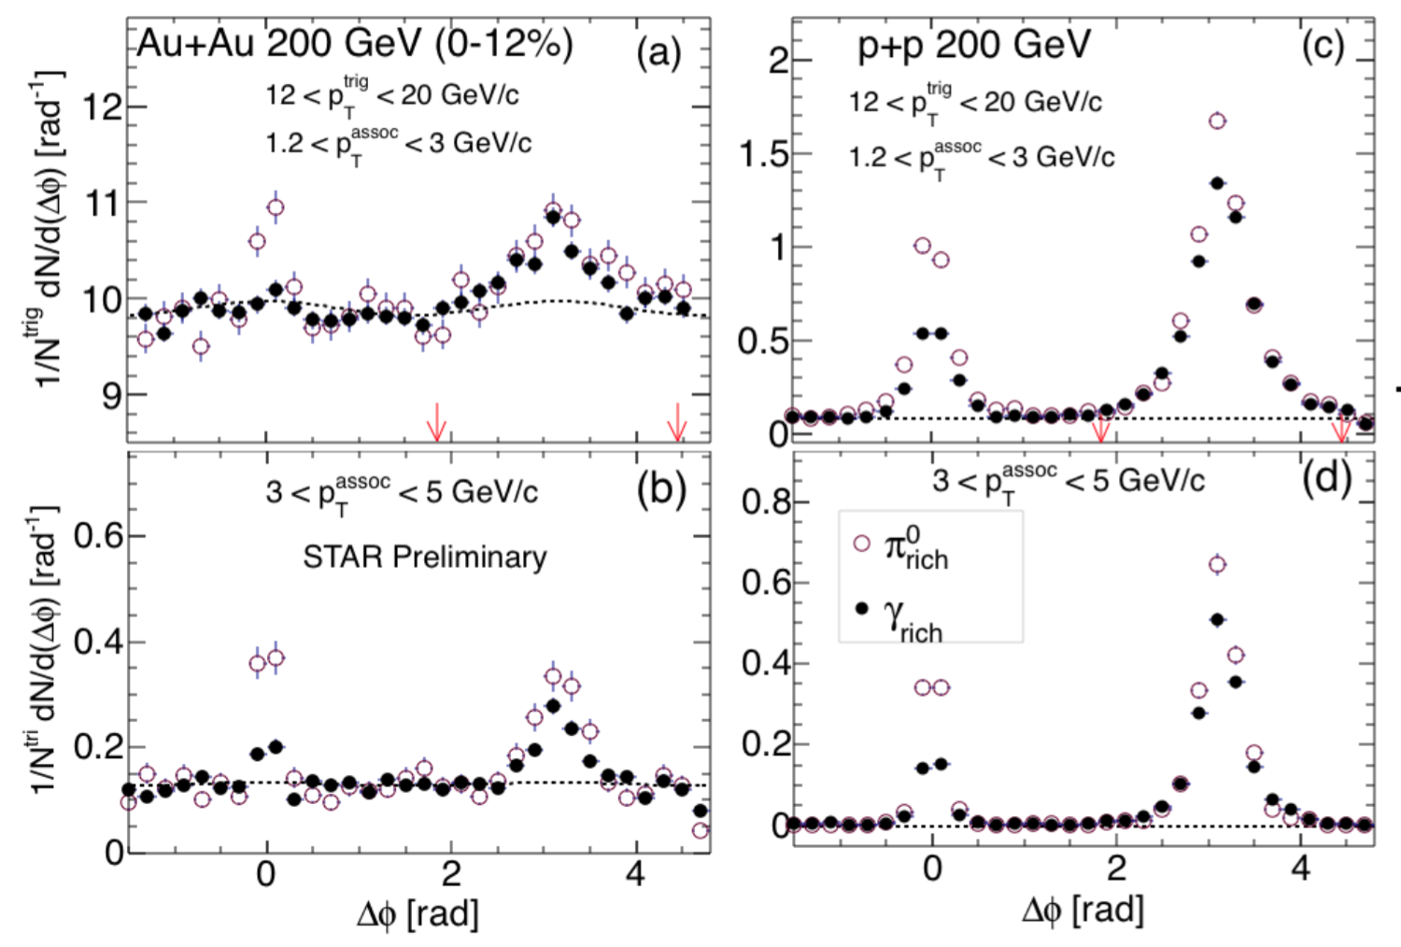
From γ-rich to direct γ
Near-side (NS):
- π⁰ is pp-like
γ-rich: Assume that NS-yield is due to π⁰ contamination
subtract appropriate scaled π⁰
“γ-rich - π⁰ = γ^{dir”}
Purity R ~70% (Au+Au)
~40% (pp)

Slide 9
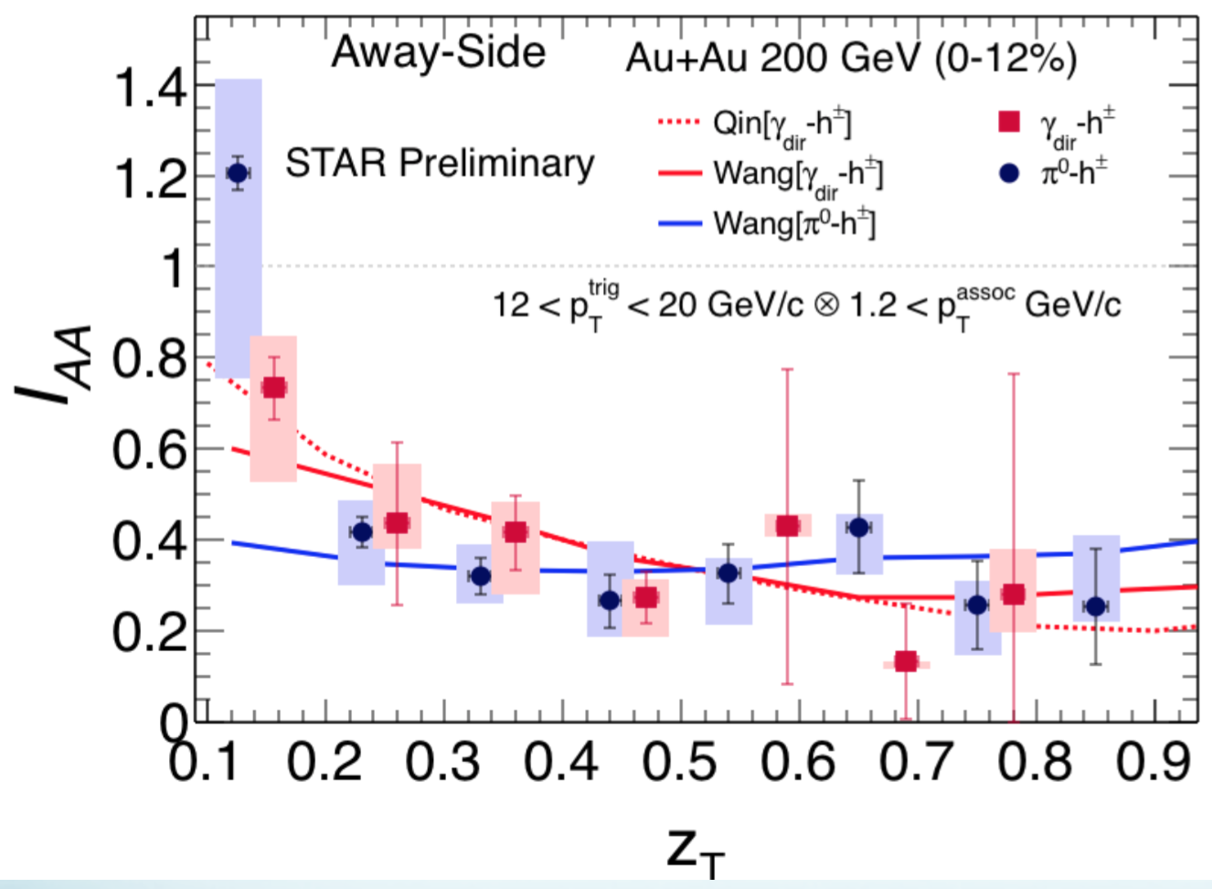
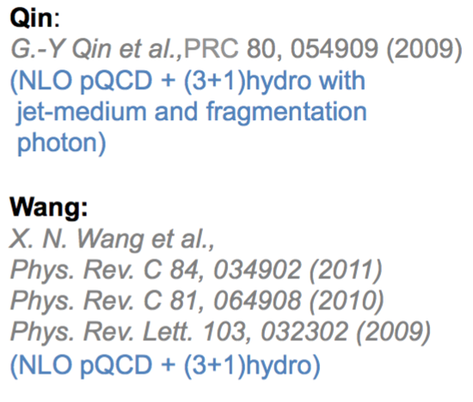
Away-Side Suppression
Similar and strong I_{AA} suppression for π⁰ and γ^{dir}
  Why the similarity?
Low z_{T} enhancement: Models don’t include redistribution

Slide 10
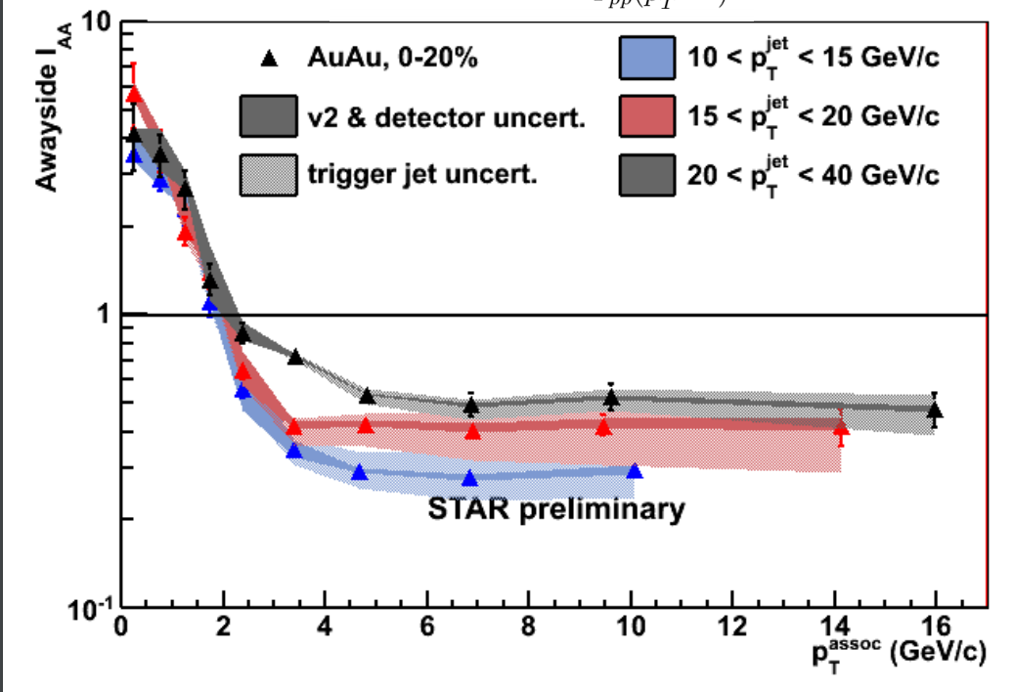
γ^{dir}-Hadron vs. Jet-Hadron Correlations
QM11 and
PRL 112 (2014)
12, 122301
careful
Similar I_{AA} suppression for π⁰, γ^{dir} and jet triggers at high p_{T}
Low p_{T} balance?

Slide 11
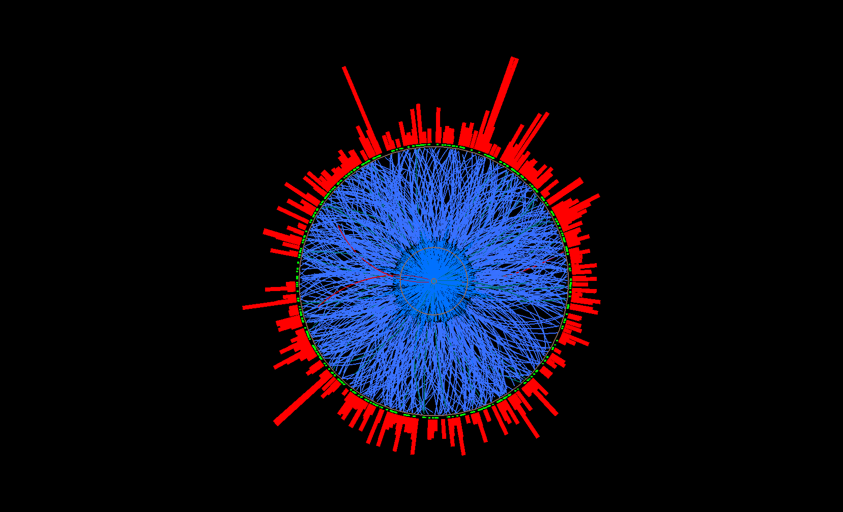
Semi-Inclusive Recoil Jets
Semi-Inclusive Recoil Jets
Semi-inclusive yield of (charged) jets recoiling from a high-p_{T} hadron trigger
Recoil jet(s)
search area
Measured
Calculable in pQCD
Trigger
particle
- Trigger on high p_{T} hadron → Selection of a high p_{T} process
- Use all jet candidates on the other azimuthal hemisphere
within +/- 45 degrees → no fragmentaion bias on recoil side!
- Combinatorial background determined via mixed events

Slide 12
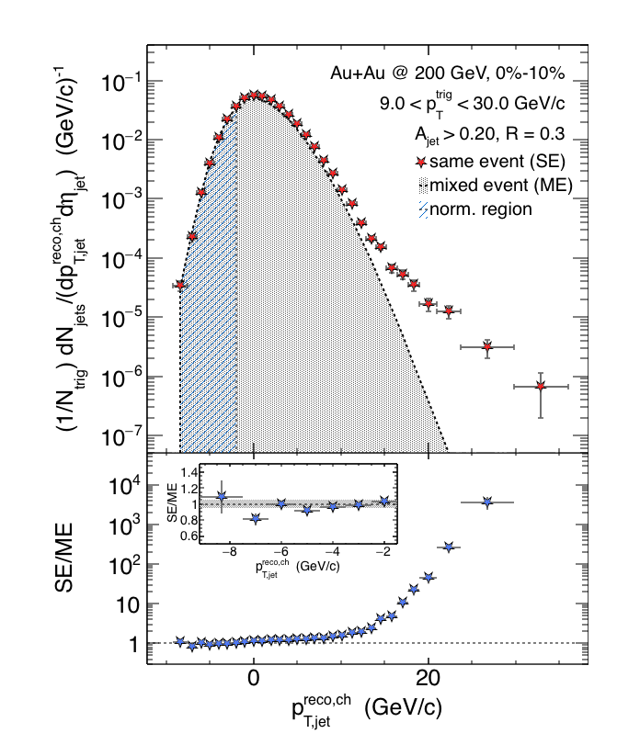
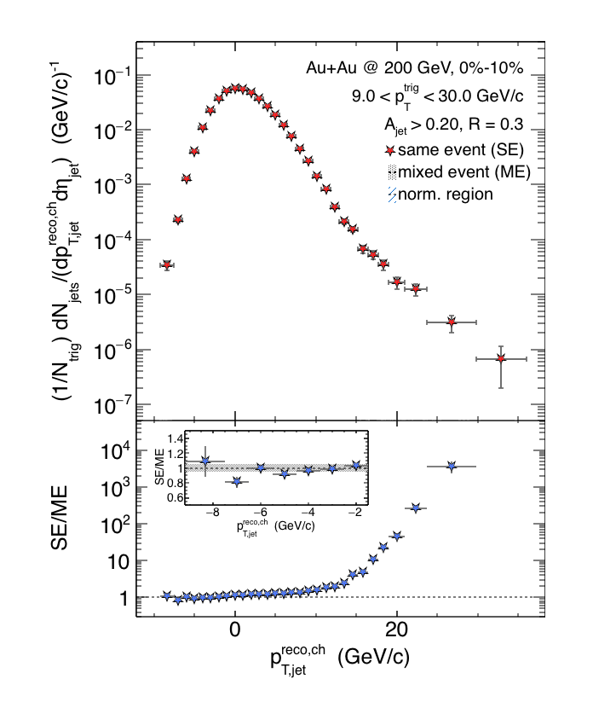

Charged Raw Recoil Jet Spectrum:
Central Au+Au
Central
- Excellent description of
low p_{T} SE spectrum with ME
- Normalization region varied
systematically
- Significant jet signal at
p_{T} - ρA > 10 GeV/c
Preliminary
Combinatorial jet background
statistically described by
mixed event technique

Slide 13
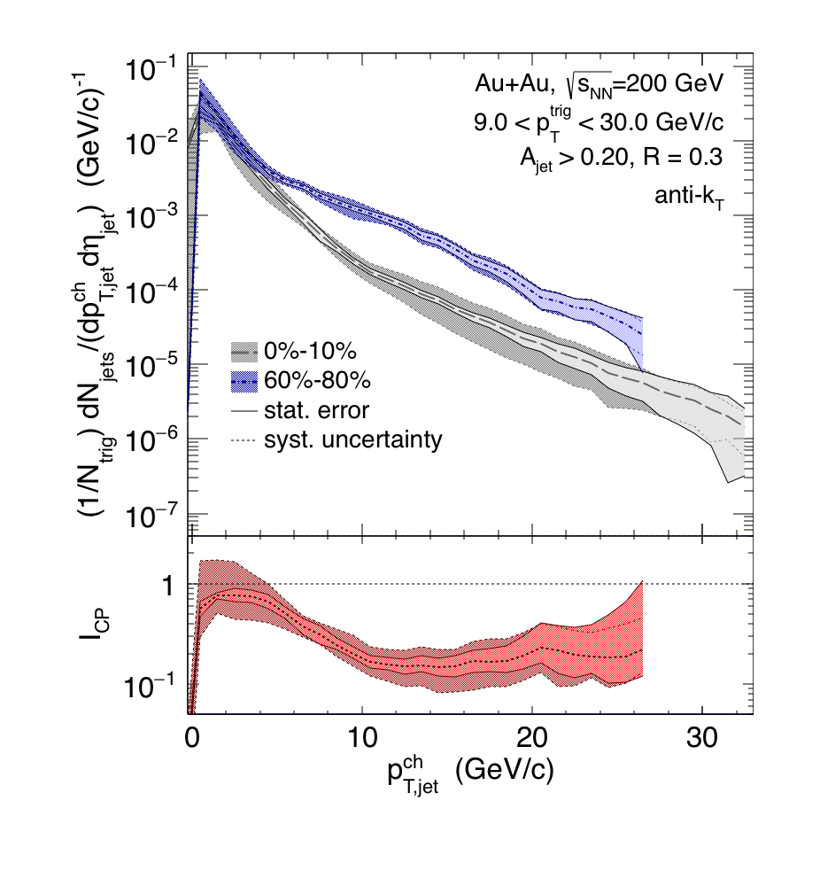
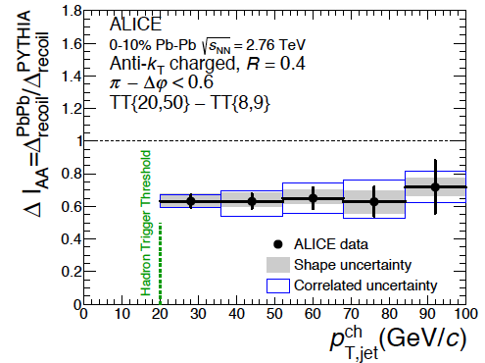
Comparison Central-Peripheral: I_{CP}
- Significant suppression (~0.2)
at p_{T} > 10 GeV/c, close to 1 at low p_{T}
- Larger suppression compared to
LHC energies! (caveat: different R)
Preliminary
ALICE
Errors show combined systematics
arXiv:1506.03984 [nucl-ex]

Slide 14
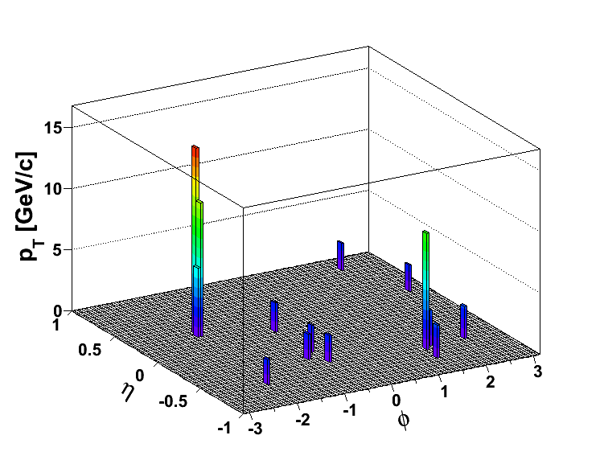
Trigger and Away-Side Jets
(Biased) Di-Jet Selection
Constituent pT^{Cut} = 0.2 GeV/c
Constituent pT^{Cut} = 2 GeV/c
→ Reduce BG
→ Reduce combinatorial jets
Di-jet Selection:
Jet pT^{Lead}>20 GeV/c
Jet pT^{SubLead}>10 GeV/c
|Δφ-π|<0.4
ATLAS, PRL 105, 252303
CMS, PRC 84, 024906 (2011)

Slide 15
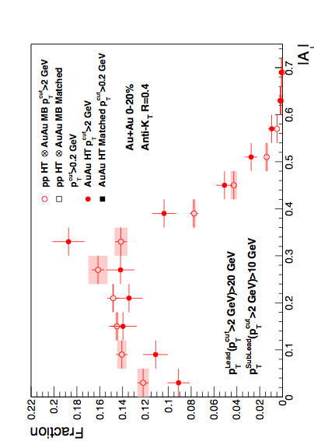
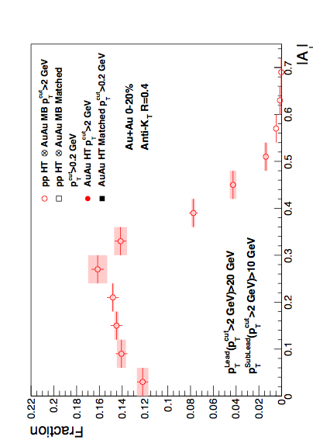
Di-Jet Imbalance AJ
Central Au+Au, R=0.4
Anti-kT R=0.4, pT^{Lead}>20 GeV & pT^{SubLead}>10 GeV with pT^{cut}>2 GeV/c
Event Fraction
Central Au+Au
anti-k_{T}, R=0.4
p-value < 10⁻⁴
(stat. error only)
Sys. Uncertainties:
- tracking eff. 6%
- tower energy
scale 2%
Preliminary
Pearson’s χ²-test
N.D. Gagunashvili,
arXiv:physics/0605123
|AJ|
Au+Au di-jets more imbalanced than p+p for pT^{cut}>2 GeV/c
Can the balance be restored?

Slide 16
Matched Di-jets w/o Constituent p_{T} Cut
pT^{Cut}=2 GeV/c
pT^{Lead}>20 GeV/c
pT^{SubLead}>10 GeV/c
|Δφ-π|<0.4
pT^{Cut}=0.2 GeV/c
pT^{Lead}>20 GeV/c (pT^{Cut}=2 GeV/c)
pT^{SubLead}>10 GeV/c (pT^{Cut}=2 GeV/c)
Rerun jet-finding algorithm
anti-kT on these events
Geom. matching
Geom. matching
Keep this jet selection
Calculate “matched” |AJ| with constituent pT,cut>0.2 GeV/c.
Geom. matching: ΔR<0.4

Slide 17
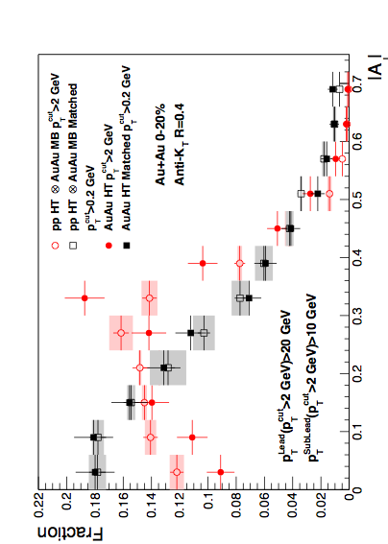
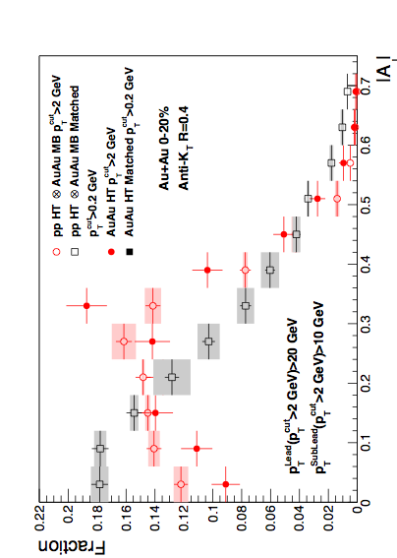
Di-Jet Imbalance AJ
Central Au+Au, R=0.4
Anti-kT R=0.4, pT^{Lead}>20 GeV & pT^{SubLead}>10 GeV with pT^{cut}>2 GeV/c
Event Fraction
Sys. Uncertainties:
- tracking eff. 6%
- tower energy
scale 2%
Central Au+Au
anti-k_{T}, R=0.4
p-value < 10⁻⁴
(stat. error only)
Preliminary
p-value = 0.8
(stat. error only)
|AJ|
Au+Au di-jets more imbalanced than p+p for pT^{cut}>2 GeV/c
Au+Au AJ ~ p+p AJ for matched di-jets (R=0.4)

Slide 18
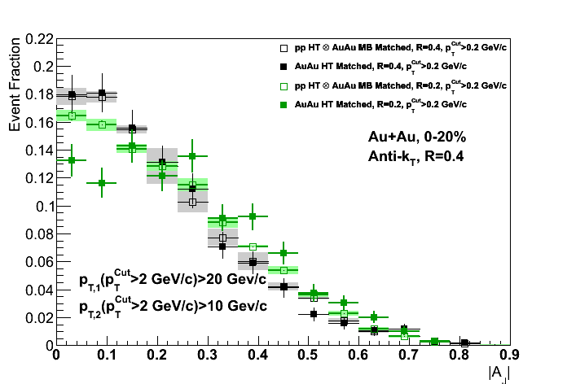
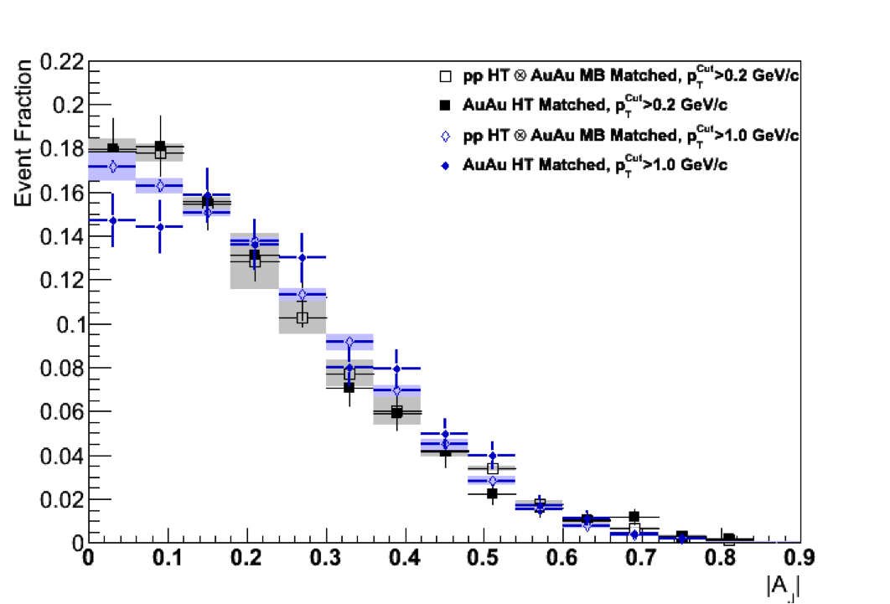
Differential Measurements
R=0.2
R=0.4
R=0.4
Matched to
Matched to
p_{T}^{Cut} > 0.2 GeV/c
p_{T}^{Cut} > 2 GeV/c
p_{T}^{Cut} > 1 GeV/c
Preliminary
Preliminary
Balance can not be recovered in smaller cone,
or harder constituents

Slide 19
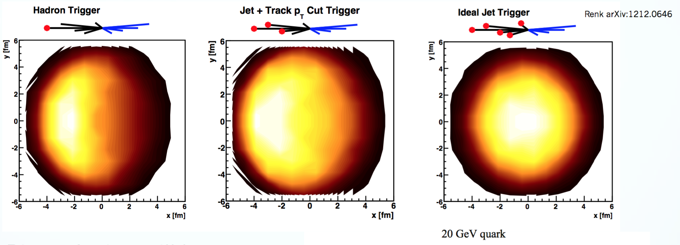
A Consistent (Qualitative) Picture
Focus on: Jet Softening
All measurements π⁰, h-jet, γ^{dir}, A_{J}, and jet-h consistent with suppression of high-z fragments
  Particularly jet-h and A_{J} suggest balancing at low-z
  Near-side is affected differently, but recoil always has long path length
  Expected difference between γ^{dir} and all others: needs more studies.
  Need to compare at the same parton p_{T} and hadron z_{T}

Slide 20
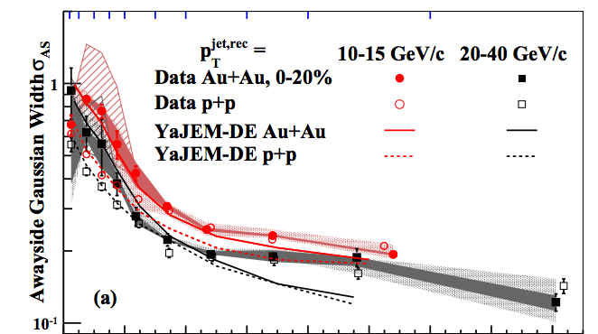
A Consistent (Qualitative) Picture
Focus on: Jet Broadening
h-Jet: Away-Side Jet cross section of narrow jets is suppressed
  Suggests broadening beyond R=0.3
Differential Di-Jet Imbalance: Broadening
Preliminary
PRL 112 (2014)
12, 122301
Coming soon:
γ^{dir}-jet

Slide 21
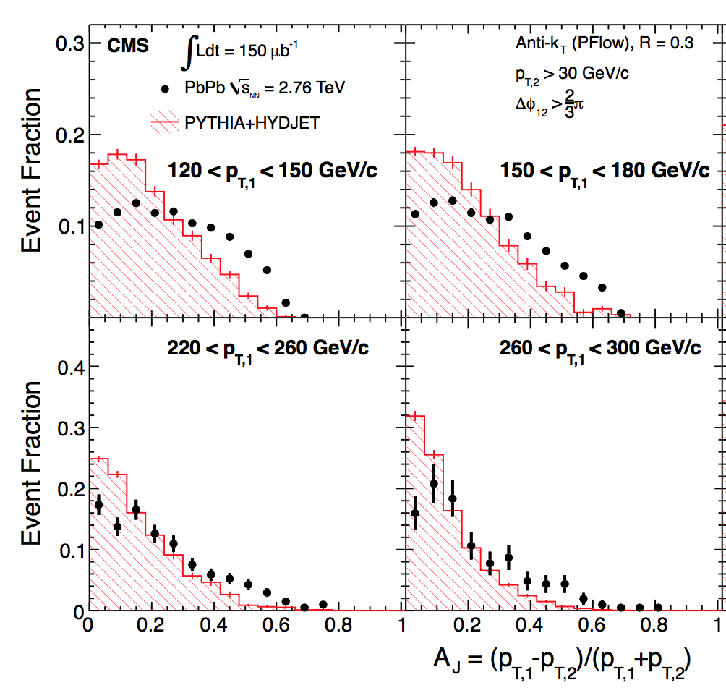
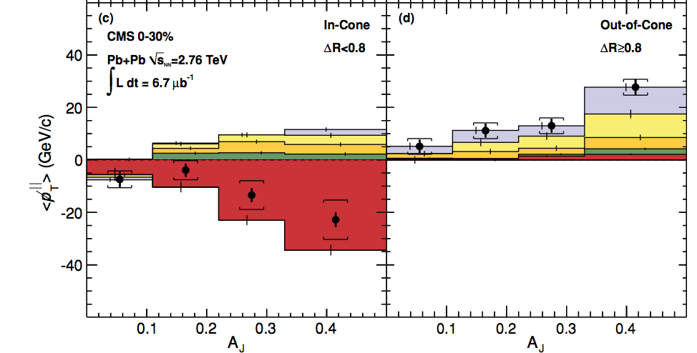
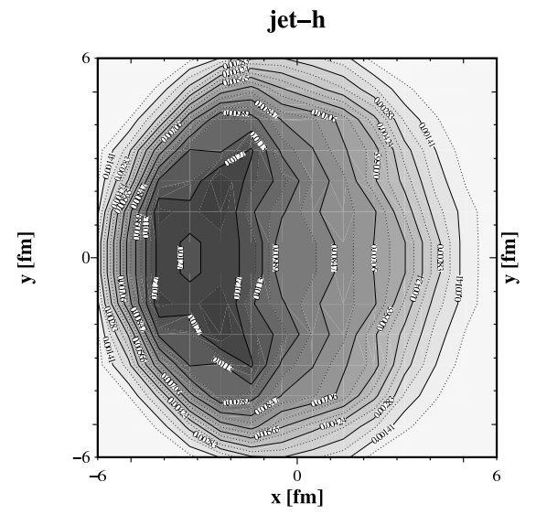
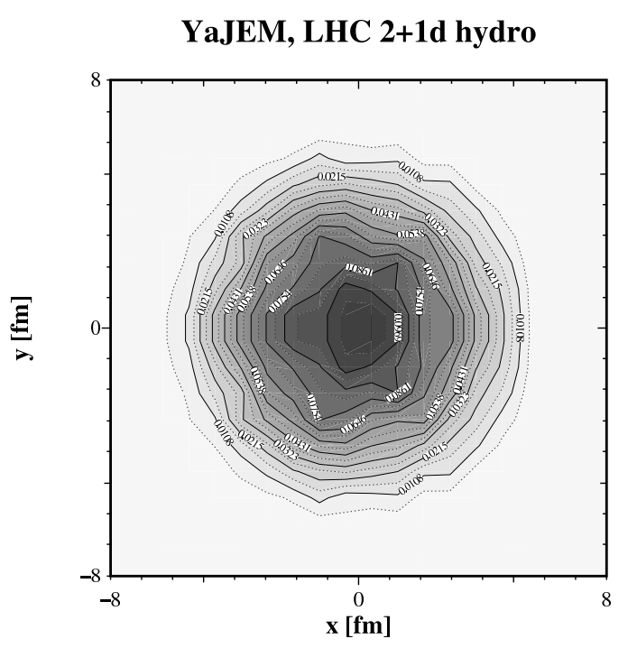
A Tool to Control Path Length
Biased Di-Jet A_{J}: “Lost” energy of the dijets is recovered in a jet of R=0.4
for pT^{Cut} = 0.2 GeV/c
Interpretation:
(Constituent) pT^{Cut} = 2 GeV/c
+ High Tower (5.5 GeV)
+ (Jet) pT^{Lead}>20 GeV/c
→ Surface Bias
+ (Recoil) pT^{SubLead}>10 GeV/c
→ Path Length Control
Contrast to LHC:
Large imbalance, balanced at large angles
“Unbiased” di-jet selection
→ longer path lengths
  & Larger energy loss at early times
→ more diffusion in medium
CMS, PRC 84,
024906 (2011)
STAR:
p_{T}^{lead}>15 GeV/c
pT^{cut}>2 GeV/c
T. Renk, PRC 87, 024905 (2013)
LHC:
A_{J} Dijet Trigger
T. Renk, PRC 85, 064908 (2012)

Slide 22
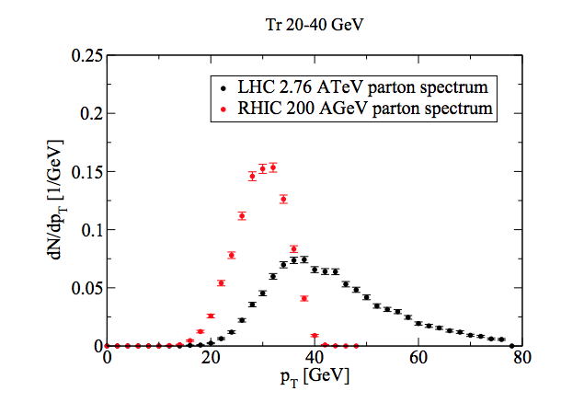
Unique Opportunity for
Jet Geometry Engineering at RHIC
p_{T}^{SubLead} & Constituent p_{T} → systematically dial in the path length of the recoil jet
R=0.4,p_{T}^{Cut}>2 GeV/c
T. Renk, PRC 87, 024905 (2013)
A RHIC Strength!
Good correlation between jet and parton energy for these jets

Slide 23
Backup

Slide 24
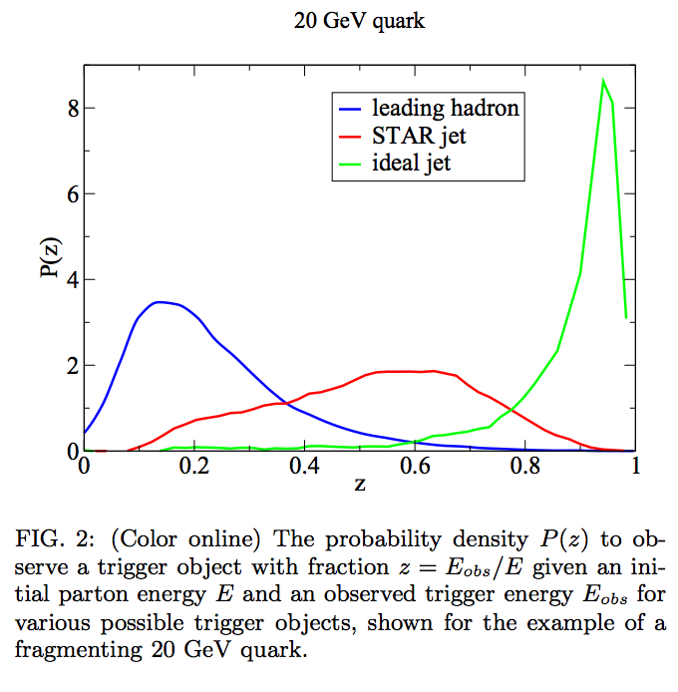

Slide 25
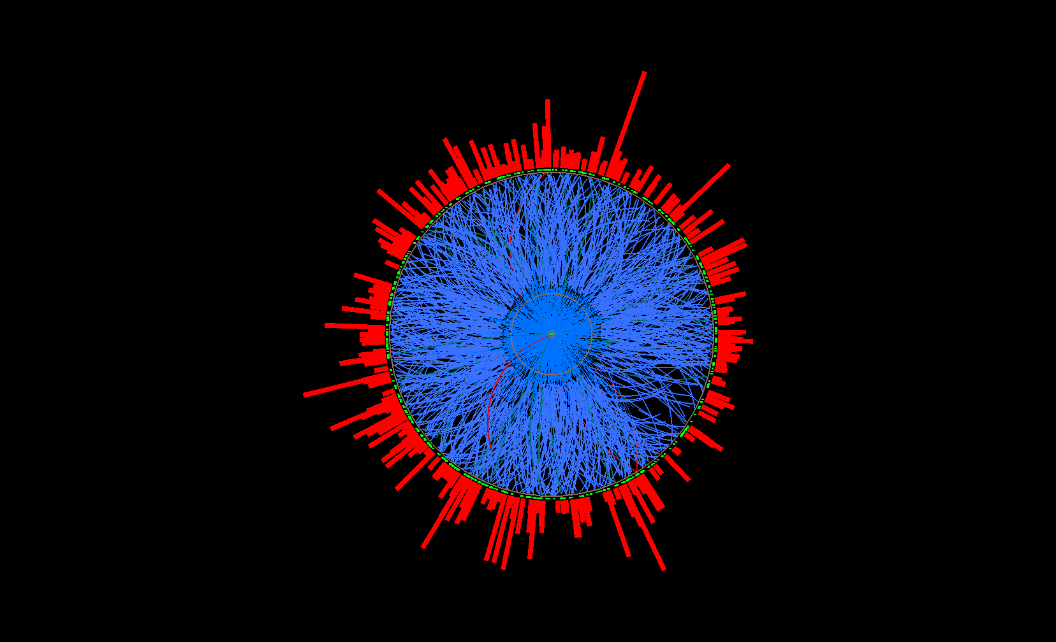
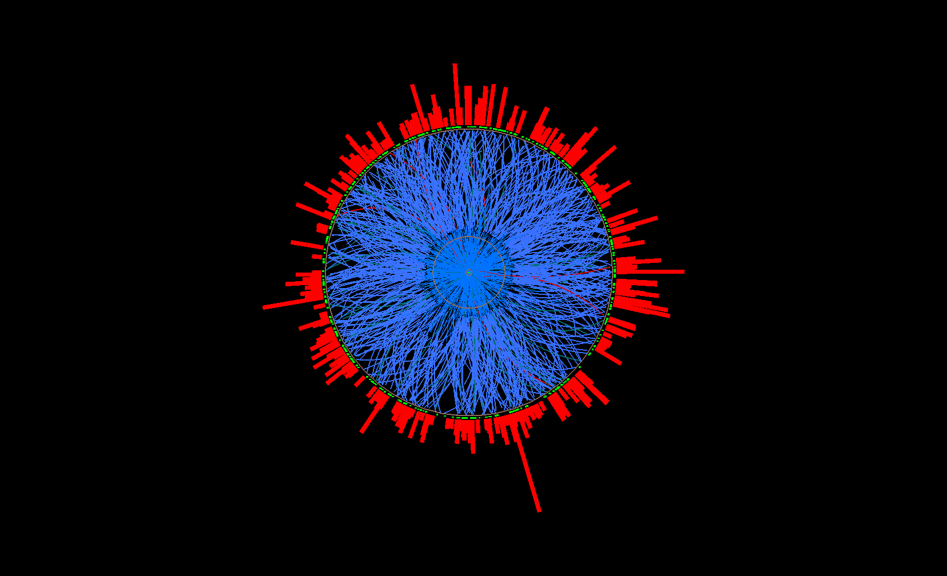
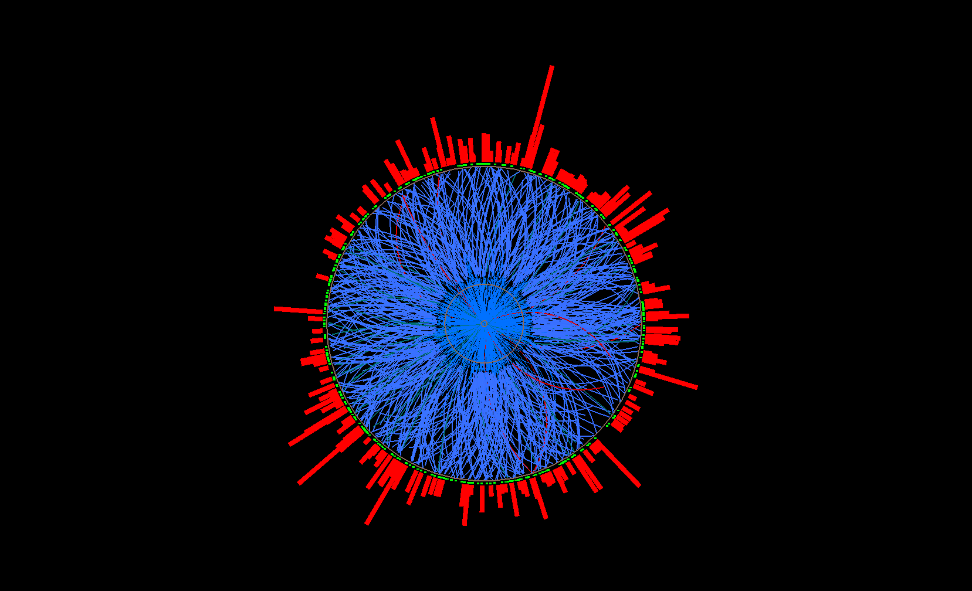
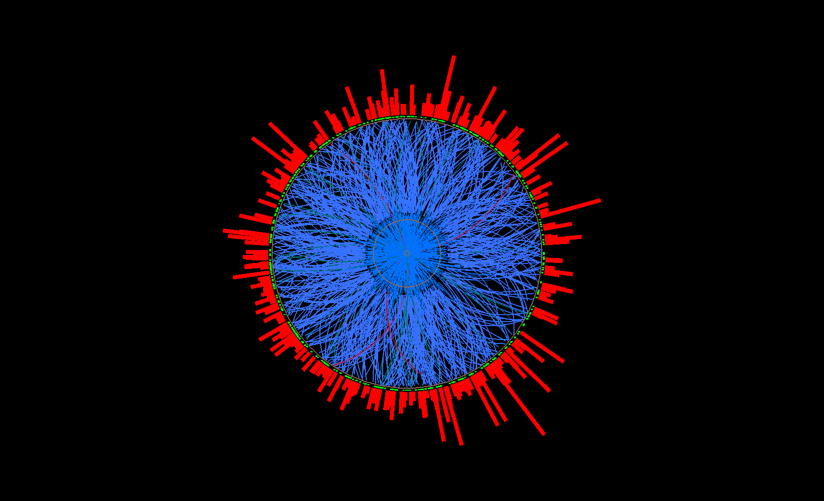
Mixed Event Generation for Jets
Mixed event
Mix only similar centrality, Ψ_{EP} ,
z-vertex position
Pick one random
track per real event
→ add to mixed
event
…
Real events
Ev. 1
Ev. 2
Ev. 3
Ev. 765

Slide 26
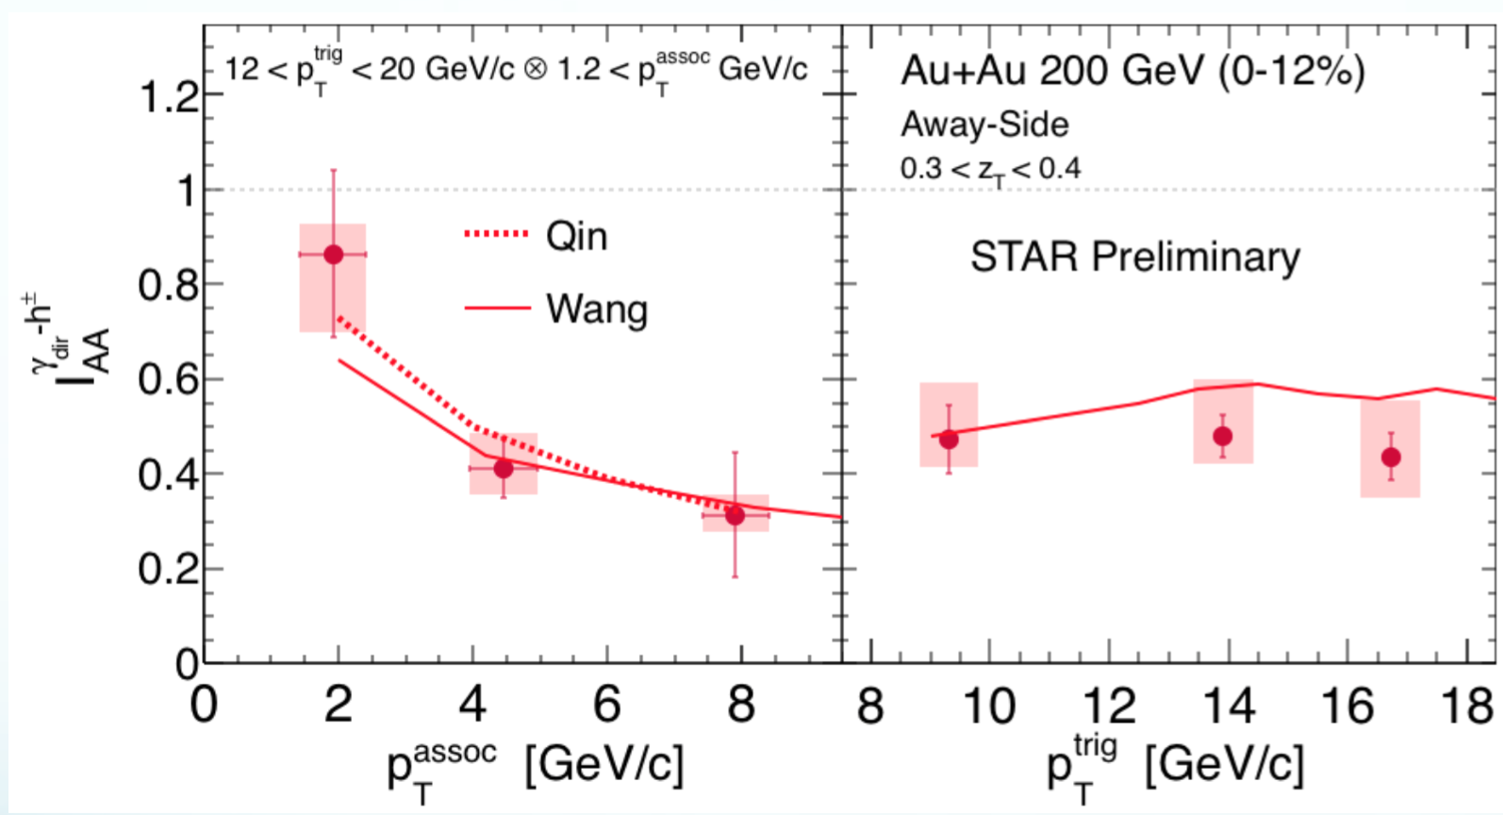
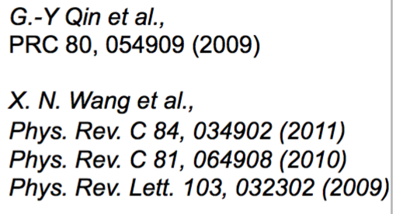
Ι_{ΑΑ} γ^{dir} – Dependence on p_{T}^{assoc} and p_{T}^{trig}
- Clear p_{T}^{assoc} dependence of away-side suppression
- No dependence on trigger γ^{dir} energy
- Good model agreement

Slide 27
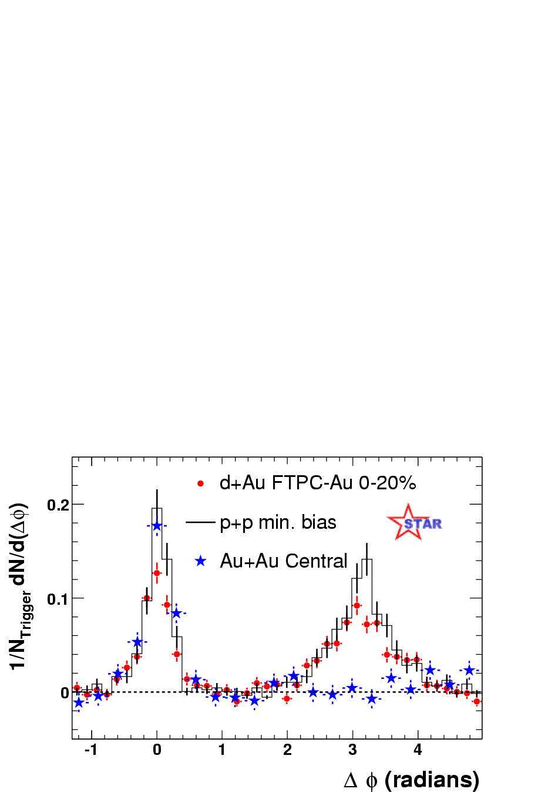
Motivation – Jets as Probes of the Medium
STAR, PRL 91 (2003) 072304
How much energy is lost to the medium?
And where does it go?
Jets are calculable, well described in pp → Explore QGP with pQCD
4 < p_{T}^{trig} < 6 GeV/c
2 < p_{T} ^{assoc}<p_{T} ^{trig}
Di-Hadron Correlations:
Away-side (Δφ=π) Suppression
Medium effect, d+Au is similar to pp
Parton energy? Flavor?
Geometry bias? Path length?

Slide 28
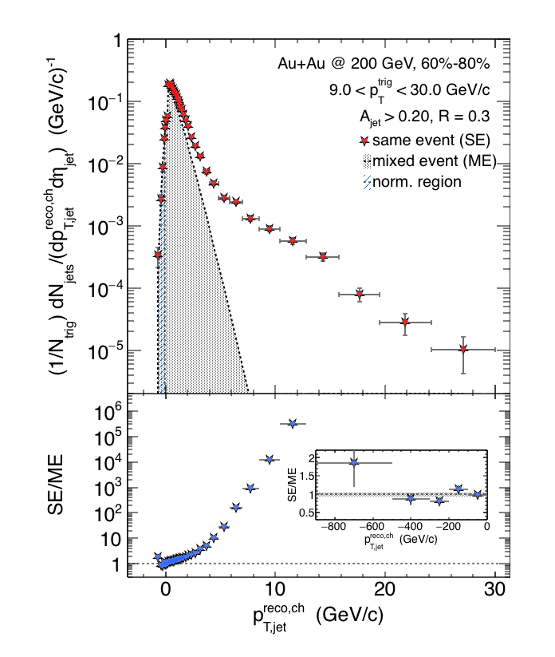
Charged Raw Recoil Jet Spectrum: Reference
Peripheral
Reference spectrum:
peripheral collisions
Much less combinatorial
background compared to
most central data
Excellent signal/background
ratio down to 3 GeV/c
Preliminary

Slide 29
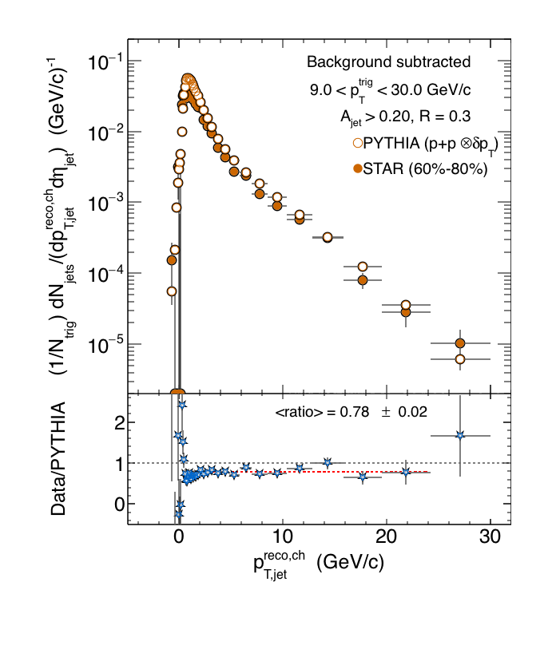
Reference vs. PYTHIA
Peripheral
Background-subtracted
spectrum in 60%-80% Au+Au
in comparison with smeared*
PYTHIA
PYTHIA shape + yield in good
agreement with 60%-80% data
Preliminary
*PYTHIA δp_{T}

Slide 30

Differential Measurements
R=0.2
R=0.4
R=0.4
Matched to
Matched to
p_{T}^{Cut} > 0.2 GeV/c
p_{T}^{Cut} > 2 GeV/c
p_{T}^{Cut} > 1 GeV/c
Balance can not be recovered in smaller cone,
or harder constituents

Slide 31


Null-Hypothesis:
Balance Restored by Uncorrelated BG?
Method 1: Random Cone (RC):
Take di-jet pair pT^{Cut}>2 GeV/c (w/o low pT)
pT^{Cut}=2 GeV/c
pT^{Lead}>20 GeV
pT^{SubLead}>10 GeV
Embed randomly
Calculate |AJ| with pT^{Cut}>0.2 GeV/c
using cone of R
the 2 Jet vectors
into a central
Au+Au MB event
pT [GeV/c]
Embed the two Jet
vectors into a Au+Au HT
event, 2R away from
reconstructed di-jet
pair in that event
Method 2: EtaCone (EC):
Take di-jet pair
pT^{Cut}>2 GeV/c (w/o low pT)
η
ϕ

Slide 32

Effect of Background Fluctuations
Anti-kT R=0.4, pT^{Lead}>20 GeV & pT^{SubLead}>10 GeV with pT^{cut}>2 GeV/c
Event Fraction
Sys. Uncertainties:
- tracking eff. 6%
- tower energy
scale 2%
Central Au+Au
anti-k_{T}, R=0.4
Preliminary
Method 2
(EC)
Method 1
(RC)
|AJ|
Balancing of Au+Au matched di-jets due to
correlated signal yield in a cone of R=0.4

Slide 33


Unfolding in One Slide
Implementation:
RooUnfold
T. Adye ey al.
arXiv:1105.1160
1) SVD with regularization
A. Hoecker, V. Kartvelishvili
arXiv:hep-ph/9509307
2) Iterative Bayesian
G. D’Agostini
arXiv:1010.0632
Embedding known truth
→ Matrix relationship
p_{T}^{meas} = A p_{T}^{truth}
Response matrix A
- typically rectangular (more p_{T}^{meas} bins)
- ideally close to diagonal
Challenge:
Numerical Inversion ignores error bars
→ need to smooth fluctuations

Slide 34

pp Reference
Au+Au HT
pp @ Au+Au
pp HT
Central Au+Au
Cannot compare
Compare
No correction to particle level. To compare on equal footing:
Embed full pp events into (unbiased) central events
Tower and efficiency uncertainty studied in pp

Slide 35


Recoil yield suppression
R=0.3
R=0.5
Preliminary
Preliminary
Calculate spectrum shift
requires distributions ~ exponential, ratio ~ flat
RHIC: smaller shift for larger R
R=0.5: smaller shift at RHIC than LHC
Out-of-cone energy transport ?
comparison requires similar trigger bias ➔ theory calculation
Spectrum Shift Periph/pp ➔Central
 | p^{ch}_{T,jet} range [GeV] | Shift R=0.3 [GeV] | Shift R=0.5 [GeV]
Au+Au @ 200 GeV | [10,20] | -6.3 ± 0.6 ± 0.8 | -3.8 ± 0.5 ± 1.8
Pb+Pb @ 2.76 TeV ALICE arXiv:1506.03984 | [60,100] |  | -8 ± 2

Slide 36

γ^{dir}-Hadron vs. Jet-Hadron Correlations

