Slide 1

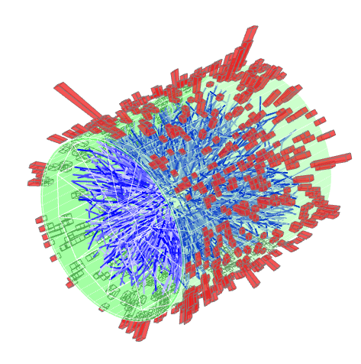

Measurement of the Shared Momentum Fraction z_{g} using Jet Reconstruction in p+p and Au+Au Collisions with STAR
Kolja Kauder for the STAR Collaboration
September 25, 2016

Slide 2
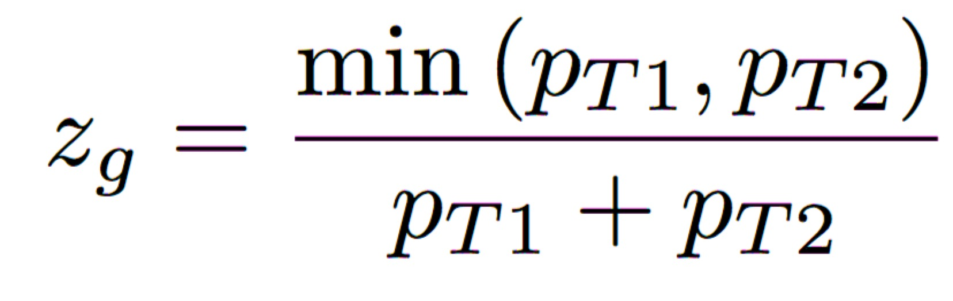
Soft-Drop Grooming
Remove wide angle soft radiation
Many applications, such as:
groomed energy, groomed radius
pp, jet mass, …
Focus here (with β=0):
“Groomed Momentum Sharing”
p_{T} fraction carried by less-energetic sub-jet after grooming
Slide from J. Thaler
ALICE Jet Workshop,Yale
Larkoski et al.,
PRD 91, 111501 (2015)

Slide 3
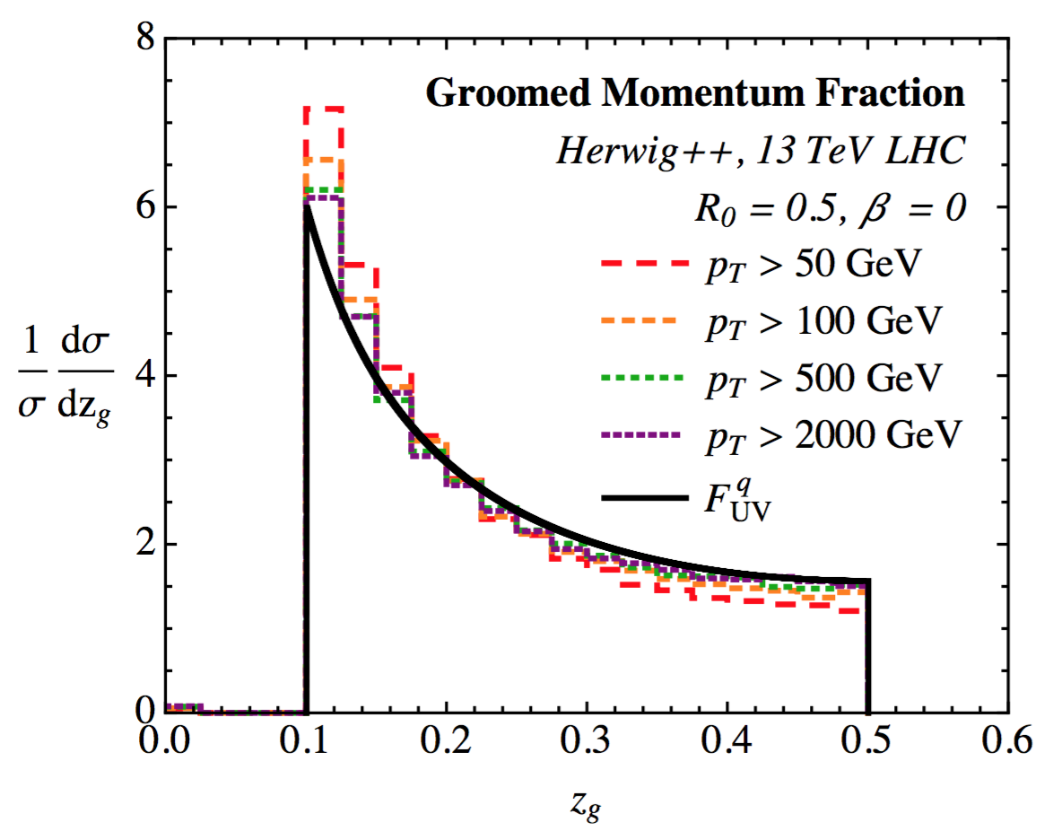
Measuring the AP Splitting Function
Role of β:
β>0 - IRC safe
β<0 - (IR)C unsafe
β=0 - IRC unsafe
– but Sudakov-safe
Larkoski et al.,
PRD 91, 111501 (2015)
RHIC Energies?
~ independent of α_{s}
~ independent of p_{T} (in UV limit)
Connection to fundamental QCD
P_{i}: Altarelli-Parisi splitting functions (symmetrized)
q→qg, g→gg, g→qg
(Kernels in DGLAP)
Note: AP functions govern split kinematics, not frequency
→ Treated differently in E-loss models

Slide 4
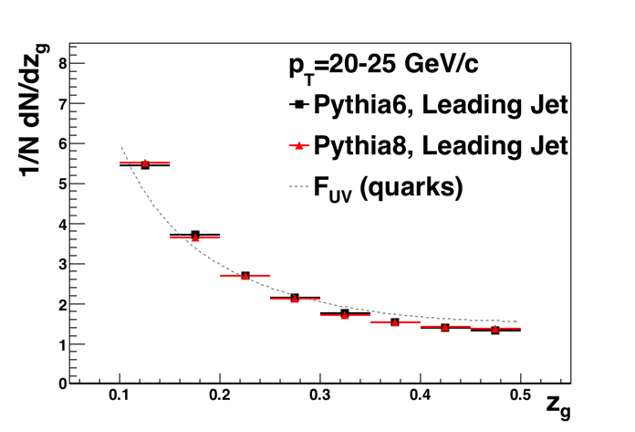
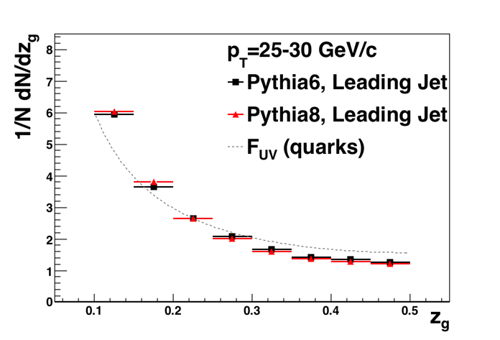
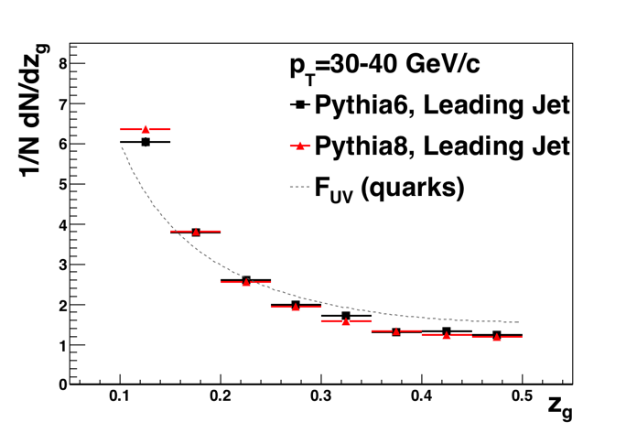
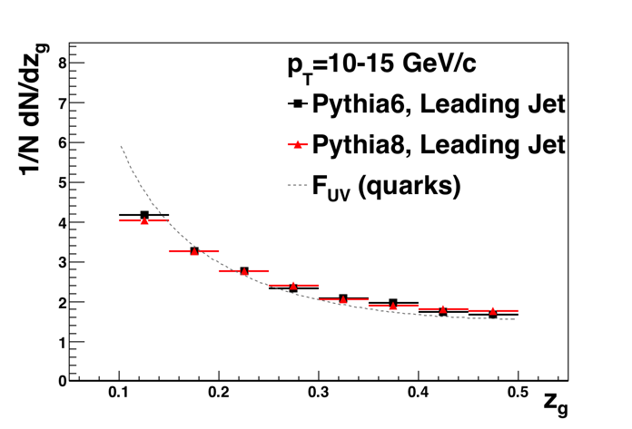

z_{g} at 200 GeV—PYTHIA
FastJet3
M. Cacciari and G. Salam
Phys. Lett. B 641, 57 (2006)
Jet reconstruction:
R=0.4
Found with anti-k_{T}
Reclustered with C/A
No background subtraction
Soft-Drop Grooming:
β=0
z_{cut}= 0.1
PYTHIA 6.410 + CTEQ5L
not decayed
later: GEANT input
PYTHIA 8.219 default
decayed as normal
Mild p_{T} dependence above ~15 GeV/c
z_{g} consistent between Pythia6 and 8
→ insensitive to decay details

Slide 5
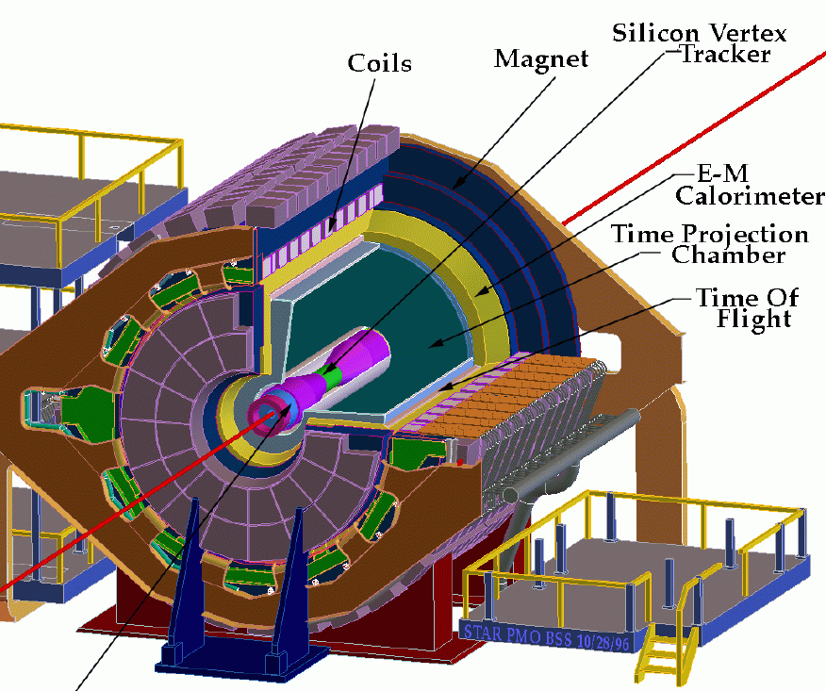
The Solenoidal Tracker At RHIC (STAR)
Tracking (charged) and EMC (neutral) in 2π (azimuth) × ±1 (η)
pp 2006 HT
AuAu 2007 HT, 0-20% central
  Efficiency difference and systematic uncertainty assessed using pp embedded into Au+Au MB
High Tower (HT) trigger:
E_{T}>5.4 GeV in one tower
Essential for high statistics
Focus on HT Trigger Jet instead of “leading jet”
– this is the trigger object we focus on

Slide 6
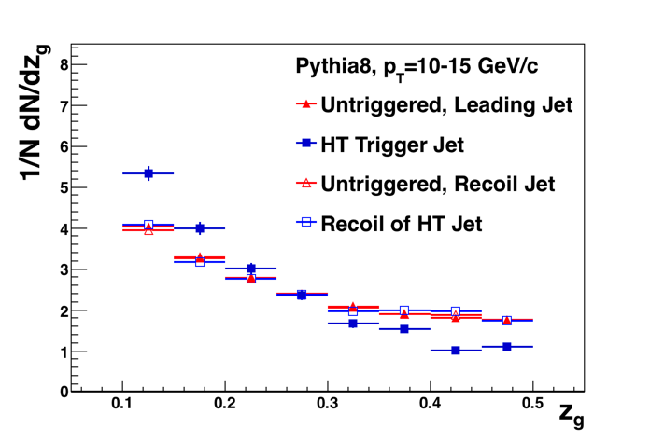
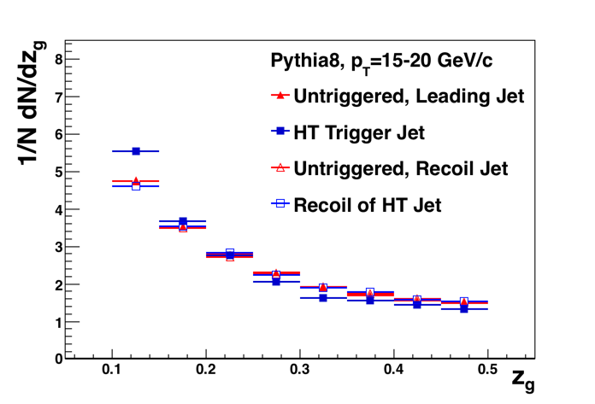
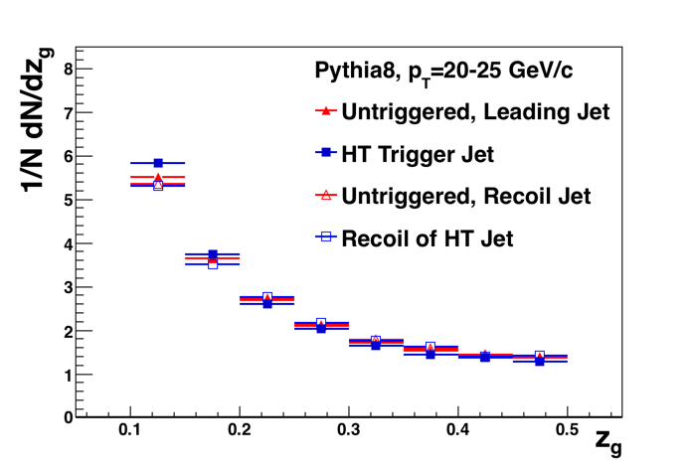
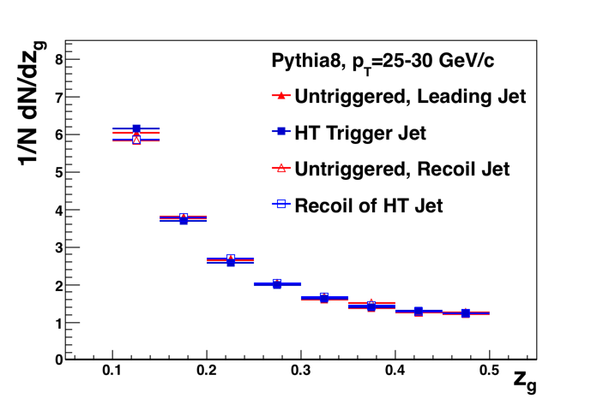
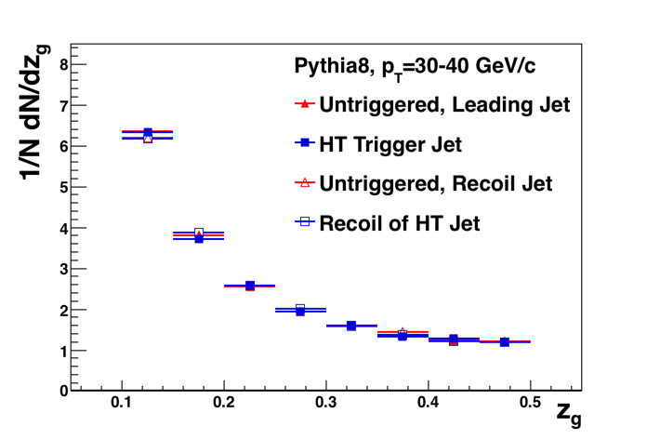
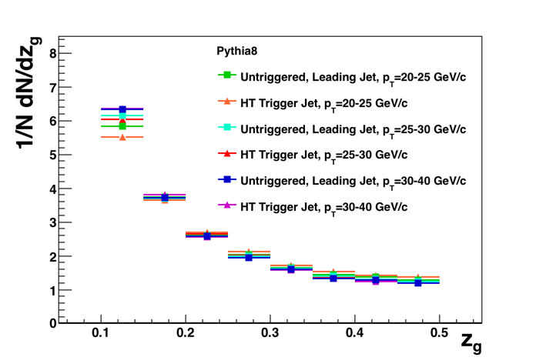
MC particle level “High Tower” z_{g} at 200 GeV—PYTHIA8
“High Tower”:
Require neutral particle with p_{T}>5.4 GeV/c
Defines Trigger Jet
Recoil Jet back-to-back
(|Δφ|<R)
HT Trigger Bias at particle level:
Recoil jet is unaffected (as expected)
Trigger jet: Bias disappears for p_{T}>~20 GeV/c

Slide 7
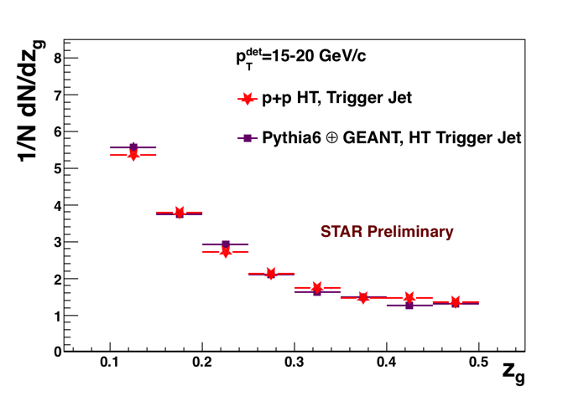
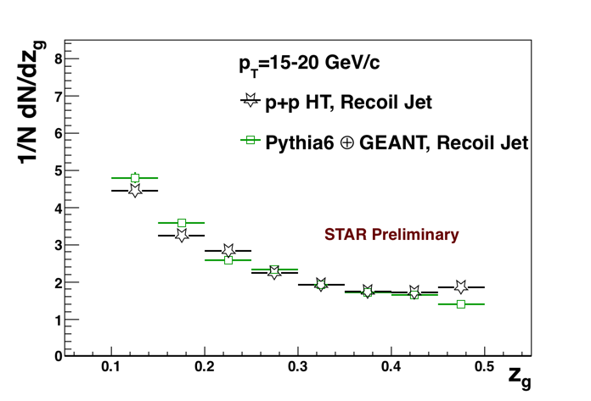
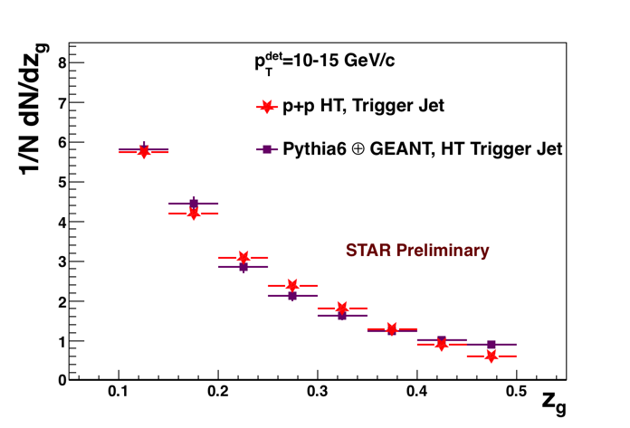
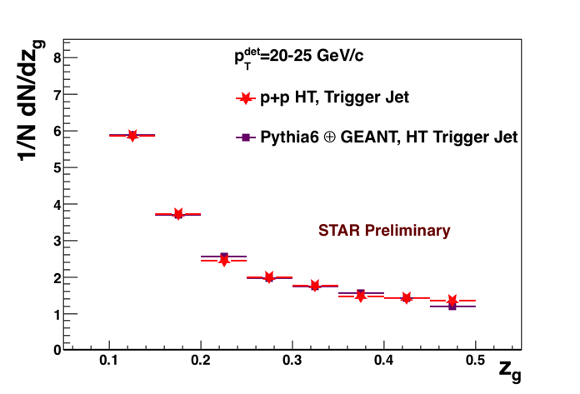
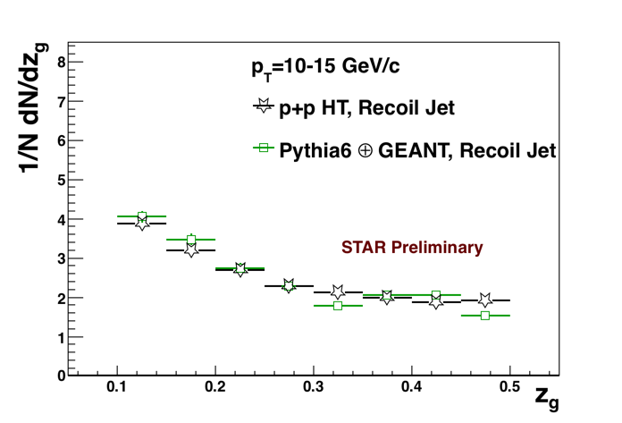
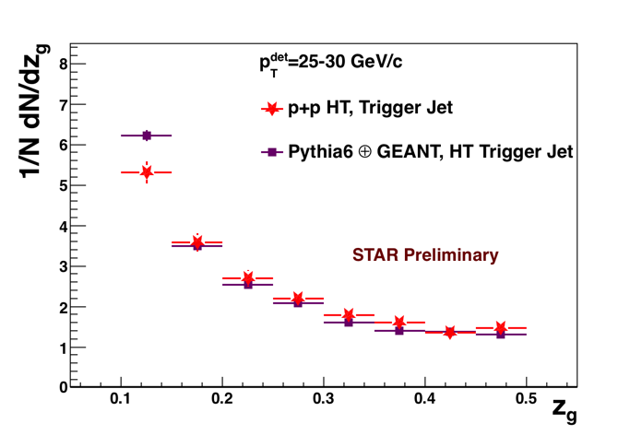
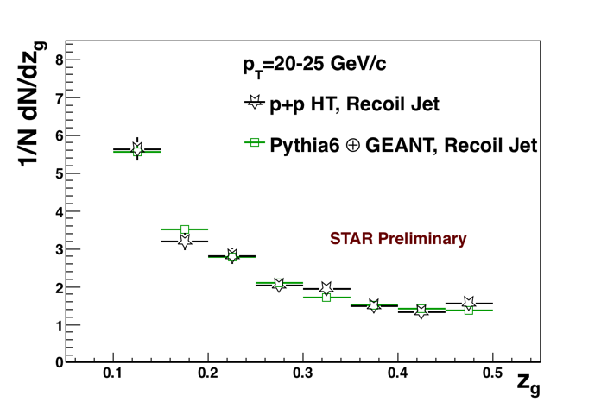
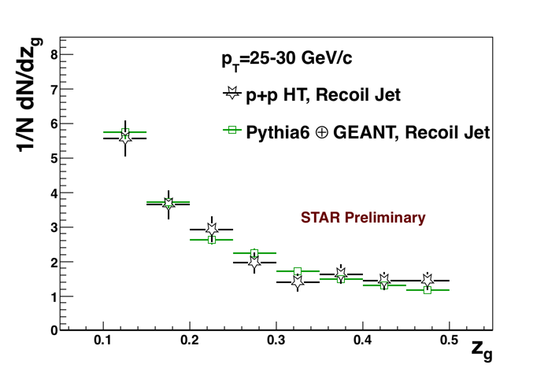
Detector Level z_{g} at 200 GeV—p+p HT
High Tower:
Neutral particle with p_{T}>5.4 GeV/c defines Trigger Jet
Trigger
Recoil
At detector level
excellent agreement with PYTHIA
→ Bin-by-bin correction of z_{g} distribution
Correction factor:
( GEANT+HT p_{T}^{det} )/ ( Pythia MB p_{T}^{part} )
PYTHIA 6.410
+ CTEQ5L
+ GEANT3
p+p HT:
Year 2006
stat. errors only

Slide 8
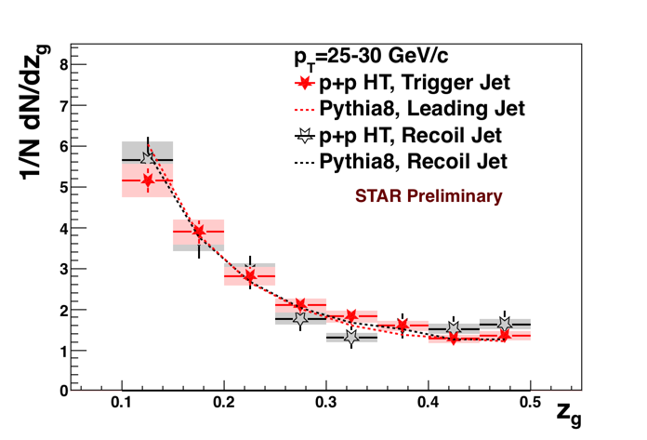
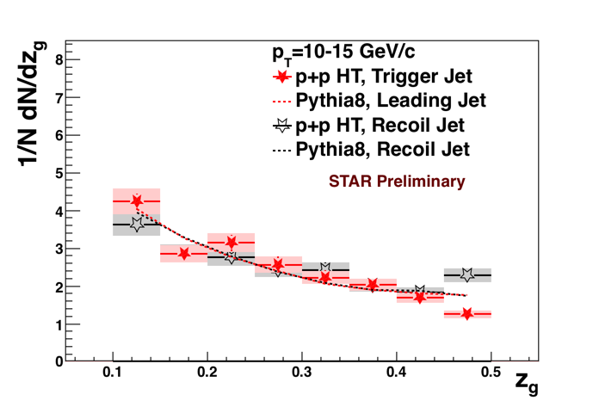
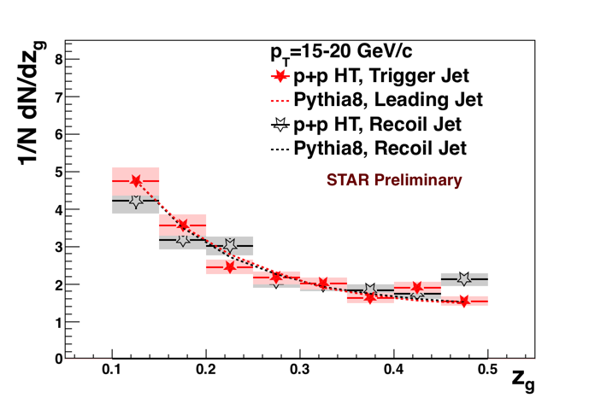
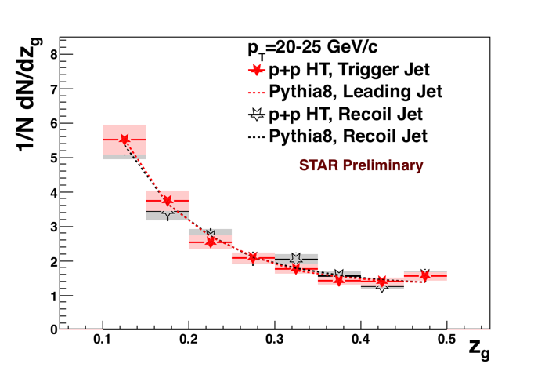
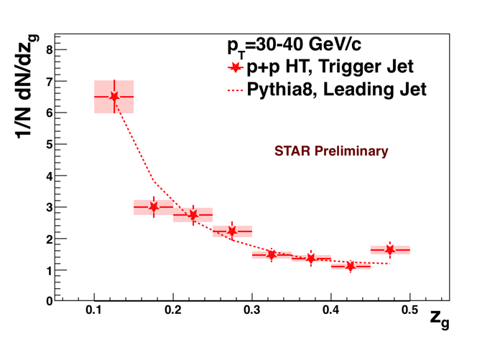
p+p HT, 200 GeV
Corrected to Particle Level
High Tower:
Neutral particle with p_{T}>5.4 GeV/c defines Trigger Jet
p+p HT Run6
Preliminary Systematics:
4% overall jet energy scale uncertainty shown
STAR PRL 100 (2008) 232003
Evaluation of tracking efficiency and tower scale uncertainty on individual subjets and their (anti-)correlation TBD
First measurement of p+p z_{g} at RHIC
After correction, Trigger ~ Recoil
Good agreement with PYTHIA

Slide 9
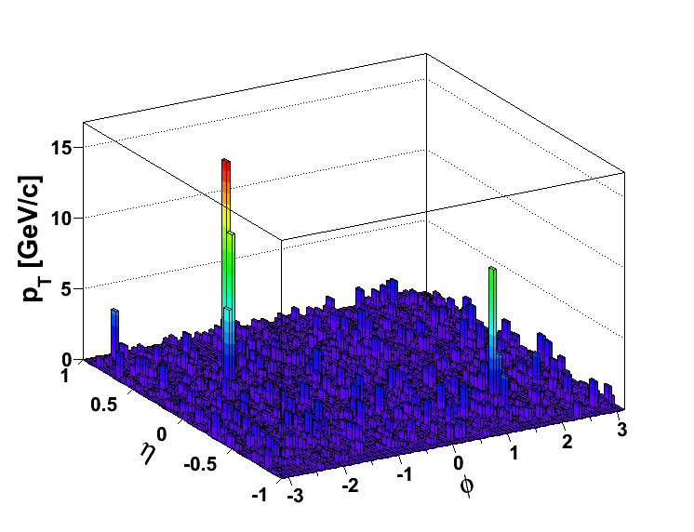
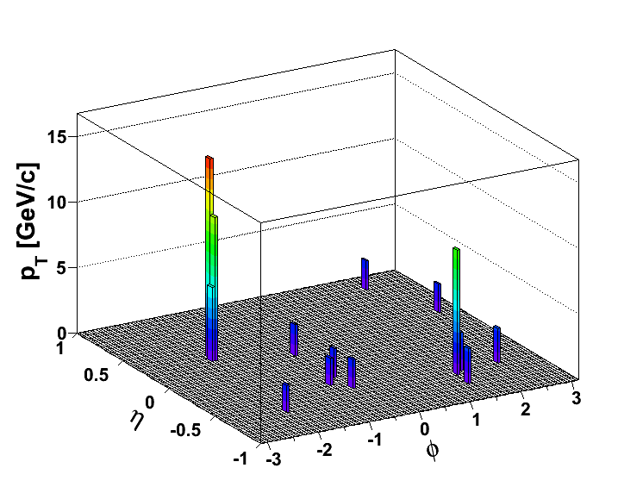
Au+Au: Trigger and Recoil Jets
(Biased) Di-Jet Selection
Constituent pT^{Cut} = 0.2 GeV/c
Constituent pT^{Cut} = 2 GeV/c
→ Reduce BG
→ Reduce combinatorial jets
Change from A_{J} Analysis:
Trigger Jet defined by HT
Di-jet Selection:
Jet pT^{Trig}>20 GeV/c
Jet pT^{Recoil}>10 GeV/c
|Δφ-π|<0.4

Slide 10
Matched Di-jets w/o Constituent p_{T} Cut
Matched Di-Jets with
soft constituents included
Hard-Core Di-jets
Rerun jet-finding algorithm
anti-kT on these events
Geom. matching
Geom. matching
Keep this jet selection
Use this p_{T}^{Trig}
Calculate z_{g} with all
constituents w/ pT,cut>0.2 GeV/c
Geom. matching: ΔR<0.4

Slide 11
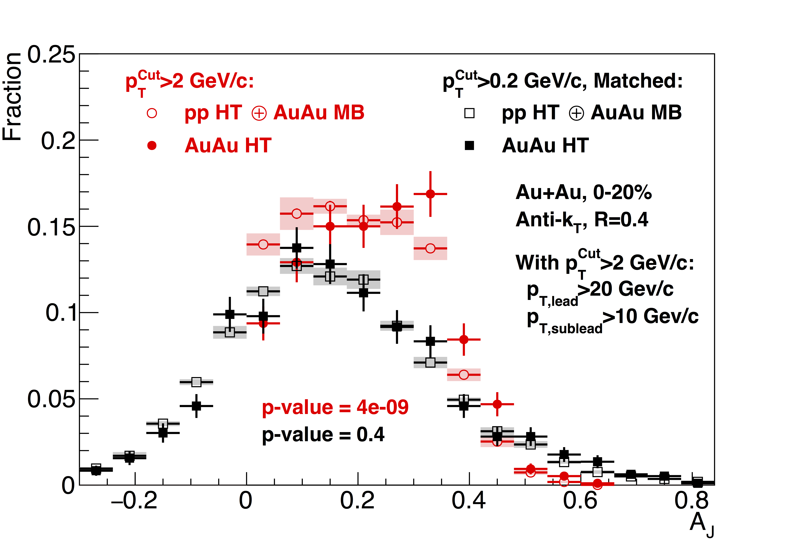

Reminder: Di-Jet Imbalance AJ
Submitted to PRL
arXiv:1609.03878
Sys. Uncertainties:
- tracking eff. 6%
- tower energy
scale 2%
Au+Au di-jets more imbalanced than p+p for pT^{cut}>2 GeV/c
Au+Au AJ ~ p+p AJ for matched di-jets (R=0.4)

Slide 12
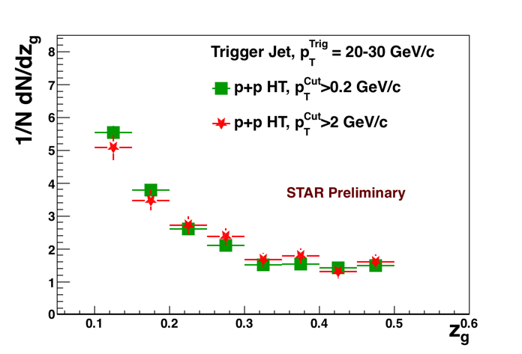
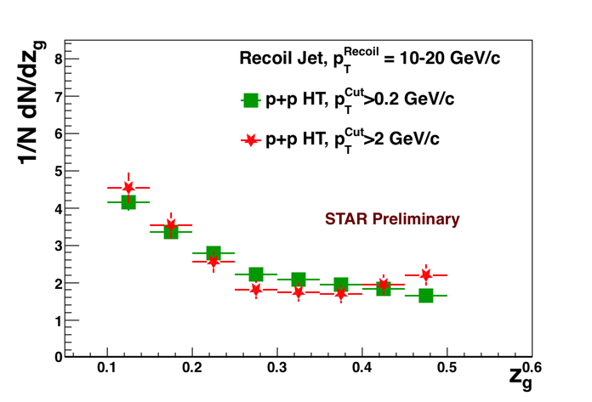
For Context: Hard Core Selection p+p at Detector Level
stat. errors only
Trigger
Recoil
Hard-core selection p_{T}^{Cut}>2 GeV/c shifts jet p_{T} and may bias toward different splitting pattern
→ However, observe rather mild effect!
Stat. uncertainty only, no unfolding

Slide 13
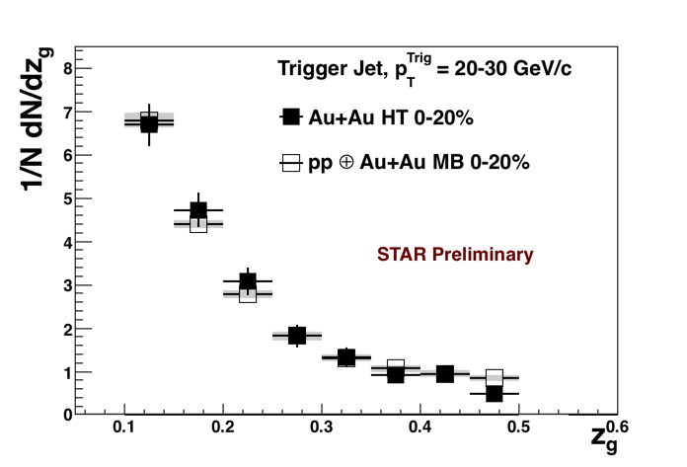
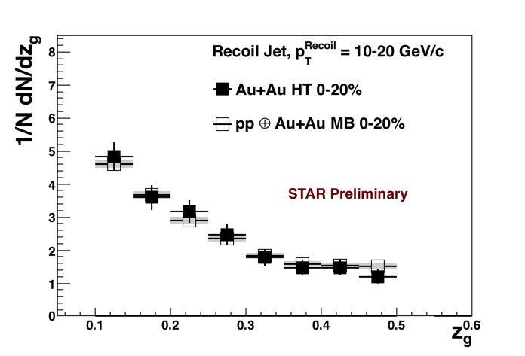
Au+Au and embedded p+p
Detector Level
Sys. Uncertainties on
embedded p+p:
tracking eff. 6%
tower
energy scale 2%
p_{T}^{Trig,Recoil}: Calculated with pT,cut>2 GeV/c
z_{g:} Measured on matched jets with pT,cut>0.2 GeV/c
Trigger
Recoil
Direct comparison to embedded p+p – no unfolding
Selected di-jets with hard cores:
No significant modification of the splitting function in
Au+Au observed with z_{g}

Slide 14
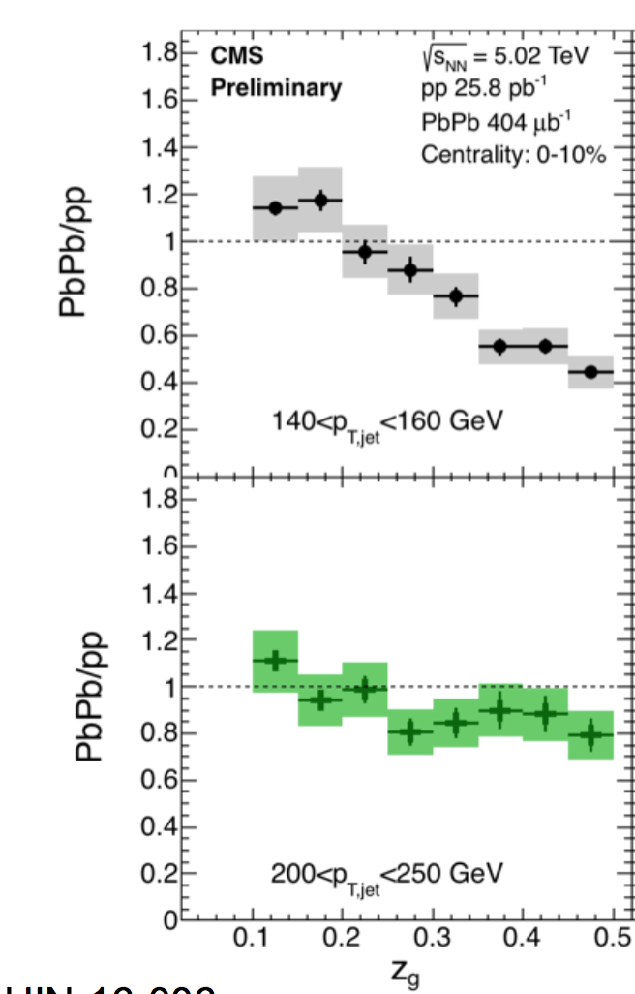
Discussion
CMS:
Significant modification of the “jet splitting function” z_{g} in central Pb+Pb
More modified
at lower p_{T}^{Jet}
Biased Di-Jets A_{J}:
“Lost” energy of the dijets is recovered in a jet of R=0.4 for pT^{Cut} = 0.2 GeV/c
Interpretation:
Selecting shorter
in-medium path length
Expectation: Some modification, more so on the recoil side
STAR: No modification found
Possible Reasons:
  Only mild medium interaction?
  Split as measured with z_{g} occurs before medium formation?
  Splitting function not affected
  by medium interactions?
M. Verweij (CMS)
BOOST ’16
HIN-16-006

Slide 15
Summary
PYTHIA
  Soft dropped z_{g} observable robust and applicable down to low jet energies (10-15 GeV)
p+p
  z_{g} (10-40 GeV) well described by Pythia at √s=200 GeV
Au+Au — Hard-core dijets
  As measured with z_{g}:
  No significant splitting modification on near- or away-side
  More input and iteration with theorists necessary
    Lots of communications already
Future:
  2D Unfolding → Optimize systematics
  Year 2007 → Year 2014: Increase kinematic reach and precision
  Inclusive z_{g} measurements

Slide 16
BACKUP

Slide 17
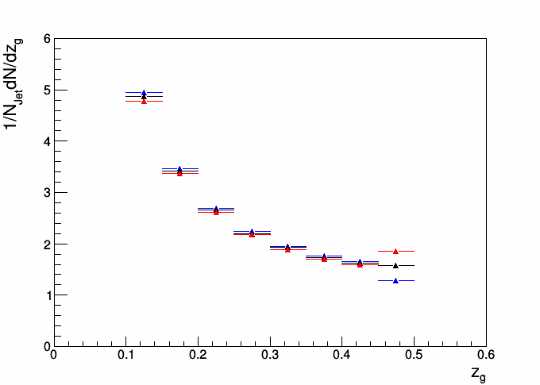
Follow up: z_{g} systematic error estimate discussion
Anti-correlated sub-
jet energy scale uncertainties (+-0.02) can lead to significant sys. uncertainties for z_{g}~0.5
(Anti)-correlated sub-jet energy scale uncertainties can arise from different sub-jet composition (EMCal tower vs tracks). Conceivable at lower jet energies (HT triggered jets)
Anti-Correlated
Sub-jet energy scale
Uncertaintiy:
p_{T1}+0.02, p_{T2}-0.02
p_{T1}-0.02, p_{T2}+0.02
Toy MC
p_{T}=20 GeV

Slide 18
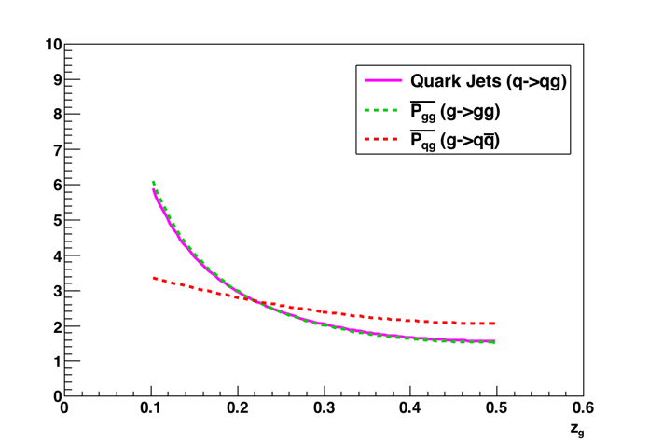
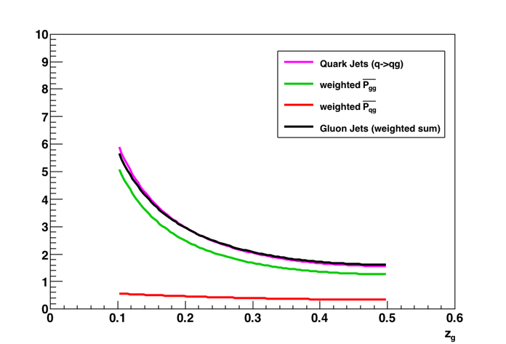
Gluons & Quarks
Glue radiation (g->gg and q->qg) is the same
g->qq is different
However gg / qq = T_{R}/C_{A} = 5—6
Weighted sum is the same
OPAL, Z Phys C 65(3):367-377

Slide 19
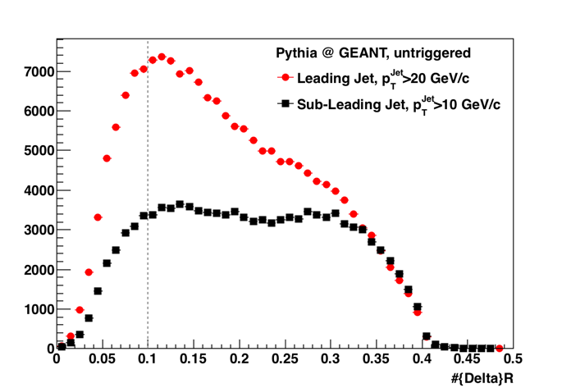
ΔR
At GEANT level:
Only ~15-20% of jets below |ΔR|<0.1

Slide 20
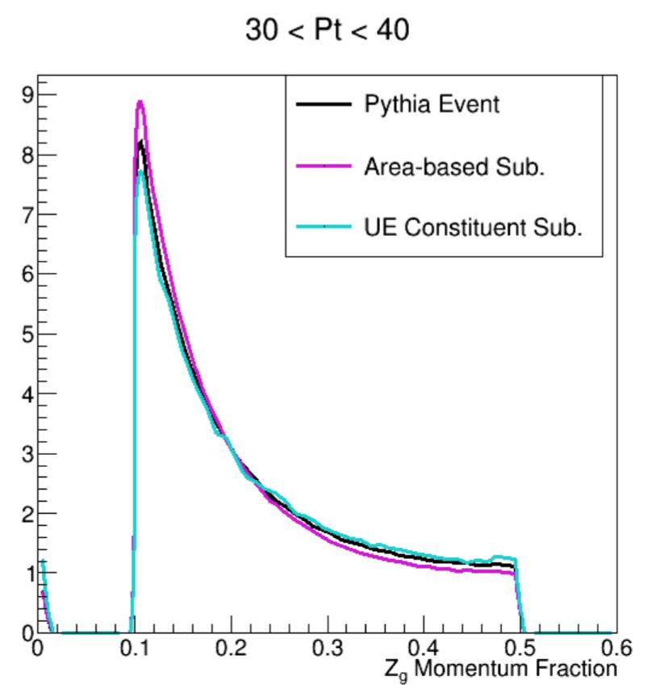
Constituent Subtraction
Constituent Subtraction:
  Distribute ρA^{Jet} to individual
  constituents by attaching it to ghosts
Two options, both with flaws
First find jets, then apply correction to individual jets
→ Cluster structure is destroyed in the process.
Subtract entire event, then find jets
Straight-forward method, but competes and cross-talks with our “match to a hard-core” method.
Toy Model Study by Dan Nemes (Yale)
Difference seems negligible, at least for the energies considered
Berta et al.
arXiv:1403.3108

Slide 21
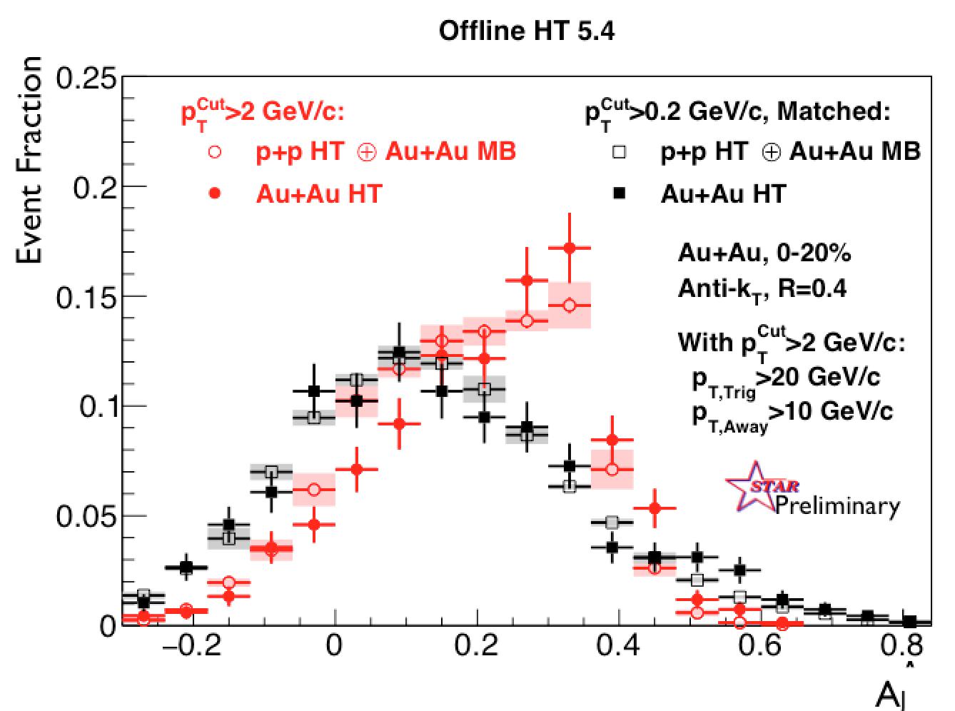
Updated Di-Jet Imbalance AJ
Requiring HT in Trigger Jet
Sys. Uncertainties:
- tracking eff. 6%
- tower energy
scale 2%
Unchanged Physics:
“Hard Core” imbalanced – balance recovered in original cone

Slide 22
z_{g} at 200 GeV—PYTHIA
FastJet3
M. Cacciari and G. Salam
Phys. Lett. B 641, 57 (2006)
Jet reconstruction:
R=0.4.
Found with anti-k_{T},
Reclustered with C/A
No background subtraction
Mild p_{T} dependence above ~15 GeV/c
Consistent between Pythia6 and 8; insensitive to particle decay
PYTHIA 6.410 + CTEQ5L
not decayed (GEANT input)
PYTHIA 8.219 default
decayed as normal

Slide 23
MC level “high tower” z_{g} at 200 GeV—PYTHIA8
“High Tower”:
Require neutral particle with p_{T}>5.4 GeV/c
Defines Trigger Jet
Recoil Jet back-to-back
(|Δφ|<R)
HT Trigger Bias at particle level:
Recoil jet is unaffected (as expected)
Trigger jet: Bias disappears for p_{T}>~20 GeV/c

Slide 24
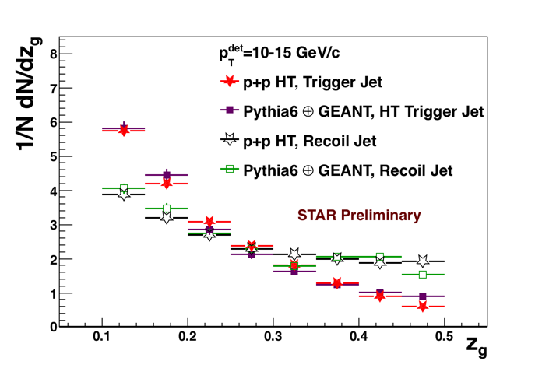
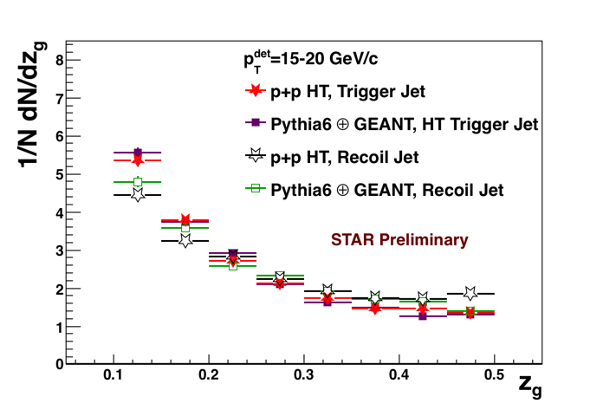
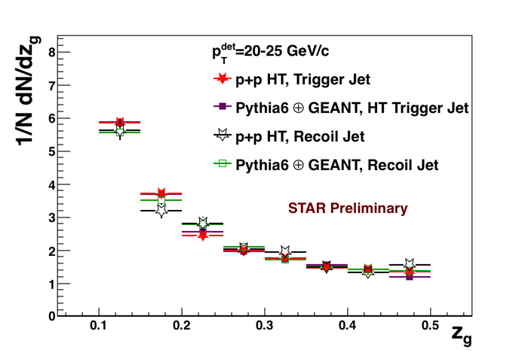
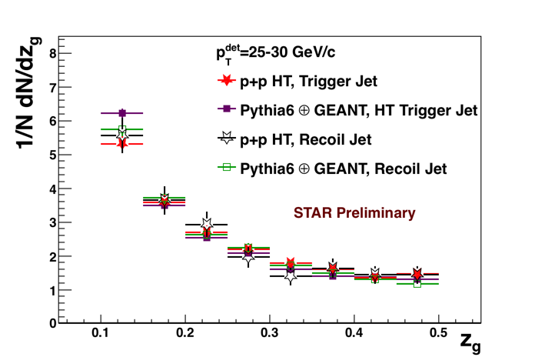
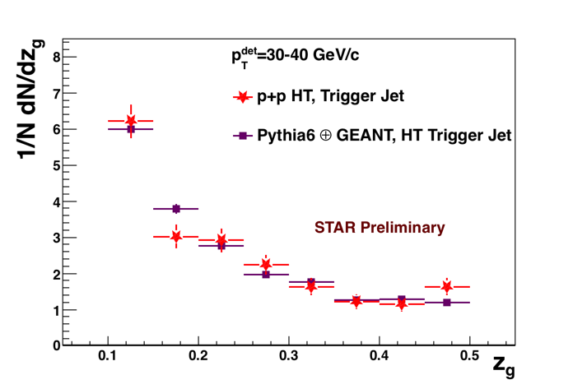
Detector Level z_{g} at 200 GeV—p+p HT
High Tower:
Require neutral particle with p_{T}>5.4 GeV/c
Defines Trigger Jet
Recoil Jet back-to-back
(|Δφ|<R)
At detector level:
Excellent agreement with PYTHIA
→ Bin-by-bin correction for p_{T}^{reco}→p_{T}^{part}
PYTHIA 6.410 + CTEQ5L + GEANT3
p+p HT: Run6 stat. errors only

Slide 25
p+p HT, 200 GeV
Corrected to Particle Level
p+p HT Run6
Preliminary Systematics:
4% overall jet energy scale uncertainty shown
STAR PRL 100 (2008) 232003
Evaluation of tracking efficiency and tower scale uncertainty on individual subjets and their (anti-)correlation TBD
First measurement of p+p z_{g} at RHIC
After correction, Trigger ~ Recoil
Good agreement with PYTHIA
High Tower:
Neutral particle with p_{T}>5.4 GeV/c defines Trigger Jet

Slide 26
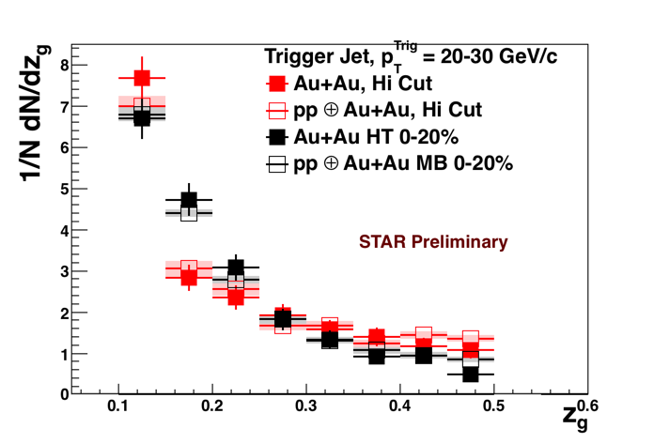
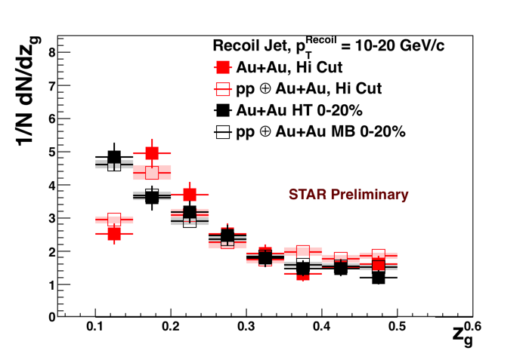
Au+Au and embedded p+p
Detector Level
Sys. Uncertainties on
embedded p+p:
tracking eff. 6%
tower
energy scale 2%
Red data points: z_{g} calculated on p_{T}^{Cut}>2 GeV/c

Slide 28
Detector Level z_{g} at 200 GeV—p+p HT
High Tower:
Neutral particle with p_{T}>5.4 GeV/c defines Trigger Jet
At detector level:
Excellent agreement with PYTHIA
→ Allows Bin-by-bin correction for z_{g}, p_{T}^{det}→p_{T}^{part}
PYTHIA 6.410 + CTEQ5L + GEANT3
p+p HT: Year 2006 - stat. errors only

