Slide 1

J/ψ Production in A+A Collisions
At STAR
Ota Kukral
for the STAR Collaboration
Czech Technical University in Prague
RHIC & AGS Annual Users’ Meeting 17 June 2014

Slide 2
Outline
J/ψ reconstruction
Au+Au results
J/ψ in U+U
Future prospects: MTD and HFT
Summary and outlook

Slide 3
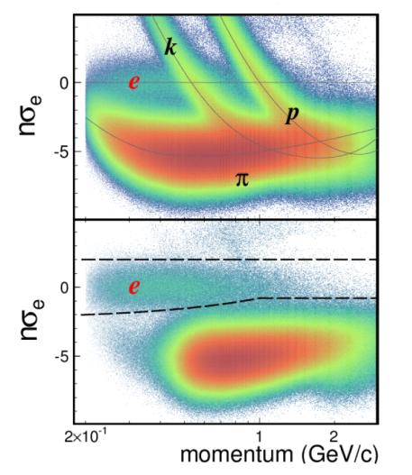
Electron ID
J/ψ → e⁺e⁻ (B.R. 5.9%)
TPC:
  nσ – distance from the expected mean value of dE/dx expressed as number
  of standard deviations
  Often -1.5 < nσ_{electron} < 2.0
TPC only
|1/β - 1| < 0.03

Slide 4
Electron ID
J/ψ → e⁺e⁻ (B.R. 5.9%)
TPC:
  nσ – distance from the expected mean value of dE/dx expressed as number
  of standard deviations
  Often -1.5 < nσ_{electron} < 2.0
TOF:
  Used mainly for p < ~1.4 GeV/c
  0.97 < 1/β < 1.03 (as β_{electron} ≈ 1)
TPC only
|1/β - 1| < 0.03
TPC + TOF

Slide 5
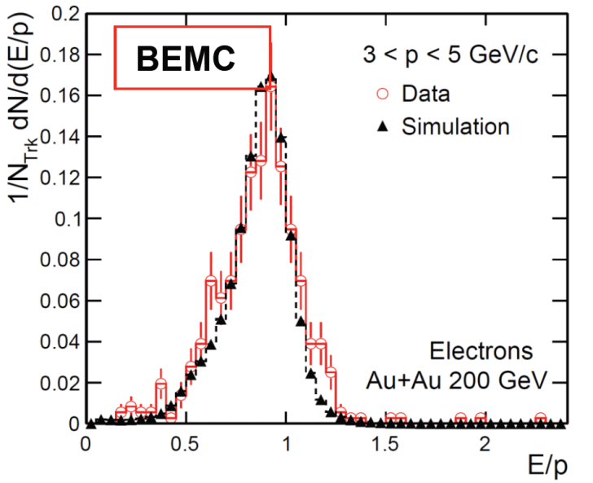
Electron ID
J/ψ → e⁺e⁻ (B.R. 5.9%)
TPC:
  nσ – distance from the expected mean value of dE/dx expressed as number
  of standard deviations
  Often -1.5 < nσ_{electron} < 2.0
TOF:
  Used mainly for p < ~1.4 GeV/c
  0.97 < 1/β < 1.03 (as β_{electron} ≈ 1)
BEMC:
  Used for p > ~ 1.4 GeV/c
  Electrons deposit most of their
  energy: E/p should be around 1
TPC only
|1/β - 1| < 0.03
TPC + TOF

Slide 6
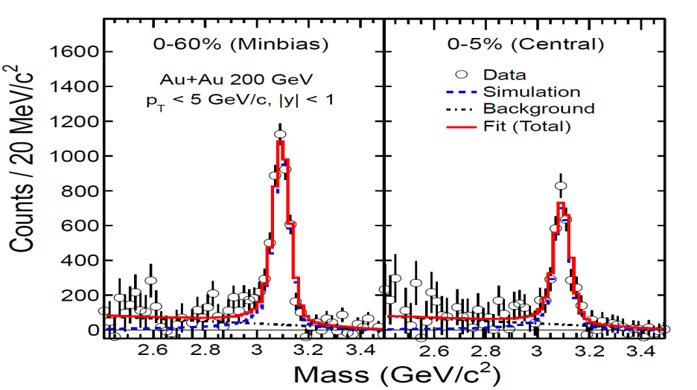
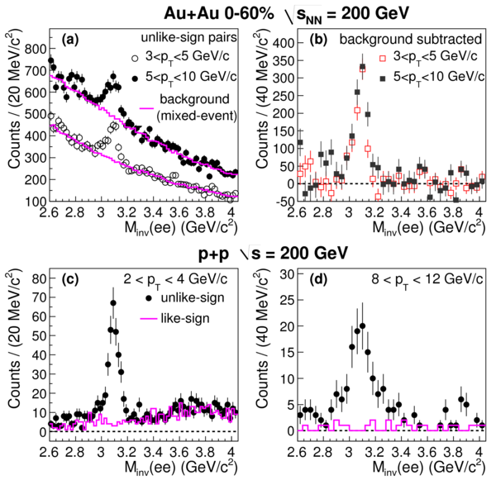
J/ψ → e⁺e⁻ signals
Combinatorial background estimated by like-sign and mixed events techniques
Clear signals for both low and high p_{T} Au+Au collisions
STAR low-p_{T} : arXiv:1310.3563
high-p_{T} : Phys.Lett. B722, 55 (2013)

Slide 7
J/ψ spectra in Au+Au at 200 GeV
Large p_{T} range
  Covers 0-10 GeV/c
J/ψ spectra softer at low p_{T} than the Tsallis Blast-Wave model prediction with the same freeze-out parameters as for light hadrons
  Recombination at low p_{T}?
  Small radial flow?
STAR low-p_{T} : arXiv:1310.3563
high-p_{T} : Phys.Lett. B722, 55 (2013)
Tsallis Blast-Wave model: Z.Tang et al., Chin.Phys.Lett. 30, 031201 (2013)

Slide 8
J/ψ spectra in Au+Au at 200 GeV
Viscous hydrodynamics
  J/ψ decoupling temperature of 120 and 165 MeV fails to describe the low p_{T} data
Y. Liu et al.
  model includes J/ψ suppression due to color screening and the statistical regeneration
  describes the data well
  peripheral: initial production dominates.
  central: regeneration becoming more significant at low p_{T}.
Y. Liu et al., Phys. Lett. B 678, 72 (2009)
U. W. Heinz and C. Shen (2011), private communication.

Slide 9
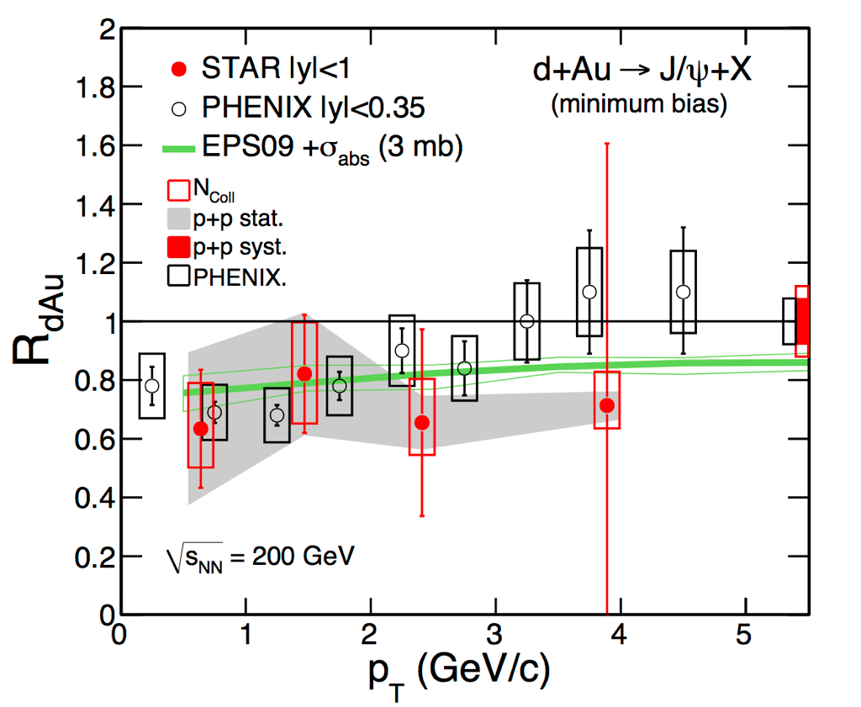
J/ψ cold nuclear matter effects
Nuclear modification factor
R_{dAu} ≈ 1 for high p_{T}
  Cold nuclear effects are small at high p_{T}
  High p_{T} results in A+A collisions provide a cleaner probe of the J/ψ interaction with the hot nuclear matter
PHENIX
STAR Preliminary
PHENIX data: Phys. Rev. C 87, 034904 (2013)
Model: E.Eskola, H.Paukkunenea and C.Salgo, Nucl. Phys. A 830, 599 (2009)

Slide 10
J/ψ suppression in Au+Au at 200 GeV
Nuclear modification factor
  Increase from low p_{T} to high p_{T}
  Consistent with unity at high p_{T} peripheral collisions
  More suppression in central than in peripheral collisions even at high p_{T}
STAR low-p_{T} : arXiv:1310.3563
high-p_{T} : Phys.Lett. B722, 55 (2013)
Liu et al., PLB 678, 72 (2009)
Zhao and Rapp, PRC 82, 064905(2010)
PLB 664, 253 (2008)

Slide 11
J/ψ suppression in Au+Au at 200 GeV
System size (N_{part}) dependence
  R_{AA} decreases with the size of the system
  Models including initial production and recombination reasonably describe the J/ψ in our measured p_{T} region
  J/ψ in central collisions suppressed even at high p_{T}
  High p_{T} data less suppressed than low p_{T}
STAR low-p_{T} : arXiv:1310.3563
high-p_{T} : Phys.Lett. B722, 55 (2013)
Liu et al., PLB 678, 72 (2009)
Zhao and Rapp, PRC 82, 064905(2010)
PLB 664, 253 (2008)
PHENIX Phys. Rev. Lett. 98, 232301 (2007)

Slide 12
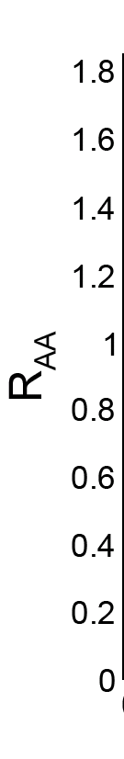
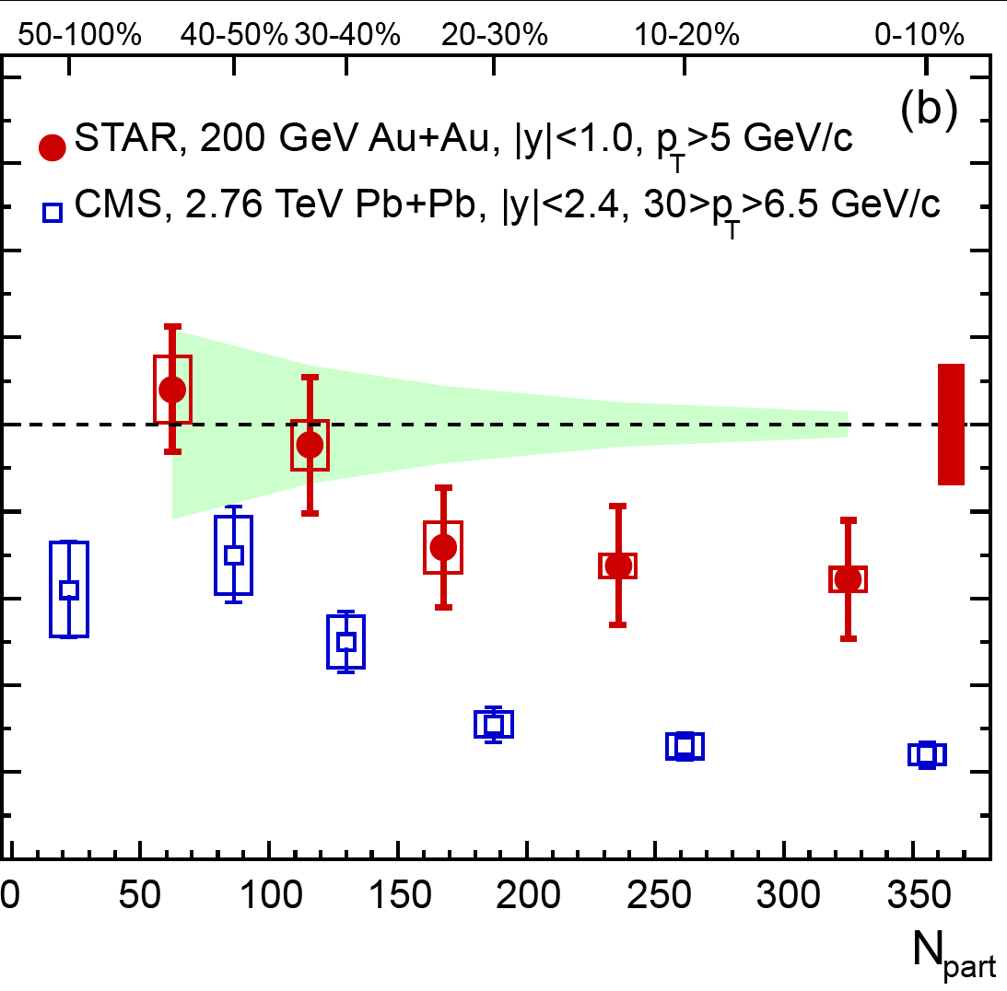
J/ψ suppression in Au+Au at 200 GeV
System size (N_{part}) dependence
  R_{AA} decreases with the size of the system
  Models including initial production and recombination reasonably describe the J/ψ in our measured p_{T} region
  J/ψ in central collisions suppressed even at high p_{T}
  High p_{T} data less suppressed than low p_{T}
  High p_{T} J/ψ at LHC (prompt) is more suppressed than at RHIC (inclusive)
STAR: Phys.Lett. B722, 55 (2013)
CMS: JHEP 05 (2012) 063

Slide 13
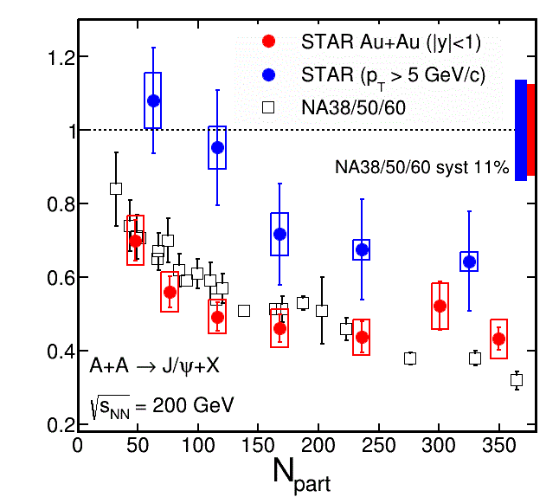
J/ψ at Beam Energy Scan (BES)
Similar suppression at RHIC and SPS
RHIC BES program: unique tool to study the interplay of CNM, screening and regeneration effects
Quarkonia sequential melting: thermometer of QGP
STAR low-p_{T} : arXiv:1310.3563
high-p_{T} : Phys.Lett. B722, 55 (2013)
SPS: Scomparin, QM2006

Slide 14
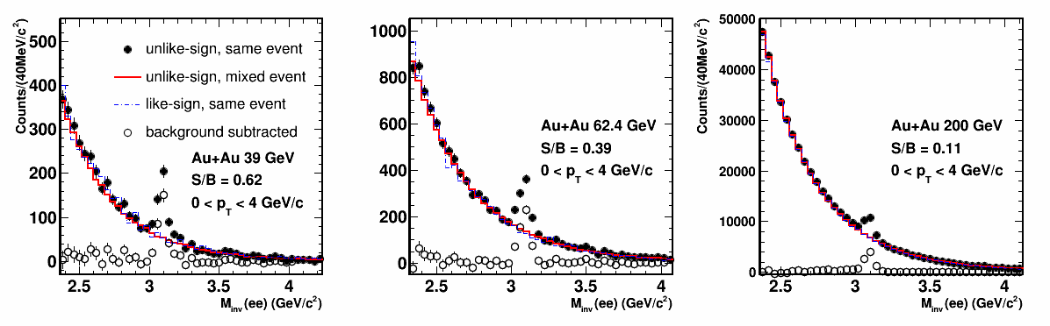
J/ψ at Beam Energy Scan (BES)
J/ψ observed at 200, 62.4 and 39 GeV
Data from Run 10
Signal up to p_{T} 4 GeV/c for 39 and 62.4 GeV
39 GeV
62.4 GeV
200 GeV

Slide 15
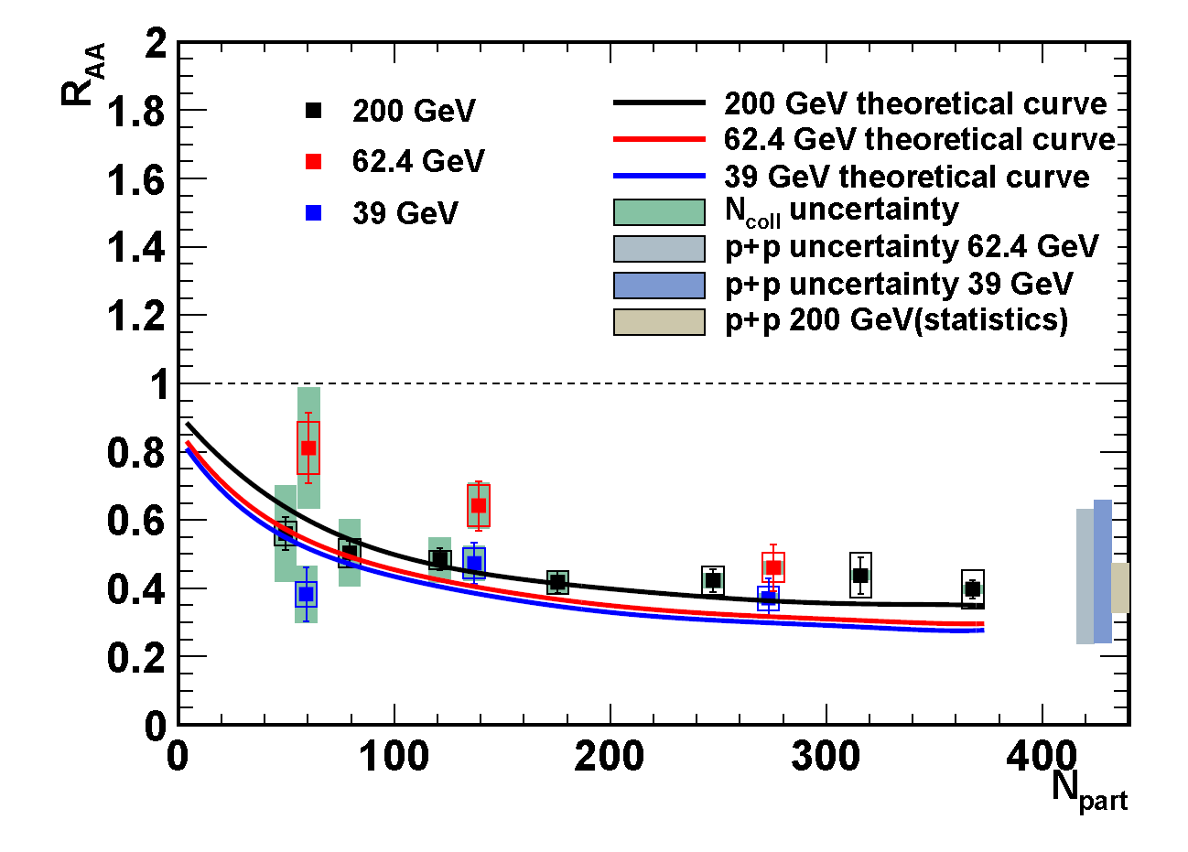
J/ψ suppression at RHIC BES
R_{AA} for J/ψ in Au+Au at 200, 62.4 and 39 GeV
Similar suppression for measured energies
  pp reference is based on CEM calculations
  Large theoretical uncertainty
Consistent with theoretical calculations
STAR Preliminary
p+p references for 39 and 62 GeV:
Nelson, Vogt et al., PRC87, 014908 (2013)
Theoretical curves:
Zhao, Rapp PRC82, 064905 (2010)

Slide 16
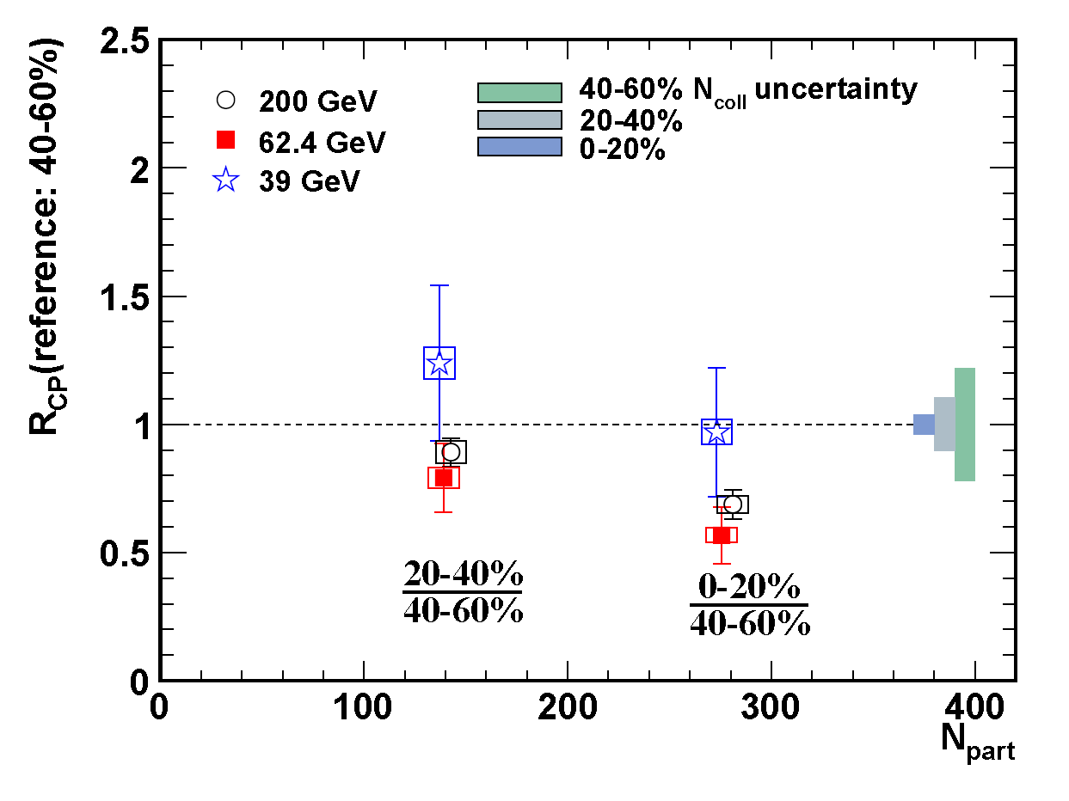
J/ψ suppression at RHIC BES
Central vs. peripheral collisions:
Significant suppression at 62.4 GeV, similar to 200 GeV
STAR Preliminary

Slide 17
J/ψ elliptic flow v₂
Consistent with zero
(p_{T} > 2 GeV/c)
The only hadron so far that does not flow.
Disfavors coalescence from thermalized charm quarks at high p_{T}
Phys. Rev. Lett. 111 (2013) 52301
[29] L. Yan, P. Zhuang, N. Xu, PRL 97 (2006), 232301.
[30] V. Greco, C.M. Ko, R. Rapp, PLB 595, 202.
[32] X. Zhao, R. Rapp, arXiv:0806.1239 (2008)
[33] Y. Liu, N. Xu, P. Zhuang, Nucl. Phy. A, 834, 317.
[34] U. Heinz, C. Shen, private communication.

Slide 18
Motivation for U+U collisions
U+U collisions at 193 GeV per nucleon
pair (2012)
Uranium nucleus is larger than Au and non-spherical
  U+U collisions (orientation averaged) provide higher energy density
  Tip-to-tip collisions provide the highest energy density
STAR Collaboration: arXiv 1310.3563 (2013)
Tip-to-tip collision

Slide 19
Motivation for U+U collisions
U+U collisions at 193 GeV per nucleon
pair (2012)
Uranium nucleus is larger than Au and non-spherical
  U+U collisions (orientation averaged) provide higher energy density
  Tip-to-tip collisions provide the highest energy density
STAR Collaboration: arXiv 1310.3563 (2013)
Tip-to-tip collision

Slide 20
Motivation for U+U collisions
U+U collisions at 193 GeV per nucleon
pair (2012)
Uranium nucleus is larger than Au and non-spherical
  U+U collisions (orientation averaged) provide higher energy density
  Tip-to-tip collisions provide the highest energy density
Tip-to-tip collision

Slide 21
J/ψ invariant yield and R_{AA} in U+U
Nuclear modification factor as a function of p_{T} similar to Au+Au
Study of centrality dependence of R_{AA} ongoing
  central trigger data available
p+p reference from 200 GeV used

Slide 22
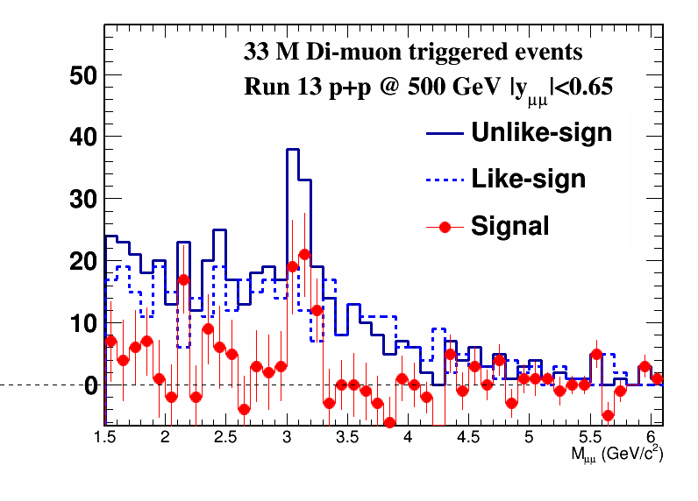
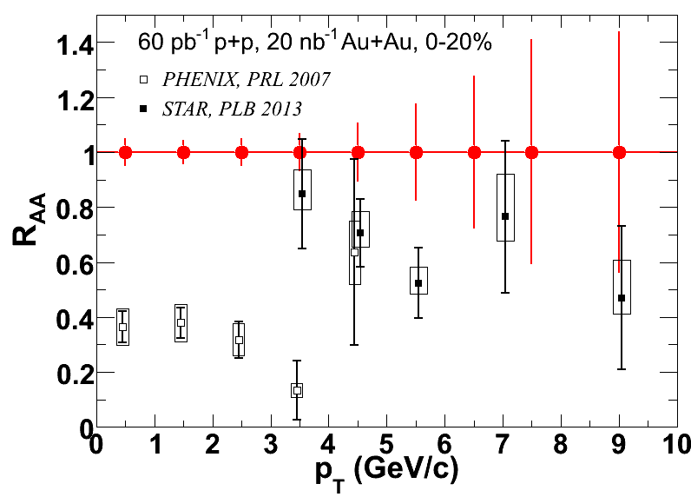
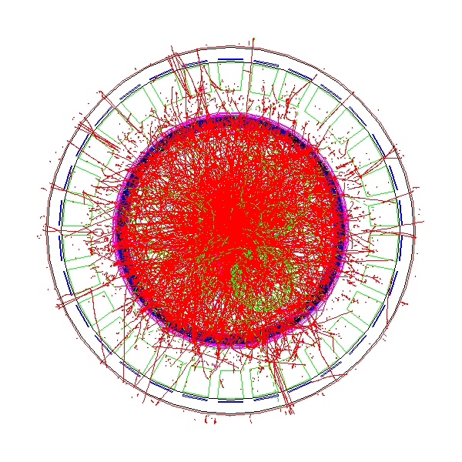
Muon Telescope Detector (MTD)
J/ψ → μ⁺μ⁻ (B.R. 5.9%)
  No γ conversion, less contribution from Dalitz decays
  Trigger capability for J/ψ in central A+A collisions
Full MTD installed for year 2014
MTD (MRPC)
J/ψ

Slide 23
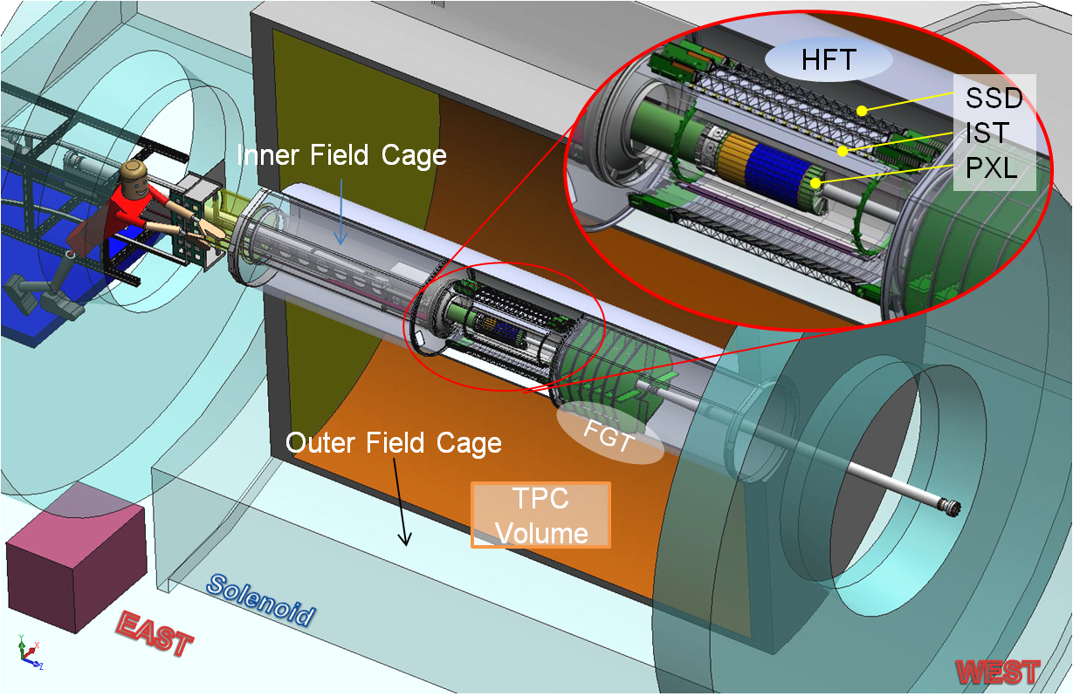
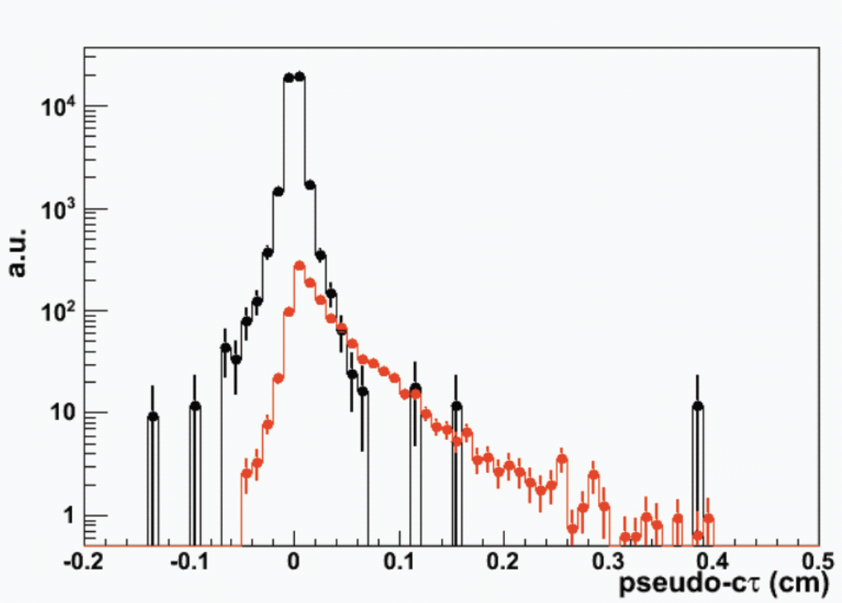
Heavy Flavor Tracker (HFT)
Inner tracking system - precise pointing resolution
Study of non-prompt J/ψ (B → J/ψ + X; cτ ≈ 500 μm)
Installed for year 2014
Detector | Radius (cm) | Hit Resolution R/ϕ - Z (μm - μm) | Radiation length
SSD | 22 | 20 / 740 | 1% X₀
IST | 14 | 170 / 1800 | <1.5% X₀
PIXEL | 8 | 12 / 12 | ~0.4% X₀
 | 2.5 | 12 / 12 | ~0.4% X₀
Simulation of separation of prompt and non-prompt J/ψ using HFT

Slide 24
Summary and outlook
J/ψ in Au+Au at 200 GeV
  Suppression observed – increases with centrality and decreases with p_{T}
  Eliptic flow consistent with zero (p_{T}>2 GeV/c)
J/ψ in Au+Au at 39 GeV and 62.4 GeV
  Similar suppression as in 200 GeV within uncertainties
J/ψ in U+U collisions at 193 GeV
  Suppresion pattern similar to Au+Au
Outlook
  2014: Large statistics Au+Au at 200 GeV
  Muon Telescope Detector: J/ψ → μ⁺μ⁻
  Heavy Flavor Tracker: separation of prompt and non-prompt J/ψ

Slide 25
Additional slides

Slide 26
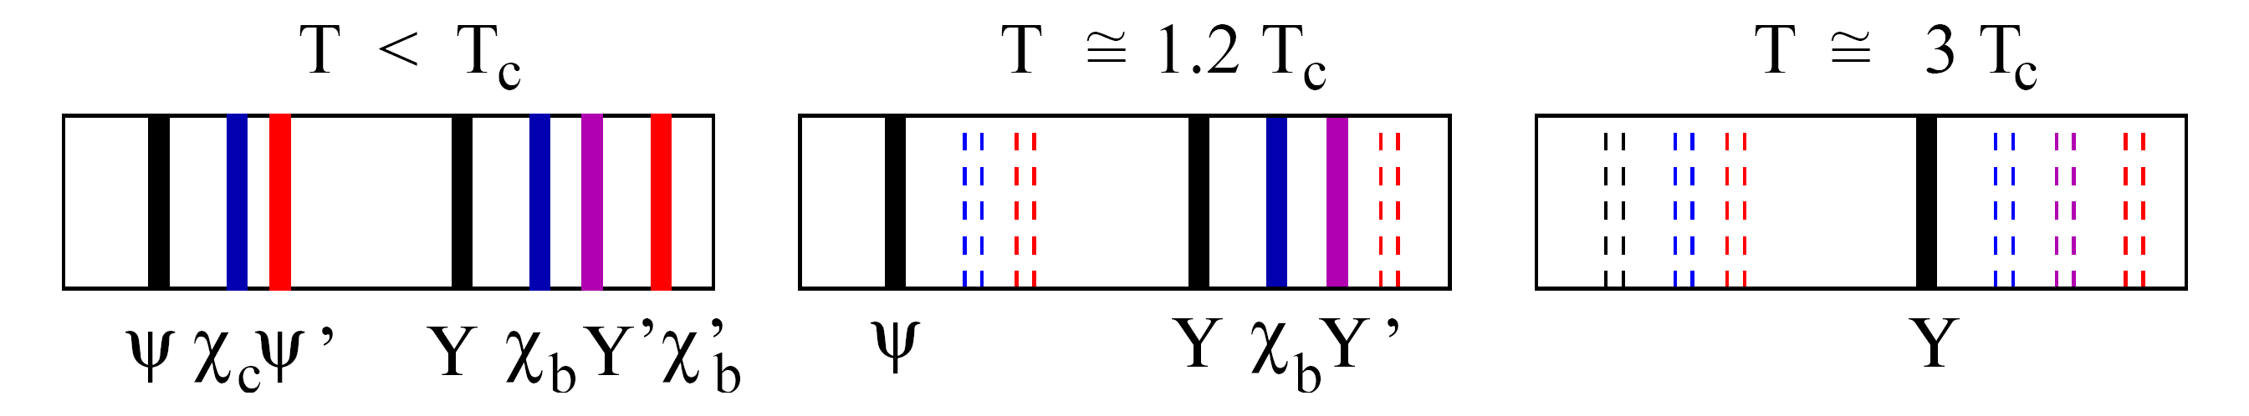

Motivation
Mass of charm quark is high (~1.3 GeV/c²)
  Production can be described by pQCD
  Produced early in hard processes
Quarkonia (J/ψ, ϒ) are expected to be suppressed in QGP
  In-medium screening of color charge – temperature dependent
Other important effects:
  Recombination from uncorrelated charm pairs
  Observed yields are a mixture of direct production + feeddown (also from B meson)
  Cold nuclear effects (such as modification to PDFs or nuclear absorption)
Satz, Nucl. Phys. A783: 249-260(2007)

Slide 27
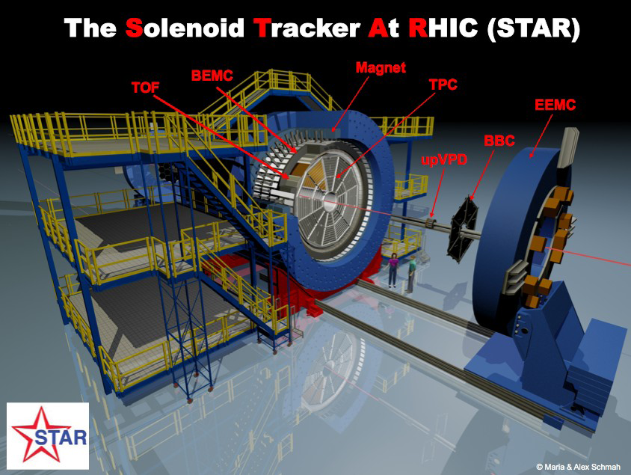
STAR experiment
Brookhaven National Laboratory, USA
Time Projection Chamber (TPC)
  Particle momentum, dE/dx
Time Of Flight (TOF)
  Particle velocity (1/β)
Barrel Electromagnetic Calorimeter (BEMC)
  Electron/photon energy

