Slide 1


The Heavy Flavor Tracker (HFT)
The Silicon Vertex Upgrade of STAR @ RHIC
Jaiby Joseph* for the STAR Collaboration
* Kent State University, USA
Lake Louise Winter Institute
Feb 20-26^{th,} 2011

Slide 2
Outline
The Heavy Flavor physics opportunities in Heavy Ion Collisions
The HFT concept and realization
Physics performance (simulations)

Slide 3
The Bottom Line
Hot and dense (partonic) matter with strong collectivity has been formed in Au+Au collisions at RHIC. Study of the properties of the new form of matter requires more penetrating probes like heavy quarks.
  Mechanism for parton energy loss.
  Thermalization
New micro-vertex detector is needed for STAR experiment.
DOE milestone for 2016: “Measure production rates, high pT spectra, and correlations in heavy-ion collisions at √s_{NN} = 200 GeV for identified hadrons with heavy flavor valence quarks to constrain the mechanism for parton energy loss in the quark-gluon plasma.”

Slide 4
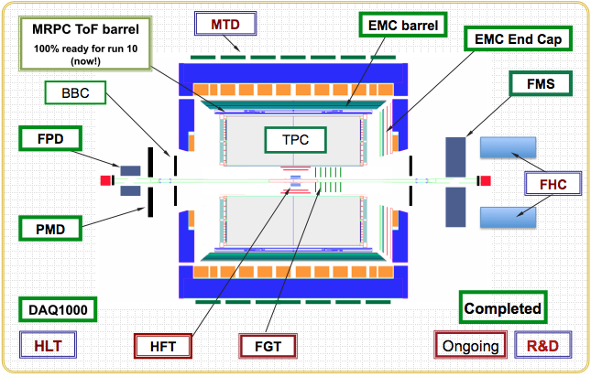
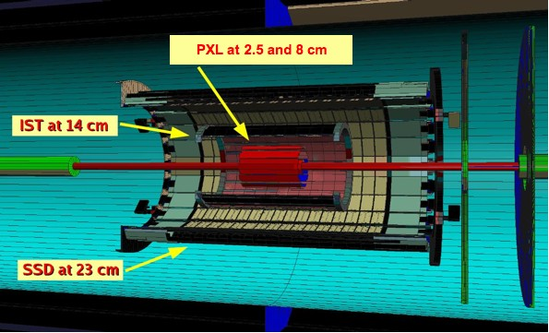
STAR Detector
TPC & HFT
Large acceptance at midrapidity, |η| <1
Full azimuthal coverage, 0 < ϕ < 2π

Slide 5
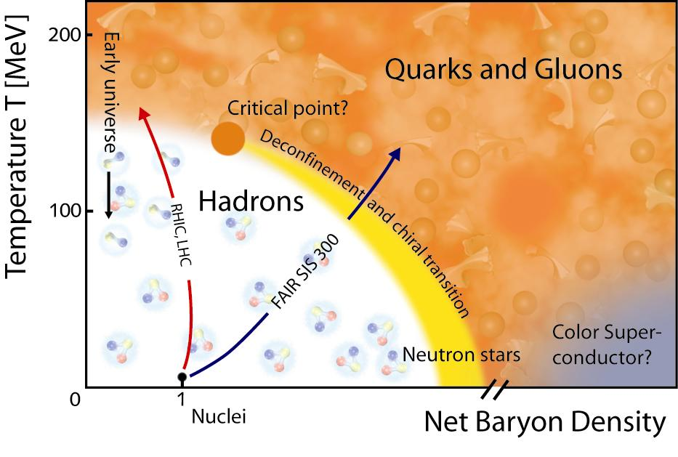
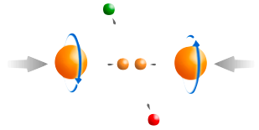
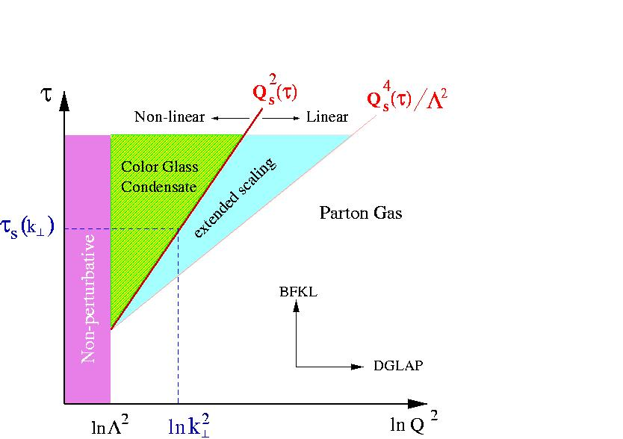
STAR Physics Program
At 200 GeV top energy
- Study medium properties, EoS
- pQCD in hot and dense medium
2) RHIC beam energy scan
- Search for the QCD critical point
- Chiral symmetry restoration
Spin program
- Study proton intrinsic properties
Forward program
- Study low-x properties, search for CGC
- Study elastic (inelastic) processes (pp2pp)
- Investigate gluonic exchanges

Slide 6
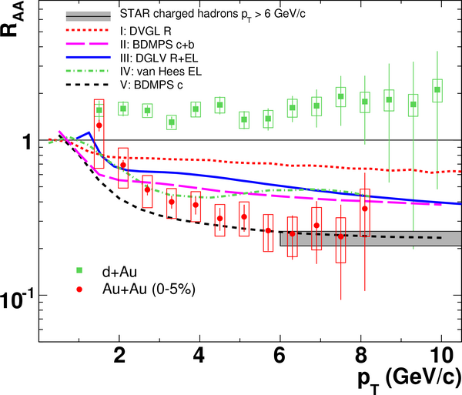
Heavy Quark Energy Loss
STAR: Phys. Rew. Lett, 98, 192301(2007).
1) Non-photonic
electrons decayed
from - charm and
beauty hadrons
2) At p_{T} ≥ 6 GeV/c,
R_{AA}(n.p.e.) ~ R_{AA}(h±)!
Contradicts naïve
pQCD predictions
Surprising results -
- challenge our understanding of the energy loss mechanism
- force us to RE-think about the elastic-collisions energy loss
- Requires direct measurements of c- and b-hadrons.

Slide 7
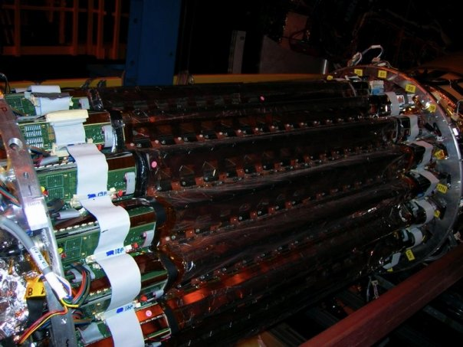

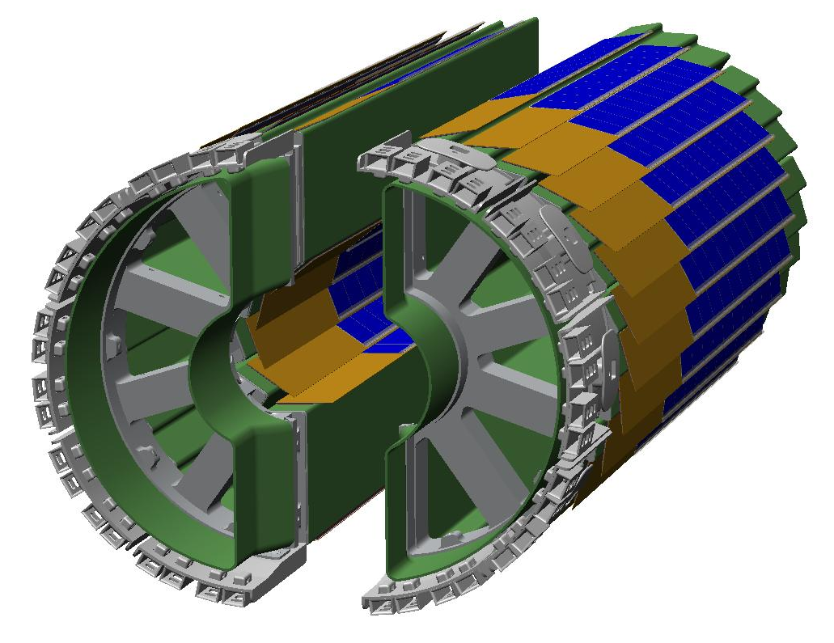
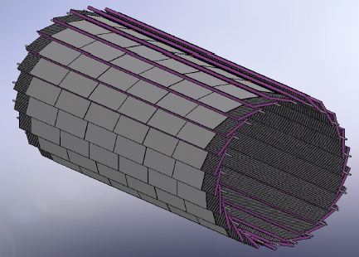
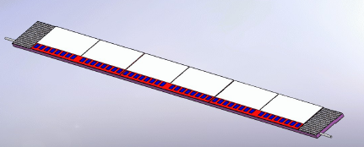
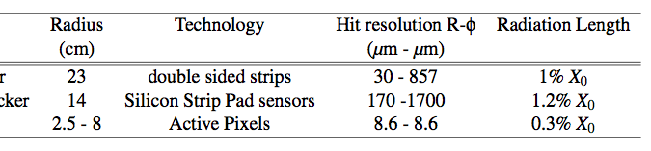
HFT
Low mass
Near the event vertex
Active pixels
SSD+ R=22cm
Technology
Pixel 1-2 R=2.5, 8cm
New beam pipe
IST R=14cm
SSD+
IST
PIXEL
Pointing resolution ~25 μm@1 GeV/c to resolve average decay length ~80 μm

Slide 8
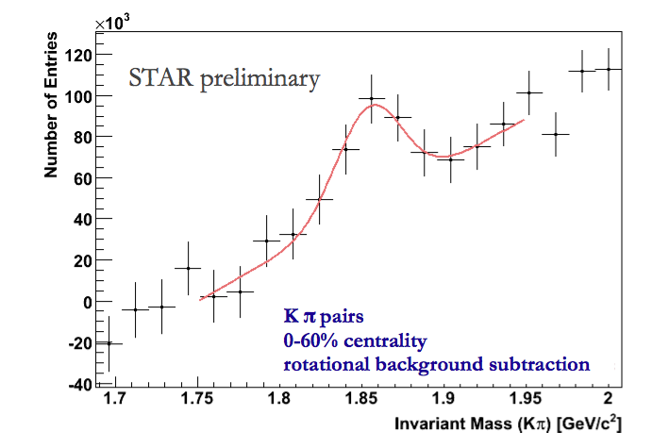
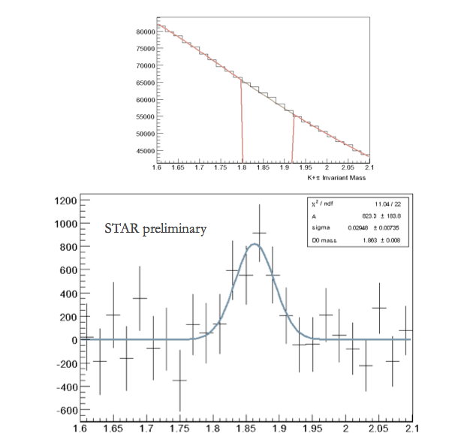
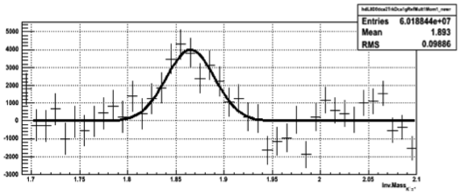
200 GeV DATA with old Silicon
TPC only Cu+Cu
(Relatively) low significance peaks have already been observed in the DATA but of limited physics reach
TPC+SVT+SSD Au+Au
STAR preliminary

Slide 9
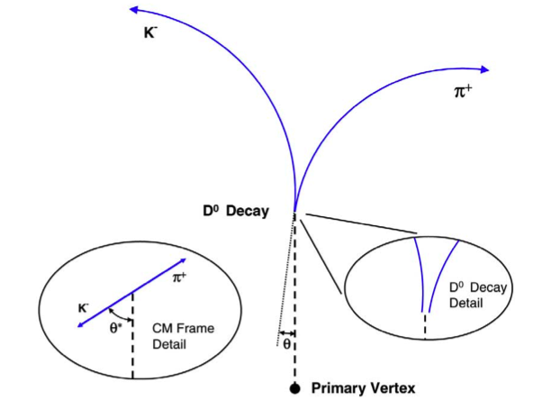
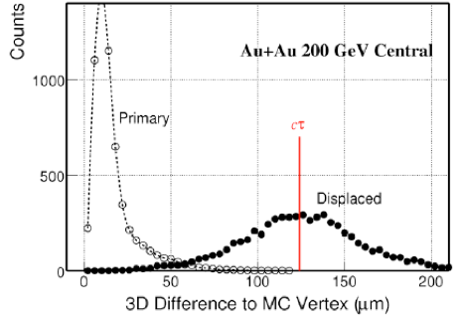
Hadronic reconstruction with HFT
STAR HFT has the capacity to reconstruct the displaced vertex of
D⁰ ➔ Kπ (B.R 3.8%, cτ = 123μm)
Λ_{c} ➔ πKp (B. R. 5.0%, cτ = 59.9μm)

Slide 10
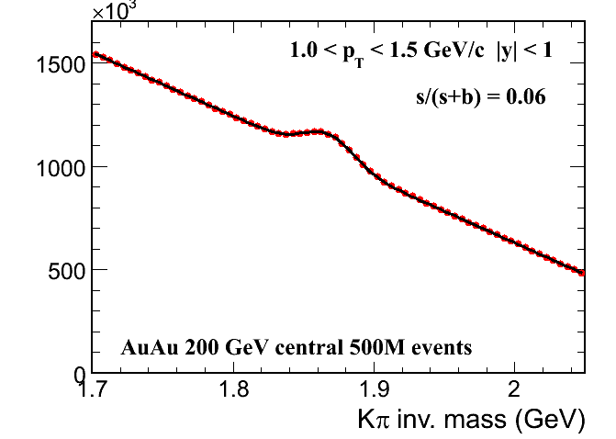
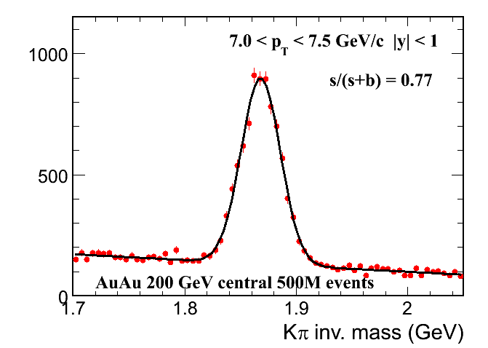
HFT Performance example on the D⁰ ➝ Kπ reconstruction
Simulation of Au+Au@200GeV Hijing events with STAR tracking software including pixel pileup (RHIC-II luminosity) extrapolated to 500 M events (~one RHIC run).
Identification done via topological cuts and PID using Time Of Flight

Slide 11
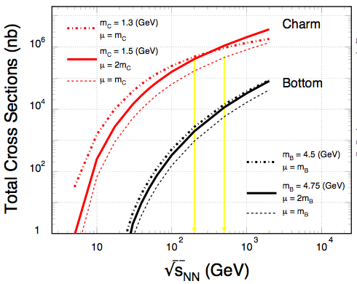
Heavy Quark Production
RHIC LHC
NLO pQCD predictions of charm and bottom for the total p+p hadro-production cross sections.
Renormalization scale and factorization scale were chosen to be equal.
RHIC: 200, 500 GeV
LHC: 900, 14000 GeV
Ideal energy range for studying pQCD predictions for heavy quark production.
Necessary reference for both, heavy ion and spin programs at RHIC.
R. Vogt http://www-rnc.lbl.gov/ISMD/talks/Aug9/1400_Vogt.pdf
Estimated error bars of measurement comparable to line thickness!

Slide 12
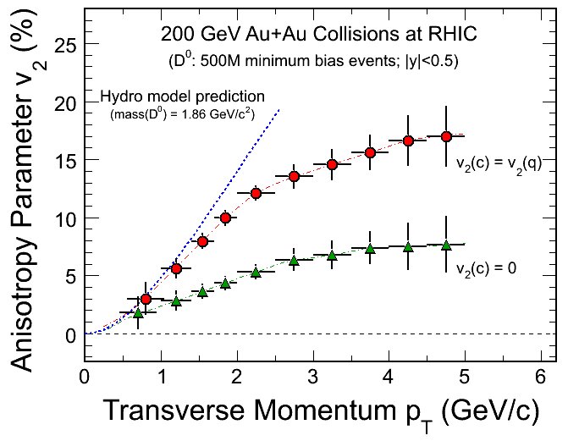
HFT - Charm Hadron v₂
Charm-quark flow
→ Thermalization
of light-quarks!
Charm-quark does
not flow
→ Drag coefficients
- 200 GeV Au+Au minimum bias collisions (500M events).
- Charm collectivity  drag/diffusion constants  medium properties!
STAR ONLY can perform precision low p_{T} flow measurements for D⁰
Notes:
Hydro model: Pasi Huovinen, private communication, January 2008.
Just to remind you: these calculations were done using my "standard" set of parameters: initial time 0.6 fm/c, first order phase transition at T_c=165 MeV, chemical equilibrium all the way until until kinetic freeze-out, freeze-out at T_f=130 MeV reproduces pion spectra and (anti)proton p_T-slope, initial profiles as a combination of participant and binary collision scaling.

Slide 13
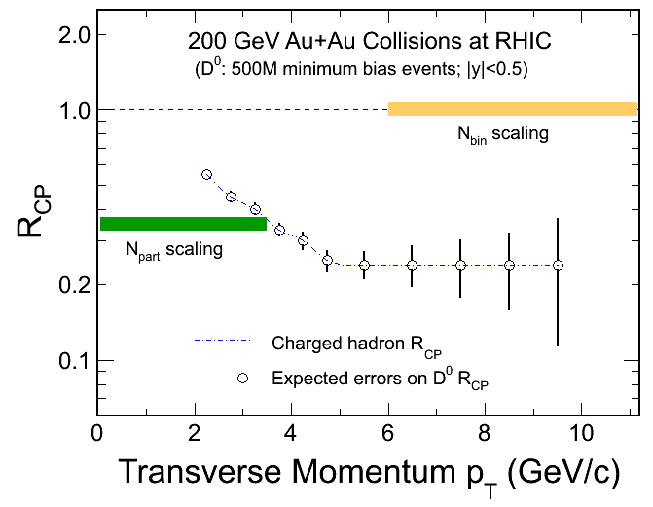
HFT - Charm Hadron R_{CP}
Simulation – D⁰ p_{T}, NOT decay electron
Significant Bottom contributions in HQ decay electrons.
200 GeV Au+Au minimum bias collisions (|y|<0.5 500M events).
Charm R_{AA}  energy loss mechanism!
Notes:
10%

Slide 14
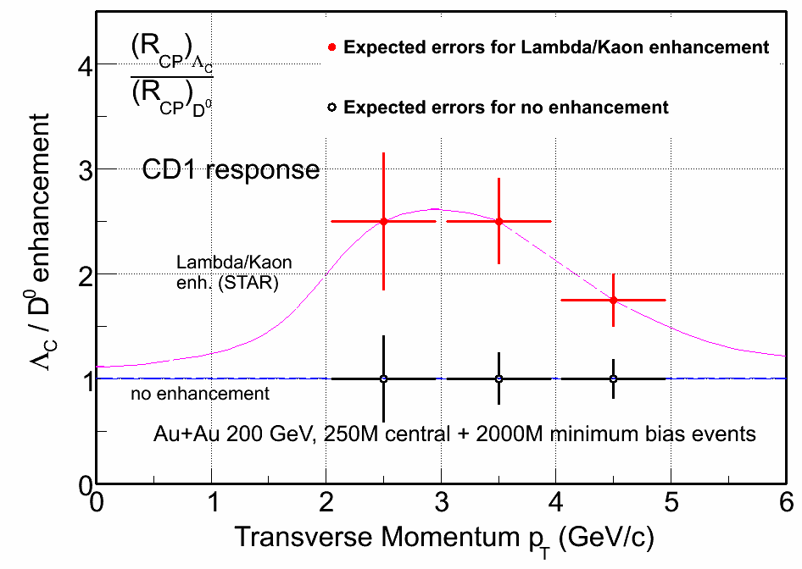
Λ_{C} Measurements
Λ_{c} ( ➔ p + K + π):
Lowest mass charm baryon
Total yield and Λ_{c}/D⁰ ratios can be measured.
Λ_{c}/D⁰ enhancement?
Measuring Λ_{c} yield is important for charmed baryon/meson ratio.

Slide 15
D_{s} Reconstruction
200 GeV Au+Au Collisions at RHIC
D_{s}→ K⁺K⁻π (BR 5.5%)
D_{s}→φπ→ K⁺K⁻π (BR 2.2%)
mass = 1968.49 ± 0.34 MeV
decay length ~ 150 μm
Work in progress …
200 GeV central Au+Au
Ideal PID
Power-law spectrum with:
n = 11, <p_{T}> = 1 GeV/c
0.5B events will work!
SIMULATION

Slide 16
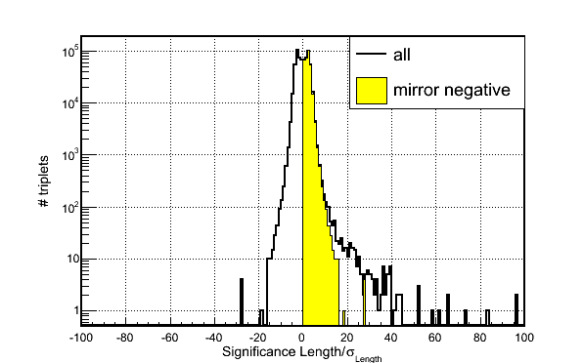
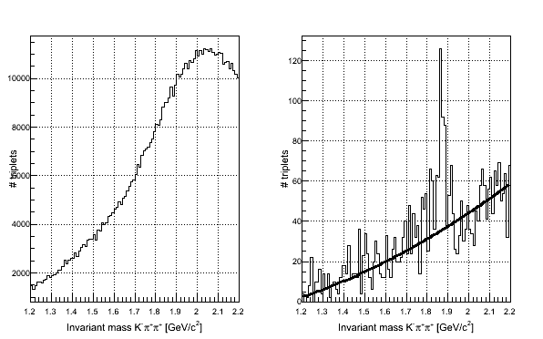
  D⁺ -> Kππ
No cuts
L/σ_{L}>6 && pixHits=2
Another charmed meson reconstructed using a full secondary vertex (Kalman) fit
The HFT is going to reconstruct ALL major charm-carrying particles
  D⁰, D_{S}, D⁺⁻, D*
This is important for ‘bottom’ contribution using the ‘subtraction’ method (next slide)

Slide 17
Strategies for Bottom Measurement
(1) All Charm states
( D^{0,±}, D_{s}, Λ_{C} )
(1.a) Displaced vertex
electrons (TOF+HFT)
+MTD trigger?
⇦
⇦
(2) Charm decay electrons
(Charm)
⇦
(1.a) - (2)
⇦
Some Bottom states
(Statistics limited at RHIC)
Bottom decay electrons
Measure Charm and Bottom hadron:
Cross sections, Spectra and v₂

Slide 18
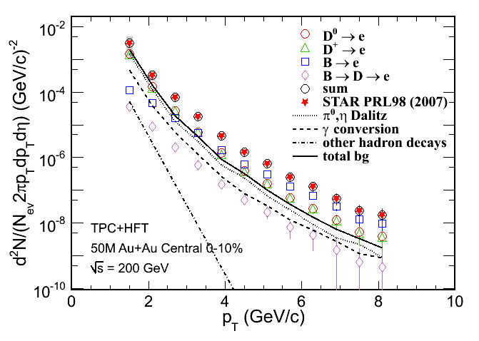
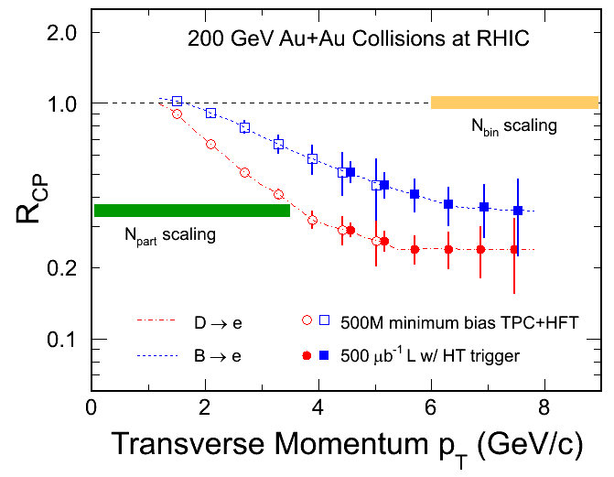
c- and b-decay Electrons
H. van Hees et al. Eur. Phys. J. C61, 799(2009). (arXiv: 0808.3710)
DCA cuts  c- and b-decay electron distributions and R_{CP}
200 GeV Au+Au minimum biased collisions (|y|<0.5 500M events)
Notes:
10%
Due to larger cτ, B->e has broader distribution than D->e. The total e yield is normalized to STAR measured NPE spectrum. B->e/NPE was normalized to STAR measured data from e-h correlation.

Slide 19
Summary
Detailed spectra of heavy flavor (c, b) is an invaluable piece of information in solving the heavy flavor RHIC puzzle.
First generation of detectors needs smart replacements
The Heavy Flavor Tracker in STAR is the most advanced answer to this need

Slide 20
Spares

Slide 21
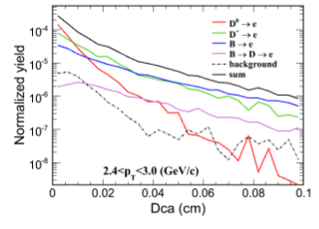
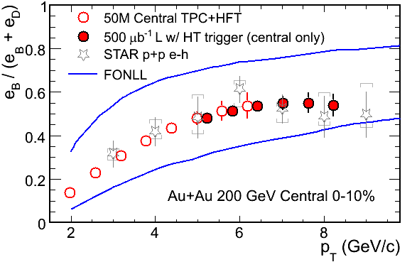
B-meson capabilities (in progress)
B->e+X approach
Rate limited, not resolution

Slide 22
HFT - Charm Hadron v₂
Charm-quark flow
→ Thermalization
of light-quarks!
Charm-quark does
not flow
→ Drag coefficients
- 200 GeV Au+Au minimum bias collisions (500M events).
- Charm collectivity  drag/diffusion constants  medium properties!
Notes:
Hydro model: Pasi Huovinen, private communication, January 2008.
Just to remind you: these calculations were done using my "standard" set of parameters: initial time 0.6 fm/c, first order phase transition at T_c=165 MeV, chemical equilibrium all the way until until kinetic freeze-out, freeze-out at T_f=130 MeV reproduces pion spectra and (anti)proton p_T-slope, initial profiles as a combination of participant and binary collision scaling.

Slide 23
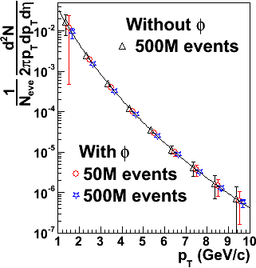
D_{s} Reconstruction
200 GeV Central Au+Au Collisions at RHIC
D_{s}→ K⁺K⁻π (BR 5.5%)
D_{s}→φπ→ K⁺K⁻π (BR 2.2%)
mass = 1968.49 ± 0.34 MeV
decay length ~ 150 μm
Work in progress …
200 GeV central Au+Au
Ideal PID
Power-law spectrum with:
n = 11, <p_{T}> = 1 GeV/c
0.5B events will work!

Slide 24
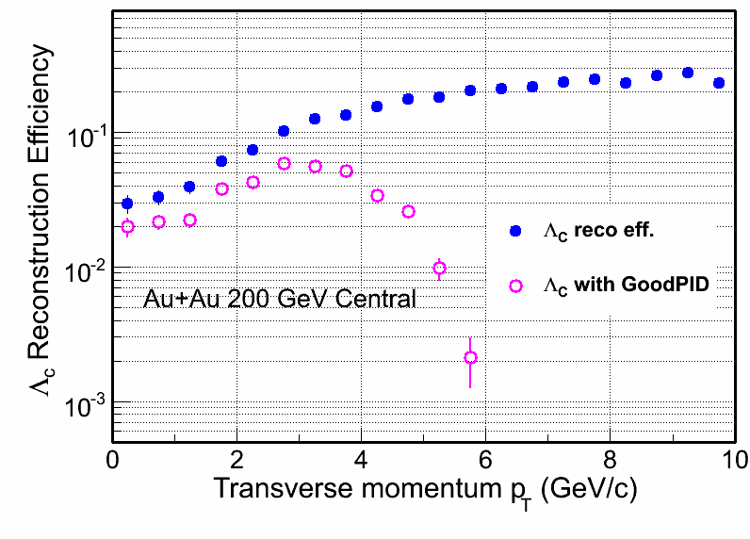
Λ_{C} Measurements
Λ_{c} ( ➔ p + K + π):
Lowest mass charm baryon
Total yield and Λ_{c}/D⁰ ratios can be measured.
Λ_{c}/D⁰ enhancement?
Measuring Λ_{c} yield is important for charmed baryon/meson ratio.

Slide 25
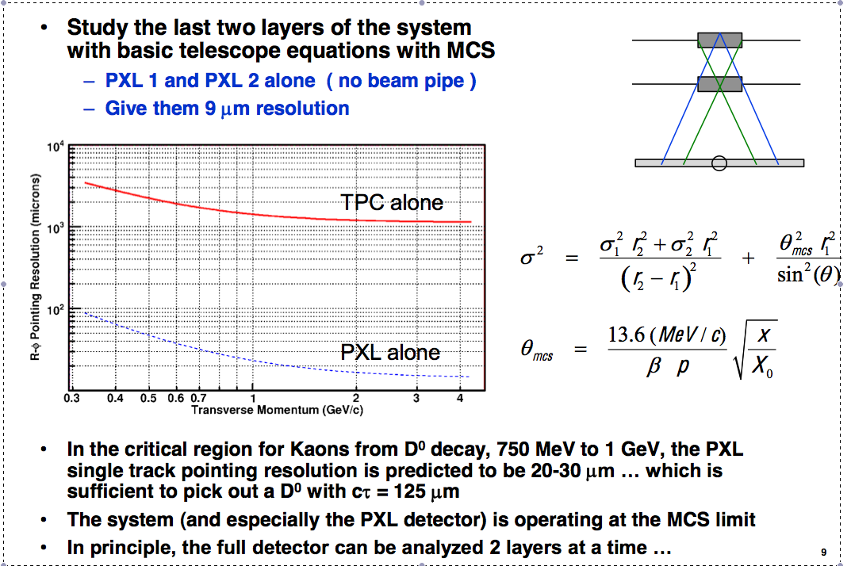
Projection error is a strong function of first-layer distance and thickness
SVT+SSD
10

Slide 26
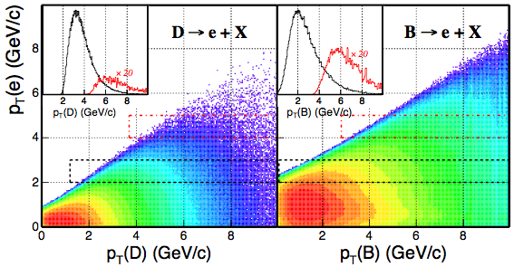
Decay e p_{T} vs. B- and C-hadron p_{T}
The correlations between the decayed electrons and heavy flavor hadrons is weak.
Key: Directly reconstructed heavy quark hadrons!
Pythia calculation Xin Dong, USTC October 2005

Slide 27
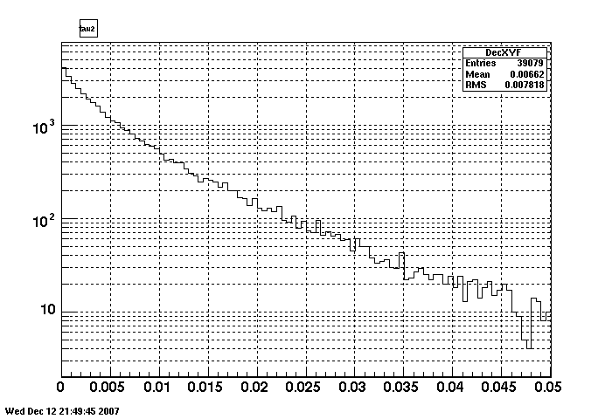
Challenge: e.g. D⁰ decay length
D⁰->K+pi
counts
Used <pt>~1GeV
1 GeV/ η=0 D⁰ has βγ∼0.5
  Un-boost in Collider !
Mean R-φ value ~ 80 μm
~1 cτ
Decay Length in X-Y plane
cm
For a realistic D⁰ distribution, at midrapidity and <p_{T}> ~ 1GeV/c, the average decay length is ~80μm

Slide 28
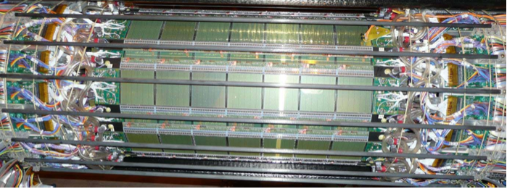
OLD (SVT)
NEW (HFT)
SSD
SSD+
23cm
22cm
IST
15cm
14cm
11cm
PIXELS
SVT
8cm
~6.5cm
SVT:~1.5%X0/layer
2.5cm
.
.
PXL:0.3-0.5%X0/layer
Detector resolutions differ by a factor of two but pointing by a factor of ten.

Slide 29
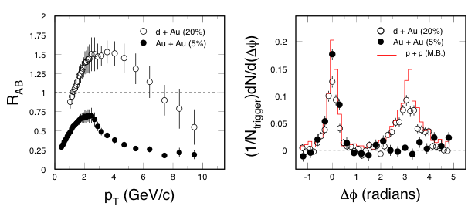
Partonic Energy Loss at RHIC
STAR: Nucl. Phys. A757, 102(2005).
Central Au+Au collisions: light quark hadrons and the away-side jet in back-to-back ‘jets’ are suppressed. Different for p+p and d+Au collisions.
Energy density at RHIC: ε > 5 GeV/fm³ ~ 30ε₀
Explore pQCD in hot/dense medium
R_{AA}(c,b) measurements are needed!

Slide 30

The QCD Phase Diagram and High-Energy Nuclear Collisions
The nature of thermalization at the top energy:
Heavy quarks
Di-lepton
1
T_{ini}, T_{C}
LHC, RHIC
2
T_{E}
RHIC, FAIR
3
Phase boundary
RHIC, FAIR, NICA
Early Universe
quark-gluon plasma
1
2
3
T_{E}
Critical Point?
  Temperature
hadron gas
CSC
nuclei
  Baryon Chemical Potential

Slide 31
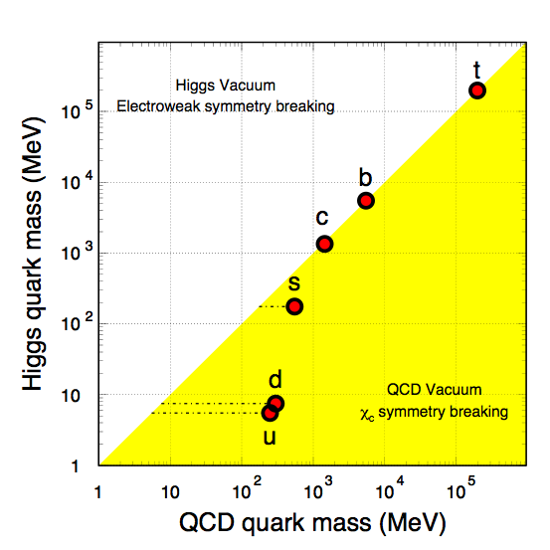
Quark Masses
- Higgs mass: electro-weak symmetry breaking (current quark mass).
- QCD mass: Chiral symmetry breaking (constituent quark mass).
Strong interactions do not affect heavy-quark mass.
New scale compare to the excitation of the system.
Study properties of the hot and dense medium at the foremost early stage of heavy-ion collisions.
Explore pQCD at RHIC.
Total quark mass (MeV)
X. Zhu, et al, Phys. Lett. B647, 366(2007).

Slide 32
Requirement for the HFT
 | Measurements | Requirements
Heavy Ion | heavy-quark hadron v₂ - the heavy-quark collectivity | - Low material budget for high reconstruction efficiency p_{T} coverage ≥ 0.5 GeV/c mid-rapidity High counting rate
 | heavy-quark hadron R_{AA} - the heavy-quark energy loss | High p_{T} coverage ~ 10 GeV/c
p+p | energy and spin dependence of the heavy-quark production | - p_{T} coverage ≥ 0.5 GeV/c
 | gluon distribution with heavy quarks | - wide rapidity and p_{T} coverage

Slide 33
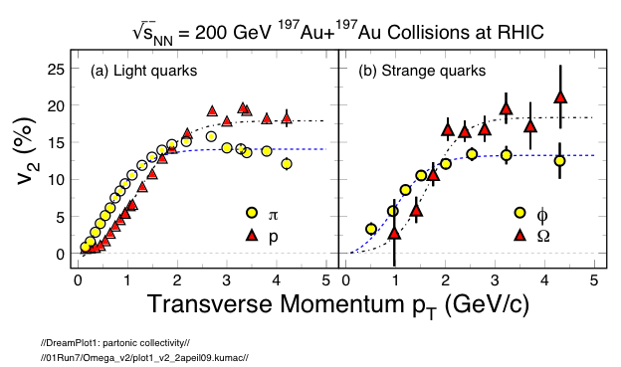
Partonic Collectivity at RHIC
STAR: preliminary
STAR: QM2009
Low p_{T} (≤ 2 GeV/c): hydrodynamic mass ordering
High p_{T} (> 2 GeV/c): number of quarks ordering
s-quark hadron: smaller interaction strength in hadronic medium
light- and s-quark hadrons: similar v₂ pattern
=> Collectivity developed at partonic stage!

Slide 34
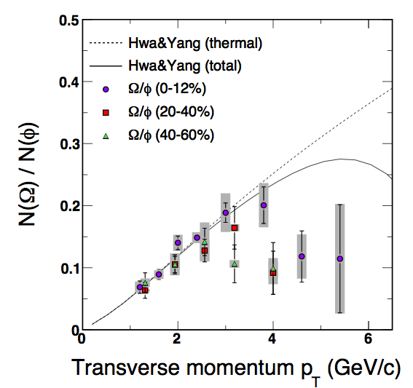
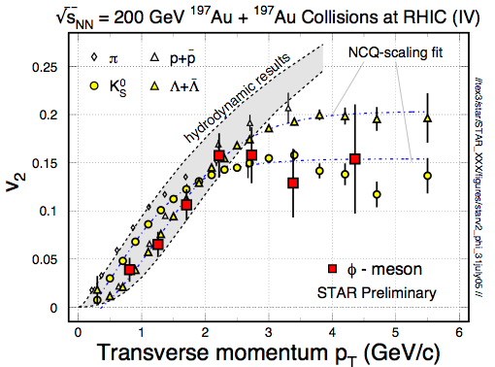
φ -meson Flow: Partonic Flow
STAR: Phys. Rev. Lett. 99, 112301(2007).
“φ-mesons (and other hadrons) are produced via coalescence of seemingly thermalized quarks in central Au+Au collisions. This observation implies hot and dense matter with partonic collectivity has been formed at RHIC”
In order to test early thermalization: v₂(p_{T}) of
c- and b-hadrons data are needed!

Slide 35
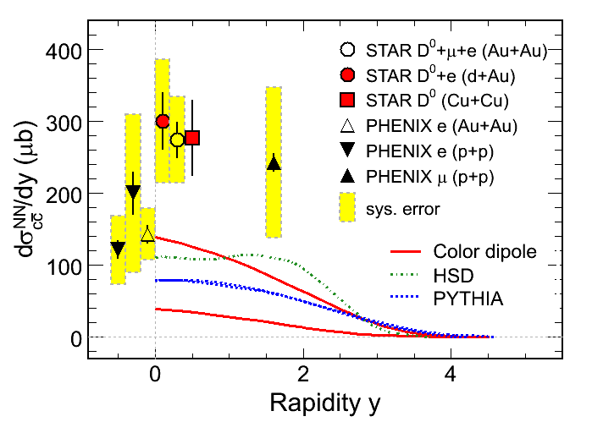
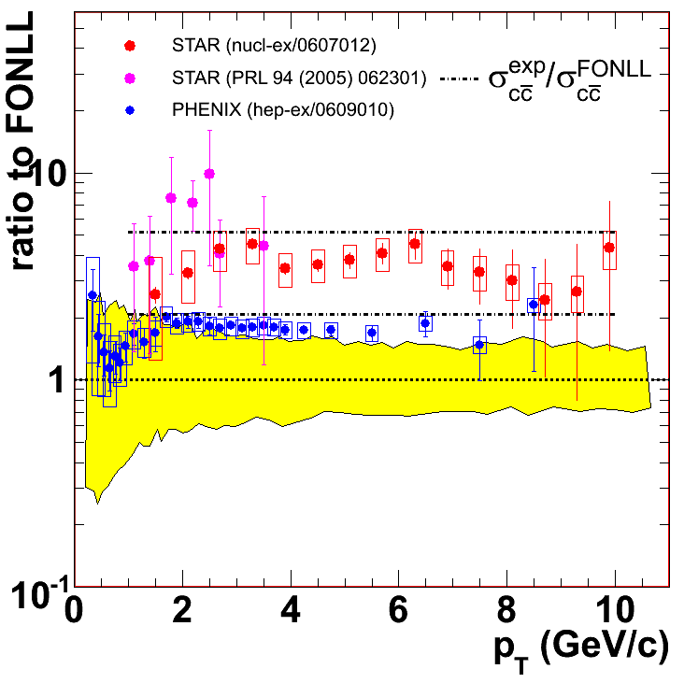
Charm Cross Sections at RHIC
Large systematic uncertainties in the measurements
New displaced, topologically reconstructed measurements for c- and b-hadrons are needed ⇦ Upgrade

Slide 36
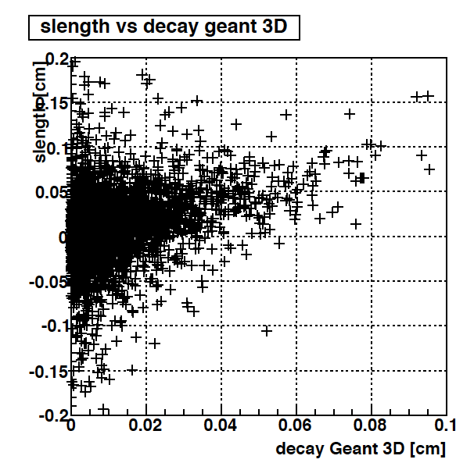
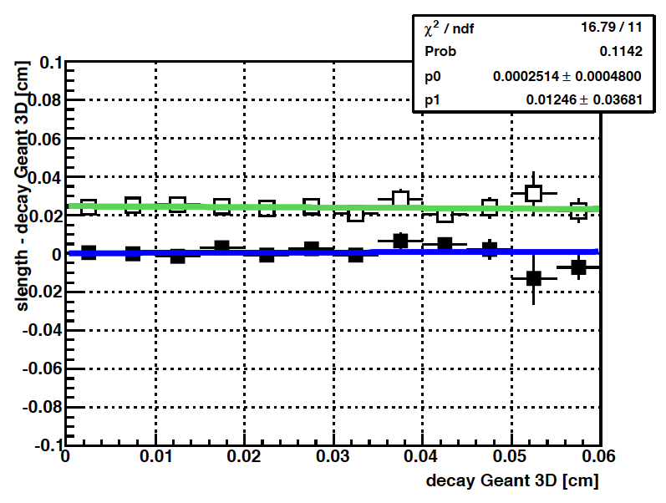
SVT+SSD D0-vertex resolution (simulation)
Reco vs. MC [cm]
Reco - MC [cm]
Mean of the difference reconstructed -MC
Rms of the difference reconstructed -MC
MC [cm]
MC [cm]
Left : correlation between reconstructed path length and MC
Right : Decay length resolution
There is no systematic shift in reconstructed quantities.
The standard deviation of the distribution is flat at ~ 250 μm , which is
of the order of the resolution of (SSD+SVT).

Slide 37
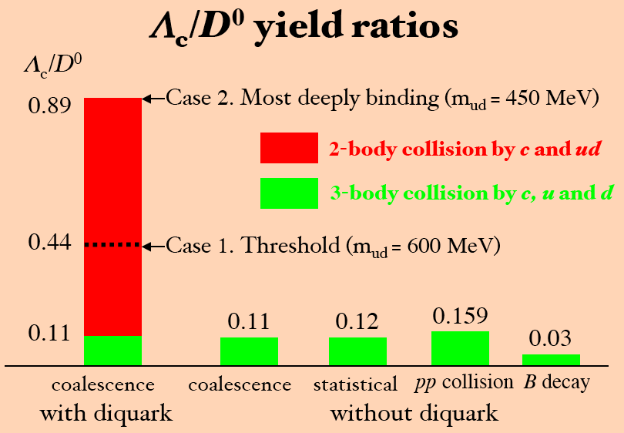
Charm Baryon/Meson Ratios
Λ_{C} → pK⁻π⁺
D⁰ → K⁻π⁻⁺
2-body collisions by c and ud
3-body collisions by c, u and d
QGP
medium
Y. Oh, C.M. Ko, S.H. Lee, S. Yasui, Phys. Rev. C79, 044905(2009).
S.H. Lee, K.Ohnishi, S. Yasui, I-K.Yoo, C.M. Ko, Phys. Rev. Lett. 100, 222301(2008).

Slide 38
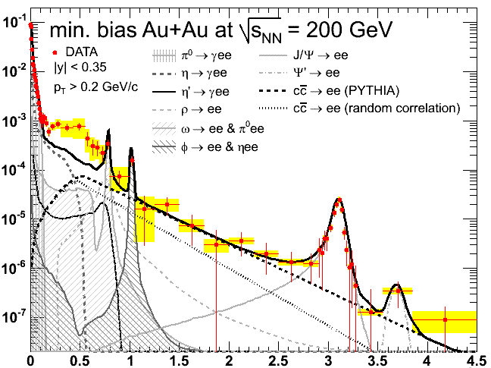
The di-Lepton Program at STAR
TOF + TPC + HFT
ρ ϕ J/ψ
Direct
radiation from
the Hot/Dense
Medium
Chiral
symmetry
Restoration
⇧ A robust di-lepton physics program extending STAR scientific reach
(1) σ
(2) v₂
(3) R_{AA}
DY, charm Bk
PHENIX: 0706.3034
Mass (GeV/c²)
p_{T} (GeV/c)

