Slide 1
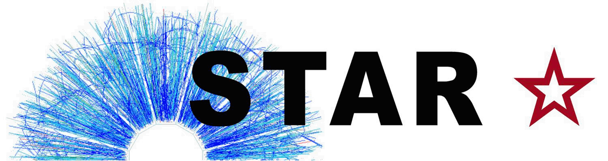
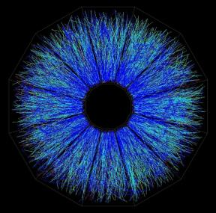
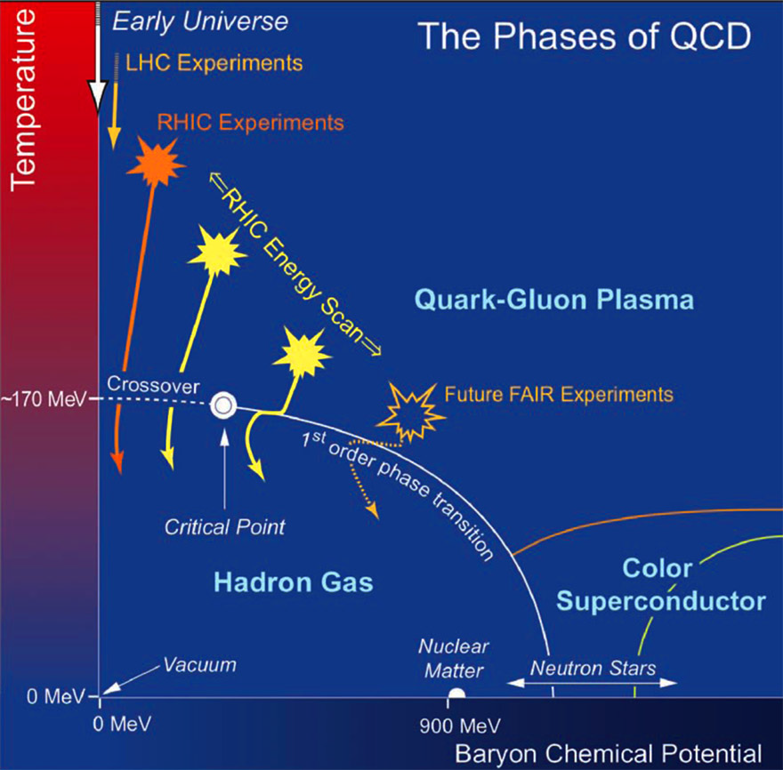


Chiral Magnet Effect, where are we?
Measure Charge Separation
QCD Topology Charge
Signal vs background study
(final-stage v2, initial colliding systems, rapidity, PID)
Dissect the necessary conditions
  Chiral Symmetry Restoration
  Strong Magnetic Field
Future Plans
Zhangbu Xu
^{For the STAR Collaboration}
Rencontres de Moriond: QCD and High Energy Interactions
LA THUILE, March 25- April 1, 2017

Slide 2

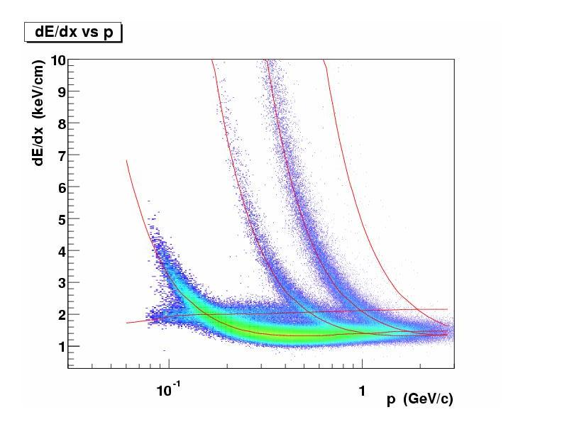
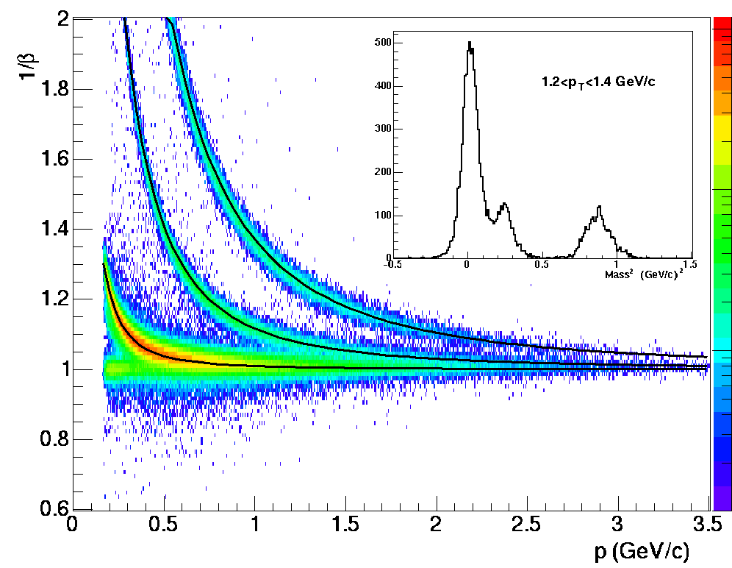
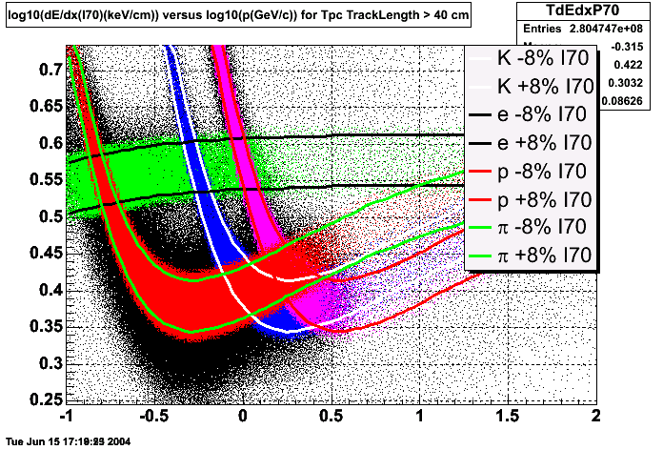
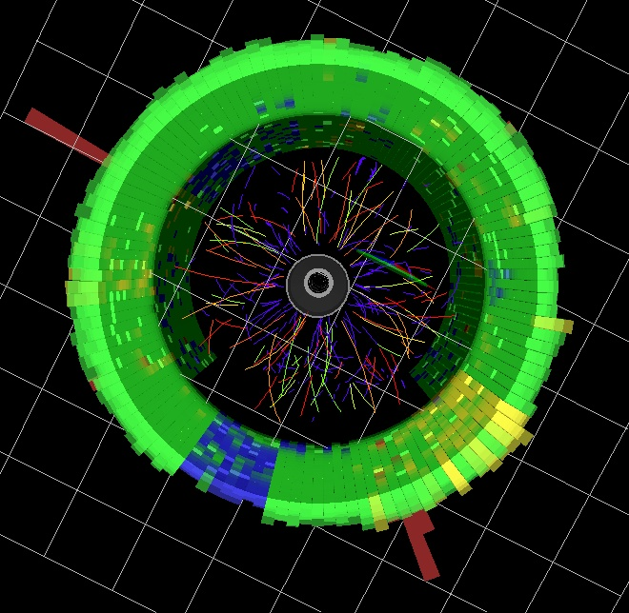
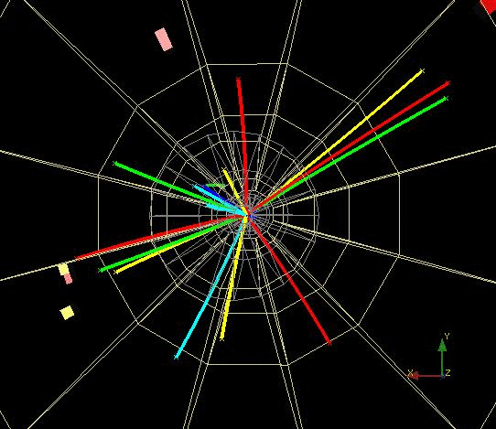
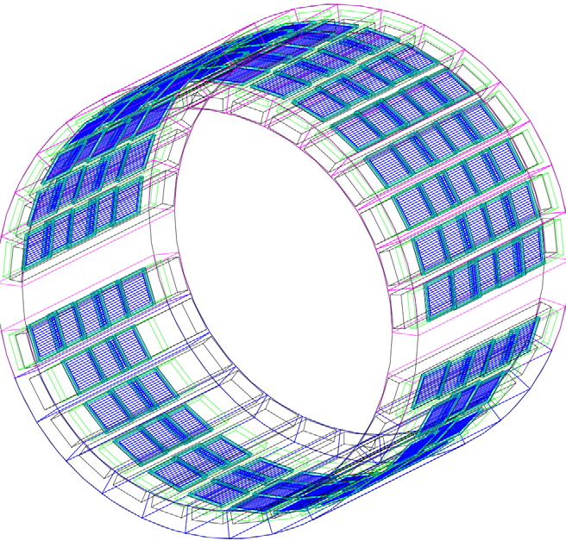
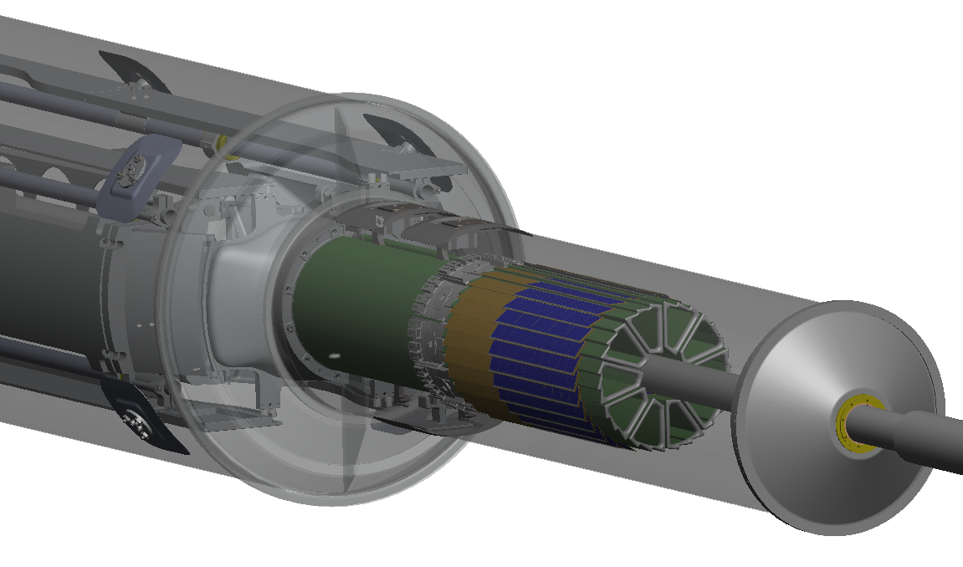
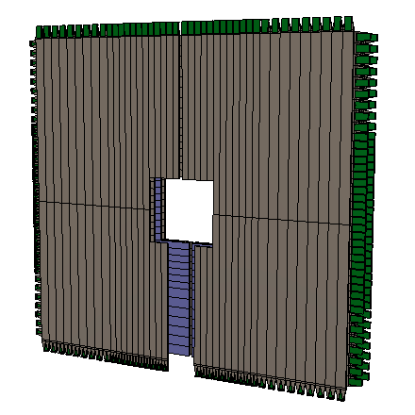
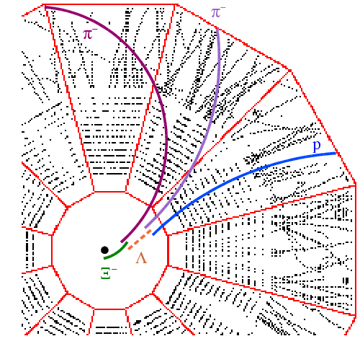
Particle Identification at STAR
TPC TOF TPC
TPC
K p d
π
e, μ
TOF
Log₁₀(p)
Charged hadrons
Hyperons & Hyper-nuclei
EM particles
MTD
HFT
EMC
Jets
Jets & Correlations
High p_{T} muons
Heavy-flavor hadrons
Forward protons
Forward photons
Multiple-fold correlations for identified particles!

Slide 3
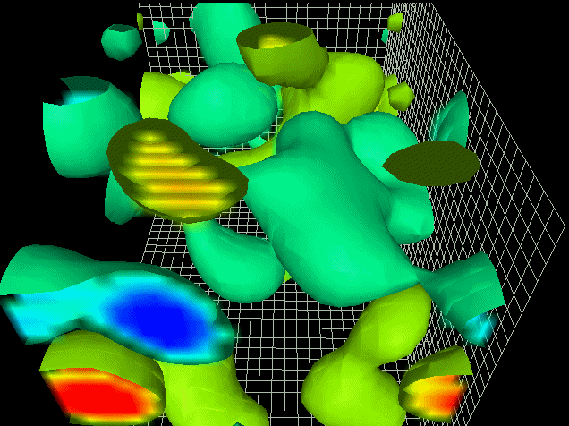
Observing Topological Charge Transitions
To observe in the lab
- add massless fermions
- apply a magnetic field
Paul Sorensen: QM2017
CME task force report:
arXiv: 1608.00982
A required set of Extraordinary Phenomena:
QCD Topological Charge
+ Chiral Symmetry Restoration
+ Strong Magnetic Field
Observable:
Chirally restored quarks separated
along magnetic field
PRC 81 (2010) 54908
PRL 103 (2009) 251601
Experimental strategy:
Measure 2 particle correlations (++,--,+-)
WRT reaction plane
Derek Leinweber, University of Adelaide

Slide 4
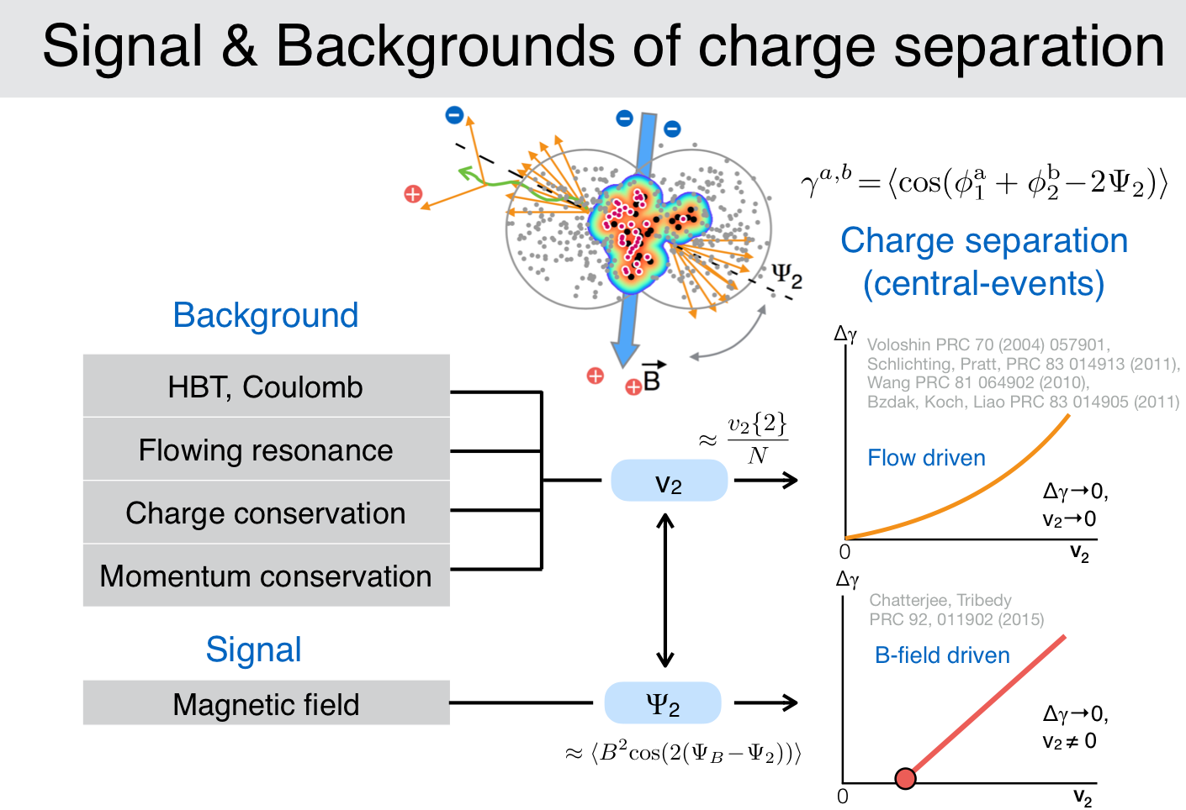
P. Tribedy, QM2017

Slide 5
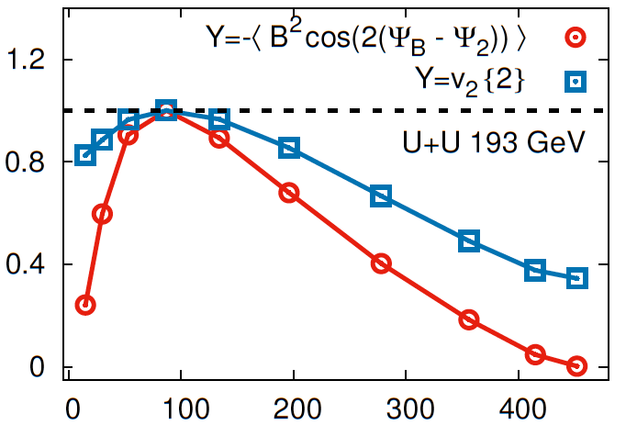
Charge separation depends on final-stage shape v₂
Number of participants
Azimuthal anisotropy (v₂) contributes to background (could be very large); PRC89(2014)
magnetic field which drives the signal, Qualitatively have similar centrality dependence.
Most comparisons and disentangle tools have to be quantitative.
U+U and Au+Au central data:
different dependence on v₂;
Not just driven by final-stage
background correlations?

Slide 6
Charge Separation depends on initial systems
Peripheral A+A
p+Au and d+Au
qualitatively similar
magnitude of charge separation
dependence on correlation
conditions
(rapidity gaps)
Qualitatively different rapidity distribution
from central to peripheral A+A (p+A)

Slide 7
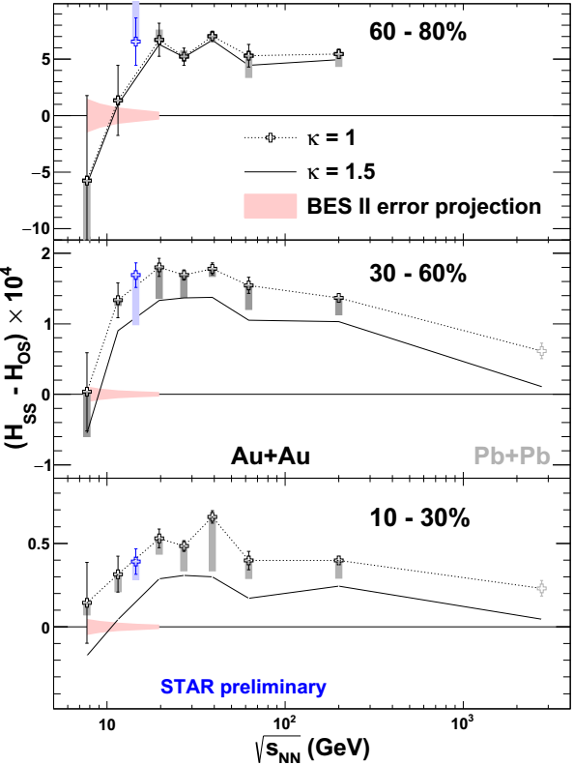
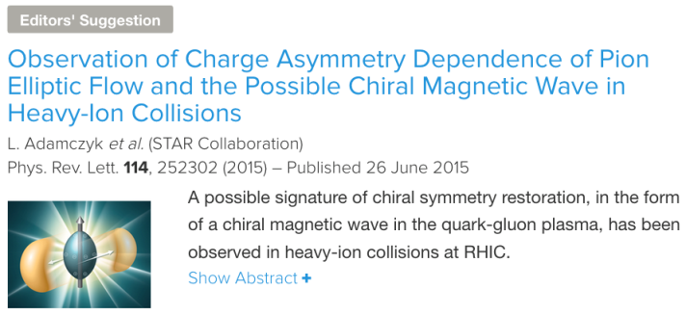
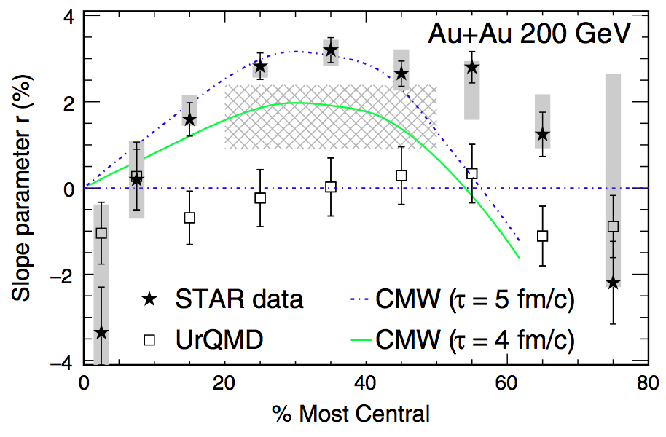
Separation appears in many forms
PRL113(2014)
peak between 10-200GeV
Has a predicted dependence
on Global charge excess:
Chiral Magnetic Wave

Slide 8
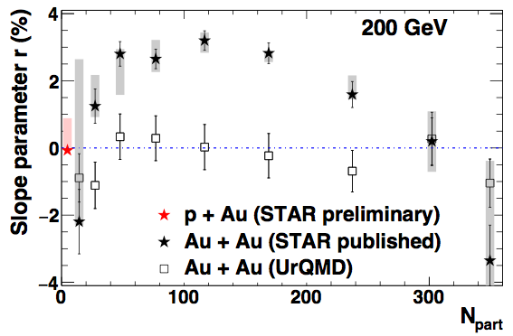
Strangeness (PID) distinguish models
STAR Preliminary
“… We demonstrate that the STAR results can be understood within the standard viscous hydrodynamics without invoking the CMW…”
“… the slope r for the kaons should be negative, in contrast to the pion case, and the magnitude is expected to be larger… Note that in these predictions are integrated over 0 < pT < ∞. In order to properly test them, a wider pT coverage is necessary…”
— Y. Hatta et al. Nuclear Physics A 947 (2016) 155
Measured kaon slope is positive:
contradict the conventional model
prediction without CMW

Slide 9
Chiral Symmetry & Magnetic Field
Two other Extraordinary phenomena to make this possible (QCD topology
reflects in charge separation)
Disentangle and assess
necessary conditions
A required set of Extraordinary Phenomena:
QCD Topological Charge
+ Chiral Symmetry Restoration
+ Strong Magnetic Field
Observable:
Chirally restored quarks separated
along magnetic field
Chiral Symmetry Restoration
  low-mass dilepton excess (change of vector meson ρ spectral function)
Strong Magnetic Field
  Global Hyperon Polarization
  Coherent photo-production of J/Ψ and low-mass dilepton in non-central A+A collisions

Slide 10
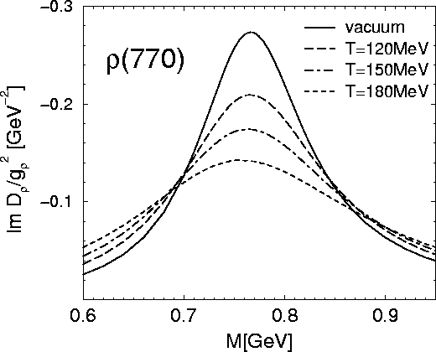
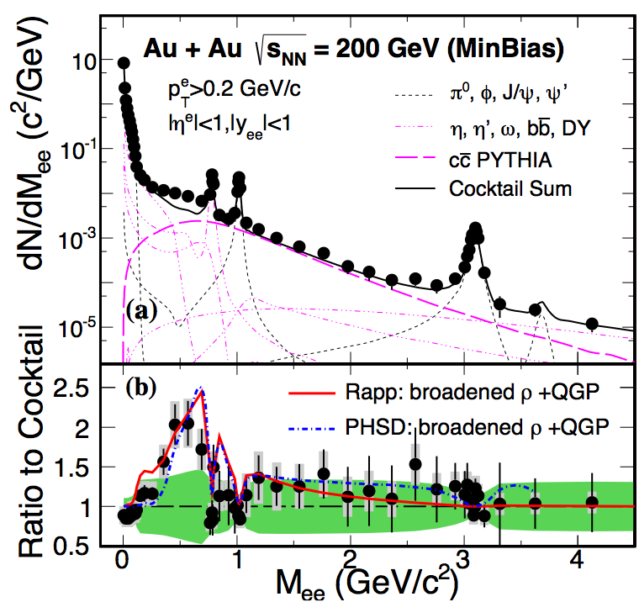
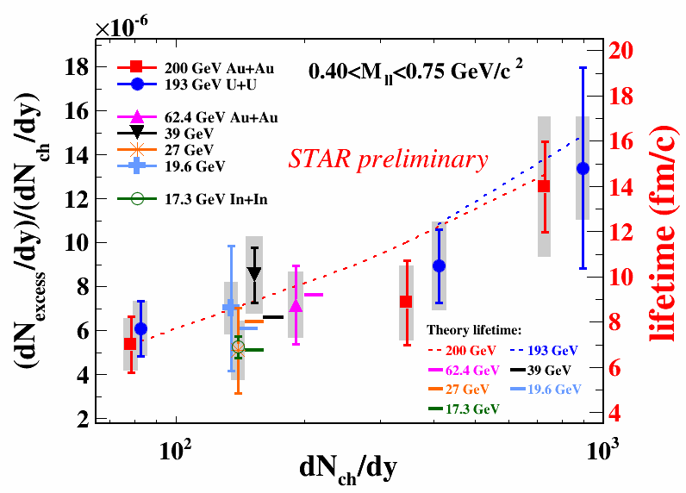
QCD phase transition is a chiral phase transition
Golden probe of chiral symmetry restoration:
change vector meson (ρ→e⁺e⁻) spectral function
STAR data (RHIC and SPS):
Consistent with continuous QGP radiation and
broadening of vector meson in-medium
PRL113(2014)
PLB750(2015)

Slide 11
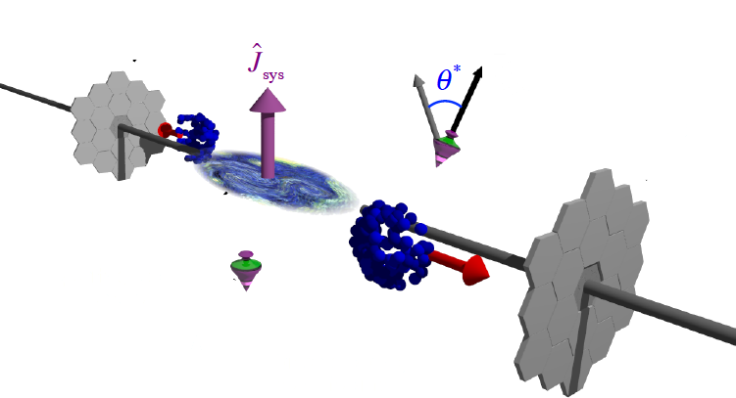
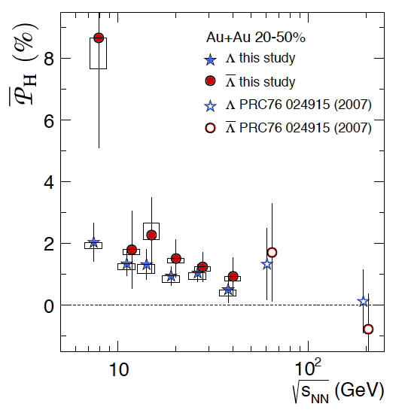
Global Hyperon Polarization
new tool to study QGP and relativistic Quantum fluid Vorticity in general
arXiv:1701.06657
Non-zero global angular momentum
transfer to hyperon polarization

Slide 12
QCD fluid responds to external field
Positive Global Hyperon Polarization
indicating a spin-orbit (Vortical) coupling
Current data not able to distinguish
Lambda/AntiLambda polarization difference,
(potentially) Direct measure of
Magnetic Field effect
Need >x10 more data
sum
STAR Preliminary
difference

Slide 13
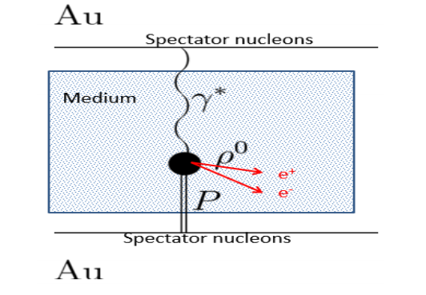
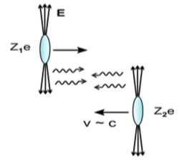
Coherent photoproduction in violent non-central A+A collisions?
Shower the nucleus with electromagnetic field
Non-central but not UPC photoproduction
Large enhancement of dilepton and J/Ψ
production at very low p_{T} (<150MeV)
Consistent with strong electromagnetic field
interacting with nucleus target collectively

Slide 14
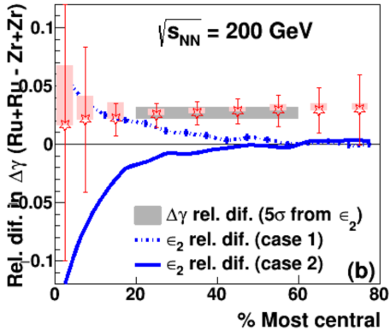
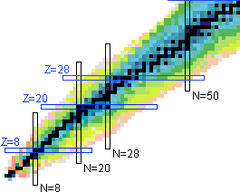
A decisive test with Isobars
1.2B minbias events
RHIC run in 2018:
Zr and Ru same geometry and mass;
charge different by 10% (20% signal difference)
5σ effect with 20% (signal)+80% (background)
Dilepton and J/Ψ:
Coherent photoproduction: Z²
Photon-photon fusion: Z⁴
Hadronic interaction: Z⁰

Slide 15
Summary
Observed charge separation was examined in Au+Au, U+U, p+Au and d+Au
scaled with final-stage v₂ in peripheral and mid-central and close to zero with different v₂ in Central U+U and Au+Au
Qualitatively different rapidity distribution from central to peripheral A+A (p+A)
Values depend on correlation conditions in p+Au and d+Au
Correct kaon ”sign” in Chiral Magnetic Wave
Largest at beam energies (10-200GeV)
Background (v₂) and signal (B field) predicted to have similar centrality (geometry) dependence
Isobar collisions will provide a decisive test
Investigation of two major necessary phenomena:
Chiral Symmetry Restoration:
observation of large excess of low-mass dilepton, consistent with vector ρ in-medium
Strong Magnetic Field:
  Suggestive difference between Global Hyperon (antihyperon) polarization);
  need more statistics
  Photoproduction in non-central collisions, a good probe of electromagnetic field interacts with nucleus collectively

Slide 16
backup

Slide 17
Notes:
Something that ties together a wide range of topics in QCD: How do collective, many body phenomena arise from QCD.

