Slide 1
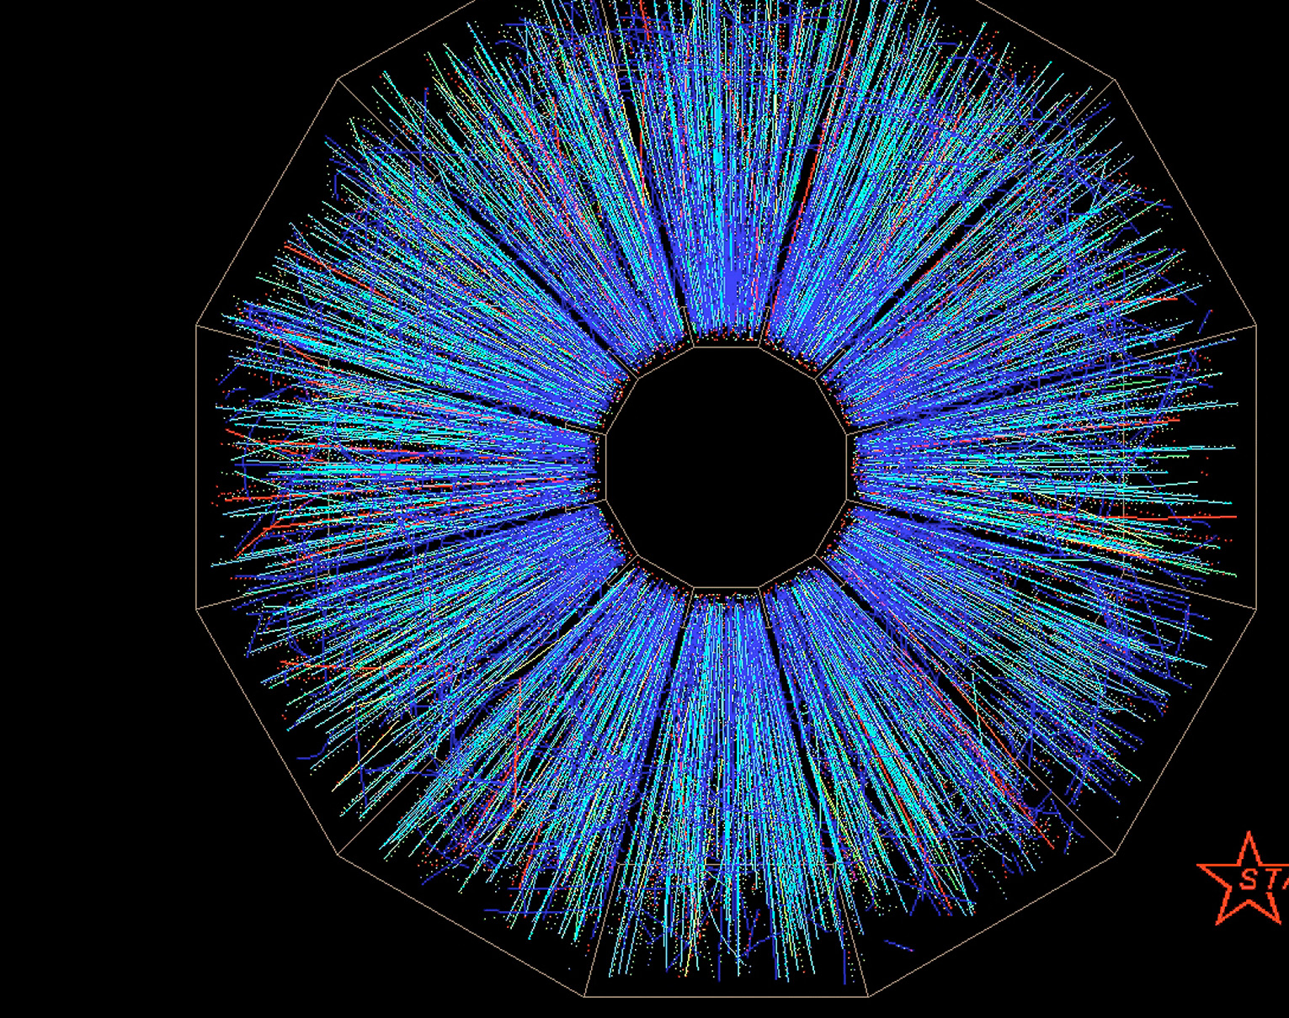
SLOW CONTROLS SOFTWARE DESIGN FOR BEACON 410A GAS MONITORS FOR THE STAR sTGC
Supported by:
Rebecca Powers (for the STAR Collaboration) with Dr. Janet Seger and Dr. David Tlusty
Department of Physics, Creighton University, Omaha, NE, 68178

Slide 2
Relativistic Heavy Ion Collider

Slide 3
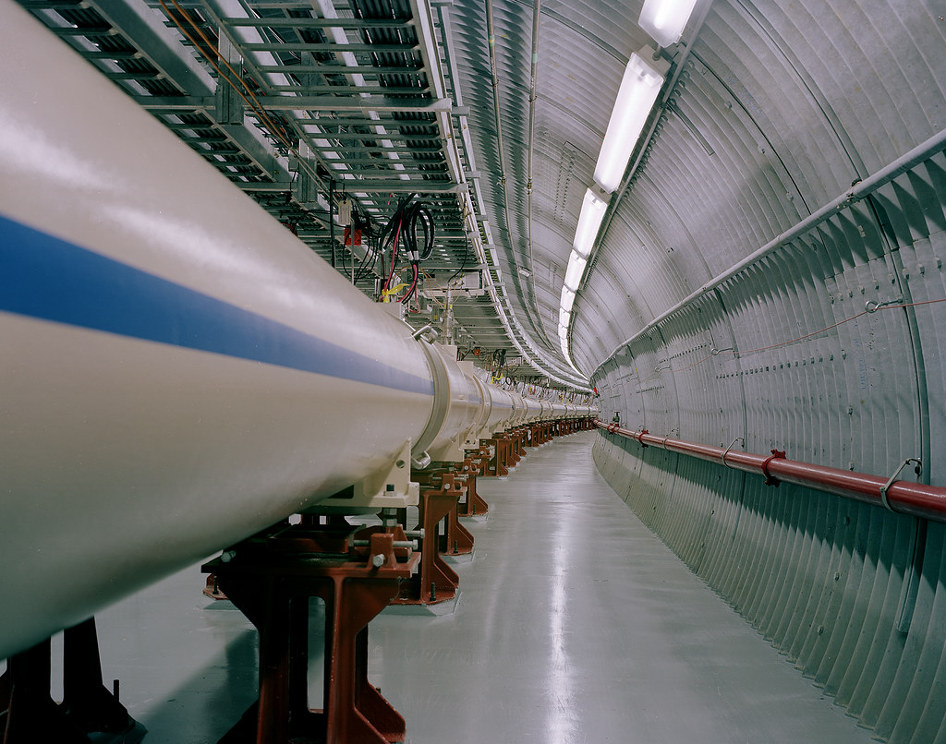
Liberation of Quarks and Gluons
Collision of two Au beams at relativistic speeds
Thousands of collisions per second
Liberates constituent quarks and gluons from accelerated particles
Physicists at RHIC use this information to explore some Nature’s phenomena

Slide 4
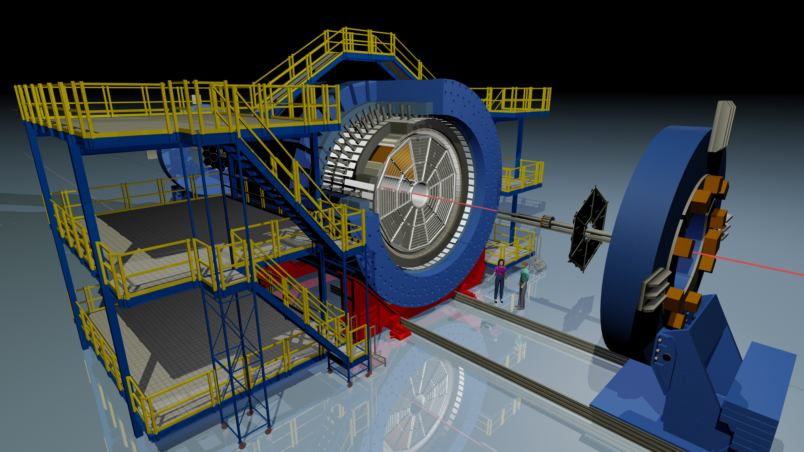
STAR Detector
The Solenoidal Tracker at RHIC, known as STAR, tracks thousands of particles produced by collisions at RHIC
Massive detector that searches for signatures of the form of matter, quark-gluon plasma (QCP), that RHIC was designed to create

Slide 5
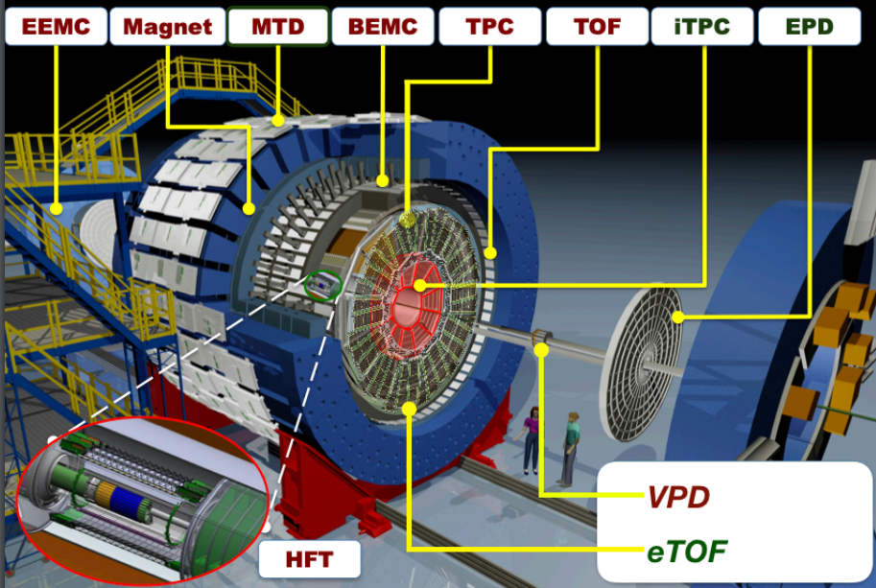

Slide 6
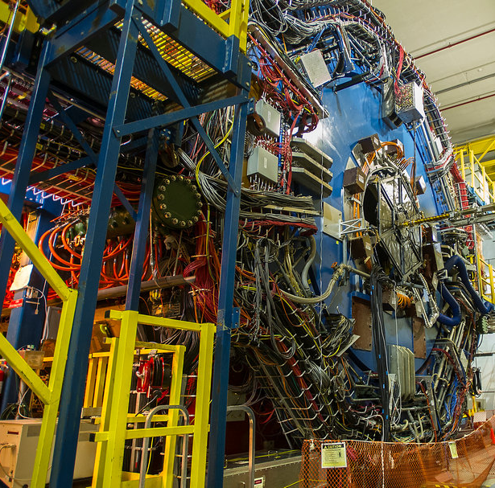
Remote Monitoring and Controls
The STAR detector is in a high radiation location when operational
Necessary to develop a system to remotely control all hardware
60,000+ parameters (voltages, currents, temperatures) are monitored and controlled remotely
Creighton is a large contributor to STAR Controls
Allows us to contribute remotely

Slide 7
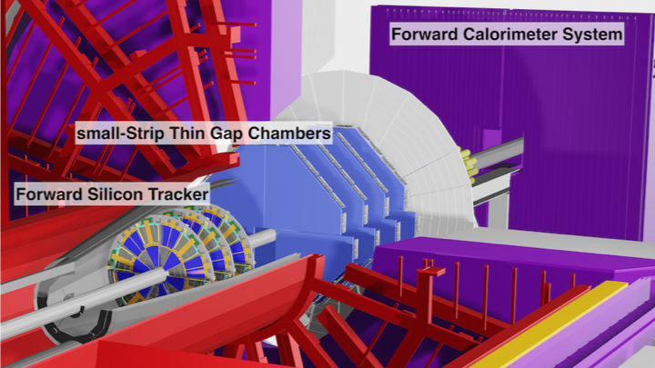
Notes:
Momentum Resolution and tracking efficiency motivated by heavy ion collision goals

Slide 8
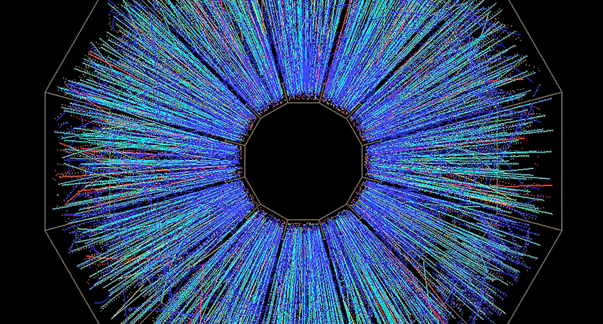
Hardware Overview

Slide 9
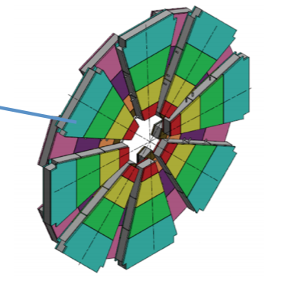
Small Strip Thin Gap Chambers (sTGC)
sTGC: New detector to “fill the gap” in STAR
Gaseous detector, uses a mixture of pentane and carbon dioxide
Carbon dioxide is gaining gas and pentane is quenching gas
Need exact composition (45% pentane and 55% carbon dioxide in molar ratio) to operate properly; monitor for safety
Ionization occurs within the gas, allowing physicists to track charged particles in the detectors

Slide 10
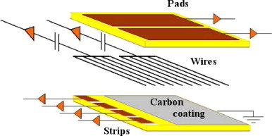
How Does the Detector Work? Cont.
Charged particles pass through ionizing gas
Electron from ionization makes cascade in electric field
Cascade is measured in the strips as a hit
N-pentane is optimal quenching gas; allows for higher voltages and consequently better efficiencies

Slide 11
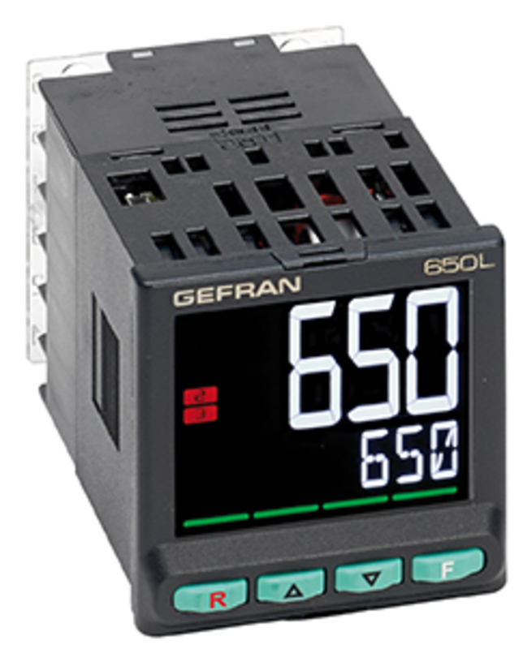
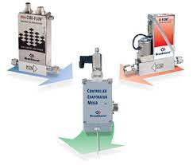
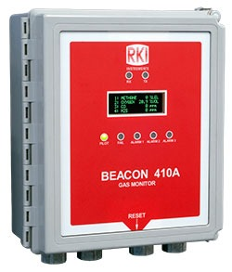
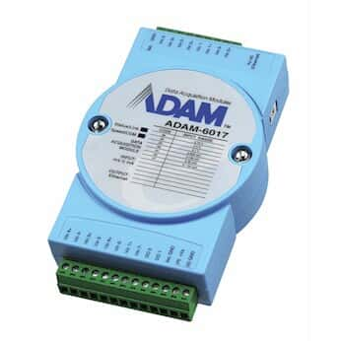
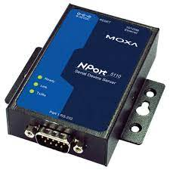
sTGC Gas System
6 Thermocouples
6 Flow Meters and Controlled Evaporation Mixer
2 Beacon 410A Pentane Sniffers
6 Pressure Transmitters
analog signal
Modbus RTU
Modbus RTU
Modbus RTU
ADAM 6017
MOXA Nport 5150 Server
MOXA Nport 5150 Server
MOXA Nport 5150 Server
Modbus TCP/IP
Python softIoc
GUI

Slide 12
Beacon 410A Gas Monitor
Fixed-mounted, continuous-monitoring controller
Capable of detecting gas at up to four locations
Alarm circuits include up to three levels of gas alarms
Simultaneously displays the target gas, unit of measure, and current gas reading for all active channel.

Slide 13
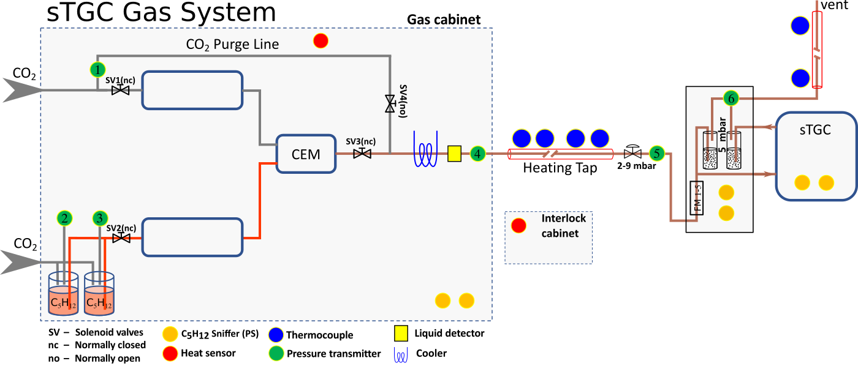
Mass Flow Controller
CO2
sTGC Detector
Controlled Evaporation Mixer
Cooling and Liquid Detection
Heating Tape
Beacons’ Second Channel
Mass Flow Controller
Beacons’ Third Channel
CO2
Beacons’ First Channel
Pentane

Slide 14
Software Overview

Slide 15
EPICS and Process Variables
EPICS (Experimental Physics and Industrial Control System) is a set of software tools, libraries, and applications used internationally to create control systems for particle accelerators
EPICS models hardware data with data entries that describe a single aspect of the process, known as “process variables.”
A typical PV could be an attribute such as temperature or current
Used instead of objects, allowing complex functionality without traditional programming
Allows the creation of IOCs

Slide 16
Python softIOCs
IOCs: Input/Output Controllers
An IOC performs input/output operations to attached hardware devices
Essentially allows us to talk to devices via ethernet
An IOC associates the values of EPICS process variables with the results of these input/output operations
“Soft” IOC = “Host-based” IOC
Runs in the same environment as which it was compiled
Python module that allows the creation of EPICS process variables (PVS) for the new Beacon gas monitors

Slide 17
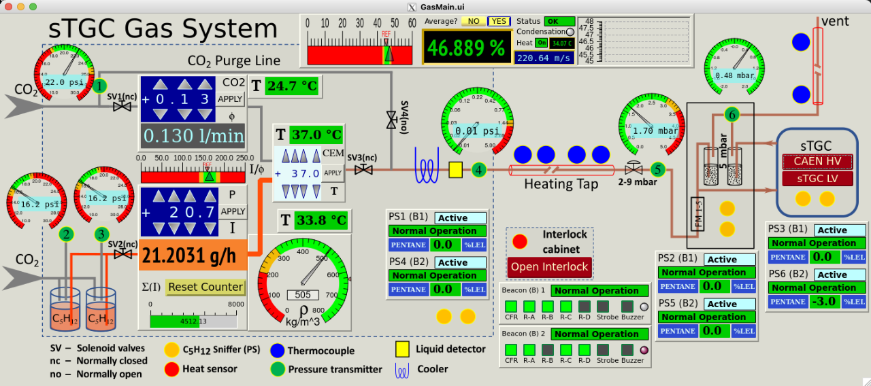
GUI (Graphical User Interface)

Slide 18
Defining MODBUS_RTU Registers
2 Beacon 410A Pentane Sniffers
Modbus is a communications protocol for transmitting data between two or more devices
Used to transmit data I/O data from Beacons and Moxas.
RTU (remote terminal unit) is able to tell a Modbus device when and what commands to execute
Modbus RTU
MOXA Nport 5150 Server

Slide 19
Goals of the Project
Install Beacon 410A Gas Sensors within the sTGC gas cabinet
Design the software for each of the Beacons.
Use SoftIOC, a Python module that allows the creation of EPICS process variables (PVs) for the new Beacon gas monitors.
Associates the values stored in the various MODBUS_RTU registers for each Beacon device, a variable associated with the device status, and four channels to monitor the gas system.
Define within each channel are the gas status, the measured value, and its units.

Slide 20
Acknowledgements
Thank you to the Department of Energy Office of Science for funding
Daniel Brandenburg. STAR Forward Rapidity Upgrade: Hard & Electromagnetic Probes. Shangdong University / BNL-CFNS. Presentation. June 4th, 2020.
Abusleme, A., et.al. “Performance of a full-size small-strip thin gap chamber prototype for the ATLAS new small wheel muon upgrade.” Nuc. Inst., Section A: Accelerators, Spectrometers, Detectors, and Associated Equipment. 2016, 817 (1), 85-92.
RKI Instruments. “Beacon 410A Gas Monitor Operator’s Manual.” Part Number: 71-0397. Revision: J. Released 6/26/20. https://www.rkiinstruments.com/pdf/Beacon_410A_Manual.pdf.
University of Chicago. “PyEpics: Epics Channel Access for Python.” Accessed Aug. 12th, 2021. https://cars9.uchicago.edu/software/python/pyepics3/overview.html.
Eric Norum. Input/Output Controller (IOC) Overview. Experimental Physics and Industrial Control System, Argonne National Laboratory. Presentation. Accessed March 30, 2022. https://epics.anl.gov/docs/USPAS2014/2-Tuesday/IOC_Overview.pdf
Special Correspondence with:
Janet Seger, Ph.D. Physics. Creighton University.
David Tlusty, Ph.D. Physics. Brookhaven National Laboratory.

Slide 21
Backup Slides

Slide 22
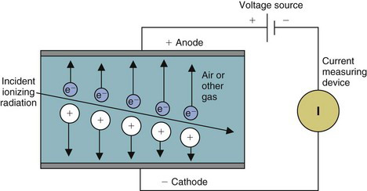
How Does the Detector Work?
A charged particle hits an atom of CO2 (gaining gas), liberating electrons
Electron hits other atoms, liberating more and more electrons and ions (avalanche)
An applied electric field makes the electrons and ions move, inducing a readout signal
Pentane (quenching gas) is used to prevent discharges
Charged CO2 ions exchange charge with pentane
Pentane loses energy in a non-radiative way
Prevents photons in the chamber, which could cause secondary avalanches

Slide 23
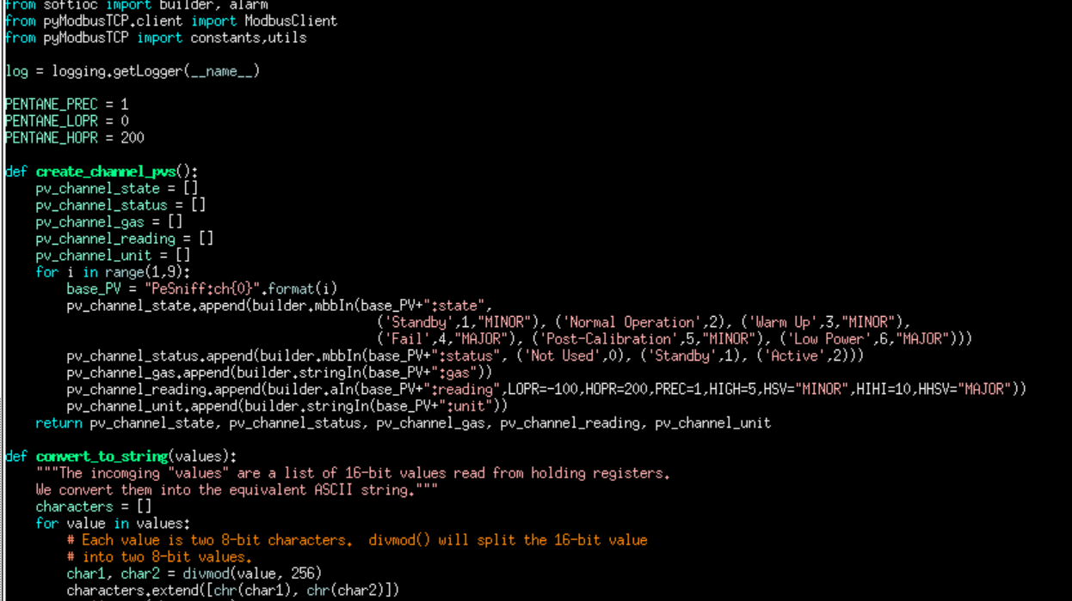
Import softIOC builder and Modbus Client
Define a function to create channel PVS
Within each PV is a multi-bit input corresponding to manual instructions
Conversion of 16-bit values which are read from holding registers into ASCII strings, later converted to a float value

Slide 24
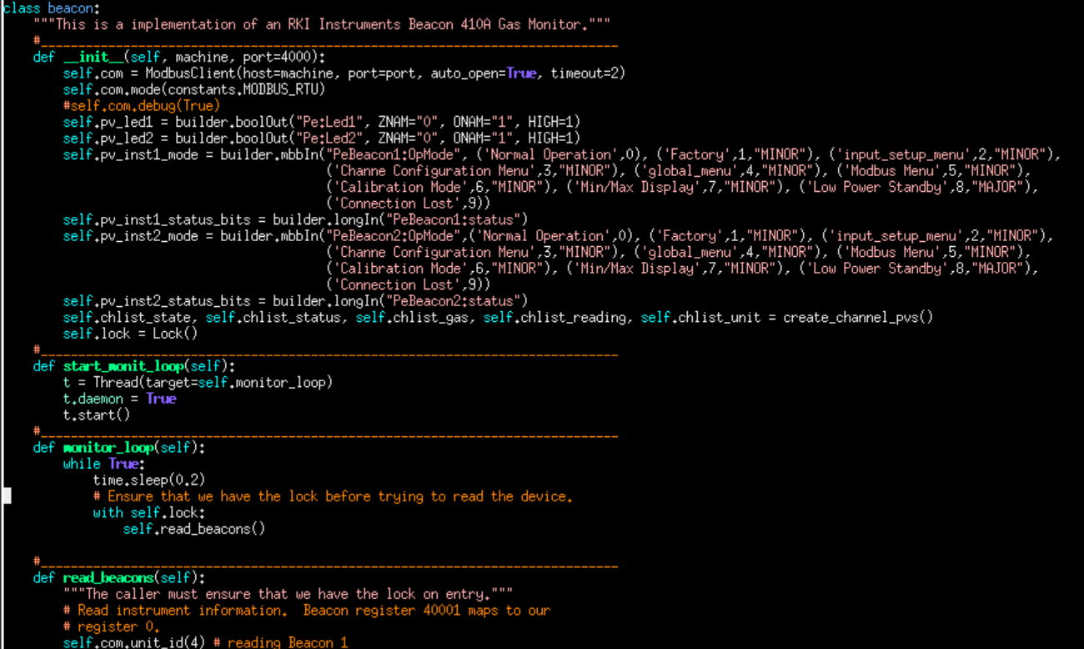
Creating a class beacon
Defines _init_ function, used each time an object is created from the class beacon.
Implementation of threading
Locking before the device is read

Slide 25
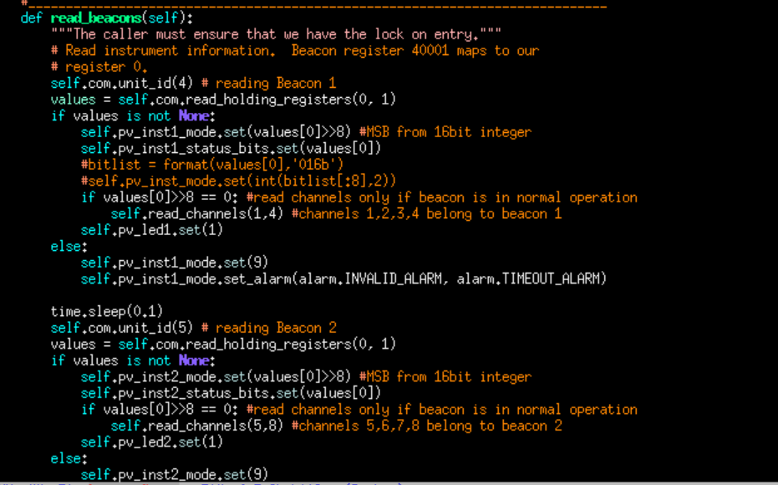
Defines a function to read Beacon instrument information
Reads registers from Beacon 1 if beacon is in normal operation. Channels 1, 2, 3, and 4 belong to Beacon 1.
Reads registers from Beacon 2 if beacon is in normal operation. Channels 5, 6, 7, and 8 belong to Beacon 2.

Slide 26
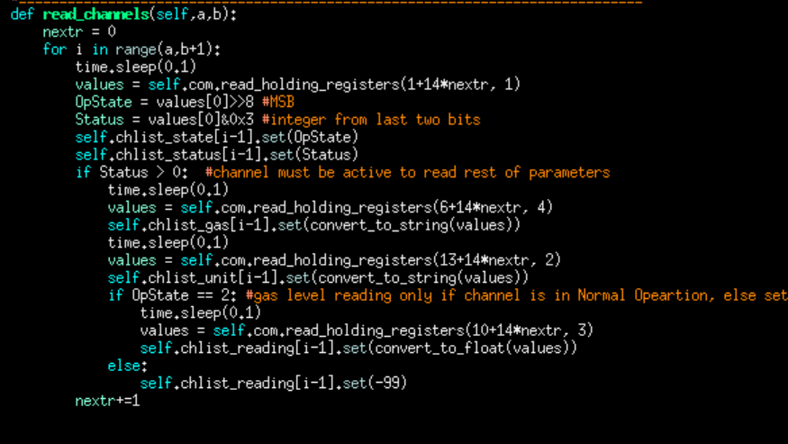
Reads channels from each beacon using read_holding_registers command

