Slide 1
Electron-Positron Production in Ultra-Peripheral Collisions at STAR
Ryan Gnabasik
Dr. Janet Seger
Creighton University – Physics Department

Slide 2
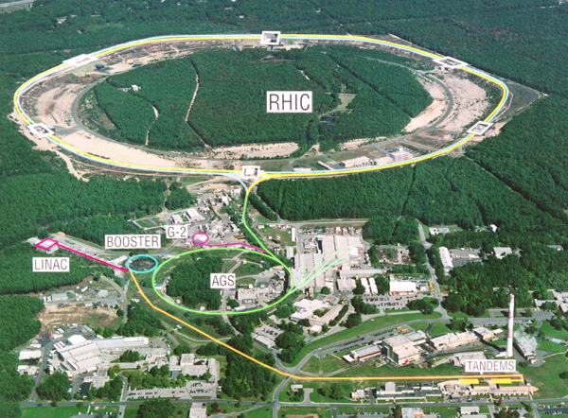
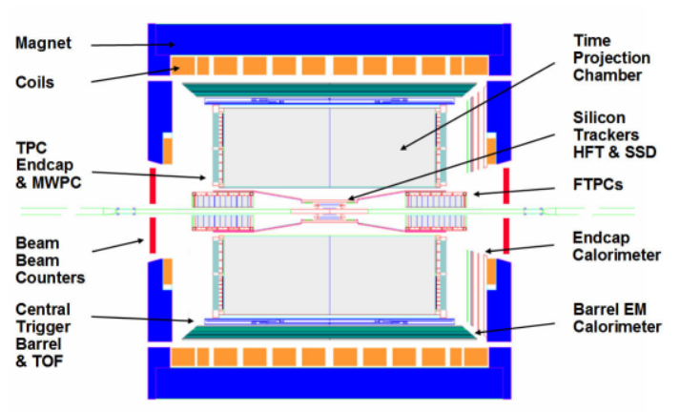
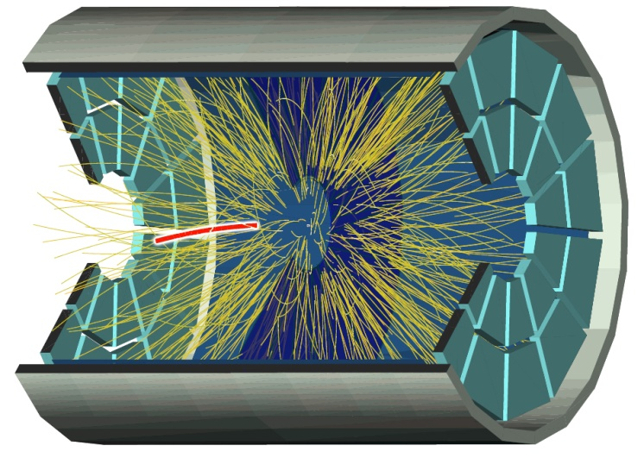
STAR
ZDCs
ZDCs
RHIC Ring
STAR Detector
Event Reconstruction

Slide 3
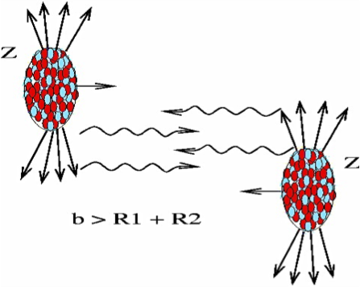
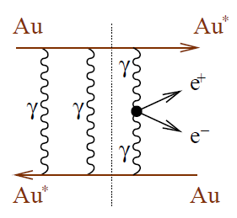
Ultra-Peripheral Collisions
Gold ions travel around the ring at 0.99996c
Electromagnetic field is focused perpendicular to the velocity of the ion due to relativistic effects
UPCs occur when the impact parameter is greater than twice the nuclear radius
Exchange photons which interact to produce electron/positron pairs
By finding a cross section for this specific type of pair production we can confirm theoretical predictions about this specific process
https://drupal.star.bnl.gov/STAR/files/userfiles/3200/image/UPC.png

Slide 4
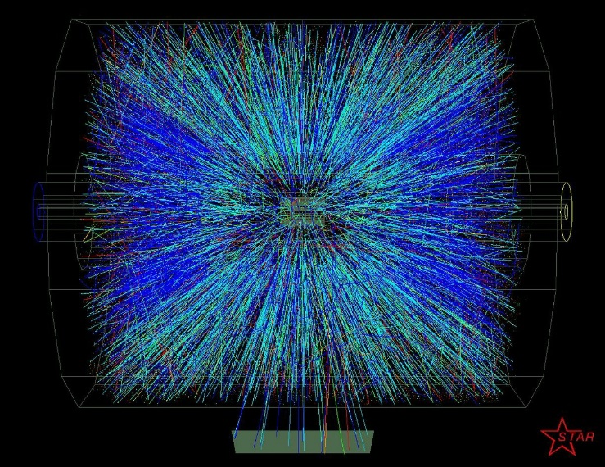
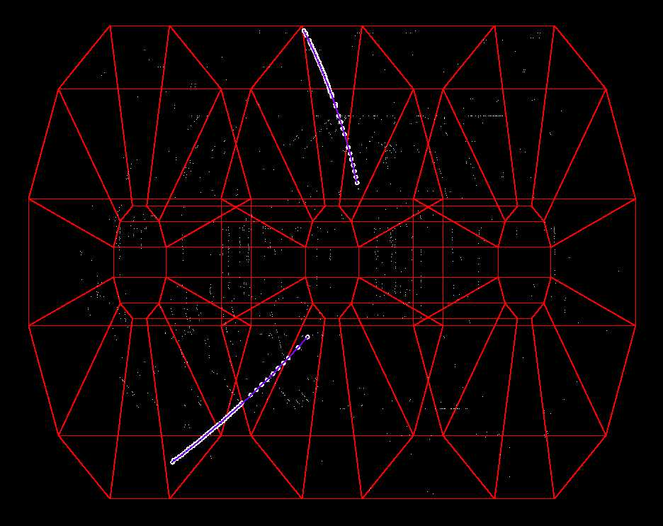
Selecting Events with Electron/Positron Pairs
Gold-Gold 200 GeV/nucleon data collected in 2010, approximately 25 million events
Trigger
Event selection
Particle Identification
Require coincident signals in ZDCs
Require low multiplicity
Require no signal in BBCs
Two tracks
Opposite sign
Vertex near center of detector
Well constructed
Electron/Positron production is not the only two track, oppositely signed process from UPCs
Need ways to eliminate everything but electrons and positrons
Images from Giessen University website based on STAR images
Notes:
10-15ish tracks
Low multiplicity
Event selection helps get rid of background
Some things that could happen are cosmic rays or left over gas in the beam
Two tracks picture
Not just e+/e- produced in UPCs that have oppositely signed tracks
So we use PID to eliminate it

Slide 5
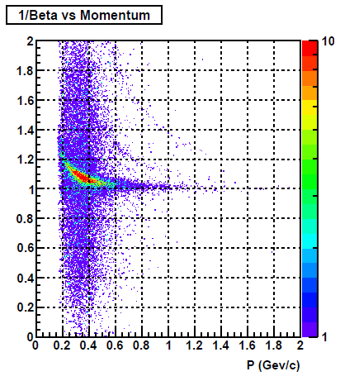
Selecting Electron Pairs: Part 1
UPC triggered events that meet event selection criteria
Two tracks
Opposite sign
Vertex near center of detector ( |z| < 100)
Well constructed (hits > 14)
$$β= \frac{v}{c}$$
p
k
π
Use time of flight (TOF) detector to determine speed of particles
Electrons and positrons should have inverse beta around 1 because of their small mass
Require events have an inverse beta between 0.96 and 1.02
electrons
Notes:
Change graphs to have units of GeV/c
Higher up are more massive particles
Below line are particles with calibration issues

Slide 6
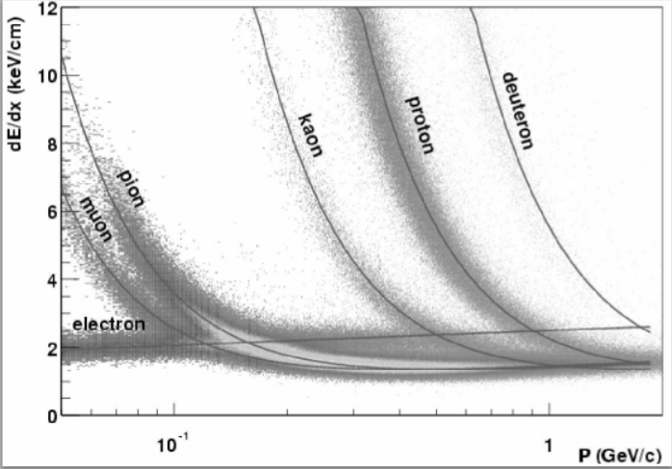
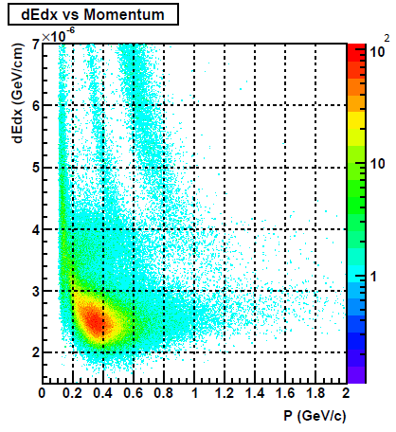
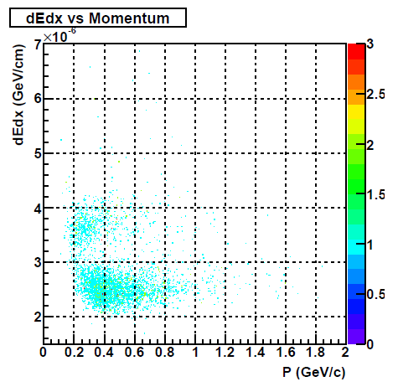
Selecting Electron Pairs: Part 2
After 1/ $β$ cut to remove contamination from slow hadrons
Example
dE/dx is a measure of how much energy a particle deposits in the detector over a distance
Well established theory for what dE/dx should look like for electrons, pions, protons, etc…
Electron curve crosses the curves of the other particles making it hard to distinguish
Keep tracks with dE/dx greater than 3.3 x ${10}^{−6}$ GeV/cm
UPC triggered events that meet event selection criteria
Two tracks
Opposite sign
Vertex near center of detector ( |z| < 100)
Well constructed (hits > 14)
Notes:
Change units to GeV/c
Find example plot of characteristic dEdx vs momentum graph
Slower it goes the more it has time to interact so the more energy it loses per distance
Electron has different shape because

Slide 7
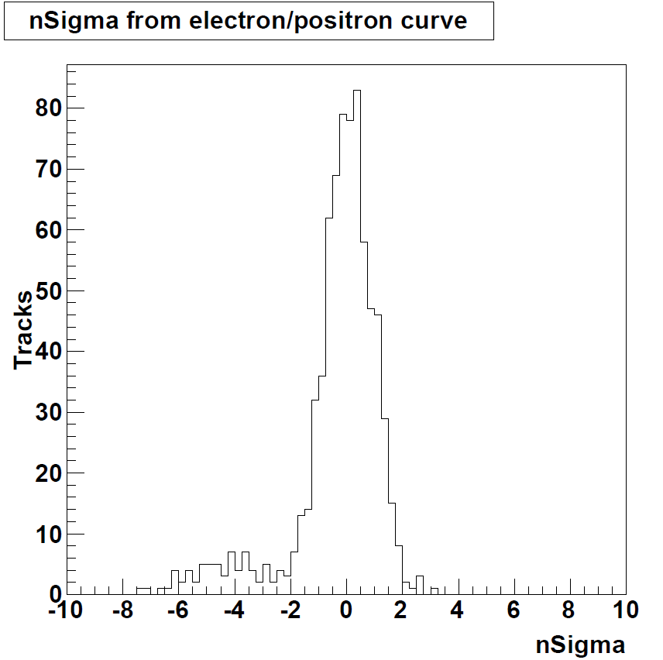
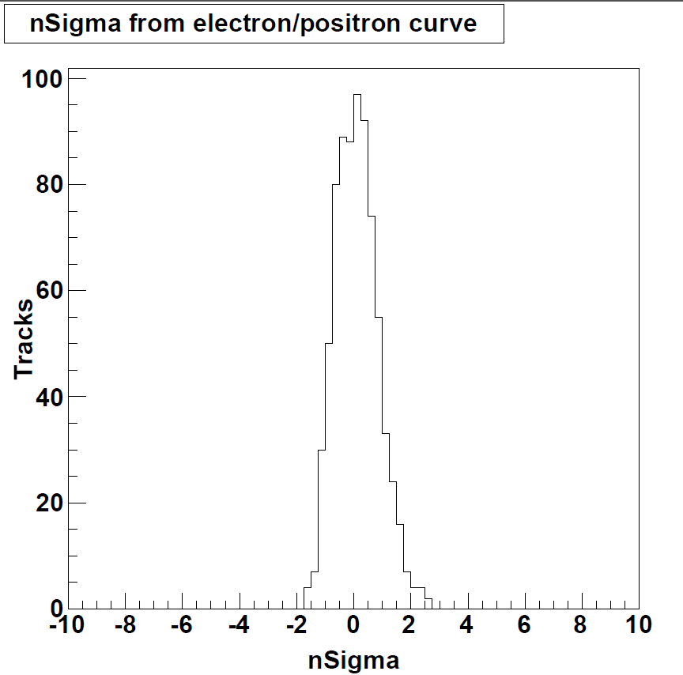
Selecting Electron Pairs: Part 3
Use well established dE/dx lines for electrons and use nSigma to quantify how far each of the tracks is from that line
After applying the first two cuts to one track that track is well identified
nSigma centered around 0 with nSigma less than 3
The partner track that did not have cuts on it has a small amount of contamination that can be removed
Require that the partner track has an nSigma less than 2.5
nSigma on the track which had both previous cuts applied to it
Purity of the sample has increased
Notes:
Only apply first two cuts to one track and then we have some small contamination in other track

Slide 8
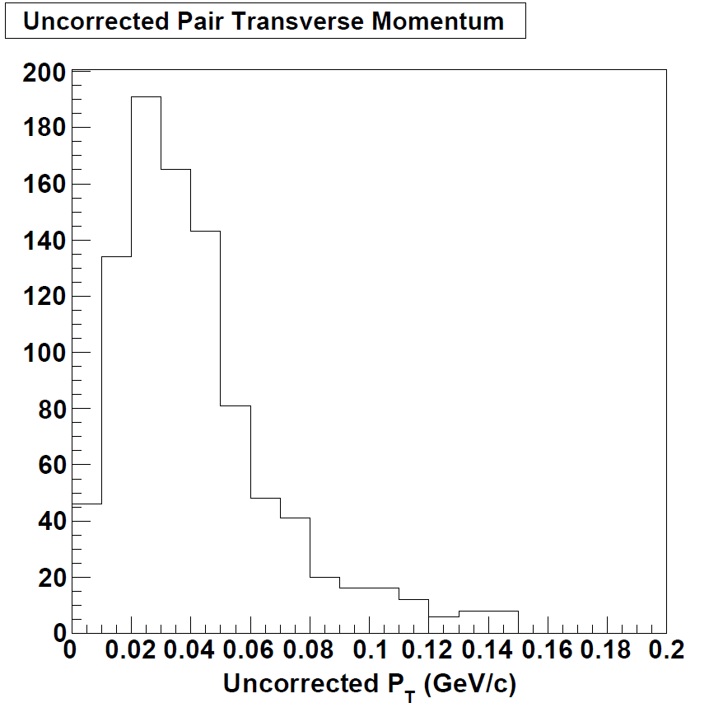
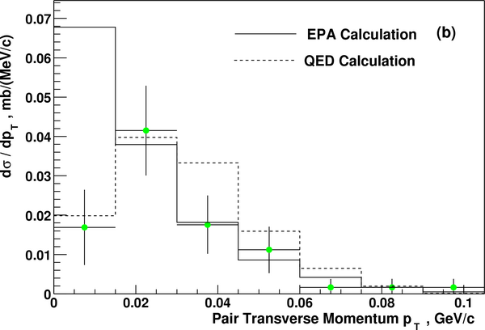
Results
Uncorrected shape appears to be consistent with previous low statistics measurement
Uncorrected Result
$${dN}/{{dP}_{T}}$$
Phys. Rev. C 70 (2004) 031902(R)
Expect the corrected data to have a peak below 0.15 GeV/c due to coherence condition
For Coherent Production:
$$P_{T}≈\frac{ℏ}{R_{A}}≲0.1 GeV/c$$
Notes:
Going to need explanation on what we are looking at
Change units in Ppt
Log plot
-1.9 for slope
Cut off before 2

Slide 9
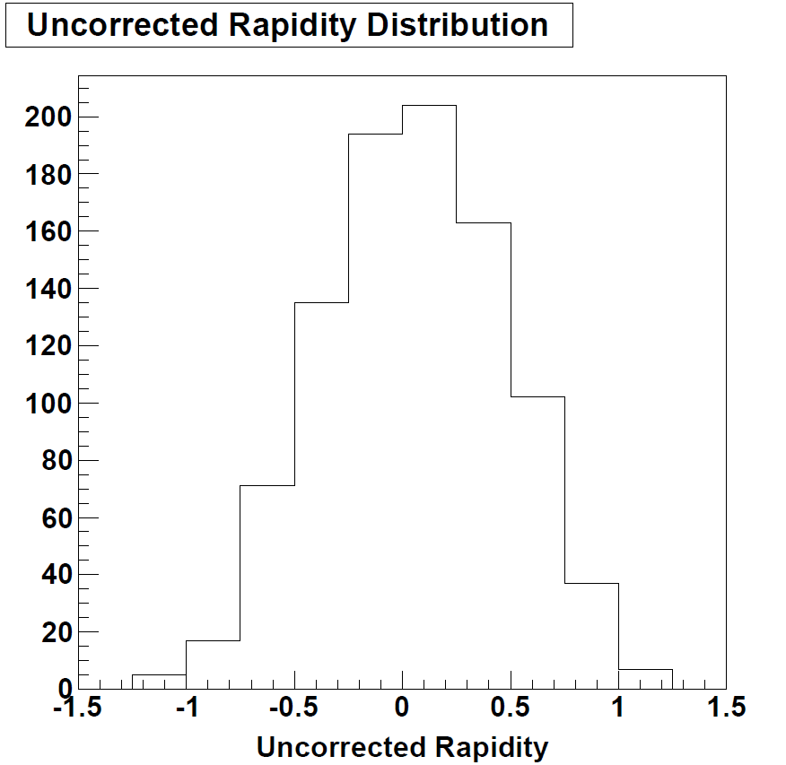
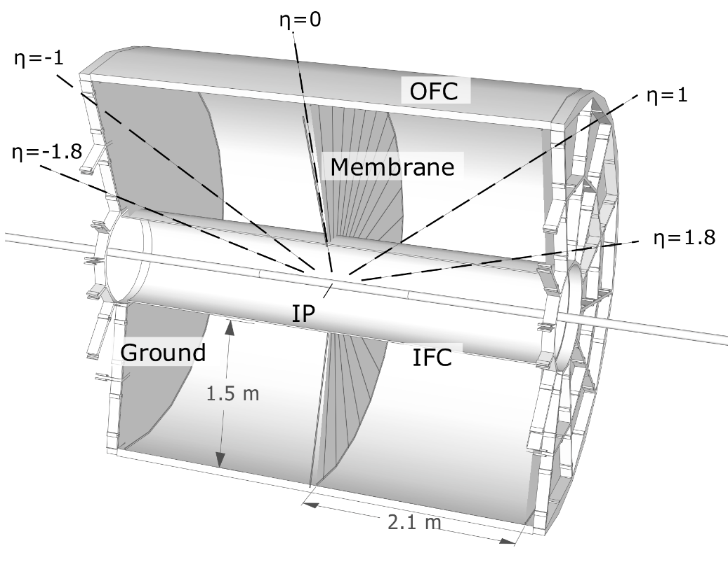
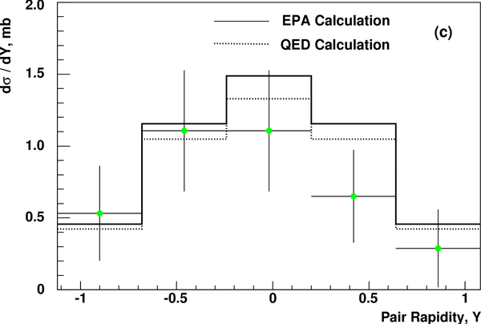
Results
Uncorrected shape appears to be consistent with previous low statistics measurement
Rapidity = 0
Uncorrected Result
Rapidity ≈ -1
Rapidity ≈ 1
Rapidity ≈ -2
Rapidity ≈ 2
$${dN}/{dy}$$
Expect the corrected rapidity distribution to be symmetric around 0
Phys. Rev. C 70 (2004) 031902(R)
http://people.physics.tamu.edu

Slide 10
Conclusions
We can use basic PID techniques to obtain a relatively pure sample of electron-positron pairs
This allows us to determine the kinematic properties of the pairs such as transverse momentum and rapidity
Future work will involve comparing this data against simulations to determine the efficiency and acceptance of the STAR detector to be able to calculate a cross section for this process
This work was partially funded by the Department of Energy
Notes:
The shape of these distributions are similar with earlier low statistics measurements

Slide 11
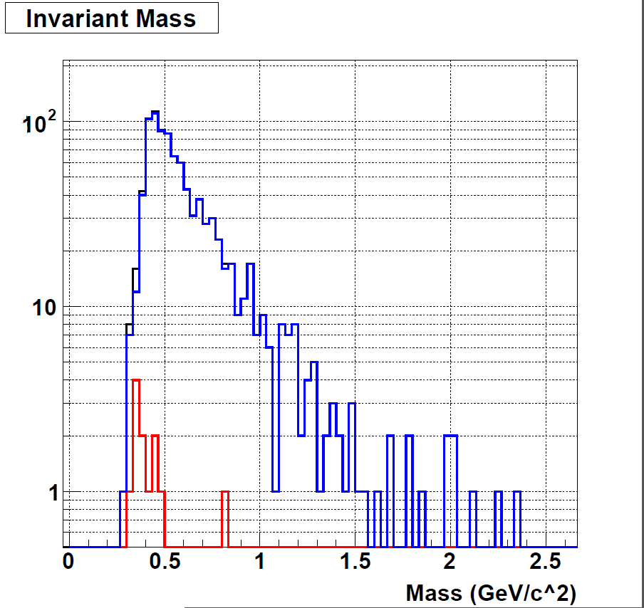
Results
Signal
Combinatorial background
Signal minus background
Combinatorial Background: Estimate of the random chance of having two tracks that meet all of our requirements by applying all of the same cuts to like-sign tracks
Events
STAR preliminary
Expect a decaying exponential curve

