Slide 1


Heavy Flavor Physics in STAR
Flemming Videbæk
Brookhaven National Laboratory
For the STAR collaboration
Notes:
Missing BNL and DOE logo
----- Meeting Notes (5/25/12 13:09) -----
nnnn

Slide 2
Overview
Heavy Flavor Physics
Recent highlights
Upgrades
  Muon Telescope Detector (MTD)
  Realization & Planned Physics from MTD
  Heavy Flavor Tracker (HFT)
  Realization & Planned Physics from HFT
Status and Summary

Slide 3
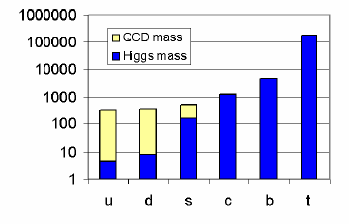
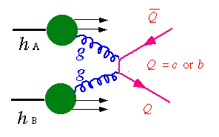
Motivation for Studying Heavy Quarks
Heavy quark mass are only slightly modified by QCD.
Interaction sensitive to initial gluon density and gluon distribution.
Interact with the medium differently from light quarks.
Suppression or enhancement pattern of heavy quarkonium production reveals critical features of the medium (temperature)
Cold Nuclear effect (CNM):
    Different scaling properties in central and forward rapidity region CGC.
    Gluon shadowing, etc
K⁺
e⁻/μ⁻
ν_{l}
K⁻
Non-photonic electron
D⁰
π
Open heavy flavor
e⁻/μ⁻
e⁺/μ⁺
Heavy quarkonia
Notes:
If the quark motivation is in Huan’s talk I can save a slide. CNM which I do not discuss in the brief overview talks

Slide 4
STAR experiment
TPC provides momentum determination & PID,
TOF PID,BEMC triggering and PID needed for charm measurements.

Slide 5
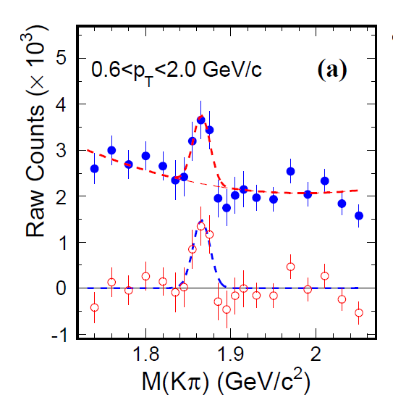
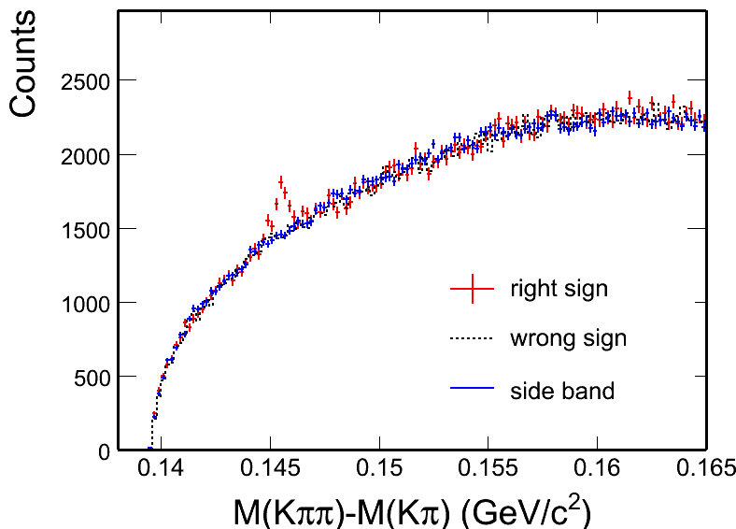
D meson signal in p+p 200 GeV
D⁰ -> K π
p+p minimum bias
4-σ and 8-σ signal observed
Different methods reproduce combinatorial background and give consistent results.
Combine D⁰ and D* results
arXiv: 1204.4244
D*

Slide 6
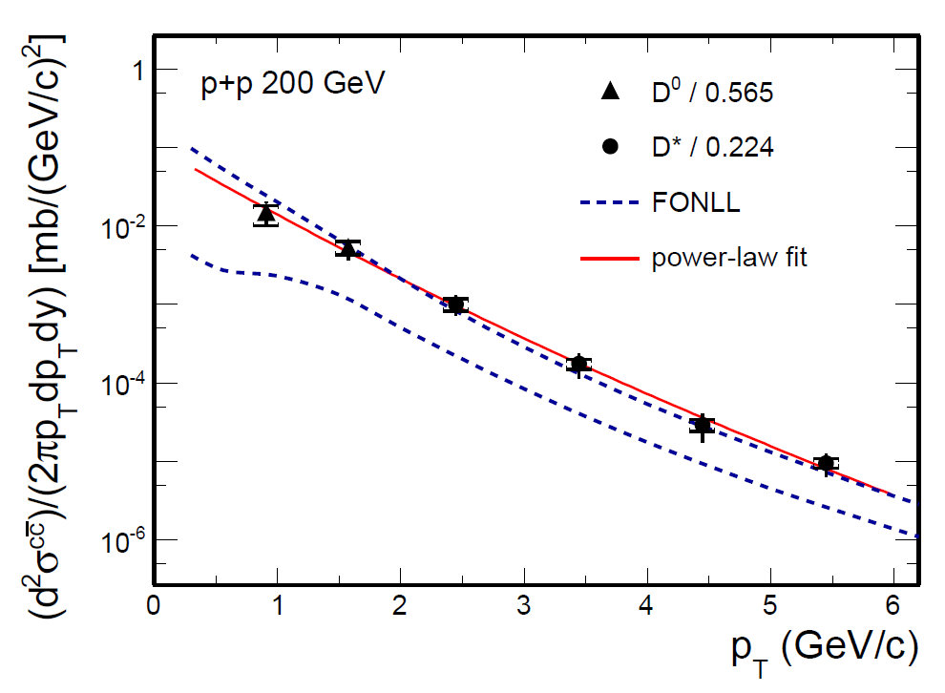
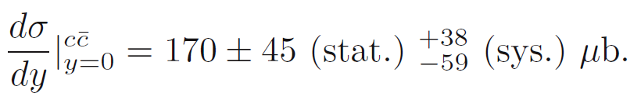
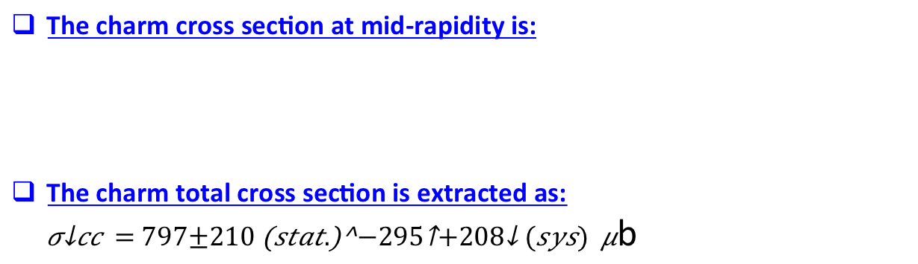
D⁰ and D* p_{T} spectra in p+p 200 GeV
D⁰ scaled by N_{cc} / N_{D0} = 1 / 0.56^{[1]}
D* scaled by N_{cc} / N_{D*} = 1 / 0.22^{[1]}
Consistent with FONLL^{[2]} upper limit.
Xsec = dN/dy|^{cc}_{y=0} × F × σ_{pp}
F = 4.7 ± 0.7 scale to full rapidity.
[1] C. Amsler et al. (PDG), PLB 667 (2008) 1.
[2] FONLL: M. Cacciari, PRL 95 (2005) 122001.
The charm cross section at mid-rapidity is:
The charm total cross section is extracted as:
b
STAR arXiv:1204.4244.
6

Slide 7
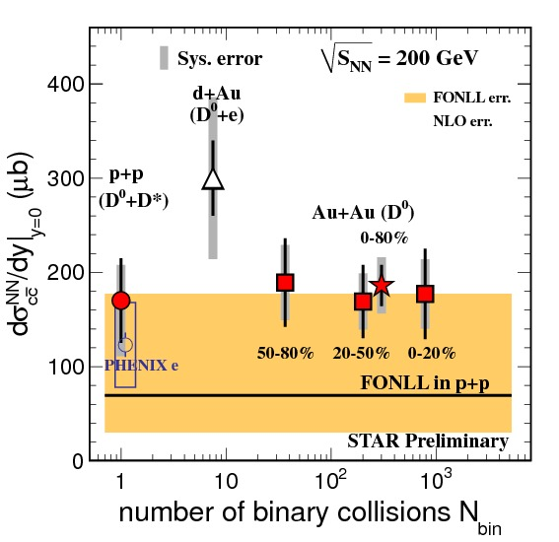
Charm cross section vs. N_{bin}
YiFei Zhang, JPG 38, 124142 (2011)
arXiv:1204.4244.
All of the measurements are consistent.
Year 2003 d+Au : D⁰ + e
Year 2009 p+p : D⁰ + D*
Year 2010 Au+Au: D⁰
.
Charm cross section in Au+Au 200 GeV:
Mid-rapidity:
  186 ± 22 (stat.) ± 30 (sys.) ± 18 (norm.) μb
Total cross section:
  876 ± 103 (stat.) ± 211 (sys.) μb
[1] STAR d+Au: J. Adams, et al., PRL 94 (2005) 62301
[2] FONLL: M. Cacciari, PRL 95 (2005) 122001.
[3] NLO: R. Vogt, Eur.Phys.J.ST 155 (2008) 213
[4] PHENIX e: A. Adare, et al., PRL 97 (2006) 252002.
Charm cross section follows number of binary collisions scaling =>
Charm quarks are mostly produced via initial hard scatterings.
7
Notes:
Assuming N_{D0} / N_{cc} = 0.56 does not change (fragmentation functions.

Slide 8
Quarkonium Production
We have additional heavy probes, other than charms, to get a more complete picture of its properties, e.g. Upsilons as a probe of the temperature.
Cleaner Probe compared to J/psi:
recombination can be neglected at RHIC
Final state Co-mover absorption is small.
  Expectation ϒ(1S) no melting, ϒ(3S) melts
Consistent with the melting of all excited states.
Notes:
Example of the

Slide 9
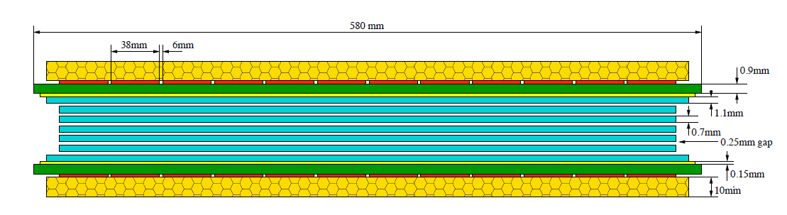
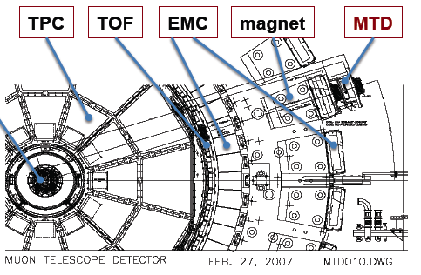
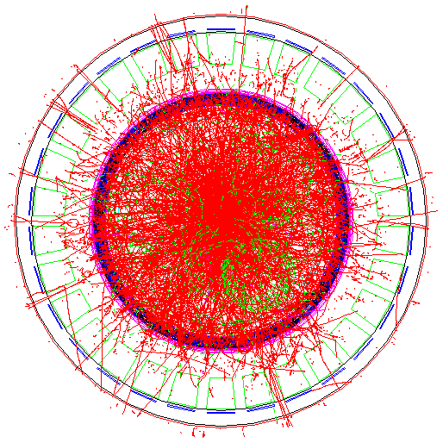
Muon Telescope Detector (MTD)
Use the magnet steel as absorber and TPC for tracking.
Acceptance: |η|<0.5 and 45% in azimuth
118 modules, 1416 readout strips, 2832 readout channels
Long-MRPC detector technology,
HPTDC electronics (same as STAR-TOF)
~43% for run 2013 and Complete for run 2014
Notes:
9

Slide 10
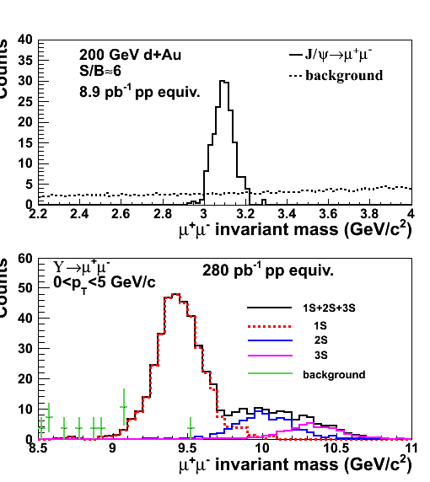
Quarkonium from MTD
J/ψ: S/B=6 in d+Au and S/B=2 in central Au+Au
Excellent mass resolution: separate different upsilon states
With HFT, study B→J/ψ X; J/ψ→μμ using displaced vertices
Heavy flavor collectivity and color
screening, quarkonia production
mechanisms:
J/ψ R_{AA} and v₂; upsilon R_{AA} …
Z. Xu, BNL LDRD 07-007; L. Ruan et al., Journal of Physics G: Nucl. Part. Phys. 36 (2009) 095001

Slide 11
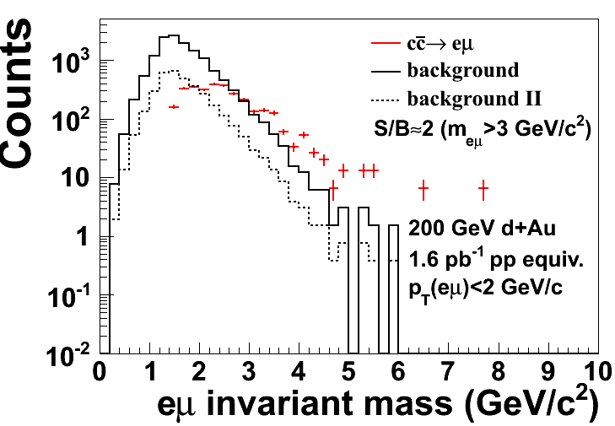
Measure charm correlation with MTD upgrade: ccbar→e+μ
An unknown contribution to di-electron mass spectrum is from ccbar. Can be disentangled by measurements of eμ correlation.
simulation with Muon Telescope Detector (MTD) at STAR from
ccbar: S/B=2 (M_{eu}>3 GeV/c2 and p_{T}(eμ)<2 GeV/c)
S/B=8 with electron pairing and tof association

Slide 12

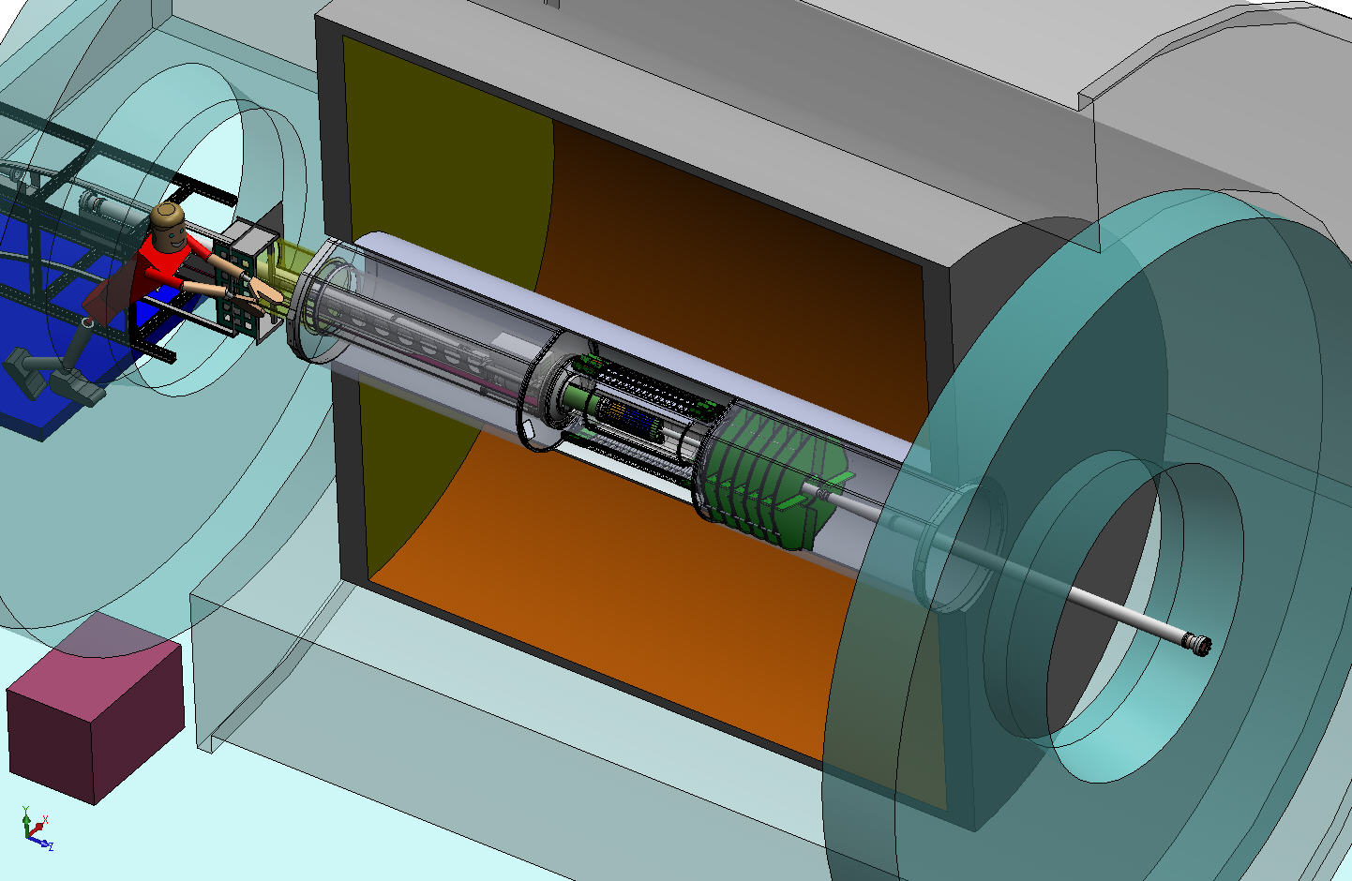
Heavy Flavor Tracker (HFT)
HFT
Detector | Radius (cm) | Hit Resolution R/ϕ - Z (μm - μm) | Radiation length
SSD | 22 | 30 / 860 | 1% X₀
IST | 14 | 170 / 1800 | 1.5 %X₀
PIXEL | 8 | 12/ 12 | ~0.4 %X₀
 | 2.5 | 12 / 12 | ~0.4% X₀
SSD
IST
PXL
Inner Field Cage
PIXEL
two layers
18.4x18.4 μm pixel pitch
10 sector, delivering ultimate pointing resolution that allows for direct topological identification of charm.
new monolithic active pixel sensors (MAPS) technology
Magnet
Return Iron
Outer Field Cage
FGT
SSD
existing single layer detector, double side strips (electronic upgrade)
IST one layer of silicon strips along beam direction, guiding tracks from the SSD through PIXEL detector. - proven strip technology
TPC Volume
Solenoid
EAST
WEST

Slide 13
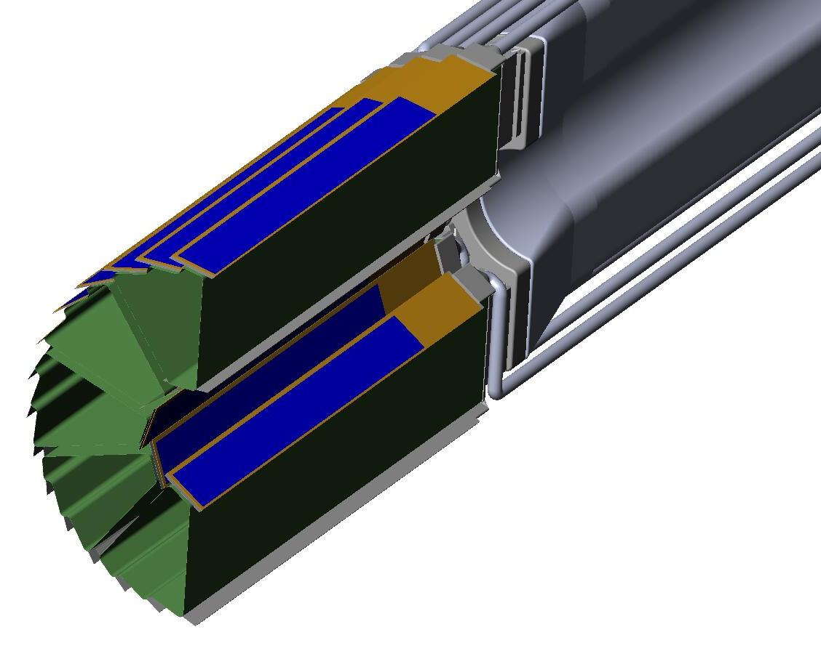
PXL Detector Design
Carbon fibre sector tubes (~ 200µm thick)
Ladder with 10 MAPS sensors (~ 2×2 cm each)
Aluminum conductor Ladder Flex Cable
20 cm
The Ladders will be instrumented with sensors thinned down to 50 micron Si
Novel rapid insertion mechanism allows for dealing effectively with repairs.

Slide 14
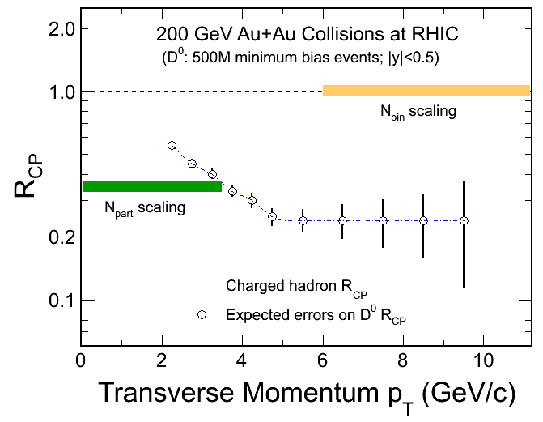
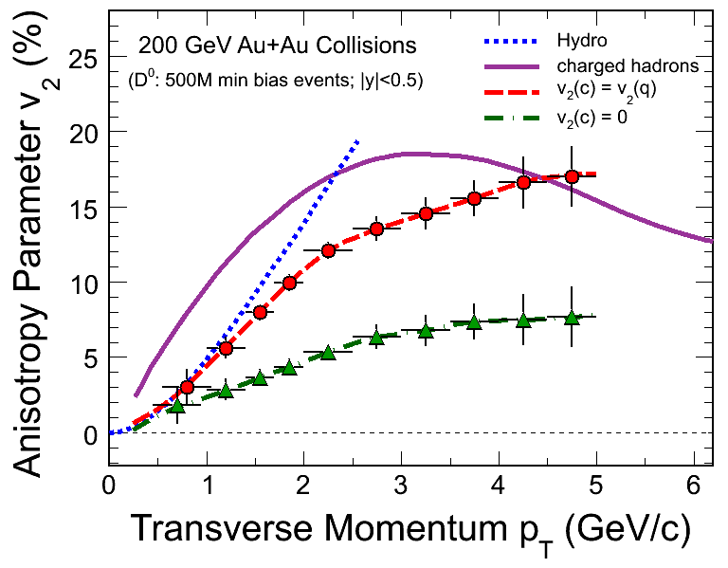
Production and flow of Topological Reconstructed Charm
R_{CP}=a*N^{10%}/N^{(60-80)%}
Open charm can be used to test and quantify in-medium absorption, and collectivity
Nuclear modification factors for D⁰ can be obtained by fully topological reconstruction.
HFT is optimized to reconstruct D⁰ in the region 0.75-2 GeV/c where hydro flow is dominant.
Data set can be obtained in one longer RHIC Au-Au run.
Notes:
50KHz *0.5*0.2 * 500M/500Hz = 5e9, is the STAR sampled minbias events at |Vz|<5cm which is 5e9/10b = 500ub⁻¹. In the mean time, RHIC delivered 50KHz *500M/500Hz = 5e10 events, i.e. 5nb⁻¹.
In another word, average prescale factor is 50KHz *0.5*0.2 /500Hz = 10, i.e. sampled mb is 500M*10 = 5e9.

Slide 15
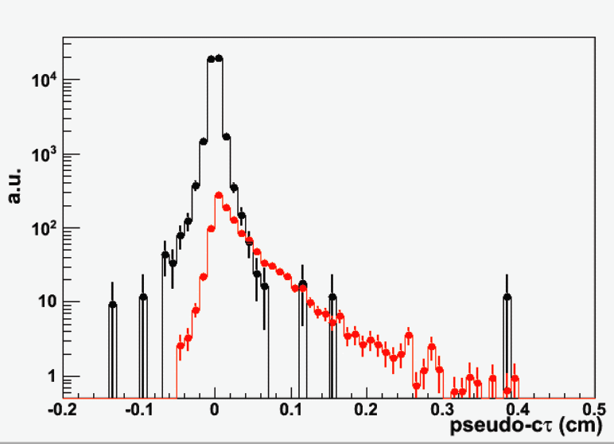
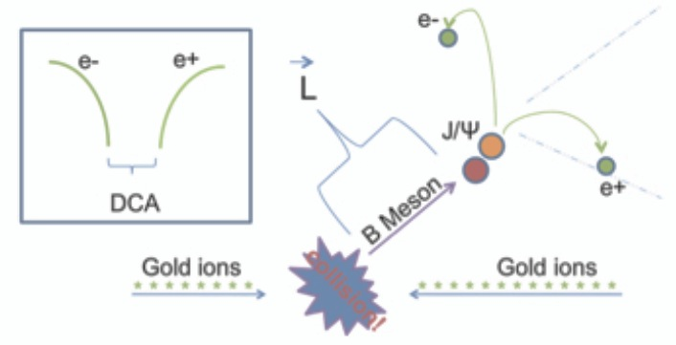
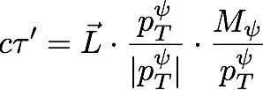
B→J/ψ + X with HFT+TPC+MTD
Prompt J/ψ
J/ψ from B
Cleanest sampling of B meson decays. Will allow to measure Nuclear modification for B.
B→J/ψ→ee suffer from low trigger efficiency.
A much better measurements: B→J/ψ->µµ
  not limited by triggers
  Less brehmstrahlung, leading to higher B meson ID efficiency
Notes:
Is the time estimate correct? Does it take into account the +-10 cm vertex cut we have to make

Slide 16
HFT Project Status
HFT upgrade was approved CD2/3 October 2011, and is well into fabrication phase
All detector components has passed the prototype phase successfully
A PXL prototype with 3+ sectors instrumented is planned for an engineering run and data taking in STAR in early 2013
The full assembly including PXL, IST and SSD should be available for RHIC run-14

Slide 17
Summary
Initial Heavy flavor measurements performed by STAR
Further high precision measurements needed
HFT upgrades will provide direct topological reconstruction for charm
MTD will provide precision Heavy Flavor measurements in muon channels.
Notes:
Work on this…

