Slide 1
Higher Moments of
Net-Particle Multiplicity Distributions
Jochen Thäder
on behalf of the STAR Collaboration
Lawrence Berkeley National Laboratory
Quark Matter 2015, Kobe, Japan
Notes:
Status Summary of STAR Higher Moments

Slide 2
Search for the QCD Critical Point
Exploring the QCD Phase Diagram
Critical Point: Endpoint of the first order phase transition
RHIC Beam Energy Scan Phase 1 (BES I) vary temperature T and baryon chemical potential μB
Event-by-event fluctuations of conserved quantities to study of the phase transition
Charge Q / baryon number B / strangeness S
Experimental observables:
Cumulants of event-by-event net-particle multiplicity distributions: Net-charge / net-proton (proxy for net-baryon) / net-kaon (proxy for net-strangeness)
Volume independent cumulant ratios
STAR Note 0598
Notes:
In high energy nuclear collisions we have clear evidence at QGP at vanishing μB
There is a phase transition …at the high baryon region, model calculations speculate a first-order phase transition.
If both are true, there must be a critical point

Slide 3
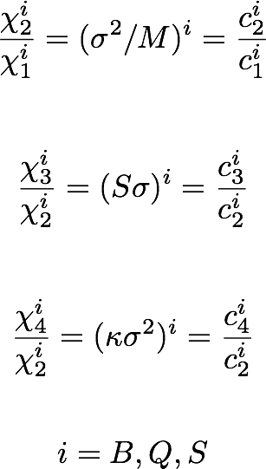
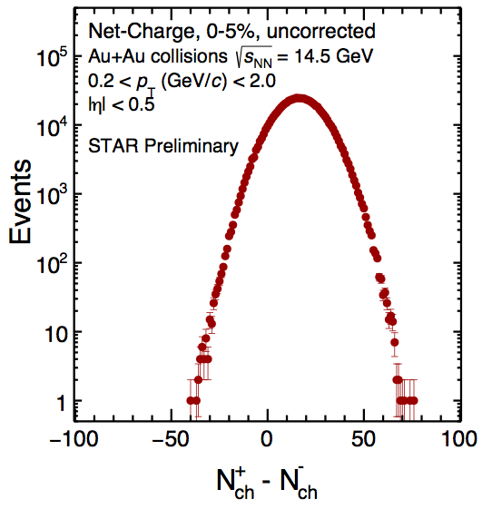
Connection to Theoretical Calculations
Freeze Out Parameters
Susceptibility ratios of conserved quantities are assumed to be related to the moments of experimentally measurable multiplicity distributions
Comparing first principal Lattice calculations with measured moments of conserved quantities, e.g. net-charge → extract the chemical freeze out parameters T and μB
Lattice QCD
Experiment
HotQCD, PRL109, 192302 (2012)
WB Group, PRL111, 062005 (2013)
Notes:
Allows to link experiments with theory calculations
Thermodynamical comparison with Statistical model allows extraction of Temperature and mu_B only on first order → here more orders
Partition function describes Thermodynamical system
→ susceptibility → allows to be tested by experiment
Look for critical behavior

Slide 4
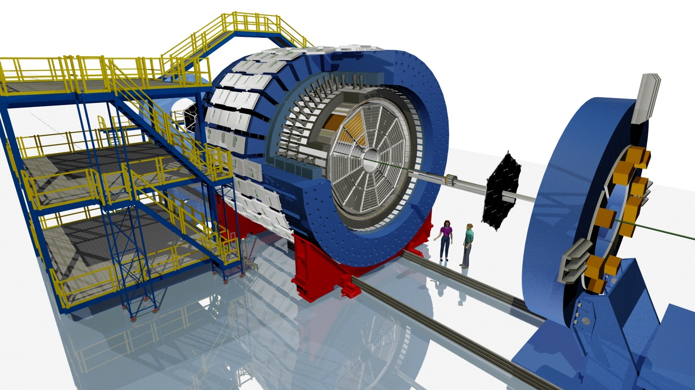
The STAR detector
Full azimuthal coverage, |η| < 1 → excellent PID, large uniform acceptance
Time-Of-Flight detector
PID (time-of-flight)
Time Projection Chamber
Tracking, PID (dE/dx), vertexing,
multiplicity
Beam-Beam Counter
Minimum-bias trigger

Slide 5
Analysis Details
test
RHIC Beam Energy Scan Phase I (BES I)
Au+Au √sNN : 7.7, 11.5, 14.5, 19.6, 27, 39, 62.4, and 200 GeV
Event Selection
Minimum bias trigger
Pile up removal with TOF
0-80% Centrality
Track selection
Good primary particles with sufficient length in the TPC DCA to primary vertex < 1 cm
Kinematic cuts (next slide)
Efficiency * acceptance corrections done
μB, T : J. Cleymans et al., PRC 73, 034905 (2006)

Slide 6
Analysis Details
test
STAR, Phys. Rev. Lett. 112, 032302 (2014)
STAR, Phys. Rev. Lett. 113, 092301 (2014)
TPC
p
p
K
K
π
π
TOF

Slide 7
Analysis Method
A. Bzdak and V. Koch, PRC86, 044904 (2012)
A. Bzdak and V. Koch, PRC91, 027901 (2015)
X. Luo, PRC91, 034907 (2015)
Apply correction on raw net-particle distributions
Finite Tracking / PID efficiency → Factorial Moments
Volume fluctuations
Remove auto-correlation effects
Net-Charge
Average efficiency for particle/anti-particles
Net-Proton / Net-Kaon
pT dependent efficiency (2 pT efficiency bins)

Slide 8
Analysis Method
Error Estimation
X. Luo, PRC91, 034907 (2015)
Statistical Errors based on Delta Theorem
With same N events:
error(net-charge) > error(net-kaon) > error(net-proton)
Protons are the favored probe
Systematic error estimation
Includes uncertainties on efficiency and efficiency fluctuations
PID and track cuts

Slide 9
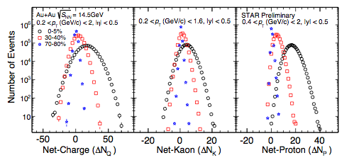
Event-By-Event Net-Particle Multiplicity Distribution
Au+Au collisions at √sNN = 14.5 GeV
Uncorrected raw event-by-event net-particle multiplicity distribution for Au+Au collisions at √sNN = 14.5 GeV
Notes:
We show as an example the 14.5 data …

Slide 10
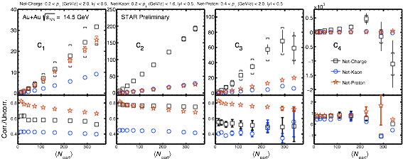
Corrected Cumulants
Au+Au collisions at √sNN = 14.5 GeV
Correction smallest for net-protons for all cumulants
Corrections approximately flat with <Npart>

Slide 11
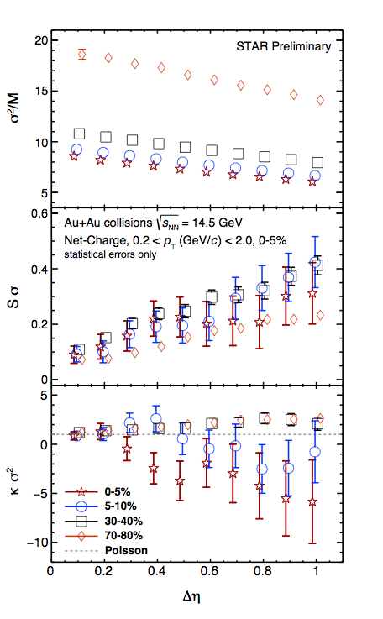
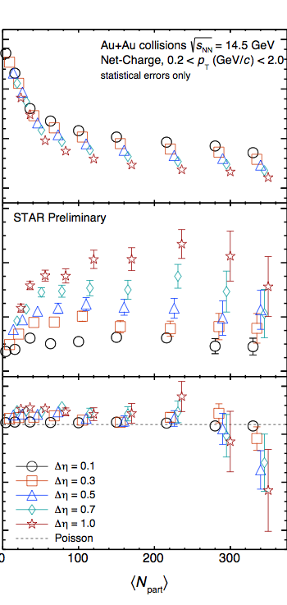
Net-Charge – Δη Dependence
Au+Au collisions at √sNN = 14.5 GeV
S. Jeon, V. Koch, arXiv:hep-ph/0304012
V. Koch, arXiv:0810.2520
M. Kitazawa, Nucl. Phys. A942 (2015) 65-96
M. Sakaida et al, PRC90 (2014) 6, 064911
t
∆η dependence of fluctuation observables encode history of the hot medium
Smooth trend for σ²/M, Sσ and κσ² with increasing Δη
Different trend of κσ² for central and peripheral collisions vs Δη
The smaller the ∆η window, the closer to poisson expectation
Ordering in Δη vs <Npart> for σ²/M, Sσ and κσ² observed
Δη
z

Slide 12
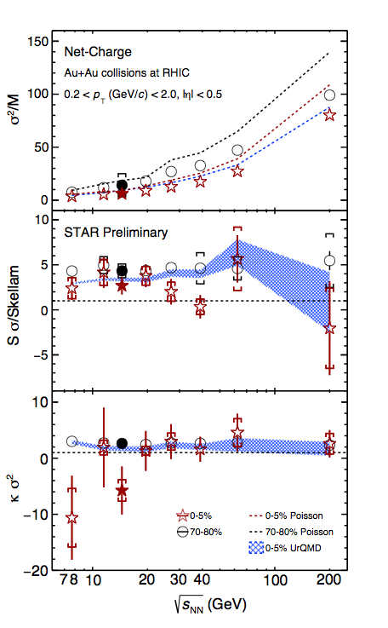
Corrected Cumulant Ratio of Net-Charge
Collision Energy Dependence
14.5 GeV data-point added to published Phys. Rev. Lett. 113, 092301 (2014)
Fits well into trends
σ²/M increases with increasing collision energy
For most central collisions (0-5%), κσ² and Sσ/Skellam are consistent with unity
UrQMD (no Critical Point), shows no energy dependence

Slide 13
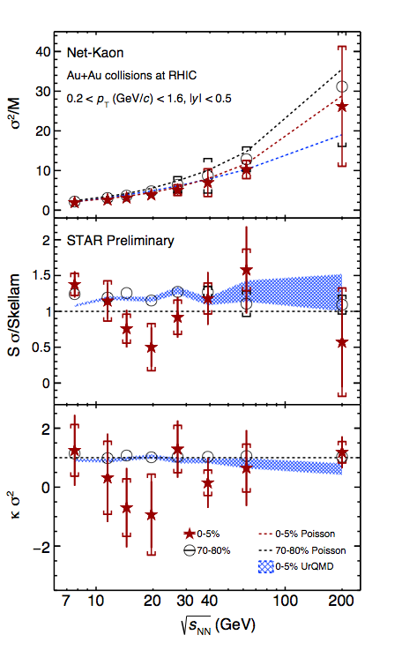
Corrected Cumulant Ratio of Net-Kaon
Collision Energy Dependence
σ²/M increases with energy
σ²/M and Sσ/Skellam are consistent with the Poisson expectation for most central collisions
For most central collisions (0-5%), κσ² is consistent with unity (= Poisson expectation)
More statistics needed
UrQMD (no Critical Point), shows no energy dependence
See Poster Ji Xu
Board ID 0127, Ex4

Slide 14
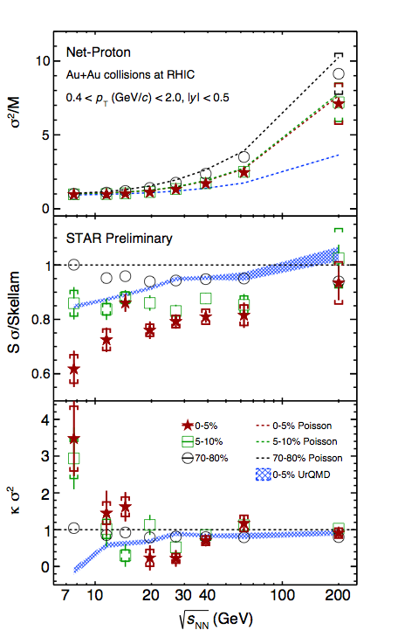
Corrected Cumulant Ratio of Net-Proton
Collision Energy Dependence
σ²/M increases with increasing energy, consistent with Poisson expectation
Sσ/Skellam increases with increasing energy
Non-monotonic behavior of net-proton κσ² seen in top 5% central collisions
5-10% central collisions in between
→ however: smooth trend in centrality
Peripheral collisions show smooth trend
Detailed extensive studies have been carried out and are still in progress
UrQMD (no Critical Point), shows suppression at lower energies - due to baryon number conservation
Notes:
19.6 GeV is 1.88 sigma from baseline 1
27 GeV is 3.0 sigma from baseline 1

Slide 15
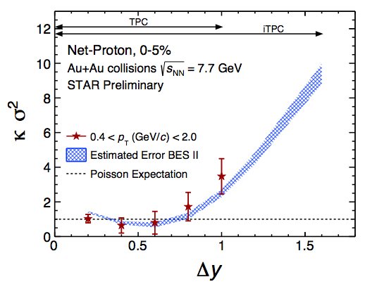
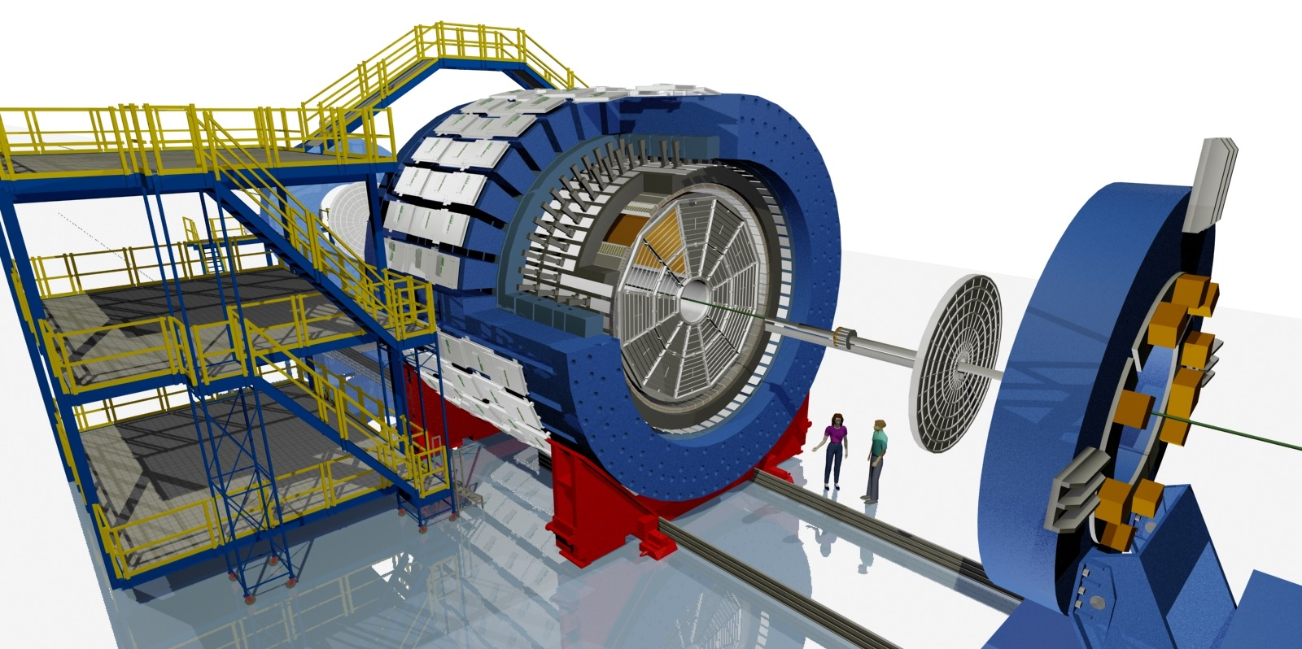
Plans for Beam Energy Scan Phase II
(2019-2020)
Event Plane Detector
endcap TOF
inner TPC
Larger rapidity acceptance crucial for further critical point search with net-protons
iTPC Upgrade
Replace aging wires
Full pad coverage → better dE/dx
-1.5 < η < 1.5
pT > 60 MeV/c
EPD Upgrade
Replaces aging BBC
Event centrality
→ Suppress auto-correlation
Better trigger & b/g reduction
-4.5 < η < -1.8 , 1.8 < η < 4.5
eTOF
Larger rapidity coverage
Extends PID in forward direction
1.05 < η < 1.5

Slide 16
Summary and Outlook
test
New results for √sNN = 14.5 GeV Au+Au collisions for net-charge, net-kaon, and net-proton
New results of energy and centrality dependence of net-kaon
Study of pseudo-rapidity dependence shows that acceptance is crucial for the critical point search
Non-monotonic behavior seen in net-proton κσ²
RHIC Beam Energy Scan II will bring larger event sample and wider phase-space to boost the critical point search

Slide 17
Thank you !!

