Slide 1
Identification of Pions, Kaons, and Protons in Photonuclear Events at STAR
Nicole Lewis
Brookhaven National Lab
Division of Nuclear Physics 2021
Supported by:

Slide 2
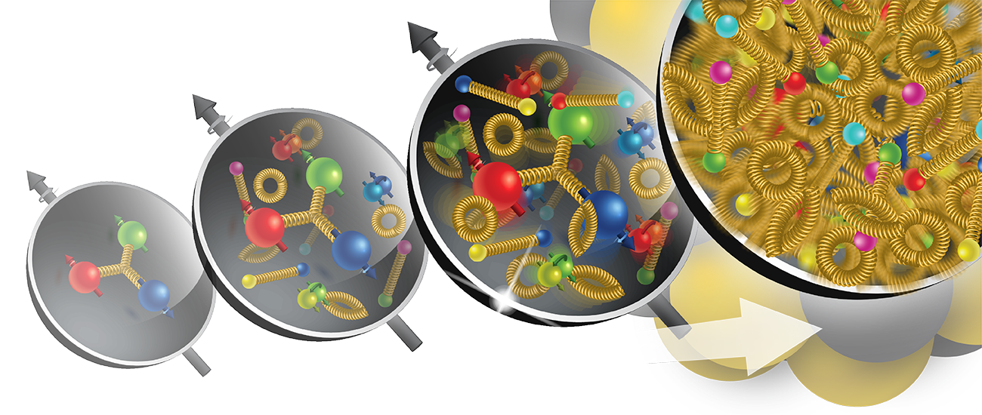
One of the major goals of RHIC and the EIC is to understand the behavior of gluons within the nucleon
Energy
Baryon number – a strictly conserved quantum number
Believed to be carried by the quarks:
$$B=\frac{1}{3}\left(n_{q}−n_{\overline{q}} \right)$$
But that is just an assumption
D. Kharzeev, Physics Letters B 378, 238-246 (1996)
$$1/3$$
$$1/3$$
$$1/3$$

Slide 3
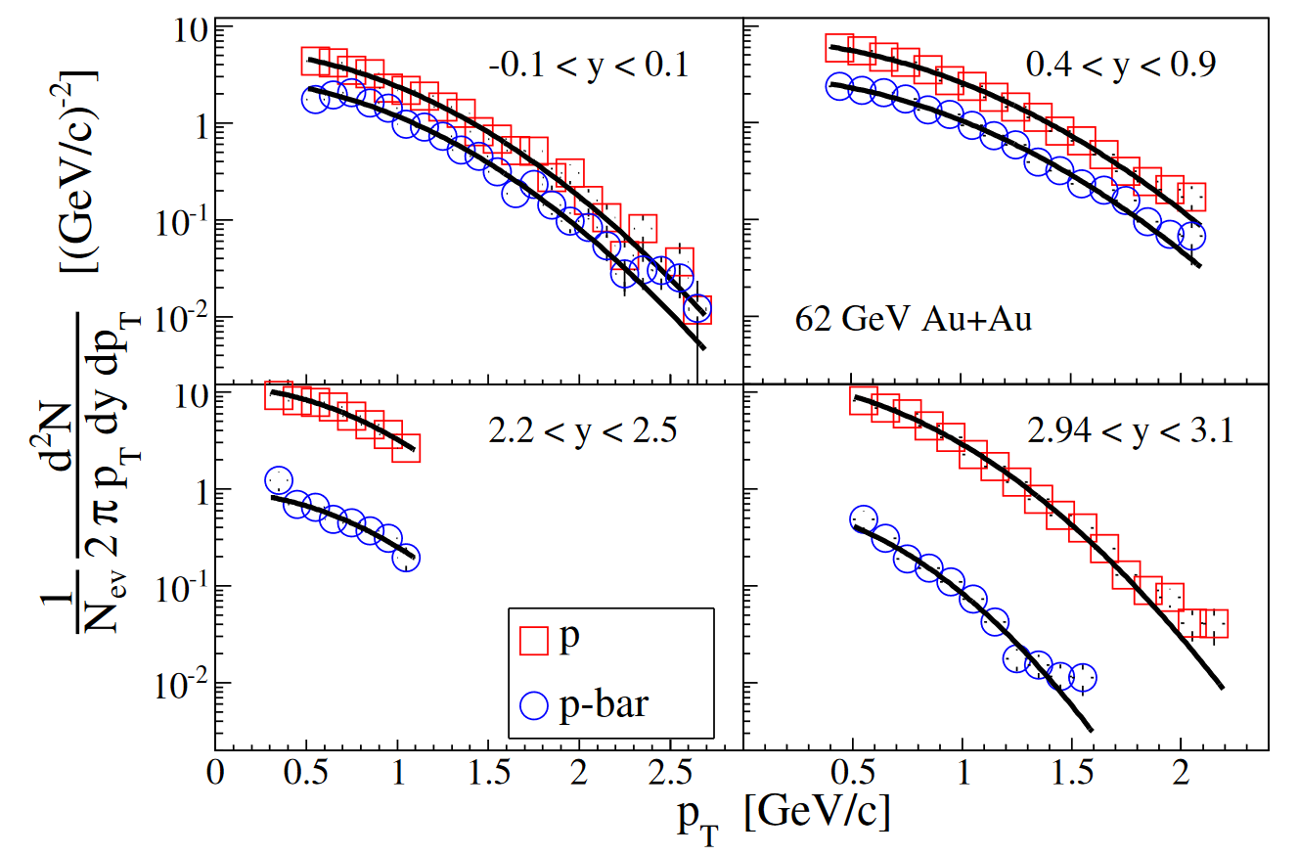
Baryon Stopping
The energy required for producing the particles in heavy-ion collisions comes from the kinetic energy lost by the baryons in the colliding nuclei
Larger effect in collisions with higher multiplicity (small impact parameter)
Net-baryon yield can be estimated from the net-proton yield: difference in number of protons and anti-protons
Cannot be fully explained by pure string fragmentations
BRAHMS Collaboration, Phys. Lett. B 677, 267-271 (2009)

Slide 4
Baryon Junction
Nonperturbative configuration of gluons linked to all three valence quarks
Carries the baryon number
Theorized to be an effective mechanism of stopping baryons in $pp$ and $AA$
D. Kharzeev, Physics Letters B 378, 238-246 (1996)
Many of the models used for heavy-ion collisions at RHIC (HIJING, AMPT, UrQMD) have implemented a nonperturbative baryon stopping mechanism
V. Topor Pop, et al, Phys. Rev. C 70, 064906 (2004)
Zi-Wei Lin, et al, Phys. Rev. C 72, 064901 (2005)
M. Bleicher, et al, J.Phys.G 25, 1859-1896 (1999)
But no signature of baryon junction has been cleanly identified in the experiment

Slide 5
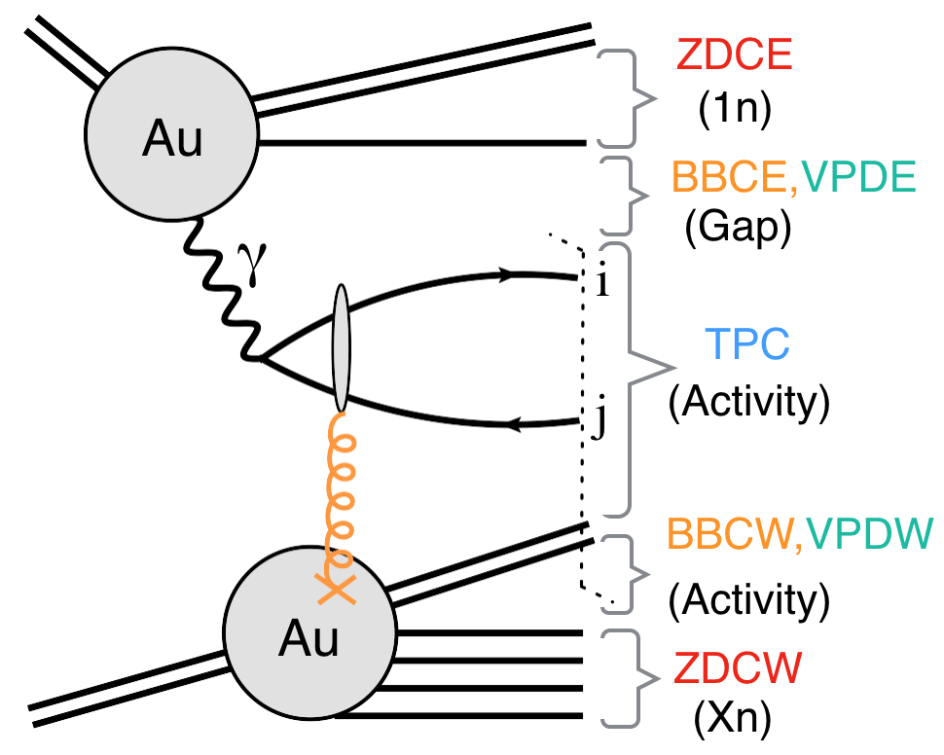
Photonuclear Events
Inclusive particle production in photonuclear collisions
Large flux of quasi-real photons produced by ultra-relativistic large-Z nuclei
Similar to $e+A$collisions except that the photon tends to have a much smaller virtuality
Can be used to study bulk properties such as collectivity from initial-state effects (i.e. radial flow, rapidity correlation) and hadron chemistry
Can be used to study baryon stopping with the cleanest possible process ($q\overline{q}$ + Baryon Junction producing a midrapidity proton)
Low $p_{T}$ rapidity distribution of $dN/dy∝\exp\left(−y/2\right)$

Slide 6
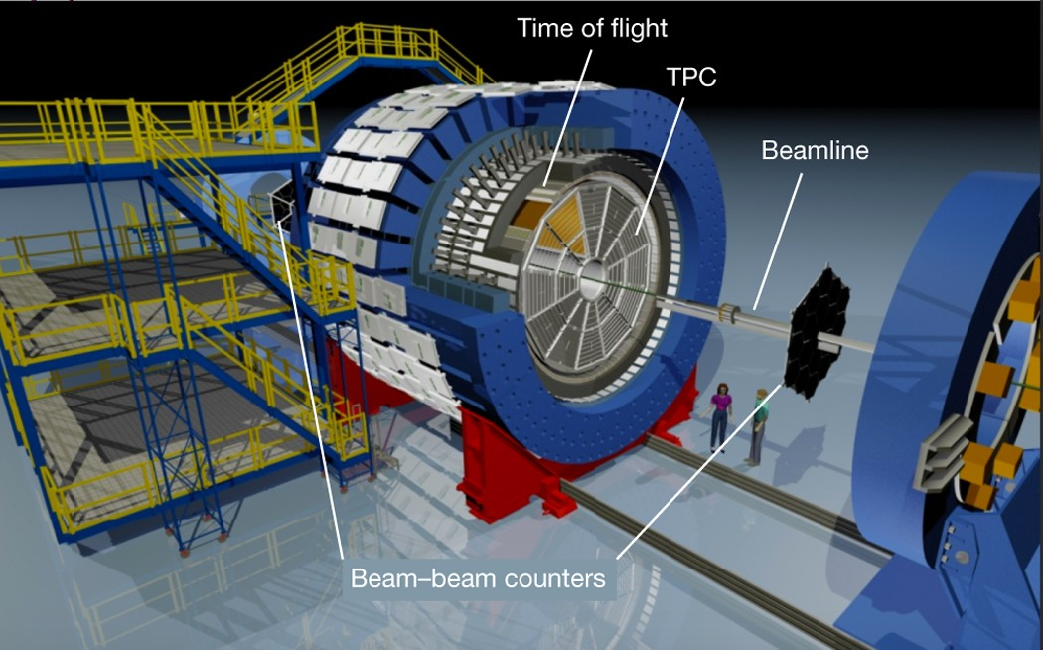
Particle Identification With STAR
Time Projection Chamber (TPC) identifies particles at lower $p_{T}$ using ionization energy loss, $dE/dx$
Time of Flight (TOF) identifies particles at higher $p_{T}$
Beam-Beam Counter (BBC) used for rapidity gap cuts
Data collected in 2017,
$Au+Au$collisions with $\sqrt{s_{NN}}=54 GeV$, trigger did not require coincidence in both sides of the detector
~700 million events

Slide 7
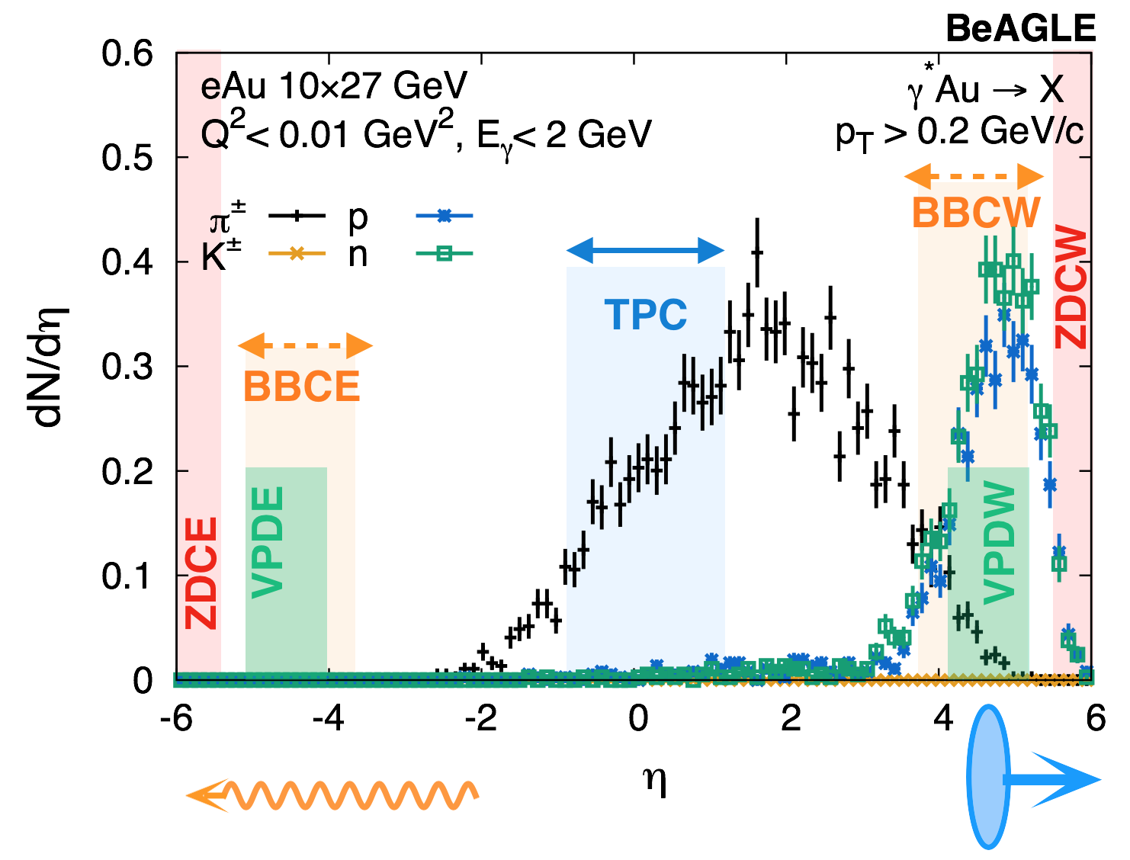
Photonuclear Events Are Selected With Rapidity Gaps
Similar technique used by ATLAS photonuclear measurements:
ATLAS Collaboration, Nuclear Physics A 967, 277 (2017)
ATLAS Collaboration, Phys. Rev. C 104, 014903 (2021)
Notes:
SLOWWW DOWN describe the right diagram
Using $eA$ to simulate $γA$ by keeping the virtuality small and setting the photon energy to be comparable to the size of the Au ion

Slide 8
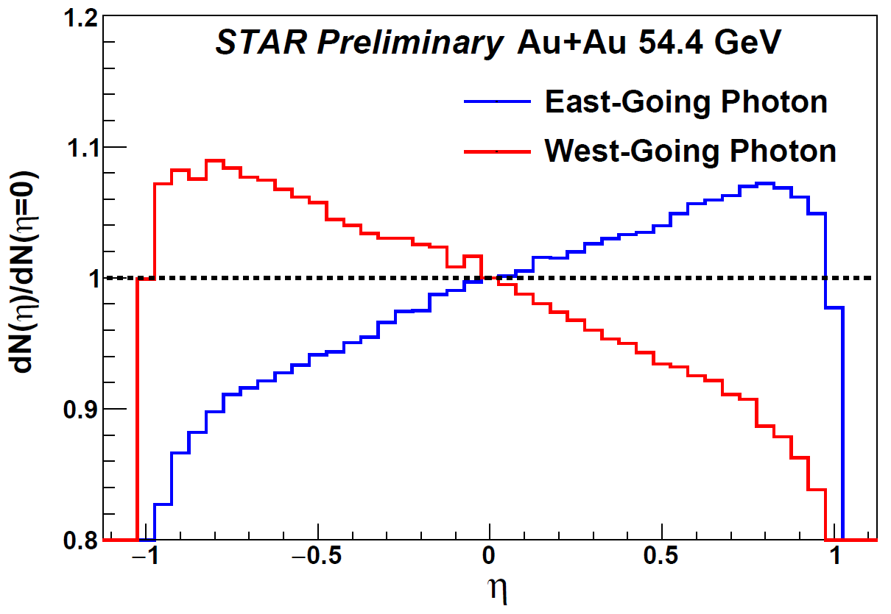
Rapidity Asymmetry in $γ+A$-Rich Events

Slide 9
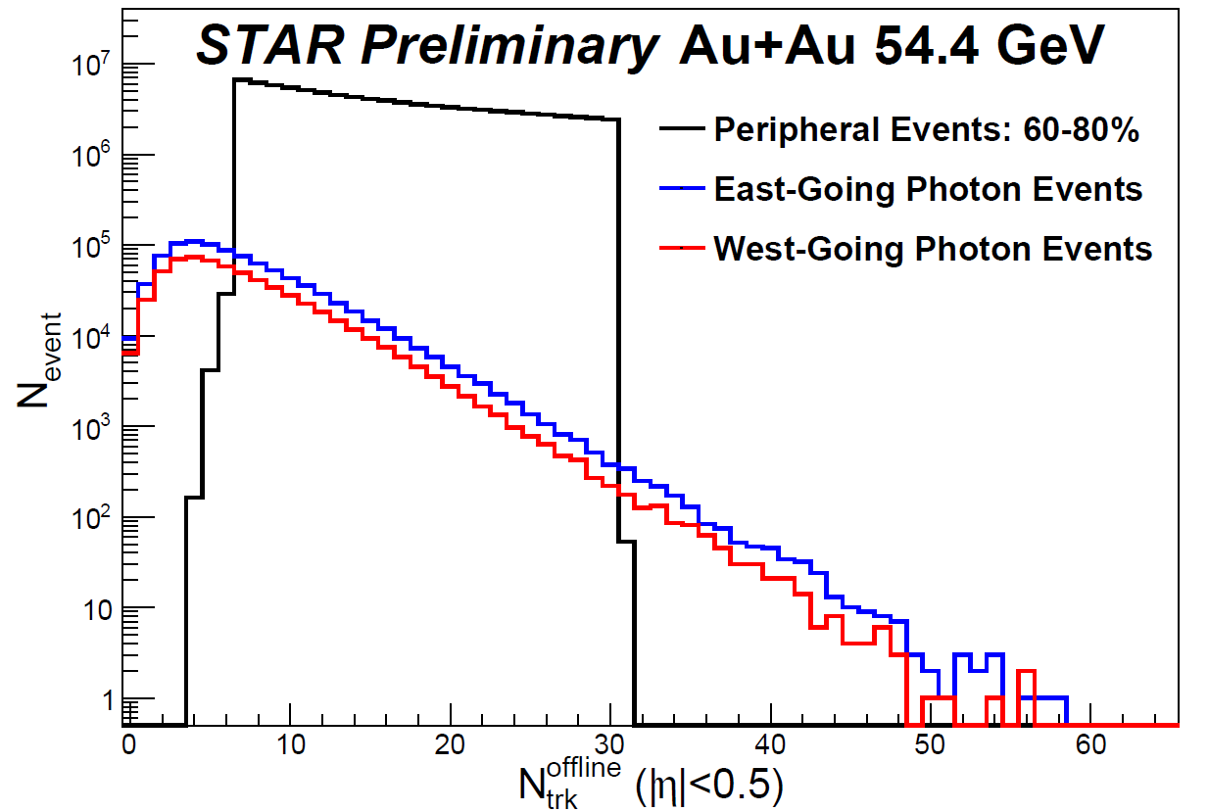
Defining $γ+A$ and $A+A$Event Classes
Most photonuclear events have low multiplicity, concentrated at equivalent $Au+Au$centrality of roughly $80$%
Using peripheral events as a baseline comparison, multiplicity consistent with $60−80\%$ $Au+Au$

Slide 10
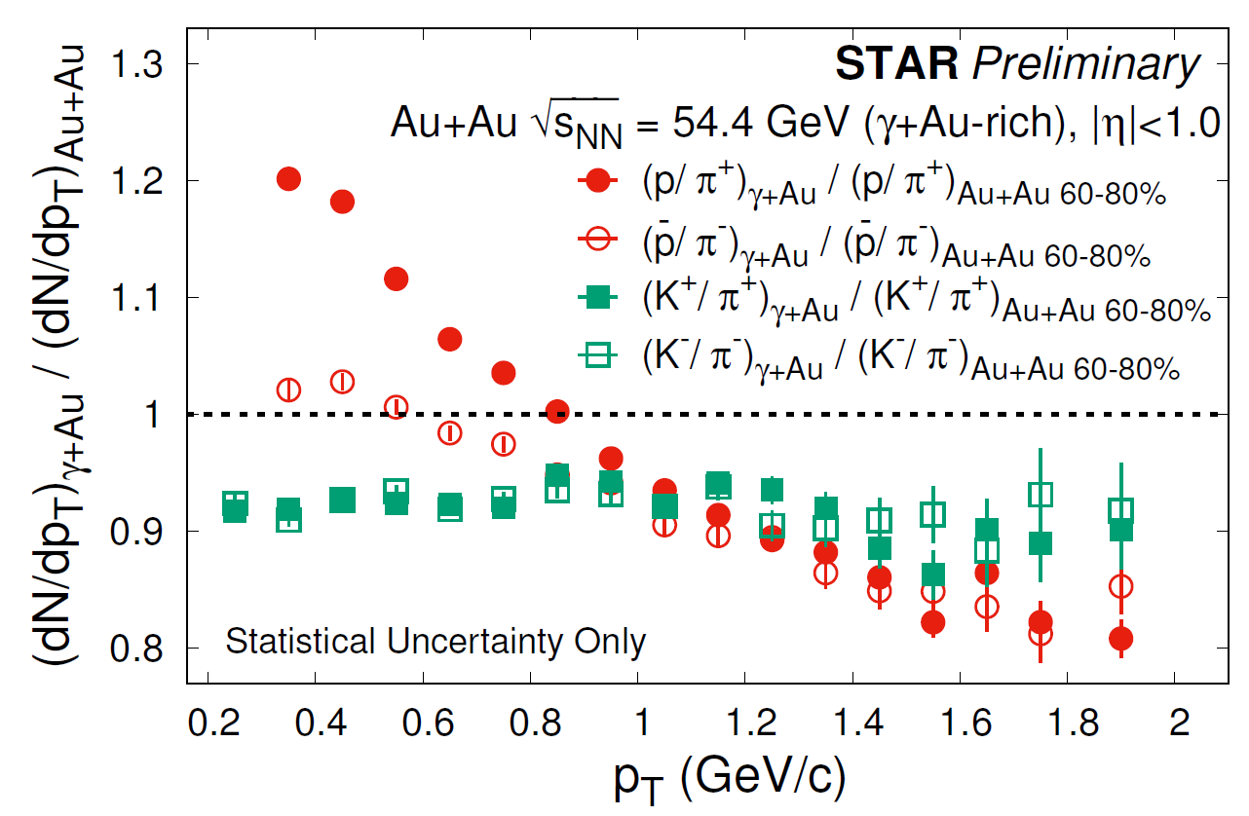
$p_{T}$ Dependence of Particle Ratios in $γ+A/A+A$
$k/π$ < 1 and flat with $p_{T}$
$→$ less access to strangeness in $γ+A$events
$\overline{p}/π$ and $p/π$ steeper than $K/π$
$→$ larger radial flow in $60−80\%$ $Au+Au$
$\overline{p}\text{/}π^{−}<p$/$π^{+}$ for $p_{T}≲1 GeV/c$
$→$ soft baryon stopping
Not corrected for efficiency, but largely canceled in the ratio

Slide 11
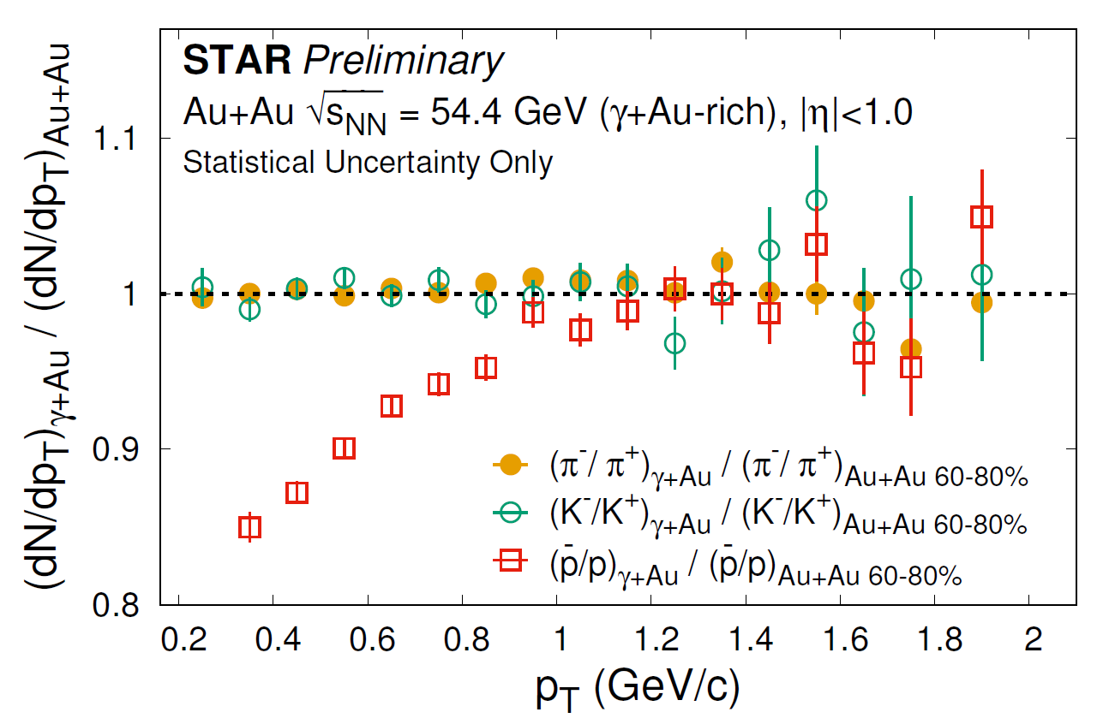
Low $p_{T}$ Baryon Enhancement in $γ+A$
Double ratio: antiparticle/particle in $(γ+A)/(A+A)$
$\overline{p}\text{/}p<1$ for $p_{T}≲1 GeV/c$
$→$ soft baryon stopping that is stronger in $γ+A$ compared to peripheral $A+A$

Slide 12
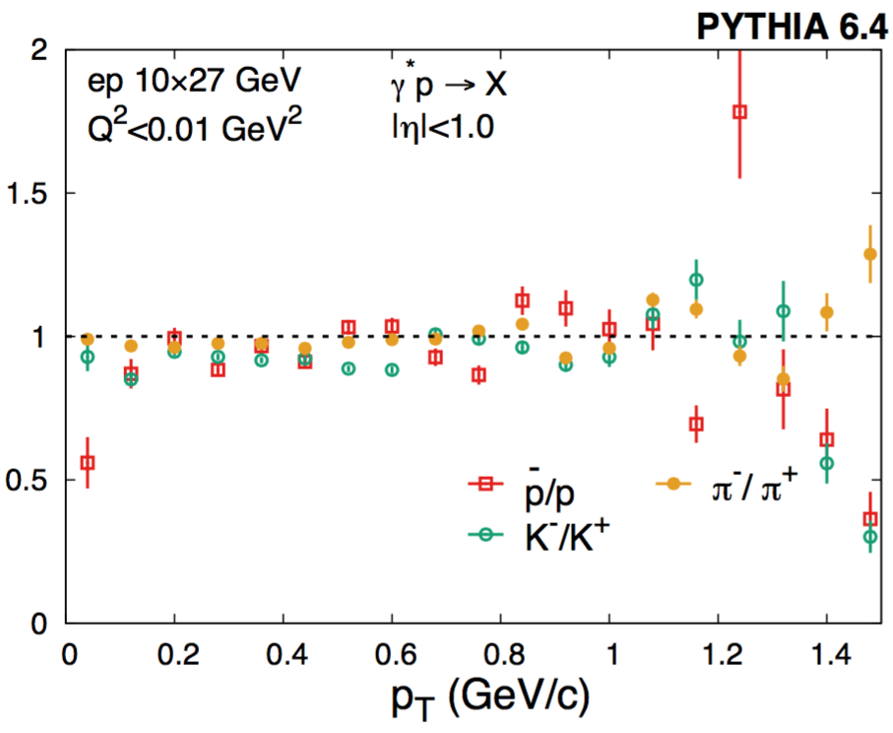
Comparison with PYTHIA
PYTHIA6 $γ^{∗}p→X$ simulation does not include a baryon junction $→$ pion, kaon, and proton ratios are all consistent with 1 within uncertainty
Possible explanation: photon fluctuates into a $q\overline{q}$ pair which is not able to stop all three valence quarks of the target baryon in the colliding ion
Baryon stopping can occur because the $q\overline{q}$ pair interacts directly with the baryon junction
Notes:
Double ratio vs single ratio

Slide 13
Summary
Studied identified particle spectra in photonuclear events via $\sqrt{s_{NN}}=54 GeV$ $Au+Au$ ultraperipheral collisions
Baryon stopping observed at low $p_{T}$
Possible evidence of a baryon junction existing inside nucleon
Next Steps
Measure these particle ratios as a function of rapidity and multiplicity
Measure the spectra and yields vs rapidity to compare with baryon junction prediction $\left(dN/dy∝\exp\left(−y/2\right)\right)$
Measure of azimuthal and rapidity correlations in photonuclear events
Unbiased $Au+Au$collisions from 2019 data set with $\sqrt{s_{NN}}=200 GeV$

Slide 14
Back Up

Slide 15
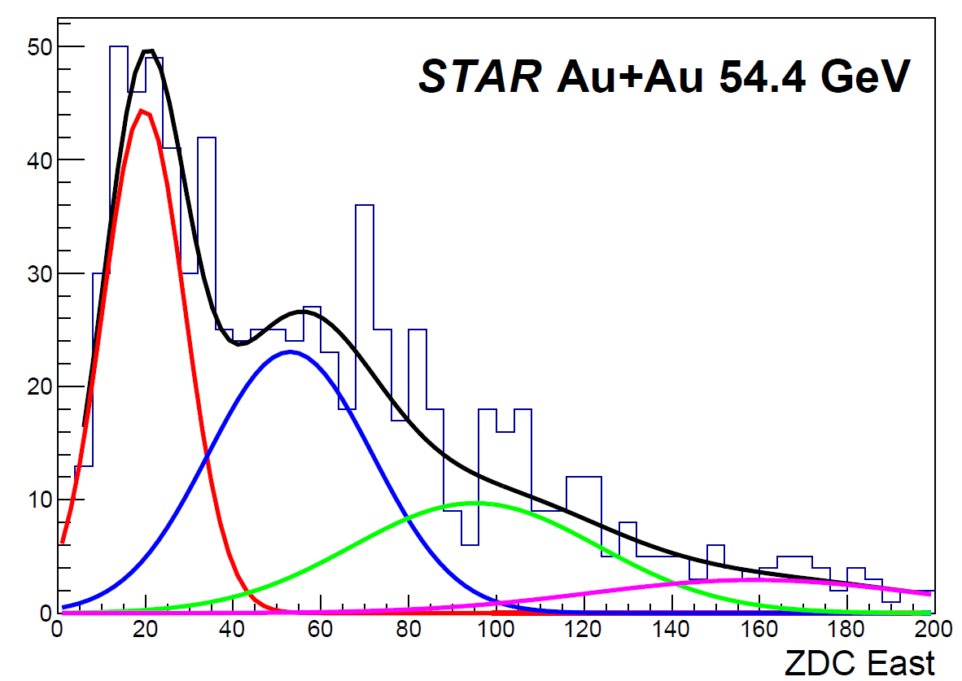
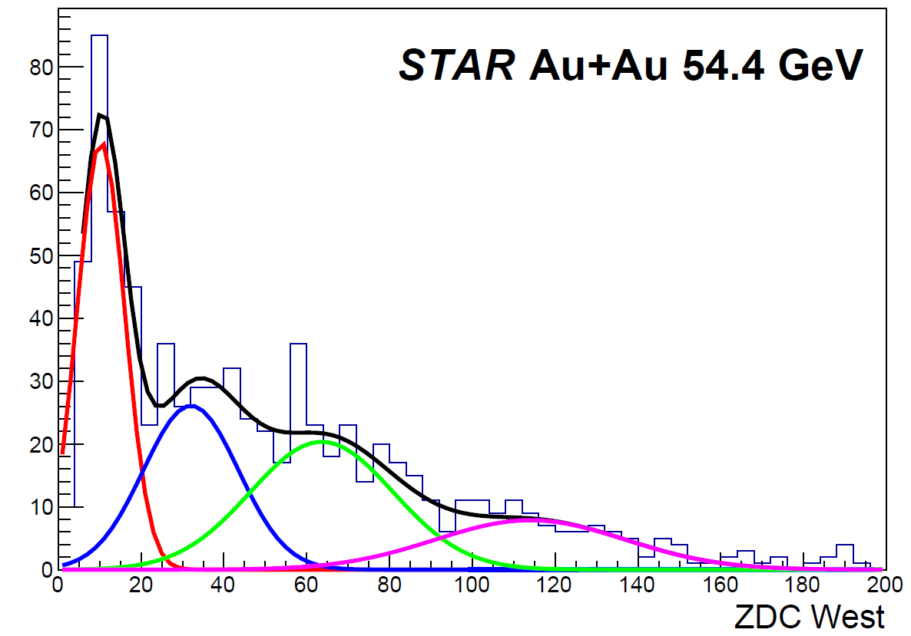
ZDC Spectra
Low multiplicity events collected with ZDC triggers
Cutting on single neutron peak, dominated by $γ+A$ events

Slide 16
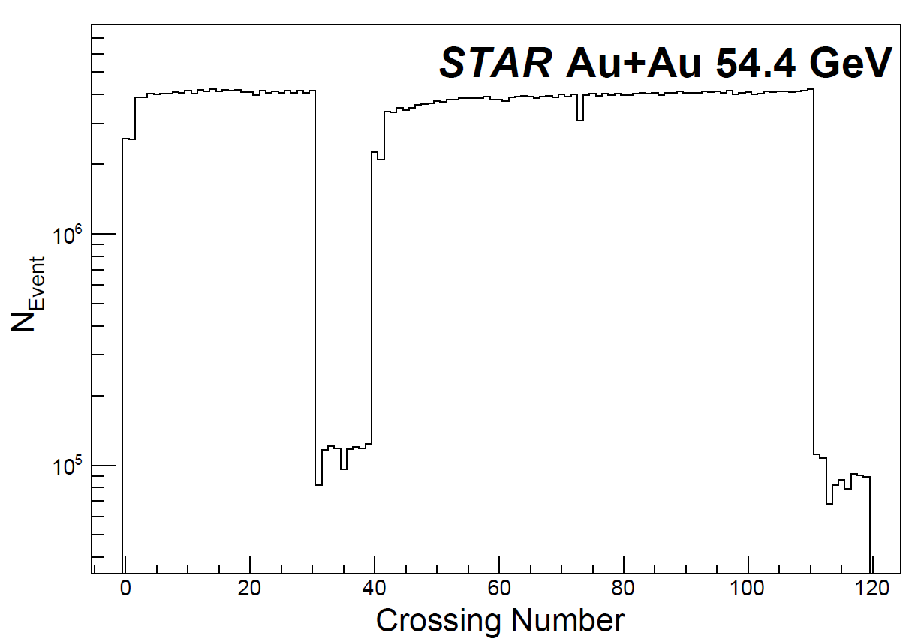
Study Beam Gas Background with Abort Gap Events
At STAR, 18 out of 120 crossings (31 to 39 and 111 to 119) have only one of the beams filled due to the abort gaps
Most abort gap events occur because of beam gas and beam material interactions
Only a small portion of these abort gap events pass our event cuts
Background contribution estimated to be about 3%
${\left(\overline{p}/p\right)}_{γ+Au}/{\left(\overline{p}/p\right)}_{Au+Au 60−80\%}$ ratio is flat with $p_{T}$ and consistent with 1 ratio for abort gap events which pass these cuts

