Slide 1


Measurements of azimuthal anisotropies in ¹⁶O+¹⁶O and 𝛾+Au collisions from STAR
Shengli Huang (for STAR Collaboration)
Stony Brook Chemistry

Slide 2
Outline
Poster 451 @ Zhengxi Yan
Motivation to study collectivity in O+O
O+O data set and analysis detail
v_{n}(p_{T}) in different centrality in O+O
v₂{2}, v₂{4} and v₃{2} vs centrality in O+O
Outlook: anisotropy in 𝛾+Au collision
Summary

Slide 3
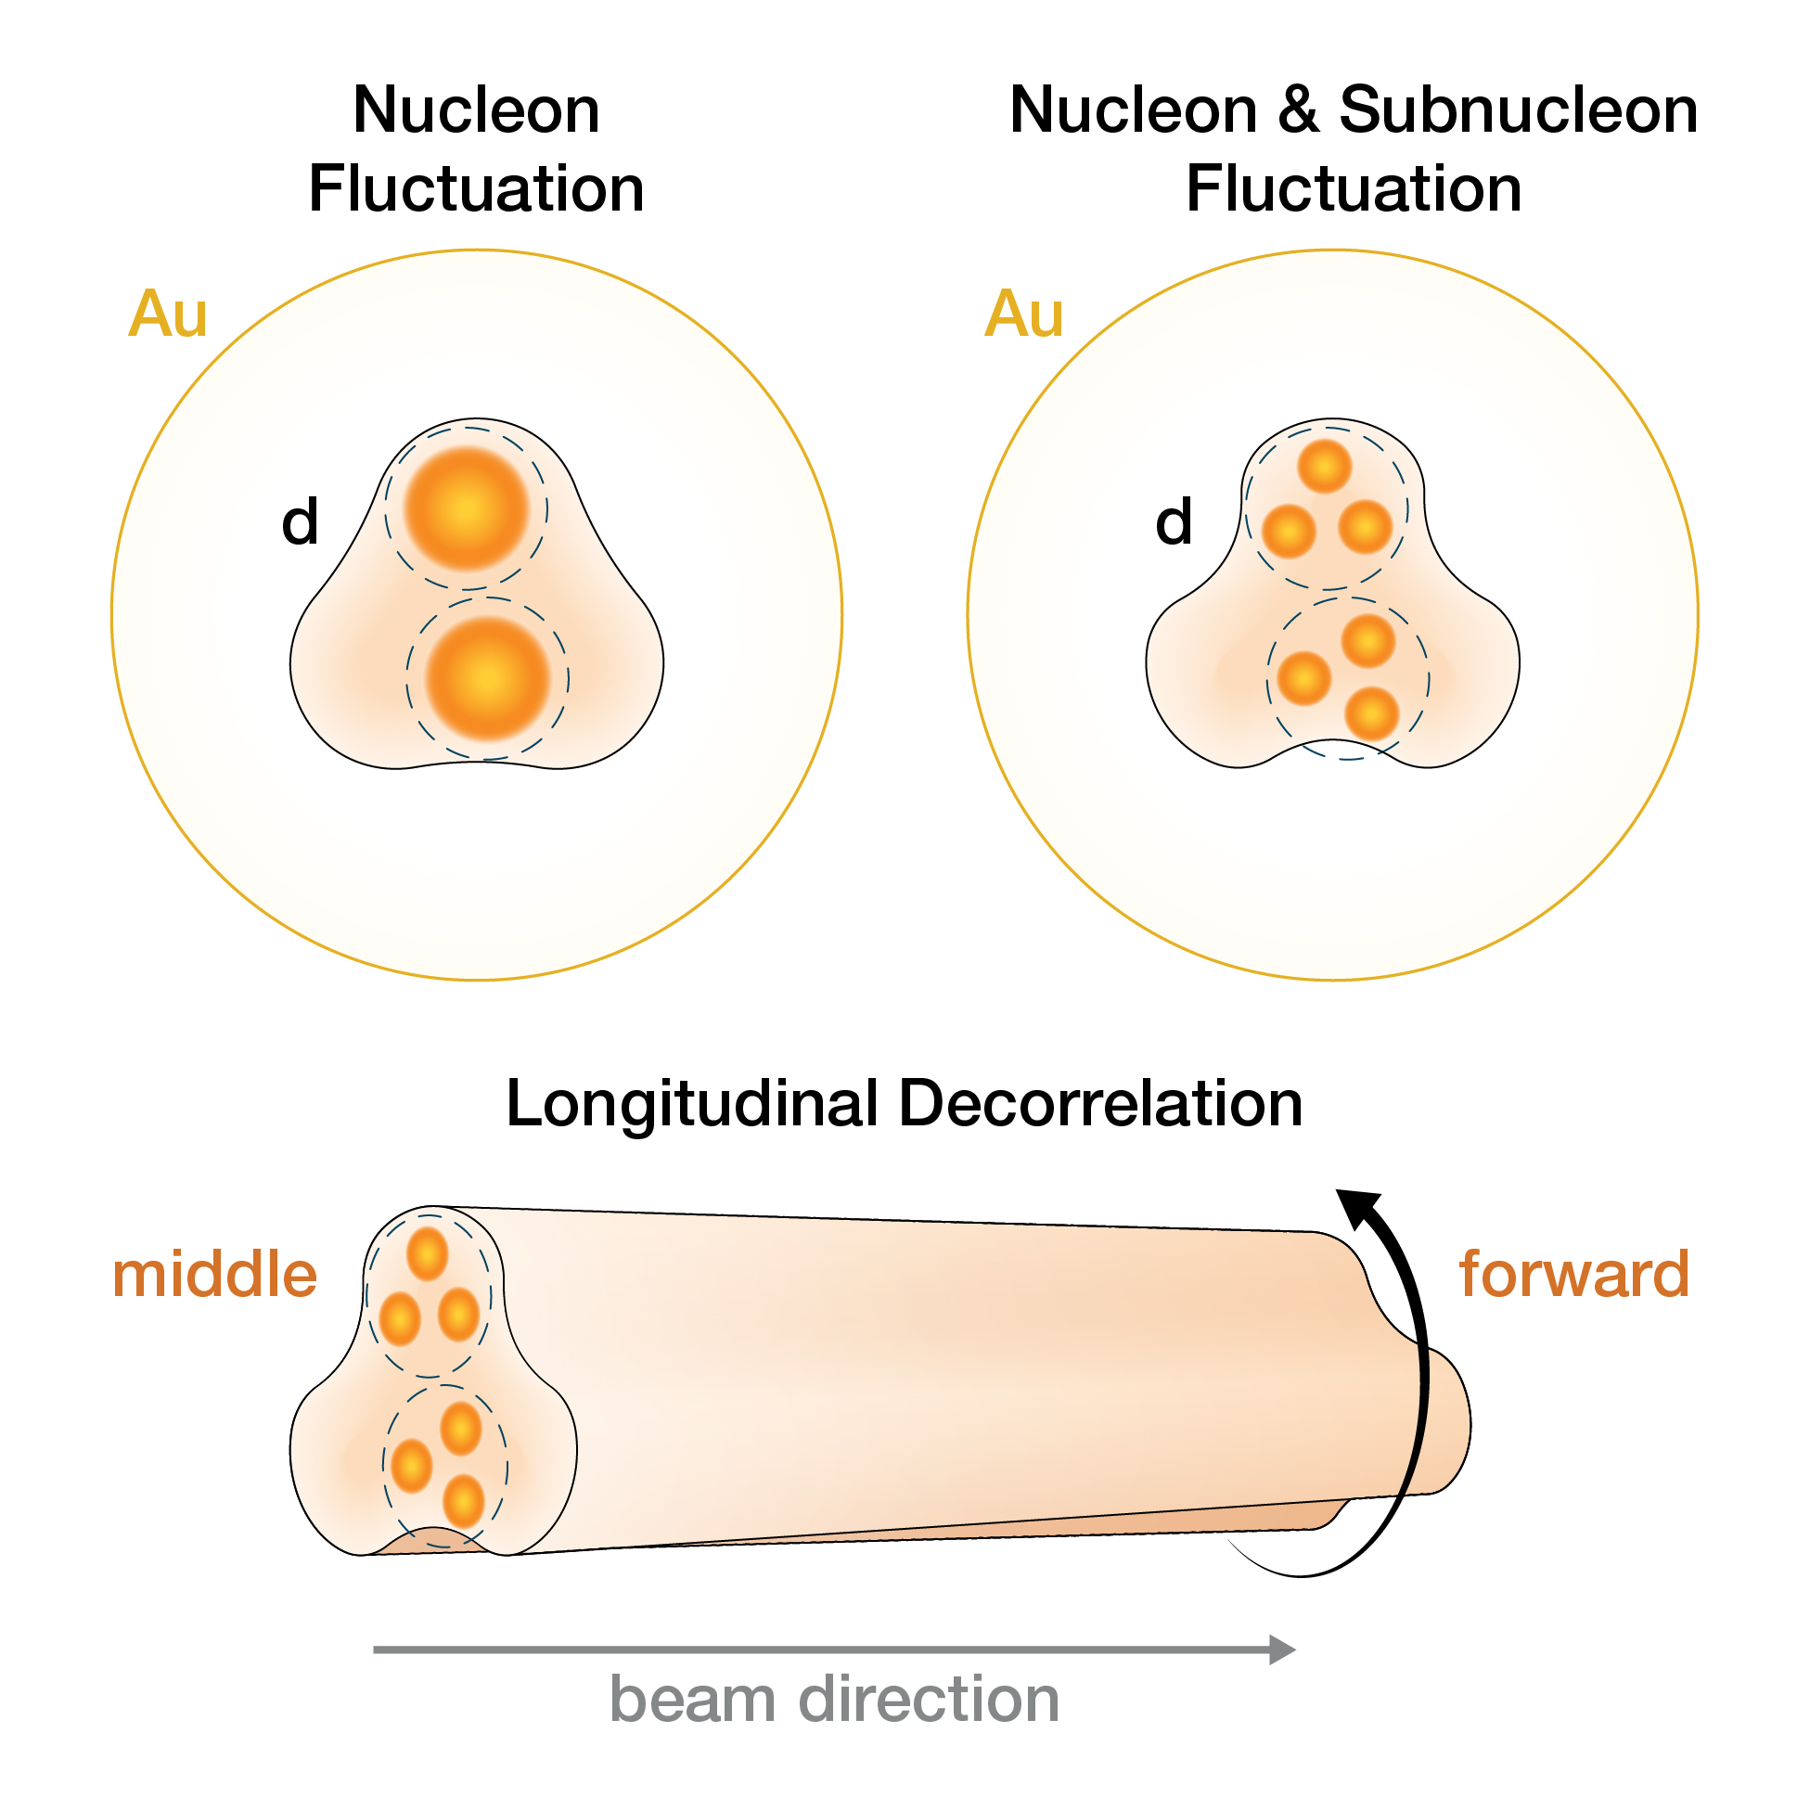
Source of Initial-State Fluctuation in Small System
Interplay between several possible sources:
1) Fluctuations in nucleon position
2) Fluctuations in nucleon position and its quark and gluon constituents
3) Fluctuations of overlap geometry along the beam direction
¹⁶O
¹⁶O
Comparing symmetric and asymmetric systems can yield additional insights into sub-nucleon fluctuations.
STAR, PRL 130, 242301

Slide 4
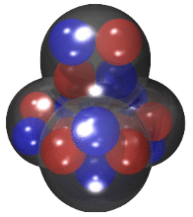
Source of Initial-State Fluctuation in Small System
Interplay between several possible sources:
1) Fluctuations in nucleon position
2) Fluctuations in nucleon position and its quark and gluon constituents
3) Fluctuations of overlap geometry along the beam direction
4) Fluctuations due to many-nucleon correlation(e.g. 𝜶-cluster)
¹⁶O
¹⁶O
Comparing symmetric and asymmetric systems can yield additional insights into sub-nucleon fluctuations.
Many-nucleon correlations may also influence the fluctuation in eccentricity as: 𝛆₂{4}.
STAR, PRL 130, 242301
¹⁶O
¹⁶O
Woods-Saxon
𝜶-cluster

Slide 5
Many-nucleon correlation
NLEFT: model with many-nucleon correlation including 𝜶 cluster
¹⁶O
¹⁶O
Lu et al., PLB 797 (2019) 134863
Woods-Saxon: without many-body nuclear correlation
Woods-Saxon
NLEFT

Slide 6
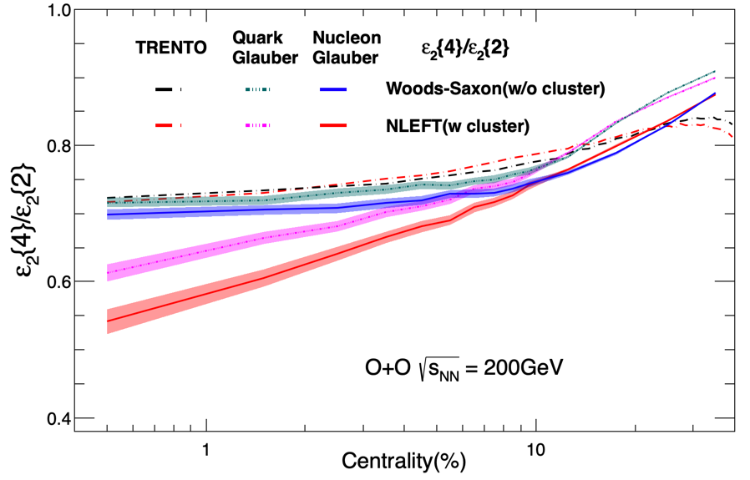
Many-nucleon correlation
NLEFT: model with many-nucleon correlation including 𝜶 cluster
¹⁶O
¹⁶O
Lu et al., PLB 797 (2019) 134863
Woods-Saxon: without many-body nuclear correlation
Woods-Saxon
NLEFT
𝜀₂{4} /𝜀₂{2} from three models:
1.TRENTO: WS ≈ NLEFT
2.Quark Glauber: WS > NLEFT
3.Nulceon Glauber: WS > NLEFT
Quark Glauber > Nucleon Glauber for NLEFT
Quark Glauber:
PRC 94, 024914 (2016)
TRENTO:
PRC.92.011901(2015);
Calculated by Giuliano

Slide 7
Many-nucleon correlation
NLEFT: model with many-nucleon correlation including 𝜶 cluster
¹⁶O
¹⁶O
Lu et al., PLB 797 (2019) 134863
Woods-Saxon: without many-body nuclear correlation
Woods-Saxon
NLEFT
𝜀₂{4} /𝜀₂{2} from three models:
1.TRENTO: WS ≈ NLEFT
2.Quark Glauber: WS > NLEFT
3.Nulceon Glauber: WS > NLEFT
Quark Glauber > Nucleon Glauber for NLEFT
Many-nucleon correlation can significantly impact the eccentricity fluctuations. However, these effects tend to be reduced by sub-nucleon fluctuations.
Quark Glauber:
PRC 94, 024914 (2016)
TRENTO:
PRC.92.011901(2015);
Calculated by Giuliano

Slide 8
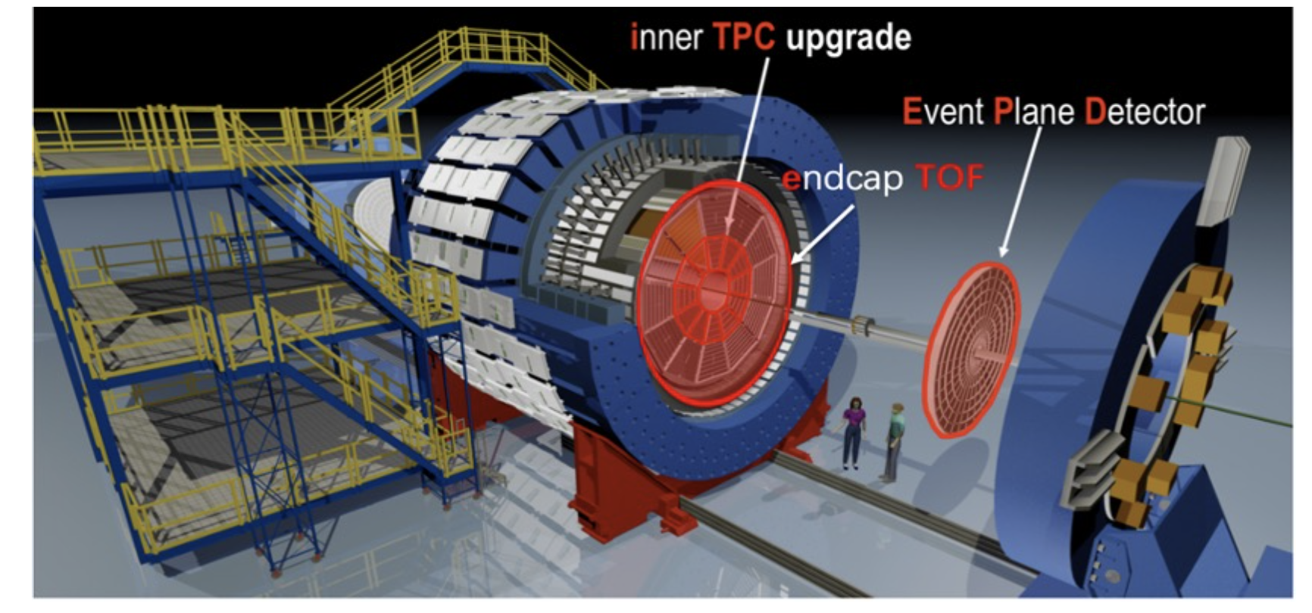
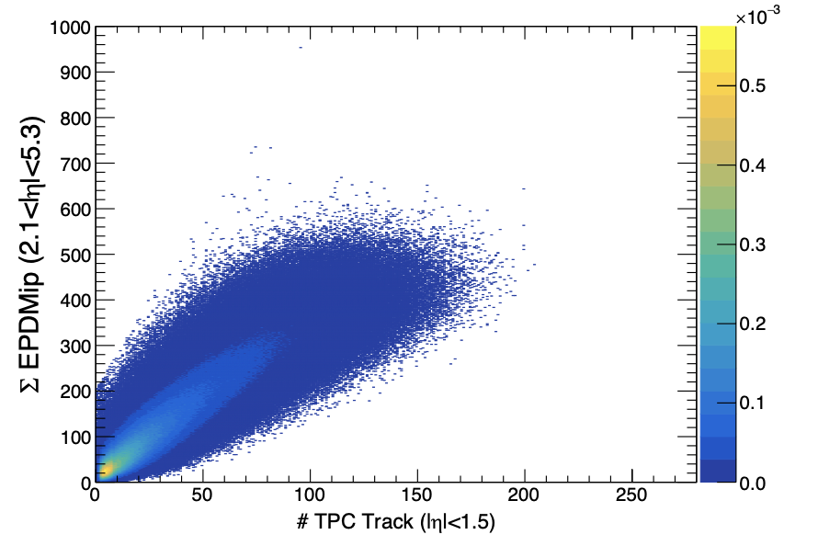
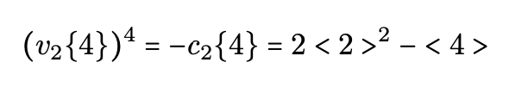
¹⁶O+¹⁶O Data Set
STAR has taken 600M MB and
250M high multiplicity O+O events in 2021
Large rapidity coverage due to iTPC |𝜂|<1.5 and EPD(2.1<|𝜂|<5.1 )
Trigger on high multiplicity event at both middle and forward rapidity regions
Two types of centrality definitions:
TPC centrality: |𝜂|<1.5, p_{T}:[0.2,2] GeV/c
EPD centrality: 2.1<|𝜂|<5.1
v₂{2}, v₃{2}: Di-hadron correlation
p_{T} associated [0.2,2.0 GeV/c]
P_{T} trigger [0.2,3.0 GeV/c]
v₂{4}: Cumulant method

Slide 9
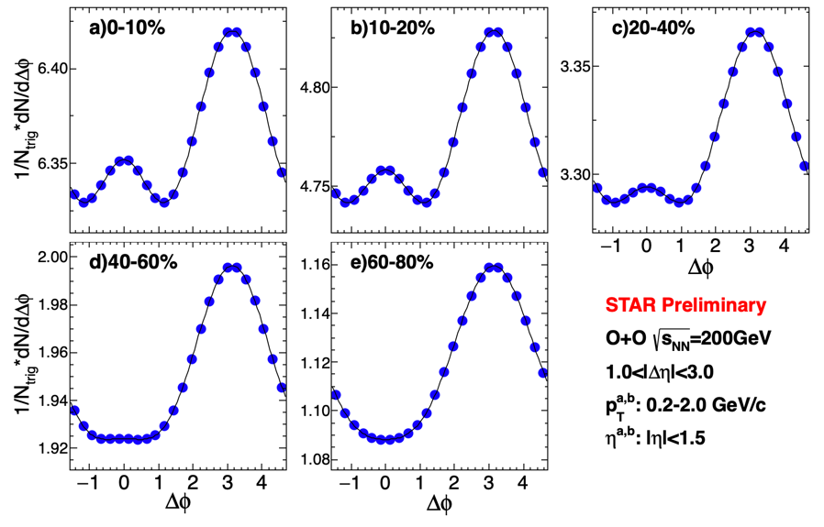
Di-hadron correlation at middle rapidity in ¹⁶O+¹⁶O
Ridge is seen in central O+O collisions while not in peripheral collisions
EPD Centrality: 2.1<|𝜂|<5.1 MB dataset only

Slide 10
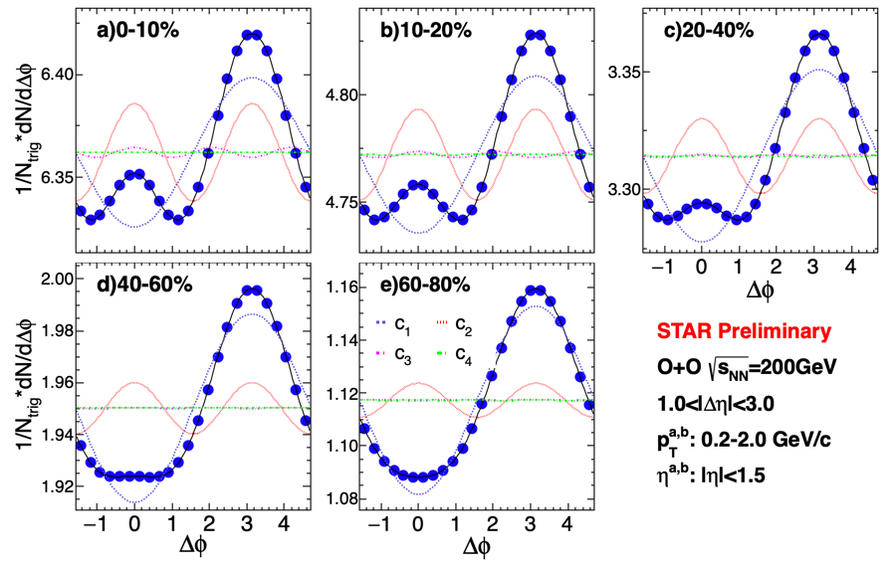
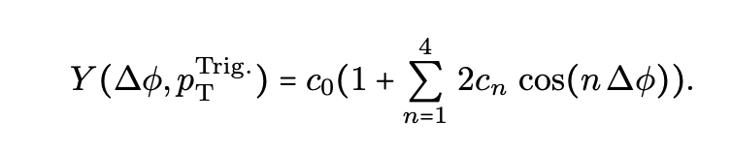


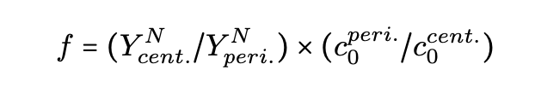

Di-hadron correlation at middle rapidity in ¹⁶O+¹⁶O
Ridge is seen in central O+O collisions while not in peripheral collisions
Flow is extracted with Fourier fitting and nonflow subtraction with 60-80% centrality:
1. C₀ method:
2. Near-side jet-yield method:
EPD Centrality: 2.1<|𝜂|<5.1
MB dataset only
3. C₁ method

Slide 11
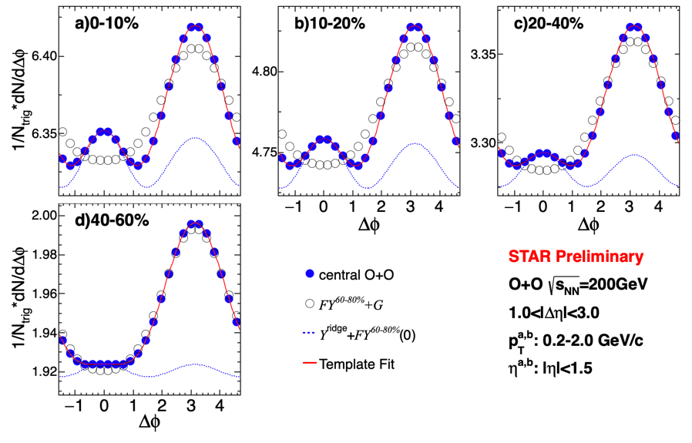
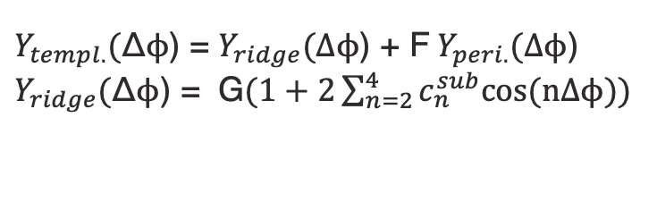
Di-hadron correlation at middle rapidity in ¹⁶O+¹⁶O
4. Template Fit:
$Y_{templ.}($Δϕ) = $Y_{ridge}(\text{Δϕ}$) + F $Y_{peri.}(\text{Δϕ}$)
$Y_{ridge}($Δϕ) = G$(1+2\sum_{n=2}^{4}{c_{n}^{sub}cos⁡(\text{n}\text{Δϕ}))}$
“F” represents the modification for the long-range away-side jet between cent. and peri.
ATLAS, PRL 116, 172301 (2016)
EPD Centrality: 2.1<|𝜂|<5.1
MB dataset only

Slide 12
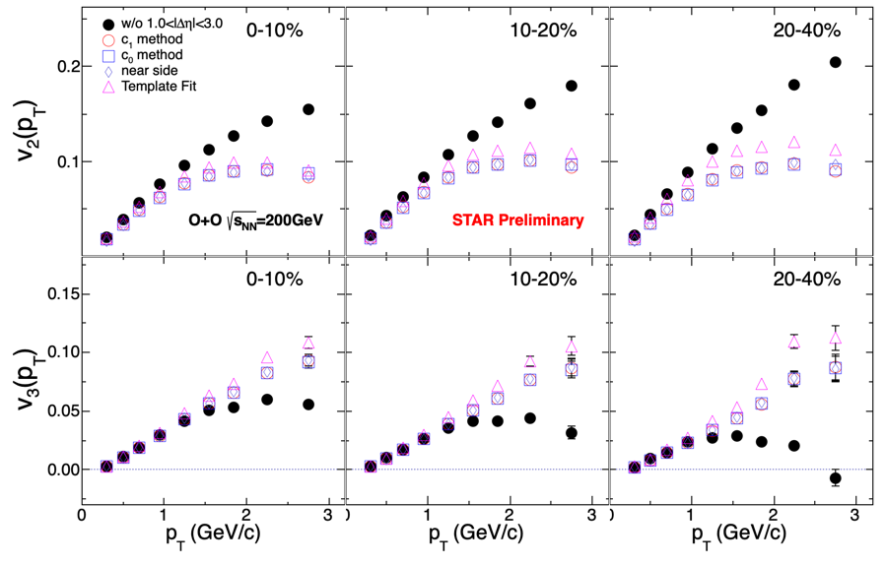
v_{n} from different subtraction
  Non-flow subtraction will always decrease v₂ and increase v₃
  Non-flow subtracted v₂ and v₃ show minimal method dependence

Slide 13
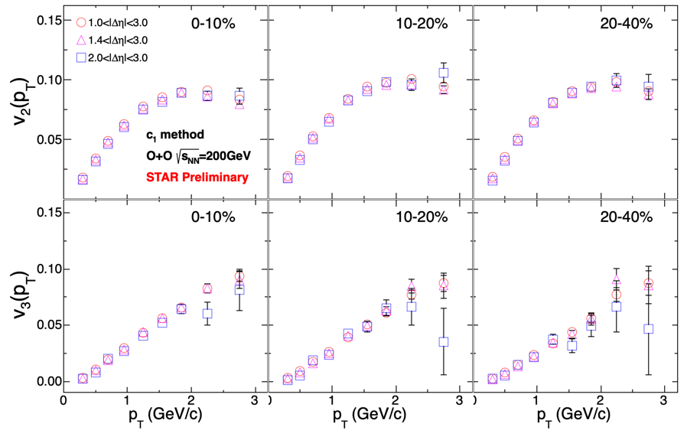
v₂ with different ∆𝜂 cut
After nonflow subtraction, v_{n} are independent of the |∆𝜂| selection

Slide 14
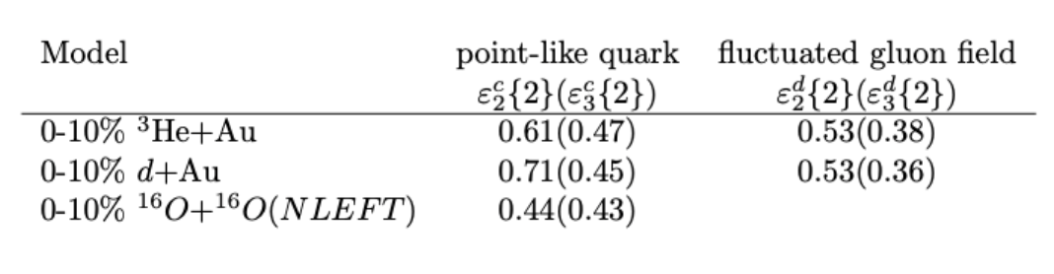
Compare to asymmetric collisions
Quark Glauber:
PRC 94, 024914(2016)
Gluon field:
PRC 94, 024919(2016)
v₂(O+O) < v₂(d+Au) ≈ v₂(³He+Au)
v₃(O+O) ≈ v₃(d+Au) ≈ v₃(³He+Au)
Sub-nucleon fluctuations:
point–like quark
𝛆₂(O+O) < 𝛆₂(³He+Au) < 𝛆₂(d+Au)
𝛆₃(O+O) ≈ 𝛆₃(d+Au) ≈ 𝛆₃(³He+Au)
Gluon fluctuation around quark
𝛆_{n}(d+Au) ≈ 𝛆_{n}(³He+Au); n=2,3
It is consistent as v₂(d+Au) ≈ v₂(³He+Au)
STAR, PRL 130, 242301

Slide 15
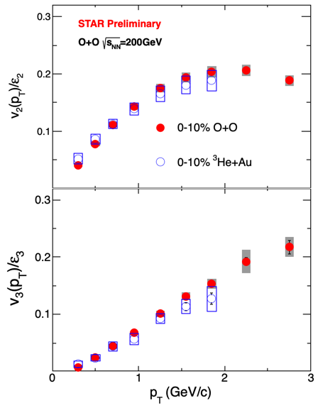
Compare to asymmetric collisions
Quark Glauber:
PRC 94, 024914(2016)
Gluon field:
PRC 94, 024919(2016)
v_{n}/𝛆_{n}(O+O) ≈ v_{n}/𝛆_{n}(³He+Au) for quark-Glauber
Consistent with expectation of sub-nucleon fluctuation
STAR, PRL 130, 242301

Slide 16
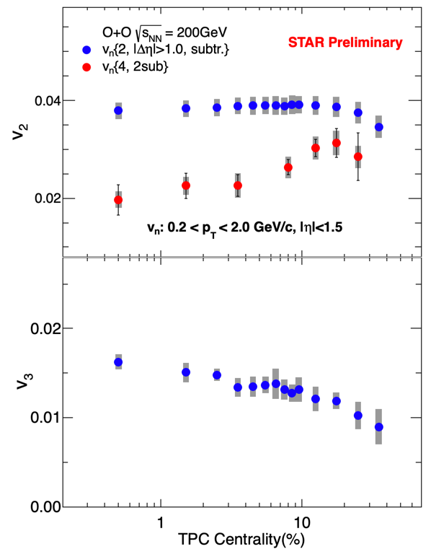
Four-particle cumulant in O+O
In central collisions:
The v₂{2} is nearly flat
The v₃{2} increases slightly
However, v₂{4} clearly decreases
MB+HM

Slide 17
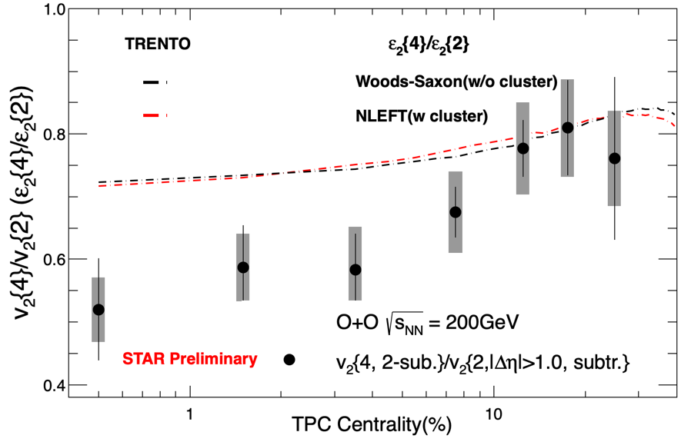
v₂{4}/v₂{2}: Flow fluctuation in central O+O
Quark Glauber:
PRC 94, 024914 (2016)
TRENTO: PRC.92.011901(2015) Calculated by Giuliano
𝛆₂{4}/𝛆₂{2} from TRENTO with NLEFT or Woods-Saxon are similar.
Larger than v₂{4}/v₂{2}.

Slide 18
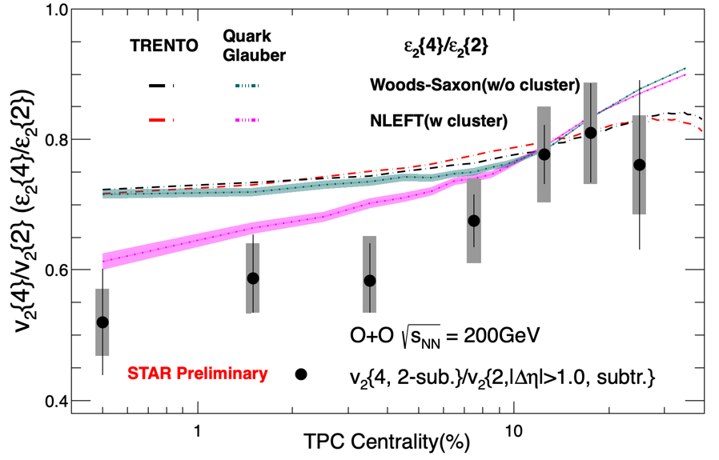
v₂{4}/v₂{2}: Flow fluctuation in central O+O
Quark Glauber:
PRC 94, 024914 (2016)
TRENTO: PRC.92.011901(2015) Calculated by Giuliano
𝛆₂{4}/𝛆₂{2} from quark Glauber with Woods-Saxon is similar as TRENTO and larger than v₂{4}/v₂{2}
𝛆₂{4}/𝛆₂{2} from quark Glauber with NLEFT are much close to v₂{4}/v₂{2}
➔ many-nucleon correlation (e.g. 𝜶 cluster) enhances the flow fluctuation?

Slide 19
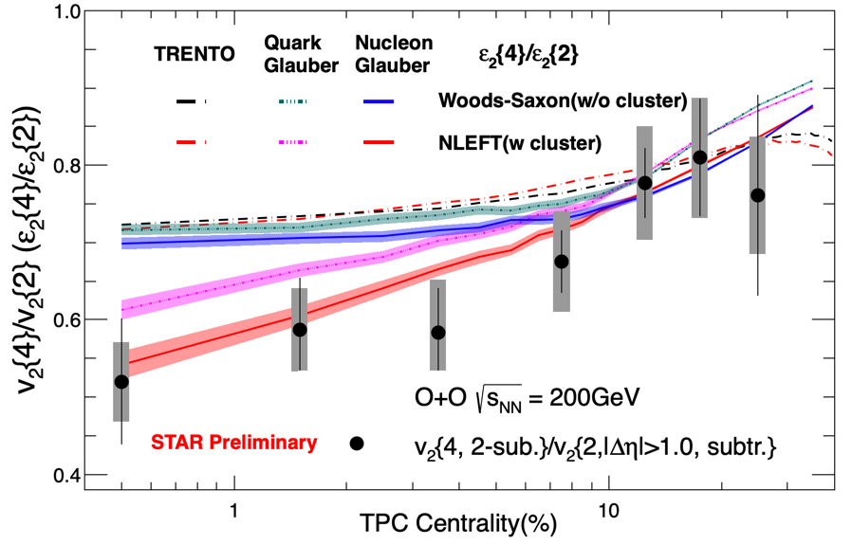
v₂{4}/v₂{2}: Flow fluctuation in central O+O
Quark Glauber:
PRC 94, 024914 (2016)
TRENTO: PRC.92.011901(2015) Calculated by Giuliano
Nucleon Glauber with NLEFT describes the v₂{4}/v₂{2} better than quark Glauber
Interplay between sub-nucleon fluctuation and many-nucleon correlation?
Detailed hydro calculations can elucidate the role of 𝜶 cluster in light nuclei

Slide 20
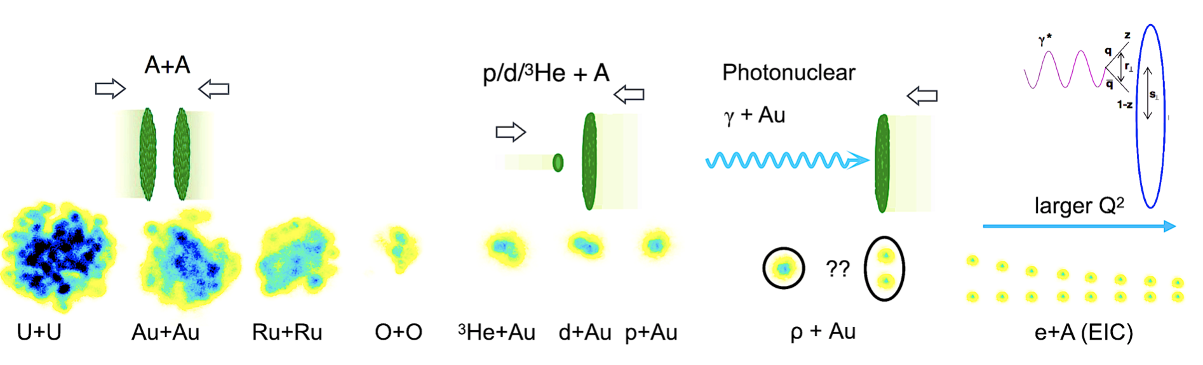
Outlook: 𝛾+Au@STAR
𝛾+Au
Symmetric small system (bridge large vs. small systems, 𝛼-clustering)
Most asymmetric systems (informative towards EIC science)
This talk
RHIC system scan: unique opportunity to investigate collectivity across various system sizes

Slide 21
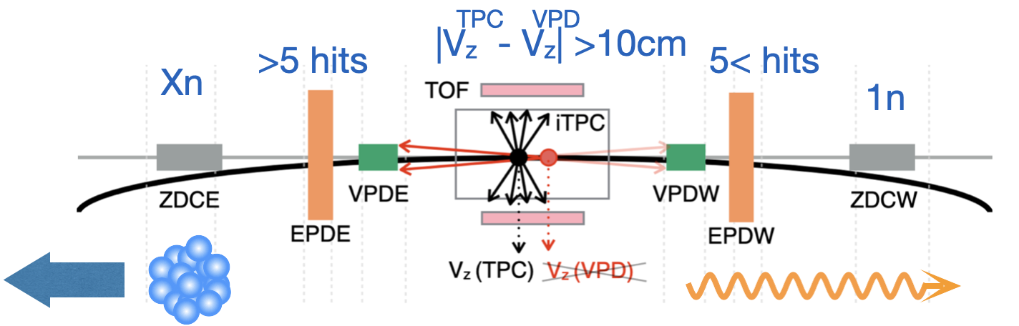
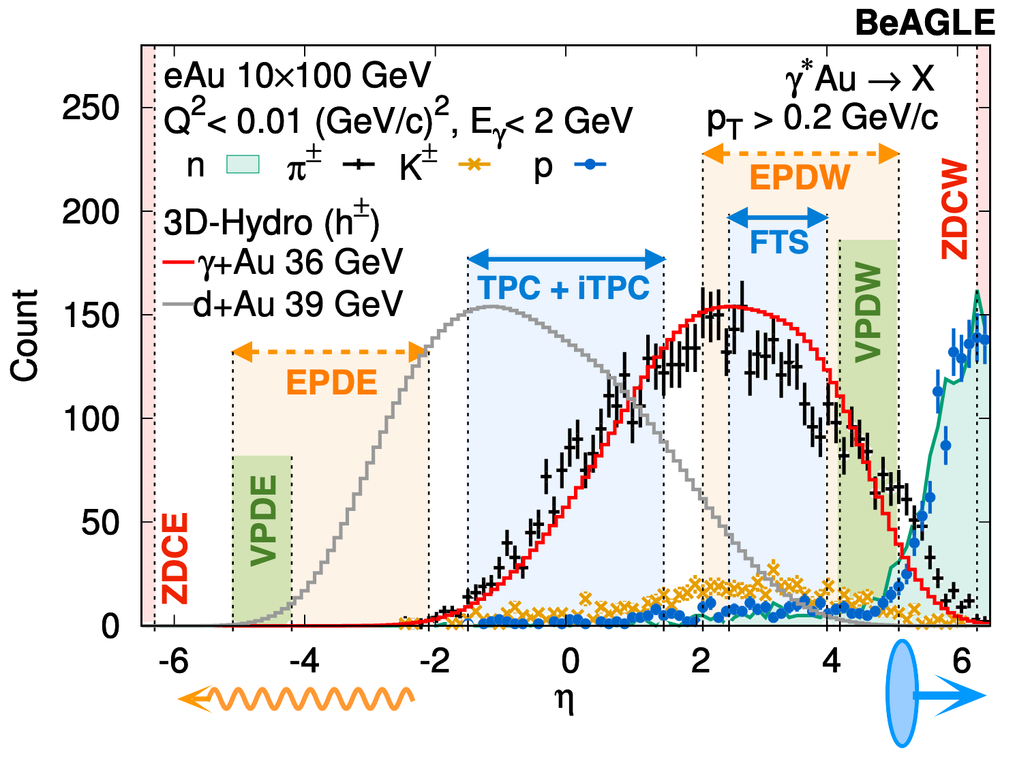
Inclusive photonuclear events at STAR
Event selection for 𝛾+Au@STAR
Asymmetic cuts on EPDs & ZDC (1nXn) on Au+Au 200 GeV collisions (year 2019) --> sample of 𝛾+Au (E_{cm}~40 GeV) events
Low
activity
High
activity

Slide 22
Exploratory study for 𝛾+Au collisions
No sign of near side ridge but different near-side di-hadron correlations between low and high activity event class -- nonflow study is under investigation.
Opportunity with Run 2023 data: 6 M (1nXn) and 100 M (0nXn) 𝛾+Au events collected

Slide 23
Summary
We measured v₂ and v₃ in O+O collisions via di-hadron correlation and four types of nonflow subtraction methods
v_{n}/𝜀_{n} are similar between O+O and ³He+Au, within a quark Glauber model
v₂{4}/v₂{2} show clear decrease in ultra-central collisions, consistent with 𝜀₂{4} /𝜀₂{2} , indicating enhanced fluctuations due to possible many-nucleon correlations.
In future, new 𝛾+Au@2023 and d+Au@2021 will provide more information for anisotropy in small system

Slide 24
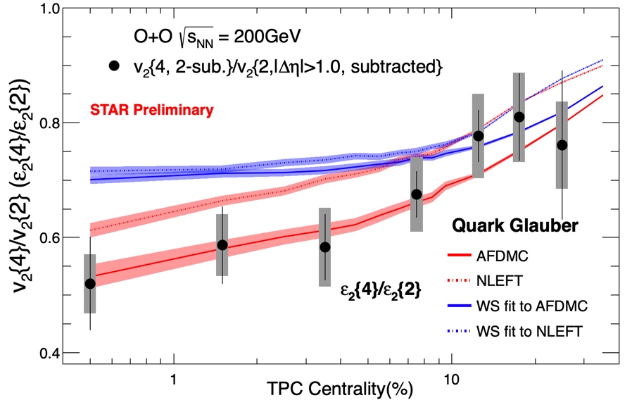
v₂{4}/v₂{2}
From quark Glauber, the 𝛆₂{4}/𝛆₂{2} ratio from AFDMC or NLEFT model with many-nucleon correlations can describe the v₂{4}/v₂{2}

Slide 25
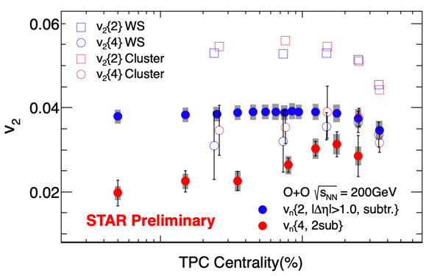
Comparing with Hydro
Hydro: TRENTO + iEBE-VISHNU
Nicholas Summerfield et al. PRC 104, L041901 (2021)

