Slide 1

Jet production in p+p and Au+Au collisions at RHIC with STAR
Mateusz Ploskon for the
Collaboration

Slide 2
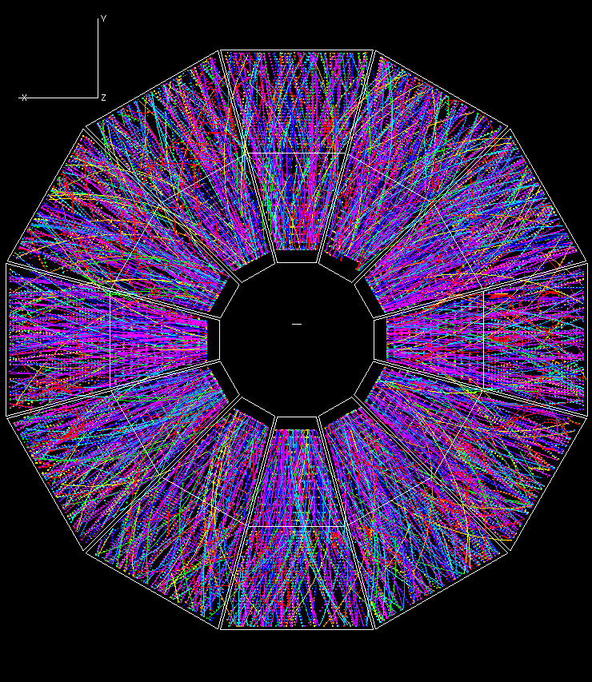
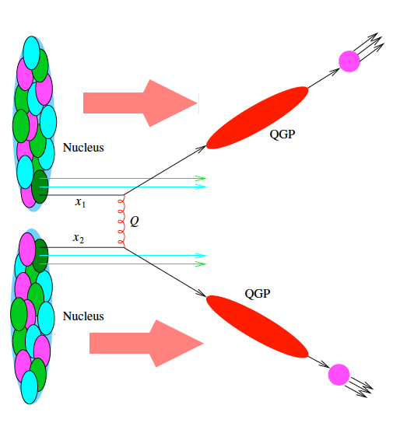
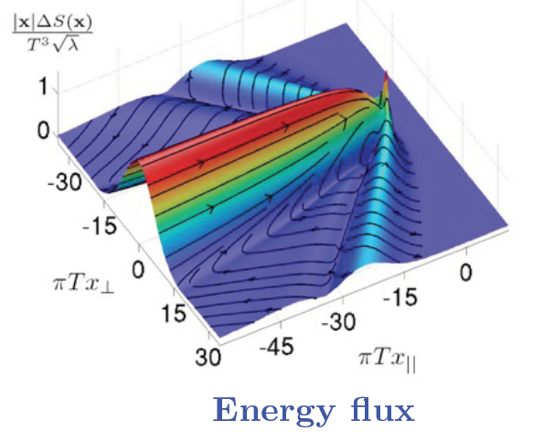
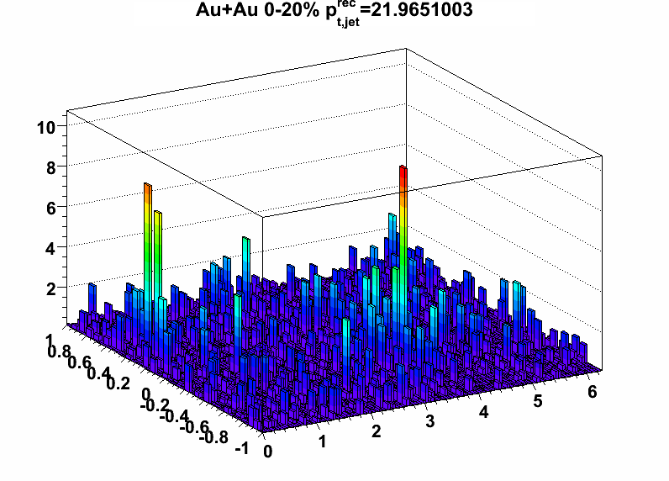
Jets in matter
Experimental reality
Theoretical abstractions
We aim to relate these quantitatively
  ➔ambitious for both experiment and theory…

Slide 3
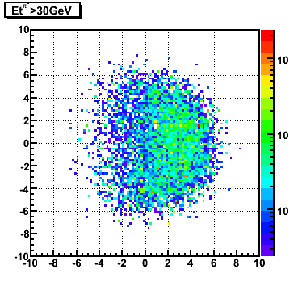
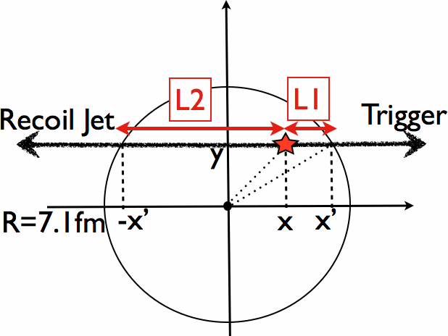
Quantitative analysis: tools of heavy-ion collisions
Inclusive cross-sections
  Scaling of x-section (“Glauber”;
  e.g. hard x-sec ~ Nbinary collisions)
Correlation measurements
  Observable “B” under a condition “A” (trigger)
Control over geometry
  Correlations with reaction plane
Jet quenching
  Geometric biases – use to the extreme
  Color charged probes
  Color neutral probes
“Discovery by/through deviation”
  use p-p and p-A collisions as references for A-A measured observables
Interpretation -> Dependent upon modeling (!)
30 GeV/c pi0 Trigger

Slide 4
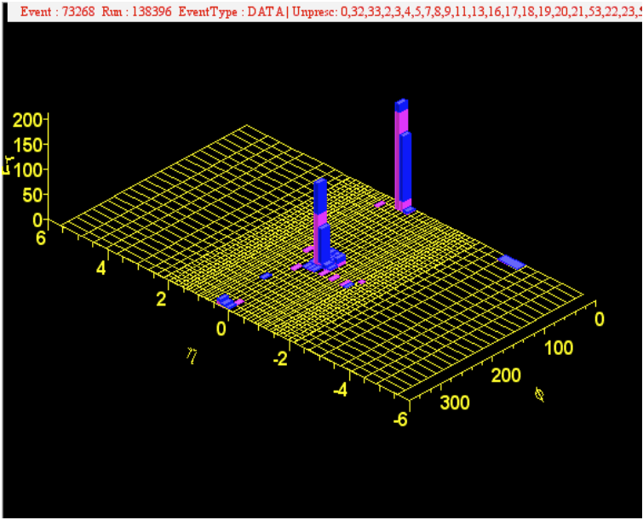
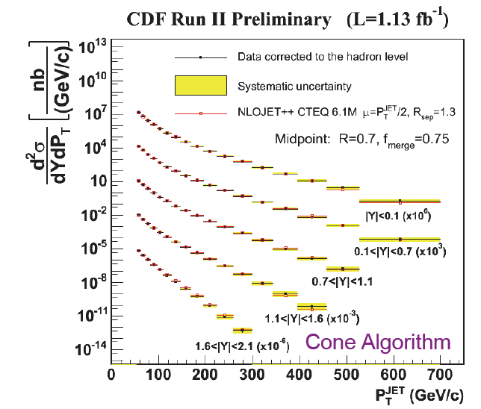
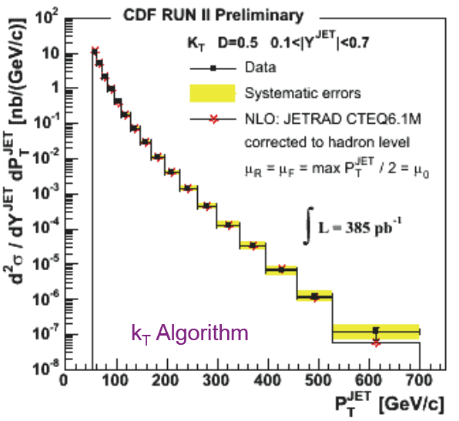
Jets at CDF/Tevatron
Good agreement with NLO pQCD
Multiple algorithms give consistent results

Slide 5
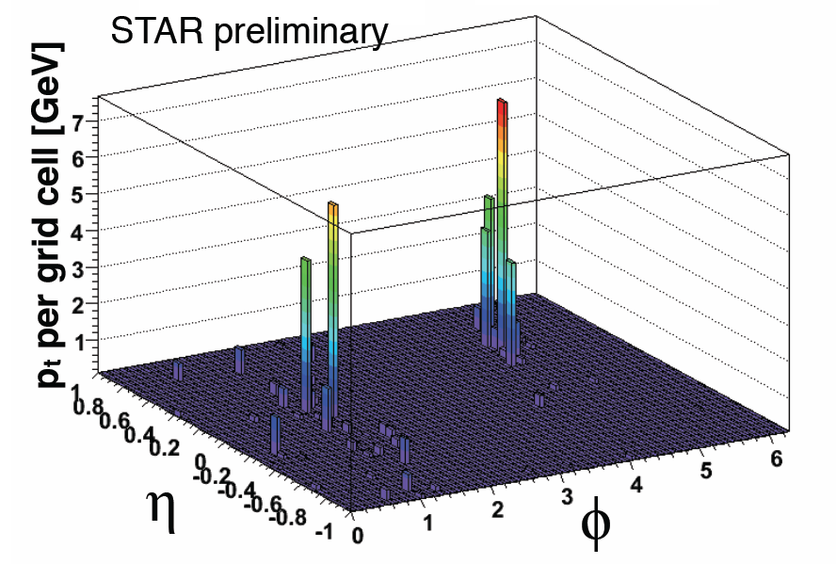
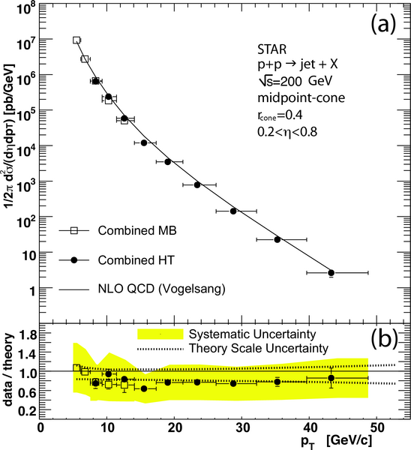
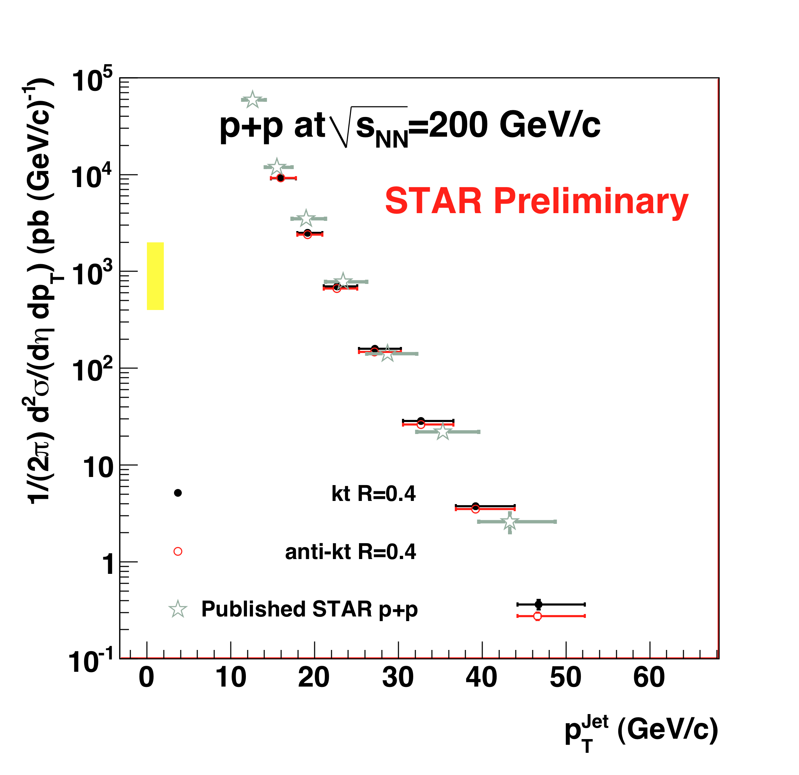
Inclusive jet cross section: 200 GeV p+p
Phys. Rev. Lett. 97 (2006) 252001
Good agreement with NLO
Different algorithms give consistent results

Slide 6
Jets in heavy ion collisions: idealization
We usually have this “factorized” picture in mind when talking about jet quenching…
production vertex: high Q²
  ➔perturbative
Propagation in strongly coupled Quark Gluon Plasma
  ➔coupling of hard and soft energy scales
  ➔”strongly coupled” jets?
What is the meaning of “factorization” here?
Vacuum fragmentation into hadrons
  ➔non-pert. QCD

Slide 7
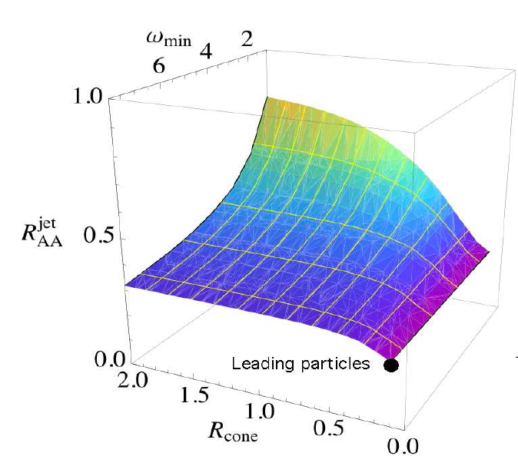
Complete Jet Reconstruction in Heavy Ion Collisions
Jet quenching is a partonic proces
      ➔obscured by hadronization
High p_{T} hadron triggers bias towards non-interacting jets
      ➔suppresses the jet population that interacts the most
      ➔no access to dynamics of energy loss
Soft hadron correlations (p_{T}<few GeV/c) are difficult to interpret as QCD jets
      ➔requires strong analysis and modeling assumptions
      ➔ no clear connection to theory
Goal of full jet reconstruction: integrate over hadronic degrees of freedom to measure medium-induced jet modifications at the partonic level ➔ much more detailed connection to theory

Slide 8
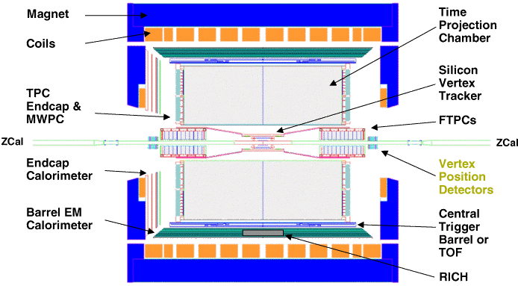
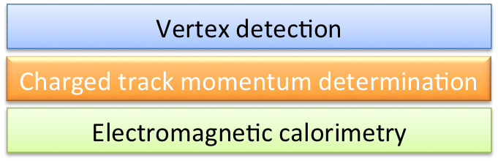
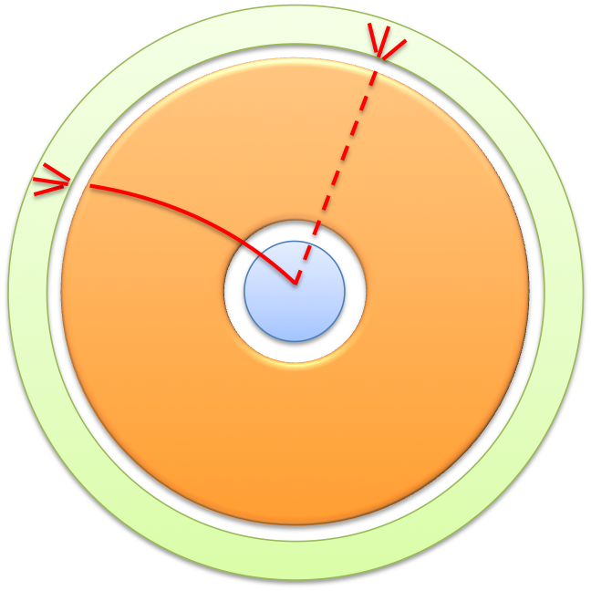
A jet detector. STAR:
Side view
Beam View:
y
x
NOTE: No hadronic calorimetry.
    Missing some neutral energy (<10%: neutrons, K⁰_{L})
    Some double-counting of hadronic energy
    High p_{T} tracking systematics
    Precise control over jet constituents and kinematic cutoffs
        ➔may be decisive in heavy ion measurements (also at LHC)
For recomb. algors: jet acceptance: 1-R
Notes:
Follow the color codes.

Slide 9
Heavy Ion collisions and background characterization
Single di-jet event from a central Au+Au (STAR):
- Two jet peaks on top of the HI background (underlying event)
Real Data
Central assumption:
Signal and background can be factorized
φ
Implies the formula:
η
φ
Main uncertainty: underlying event non-uniformities induce uncertainties on background estimation => jet energy resolution
Extra handle: utilize multiple jet algorithms and their different sensitivity to heavy-ion background.

Slide 10
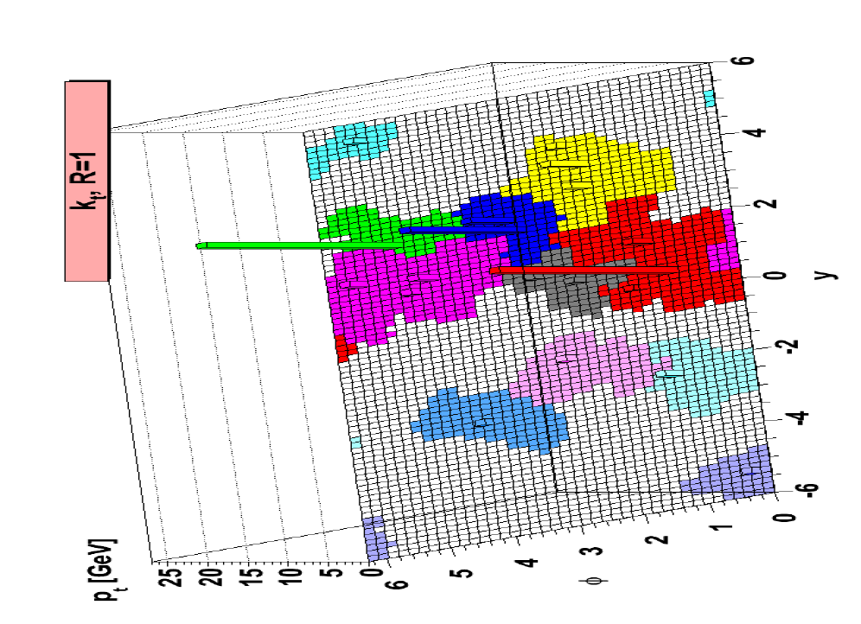


Modern algorithms
Collinear and infrared safe
Improved performance
Rigorous definition of jet area
Different algorithms -> different response to the underlying event
  Developed for uniform bg subtraction (pile-up) at LHC
  ρ: median pT per unit area of the diffuse background in an event – measured using background “jets” as found by kT algorithm
  δρ: uncertainty due to noise fluctuations – non-uniformity of the event background
Figure from FJ
Jets in eta phi
M. Cacciari, G. Salam, G. Soyez JHEP 0804:063,2008. e-Print: arXiv:0802.1189 [hep-ph]
M. Cacciari, G.Salam Phys.Lett.B659:119-126,2008. e-Print: arXiv:0707.1378 [hep-ph]

Slide 11

What is ρ?
ρ is an event-by-event measure of energy density (p_{T} per unit area)
ρ is constructed from a distribution of clusters (objects returned by a (k_{T}) jetfinder)
φ
η

Slide 12
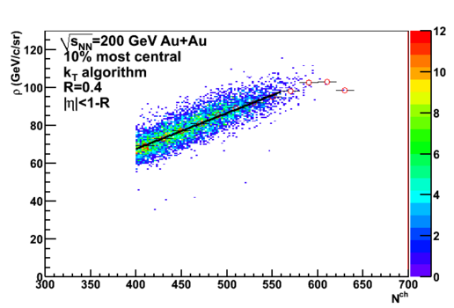

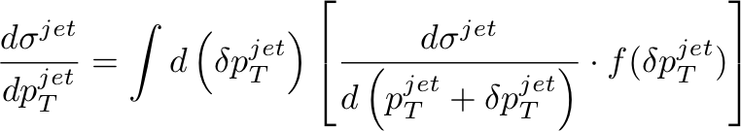
Definitions
STAR Preliminary
Signal jet:
Strict definition of δp_{T} term:
Smearing/irresolution:

Slide 13
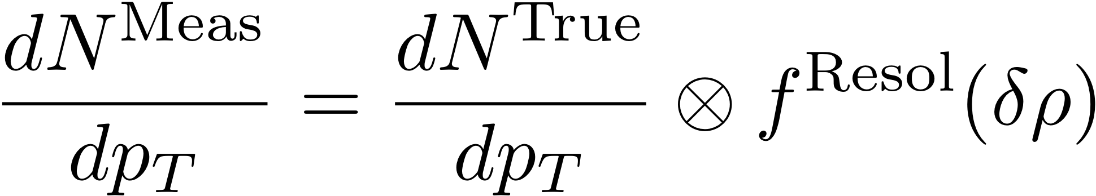
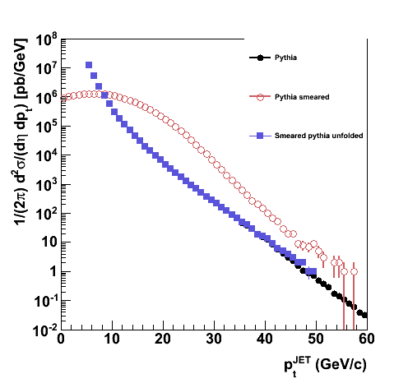
Why complex? underlying event
Background variations distort measured inclusive cross section
Pythia
Pythia smeared
Pythia unfolded
unfolding
Correction checked via model studies
Data-driven correction schemes progressing
Unfolding must be numerically stable

Slide 14
HI Jet Reconstruction: strategy
What we have learned over the past two years:
“anti-quenching” biases lurk everywhere!
  “High Tower” calorimeter triggers
  Seeded reconstruction algorithms
  Track and tower p_{T} cuts to suppress background
  Imposition of jet shape
No shortcuts: we have to face the full event background and its fluctuations head-on
  complex interplay between event background and jet signal
Need multiple independent background correction schemes to assess systematics
  more is better than few, but must be independent
  no shortcuts: corrections depend on observable

Slide 15
Crucial analysis steps and their estimations
Data driven:
  Uncertainties on detector performance
  Verification of background non-uniformities and pT irresolution
  Estimation of “false”-jet contamination
Simulation/MC dependent:
  Training input spectrum for the unfolding procedure – negligible dependence on the functional form only (Pythia p-p spectrum)
  Estimations of unobserved neutral energy (~5% of jet energy) – Pythia/Herwig
  For HI background studies: tests with different fragmentation patterns (Pythia/Herwig/qPythia)
  Currently NOT correcting for hadronization
    p-p: Pythia/Herwig
    AA: unclear

Slide 16
Methods to study δp_{T}
Embedding
  Reconstruct a known object (a jet) within a minimum bias / central HI event and compare the reconstructed energies
  Dependency on fragmentation pattern
“Random cones”
  Randomly choose an area within a real event at the jet resolution scale and report the deviation from the estimated average background
  Tuned behavior: choose R^{rnd cone} for each signal jet

Slide 17

Probing the background: Embedding of a single 4-vector into the HI background
We would like to get at irresolution (the distribution):
The observable is:
  Inject an object into an event and study the jet spectrum containing embedded object
    Where:
  ρ is estimated by kT before embedding the particle
Note: all events are central; particle is within |η|<1.-R

Slide 18
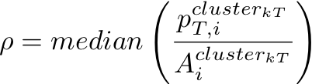
Embedding
Measure background (ρ) in real event
Inject the probe and run jet finder
Extract the “probe cluster/jet” (containing the probe)
Report δp_{T}
The “probe” particle
Reconstructed
“probe cluster”

Slide 19
Embedding
Measure background (ρ) in real event
Inject the probe and run jet finder
Extract the “probe cluster/jet” (containing the probe)
Report δp_{T}
Notes:
Study δp_{T} as a function of probe p_{T} (in min. bias event sample) – the cartoon shows a particular event (jets present)
In the limit of p_{T}^{probe} -> 0: recover the measured jet spectrum
Use probes (jets) with different fragmentation patterns (Pythia jets (QM results – shown later in the talk), qPythia jets)
The “probe” particle
Reconstructed
“probe cluster”

Slide 20
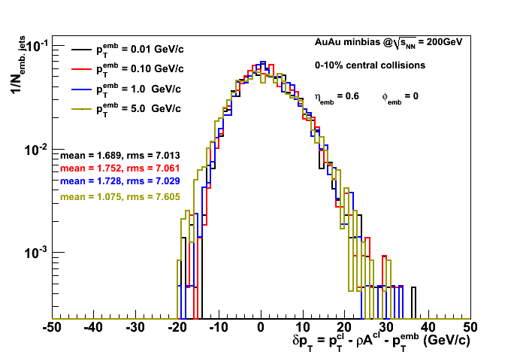
Determination of δp_{T} as a function of the pT of the probe
STAR Preliminary

Slide 21
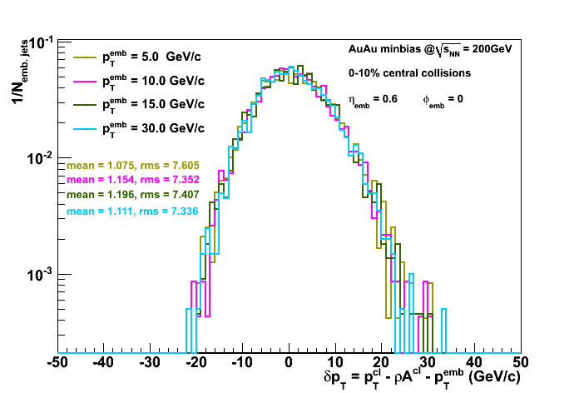
Determination of δp_{T} as a function of the pT of the probe
STAR Preliminary
More to discuss in the evening session…
Good:
δp_{T} almost independent
on p_{T} of the probe

Slide 22
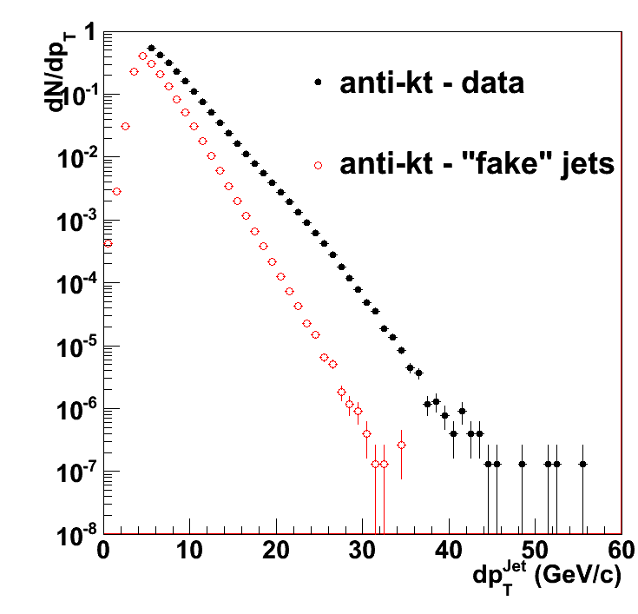
Technical comment: “false jets”
False jet definition requires care:
  Signal in excess of background model from random association of soft particles not due to hard scattering
Rate estimation for uncorrelated particle production :
Central Au+Au dataset (real data)
Randomize azimuth of each charged particle and calorimeter tower
Run jet finder
Remove leading particle from each found jet
Re-run jet finder
Uncorrelated particle production
STAR Preliminary
Generalize to correlated production in limited phase space Δη x Δφ
    ➔work in progress

Slide 23
Results

Slide 24
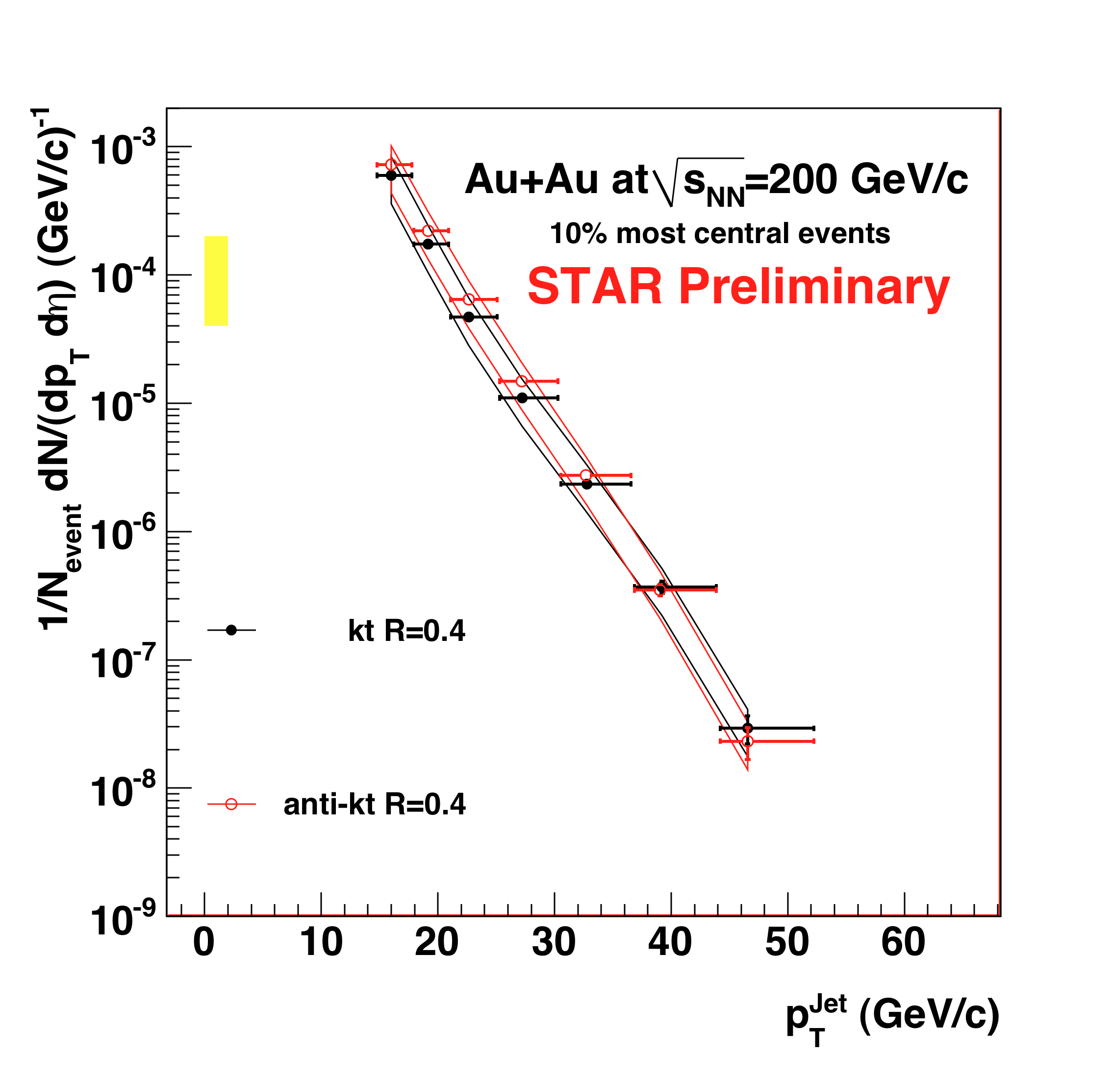
Inclusive jet cross sections at √s=200 GeV
Background correction ~ factor 2 uncertainty in cross-section

Slide 25
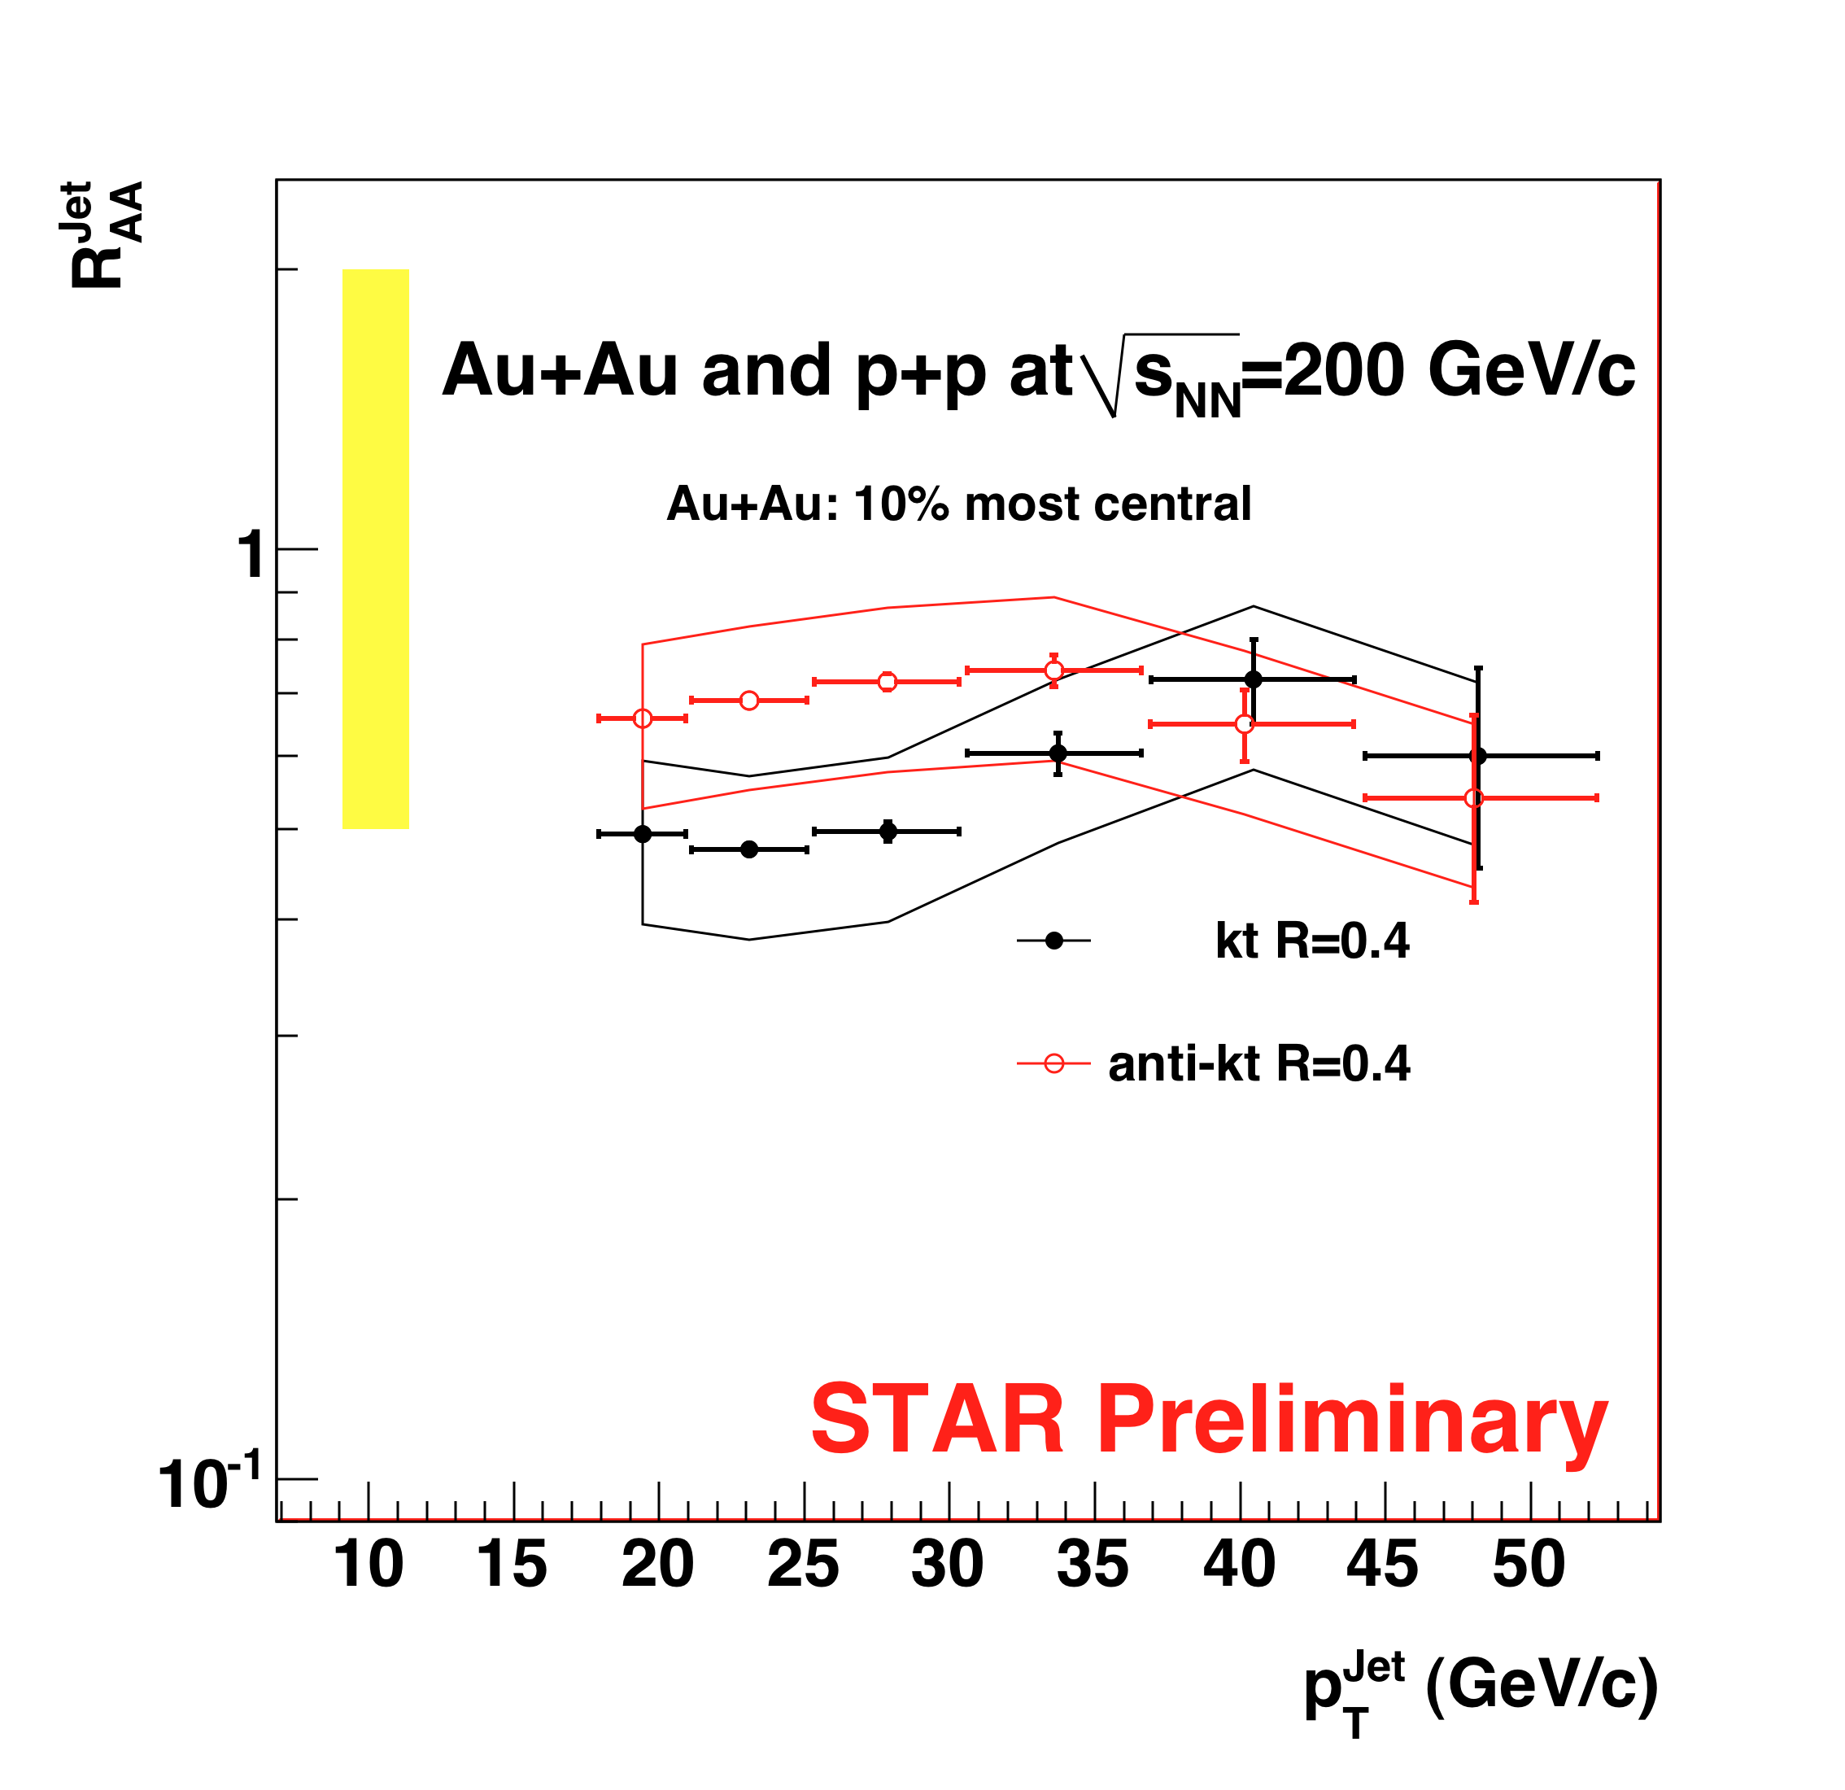
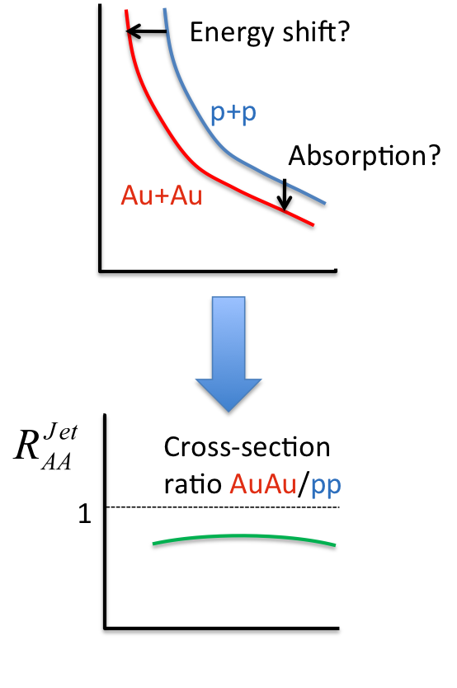
Inclusive Jet R_{AA}
R=0.4
For a fixed R:
R_{AA} of pions ~ 0.2
R_{AA}(jet) > R_{AA} (pion): recover (much) larger fraction of xsection
R_{AA} < 1 : full jet cross-section still not seen ➔jet broadening
But systematically tricky measurement (large relative uncertainties)…

Slide 26
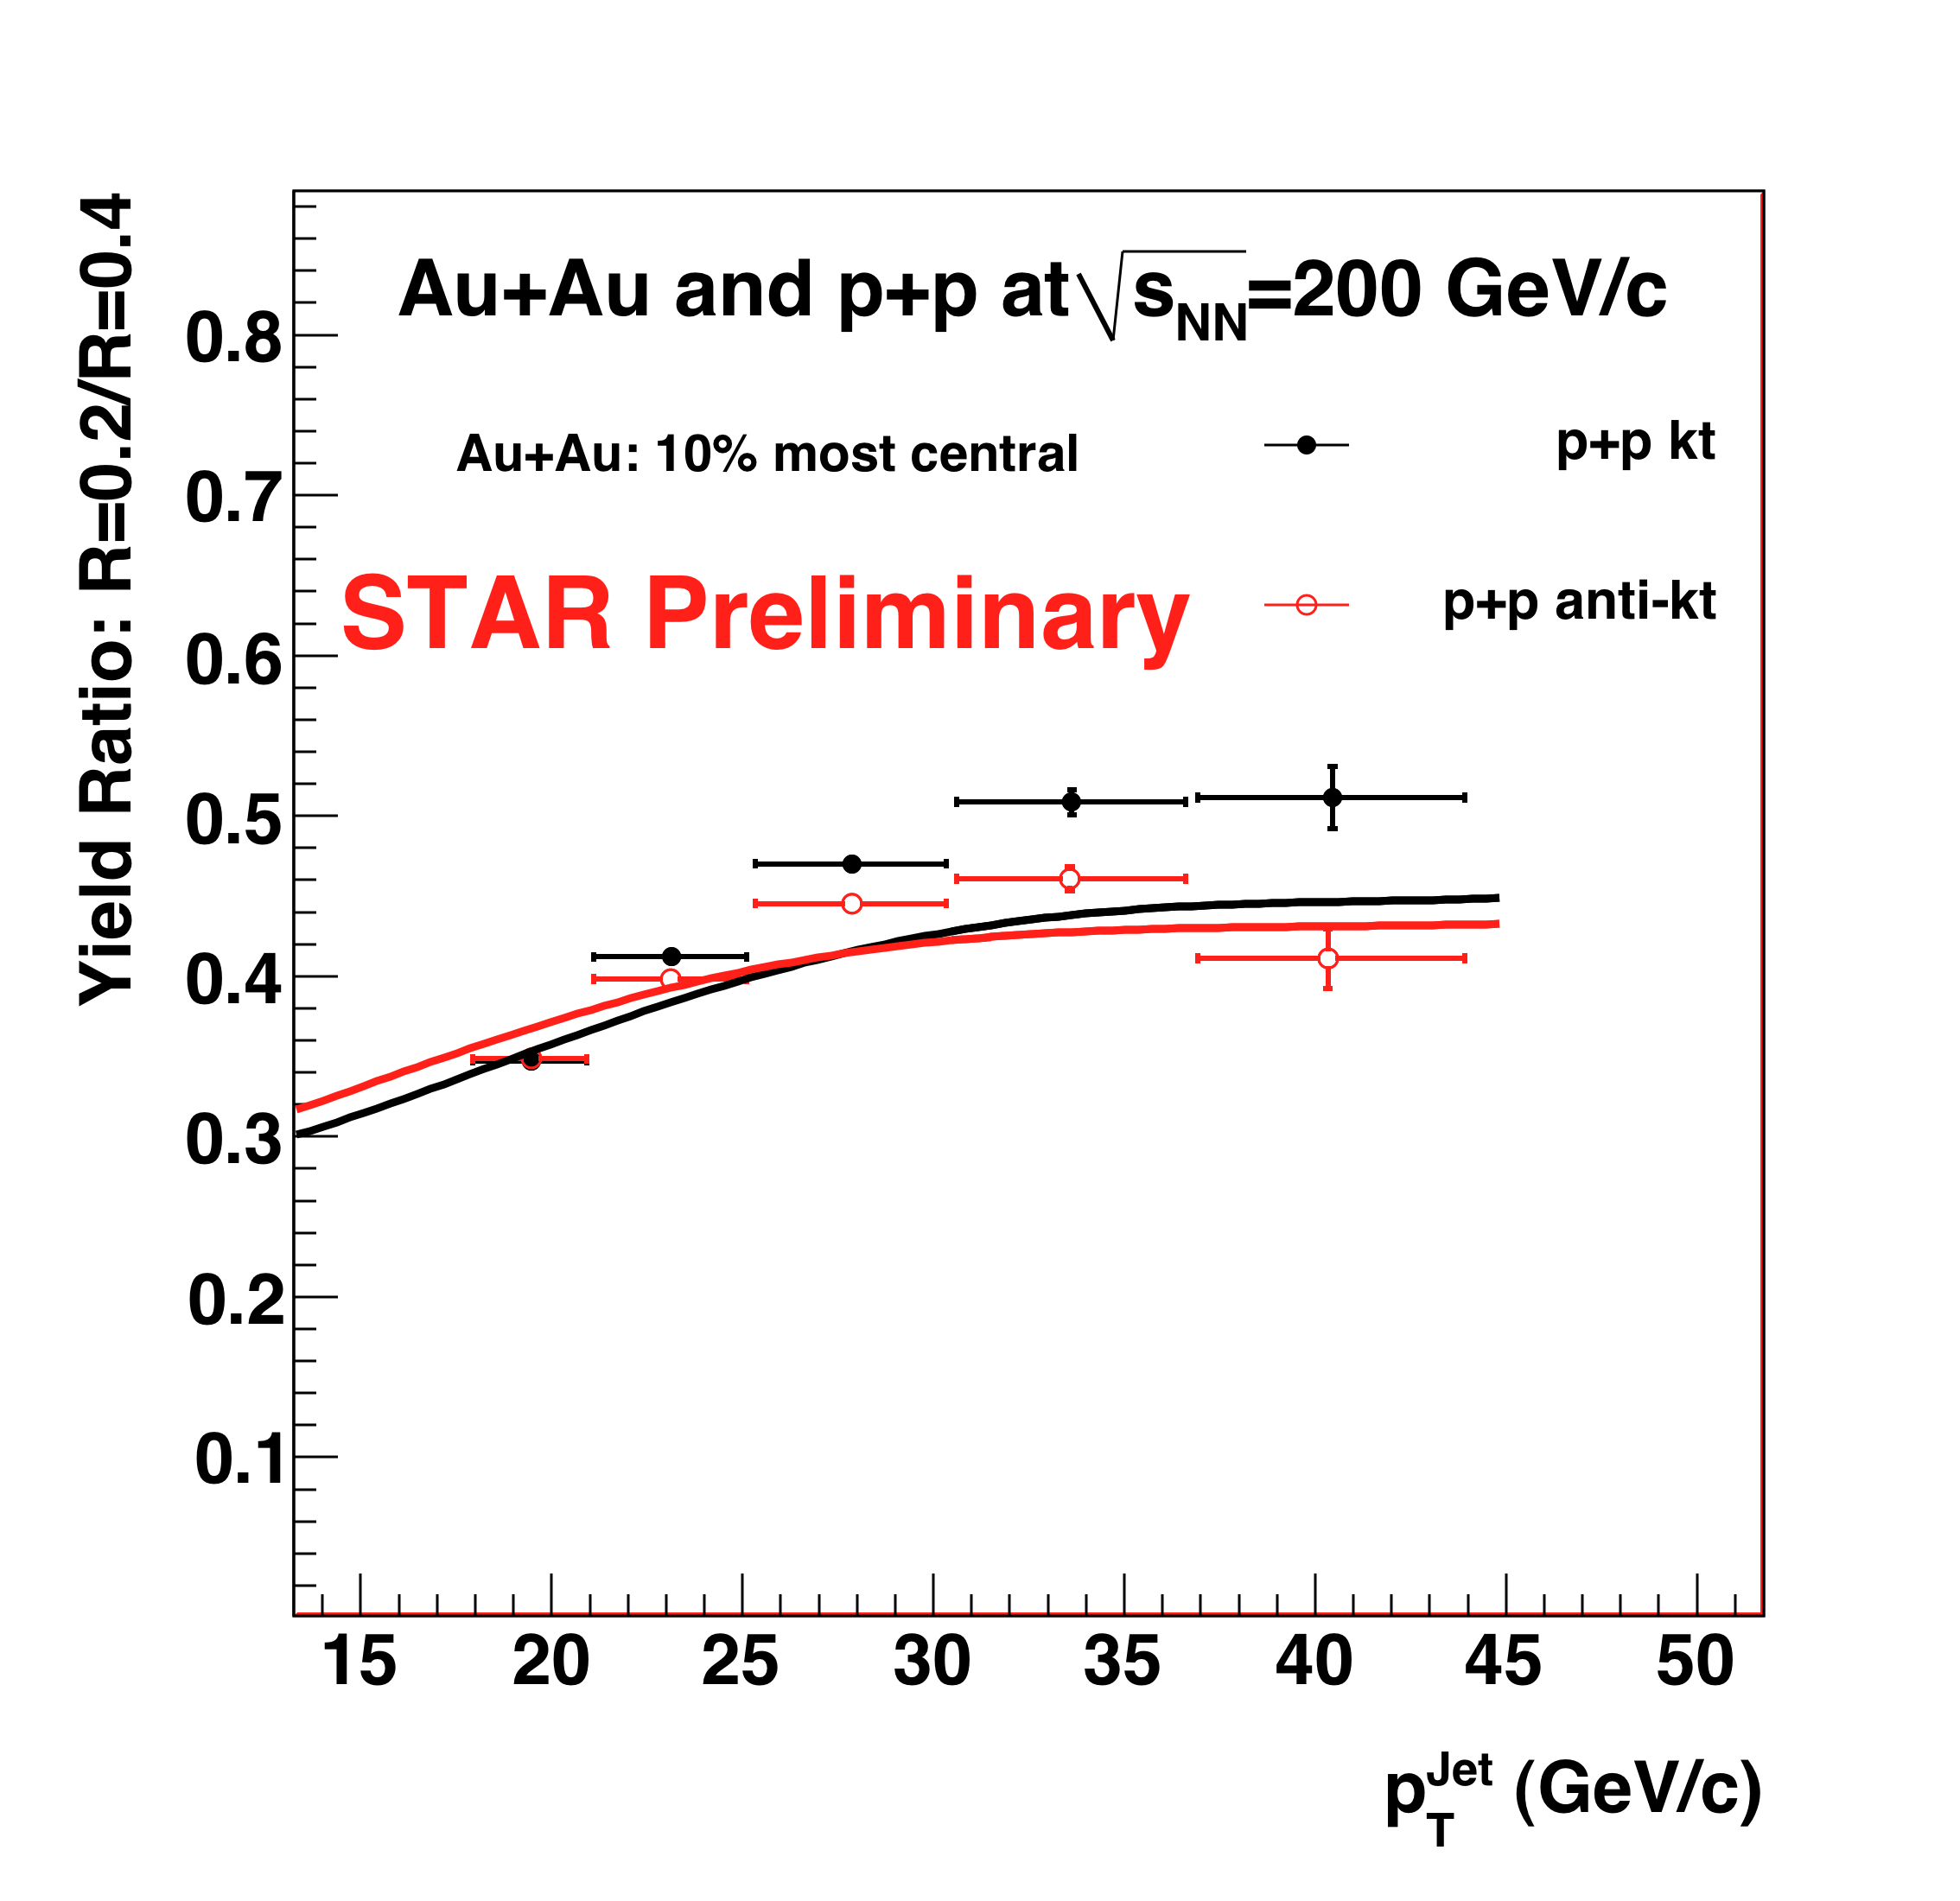
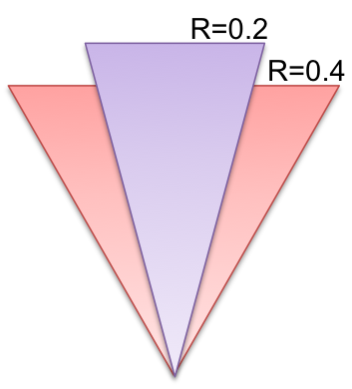
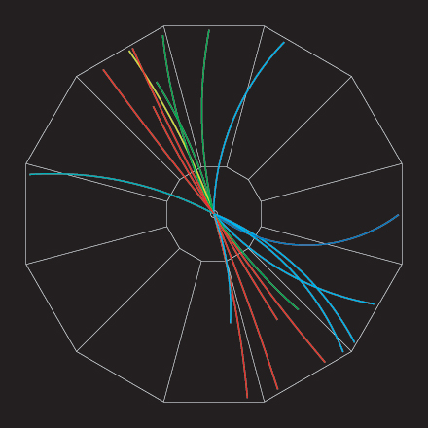
Incl. cross-section ratio: p+p R=0.2/R=0.4
compare within same dataset: systematically better controlled than R_{AA}
Solid lines:
Pythia – particle level
Narrowing of the jet structure with increasing jet energy

Slide 27
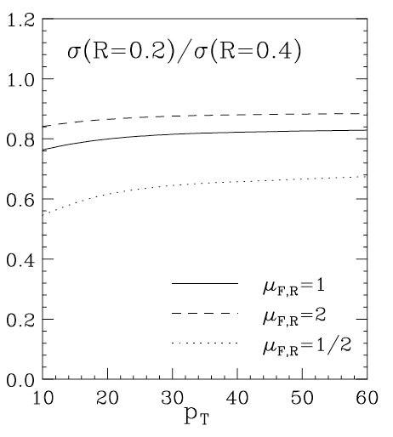
Inclusive cross-section ratio in p+p: compare to NLO pQCD
NLO pQCD calculation
W. Vogelsang – priv. comm. 2009
Solid lines:
Pythia – particle level
Narrowing of structure with increasing energy
NLO: narrower jet profile
  ➔hadronization effects?

Slide 28
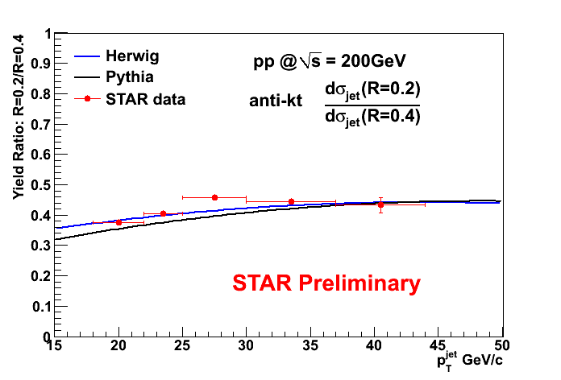
Hadronization effects: HERWIG vs. PYTHIA
Different hadronization models generate similar ratio

Slide 29
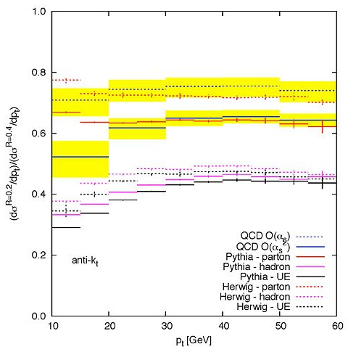
σ(R=0.2)/σ(R=0.4) : NNLO calculation
G. Soyez, private communication
p+p
√s=200 GeV
QCD NLO
QCD NNLO
PYTHIA parton level
PYTHIA hadron level
HERWIG hadron level
|η|<0.6
Broadening due to combined effects of higher order corrections and hadronization

Slide 30
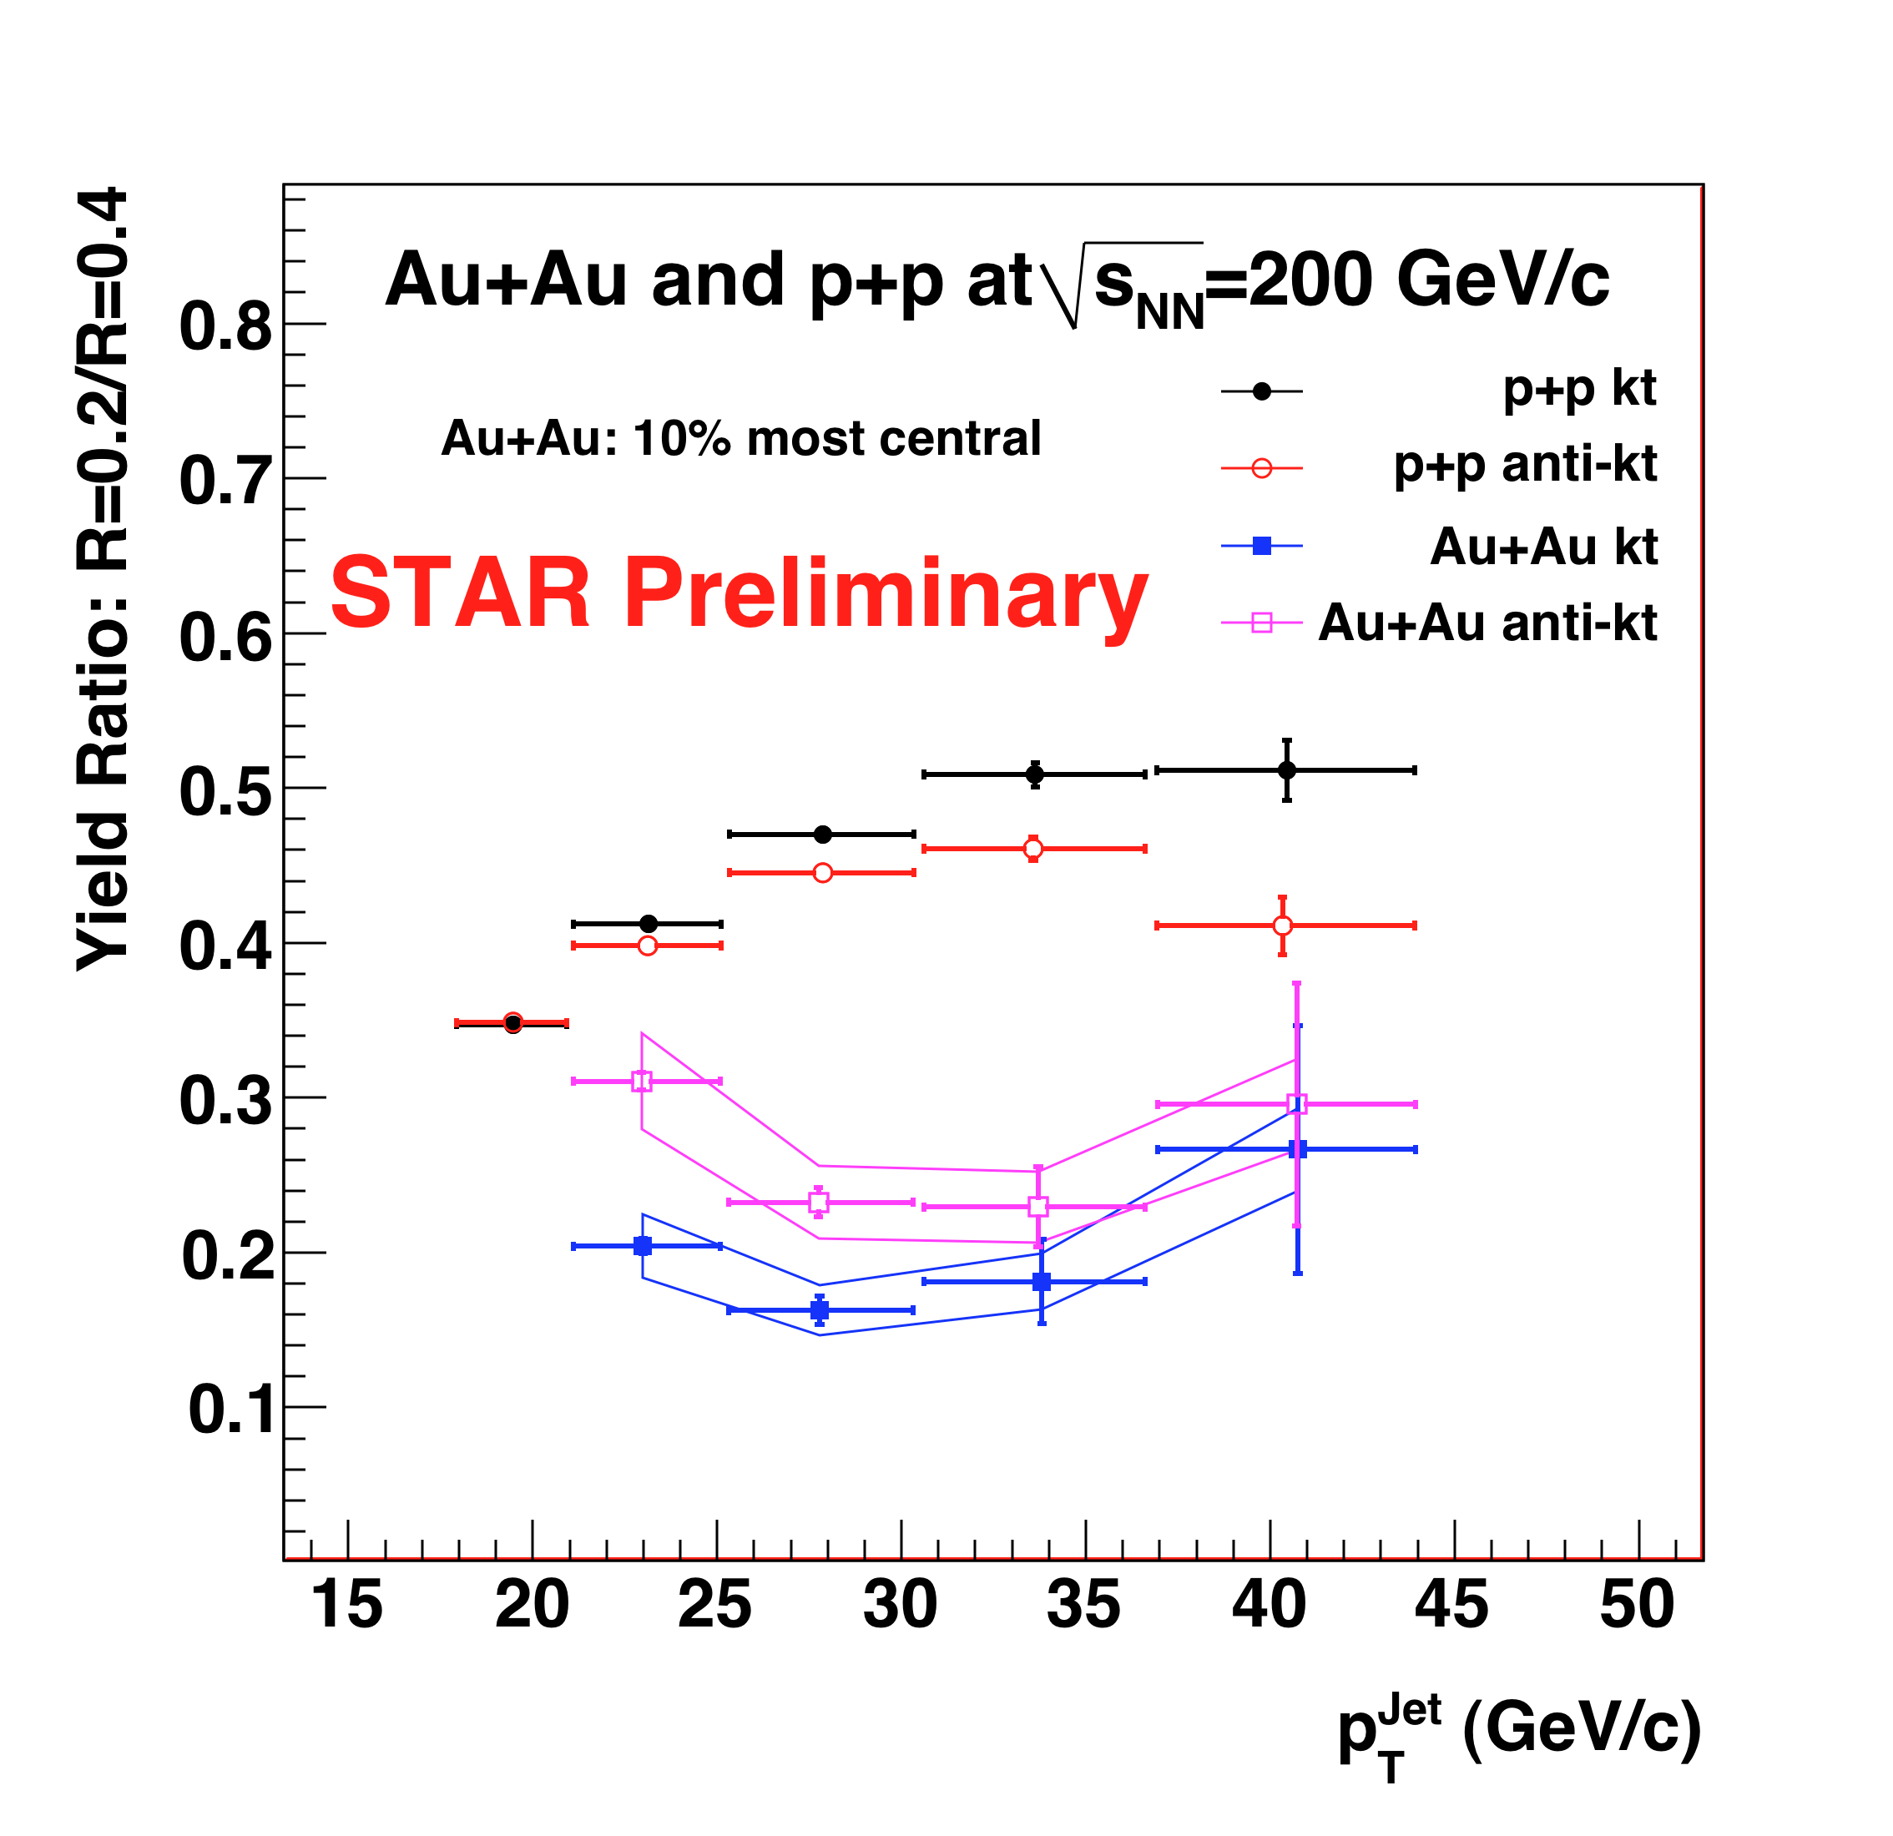
Incl. cross-section ratio: Au+Au R=0.2/R=0.4
Marked suppression of ratio relative to p+p
  ➔medium-induced jet broadening
  ➔now observed with full jets, not hadron correlations

Slide 31
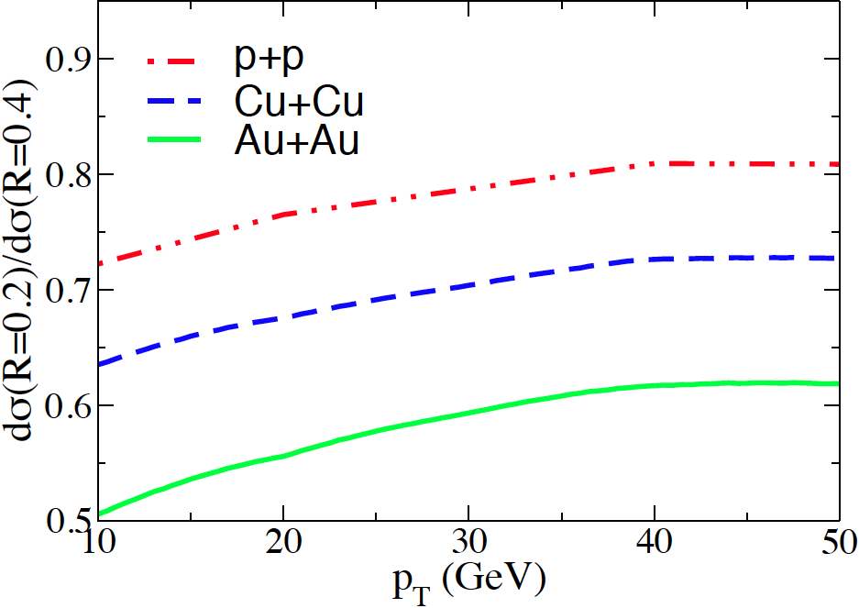
Incl. cross-section ratio Au+Au: compare to NLO
NLO Calculation
B.-W. Zhang and I. Vitev
Phys. Rev. Lett. 104, 132001 (2010)
Stronger broadening seen in measurement than NLO calculation…
  ➔ how to assess hadronization effects?

Slide 32
Outlook: full jet measurements in heavy ion collisions
Promises qualitatively new insights into jet quenching and the dynamics of the Quark Gluon Plasma
Study quenching at the partonic level
  ➔ advance over hadronic measurements
New approaches:
  experiment: jet shapes, energy flow and correlations,…
  theory: N^{n}LO, Monte Carlos, Soft Colinear Effective Theory, AdS/CFT…
But significant conceptual and technical challenges remain, still very much a work in progress:
  ➔requires close collaboration of experiment and theory
  ➔Jet Collaboration, TECHQM,…

Slide 33
Outlook: full jet measurements in heavy ion collisions
Promises qualitatively new insights into jet quenching and the dynamics of the Quark Gluon Plasma
Study quenching at the partonic level
  ➔ advance over hadronic measurements
New approaches:
  experiment: jet shapes, energy flow and correlations,…
  theory: N^{n}LO, Monte Carlos, Soft Colinear Effective Theory, AdS/CFT…
But significant conceptual and technical challenges remain, still very much a work in progress:
  ➔requires close collaboration of experiment and theory
  ➔Jet Collaboration, TECHQM,…
See Joern’s and Elena’s talks for di-jet correlations; jet-hadron correlations and more

Slide 34
If time allows…

Slide 35
Pause: Quantitative analysis: tools of heavy-ion collisions
Inclusive cross-sections
  Scaling of x-section (“Glauber”;
  e.g. hard x-sec ~ Nbinary collisions)
Correlation measurements
  Observable “B” under a condition “A” (trigger)
Control over geometry
  Correlations with reaction plane
Jet quenching
  Geometric biases – use to the extreme
  Color charged probes
  Color neutral probes
“Discovery by/through deviation”
  use p-p and p-A collisions as references for A-A measured observables
Interpretation -> Dependent upon modeling (!)
30 GeV/c pi0 Trigger

Slide 36
Pause: Quantitative analysis: tools of heavy-ion collisions
Inclusive cross-sections
  Scaling of x-section (“Glauber”;
  e.g. hard x-sec ~ Nbinary collisions)
Correlation measurements
  Observable “B” under a condition “A” (trigger)
Control over geometry
  Correlations with reaction plane
Jet quenching
  Geometric biases – use to the extreme
  Color charged probes
  Color neutral probes
“Discovery by/through deviation”
  use p-p and p-A collisions as references for A-A measured observables
Interpretation -> Dependent upon modeling (!)
30 GeV/c pi0 Trigger

Slide 37
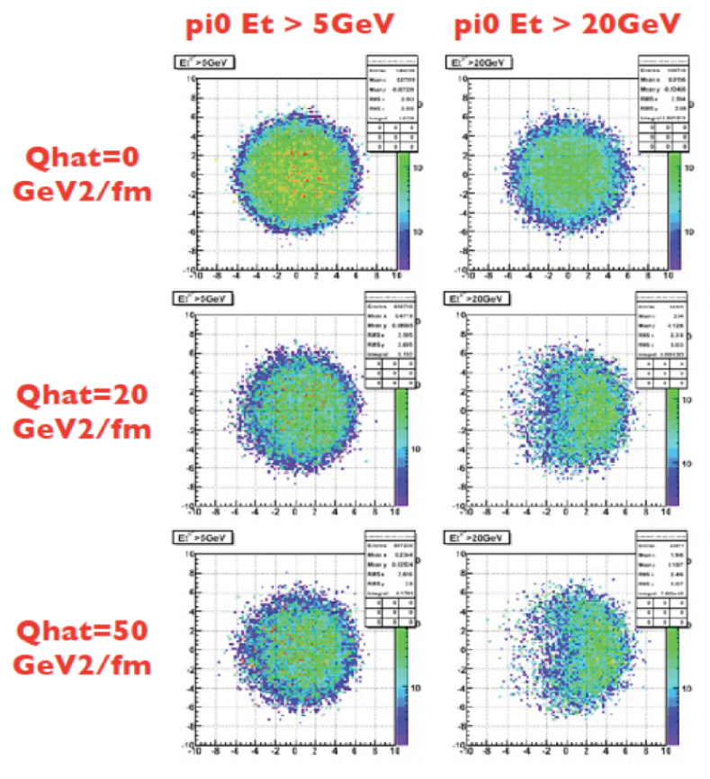
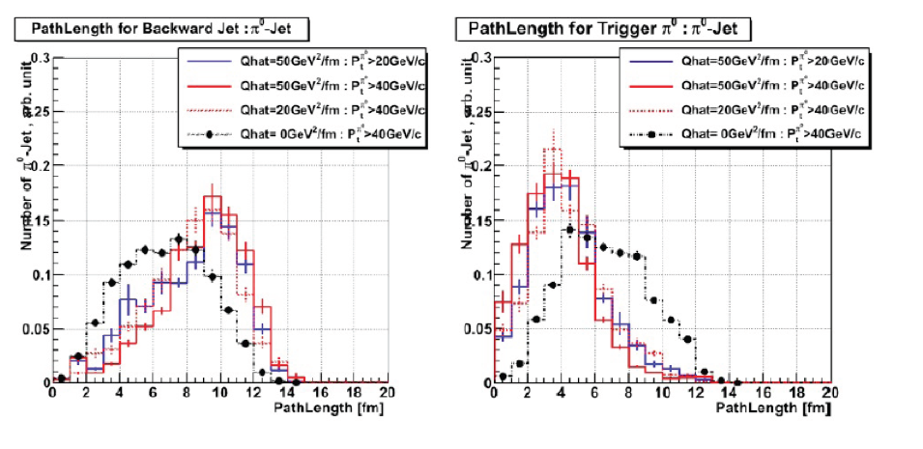
Next generation measurement: controlled variation of jet path length
π⁰
trigger
Calculation: qPYTHIA
R
Jet
L2
L1

Slide 38
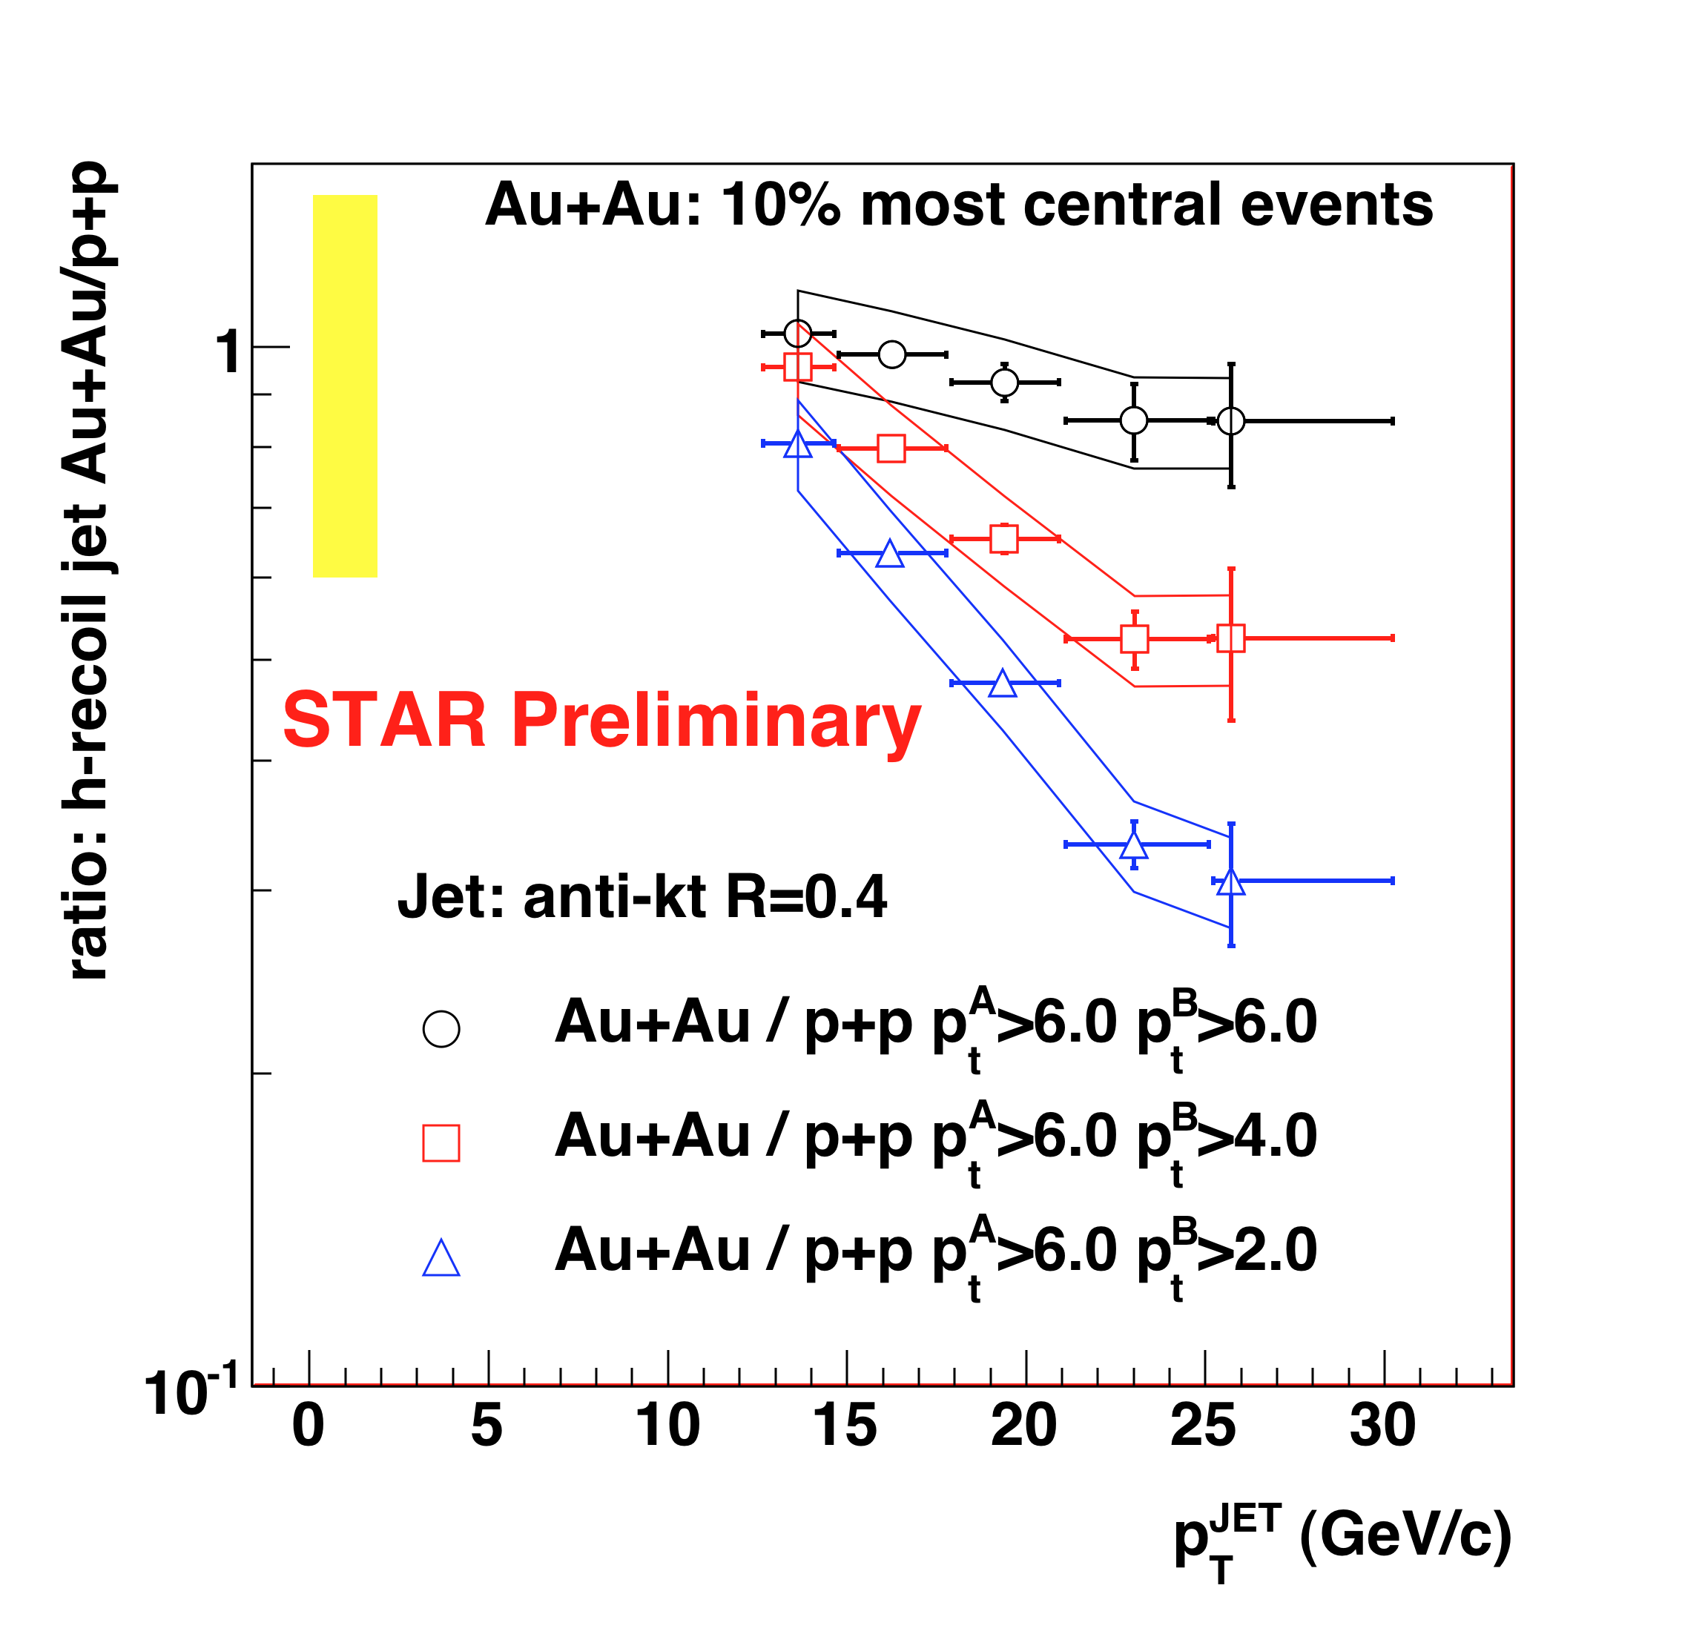
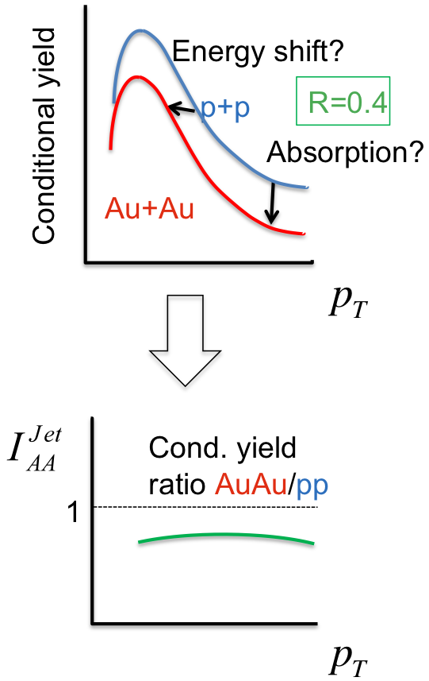
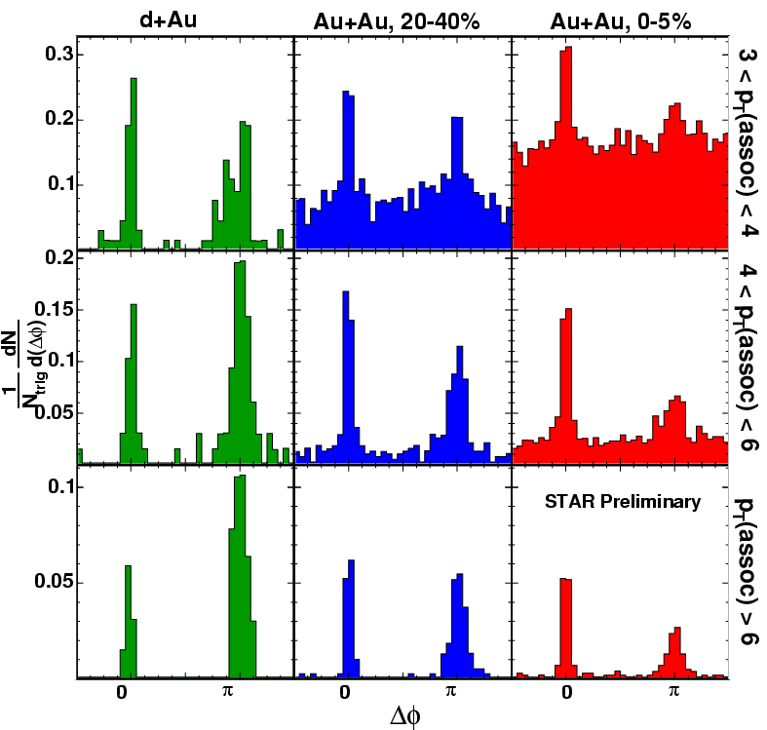
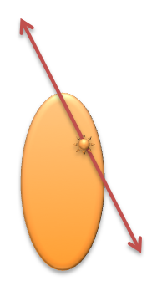
STAR Au+Au: hadron-jet correlation
high p_{T} dihadrons:
bias towards non-interacting jet population
trigger
π⁰
Conditional yield
R
Jet
Δφ
Event selection maximizes recoil path length distribution in matter

Slide 39
Extra

Slide 40
HI Jet Reconstruction: the observables
Primary observables (jets):
  Cross sections vs p+p
  Cross sections vs R: Energy redistribution (aka jet broadening)
  h+jet and jet+jet coincidences
  subjet distributions
  ....
Secondary observables (hadrons):
  longitudinal momentum distributions
  Transverse momentum distributions (j_{T})
  …..
Note: in HI collisions we should very little rely on kinematics since E is smeared. Counting is more robust!

Slide 41
Systematic Corrections
Trigger corrections:
  p+p trigger bias correction
  p+p Jet patch trigger efficiency
Particle level corrections:
  Detector effects: efficiency and pT resolution
  “Double* counting” of particle energies
    * electrons: - double; hadrons: - showering corrections
    All towers matched to primary tracks are removed from the analysis
Jet level corrections:
    Spectrum shift:
      Unobserved energy
      TPC tracking efficiency
    BEMC calibration (dominant uncertainty in p+p)
    Jet pT resolution
    Underlying event (dominant uncertainty in Au+Au)
Full assessment of jet energy scale uncertainties
Data driven correction scheme
Weak model dependence: only for single-particle response, p+p trigger response
No dependence on quenching models

Slide 42

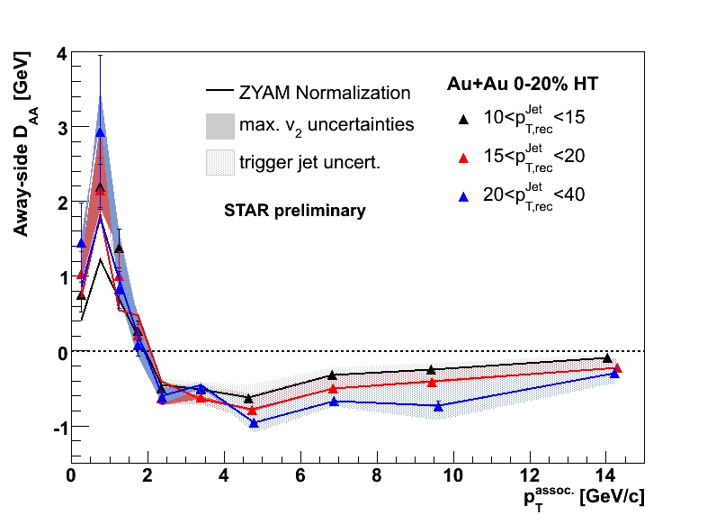
JH: Away-side DAA vs jet energy
Jet energy [GeV] | ΔB [GeV] (stat. only)
10-15 | 2.3 +- 0.48
15-20 | 1.2 +- 0.64
20-40 | 1.5 +- 1.2
Away-side yields enhancement/suppression not fully balanced, more energy at low pT in Au+Au
But significant amount of energy ~3-4 GeV at
low pT compensated by high-pT suppression!
Jet-quenching at work !
Jörn Putschke, INT 2010
Notes:
D_{AA}=Y_{AA}(p_T^{assoc})\cdot \left< p_T \right>^{AA}-Y_{pp}(p_T^{assoc})\cdot \left< p_T \right>^{pp}
\Delta B = \int dp_T^{assoc} D_{AA}(p_T^{assoc})
D_{AA}(p_T^{assoc})=Y_{AA}(p_T^{assoc})\cdot p^{assoc}_{T,AA}-Y_{pp}(p_T^{assoc})\cdot p^{assoc}_{T,pp}

Slide 43
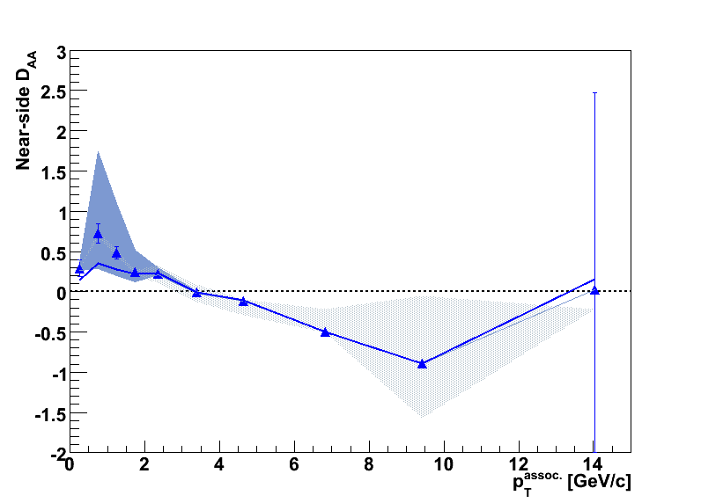
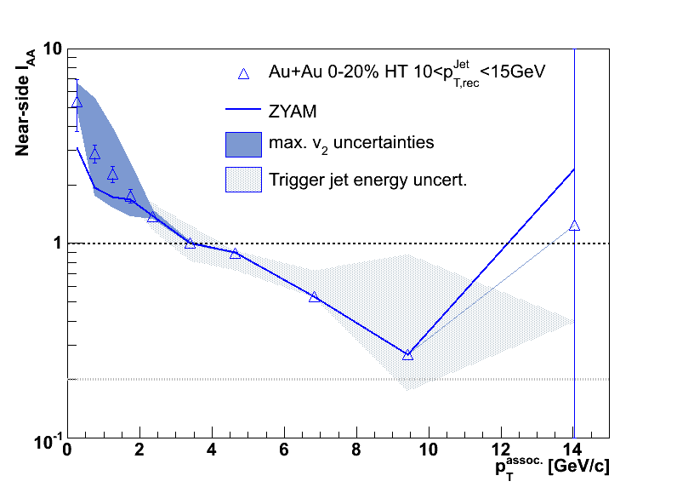
JH: Near-side IAA and energy balance DAA...
Trigger jet energy selection
STAR Preliminary
0-20% Au+Au
10<pT,rec^{Jet}<15 GeV
(effect smaller for
larger jet energies)
STAR Preliminary
0-20% Au+Au
ΔB~0.4 +- 0.2 (stat.) GeV for jet energies 10-15 GeV (ΔB~1.6 GeV w/o p+p energy shift)
Is the near-side suffering energy loss even with these stringent jet criteria !?
Are we just biasing the p+p like fragmentation after energy loss and do not
see the energy loss in this analysis and di-hadrons, because it happens below 2 GeV?
Caveat: Δη study on near-side required; in progress ...
Jörn Putschke, INT 2010
Notes:
D_{AA}=Y_{AA}(p_T^{assoc})\cdot \left< p_T \right>^{AA}-Y_{pp}(p_T^{assoc})\cdot \left< p_T \right>^{pp}
\Delta B = \int dp_T^{assoc} D_{AA}(p_T^{assoc})

Slide 44
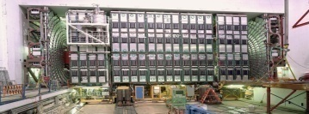
pQCD view of jets in hadronic collisions…
Final State Radiation
(FSR)
Detector
{π,K,p,n,…}
Initial State Radiation
(ISR)
Hadronization
Jet
p
Beam
Remnants
=
(uud)
Beam
Remnants
p
=
(uud)

