Slide 1




Spin Physics at STAR
W and Forward Physics
Akio Ogawa
BNL
2015 May 26
QCD Evolution 2015 @ Jlab

Slide 2

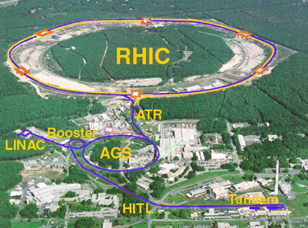
The Relativistic Heavy Ion Collider
Brhams
pp2pp
Au+Au
Polarized p+p
d+Au
Polarized p + Au
RHIC is a QCD lab
PHENIX
STAR

Slide 3
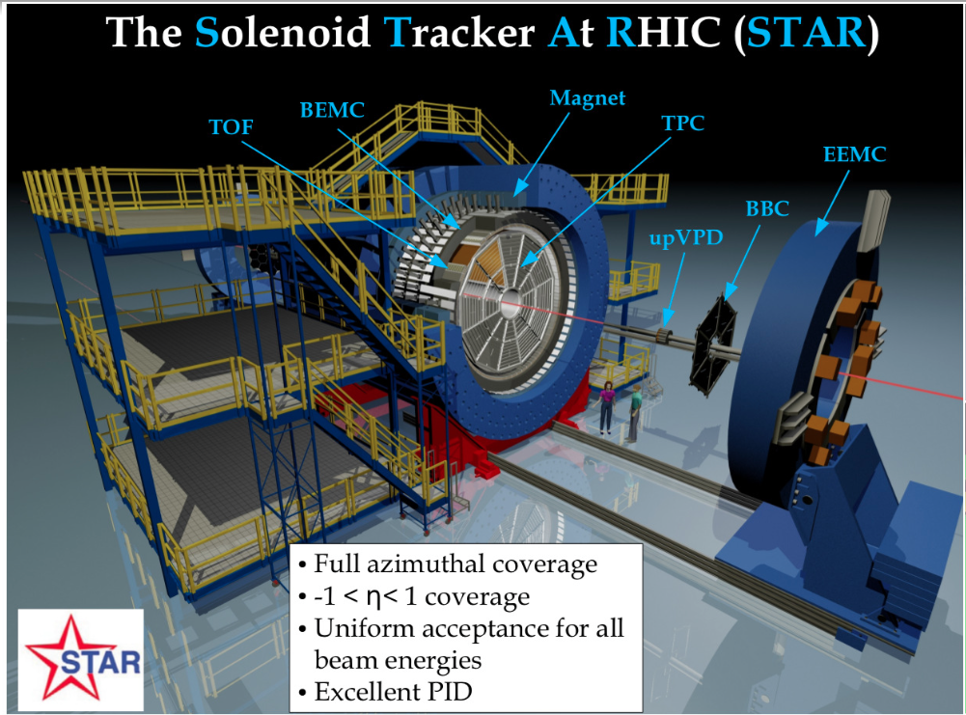

Slide 4
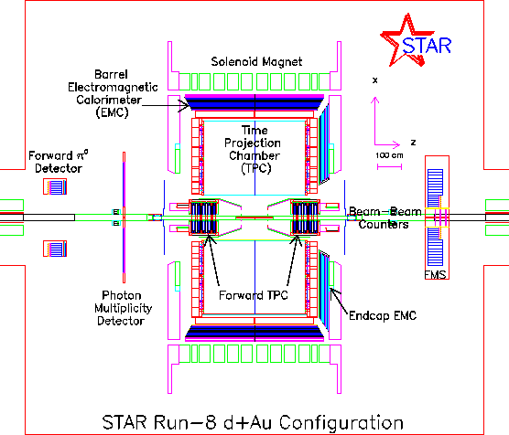
The STAR Detector
TPC: -1.4 < η < 1.4
BEMC: -1.0 < η < 1.0
EEMC: 1.0 < η < 2.0
FMS: 2.5 < η < 4.2
Mid Rapidity : Charged particles & EM Calorimeter
Forward Rapidity : EM Calorimeter

Slide 5
STAR Spin Program
Mid Rapidity TPC BEMC EEMC | Jet Di-Jet | σ High-x gluon density
 |  | A_{LL} Gluon Spin
 |  | A_{N} Collins
 |  | A_{N} IFF
 | W,Z | σ
 |  | A_{L} Sea Quark Spin
 |  | A_{N} Sivers
Forward Rapidity EEMC FMS | pi0, eta, EM-Jet (Photon, DY) | A_{LL} Gluon Spin
 |  | A_{N} Twist-3, Collins, Sivers
Roman-Pot | proton | Elastic and Diffraction
R. Fatemi’s
talk
This talk
Wide range of physics in the past and future !

Slide 6
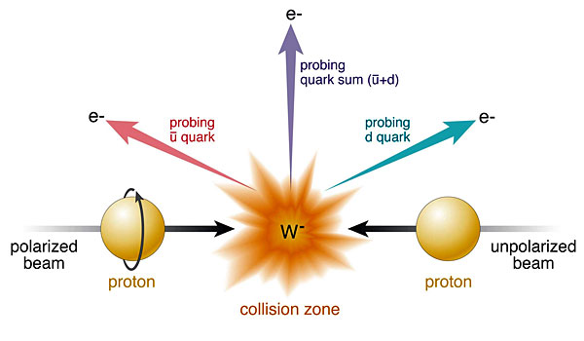

Physics with W⁺/W⁻/Z⁰
Sensitive to u-bar & d-bar at
x>0.1
very high Q²
Single Longitudinal Spin Parity Violating A_{L}
Single Transverse Spin A_{N}
Sivers effect and its sign change:
TMD Q² Evolution
(Unpolarized) W⁺/W⁻ cross section ratio
Sivers_{DIS} = - Sivers (DY or W or Z)

Slide 7
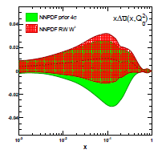
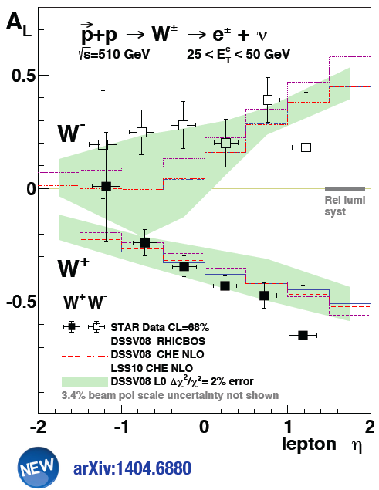

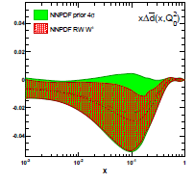

W A_{L} Results
first result from muon arms
arXiv:1406.5539

Slide 8
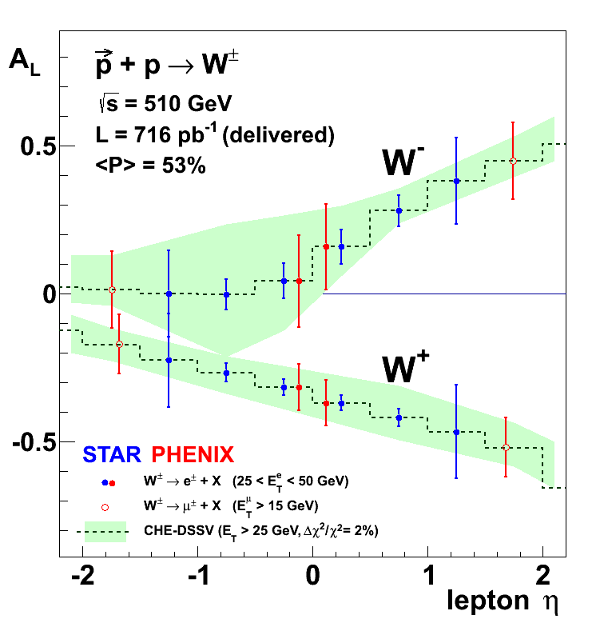
“On tape” W-Pseudo-Results
Pseudo-data randomized around DSSV
uncertainties correspond to 2009-2013
arXiv:1304.079
RHIC W± data will be a strong constraint for

Slide 9
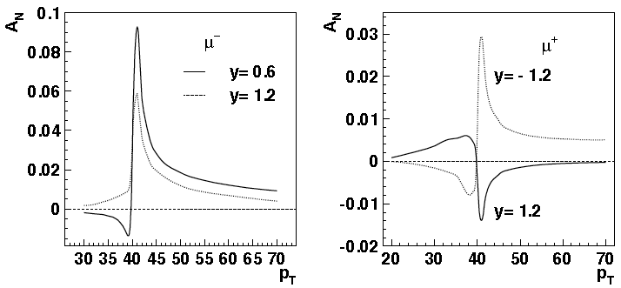
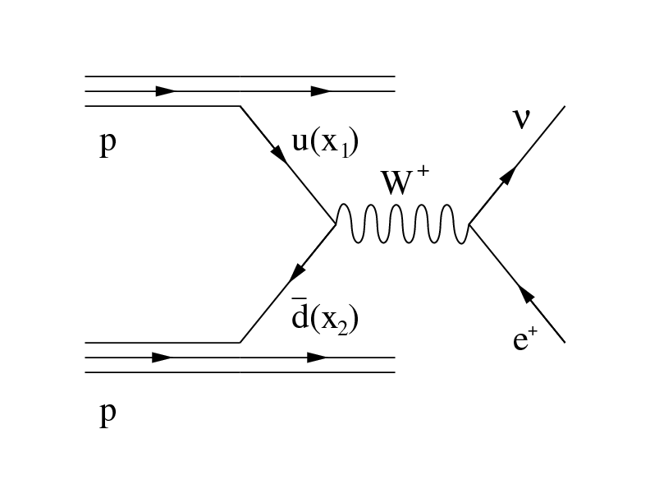
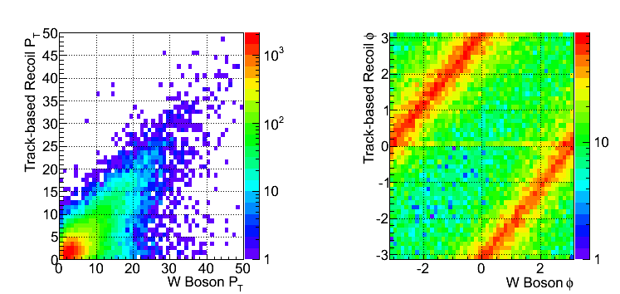
W reconstruction with recoil
Decay Lepton Asymmetries
Decay lepton A_{N} is small and hard to measure
W p_{T} ~ few GeV << ~40GeV from W decay
Z.-B. Kang & J.-W. Qui arXiv:0903.3629
W momentum reconstruction well tested at FermiLab and LHC
[CDF: PRD 70, 032004 (2004); ATLAS: JHEP 1012 (2010) 060]

Slide 10
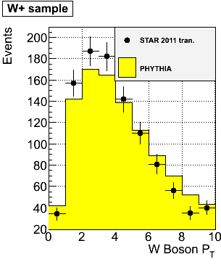
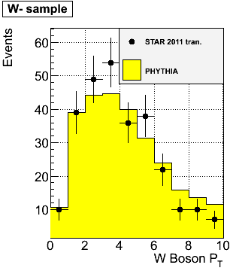
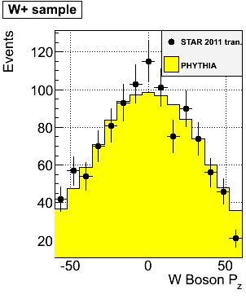
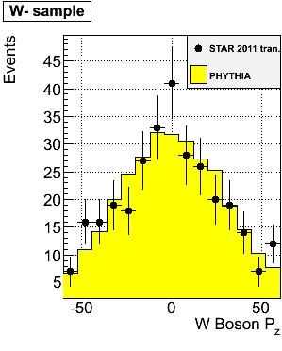
W kinematics reconstruction
Data vs MC comparison for W p_{T} and P_{Z}
Track-P_{T} in the recoil > 0.2 GeV
Total recoil-P_{T} > 0.5 GeV
Good data/MC agreement for reconstructed P_{T} of W⁺ and W⁻
This enables W A_{N} measurement
This helps W⁺/W⁻ x-section ratio

Slide 11
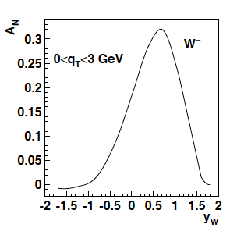
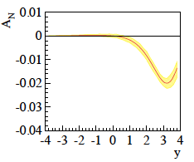
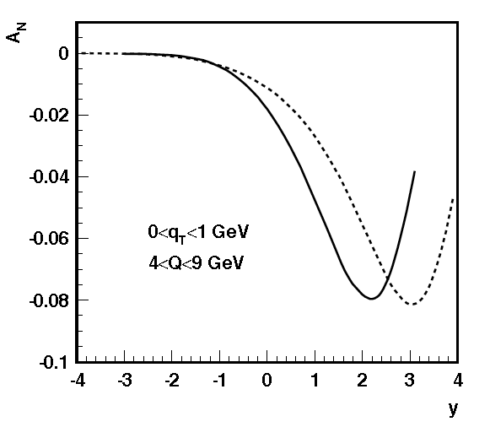
The TMD evolution
Z.-B. Kang & J.-W. Qui arXiv:0903.3629
Z. Kang: original paper arXiv:1401.5078
before evolution
after evolution
much stronger than
any other known
evolution effects
needs input from
data to constrain
non-perturbative
part in TMD evolution
current data extremely limited
further constraints
cannot come from fixed
target SIDIS
→ too small lever arm in
Q² & p_{T}
STAR W (and DY) data will
be the key measurement
for Sivers (TMD) evolution
÷ ~10
Z.-B. Kang & J.-W. Qui Phys.Rev.D81:054020,2010
Z. Kang et al. arXiv:1401.5078
before evolution
after evolution
DY
÷ ~4
200 GeV
500 GeV
4 < Q < 9 GeV
0 < q_{T} <1 GeV

Slide 12
W A_{N} Results
Run2011 transverse spin → 25/pb and P=53%
Systematics estimated via a Monte Carlo
We use the “left-right” formula to cancel dependencies on geometry and luminosity

Slide 13
Z⁰ Asymmetry
Clean experimental momentum reconstruction
Negligible background
electrons rapidity peaks within tracker accept. (|η|< 1)
Statistics limited
Z⁰ boson selection criteria
Two tracks each pointing to a cluster (no isolation requirements)
E_{T} > 25 GeV for both candidates
The two candidate tracks have opposite charge
|Zvertex|< 100 cm
Invariant Mass within ± 20% from the nominal M_{Z}
A_{N} measured in a single y, P_{T} bin
2011 pp-tran. ~25 pb⁻¹: 50 events pass selection

Slide 14
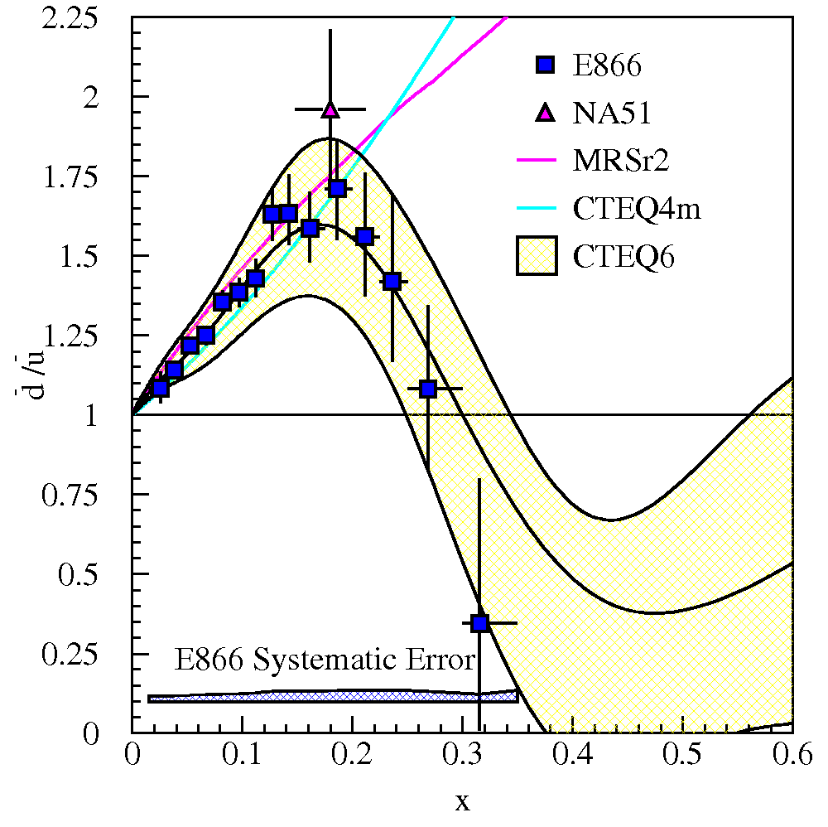
unpolarized W+/W- ratios
Current data: E866/NuSea (Drell-Yan)
Unpolarized asymmetries: Quantitative calculation of Pauli blocking does not explain ratio
→ Non-pQCD effects are large for sea quarks?
LHC coverage: ~10⁻³ < x < 10⁻¹
RHIC coverage: x > ~10⁻¹
STAR data
pp – run11 transverse @ √500 GeV Integrated Luminosity ~25 pb⁻¹
pp – run12 long @ √510 GeV Integrated luminosity: ~ 77 pb⁻¹
Total Int. lumi: 102 pb⁻¹

Slide 15
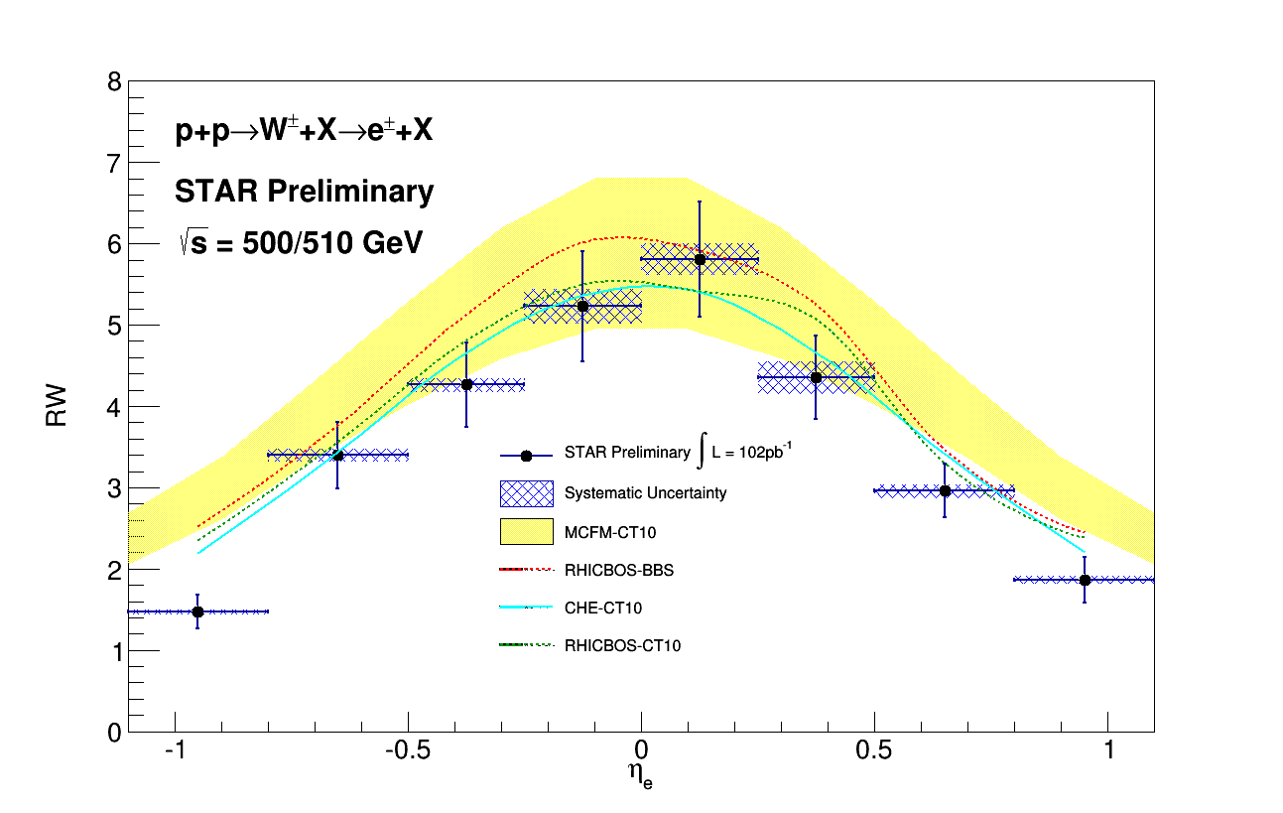
W+/W- versus Electron-Eta
Collected Lumi = 102 pb⁻¹
σ(W+) / σ(W-)
Systematics uncertainties (blue shades) come from background subtraction:

Slide 16
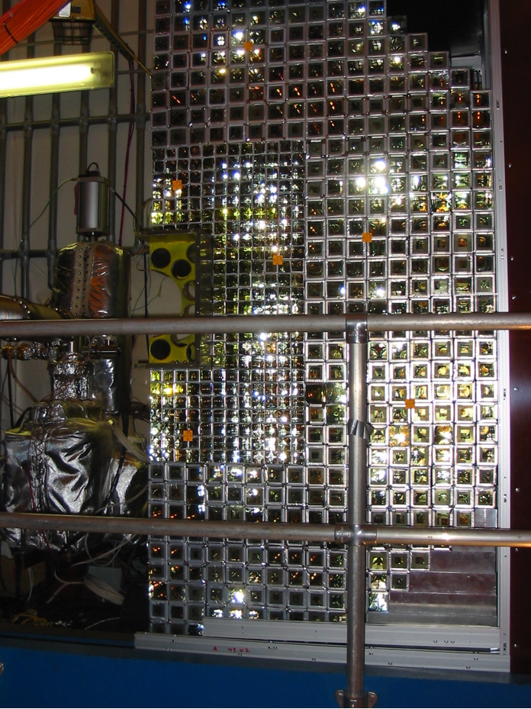
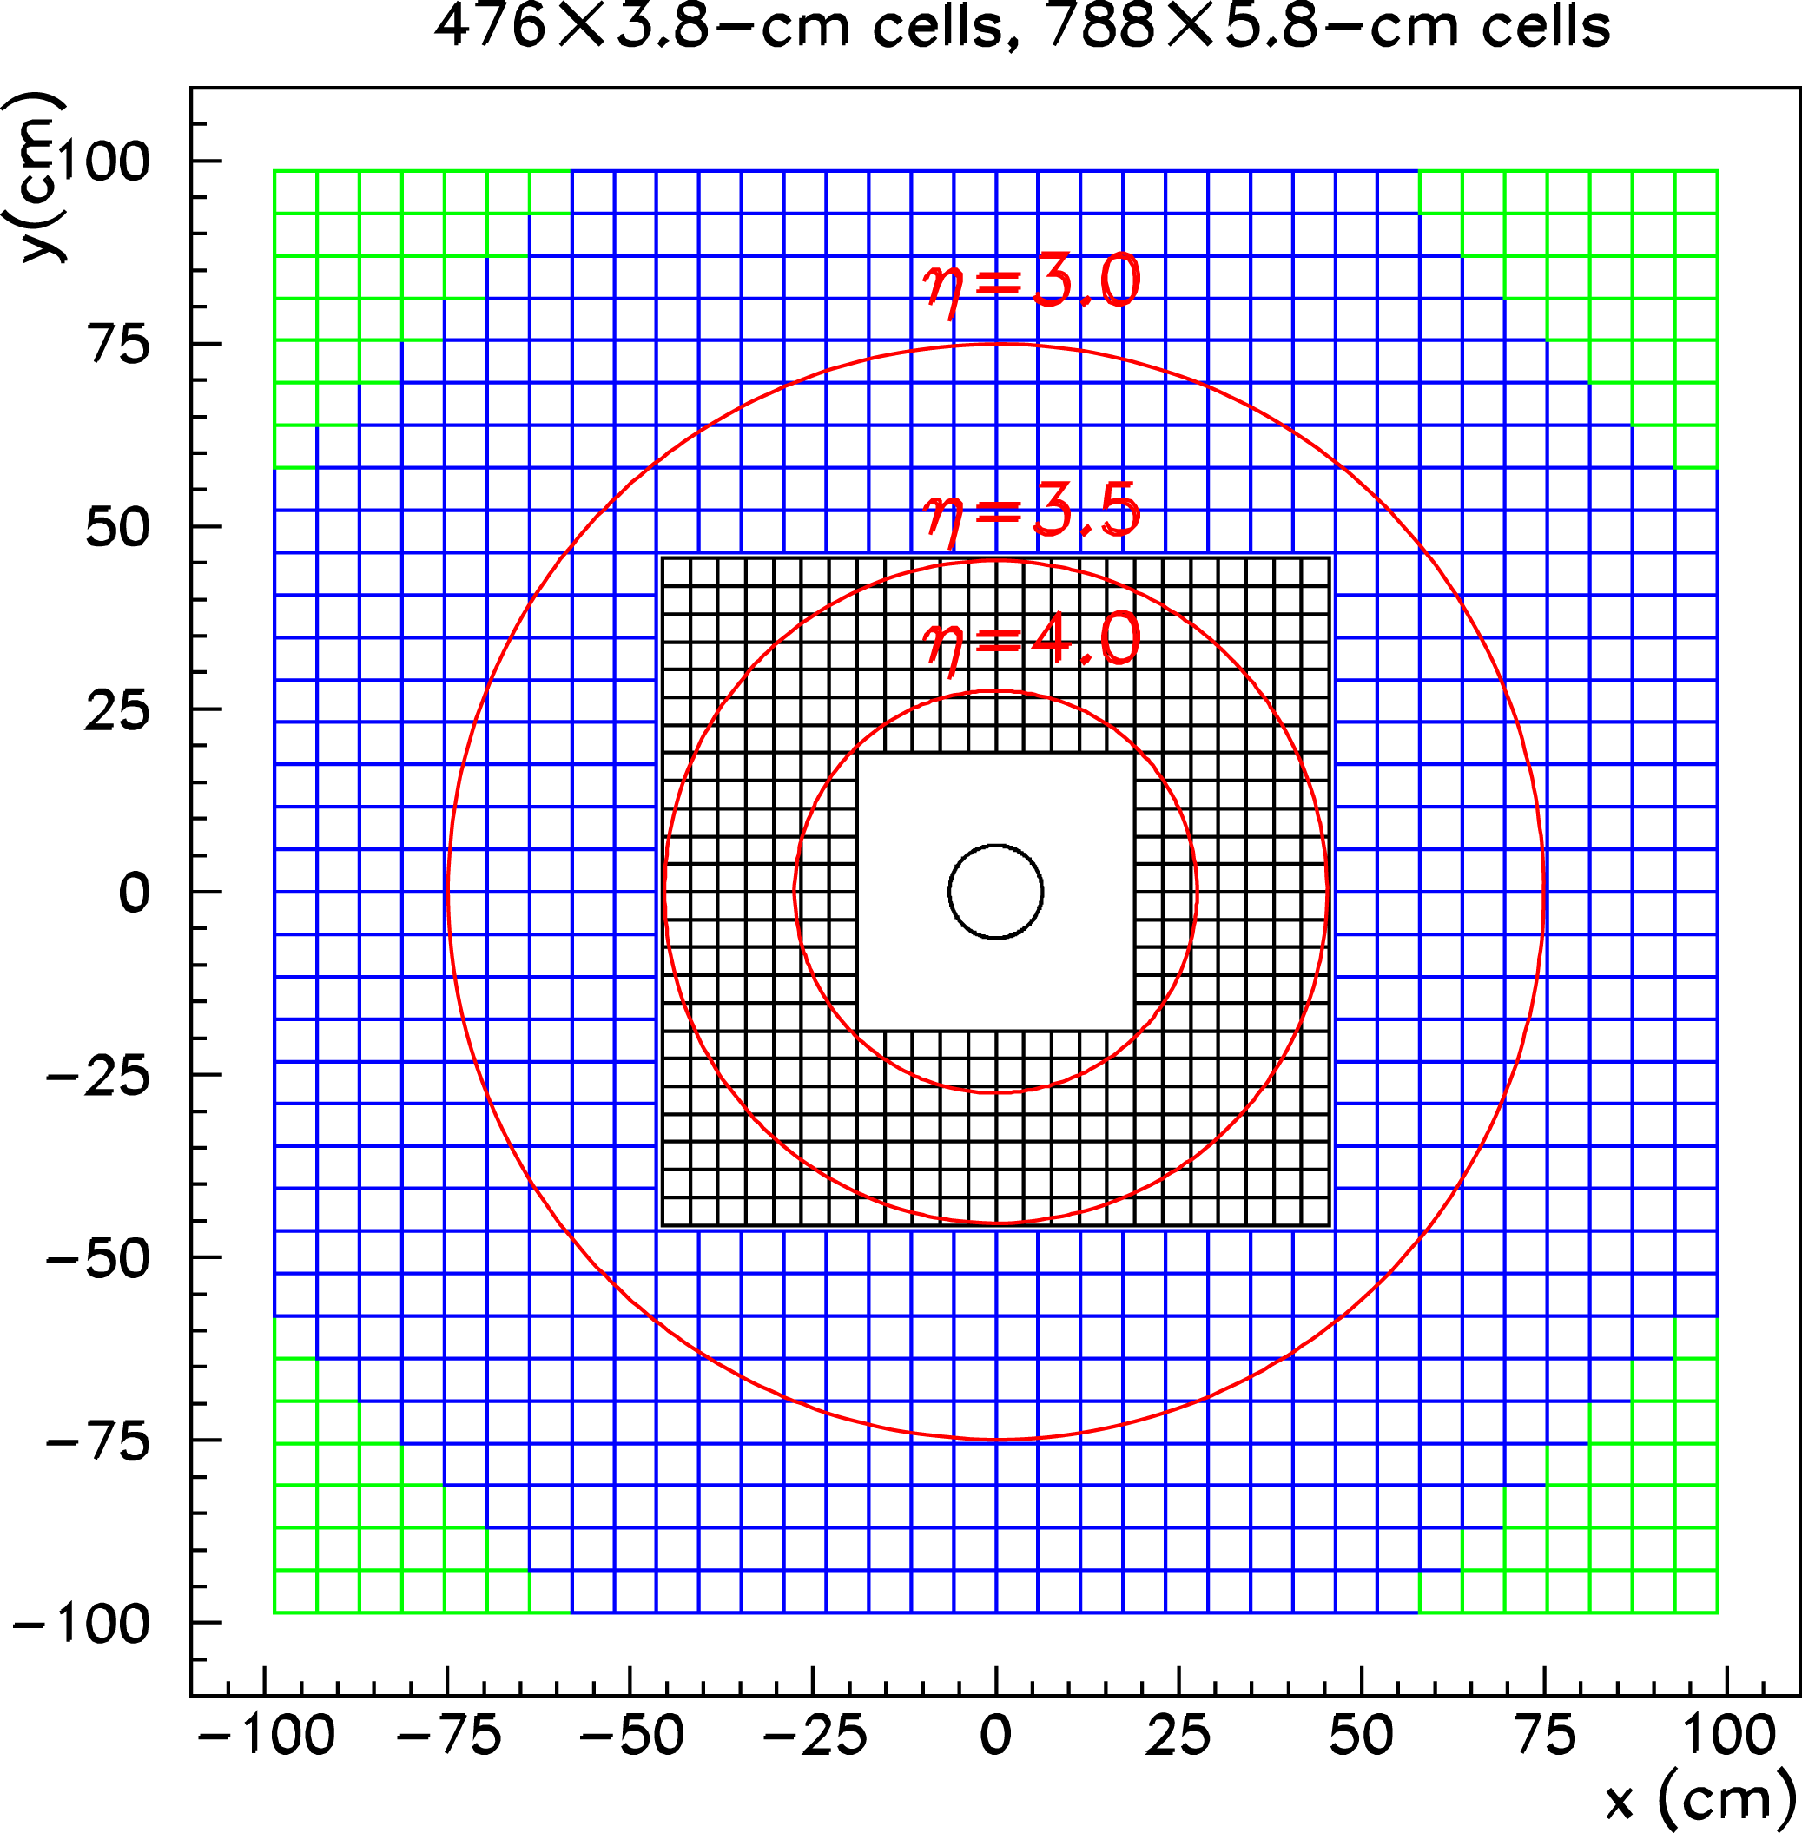
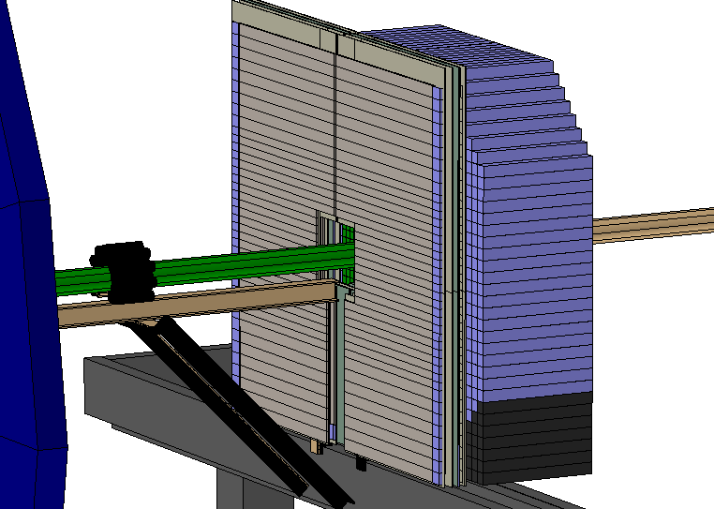
Forward Physics

Slide 17
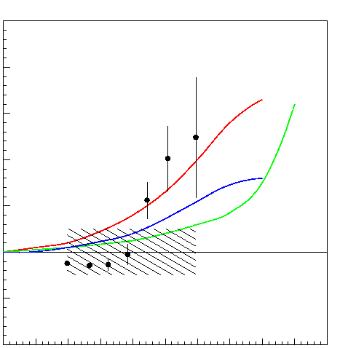
13 years ago @ SPIN2002
A_{N} (π⁰)
Theory predictions
at p_{T} = 1.5 GeV/c
Collins effect
Anselmino, et al.
PRD 60 (1999) 054027.
Sivers effect
Anselmino, et al.
Phys. Lett. B442 (1998) 470.
Twist 3 effect
Qiu and Sterman,
Phys. Rev. D59 (1998) 014004.
STAR FPD Preliminary Data
Assuming A_{N}(CNI)= 0.013
p_{T}=1.1 - 2.5 GeV/c
0.4
0.2
0.0
sqrt(s)=200GeV
-0.2
x_{F} ~ E / 100 GeV
0
0.2
0.4
0.6
0.8
1.0

Slide 18
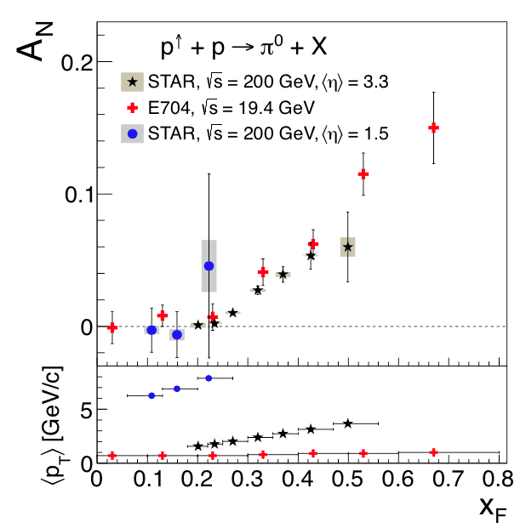
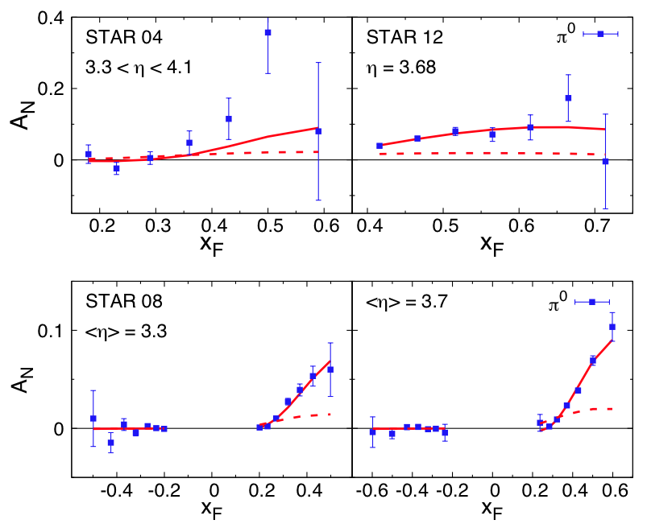
Inclusive pi0 A_{N}
A_{N} from STAR FMS and EEMC
arXiv:1404.1033
“We show for the first time that it is possible to simultaneously describe spin/azimuthal asymmetries in proton-proton collisions, semi-inclusive deep-inelastic scattering, and electron-positron annihilation”

Slide 19
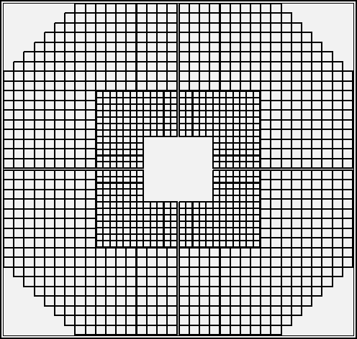
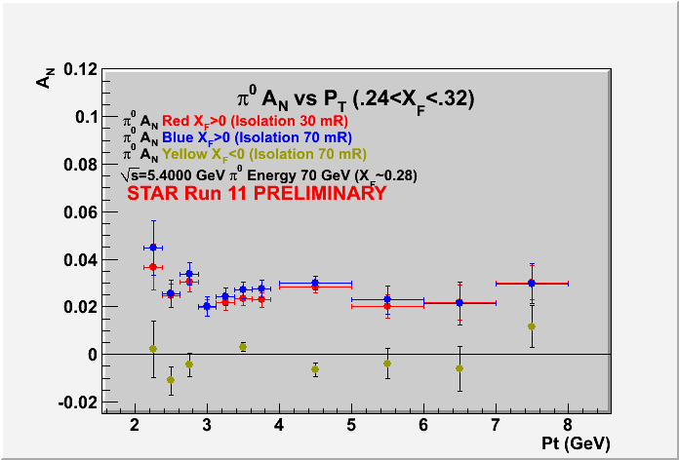
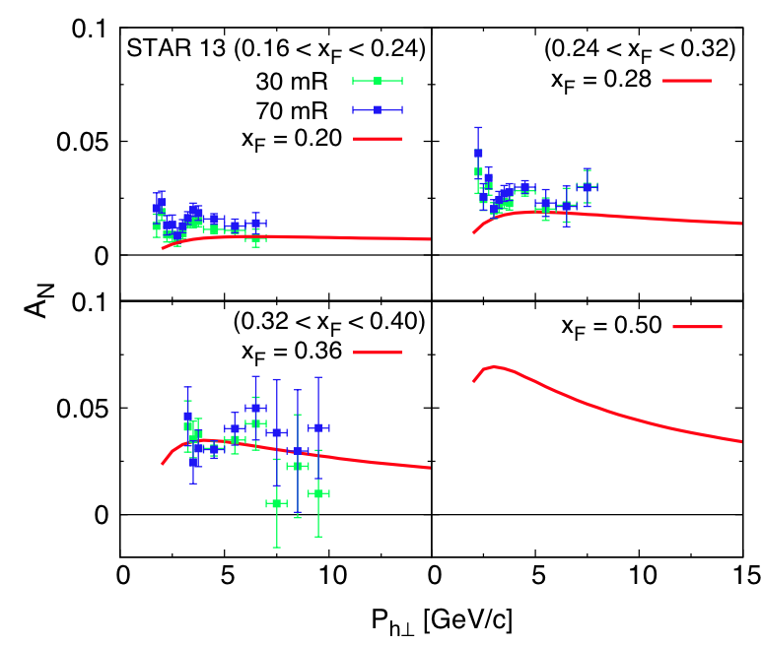
Pi0 A_{N} P_{T} Dependence

Slide 20
Inclusive pi0 A_{N}
arXiv:1404.1033
“We repeat that the fragmentation contribution in twist-3 factorization goes beyond the pure Collins effect. Independent information on the FFs H^{π/q}, Hˆ^{π/q},I from other sources is needed before one can ultimately claim the intriguing data on A_{N}^{π} is fully understood.”
Kanazawa,Koike,Metz,Pitonyak

Slide 21
“EM-Jet”
EM-Jet Energy 60-80 GeV
# Jets
dE/d(ΔR) (arbitrary scale)
No. of photons in leading EM-Jets
EM-Jet Energy 60-80 GeV
Z _{ϒϒ}<0.8, no. photons =2
# Jets
dE/d(ΔR) distribution of EM-Jets
2-photon jets are mostly π⁰
Events with more than 2 photons show
jet-like energy flow
m_{γγ} (GeV/c²)
γγ invariant mass 2-photon EM-jets

Slide 22
A_{N} for different # photons in EM-Jets
1-photon events, which include a large π⁰ contribution in this analysis, are similar to 2-photon events
Three-photon jet-like events have a clear non-zero asymmetry, but substantially smaller than that for isolated π⁰’s
A_{N} decreases as the event complexity increases (i.e., the "jettiness”
A_{N} for #photons >5 is similar to that for #photons = 5
Jettier events

Slide 23
A_{N} vs. EM-Jet Energy
π⁰-Jets
2γ-EM-Jets with
m_{γγ} <0.3 GeV/c²
Z_{γγ} <0.8
EM-Jets
with no. photons >2
Asymmetries for jettier events are much smaller

Slide 24
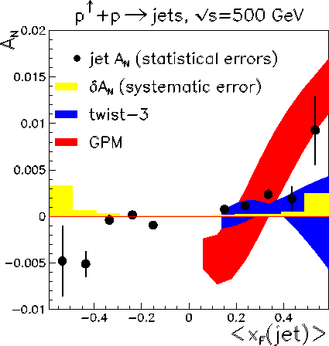
Jet A_{N} at A_{N}DY
From fits to SIDIS Sivers moments
Projected for pp forward jet A_{N}
M. Anselmino et al
PhysRevD.88.054023
arXiv:1304.7691
Leonard Gamberg, Zhong-Bo Kang, Alexei Prokudin
Phys. Rev. Lett. 110, 232301(2013)
arXiv:1302.3218

Slide 25
Collins Asymmetry with EM-Jet
Collins angle and Z_{EM} are calculated w.r.t. the “EM-Jet”
Background asymmetries are subtracted statistically
One sided systematic uncertainty accounts for Collins angle resolution
Hint of possible non-zero Collins asymmetries for pi0?

Slide 26
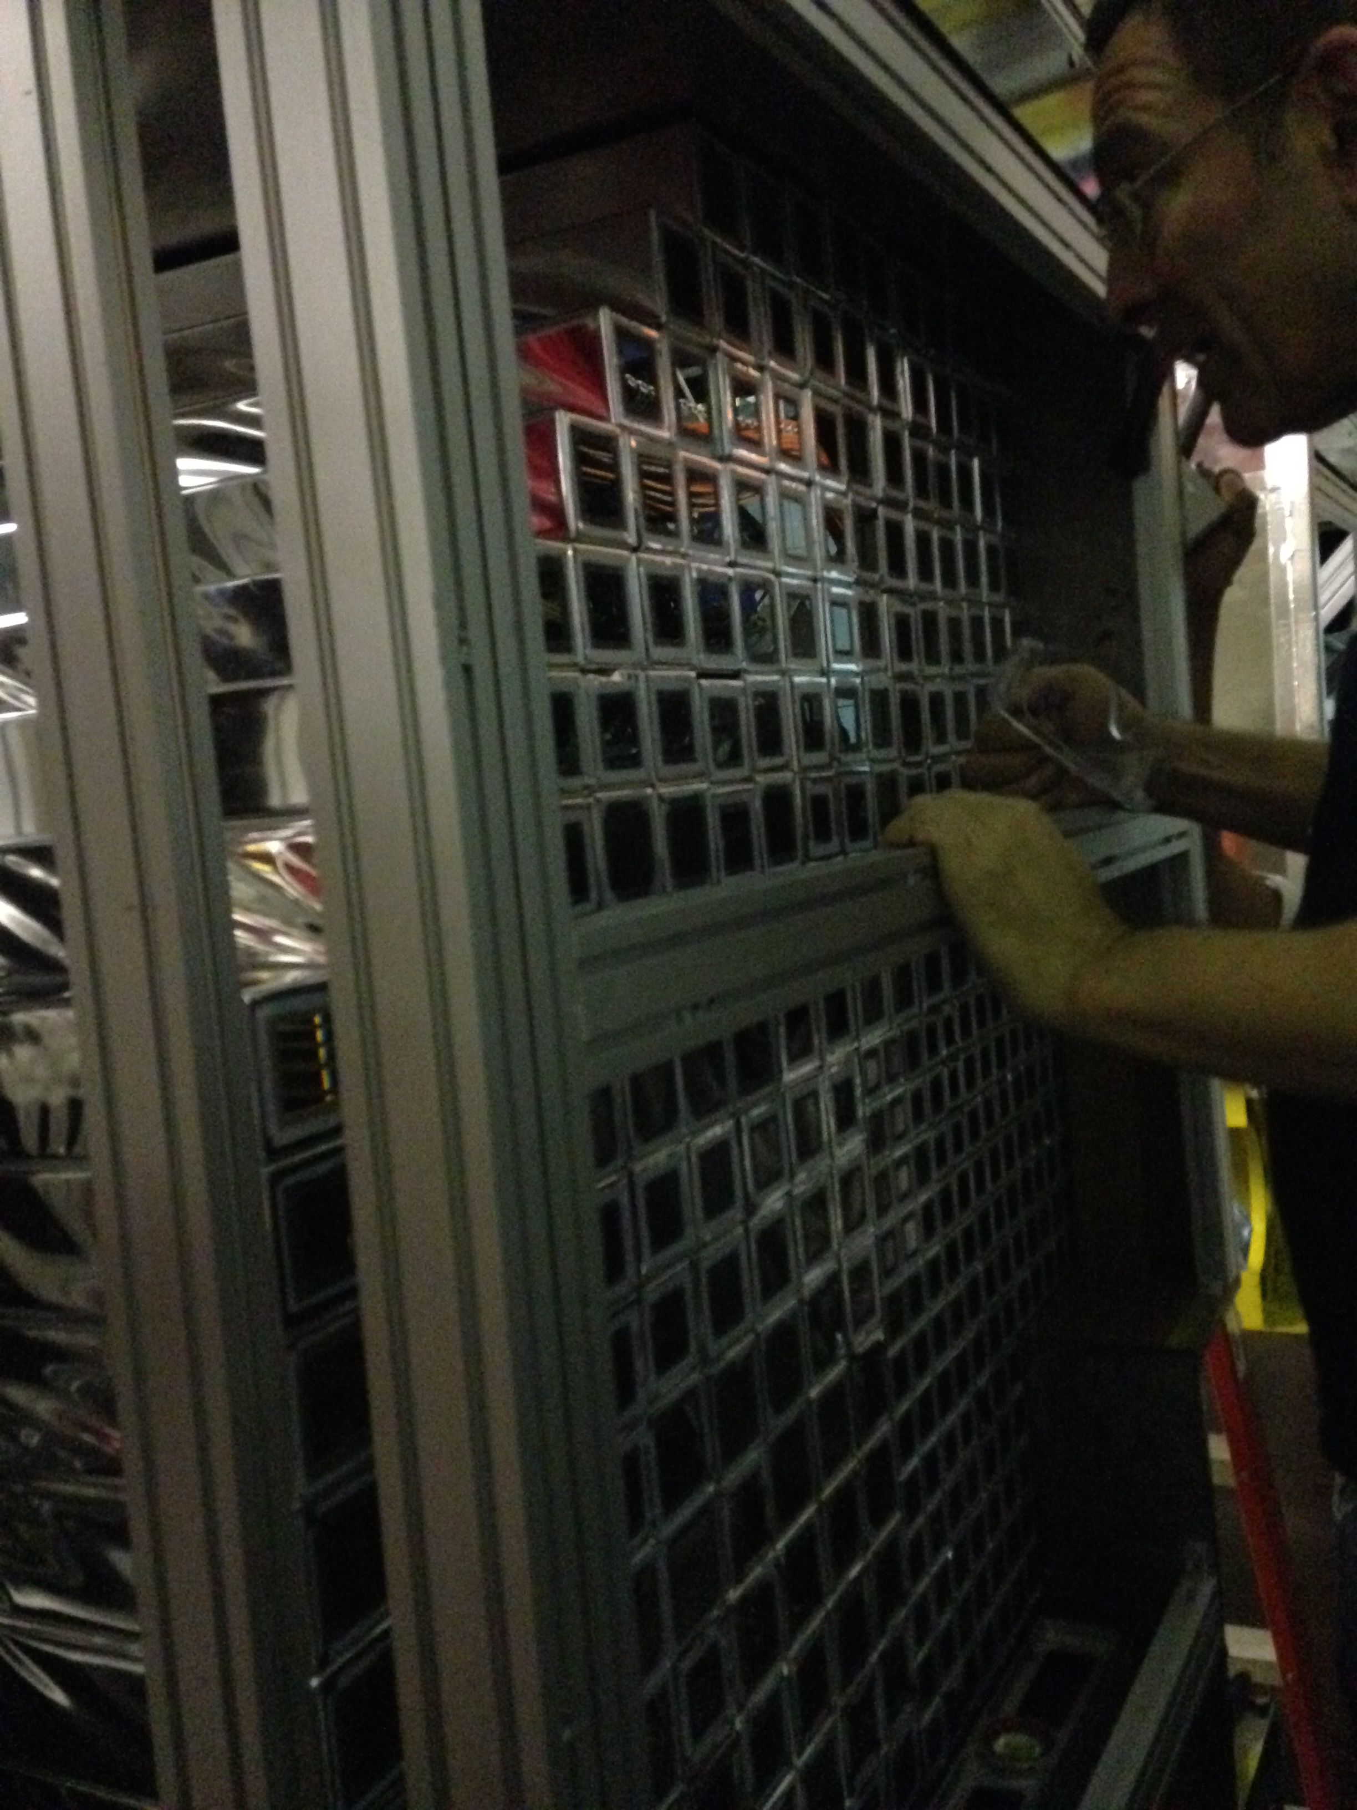
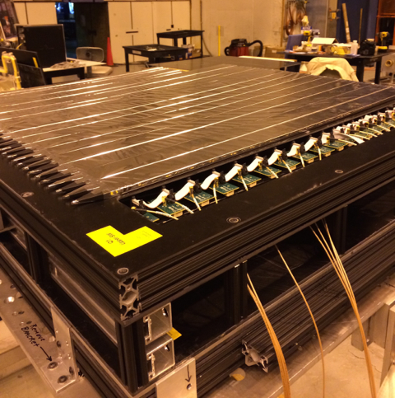
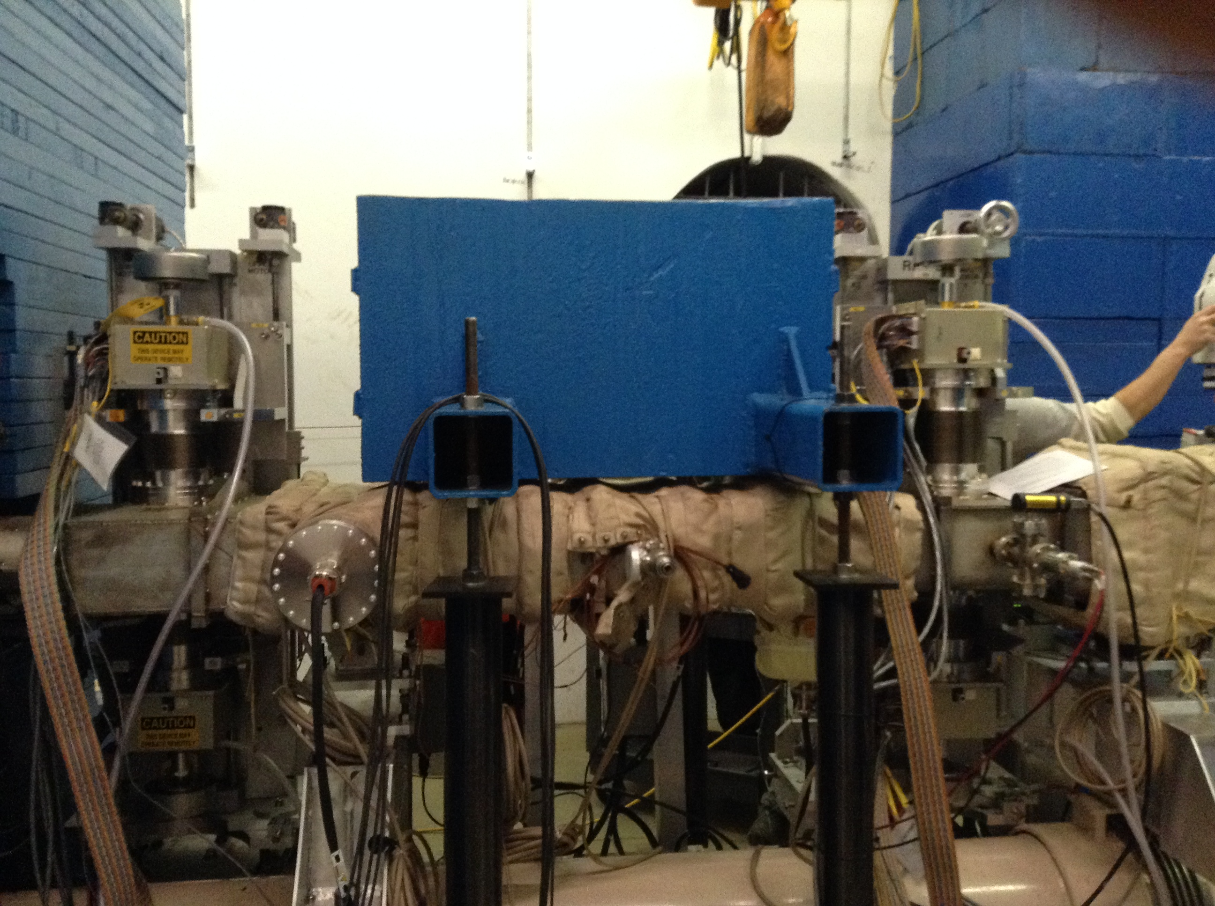
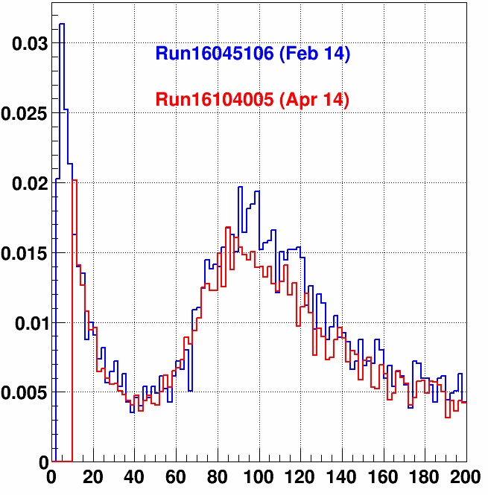
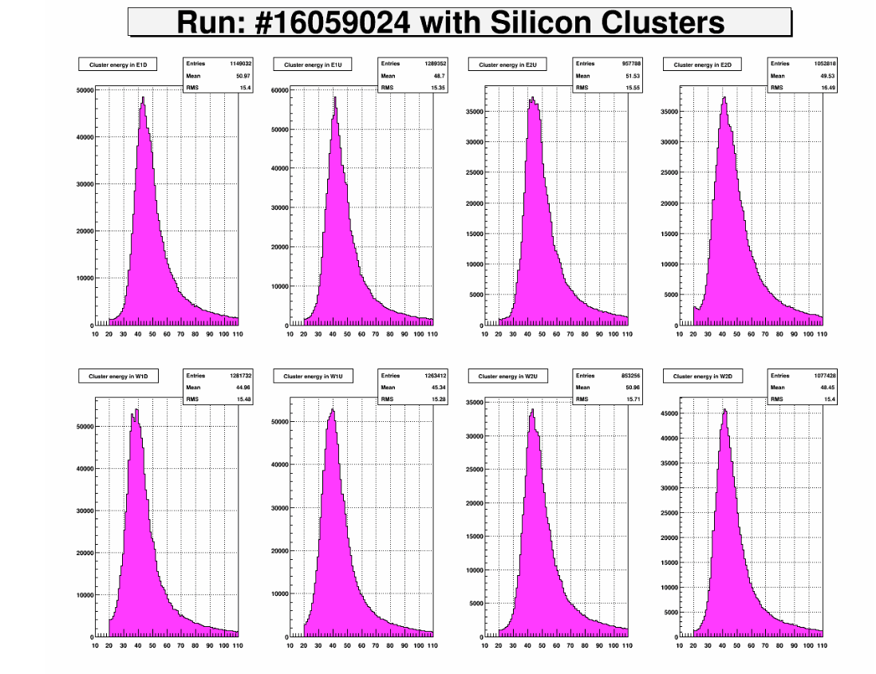
Run 15
FMS refurbishment
  Annealing PbG with sun light and re-stack
  Replaced unstable PMT-bases
  Trigger upgrade
FPS for photon/electron/hadron PID
  SiPM (Hamamatsu S12572) readout
  3 layer scinti. with Pb conveter in front of FMS
Roman-Pot
  Elastic and Diffractive physics
  Pi0 A_{N} with tagging diffractive proton
  GPD E_{g} by J/psi UPC
p+p 200 GeV Transverse Spin ~40/pb P~60%
p+p 200GeV Longitudinal Spin ~50/pb P~60%
p+Au 200GeV Transverse Spin ~300/nb P~60%
(2012 was 22/pb P= 63%)
Si Detector Performance
ADC Ch (0.25pC/ch)

Slide 27
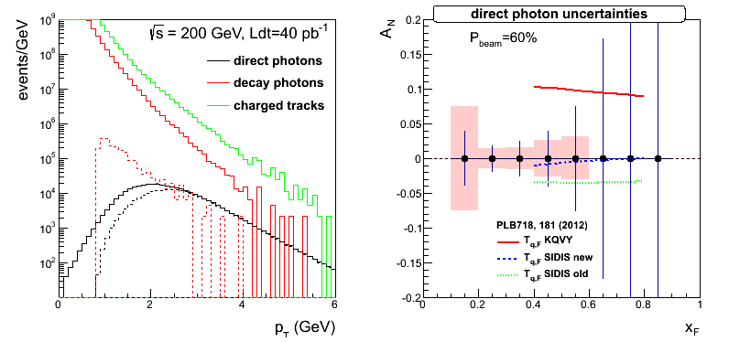
RUN15 Goal
Direct Photon x-section & A_{N} at pT>2.0GeV <- FPS
Pi0 / eta A_{N}
  x_{F} and P_{T} dependences
  Jetty vs Isolated
  Diffractive vs non-diffractive <- Roman Pot
  pp vs pA
Study di-electron channel (J/psi) towards DY <- Trigger upgrades, FPS
Last call for PRE-dictions!!!
Photon A_{N}
Pi0 A_{N} with diffractive proton tagged
Pi0 A_{N} at p+Au collisions

Slide 28
Run17 Plan
RHIC plans to deliver ~400 pb⁻¹ transverse p-p 500GeV in 2017
  Measure A_{N} for γ, W±, Z⁰, DY
  DY and W±, Z⁰ give Q² evolution
  W± give sea-quark Sivers
  All three A_{N} give sign change
Constrain TMD evolution sea-quark Sivers function
Test sign-change if TMD-evolution suppression factor ~5 or less

Slide 29

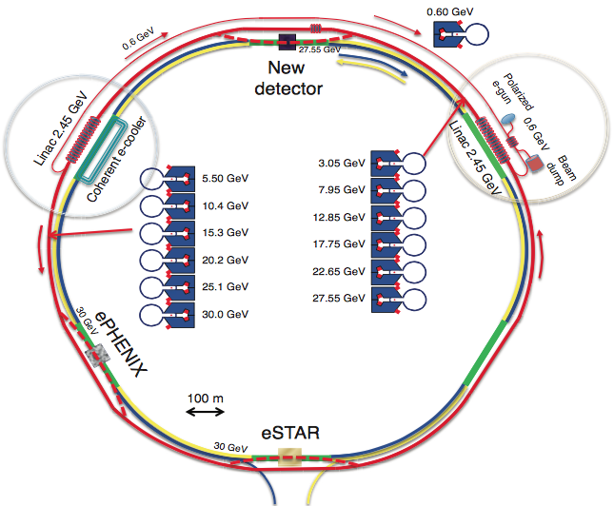
future!

Slide 30
Summary
STAR has a rich spin program : pi0, jets to W bosons with unpol, longitudinal and transverse polarized proton, and now pol p+Au as well.
Run13 data on A_{L} of W± at RHIC will be a strong constraint for
First measurement of A_{N} for W± and Z⁰ production at RHIC by reconstruction of the boson kinematics
Preliminary measurement of unpolarized W+/W- cross section ratios
Forward A_{N}
  Isolated pi0/eta continued to show large A_{N} How to measure Twist-3 FF?
  “EM-jet” has small A_{N}
  A hint for non-zero pi0 Collins asymmetry around “EM-jet”
  Successful Run15 with improved FMS, FPS, Roman-Pot for both p+p and p+Au
      Last call for prediction : A_{N} for photons, diffraction, pAu!
Run17 with 400/pb can give statistical significance to test the Sivers’ sign change and pin down TMD evolution. STAR can have access to A_{N} for photons, W±, Z⁰, DY

Slide 31
STAR Spin Program
Mid Rapidity TPC BEMC EEMC | Jet Di-Jet | σ High-x gluon density
 |  | A_{LL} Gluon Spin
 |  | A_{N} Collins
 |  | A_{N} IFF
 | W,Z | σ
 |  | A_{L} Sea Quark Spin
 |  | A_{N} Sivers
Forward Rapidity EEMC FMS | pi0, eta, EM-Jet (Photon, DY) | A_{LL} Gluon Spin
 |  | A_{N} Twist-3, Collins, Sivers
Roman-Pot | proton | Elastic and Diffraction
R. Fatemi’s
talk
This talk
To be continued to R.Fatemi’s Talk on Thursday

Slide 32
Backup

Slide 33
W+/W- versus Boson-Rapidity
σ(W+) / σ(W-)

