Slide 1

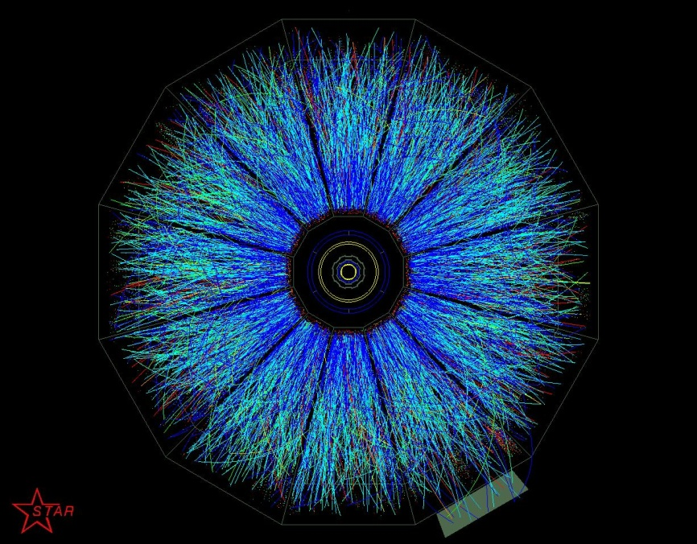




Femtoscopy of identified particles at STAR
Neha Shah
for the STAR Collaboration
University of California Los Angeles

Slide 2
Outline
  Systematic baryon probes (√s_{NN}=7.7 - 200 GeV)
  p-p femtoscopy and homogeneity length for deuteron
  p-Λ femtoscopy
  Spatial correlations – coalescence connection
    p-n-Λ (coalescence into hypertriton )
  Λ-Λ correlations
  Latest results on
    Azimuthal HBT
  π-K correlations

Slide 3
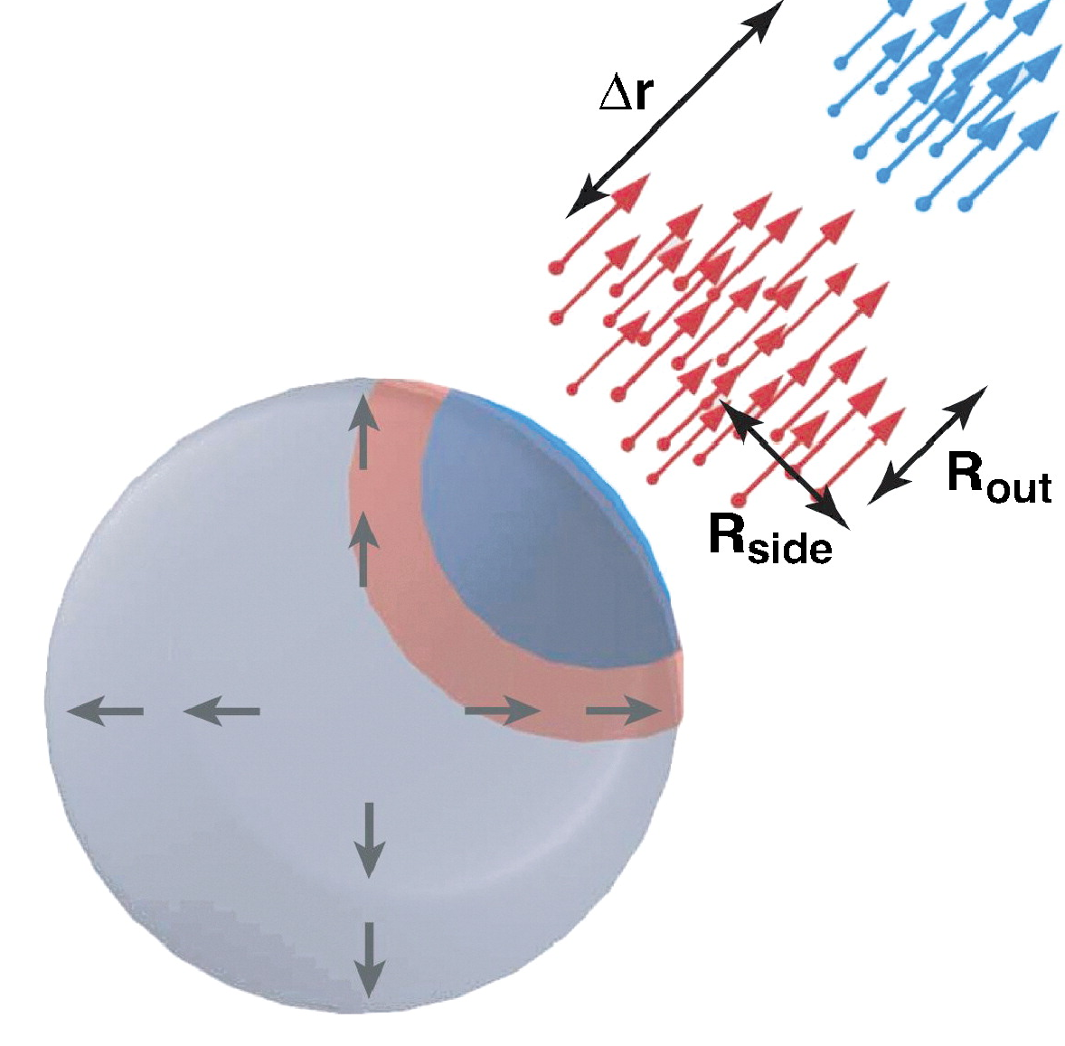
Femtoscopy 101
The goal: probe the geometrical (sub)structure of the emitting source at the femtometer scale
The procedure: measure 2-particle correlations in relative momentum (q)
The connection:
- Koonin-Pratt equation
The result: separation distribution
often characterized by homogeneity or “HBT” radius
usually depends on (flow)

Slide 4
Probing Baryon Geometry via Correlations
Baryon sector:
[1] Phys.Part.Nucl.Lett. 8 (2011) 931
[2] Phys. Rev. C 74 (2006) 064906
[3] Poster 155 – N. Shah
[4] Poster 308 – W. Llope
[5] Talk in Parallel 5A - Yuhui Zhu
Femtoscopy
Coalescence

Slide 5
(Anti)Proton-(Anti)Proton Femtoscopy – 200 GeV
0-10%
10-30%
30-80%
Complex correlation structure
Strong & Coulomb (well-understood)
Fermi statistics / annihilation
Corrected for purity and correlated feed-down (“residual correlations”) from p-Λ
Reasonable fit (Gaussian source) and centrality dependence
STAR Preliminary
Eur. Phys. J.C 49 (2007) 75

Slide 6
Proton Femtoscopy in BES program:
Fit: R = 4.15 ± 0.43 fm (0-10%)
R = 3.63 ± 0.21 fm (10-30%)
R = 2.74 ± 0.32 fm (30-80%)
Fit: R = 4.51 ± 0.23 fm (0-10%)
R = 3.62 ± 0.11 fm (10-30%)
R = 2.91 ± 0.13 fm (30-80%)
Reasonable systematics:
Source size increases with √s_{NN}
Source size increases for more central collisions
Fit: R = 4.68 ± 0.16 fm (0-10%)
R = 4.15 ± 0.27 fm (10-30%)
R = 3.45 ± 0.34 fm (30-80%)
Phys.Part.Nucl.Lett. 8 (2011) 931

Slide 7
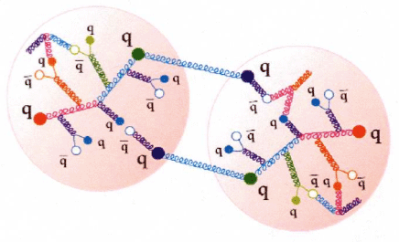
Nucleon-Nucleon Femtoscopy, continued
Two-nucleon iso-triplet (e.g. p-p) state
attractive, but unbound
increased population at q~20 MeV/c
relative to combinatorics (product of singles distributions)
enhancement ~ 1/size
Iso-singlet system has bound state: deuteron
enhancement of deuteron yield relative to
product of singles distributions
enhancement ~ 1/size

Slide 8
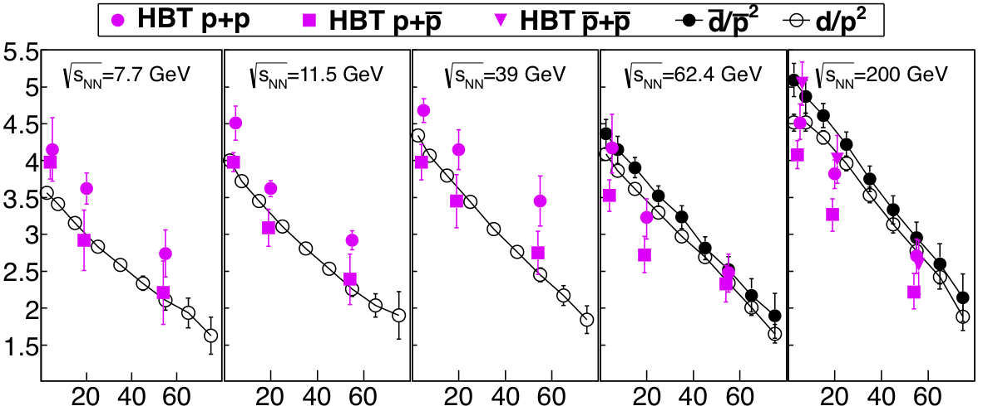
Homogeneity length through coalescence
spatial length scales
drive composite yields
(cross-sections evaluated
at same particle velocity)
(anti)deuteron Gaussian width: δ ~ 2.8 fm
R_{G} (fm)
STAR
Preliminary
Centrality (%)
Poster – W. Llope (308)

Slide 9
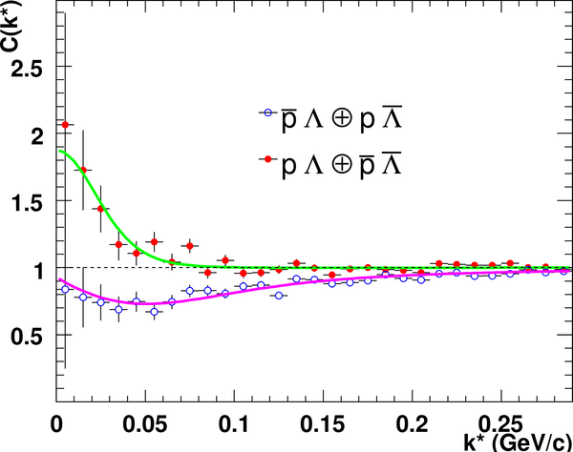
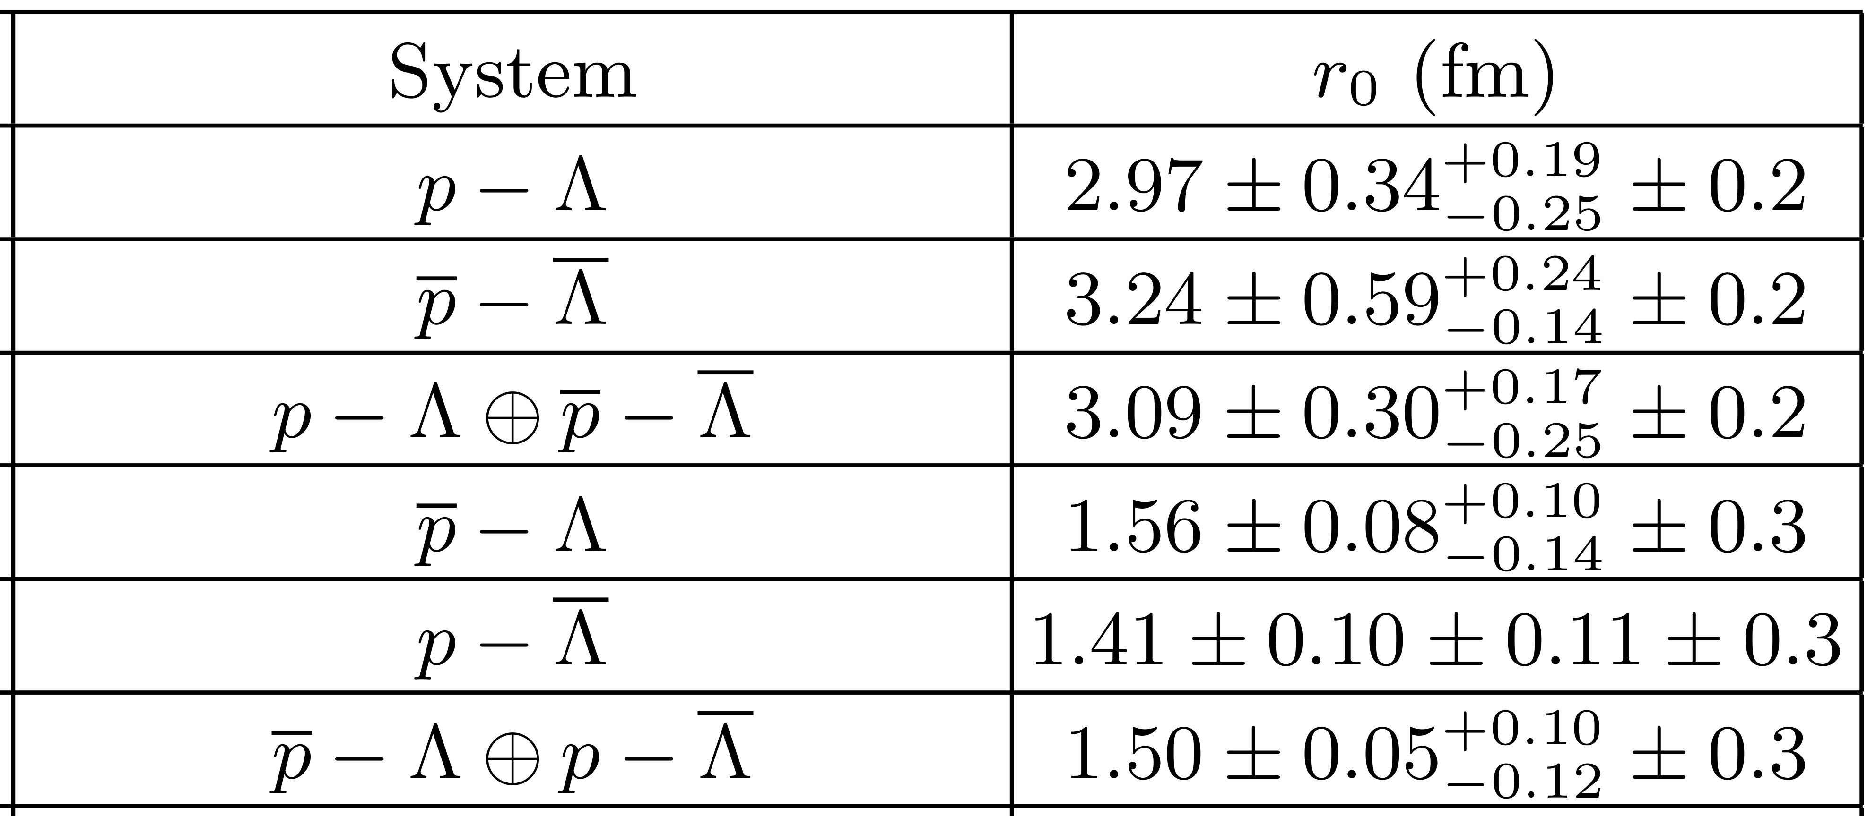
Nucleon-Hyperon Correlation
Proton-Λ source size is smaller than p-p
Spatial Strangeness-Baryon correlations are stronger than Baryon-Baryon correlations
Phys. Rev. C 74 (2006) 64906
p-p
4.5 ± 0.3

Slide 10
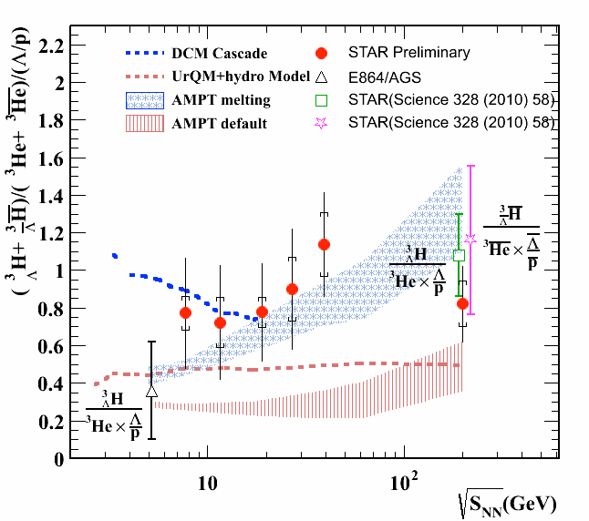
Nucleon-Nucleon Correlation and Baryon Coalescence
Nucleon-Nucleon correlations & homogeneity length for deuteron: spatial length scales drive composite yields (Coalescence)
Proton-Λ correlations : Spatial Strangeness-Baryon correlations are stronger than Baryon-Baryon correlations
Expect enhanced hyper nucleus production
Talk - Y. Zhu (5A )

Slide 11
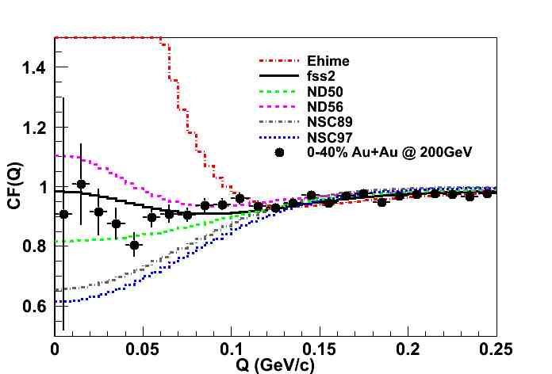
Λ-Λ Correlation Function
Type of ΛΛ interaction:
  Meson exchange models: Nijmegen model D, F, Soft Core (89, 97)
  Quark cluster model interaction: fss2
  Phenomenological model: Ehime
ΛΛ interaction → Attractive
Inclusive ΛΛ correlations: Feed down contributions included in theoretical models.
STAR preliminary
Poster – N. Shah (155)

Slide 12
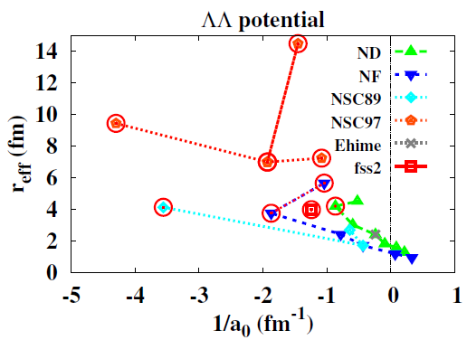
Λ-Λ Correlation Function
Uncertainties not included
A. Ohnishi, HHI workshop proceedings 2012
Scattering length (a₀) is negative in most fits
Current fit from different potential models to data gives indication towards non-existence of bound H-dibaryon

Slide 13
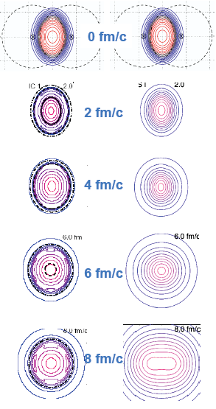
Time evolution of the collision geometry
Spatial eccentricity
Initial out-of-plane eccentricity
Stronger in-plane pressure gradients drive preferential in-plane expansion
Longer lifetimes or stronger pressure gradients cause more expansion and more spherical freeze-out shape
We want to measure the eccentricity at freeze out, ε_{F}, as a function of energy using azimuthal HBT:
Non-monotonic behavior could indicate a soft point in the equation of state.
Target
Projectile
With 1st
order P.T.
Without 1st
Order P.T.
Kolb and Heinz, 2003, nucl-th/0305084

Slide 14
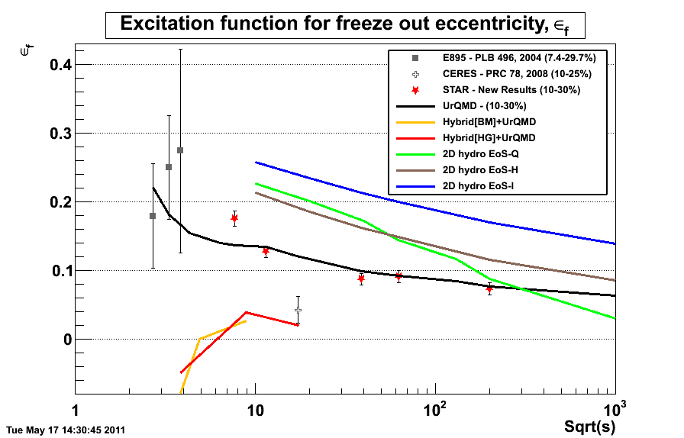
Azimuthal HBT
Is there a non-monotonic behavior?
J. Phys. G: Nucl. Part. Phys. 38 (2011) 124148
√s_{NN} (GeV)
Evolution of the initial shape depends on the pressure anisotropy
- Freeze-out eccentricity sensitive to the 1st order phase transition.

Slide 15
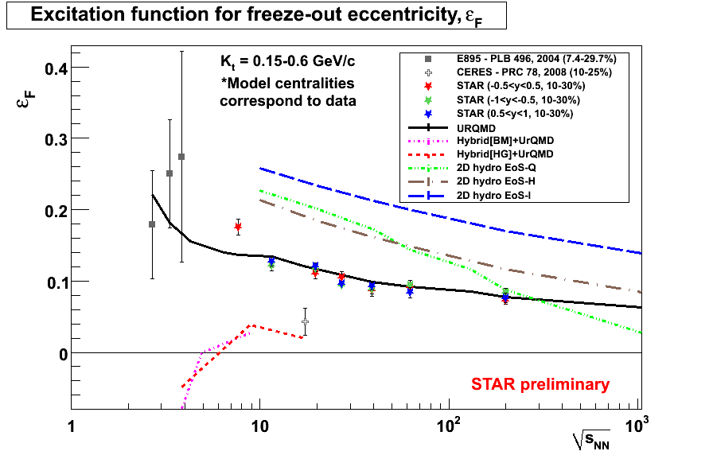
Complete Energy Scan
-1.0<y<-0.5
-0.5<y<0.5
0.5<y<1.0
Is the discrepancy due to centrality or rapidity range? - NO

Slide 16
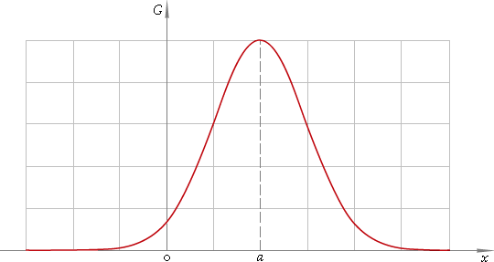
π-K Correlations
Probes size of emitting source as well as emission asymmetries between particles of different masses
Flow induces a mass ordering to average emission position
Heavy particles preferentially emitted from the edge of the source
→ offset, points in direction of motion
π-K correlations ⇒ unique information on offset
Separation distribution in pair c.m.
S(Δr)
R
d
Δr = r_{K}-r _{π}
Poster – Y. Yang (305)

Slide 17
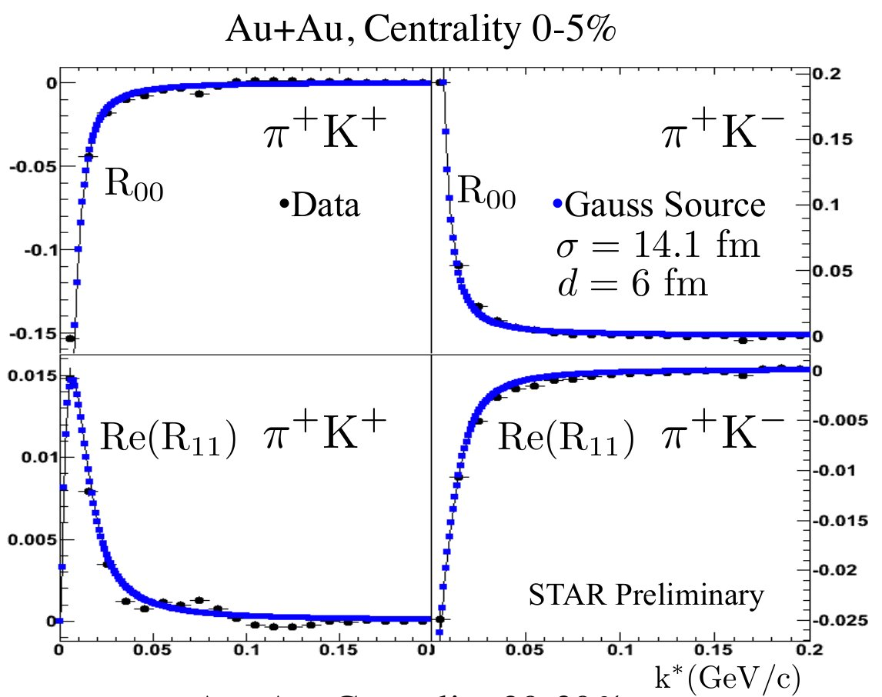
π-K Correlations
Source asymmetry signal in Au+Au collisions at √s_{NN} = 200 GeV
Offset is roughly half of the source size
Flow strongly affects geometric substructure
Consistent with measurements from Au+Au at √s_{NN} = 130 GeV
STAR Preliminary
STAR Preliminary
Phys. Rev. Lett. 91 (2003) 262302
STAR Preliminary
STAR Preliminary
Poster – Y. Yang (305)
Notes:
Spherical harmonic moments of the pion-kaon correlation function for Au+Au 200 GeV are plotted here for 0-5%. The measured source size and offset which is roughly half of the source size are listed here. The measurements are consistent with our previous measurement at 130 GeV

Slide 18
Summary
Proton femtoscopy
  BES measurements shows source size increases with √s_{NN} and for more central collisions
  Measurement of homogeneity length for deuteron through coalescence agrees well with the proton femtoscopy measurements
Systematic of nucleon-hyperon femtoscopy suggests strong baryon-strangeness correlations as compared to baryon-baryon correlations
Λ-Λ correlation
  Attractive ΛΛ interaction
  Current fit from different potential models to data gives indication towards non-existence of bound H-dibaryon
Azimuthal HBT
  A monotonic decrease in the freeze-out eccentricity with increasing collision energy from 7.7 – 200 GeV
π-K correlation
  π-K emission asymmetry observed in Au+Au collisions at √s_{NN} = 200 GeV

Slide 19
Backup

Slide 20

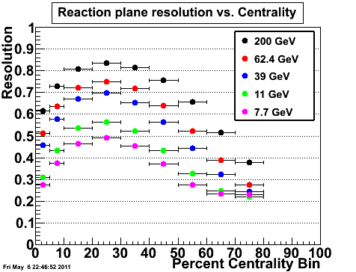
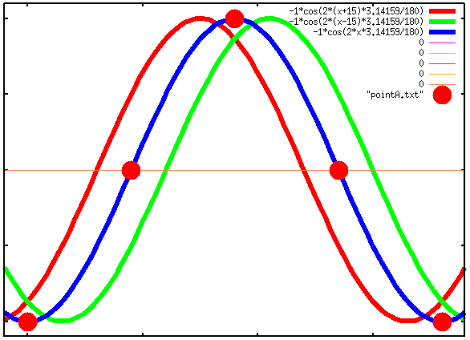
Event plane resolution and finite angular bins
90º
Oscillations reduced by
reaction plane resolution
and finite angular bins
45º
135º
0º
Reaction Plane resolution vs. Centrality
R²_{out}
actually
STAR preliminary
0 45 90 135 180

