Slide 1




Measurements of D_{S}± - meson production in Au+Au collisions at
√s_{NN} = 200 GeV in STAR
Md. Nasim
University of California, Los Angeles
(for the STAR Collaboration)

Slide 2

Outline
Motivation
STAR detector and analysis details
p_{T} spectra, particle ratio and R_{AA}
Elliptic flow (v₂) of D_{S}
Summary

Slide 3
Why Study D_{s}± ?
D_{S} meson : one charm and one strange quark
Strangeness enhancement due to QGP is
expected to affect the yield of D_{S}
Charm
quark
Strange
quark
D_{S} meson

Slide 4
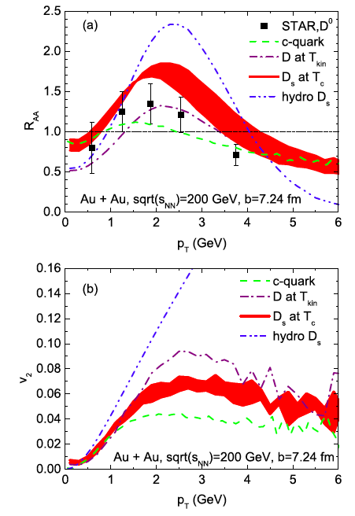
Why Study D_{s}± ?
D_{S} meson : one charm and one strange quark
Strangeness enhancement due to QGP is
expected to affect the yield of D_{S}
R_{CP} or R_{AA} of D_{S} > D⁰ predicted
Ref: M. He et al., PRL 110, 112301 (2013)

Slide 5
Why Study D_{s}± ?
D_{S} meson : one charm and one strange quark
Strangeness enhancement due to QGP is
expected to affect the yield of D_{S}
R_{CP} or R_{AA} of D_{S} > D⁰ predicted
Elliptic flow of D_{S} < D⁰ is expected
due to earlier freeze out of D_{S}
Good Probe to study the
hadronization and strangeness
enhancement
Ref: M. He et al., PRL 110, 112301 (2013)

Slide 6
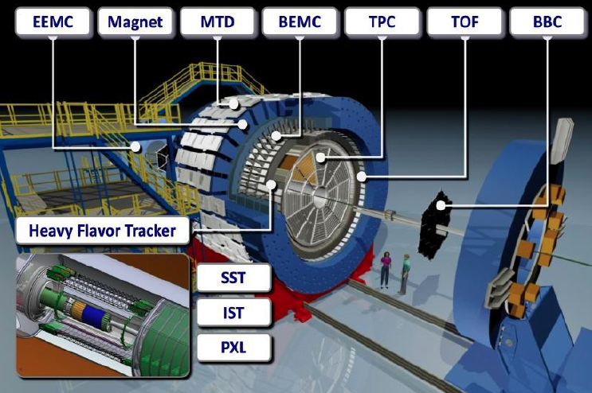
STAR Detector in Year 2014
SSD
Full 2π coverage
Pseudorapidity coverage ~ ±1 unit

Slide 7
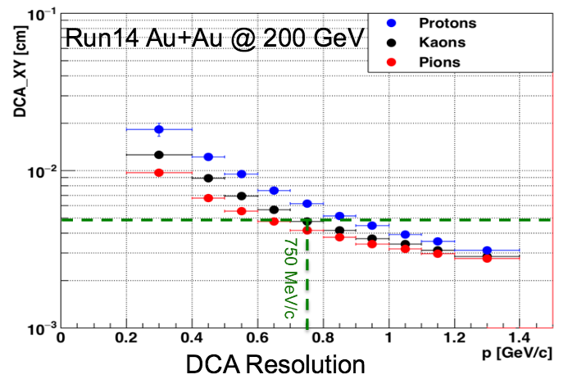
STAR Detector in Year 2014
SSD
Full 2π coverage
Pseudorapidity coverage ~ ±1 unit
For Details about HFT : See talk by G. Contin (Tuesday, 3.00 PM, Futute Exp. Fac. Upgr.

Slide 8
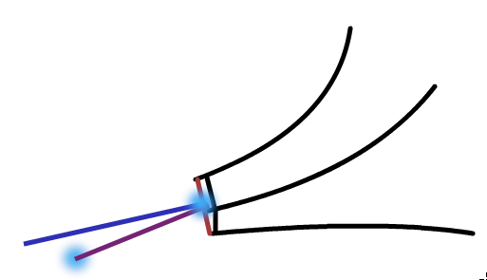
Analysis Details
Au+Au at √s_{NN} = 200 GeV in 2014
750 M minimum bias events analyzed (70% of collected data)
|Vz| <= 6 cm
Centrality using raw charged particle measured in TPC and Glauber Model
Decay Channel : D_{S}± φ ( K⁺+K⁻) + π±
Branching Ratio: 2.32 ± 0.14 %
Decay Length : 150 ± 2 μm
Mass : 1968.47 ± 0.33 MeV/c²
π⁺
K⁺
K⁻
Secondary Vertex :
Using HFT
Sec. Vertex
θ
Prim. Vertex
D_{S} K* + K decay channel :
See Poster by L. Zhou (ID :336)

Slide 9
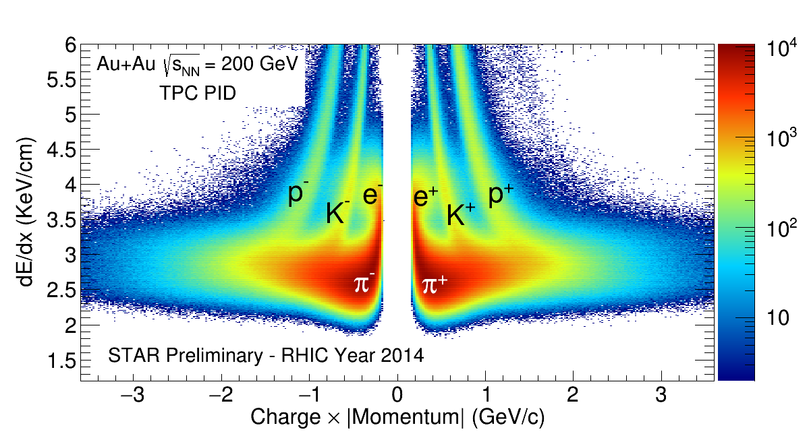
Particle Identification
TPC
π
K
p
d
TPC PID: Using dE/dx
TOF PID: Using Time of Flight (β)*
*TOF PID has been applied only when β information is available.

Slide 10
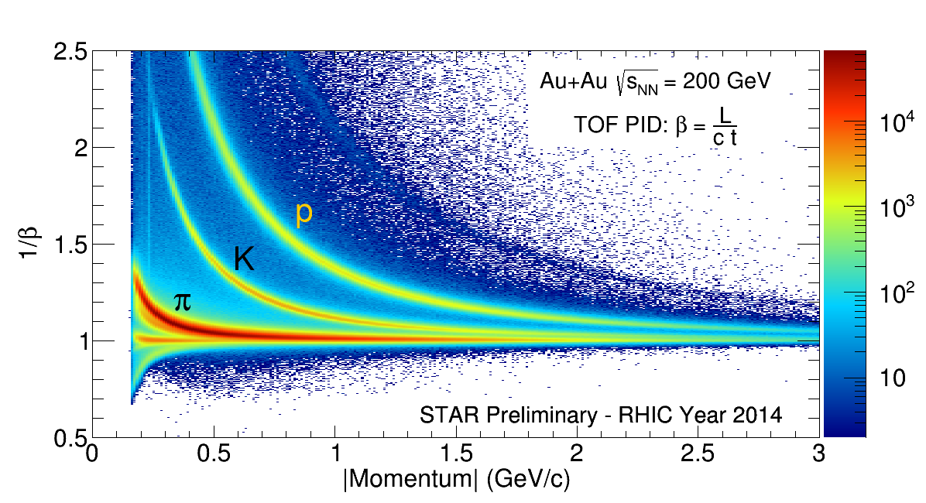
Particle Identification
TOF
π
K
p
d
TPC PID: Using dE/dx
TOF PID: Using Time of Flight (β)*
*TOF PID has been applied only when β information is available.

Slide 11
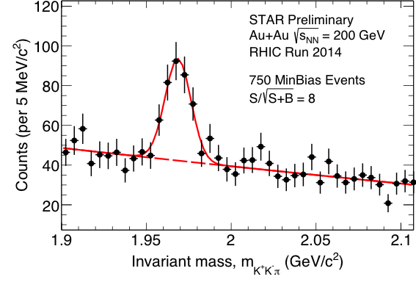
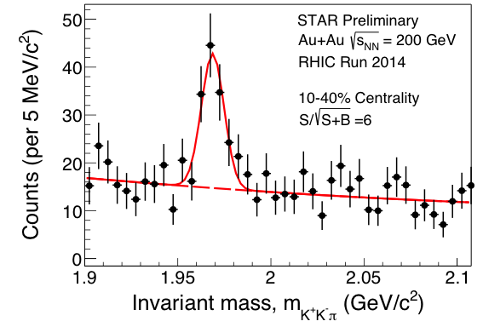
p_{T} integrated D_{S}± Signal
2.5 <p_{T} < 5.0 GeV/c
First measurement of D_{S} meson at RHIC.
We will present D_{S} spectra for 10-40% centrality
and for 2.5 <p_{T}<5.0 GeV/c.
Lower p_{T} and more peripheral collisions studies
are underway.

Slide 12
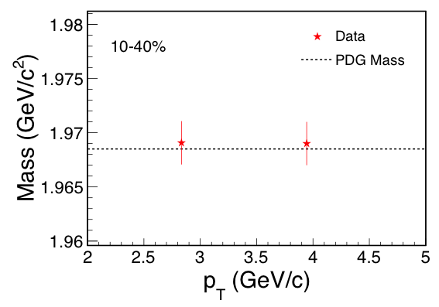
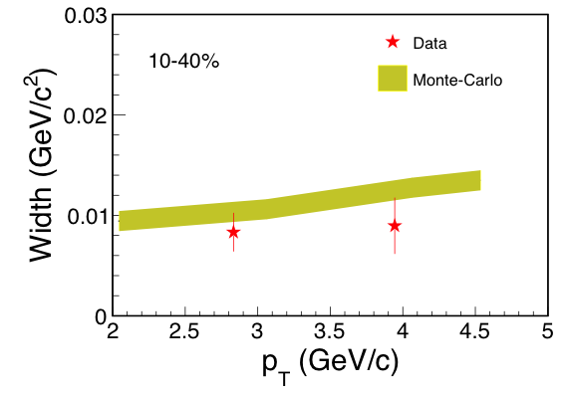
Mass and width
STAR Preliminary
STAR Preliminary
Mass is consistent with PDG value
Width is consistent with the results from detector simulations.

Slide 13
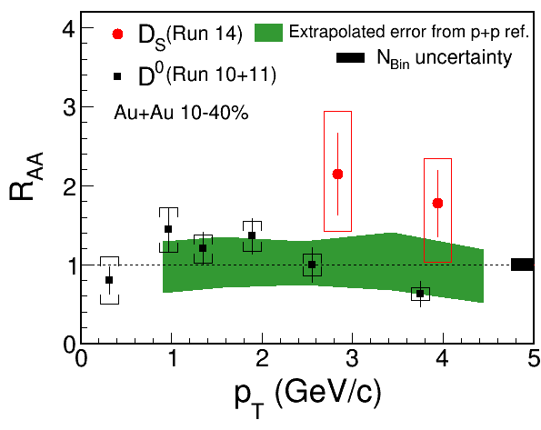
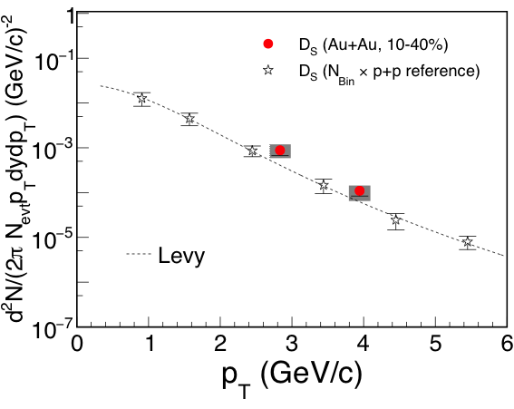
R_{AA} of D_{S}
STAR charm cross-section: Phys. Rev. D 86 (2012) 72013
D_{S} spectra for p+p collision has been calculated
from measured charm cross-section in STAR.
Fragmentation factor from charm to D_{S} is 0.09±0.01 *
STAR Preliminary
STAR Preliminary
The R_{AA} of D_{S} is higher than unity but statistically not significant.
STAR D⁰ R_{AA}: Phys. Rev. Lett. 113 (2014) 142301
*Ref: H1 Collaboration, Eur.Phys.J.C38(2005)447 and ZEUS Collaboration, Eur.Phys.J.C44(2005)351

Slide 14
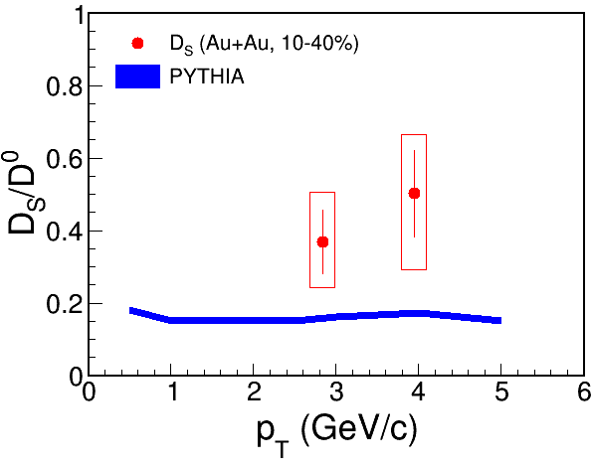
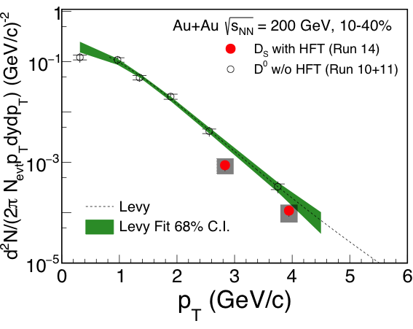
Invariant Yield and D_{S}/D⁰
(ver. 6.4)
STAR Preliminary
STAR Preliminary
The ratio D_{S}/D⁰ is less than unity and seems to be higher than prediction for p+p collision from PYTHIA
STAR Au+Au D⁰: Phys. Rev. Lett. 113 (2014) 142301

Slide 15
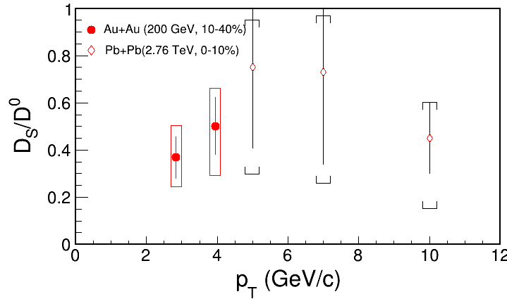
Invariant Yield and D_{S}/D⁰
(ver. 6.4)
STAR Preliminary
STAR Preliminary
STAR Preliminary
STAR and ALICE data are consistent with large uncertainties
Pb+Pb (ALICE: arXiv:1509.07287)
STAR Au+Au D⁰: Phys. Rev. Lett. 113 (2014) 142301

Slide 16
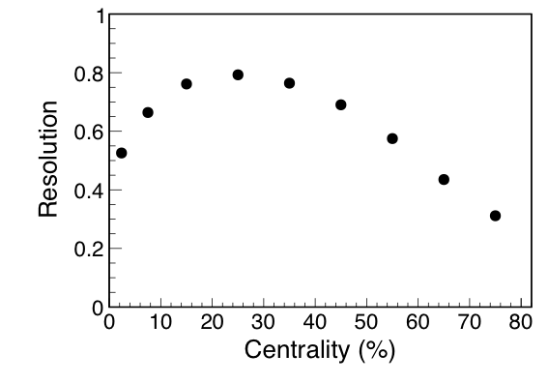
Elliptic Flow Analysis
STAR Preliminary
Method: Full Event Plane
Event Plane: Using TPC tracks
Resolution: Using Eta sub-event
D_{S} v₂ :
By fitting Yield vs
with function p0(1+2 v₂^{raw} cos(2 ))
STAR Preliminary
raw
STAR Preliminary

Slide 17
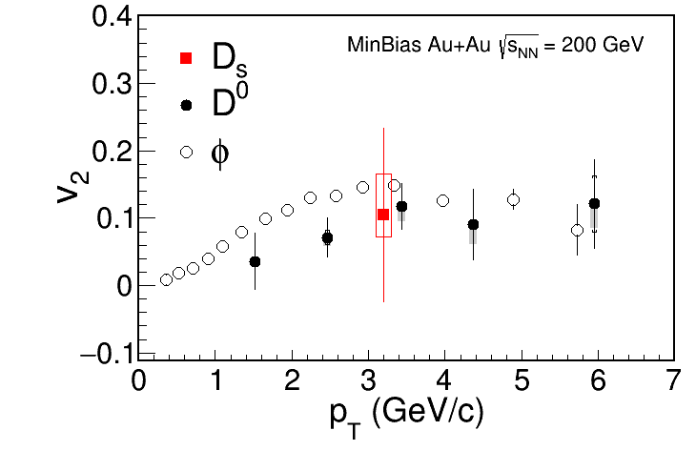
Elliptic Flow of D_{S}
For D⁰ v₂ :
See talk by
M. Lomnitz
(Tuesday, 9 AM,
Collective
Dynamics)
STAR Preliminary
-meson v₂
e-Print :1507.05247
First measurement of D_{S} v₂ in heavy-ion experiment.
Need more statistics.

Slide 18
Summary
We have observed a clear signal of D_{S} at RHIC for the first time
D_{S} in Au+Au 200 GeV for 10-40% central collisions:
- D_{S}/D⁰ seems to be higher than p+p prediction (from
PYTHIA 6.4) at p_{T} = 2.8 and 3.9 GeV/c
- R_{AA} = 2.1±0.5±^{0.7} and 1.7±0.4±^{0.5} at p_{T} = 2.8 and 3.9
GeV/c, respectively
First measurement of elliptic flow of D_{S} is presented
Stay tuned for Run 16 Data with increased statistics and improved detector performance
_{0.7}
_{0.7}
Thank You

Slide 19
Back-up

Slide 20
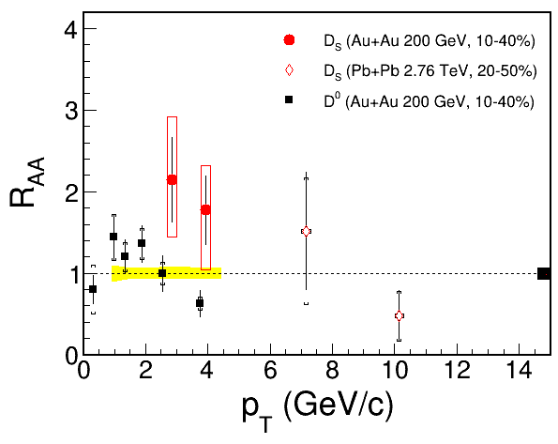
R_{AA}
D_{S} Pb+Pb (ALICE: arXiv:1509.07287)
STAR Preliminary
D⁰Au+Au (STAR: PRL 113 (2014) 142301)

Slide 21
φ-meson signal

