Slide 1


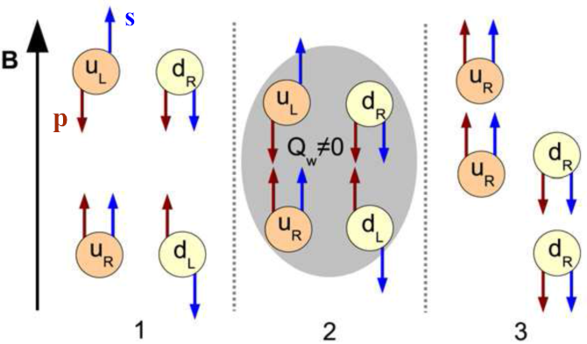
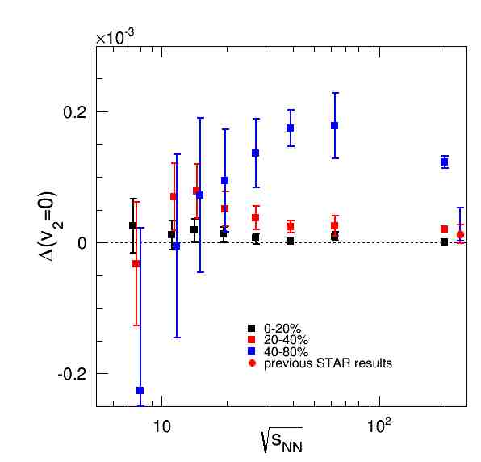
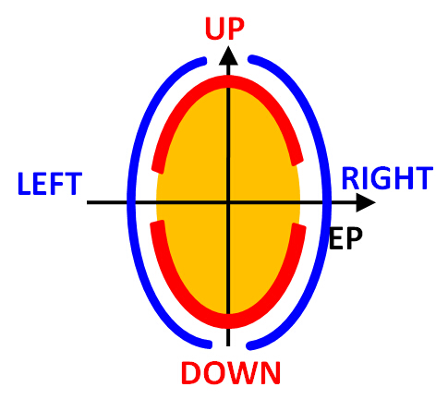
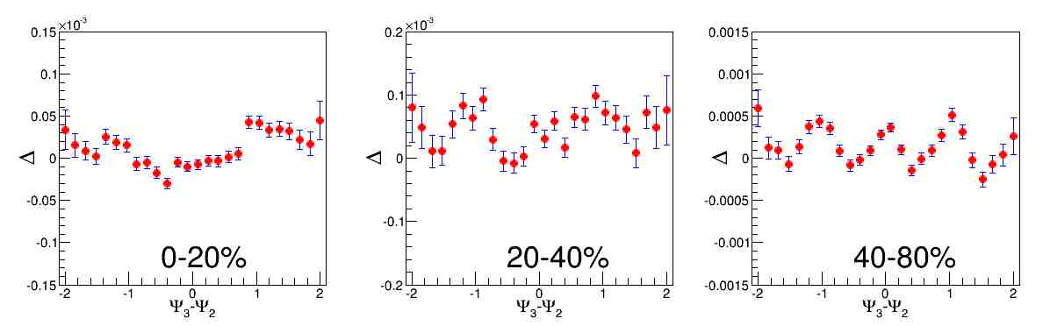
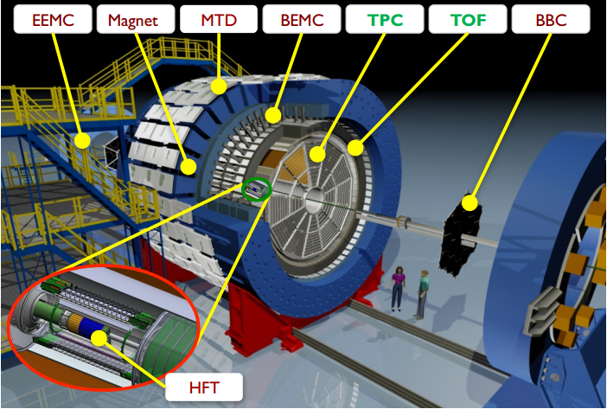
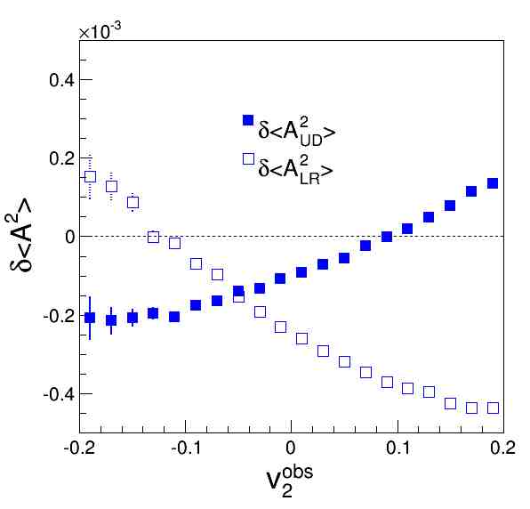
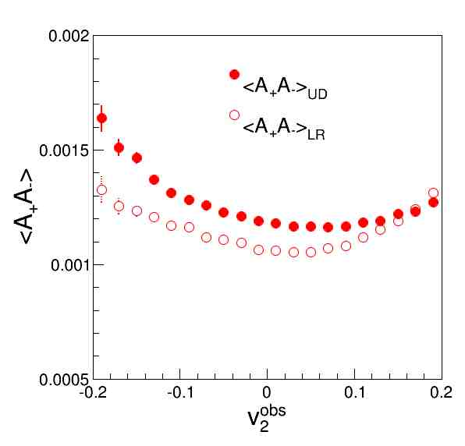
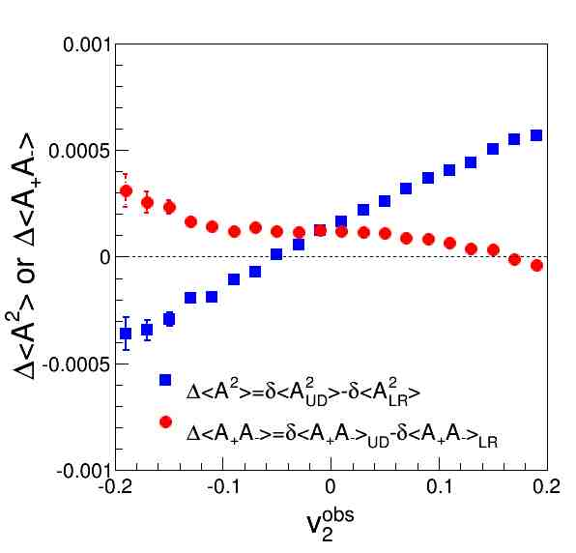
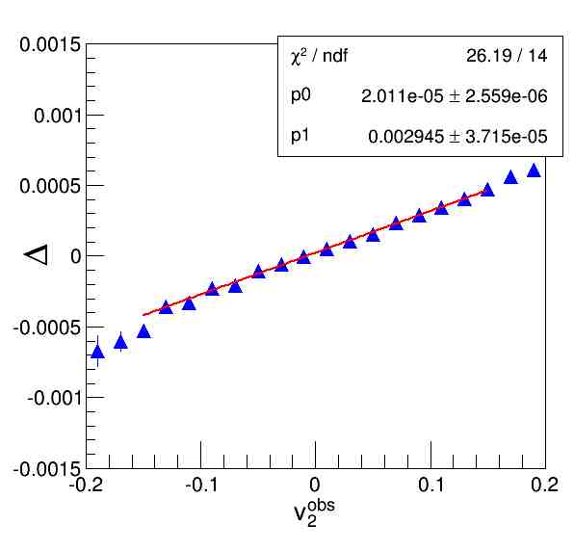











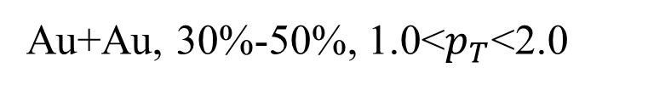
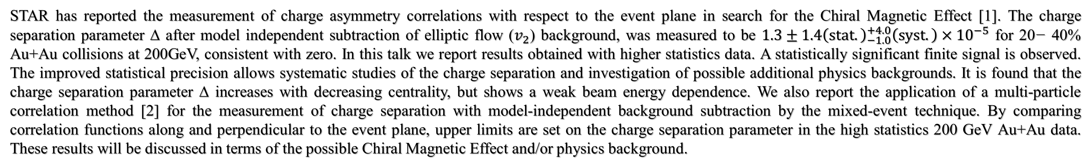


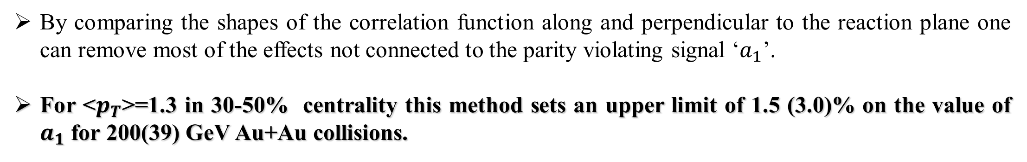
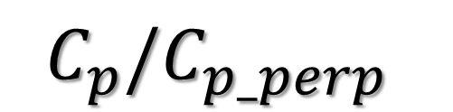


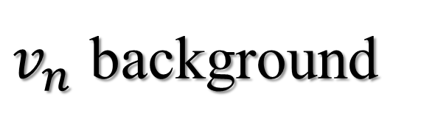
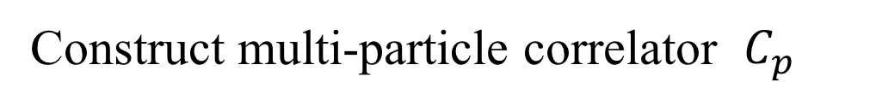
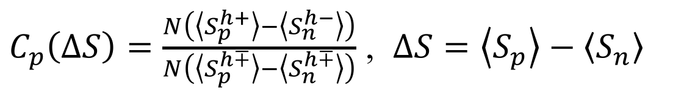
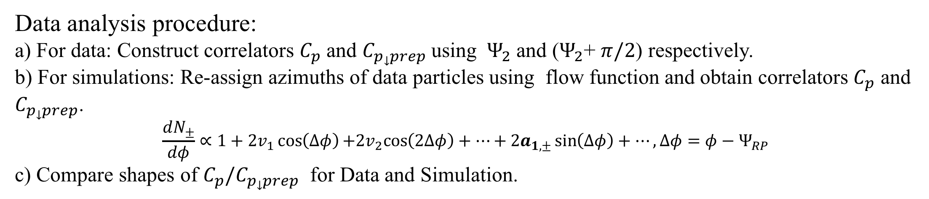


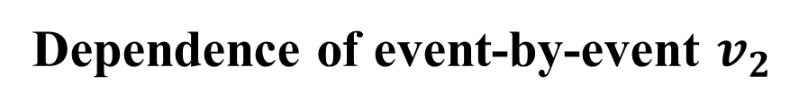

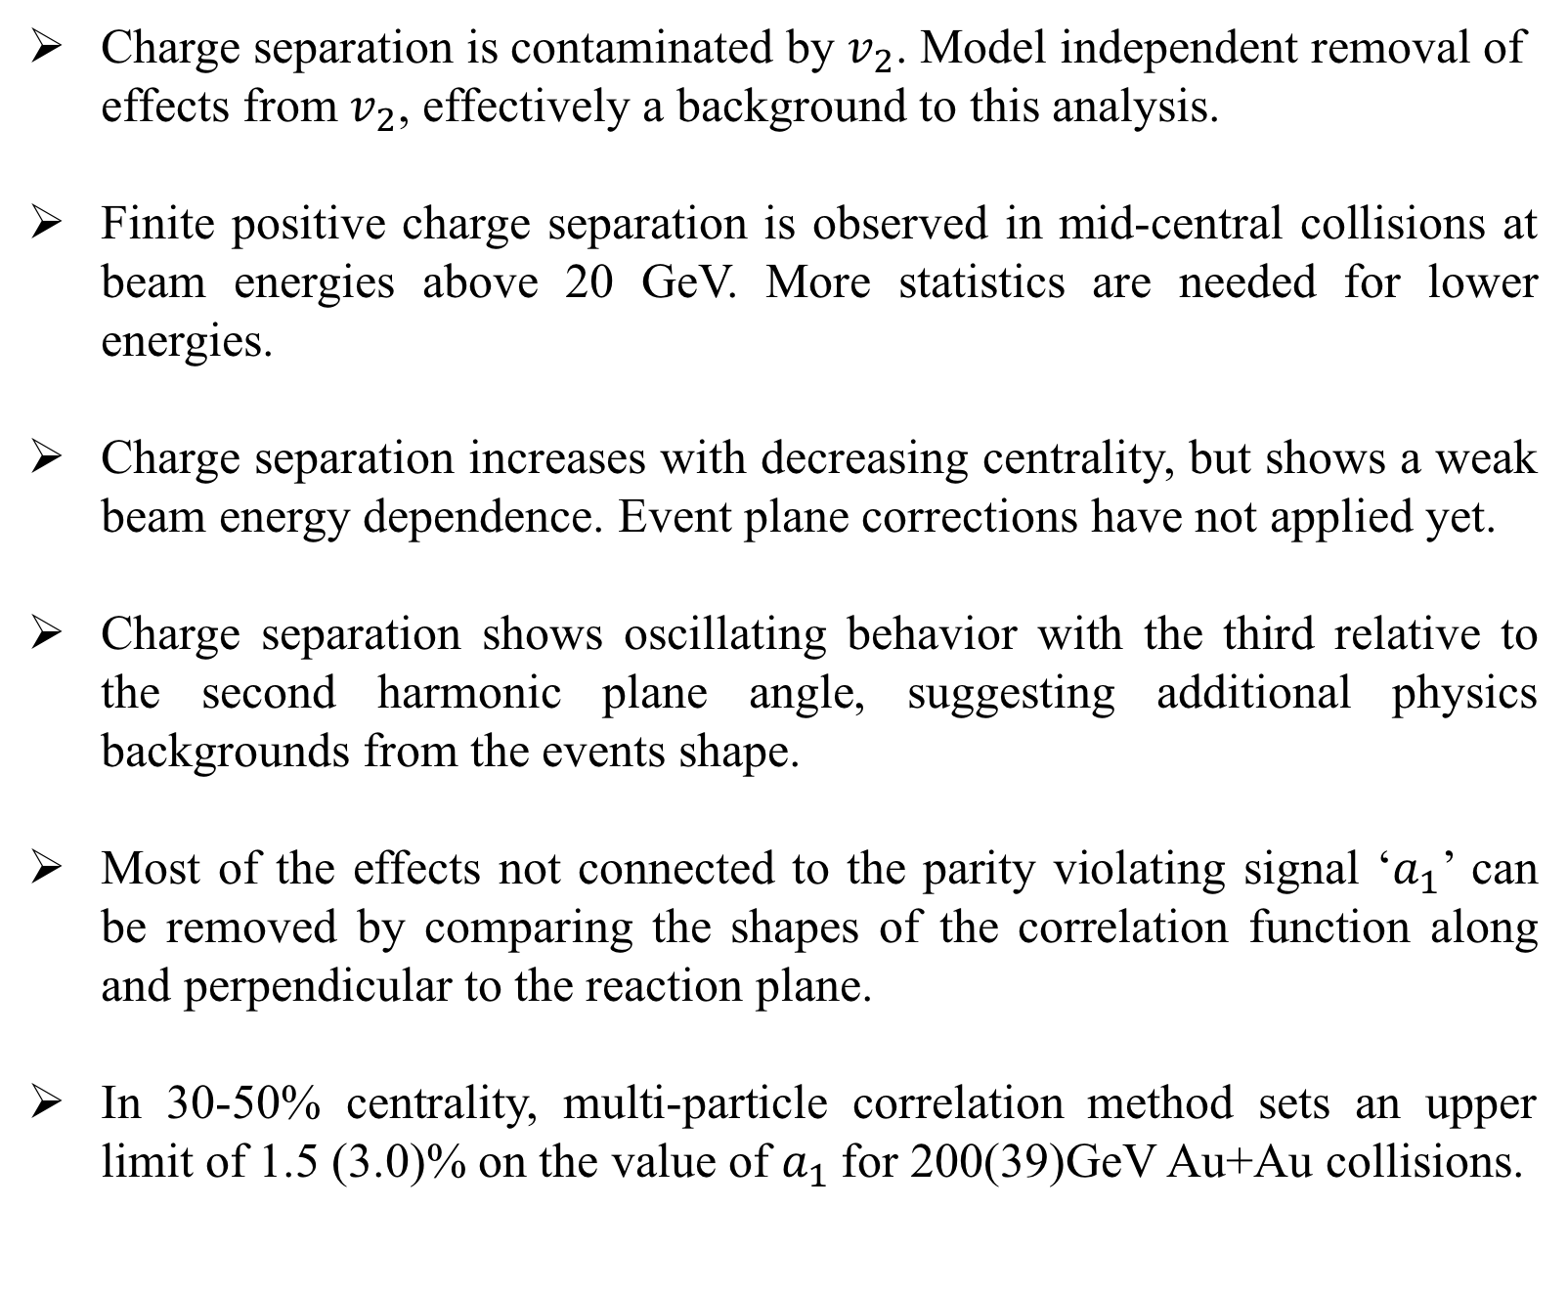
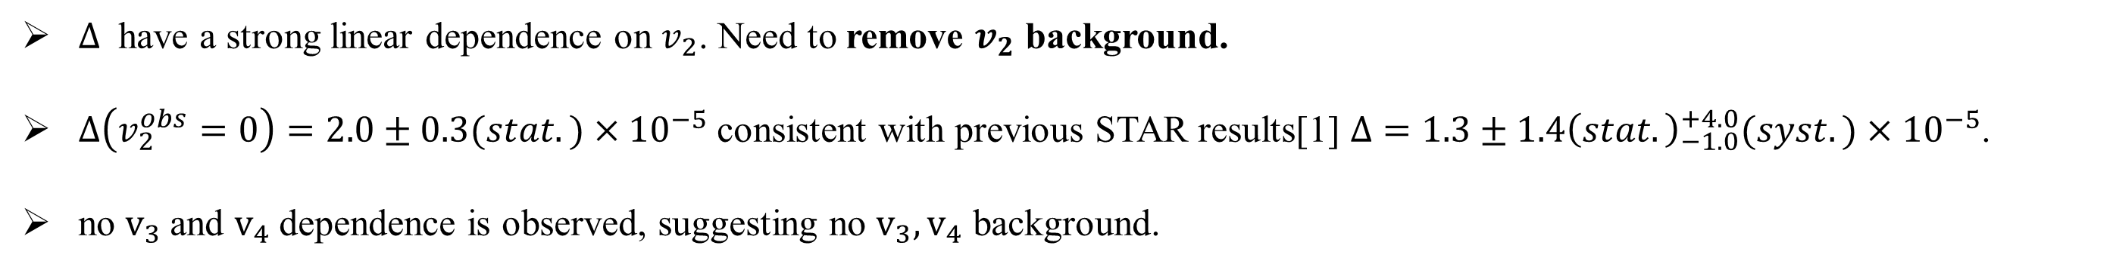
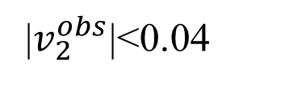
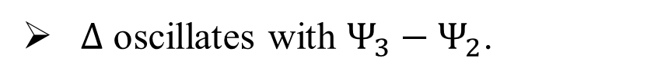


Charge Asymmetry Correlations to Search for the Chiral Magnetic Effect from Beam Energy Scan by STAR
Biao Tu ¹, N. N. Ajitanand ² (for the STAR collaboration)
¹ Institute of Particle Physics, Central China Normal University, Wuhan, Hubei 430079, People’s Republic of China
² Department of Chemistry, Stony Brook University, Stony Brook, New York 11794-3400, USA
Abstract
STAR has reported the measurement of charge asymmetry correlations with respect to the event plane in search for the Chiral Magnetic Effect [1]. The charge separation parameter ∆ after model independent subtraction of elliptic flow ($v_{2}$) background, was measured to be $1.3±1.4{\left(stat.\right)}_{−1.0}^{+4.0}\left(syst.\right)×{10}^{−5}$ for 20− 40% Au+Au collisions at 200GeV, consistent with zero. In this talk we report results obtained with higher statistics data. A statistically significant finite signal is observed. The improved statistical precision allows systematic studies of the charge separation and investigation of possible additional physics backgrounds. It is found that the charge separation parameter ∆ increases with decreasing centrality, but shows a weak beam energy dependence. We also report the application of a multi-particle correlation method [2] for the measurement of charge separation with model-independent background subtraction by the mixed-event technique. By comparing correlation functions along and perpendicular to the event plane, upper limits are set on the charge separation parameter in the high statistics 200 GeV Au+Au data. These results will be discussed in terms of the possible Chiral Magnetic Effect and/or physics background.
[1] L. Adamczyk et al. (STAR Collaboration) Phys. Rev. C 89, 044908 (2014). [2] N. N. Ajitanand, R. A. Lacey, A. Taranenko, and J. M.Alexander, Phys. Rev. C 83, 011901(R) (2011)
Motivation
Q_{w}<0: LH→RH, Q_{w}>0: RH→LH
Sign of Q_{w} is random, and ⟨Q_{w}⟩=0
A large magnetic field
Charge Separation (Chiral Magnetic Effect)
It is across the Reaction-Plane (xz- plane)
Energy dependence
Color Deconfinement
“free”quarks
Topological charge
$$Q_{w}=\frac{g^{2}}{32π^{2}}\int{d^{4}xF_{μν}^{α}F_{α}^{μν}}$$
In central collisions, the values of Δ are consistent with zero, but larger than zero in middle and peripheral collisions at $\sqrt{s_{NN}}>20GeV$. Event plane corrections have not applied yet.
Charge separation has a weak energy dependence in middle central collisions
Higher statistics needed for $\sqrt{s_{NN}}<20GeV$
Nuclear Physics A 803.3 (2008)
Analysis method
Multiplicity asymmetry method[1]
Average dynamical variance
$$δ\left\langle A_{UD}^{2}\right\rangle =\left(δ\left\langle A_{+,UD}^{2}\right\rangle +δ\left\langle A_{−,UD}^{2}\right\rangle \right)/2$$
$$δ\left\langle A_{LR}^{2}\right\rangle =\left(δ\left\langle A_{+,LR}^{2}\right\rangle +δ\left\langle A_{−,LR}^{2}\right\rangle \right)/2$$
Covariance
$$δ{\left\langle A_{+}A_{−}\right\rangle }_{UD}={\left\langle A_{+}A_{−}\right\rangle }_{UD}−{\left\langle A_{+}A_{−}\right\rangle }_{UD,stat+det}$$
$$δ{\left\langle A_{+}A_{−}\right\rangle }_{LR}={\left\langle A_{+}A_{−}\right\rangle }_{LR}−{\left\langle A_{+}A_{−}\right\rangle }_{LR,stat+det}$$
The difference between UD and LR measurements
$$Δ\left\langle A^{2}\right\rangle =δ\left\langle A_{UD}^{2}\right\rangle −δ\left\langle A_{LR}^{2}\right\rangle$$
$$Δ\left\langle A_{+}A_{−}\right\rangle =δ{\left\langle A_{+}A_{−}\right\rangle }_{UD}−δ{\left\langle A_{+}A_{−}\right\rangle }_{LR}$$
Charge separation can be quantified by
 ↑  ↑ $Δ=Δ\left\langle A^{2}\right\rangle −Δ\left\langle A_{+}A_{−}\right\rangle$
Δ > 0 would indicate a charge separation effect consistent with CME (however, see caveat in [Wang, Koch,[1]]).
Additional physics background from event shape?
Charge Multiplicity Asymmetries
Au+Au 200GeV Run11
|$v_{2}^{obs}$|<0.04
Multi-particle correlation method[2]
Phys. Rev. C 81, 064902 (2010)
Phys. Rev. C 81, 031901(R) (2010)
$$S=\sin\left(Δφ\right)$$
$$Δφ=φ−Ψ_{RP}$$
$\left\langle S_{p}^{h+}\right\rangle$and $\left\langle S_{n}^{h−}\right\rangle$= average S over the positively and negatively charged hadrons in the same event
$\left\langle S_{p}^{h∓}\right\rangle$and $\left\langle S_{n}^{h∓}\right\rangle$= average S over randomly chosen hadrons and remaining hadrons in the mixed event
Construct multi-particle correlator $C_{p}$
$C_{p}\left(ΔS\right)=\frac{N\left(\left\langle S_{p}^{h+}\right\rangle −\left\langle S_{n}^{h−}\right\rangle \right)}{N\left(\left\langle S_{p}^{h∓}\right\rangle −\left\langle S_{n}^{h∓}\right\rangle \right)}$ , $ΔS=\left\langle S_{p}\right\rangle −\left\langle S_{n}\right\rangle$
$Δ$ oscillates with $Ψ_{3}−Ψ_{2}$.
Need further investigation.
Data analysis procedure:
a) For data: Construct correlators $C_{p}$ and $C_{p_prep}$ using $Ψ_{2}$ and ($Ψ_{2}$+ $π/2$) respectively.
b) For simulations: Re-assign azimuths of data particles using flow function and obtain correlators $C_{p}$ and $C_{p_prep}$.
$$\frac{dN_{±}}{dφ}∝1+2v_{1}\cos\left(Δφ\right)+2v_{2}cos\left(2Δφ\right)+⋯+2a_{1,±}\sin\left(Δφ\right)+⋯, Δφ=φ−Ψ_{RP}$$
c) Compare shapes of $C_{p}/C_{p_prep}$ for Data and Simulation.
$$C_{p}/C_{p_perp}$$
200GeV
Au+Au, 30%-50%, 1.0<$p_{T}$<2.0
SIM : Black symbols
Data : Red Symbols
$a_{1}$=0.0
$a_{1}$=0.01
$a_{1}$=0.015
$a_{1}$=0.02
The Solenoidal Tracker at RHIC (STAR) and Data sets
$$ΔS$$
$$ΔS$$
$$ΔS$$
$$ΔS$$
Event selection
|Vz|<30cm: 11.5,14.5,19.6,27,39,62.4,200GeV
|Vz|<50cm: 7.7GeV
|Vz-vpdVz|<3cm : 62.4,200GeV
|Vr|<2cm: 7.7,11.5,14.5,19.6,27,39,62.4,200GeV
Track selection
Pseudo-rapidity |𝜂|<1
Number of TPC hits nfit>20
0.15<$p_{T}$<2.0GeV/c
DCA<2cm
Ratio of nfit to maximum fit points rfit>0.52
39GeV
This analysis sets LPV signal $a_{1}$<0.015
$a_{1}$=0.0
$a_{1}$=0.02
$a_{1}$=0.03
$a_{1}$=0.04
$$ΔS$$
$$ΔS$$
$$ΔS$$
$$ΔS$$
This analysis sets LPV signal $a_{1}$<0.03
By comparing the shapes of the correlation function along and perpendicular to the reaction plane one can remove most of the effects not connected to the parity violating signal ‘$a_{1}$’.
For <$p_{T}$>=1.3 in 30-50% centrality this method sets an upper limit of 1.5 (3.0)% on the value of $a_{1}$ for 200(39) GeV Au+Au collisions.
$v_{n}$ background
Summary
Dependence of event-by-event $v_{2}$
Au+Au 200GeV 20-40%
Charge separation is contaminated by $v_{2}$. Model independent removal of effects from $v_{2}$, effectively a background to this analysis.
Finite positive charge separation is observed in mid-central collisions at beam energies above 20 GeV. More statistics are needed for lower energies.
Charge separation increases with decreasing centrality, but shows a weak beam energy dependence. Event plane corrections have not applied yet.
Charge separation shows oscillating behavior with the third relative to the second harmonic plane angle, suggesting additional physics backgrounds from the events shape.
Most of the effects not connected to the parity violating signal ‘$a_{1}$’ can be removed by comparing the shapes of the correlation function along and perpendicular to the reaction plane.
In 30-50% centrality, multi-particle correlation method sets an upper limit of 1.5 (3.0)% on the value of $a_{1}$for 200(39)GeV Au+Au collisions.
$v_{2}^{obs}=\left\langle cos2\left(φ−ψ_{EP}\right)\right\rangle$0.15<$p_{T}$<2GeV/c
$Δ$ have a strong linear dependence on $v_{2}$. Need to remove $v_{2}$ background.
$Δ\left(v_{2}^{obs}=0\right)=2.0±0.3(stat.)×{10}^{−5}$ consistent with previous STAR results[1] $Δ=1.3±1.4{\left(stat.\right)}_{−1.0}^{+4.0}(syst.)×{10}^{−5}$.
no $v_{3}$and $v_{4}$dependence is observed, suggesting no $v_{3},v_{4}$ background.
The STAR Collaboration: http://drupal.star.bnl.gov/STAR/presentations

