Slide 1
Bulk properties of the system formed in Au+Au collisions at √s_{NN} = 14.5 GeV using the
STAR detector at RHIC
Vipul Bairathi
(for the STAR Collaboration)
National Institute of Science Education and Research, India
Outline
Introduction & Motivation
STAR Experiment at RHIC
Results
  Identified particle production and freeze out parameters
  Azimuthal anisotropy of identified hadrons
Summary
Quark Matter
Kobe, Japan
Sept. 27 – Oct. 3, 2015

Slide 2
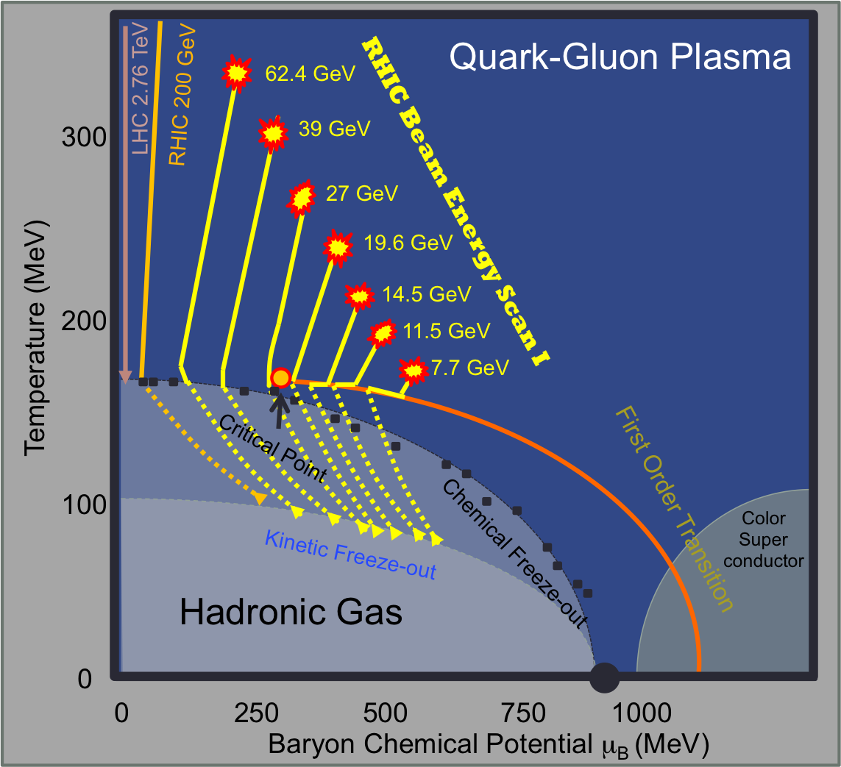
Motivation: RHIC BES Program
Goals of RHIC beam energy scan program
Search for turn-off of QGP signatures
Search for the first-order phase transition
Search for critical point
Freeze out in heavy-ion collisions
Chemical freeze out (T_{ch}, μ_{B})
Inelastic collisions among particles cease
Kinetic freeze out (T_{kin}, <β>)
Elastic collisions among particles cease
Elliptic flow (v₂) of identified hadrons
New data: Au+Au √s_{NN} = 14.5 GeV
Corresponding μ_{B}= 260 MeV fills a gap in μ_{B} of about 100 MeV between √s_{NN}= 11.5 GeV (μ_{B}= 315 MeV) and 19.6 GeV (μ_{B}= 205 MeV).
Cross Over
QCD Phase Diagram
https://drupal.star.bnl.gov/STAR/starnotes/public/sn0598

Slide 3


STAR Experiment at RHIC
BES-I Dataset
EEMC
Magnet
MTD
BEMC
TPC
TOF
BBC
Year | √s_{NN} (GeV) | Minimum Bias Events(10⁶)
2010 | 62.4 | 67
2010 | 39 | 130
2011 | 27 | 70
2011 | 19.6 | 36
2014 | 14.5 | 20
2010 | 11.5 | 12
2010 | 7.7 | 4
HFT
@ Maria & Alex Schmah
Large Coverage: 0 < φ < 2π, |η| < 1.0
Uniform acceptance: transverse momentum (p_{T}) and rapidity (y)
Excellent particle identification capabilities (TPC and TOF)
M. Anderson et al., Nucl. Instrum. Meth. A 499 (2003) 659
W. J. Llope., Nucl. Instrum. Meth. A 661 (2012) S110–S113

Slide 4
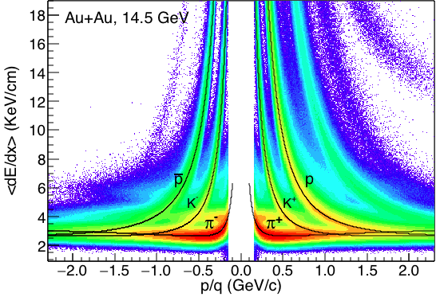
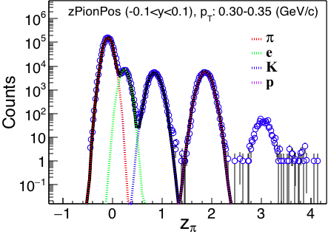
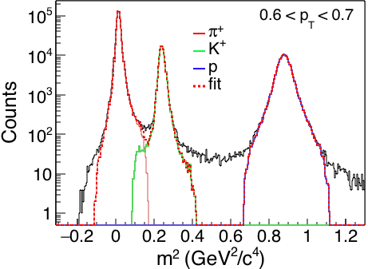
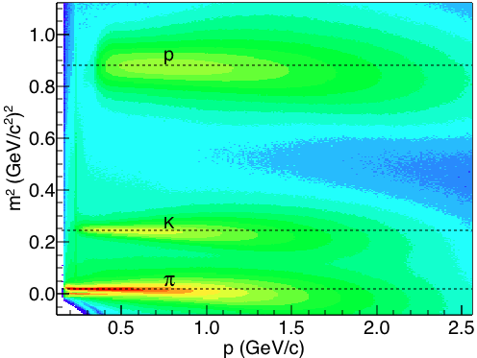
Particle Identification
Time Projection Chamber (TPC)
Au + Au √s_{NN} = 14.5 GeV
H. Bichsel, NIM A. 562 (2006) 154
Time Of Flight (TOF)
p = momentum
t = time of flight
L = path length

Slide 5
Identified particle production and freeze out properties
See also
Talk of James Brandenburg Heavy flavors and Strangeness Monday, 11.15-11.35

Slide 6
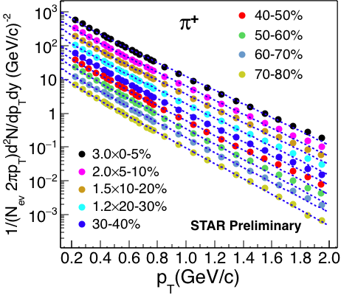
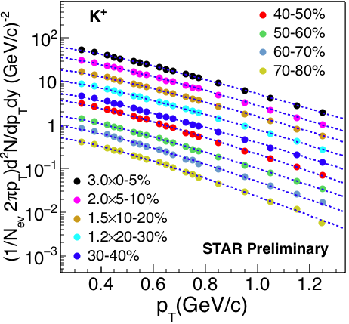
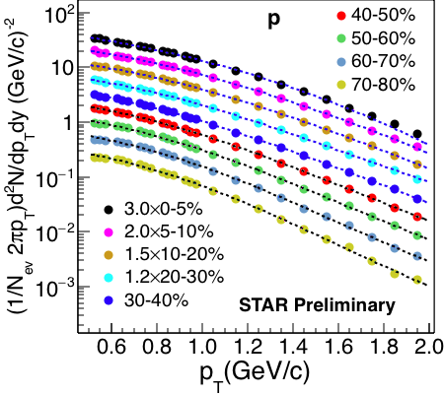
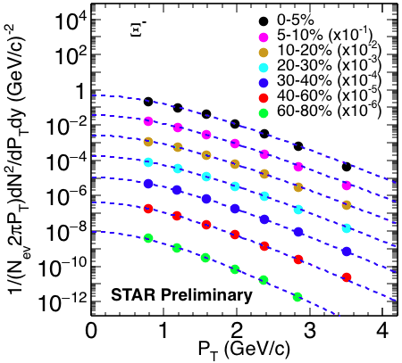
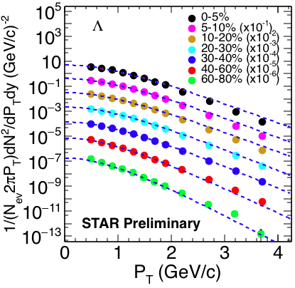
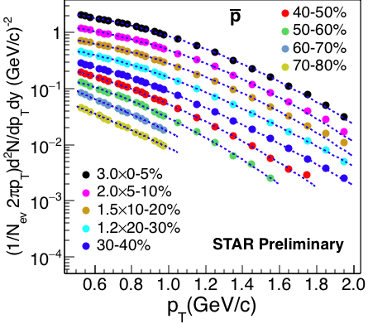
Transverse Momentum Spectra
Au + Au √s_{NN} = 14.5 GeV
Bose-Einstein fit
(m_{T}-m) Exponential fit
Double Exponential fit
Boltzmann fit
Boltzmann fit
Double Exponential fit

Slide 7
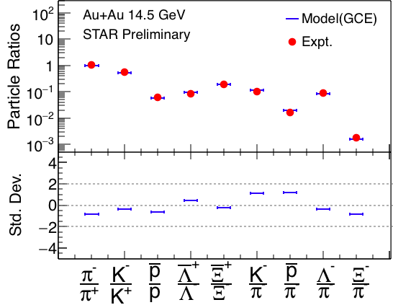
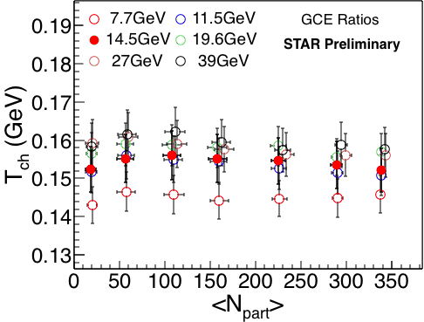
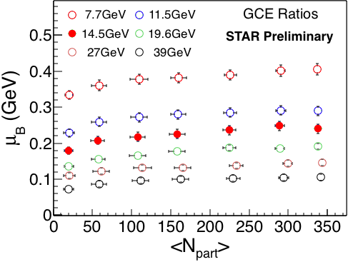
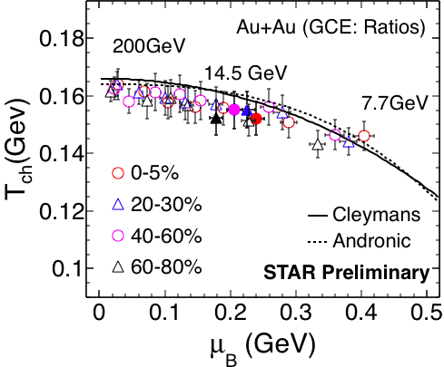
Chemical Freeze out
0-5%
(Yield_{Model} – Yield_{Data})
Error_{Data}
STAR, SQM 2013, Brimingham, UK
S. Wheaton & Cleymans, Comput. Phys. Commun., 180, 84-109 (2009)
New results for Au+Au, 14.5 GeV
Particles used in fit : π, K, p, Λ, Ξ and their anti-particles.
T_{ch} increases as collision energy increases.
μ_{B} decreases with increase in collision energy.
Centrality dependence is observed for μ_{B}.
J. Cleymans et al. Phys. Rev. C 73, 034905 (2006)
A. Andronic et al. Nucl. Phys. A 834, 237C (2010)

Slide 8
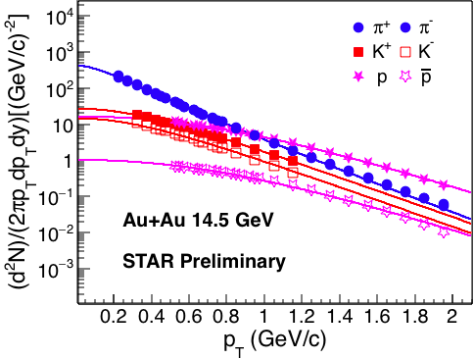
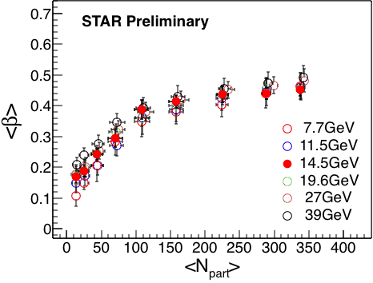
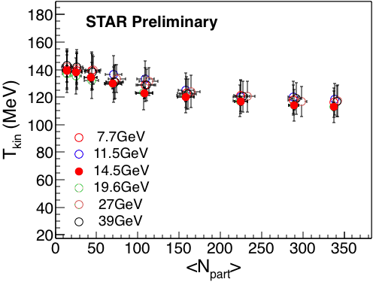
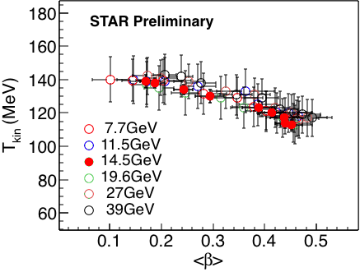
Kinetic Freeze out
Blast-Wave Fit
Centrality 0-5%
Peripheral
Central
E. Schnedermann, J. Sollfrank, and U. W. Heinz, Phys. Rev. C 48, 2462 (1993).
New results for Au+Au 14.5 GeV data
<β> decreases from central to peripheral collisions.
T_{kin} increases from central to peripheral collisions.
An anti-correlation observed between T_{kin} and <β>.
Peripheral
Central
STAR, QM 2014, Darmstadt, Germany

Slide 9
Elliptic flow (v₂) of Identified hadrons
See also
Talk of Liao Song, Session: Correlations and fluctuations Tuesday, 14.40-15.00
Poster by Shusu Shi, Board: 0833 / 351,
Tuesday, 16.30-18.30

Slide 10
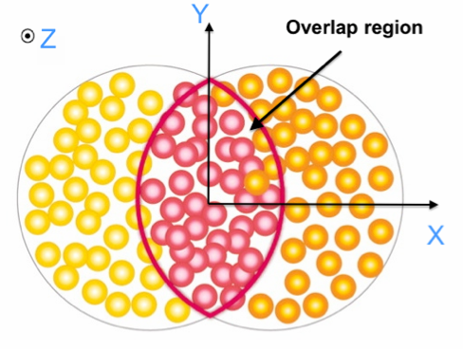
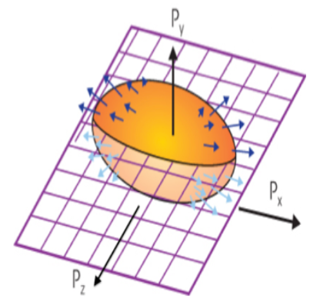


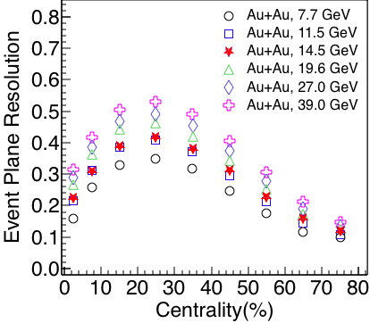

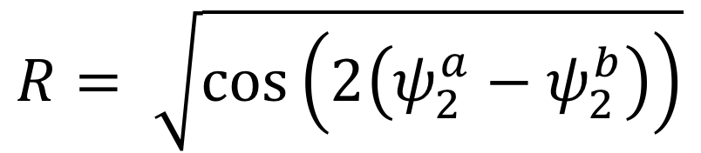
Elliptic Flow (v₂)
p_{y}
Interactions
Pressure(P)
p_{x}
p_{z}
η-sub event plane method is used for calculation of v₂.
The observed v₂ is corrected for event plane resolution.
A.M. Poskanzer & S. Voloshin, Phys. Rev. C58 (1998)

Slide 11
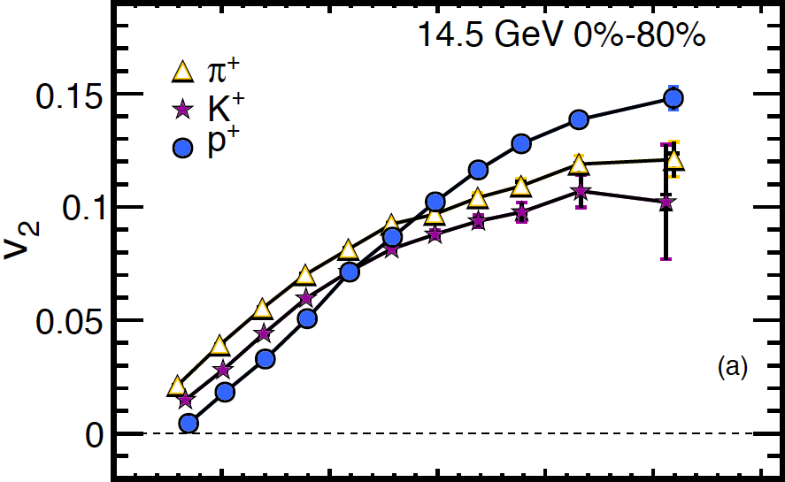
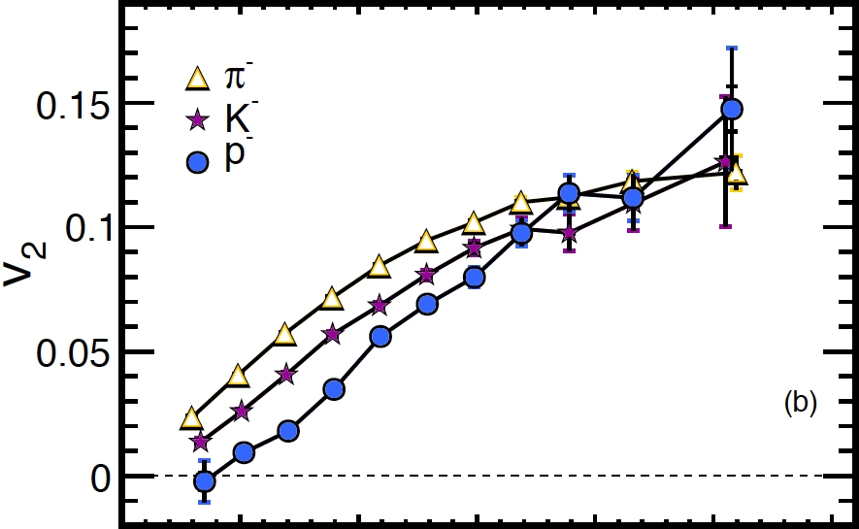
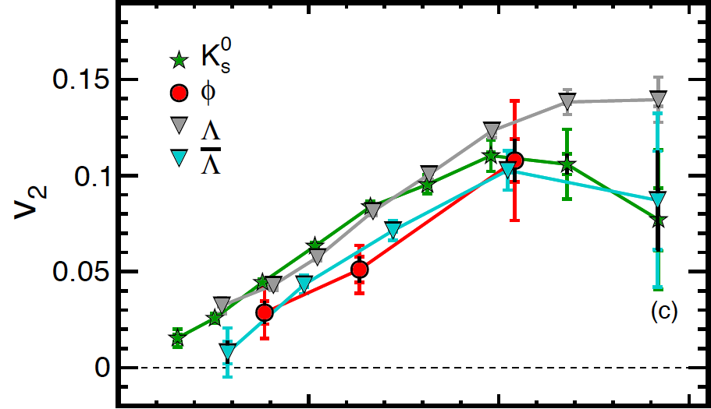
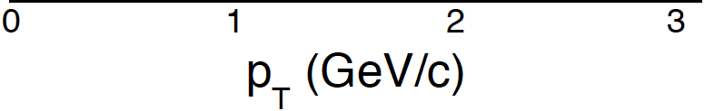
v₂ measurement
New measurement for Au+Au, 14.5 GeV data
STAR Preliminary
STAR Preliminary
STAR Preliminary
Mass ordering of v₂ is observed at low p_{T} for π⁺, K⁺, p and their antiparticles.
No mass ordering observed for K_{s}⁰, ϕ, Λ and Λ-bar.
Difference between v₂ of Λ and Λ-bar observed.

Slide 12
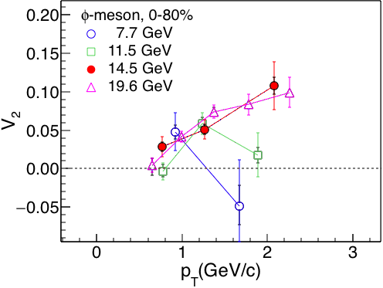
v₂ measurement
New measurement for Au+Au, 14.5 GeV data
STAR Preliminary
STAR Preliminary
STAR Preliminary
STAR Preliminary
Mass ordering of v₂ is observed at low p_{T} for π⁺, K⁺, p and their antiparticles.
No mass ordering observed for K_{s}⁰, ϕ, Λ and Λ-bar.
Difference between v₂ of Λ and Λ-bar observed.
Finite ϕ-meson v₂ in Au+Au at 14.5 GeV.

Slide 13
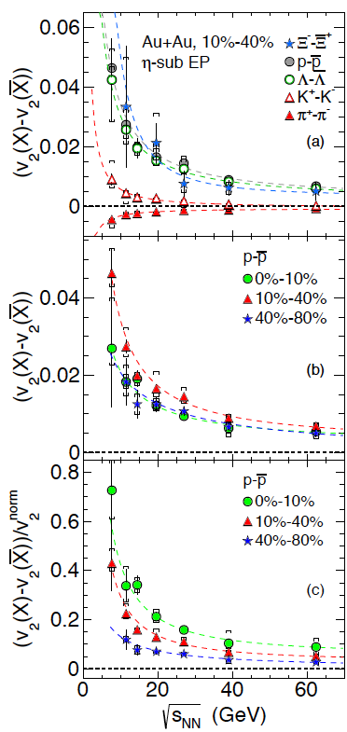
v₂ of Particles and Antiparticles
New result for Au+Au, 14.5 GeV data
STAR Preliminary
STAR Preliminary
14.5 GeV
STAR Preliminary
L. Adamczyk et. al, (STAR Collaboration) Phys. Rev. C 88 (2013) 14902
increases with decrease in energy.
relative to proton v₂ (at p_{T} = 1.5 GeV/c) shows a centrality dependence.
STAR Preliminary

Slide 14
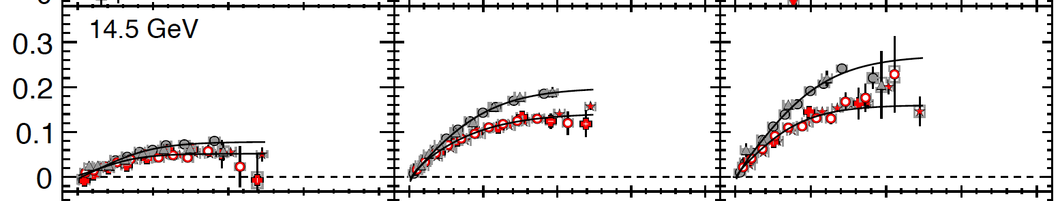

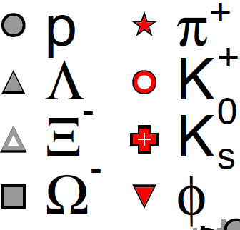

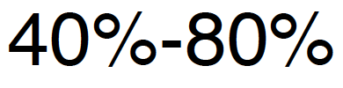

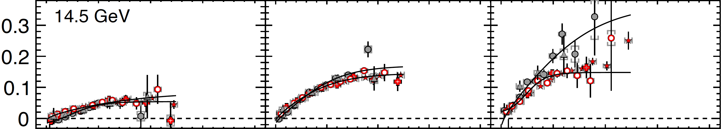
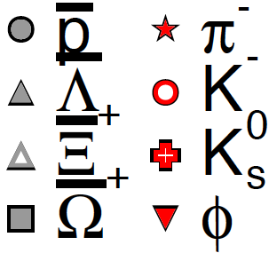
Centrality dependence
(a)
STAR Preliminary
(b)
Fit function:
n = 3 for baryons, 2 for mesons
Centrality dependence of v₂ is observed.
Baryon-meson separation of v₂ is more prominent for particles compared to anti-particles at transverse kinetic energy (m_{T} − m₀) > 1 GeV/c²

Slide 15
Summary
(A) New Measurements:
Transverse momentum spectra and elliptic flow v₂ of identified hadrons in Au+Au collisions at 14.5 GeV were presented.
The results for Au+Au collisions at 14.5 GeV are consistent with the trends established by the other BES energies.
(B) Observations:
Chemical Freeze-out:
  T_{ch} increases as collision energy increases.
  μ_{B} decreases collision energy increases.
  Centrality dependence of μ_{B} is observed.
Kinetic Freeze-out:
  Centrality dependence is observed for T_{kin} and <β>.
  T_{kin} and <β> are anti-correlated.
Elliptic flow v₂:
  Low p_{T} mass ordering of v₂ for π⁺, K⁺, p and their anti-particles is observed for Au+Au at 14.5 GeV.
  Centrality dependence is observed for v₂(p)–v₂( ) when normalized to proton v₂ for all BES energies.
Au+Au, 14.5 GeV
0-5% Most Central
T_{ch}(MeV) | 152 ± 6
μ_{B} (MeV) | 240 ± 12
T_{kin}(MeV) | 113 ± 3
<β> | 0.45 ± 0.02

Slide 16
BackUp

Slide 17
Chemical Freeze-out: THERMUS Model
Chemical freeze out:
Inelastic collisions among the particles ceases and particle yields get fixed.
THERMUS: Statistical thermal model
Grand Canonical Ensemble: Quantum numbers (B, S, Q) conserved on average
Thermodynamics quantities extracted:
Chemical freeze out temperature T_{ch}
Baryon chemical potential μ_{B}
S. Wheaton & Cleymans, Comput. Phys. Commun., 180, 84-109 (2009)

Slide 18
Kinetic Freeze-out: Blast Wave Model
Kinetic freeze out:
Elastic collisions among the particles stop and the momentum distribution gets fixed
Blast-Wave (BW) Model:
I₀, K₁: Modified Bessel functions
ρ(r) = tanh⁻¹b, b: transverse radial flow velocity,
r/R: relative radial position; R: radius of fireball
T_{kin}: Kinetic freeze-out temperature
Hydrodynamic based model
Assumes local thermalization of particles at a kinetic freeze-out temperature and moving with a common radial flow velocity
E. Schnedermann, J. Sollfrank, and U. W. Heinz, Phys. Rev. C 48, 2462 (1993).

Slide 19
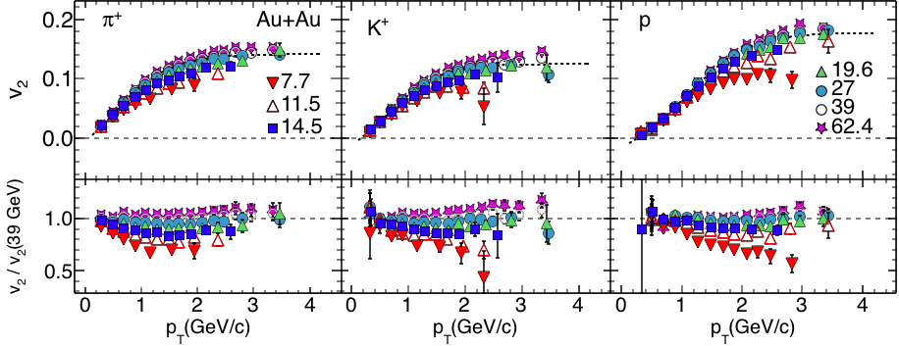
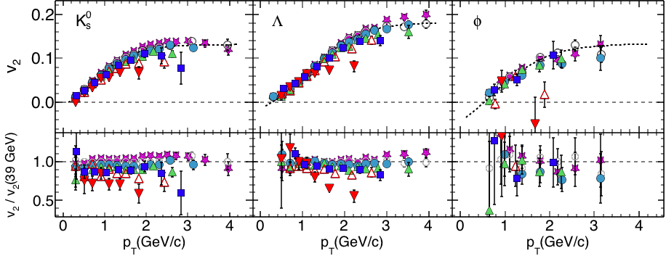
Comparison with BES energies
0-80%
L. Adamczyk et. al, (STAR Collaboration) Phys. Rev. C 88 (2013) 14902

