Slide 1


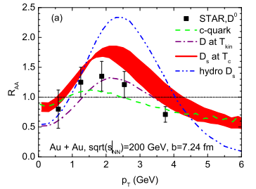
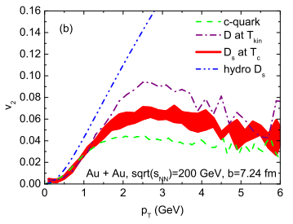
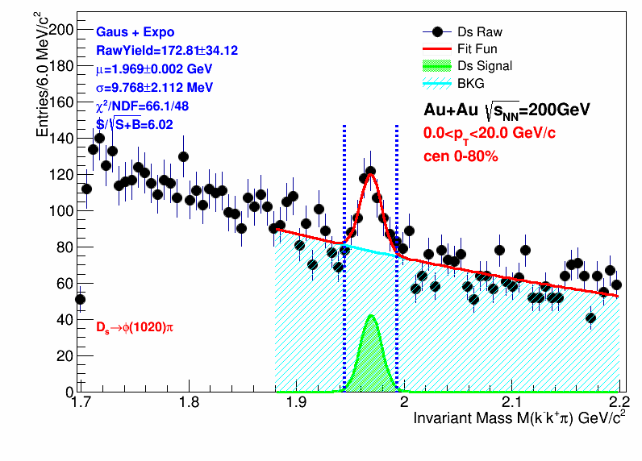
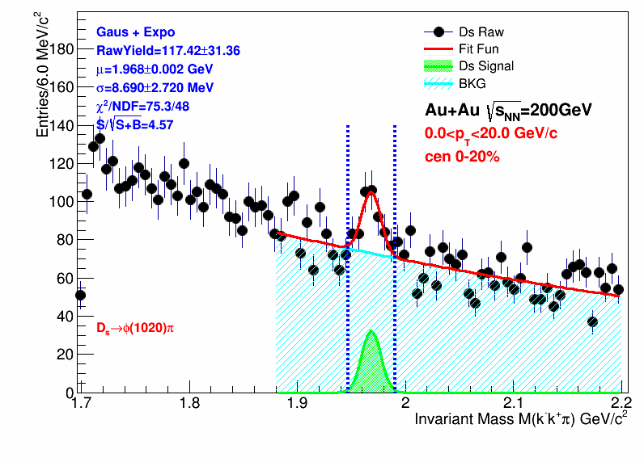
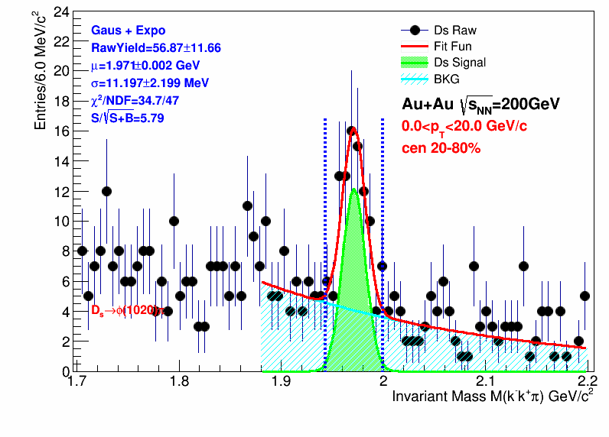
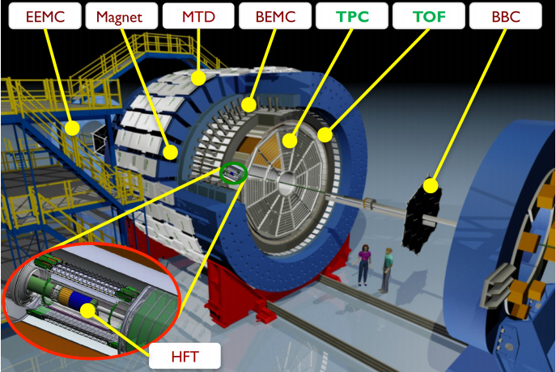
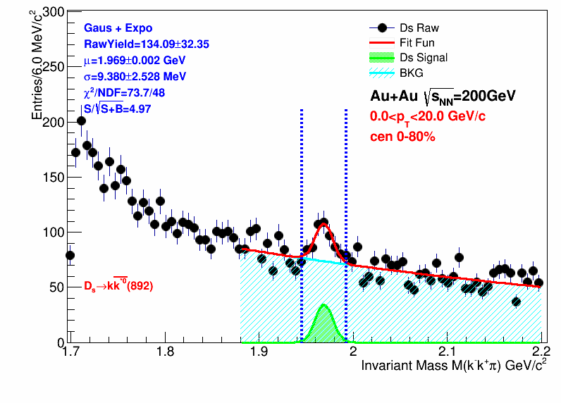
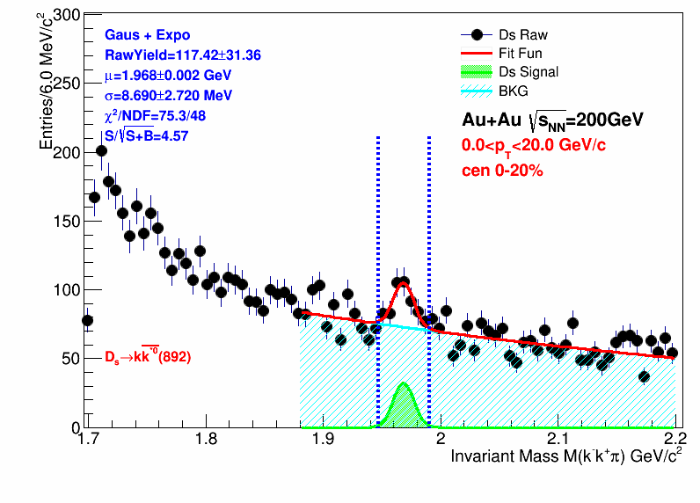
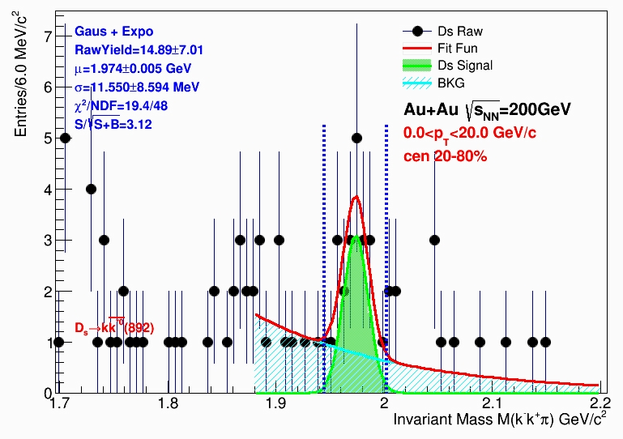
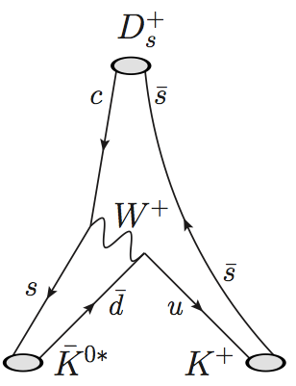
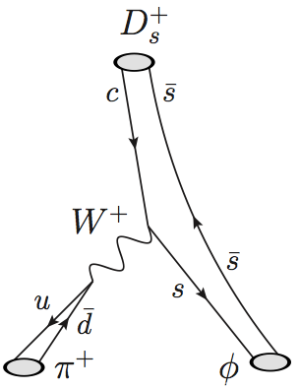
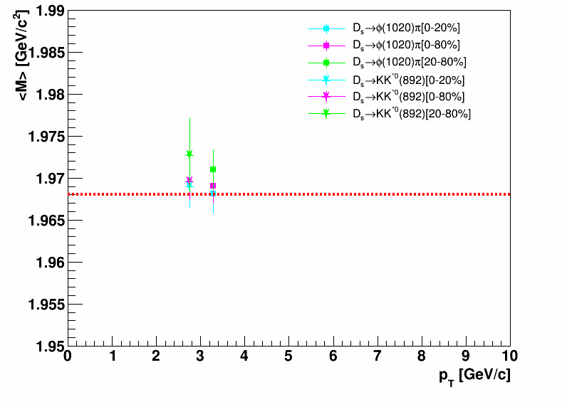
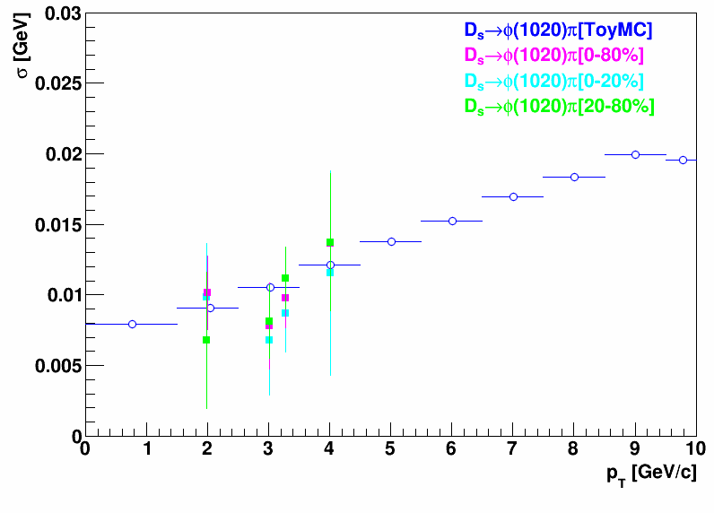
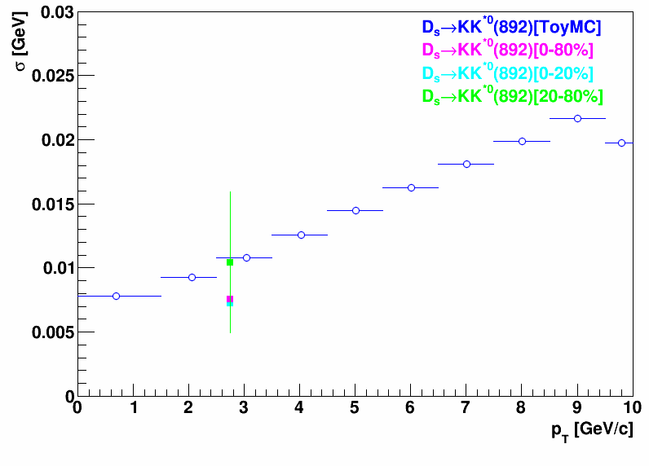
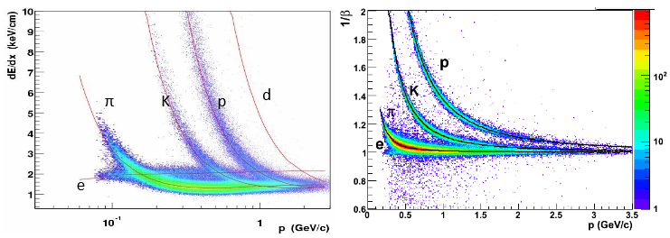
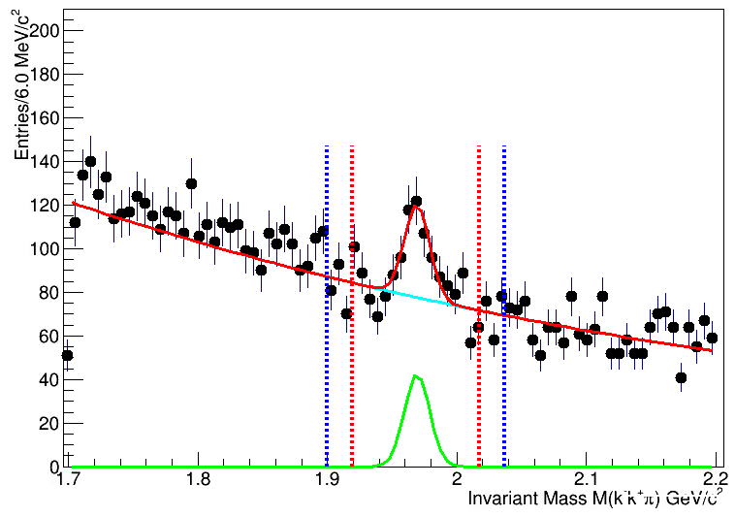
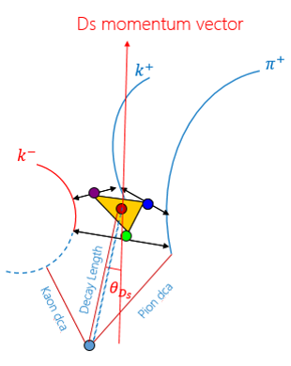
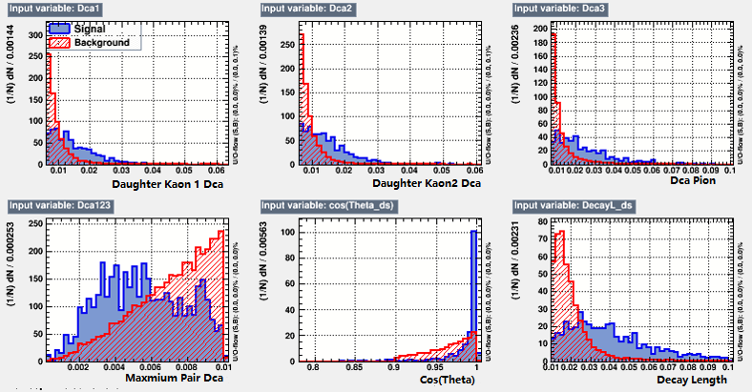



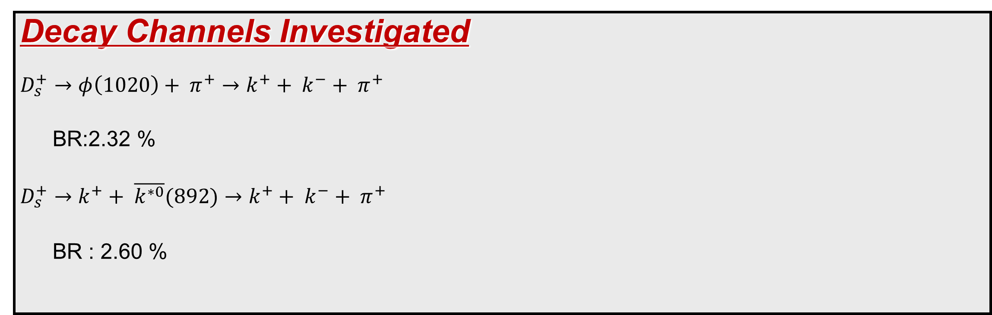
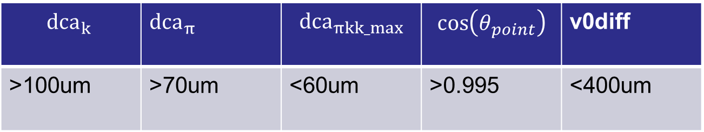


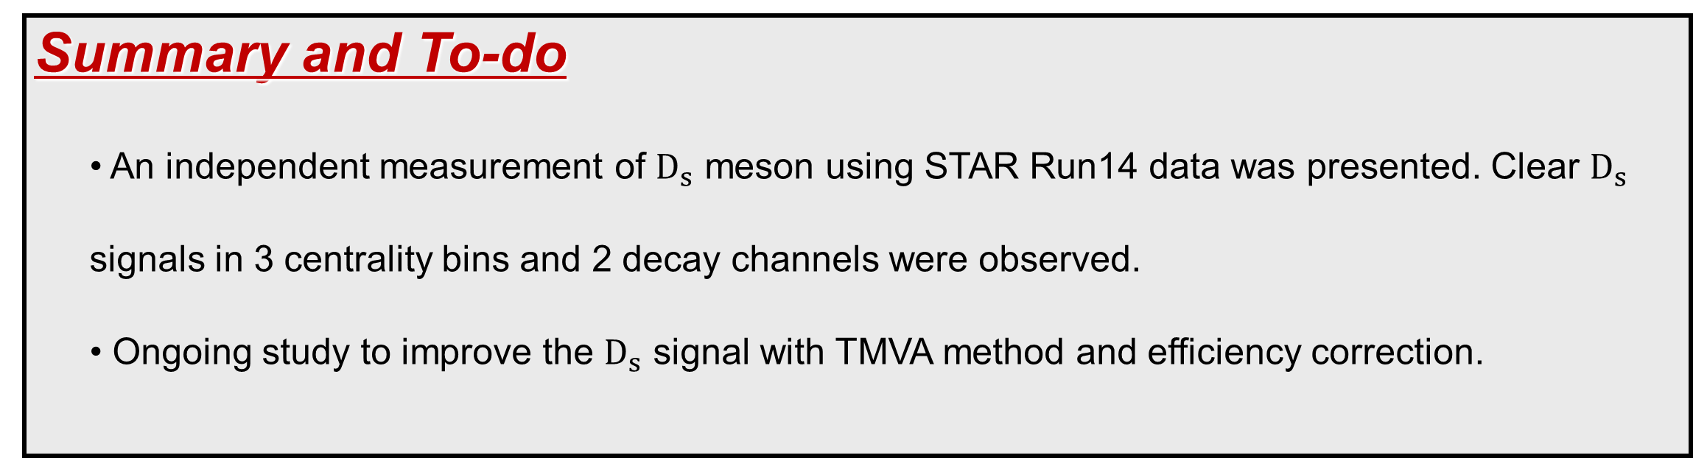



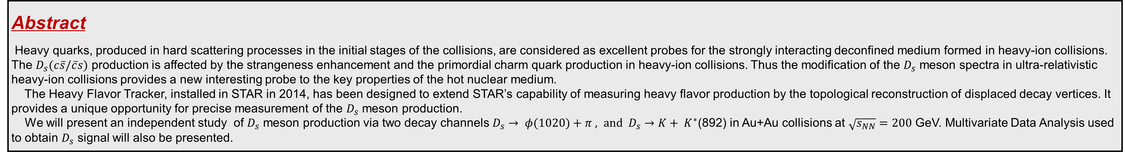


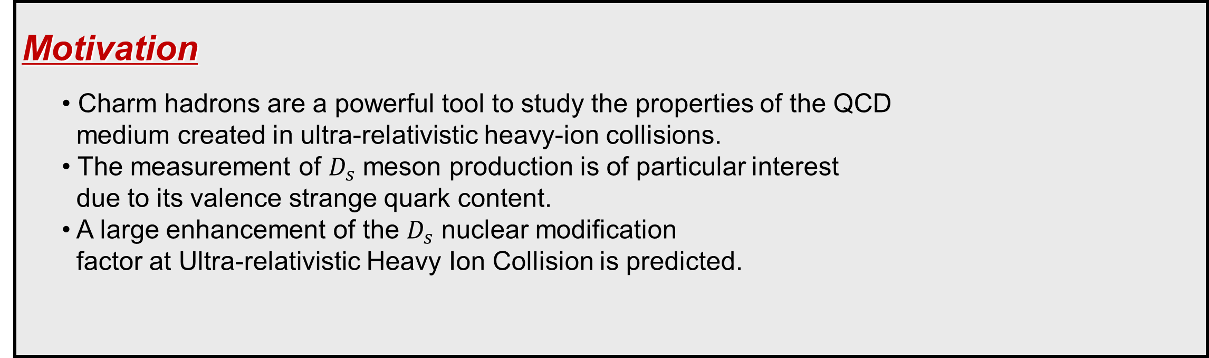
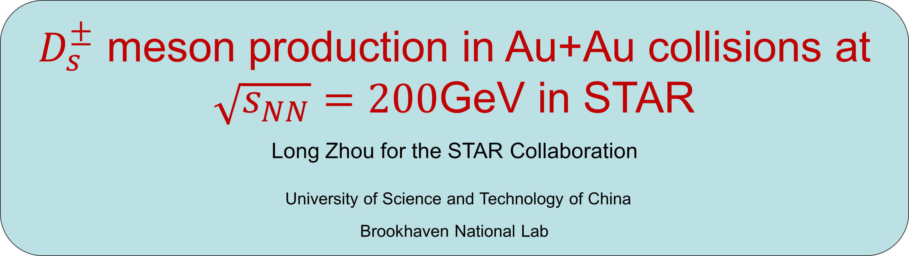
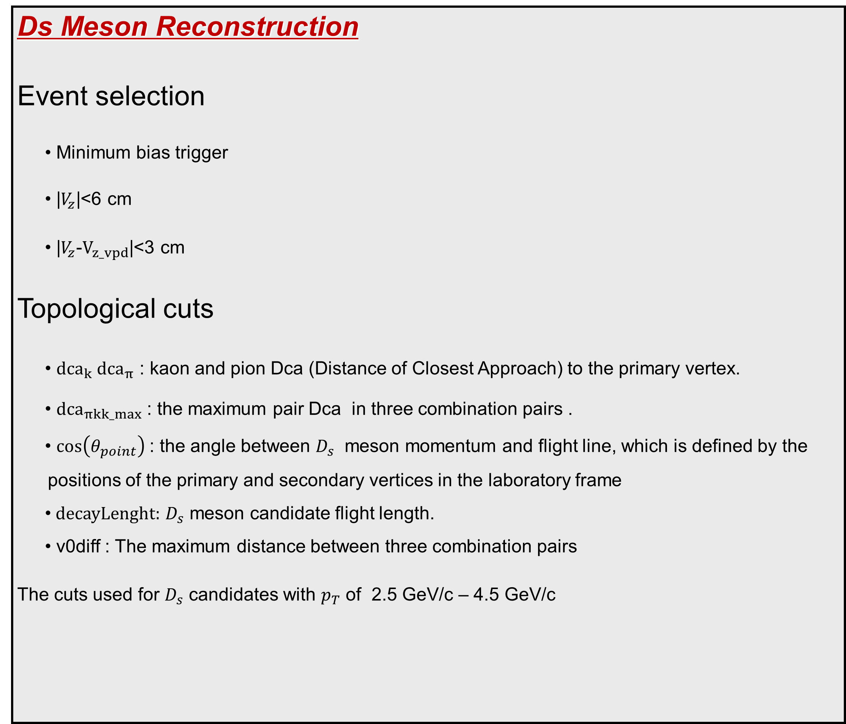
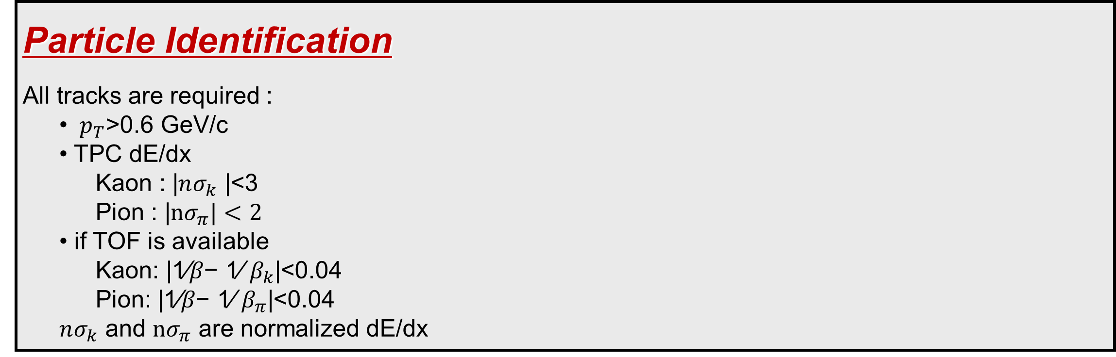
$D_{s}^{±}$ meson production in Au+Au collisions at $\sqrt{s_{NN}}=200$GeV in STAR
Long Zhou for the STAR Collaboration
University of Science and Technology of China
Brookhaven National Lab
Abstract
Heavy quarks, produced in hard scattering processes in the initial stages of the collisions, are considered as excellent probes for the strongly interacting deconfined medium formed in heavy-ion collisions. The $D_{s}(c\overline{s}/\overline{c}s)$ production is affected by the strangeness enhancement and the primordial charm quark production in heavy-ion collisions. Thus the modification of the $D_{s}$ meson spectra in ultra-relativistic heavy-ion collisions provides a new interesting probe to the key properties of the hot nuclear medium.
The Heavy Flavor Tracker, installed in STAR in 2014, has been designed to extend STAR’s capability of measuring heavy flavor production by the topological reconstruction of displaced decay vertices. It provides a unique opportunity for precise measurement of the $D_{s}$ meson production.
We will present an independent study of $D_{s}$ meson production via two decay channels $D_{s}→ φ(1020)+π , and D_{s}→K+ K^{∗}$(892) in Au+Au collisions at $\sqrt{s_{NN}}=200$ GeV. Multivariate Data Analysis used to obtain $D_{s}$ signal will also be presented.
Motivation
  • Charm hadrons are a powerful tool to study the properties of the QCD
  medium created in ultra-relativistic heavy-ion collisions.
  • The measurement of $D_{s}$ meson production is of particular interest
  due to its valence strange quark content.
  • A large enhancement of the $D_{s}$ nuclear modification
  factor at Ultra-relativistic Heavy Ion Collision is predicted.
Results
$D_{s}$ signal from${ D}_{s}→π+ϕ (1020)$ decay channel
$D_{s} signal from D_{s}→K+K^{∗}(892)$ decay channel
$D_{s}$ meson mean and width
PRL 110, 112301 (2013)
Experimental Setup
Vertex Position Detector (VPD)
Time of Flight (TOF)
Time Projection Chamber (TPC)
  • Measurement of a charged particle energy loss
  (dE/dx)
  • Tracking and momentum reconstruction
Heavy Flavor Tracker (HFT)
  • Four layer silicon detector, provides high space
  point resolution (DCA < 50 microns for 750 MeV/c kaons)
Decay Channels Investigated
$$D_{s}^{+}→φ\left(1020\right)+ π^{+}→k^{+}+ k^{−}+ π^{+}$$
  BR:2.32 %
$D_{s}^{+}→k^{+}+ \overline{k^{∗0}}(892)→k^{+}+ k^{−}+ π^{+}$
  BR : 2.60 %
$$D_{s} : cτ=149.9um$$
Particle Identification
All tracks are required :
  • $p_{T}$>0.6 GeV/c
  • TPC dE/dx
    Kaon : |$nσ_{k}$ |<3
    Pion : |$nσ_{π}|<2$
  • if TOF is available
    Kaon: |1⁄𝛽− 1⁄ $β_{k}$|<0.04
    Pion: |1⁄𝛽− 1⁄ $β_{π}$|<0.04
  $nσ_{k}$ and $nσ_{π}$ are normalized dE/dx
TOF PID
The mean and with are consistent with Toy MC simulation.
TMVA Method
TMVA stands for Toolkit for Multi-Variate Analysis
Signal
  • Toy-MC simulation
  • Momentum resolution obtained from real data
Background
  • Side-Band Background
  • Mass Window
    |$M_{φ} − M_{φ}^{PDG}$| < 8 MeV
    |$M_{Ds} − M_{Ds}^{PDG}$| in $5σ$ - $7σ$
Ongoing study to optimize the cuts with TMVA.
$$−7σ$$
$$−5σ$$
$$5σ$$
$$7σ$$
Ds Meson Reconstruction
Event selection
  • Minimum bias trigger
  • |$V_{z}$|<6 cm
  • |$V_{z}$-${\text{V}}_{z_vpd}$|<3 cm
Topological cuts
  • ${dca}_{k} {dca}_{π}$ : kaon and pion Dca (Distance of Closest Approach) to the primary vertex.
  • ${dca}_{πkk_max}$ : the maximum pair Dca in three combination pairs .
  • $\cos\left(θ_{point}\right)$: the angle between $D_{s}$ meson momentum and flight line, which is defined by the positions of the primary and secondary vertices in the laboratory frame
  $\text{•} decayLenght:$ $D_{s}$ meson candidate flight length.
  $\text{•}$v0diff : The maximum distance between three combination pairs
The cuts used for $D_{s}$ candidates with $p_{T}$ of 2.5 GeV/c – 4.5 GeV/c
Summary and To-do
  • An independent measurement of $D_{s}$ meson using STAR Run14 data was presented. Clear $D_{s}$
  signals in 3 centrality bins and 2 decay channels were observed.
  • Ongoing study to improve the $D_{s}$ signal with TMVA method and efficiency correction.
$${dca}_{k}$$ | ${dca}_{π}$ | $${dca}_{πkk_max}$$ | $$\cos\left(θ_{point}\right)$$ | v0diff
>100um | >70um | <60um | >0.995 | <400um
The STAR Collaboration: http://drupal.star.bnl.gov/STAR/presentations

