Slide 1
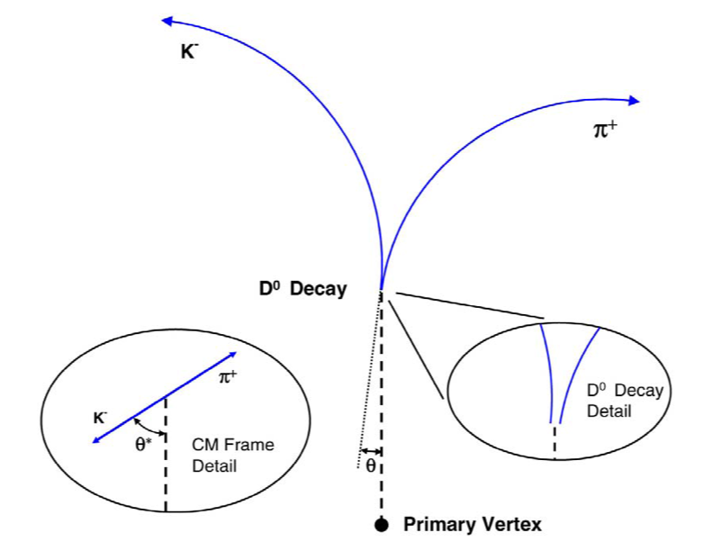
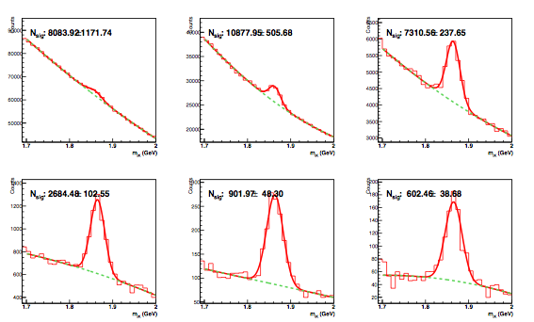
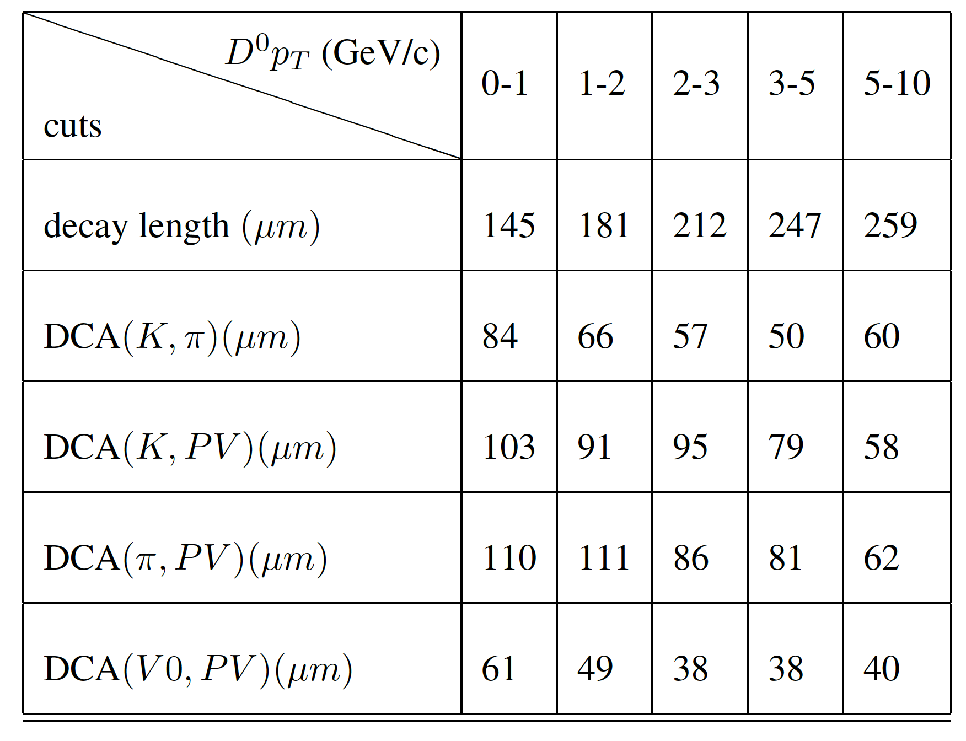
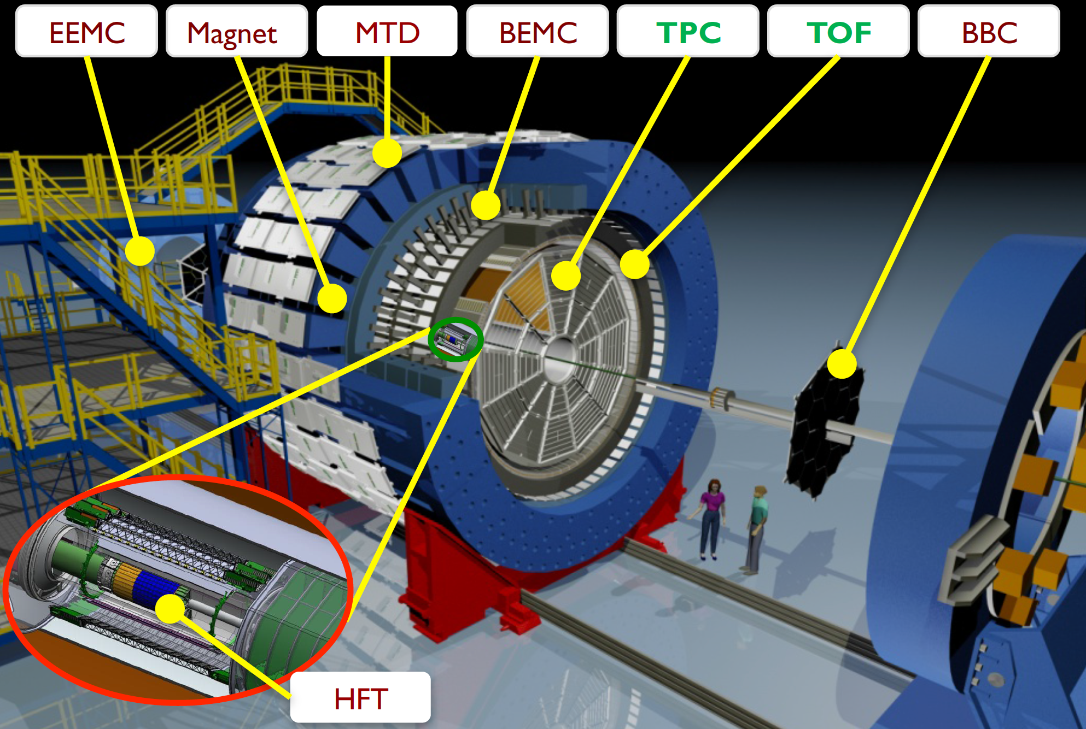
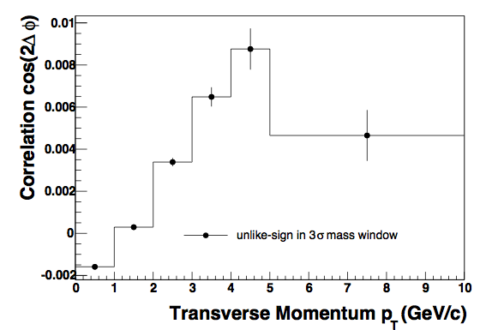
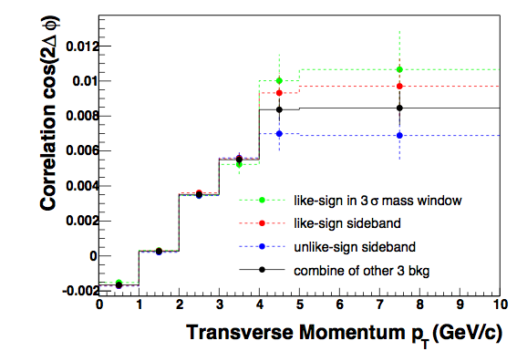
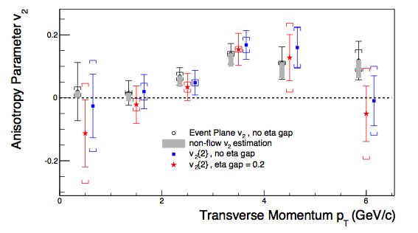
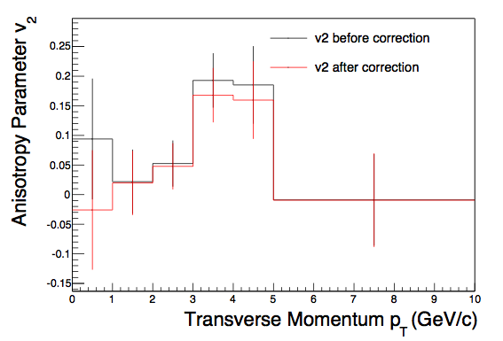
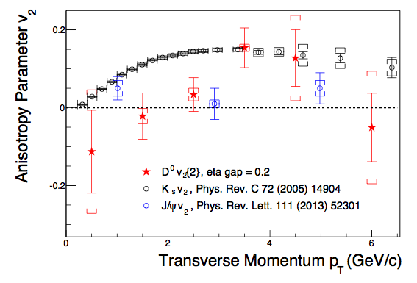
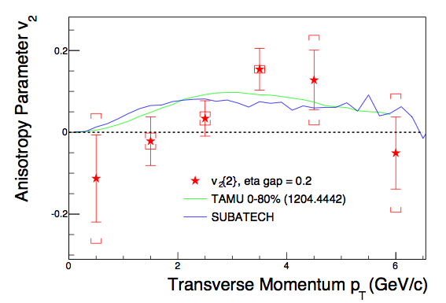
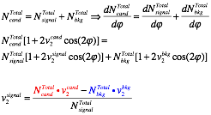
Abstract
The observed azimuthal anisotropies of light flavor hadrons suggest large partonic collectivity in the hot and dense medium created in relativistic heavy-ion collisions. Since heavy quark interactions with the medium may be different from light quark interactions, the measurements of heavy quark elliptic anisotropy is complementary to those of light quarks and can provide new insight in understanding the path length dependence of heavy quark energy loss in the medium and the degree of thermalization. In this poster, we present the STAR measurement of elliptic anisotropy (v₂) of D⁰ in Au+Au collisions at √s_{NN}=200 GeV using the two-particle correlation method. The data were taken in the first year of physics running with the new STAR Heavy Flavor Tracker detector, which greatly improves open heavy flavor hadron measurements by the topological reconstruction of secondary decay vertices. The results are compared with theoretical predictions for D⁰ meson anisotropy and other STAR published anisotropy measurement.
Motivation
D⁰ meson Reconstruction
Produced by initial hard scatterings and receive influences throughout the whole evolution in heavy ion collisions.
The charm quark flow is a unique tool to study the extent of thermalization of the bulk medium dominated by light quarks and gluons.
At high pT, D meson azimuthal anisotropy is sensitive to the path length dependence of charm quark energy loss in the medium, which offers new insights of heavy quark energy loss mechanisms.
The two particle correlation method can apply eta gap between D meson candidate and reference hadrons which suppress non-flow effect effectively.
Trigger and event selection:
Trigger: minimum bias trigger
|Vzprimary vertex| < 6 cm
|Vzprimary vertex - Vzvpd| < 3 cm
Reference hadron selection:
0.2 < pT < 2 GeV/c
|eta| < 1.0
DCA < 2 cm
Fitting hits in TPC > 20
(#Fit points/#possible points) in TPC > 0.52
Topological cut definition
DCA(K,π): The distance of closest approach (DCA) between Kaon track and π track
Decay Length: the distance between primary vertex to the reconstructed D⁰ decay vertex.
DCA(V0,PV): The DCA between reconstructed D⁰ track to primary vertex. (= decay length x sin(θ))
Kaon and π selection:
pT > 0.6 GeV/c
Fitting hits in TPC > 20
Fitting possibility in TPC > 0.52
at least one hit in every layer of PXL and IST
|nσPion| < 3.0 ; |nσKaon| < 2.0. For dE/dx in TPC
The Solenoidal Tracker at RHIC (STAR)
0<pT<1GeV/c
1<pT<2GeV/c
2<pT<3GeV/c
Main subdetectors used for this analysis are:
Time Projection Chamber (TPC)
PID via energy loss dE/dx.
Charged particle track and momentum reconstruction.
Heavy Flavor Tracker (HFT)
HFT: Pixel detector + IST +SST.
Provides high resolution space points (σ= 6.3µm for the innermost 2 layers).
3<pT<4GeV/c
4<pT<5GeV/c
5<pT<10GeV/c
Candidate and Background correlation
Background v2 is a combination of 3 different methods.
Candidate v2 comes from unlike-sign pairs.
Candidate correlation
background correlation
Methodology
Definition of correlation v2 :
The correlation of D meson and hadron is a product of anisotropy of D meson and hadron.
Reference Hadron v2:
Using the same method, the correlation of hadron1 and hadron2 is the square of hadron v2
Systematic Uncertainty
pT bin (GeV/c) | D⁰ v2 with stat. | Yield Error | Bkgd Error
0-1 | -0.026±0.101 | ±0.000 | ±0.145
1-2 | 0.020±0.054 | ±0.000 | ±0.027
2-3 | 0.048±0.039 | ±0.000 | ±0.010
3-4 | 0.168±0.046 | ±0.001 | ±0.024
4-5 | 0.160±0.066 | ±0.001 | ±0.063
5-10 | -0.009±0.079 | ±0.011 | ±0.109
Two systematic uncertainties:
Yield error: using exponential to fit background as reference.
Background v2 uncertainty: The biggest difference between these three bands to default v2.
Acceptance Correction:
Fix the non-uniform acceptance by subtracting the red terms
ref. PhysRevC.83.044913
Calculate D meson v2:
εtrigger : trigger efficiency
ND-hadron: number of D-hadron pair in different centrality
The hadron v2 is weighted by the number of D-hadron pair
Calculate D meson v2 in different D meson pT bins.
Results
STAR Preliminary
Consistent with event plane method
Two particle correlation method can apply eta gap between D meson and reference hadrons.
Eta gap suppresses non-flow effect
Discussion
Data compared to theoretical predictions, which has no effect of non-flow.
D⁰ v2 compared with Ks and J/Ψ v2 measurement
STAR Preliminary
STAR Preliminary
D⁰ v2 calculation
Equation for background extraction :
Candidate and background sample :
Candidate: unlike-sign pair in (-3σ,3σ)
Background: average of following:
like-sign pair in (-3σ,3σ)
like-sign pair in (±4σ,±9σ)
unlike-sign pair in (±4σ,±9σ)
Ncand: Integral in (-3σ,3σ)
Nsignal and Nbkg : Calculate from fitting function
σ is square root of variance from Gaussian
Conclusion
Two-particle correlation method v2 is consistent with event plane method.
D⁰ v2 is finite for pT > 3.0 GeV/c and lower than light hadrons for pT < 3.0 GeV/c.
Good agreement between theoretical predictions and experimental results.
The STAR Collaboration: http://drupal.star.bnl.gov/STAR/presentations

