Slide 1


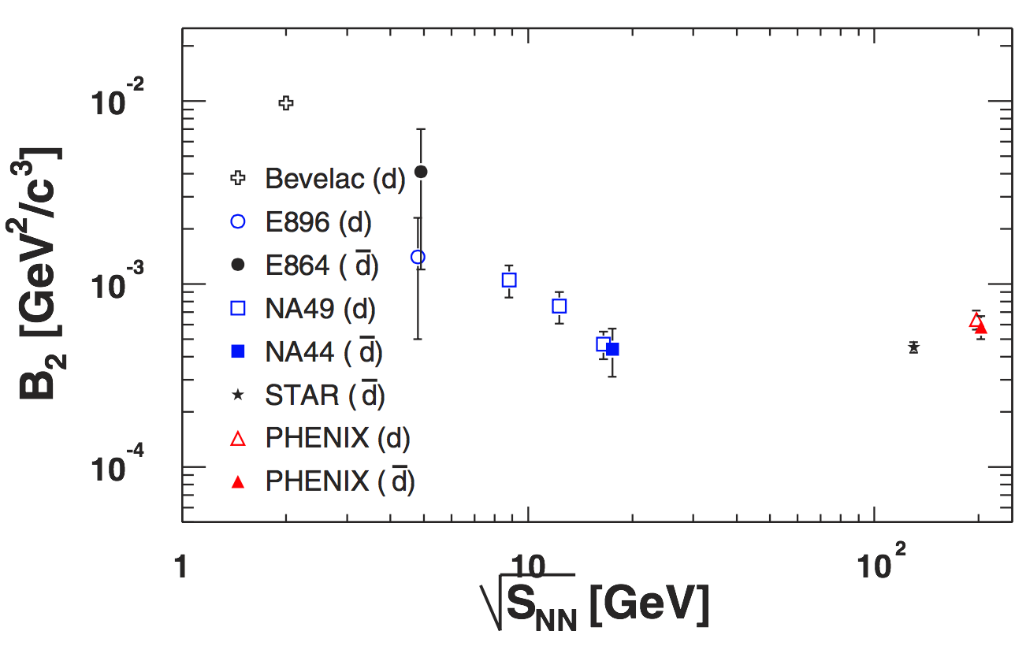
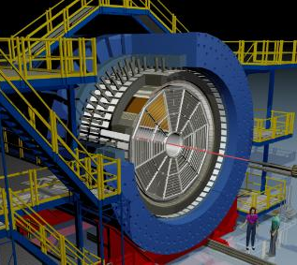
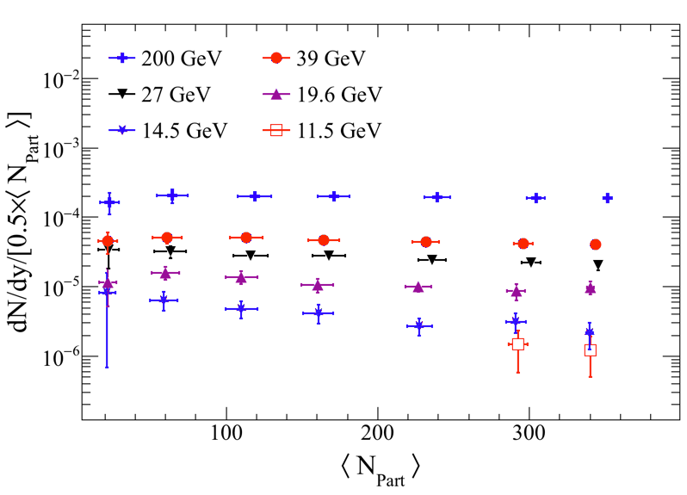






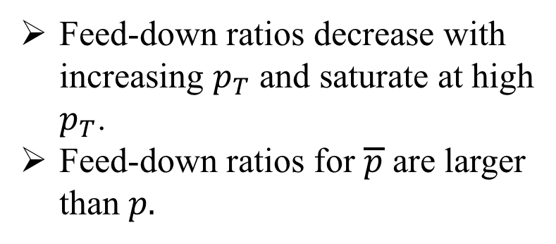

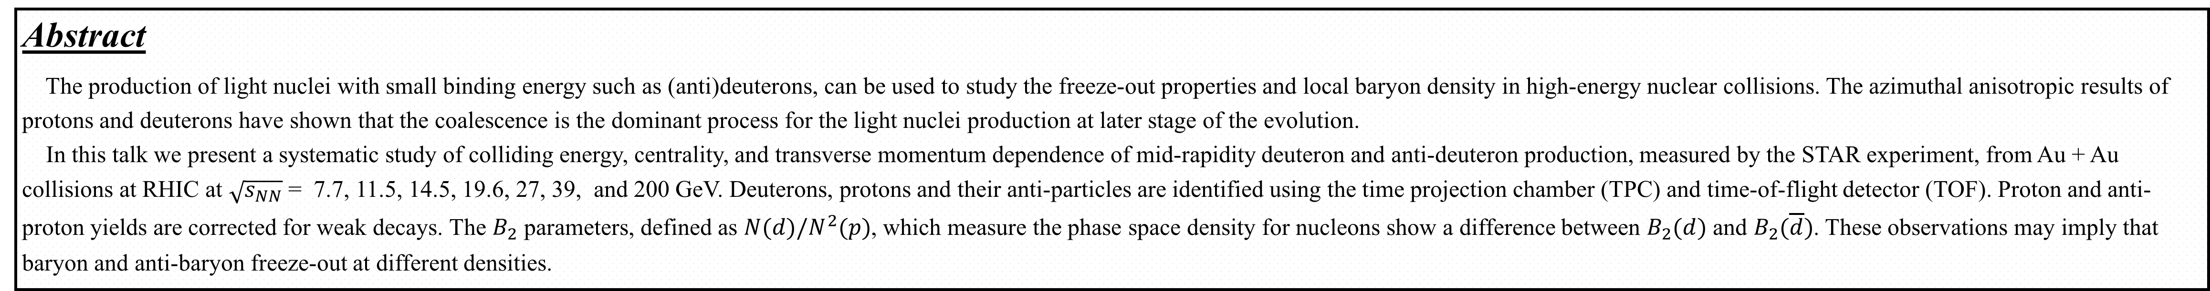
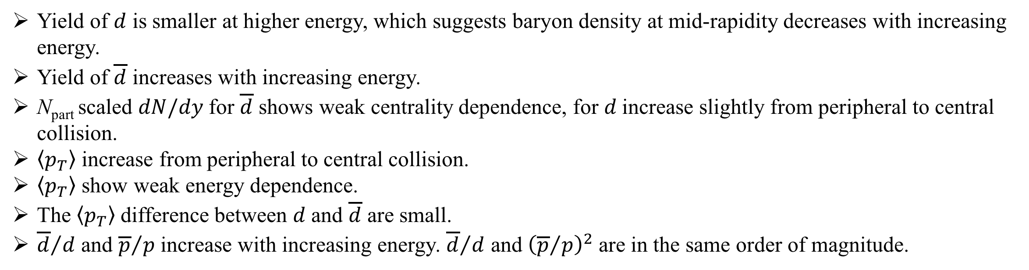


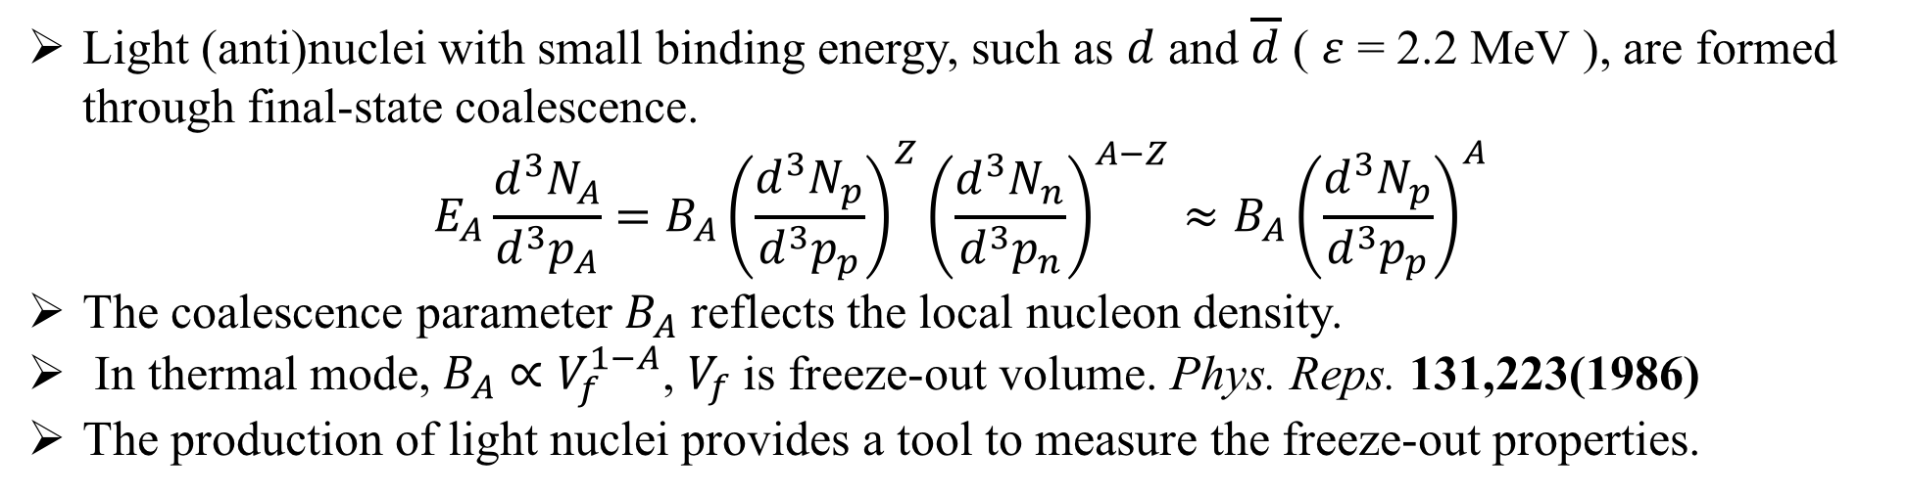
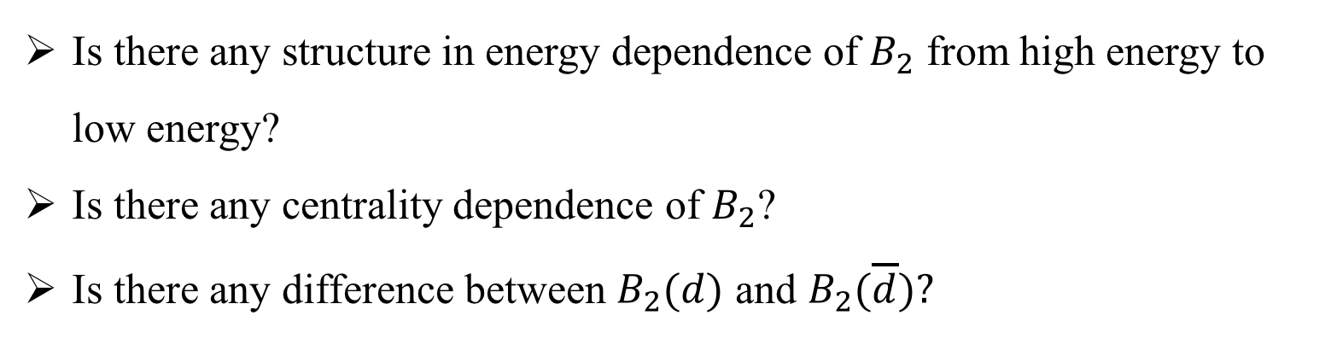
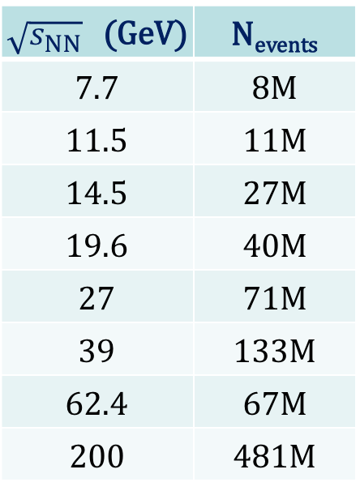

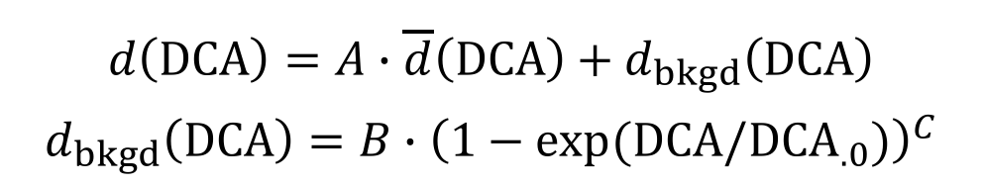


Beam energy dependence of $d$ and $\overline{d}$ production in Au + Au collisions at RHIC
Ning Yu (Central China Normal University), for the STAR Collaboration
Abstract
The production of light nuclei with small binding energy such as (anti)deuterons, can be used to study the freeze-out properties and local baryon density in high-energy nuclear collisions. The azimuthal anisotropic results of protons and deuterons have shown that the coalescence is the dominant process for the light nuclei production at later stage of the evolution.
In this talk we present a systematic study of colliding energy, centrality, and transverse momentum dependence of mid-rapidity deuteron and anti-deuteron production, measured by the STAR experiment, from Au + Au collisions at RHIC at $\sqrt{s_{NN}}$ = 7.7, 11.5, 14.5, 19.6, 27, 39, and 200 GeV. Deuterons, protons and their anti-particles are identified using the time projection chamber (TPC) and time-of-flight detector (TOF). Proton and anti-proton yields are corrected for weak decays. The $B_{2}$ parameters, defined as $N(d)/N^{2}(p)$, which measure the phase space density for nucleons show a difference between $B_{2}(d)$ and $B_{2}(\overline{d})$. These observations may imply that baryon and anti-baryon freeze-out at different densities.
Introduction and Motivation
Light (anti)nuclei with small binding energy, such as $d$ and $\overline{d}$ ( $ε$ = 2.2 MeV ), are formed through final-state coalescence.
$$E_{A}\frac{d^{3}N_{A}}{d^{3}p_{A}}=B_{A}{\left(\frac{d^{3}N_{p}}{d^{3}p_{p}}\right)}^{Z}{\left(\frac{d^{3}N_{n}}{d^{3}p_{n}}\right)}^{A−Z}≈B_{A}{\left(\frac{d^{3}N_{p}}{d^{3}p_{p}}\right)}^{A}$$
The coalescence parameter $B_{A}$ reflects the local nucleon density.
In thermal mode, $B_{A}∝V_{f}^{1−A}$, $V_{f}$is freeze-out volume. Phys. Reps. 131,223(1986)
The production of light nuclei provides a tool to measure the freeze-out properties.
PRL 94,122302(2005)
Most Central Collisions
Is there any structure in energy dependence of $B_{2}$ from high energy to low energy?
Is there any centrality dependence of $B_{2}$?
Is there any difference between $B_{2}(d)$ and $B_{2}(\overline{d})?$
Data Sets, Cuts, and Pariticle Identification
Detector Corrections
Event Cuts
$\left|V_{z}\right|<70$cm for 7.7, 14.5, 19.6 GeV,
$<50$cm for 11.5 GeV,
$<40$cm for 39, 62.4 GeV,
$<30$cm for 200 GeV;
$\left|V_{r}−(0cm, −0.89cm)\right|<1$cm for 14.5 GeV,
$\left|V_{r}\right|<2$cm otherwise.
Track Cuts
$p_{T}>$ 0.6 GeV/c
N_{HitFits} > 25,
N_{HitDedx} > 15,
DCA < 1 cm
$\left|y\right|$ < 0.3
Centrality
Multiplicity with $\left|η\right|$ < 0.5
Secondary particle contamination from beam pipe.
This effect will be vanished at high $p_{T}$. It is assumed $d$ and $\overline{d}$ have similar DCA distribution. The contamination for $d$ can be extracted from the difference of these two distributions.
TPC Tracking Efficiency and Acceptance
TPC
TOF
STAR Preliminary
 | N_{events}
7.7 | 4M
11.5 | 11M
14.5 | 27M
19.6 | 40M
27 | 71M
39 | 133M
62.4 | 67M
200 | 481M
TOF Matching Efficiency
STAR Preliminary
$$d\left(DCA\right)=A∙\overline{d}\left(DCA\right)+d_{bkgd}\left(DCA\right)$$
$$d_{bkgd}\left(DCA\right)=B∙{\left(1−exp⁡(DCA/{DCA}_{.0})\right)}^{C}$$
Deuteron can be identified up to 4 GeV/c
Proton Feed-down Corrections
Deuteron Transverse Momentum Distribution
Protons have many contributions from weak decay of multi-strange particles. These contributions should be removed to get the primary proton.
In STAR experiment, for the proton parent particles, only $Λ$, $Ξ^{−}$,$Ω^{−}$and their anti-particles can be measured. For $Ξ^{0}$, it is assumed the spectra of $Ξ^{−}$ and $Ξ^{0}$ are the same. For these particles, corrected spectra and the embedding detector simulation are used to get the weak decay protons.
For $Σ^{+}$, it is assumed the ratio $Σ^{+}/Λ≈$ 0.27 and $p_{T}$ independent.
STAR Preliminary
STAR Preliminary
STAR Preliminary
STAR Preliminary
STAR Preliminary
STAR Preliminary
STAR Preliminary
STAR Preliminary
STAR Preliminary
Feed-down ratios decrease with increasing $p_{T}$ and saturate at high $p_{T}$.
Feed-down ratios for $\overline{p}$ are larger than $p.$
dN/dy and Mean p_{T}
Results
$$d$$
$$\overline{d}$$
Anti-particle particle ratios
Because $B_{2}$ is not $p_{T}$ independent, we study the energy dependent of $p_{T}$ integrated
$$B_{2}=N(d)/N^{2}(p)$$
In thermal model grand canonical ensemble (GCE), integral $B_{2}(d)$ and $B_{2}(\overline{d})$ should be the same if iso-spin effect can be neglected.
For the most 5% collision centrality
$$\frac{B_{2}(d)−B_{2}(\overline{d})}{B_{2}(d)}≈0.29±0.14$$
with a straight line fit, which might represent the iso-spin effect is not negligible in heavy-ion collision or particle and antiparticle have different freeze-out volume.
STAR Preliminary
STAR Preliminary
$$d$$
STAR Preliminary
$$\overline{d}$$
STAR Preliminary
Summary
Yield of $d$ is smaller at higher energy, which suggests baryon density at mid-rapidity decreases with increasing energy.
Yield of $\overline{d}$ increases with increasing energy.
N_{part} scaled $dN/dy$ for $\overline{d}$ shows weak centrality dependence, for $d$increase slightly from peripheral to central collision.
$\left\langle p_{T}\right\rangle$ increase from peripheral to central collision.
$\left\langle p_{T}\right\rangle$ show weak energy dependence.
The $\left\langle p_{T}\right\rangle$difference between $d$ and $\overline{d}$ are small.
${\overline{d}}/d$ and ${\overline{p}}/{p }$increase with increasing energy. ${\overline{d}}/d$ and ${\left({\overline{p}}/p\right)}^{2}$ are in the same order of magnitude.
We report STAR new results on $d$ and $\overline{d}$ productions in Au + Au collisions at $\sqrt{s_{NN}}$ = 7.7, 11.5, 14.5, 19.6, 27, 39, and 200 GeV.
Both the N_{part} scaled yields ($dN/dy$) and mean transverse momenta ($\left\langle p_{T}\right\rangle$) of $d$ and $\overline{d}$ show collision energy dependence. Blast Wave function fits to deuteron spectra well.
The coalescence parameter $B_{2}$: $N(d)/N^{2}(p)$, decrease as collision energy increases, which shows that as energy decreases, the freeze-out volume for nucleons becomes smaller. The relative change of the $B_{2}$: $\left(B_{2}(d)−B_{2}(\overline{d})\right)/B_{2}(d)$, show little energy dependence, the averaged valued is $0.29±0.14$, which might represent the iso-spin effect is not negligible in heavy-ion collision or particle and antiparticle have different freeze-out volume.
High statistics data are needed for future studies, especially at the high net-baryon, i.e. low collision energy, region.
The STAR Collaboration: http://drupal.star.bnl.gov/STAR/presentations

