Slide 1
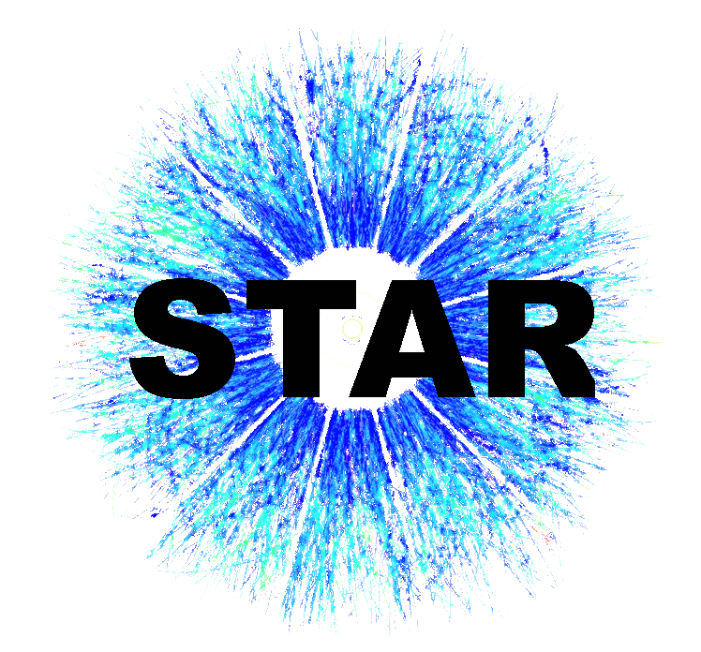

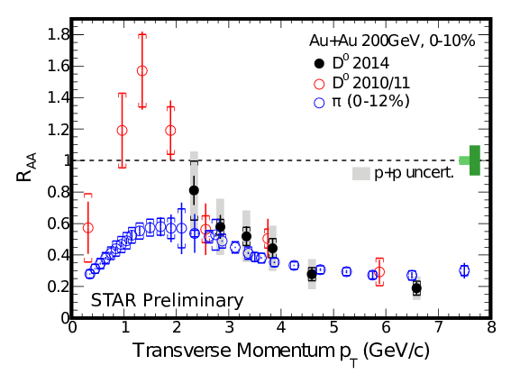
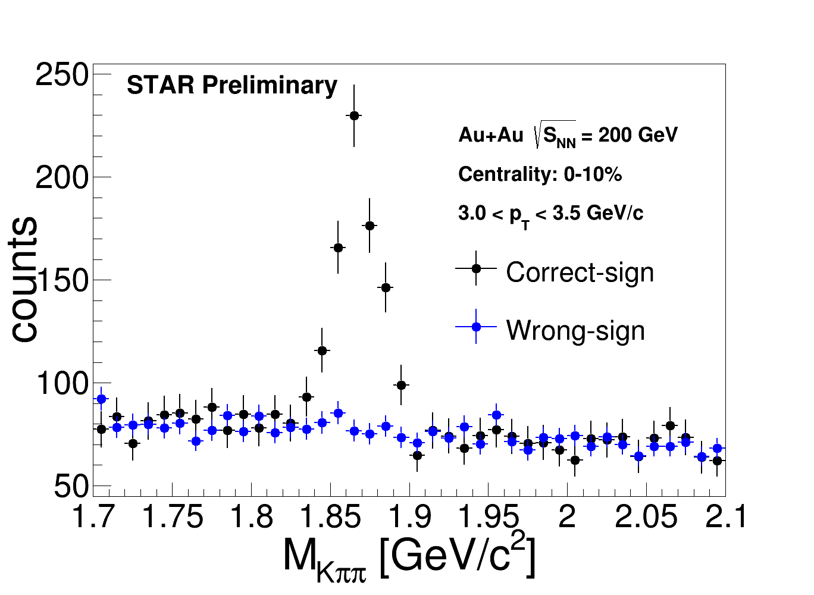
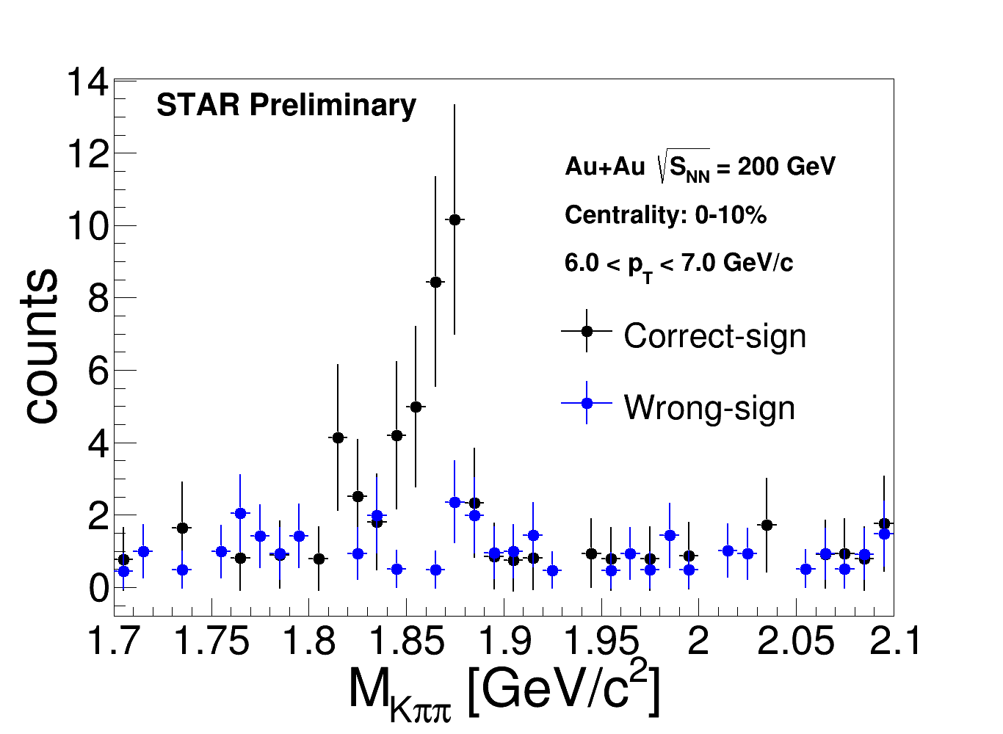
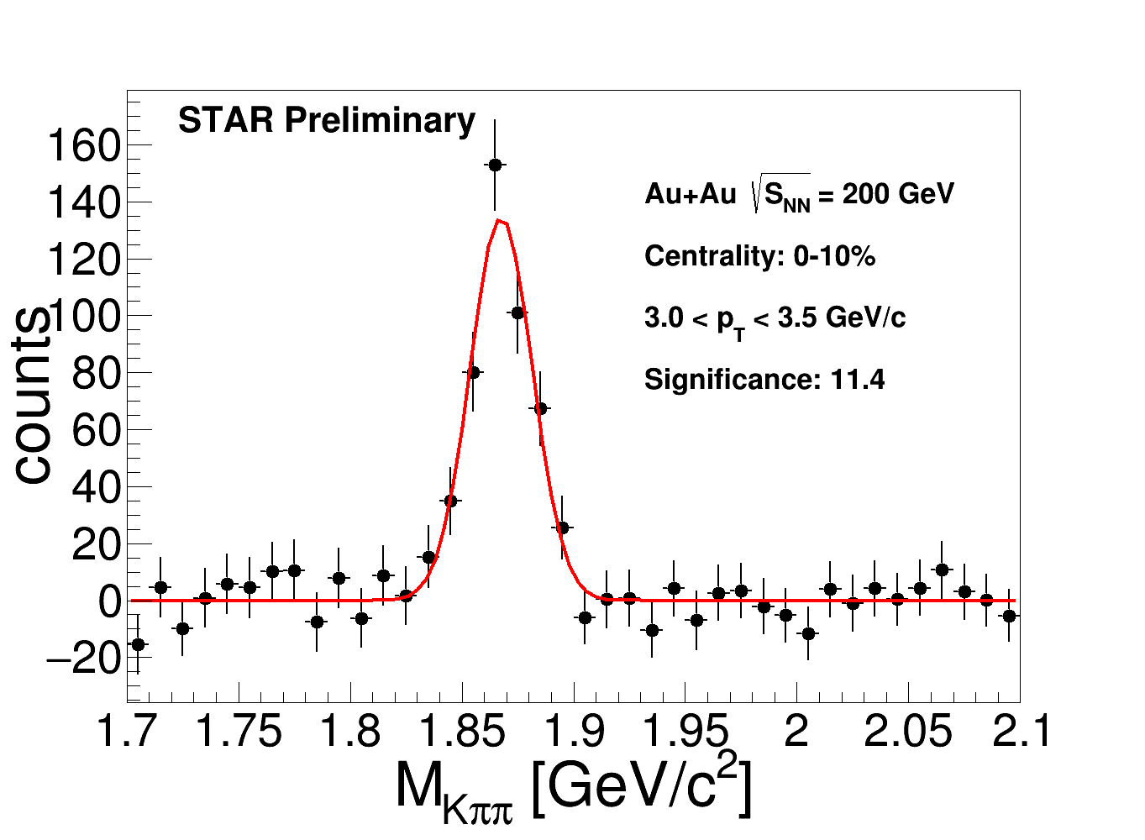
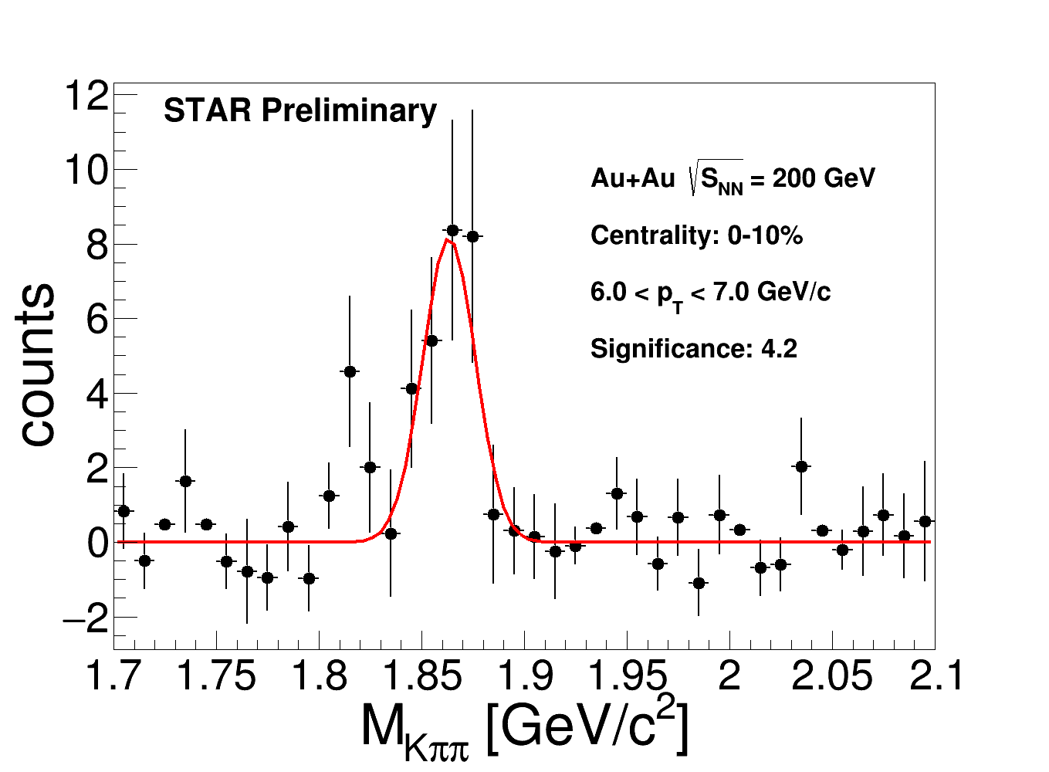
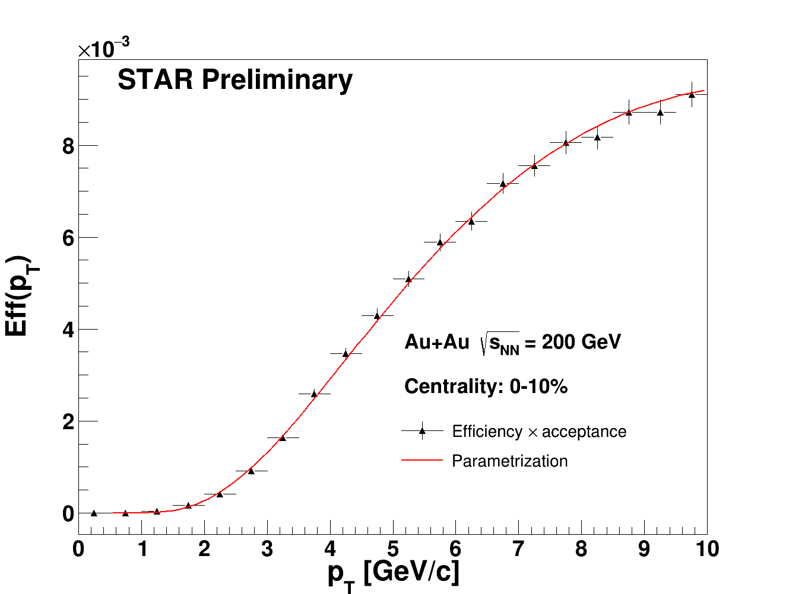
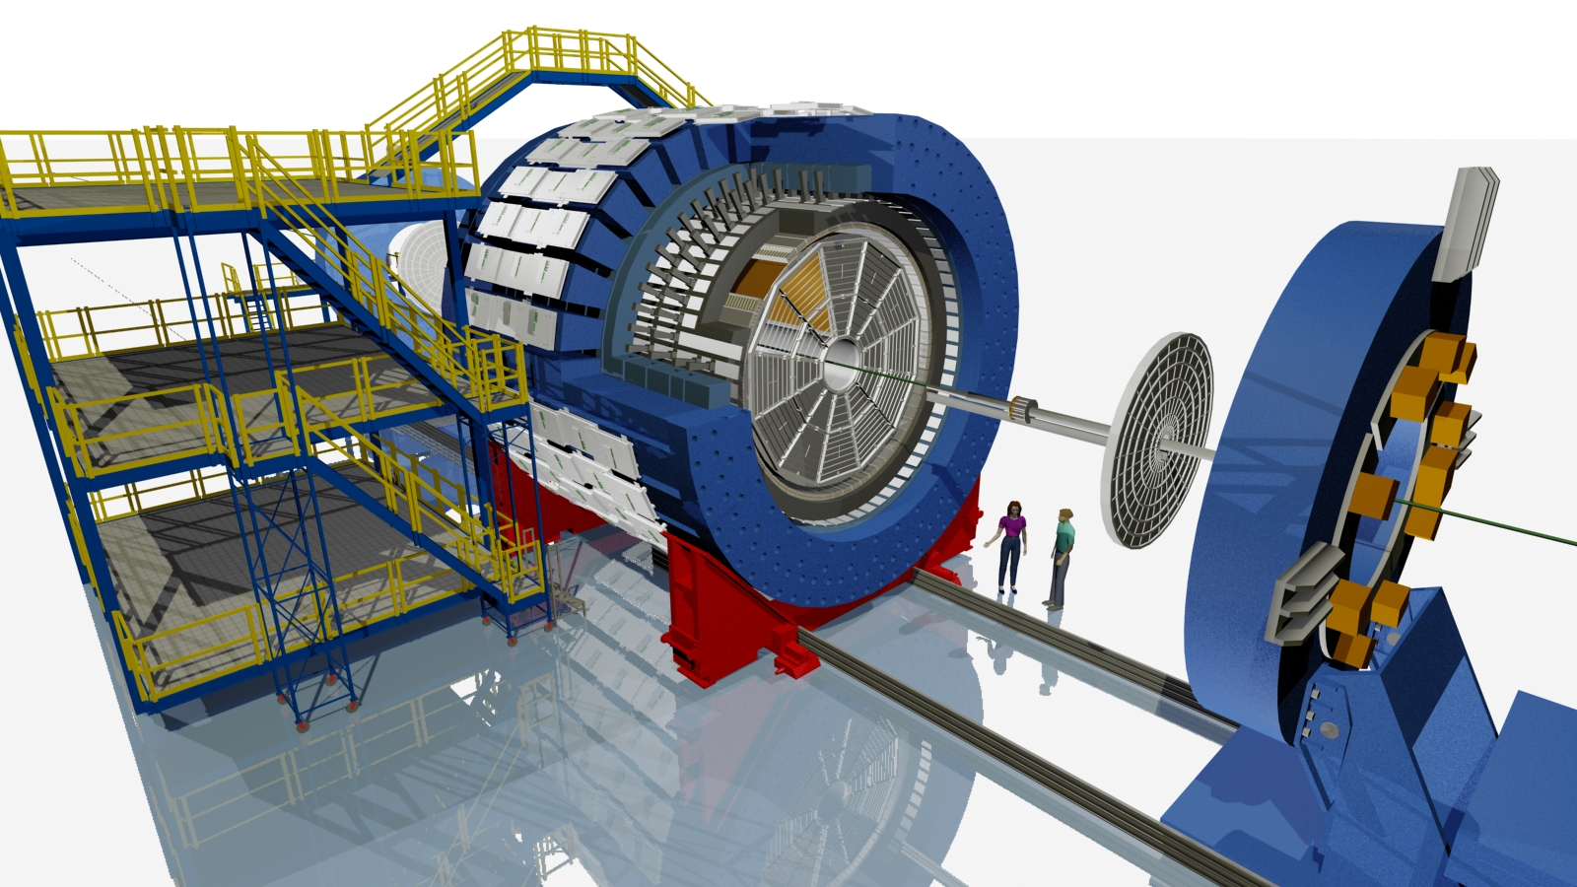
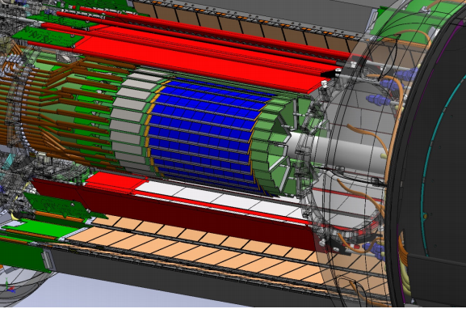
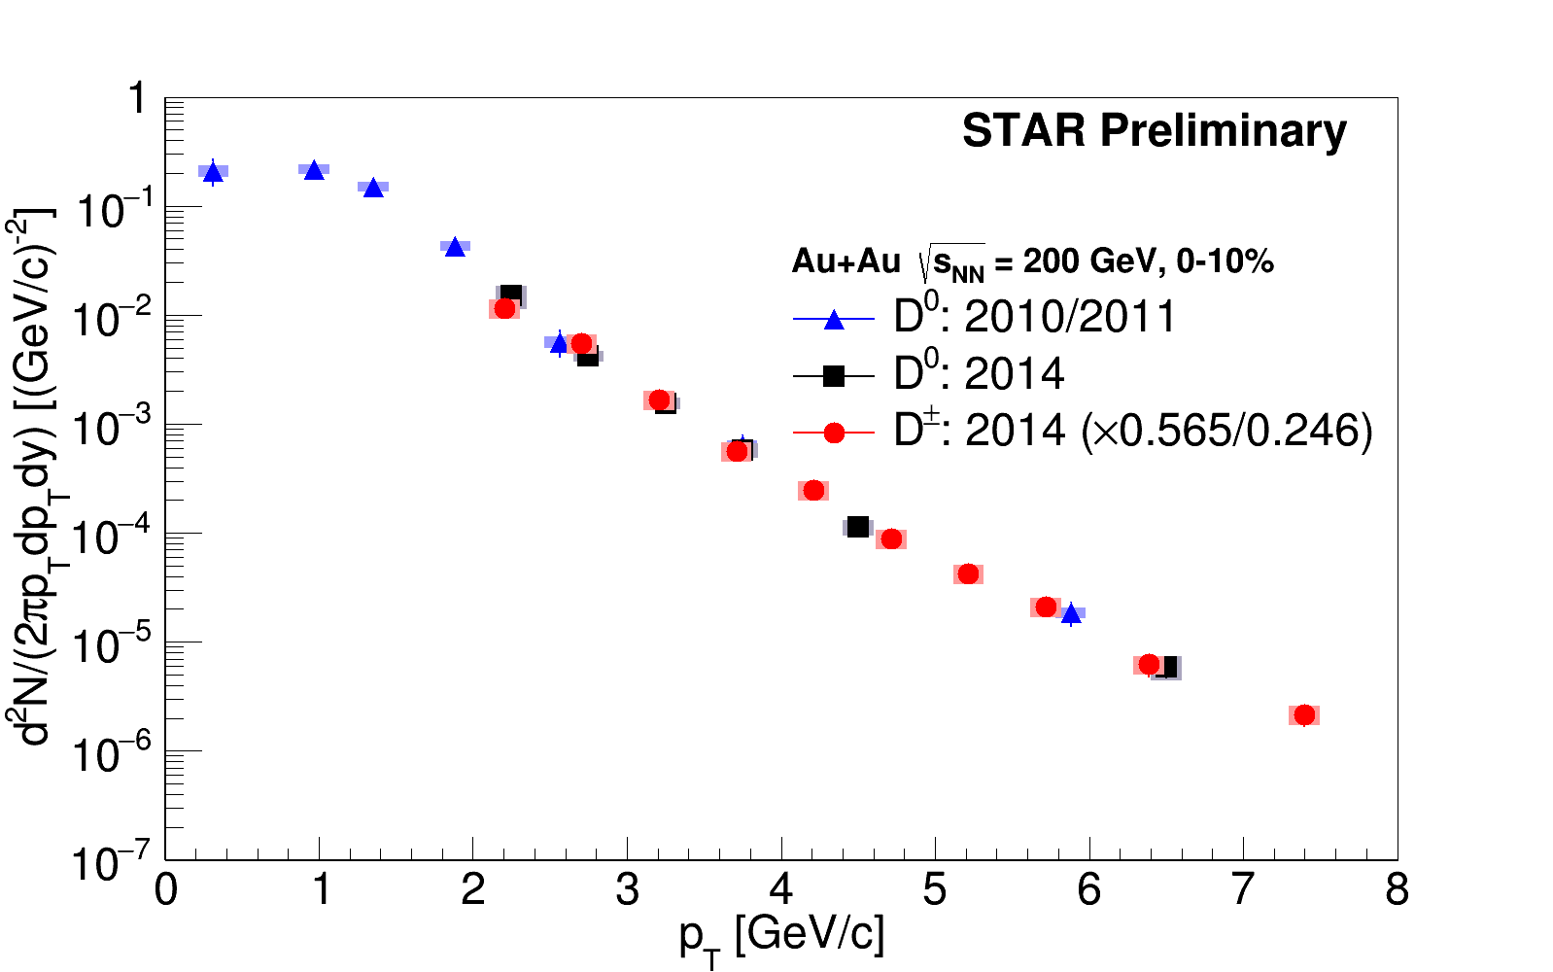
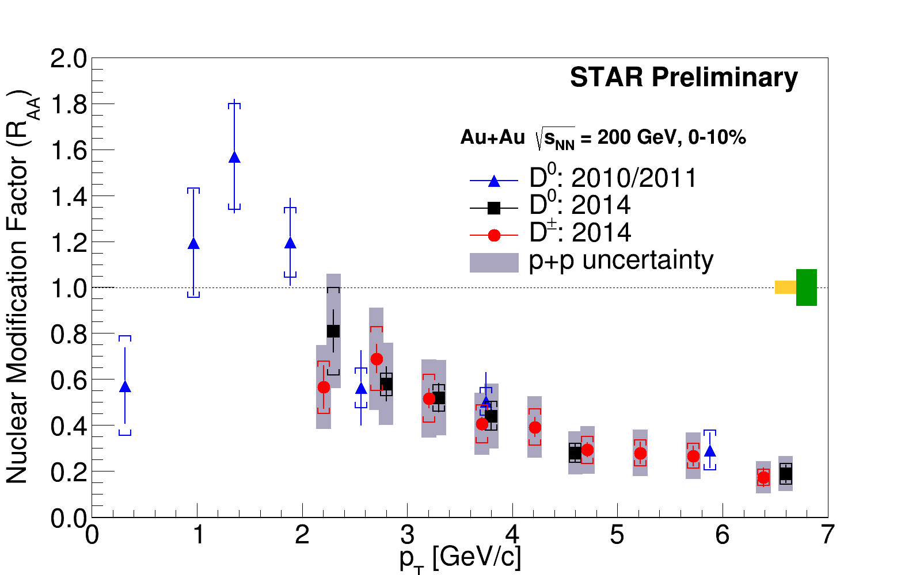
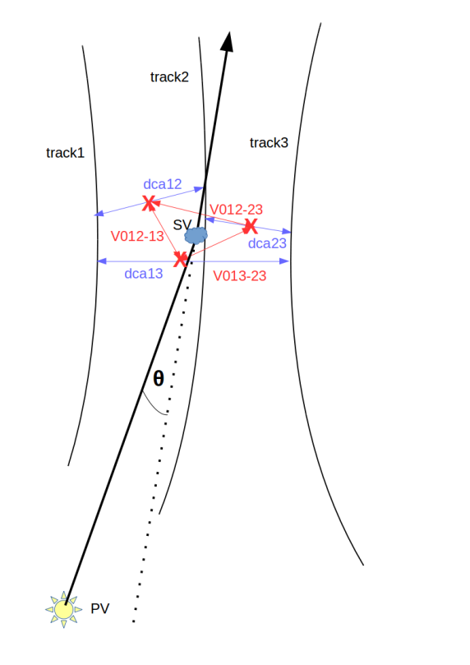


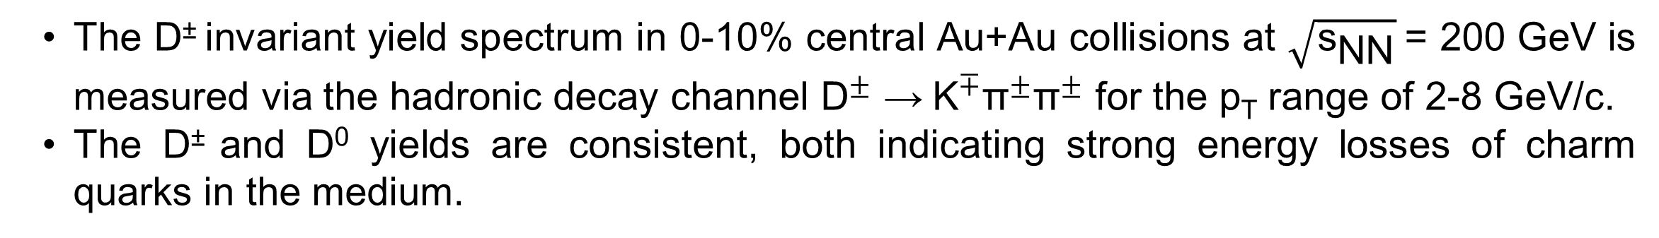
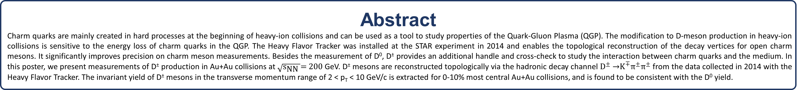
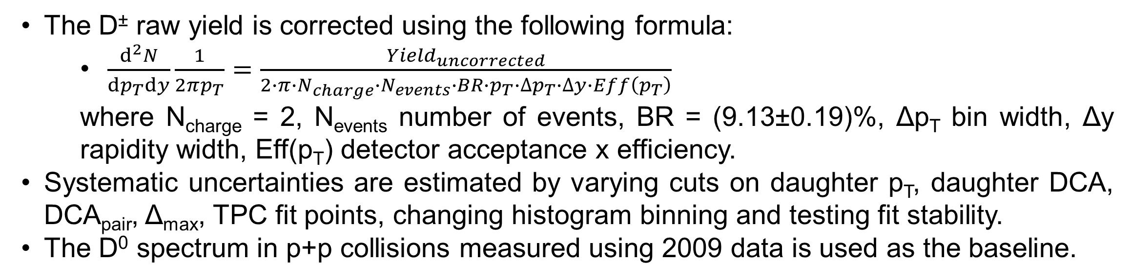

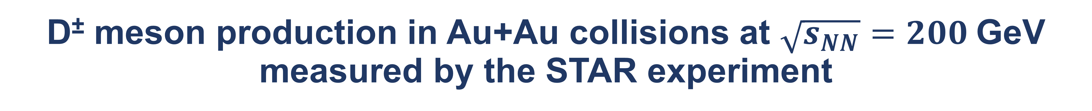

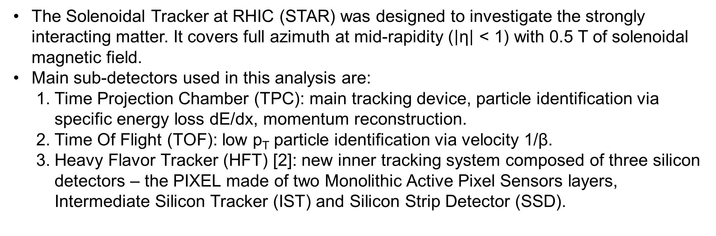
D± meson production in Au+Au collisions at $\sqrt{s_{NN}}=200$GeV measured by the STAR experiment
Jakub Kvapil, for the STAR Collaboration
Faculty of Nuclear Sciences and Physical Engineering
Czech Technical University in Prague
Abstract
Charm quarks are mainly created in hard processes at the beginning of heavy-ion collisions and can be used as a tool to study properties of the Quark-Gluon Plasma (QGP). The modification to D-meson production in heavy-ion collisions is sensitive to the energy loss of charm quarks in the QGP. The Heavy Flavor Tracker was installed at the STAR experiment in 2014 and enables the topological reconstruction of the decay vertices for open charm mesons. It significantly improves precision on charm meson measurements. Besides the measurement of D⁰, D± provides an additional handle and cross-check to study the interaction between charm quarks and the medium. In this poster, we present measurements of D± production in Au+Au collisions at $\sqrt{{\text{s}}_{\text{NN}} }\text{=}\text{ 200 }$GeV. D± mesons are reconstructed topologically via the hadronic decay channel ${\text{D}}^{±} \text{→}{\text{K}}^{∓}{\text{π}}^{±}{\text{π}}^{±}$ from the data collected in 2014 with the Heavy Flavor Tracker. The invariant yield of D± mesons in the transverse momentum range of 2 < p_{T} < 10 GeV/c is extracted for 0-10% most central Au+Au collisions, and is found to be consistent with the D⁰ yield.
Motivation
D± raw yields
Heavy quarks are mostly created in the initial phase of heavy-ion collisions. Therefore they experience the entire evolution of the system and are a good probe to study the properties of the Quark-Gluon Plasma (QGP).
The strong suppression of high-p_{T} D⁰ meson yields indicates large energy loss of charm quarks in the QGP.
Besides the D⁰ meson, D± provides an independent handle to study the charm quark interaction with the medium.
The Hadronic decay channel ${\text{D}}^{±} \text{→}{\text{K}}^{∓}{\text{π}}^{±}{\text{π}}^{±}$ is used.
Background is estimated via the wrong-sign method: 2 correct-signal (D⁺, D⁻) and 6 wrong-signal (background) combinations.
D± raw yields and significance are calculated using the bin-counting method in the 0-10% central Au+Au collisions for 2 < p_{T} < 10 GeV/c.
Significance: $\frac{signal}{\sqrt{signal+background}}$
Nuclear modification factor (R_{AA}) [1].
STAR detector
Acceptance and reconstruction efficiency
The Solenoidal Tracker at RHIC (STAR) was designed to investigate the strongly interacting matter. It covers full azimuth at mid-rapidity ($\left|\text{η}\right| \text{<} \text{1}$) with 0.5 T of solenoidal magnetic field.
Main sub-detectors used in this analysis are:
  Time Projection Chamber (TPC): main tracking device, particle identification via specific energy loss dE/dx, momentum reconstruction.
  Time Of Flight (TOF): low p_{T} particle identification via velocity 1/β.
  Heavy Flavor Tracker (HFT) [2]: new inner tracking system composed of three silicon detectors – the PIXEL made of two Monolithic Active Pixel Sensors layers, Intermediate Silicon Tracker (IST) and Silicon Strip Detector (SSD).
Data-driven fast simulator has been
developed using
  centrality-dependent V_{z} distributions from data
  ratio of HFT matched tracks to TPC tracks from data
  TPC efficiency and momentum resolution from embedding
and validated with full GEANT simulation.
Time Projection Chamber
Time Of Flight
Barrel ElectroMagnetic Calorimeter
Muon Telescope Detector (2014)
Vertex Position Detector
Results
Magnet
The D± raw yield is corrected using the following formula:
  $\frac{d^{2}N}{dp_{T}dy}\frac{1}{2πp_{T}}=\frac{{Yield}_{uncorrected}}{2∙π∙N_{charge}∙N_{events}∙BR∙p_{T}∙{∆p}_{T}∙∆y∙Eff\left(p_{T}\right)}$
  where N_{charge} = 2, N_{events} number of events, BR = (9.13±0.19)%, Δp_{T} bin width, Δy rapidity width, Eff(p_{T}) detector acceptance x efficiency.
Systematic uncertainties are estimated by varying cuts on daughter p_{T}, daughter DCA, DCA_{pair}, Δ_{max}, TPC fit points, changing histogram binning and testing fit stability.
The D⁰ spectrum in p+p collisions measured using 2009 data is used as the baseline.
Heavy Flavor Detector (2014-2016)
STAR detector with main mid-rapidity detectors.
HFT resolution [3].
D± reconstruction
About 900 million minimum-bias Au+Au events at $\sqrt{{\text{s}}_{\text{NN}}} \text{=} \text{200 }$GeV recorded in year 2014 are used for this analysis.
Event selection cuts:
  Vertex position |V_{z}| < 6 cm
  Vertex correlation |V_{z}(VPD)-V_{z}| < 3 cm.
  Track selection cuts:
    Hits in the two PIXEL and one IST layers are required.
    At least 20 space points in the TPC for track reconstruction.
    Pseudo-rapidity: $\left|\text{η}\right| \text{< 1}$.
    Topological cuts:
      Daughter DCA to primary vertex: DCA_{π} > 100 μm, DCA_{K} > 80 μm.
      Pointing angle of reconstructed vertex to primary vertex: cos(θ) > 0.998.
      D± decay length between 30 μm and 2000 μm (PDG cτ = 311.8 μm).
      DCA between daughter pairs: DCA_{pair}< 80 μm.
      Longest edge of the triangle formed by reconstructed daughter pair vertices must fulfil Δ_{max} < 200 μm.
      Particle identification:
        Daughter p_{T} > 500 MeV/c.
        TPC: |nσ_{π}| < 3.0 for pions and |nσ_{K}| < 2.0 for kaons.
        TOF: |1/β-1/β_{π}| < 0.03 for pions and |1/β-1/β_{K}| < 0.03 for kaons. TOF information is used when available, otherwise only TPC is used.
N_{col} uncert.
σ_{pp} uncert.
Δ_{max}
The invariant yield of D± mesons with 2 < p_{T} < 8 GeV/c in 0-10% central Au+Au collisions is consistent with that of D⁰ mesons within uncertainties. The nuclear modification factor (R_{AA}) for D± also exhibits strong suppression at high p_{T}, indicating substantial energy loss of charm quarks in the medium.
DCA_{pair}
Conclusion
The D± invariant yield spectrum in 0-10% central Au+Au collisions at $\sqrt{{\text{s}}_{\text{NN}}} \text{=} \text{200 }$GeV is measured via the hadronic decay channel ${\text{D}}^{±} \text{→} {\text{K}}^{∓}{\text{π}}^{±}{\text{π}}^{±}$ for the p_{T} range of 2-8 GeV/c.
The D± and D⁰ yields are consistent, both indicating strong energy losses of charm quarks in the medium.
D± three body decay, DCA_{pair} (blue lines), Δ_{max} (red lines).
References
[1] G. Xie, for the STAR Collaboration, Nuclear Physics A, Volume 956, Pages 473-476
[2] J. Schambach, for the STAR Collaboration, Physics Procedia, Volume 66, 2015, Pages 514-519
[3] L. Adamczyk, for the STAR Collaboration, arXiv:1701.06060 [nucl-ex]
This work was supported by the grant LG15001 and LM2015054 of Ministry of Education, Youth and Sports of the Czech Republic.
The STAR Collaboration
drupal.star.bnl.gov/STAR/presentations

