Slide 1
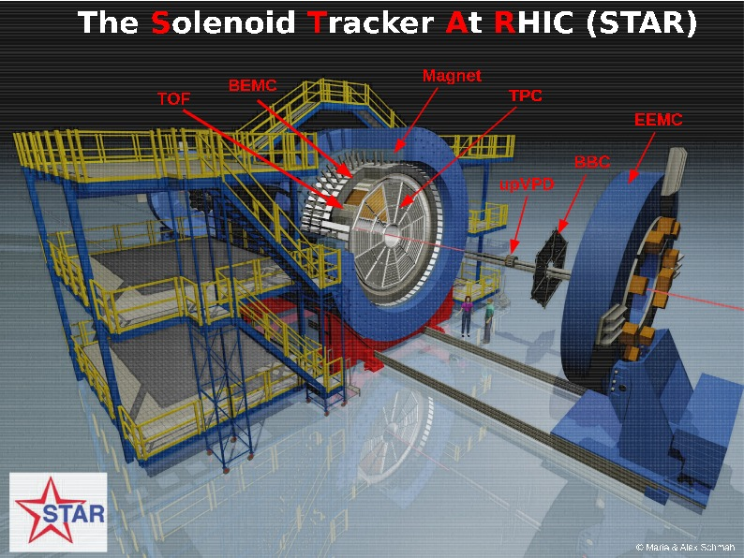
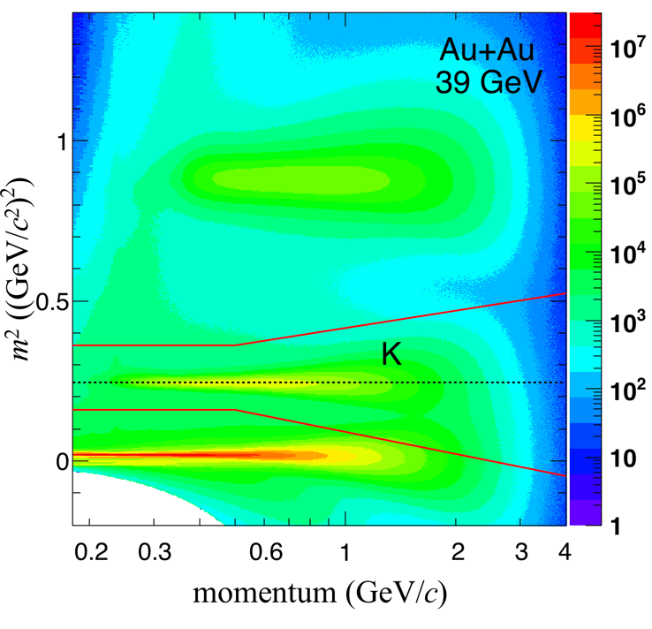
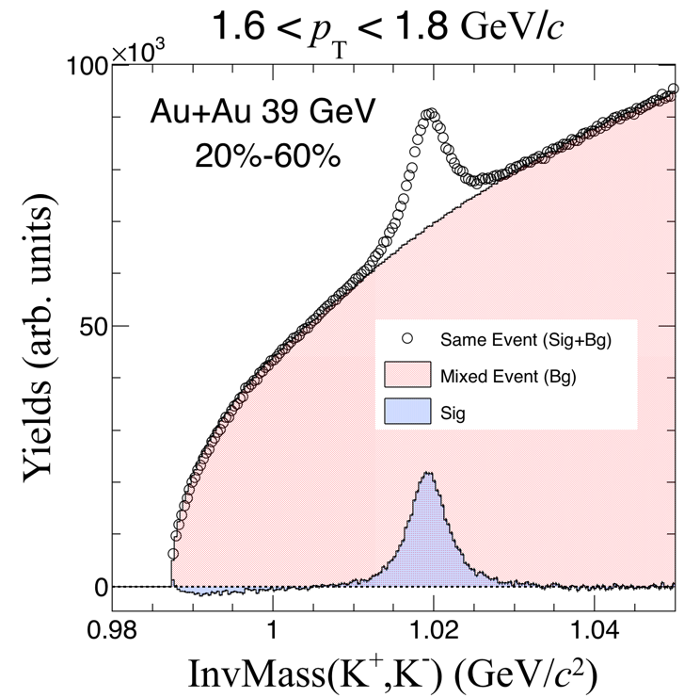
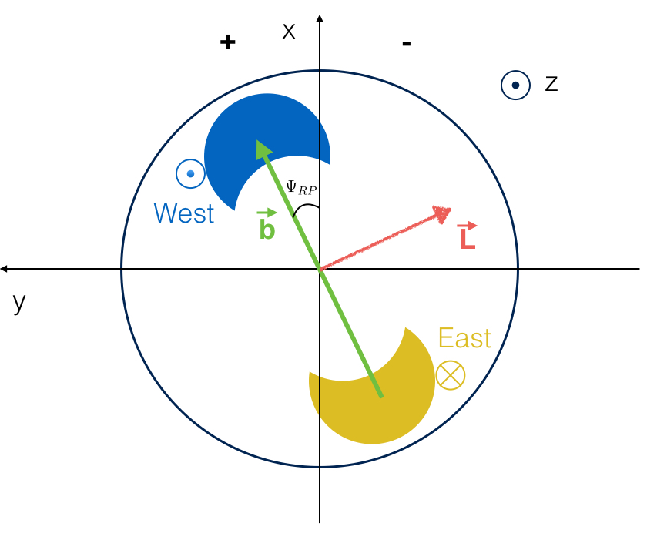
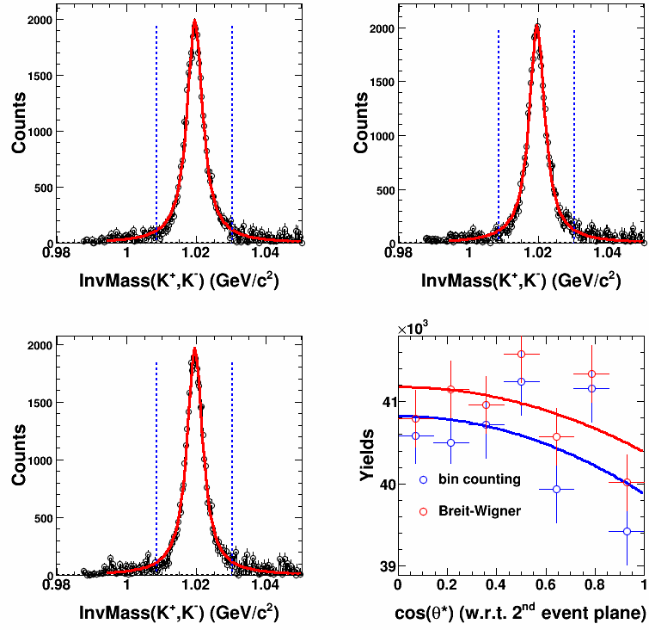
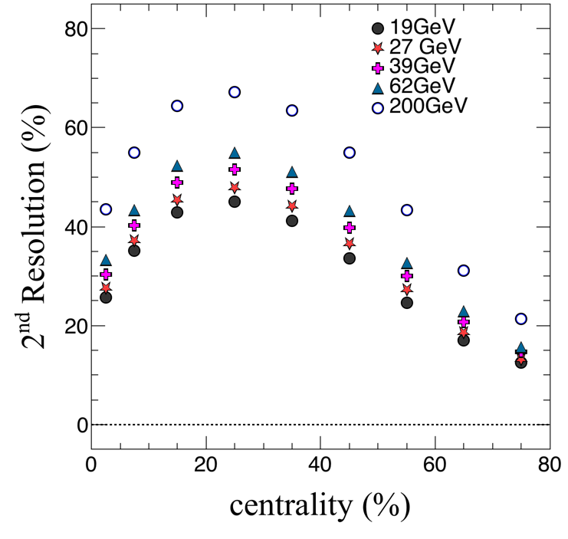
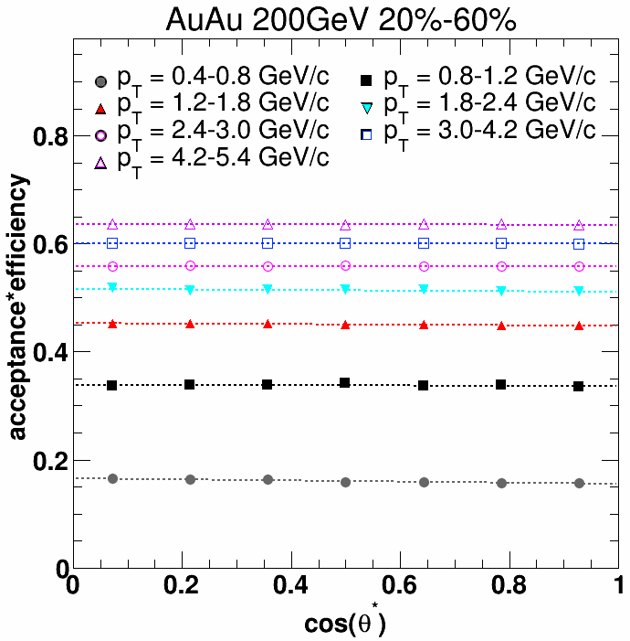
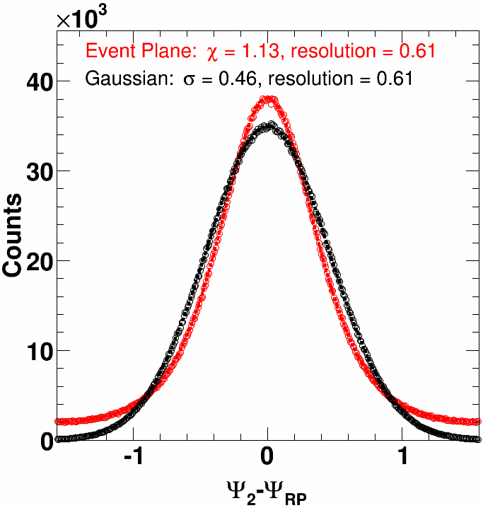
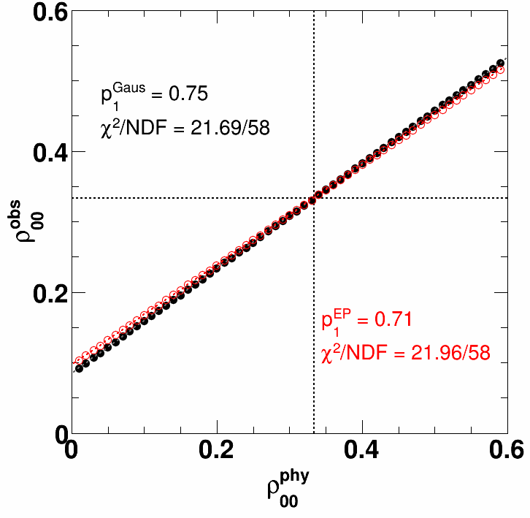
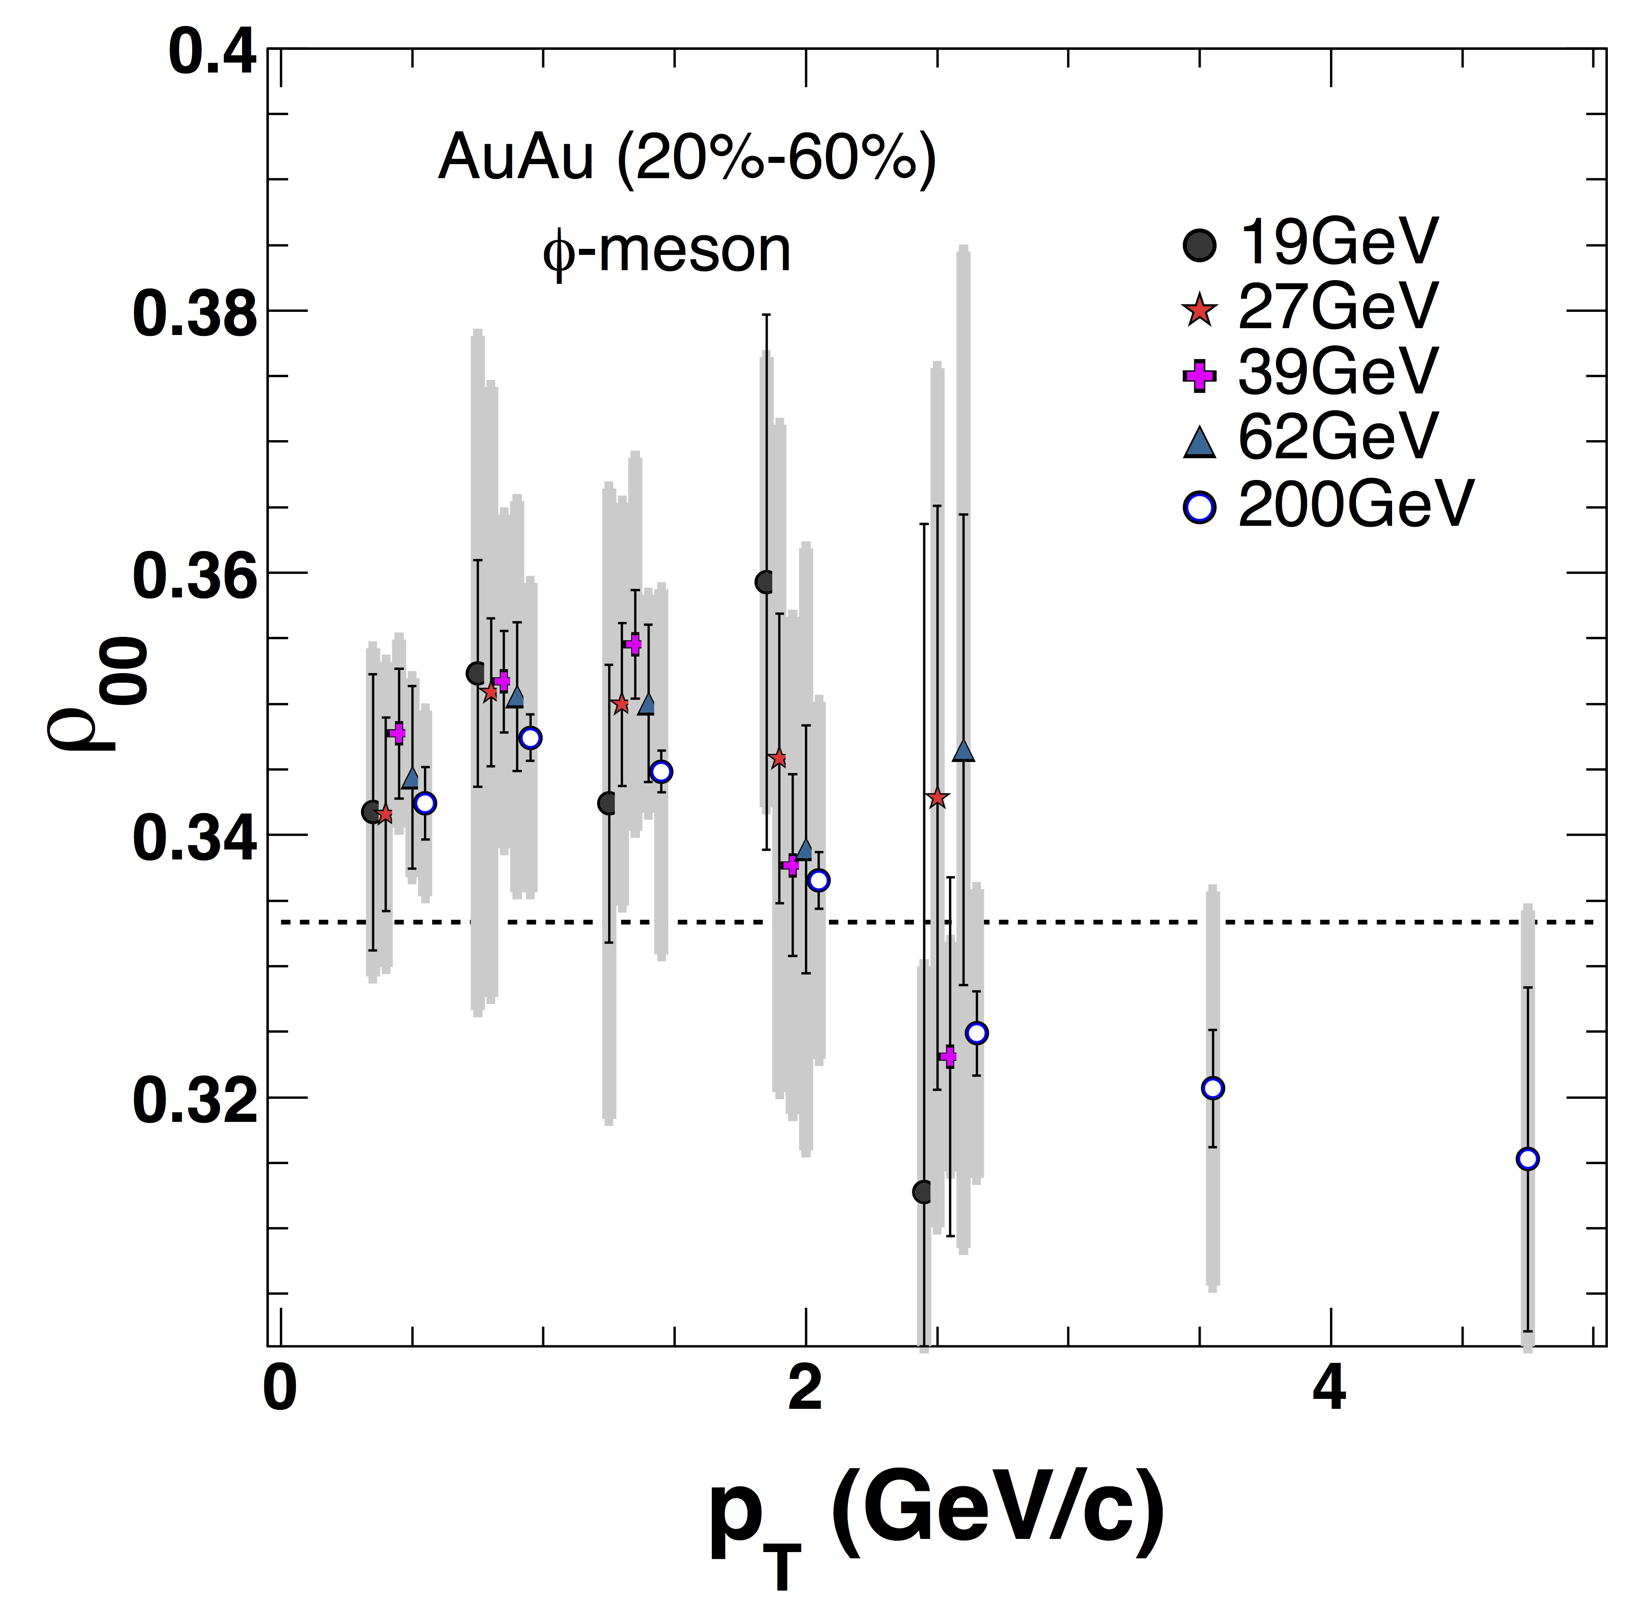
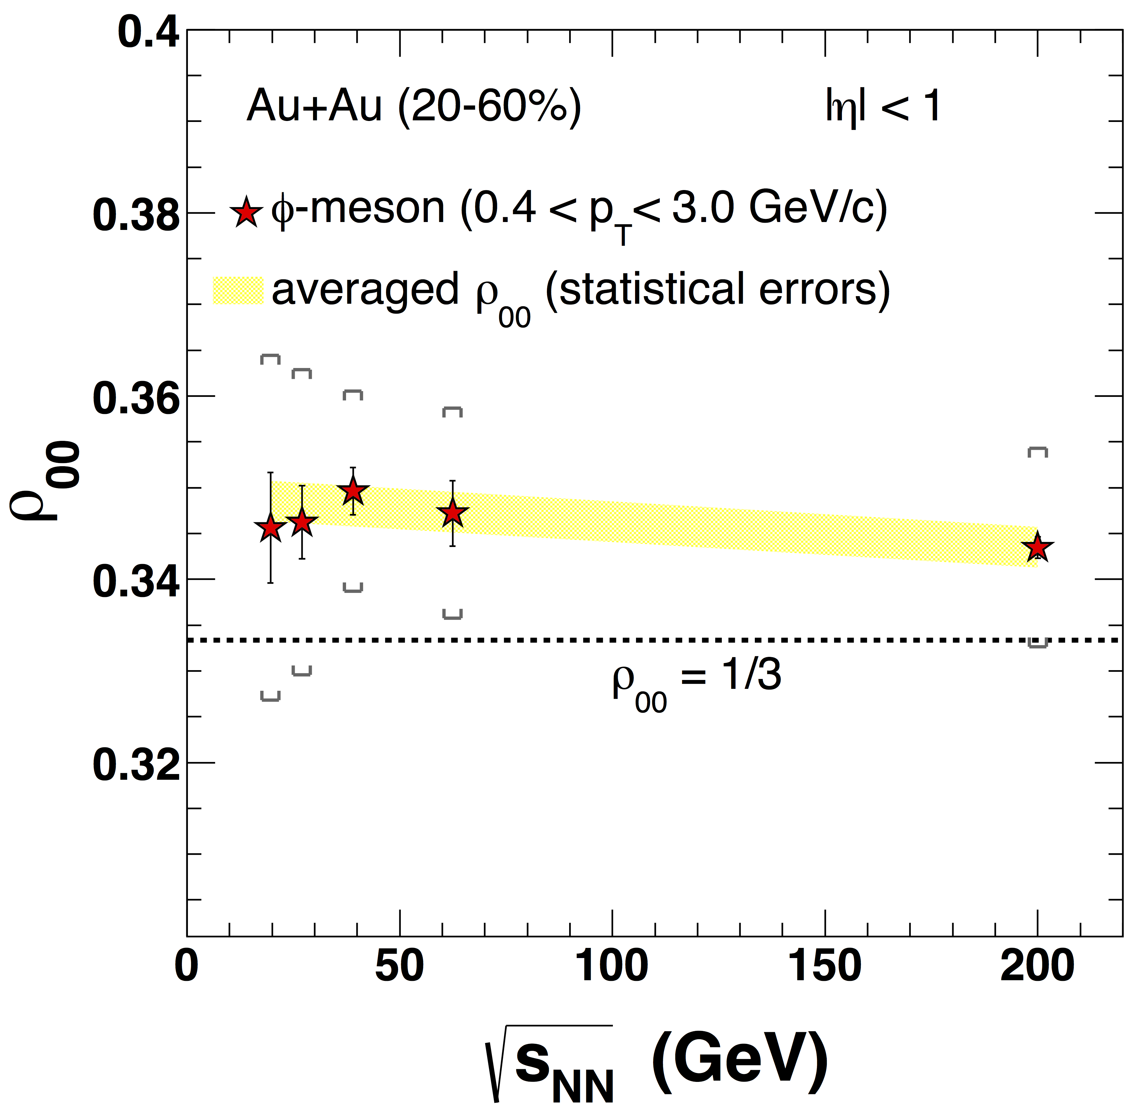
Collision Energy Dependence of ϕ-Meson Spin Alignment
at the STAR experiment
Xu Sun, for the STAR Collaboration
Central China Normal University & Lawrence Berkeley National Laboratory
Abstract: Chirality is the only fundamental symmetry in the nuclear matter. The study of the vorticity and possible chiral vortical effect allows us to access this fundamental property of the hot and dense nuclear matter created in high-energy nuclear collisions, especially at the high baryon density region. Global polarization parameters of identified particles can be extracted from the azimuthal distribution of particles relative to the event plane. Recently, STAR has reported global polarization measurement of Λ-baryons (J=1/2).
The spin alignment of ϕ-meson (J=1) could be sensitive to hadronization scenarios and possible vorticity of the colliding system. In this poster, a systematic measurement of ϕ-meson spin alignment parameters from RHIC-STAR detector will be presented in Au+Au collisions at √s_{NN} =19.6, 27, 39, 62.4 and 200 GeV. The beam energy dependence of spin alignment parameters will be discussed in association with the possible vorticity of the collision system.
STAR Detector
Motivation
STAR Detector
STAR Detector
Non-central HICs have large angular momentum
Baryon stopping may transfer angular momentum, in part, to the fireball
Due to spin-orbit coupling, this orbital motion may result in net polarization of produced particles along the direction of the initial angular momentum (L) perpendicular to the reaction plane
Vorticity, $\vec{ω}=\vec{∇}×\vec{v}$, may be measurable through net spins of emitted particles
ϕ-meson is expected to originate predominantly from primordial production
Sensitive to hadronization scenarios: recombination, fragmentation…^{[1][2]}
Particle Identification and ρ₀₀ extraction at STAR
The Solenoidal Tracker At RHIC (STAR)
STAR Preliminary
STAR Detector
Geometry and Event Plane Reconstruction
Full azimuthal coverage
-1 < η < 1 coverage
Uniform acceptance for all beam energies
Excellent PID
STAR Preliminary
00-conponent of ϕ-meson spin density matrix (ρ₀₀) can be measured by angular distribution of decay daughter ϕ→K⁺+K⁻ using:
$\frac{dN}{d\left(cosθ^{∗}\right)}=\frac{3}{4}\left[\left(1−ρ_{00}\right)+\left(3ρ_{00}−1\right)\cos^{2}θ^{∗}\right]$,
where θ* is the angle between K⁺ and polarization
direction of the collision system in the ϕ-meson
rest frame
A deviation of ρ₀₀ from 1/3 indicates a spin alignment
2/7 < cos(θ*) < 3/7
3/7 < cos(θ*) < 4/7
√s_{NN} (GeV) | Num of Events (10⁶) | z-vertex range (cm)
19.6 | 29.1 | [-70.0,70.0]
27 | 58.1 | [-70.0,70.0]
39 | 117.7 | [-40.0,40.0]
62.4 | 54.6 | [-40.0,40.0]
200 | 374.9 | [-30.0,30.0]
Reaction Plane is defined by impact parameter and beam direction => can be estimated by the event plane^{[3]}
Finite event plane resolution need to be corrected
4/7 < cos(θ*) < 5/7
STAR Preliminary
Residual background subtracted
Use 7 cosθ* bins
Use Breit-Wigner fits and bin counting to extract raw yields
Use angular distribution of K⁺ to extract ρ₀₀
STAR Preliminary
STAR Detector
STAR Detector
Efficiency and Event Plane Resolution Corrections
Beam Energy Dependent ρ₀₀
STAR Preliminary
STAR Preliminary
STAR Preliminary
STAR Preliminary
ϕ-meson efficiency is calculated with K⁺ and K⁻ embedding data and shows very weak cos(θ*) dependence
Generated Monte Carlo ϕ-meson events with different ρ₀₀ by using STAR published ϕ-meson spectra and elliptic flow^{[4,5]} and smeared event plane with two different event plane distributions^{[6]} based on event plane resolution measured by STAR
Resolution correction factor can be extracted with a linear fit
STAR Preliminary
First measurement of ϕ-meson spin alignment at BES energies
Weak beam energy dependence
References
[1] Z.T. Liang and X. N. Wang, Phys. Lett. B629,20 (2005)
[2] B.I.Abelev et al (STAR Collaboration), Phys. Rev. C77, 061902(R) (2008) [3] A.M.Poskanzer and S.A.Voloshin, Phys. Rev. C58, 1671 (1998)
[4] L. Adamczyk et al (STAR Collaboration), Phys. Rev. C93, 021903(R) (2016)
[5] L. Adamczyk et al (STAR Collaboration), Phys. Rev. C93, 014907 (2016)
[6] S.A.Voloshi and Y. Zhang, Z. Phys. C70, 665 (1996)
Summary and Outlook
ϕ-meson spin alignment signal shows weak beam energy dependence
The future new EPD, providing independent event plane determination and better resolution, will help to keep the systematic uncertainties under control
STAR Detector
STAR Detector
The STAR Collaboration
drupal.star.bnl.gov/STAR/presentations

