Slide 1
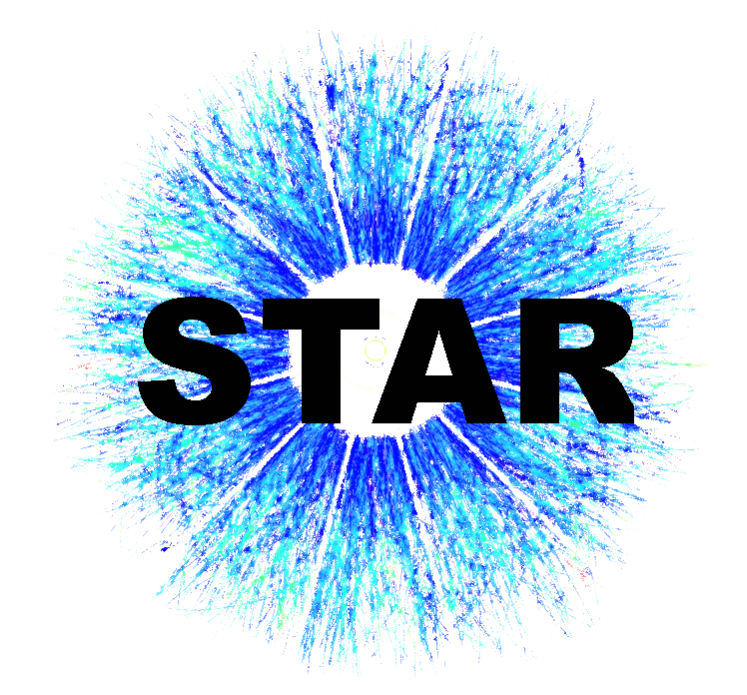



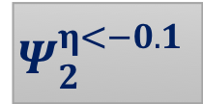

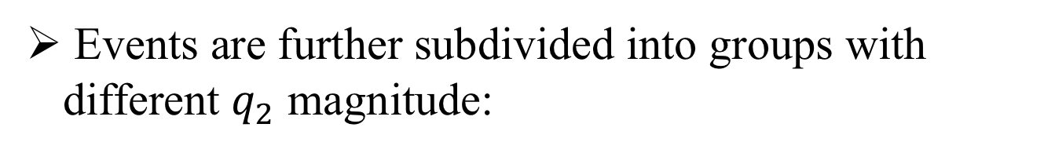

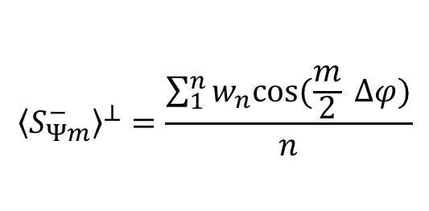


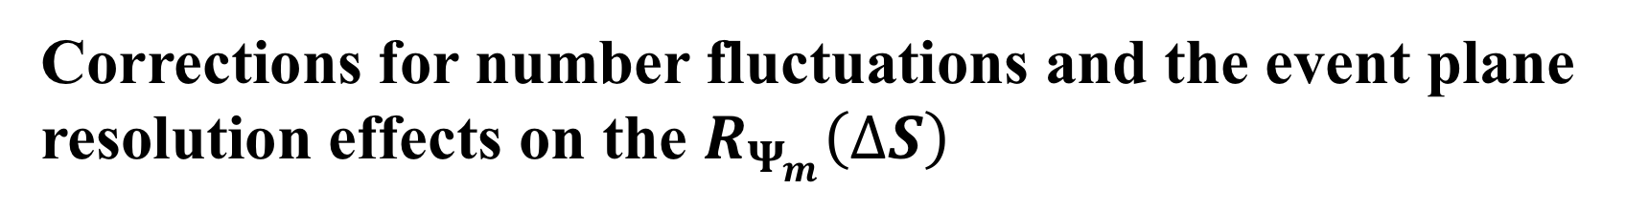
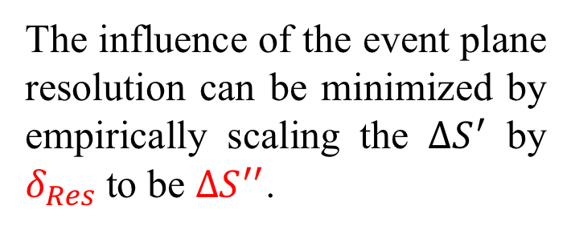
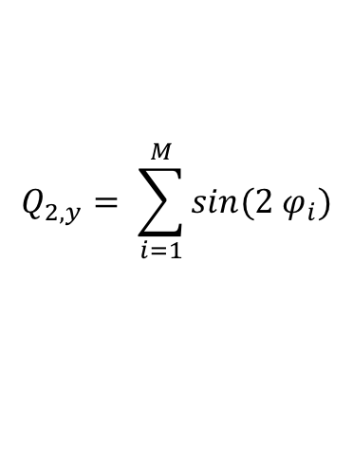




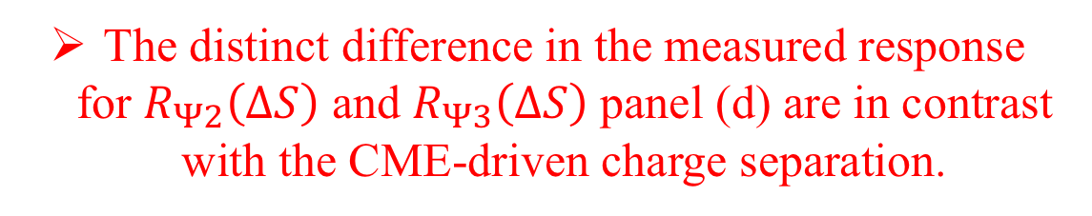

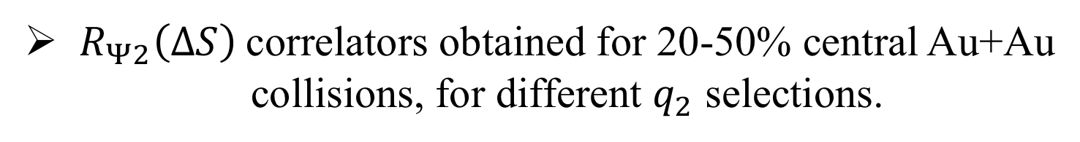






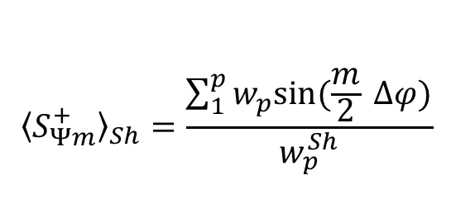
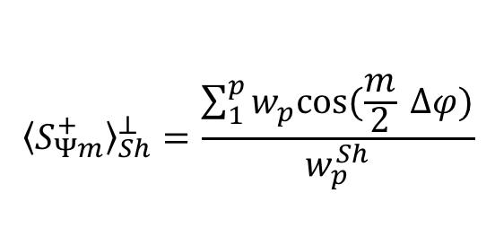
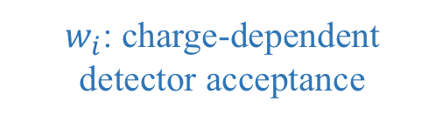






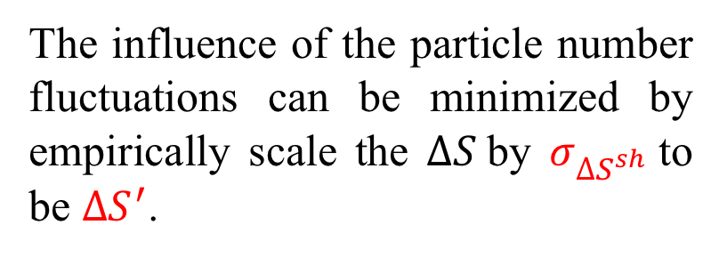
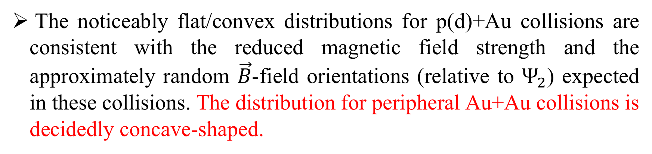
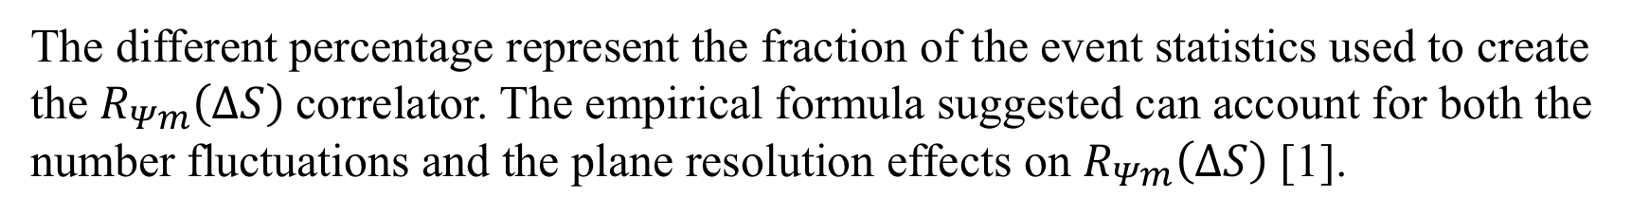
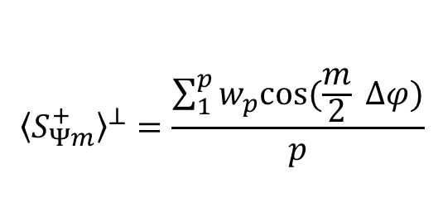

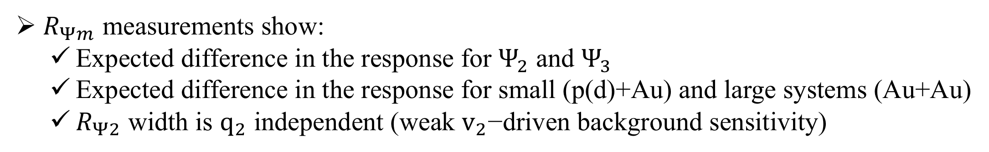
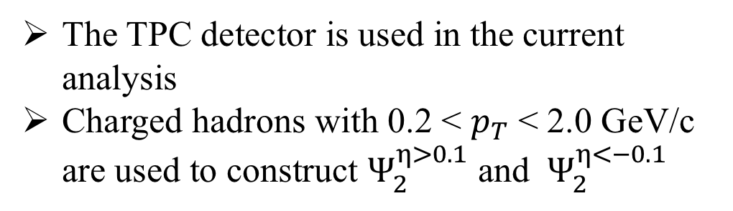
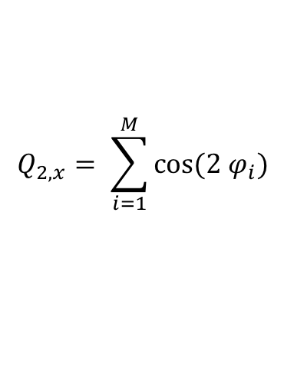
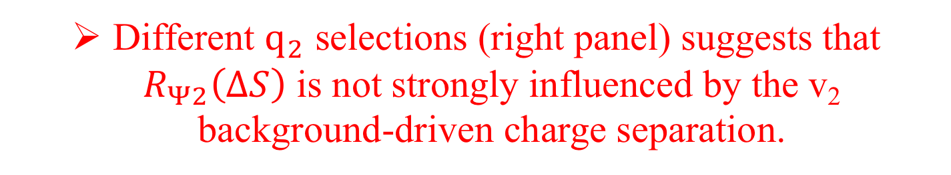


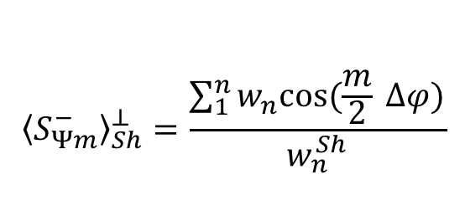




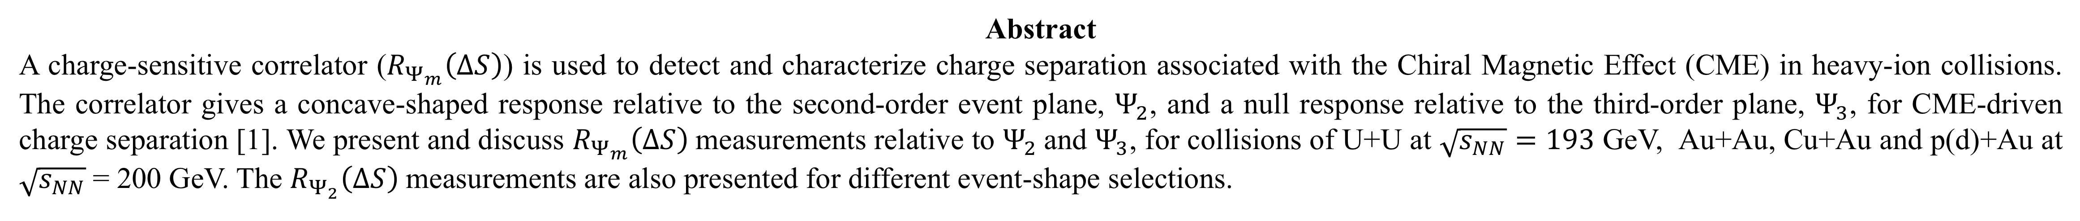
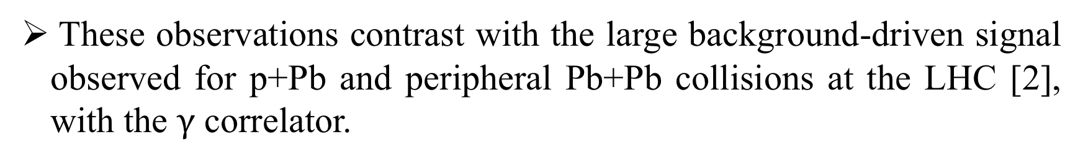


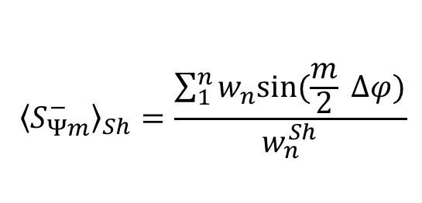

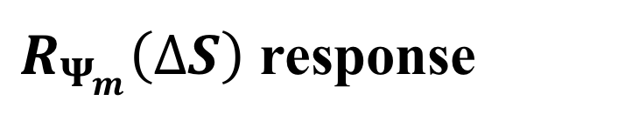


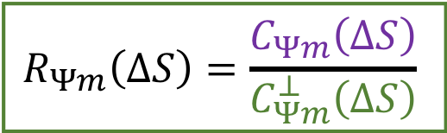


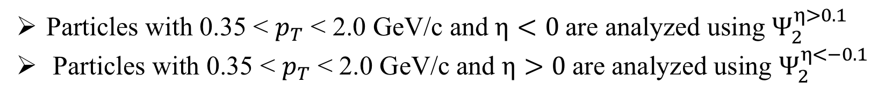

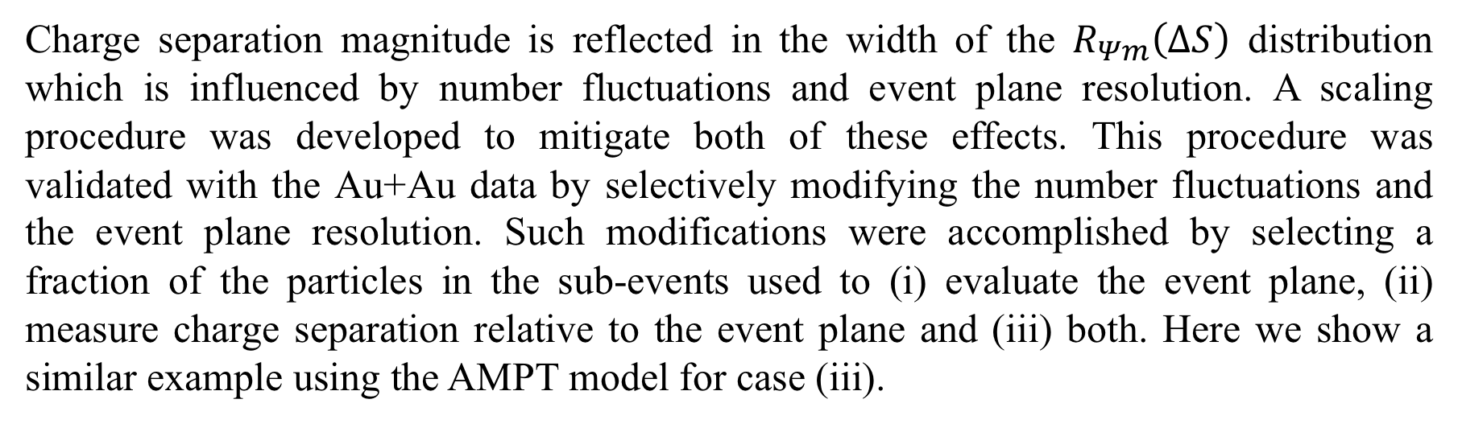

Collision-system dependence of charge separation relative to the second- and third-order event planes; Implications for the Chiral Magnetic Effect in STAR
Niseem Magdy
for the STAR Collaboration
University of Illinois at Chicago
Abstract
A charge-sensitive correlator ($R_{Ψ_{m}}\left(∆S\right)$) is used to detect and characterize charge separation associated with the Chiral Magnetic Effect (CME) in heavy-ion collisions. The correlator gives a concave-shaped response relative to the second-order event plane, $Ψ_{2}$, and a null response relative to the third-order plane, $Ψ_{3}$, for CME-driven charge separation [1]. We present and discuss $R_{Ψ_{m}}\left(∆S\right)$measurements relative to $Ψ_{2}$and $Ψ_{3}$, for collisions of U+U at $\sqrt{s_{NN}}=193$ GeV, Au+Au, Cu+Au and p(d)+Au at $\sqrt{s_{NN}}$= 200 GeV. The $R_{Ψ_{2}}\left(∆S\right)$measurements are also presented for different event-shape selections.
The STAR experiment at RHIC
$R_{Ψ_{m}}\left(∆S\right)$ response
EbE-Hydro + LCC
The TPC detector is used in the current analysis
Charged hadrons with 0.2 < $p_{T}$ < 2.0 GeV/c are used to construct $Ψ_{2}^{η>0.1}$ and $Ψ_{2}^{η<−0.1}$
(a)
(b)
(c)
Au+Au 200 GeV
(d)
30-40%
$$R_{Ψ_{m}}\left(∆S\right)$$
$$a_{1}=0.0\%$$
$$R_{Ψ_{m}}\left(∆S\right)$$
$$Ψ_{2}^{η<−0.1}$$
$$Ψ_{2}^{η>0.1}$$
STAR Preliminary
$$∆S^{′′}$$
$$∆S^{′′}$$
$$∆S^{′′}$$
$$∆S^{′′}$$
Particles with 0.35 < $p_{T}$ < 2.0 GeV/c and $η<0$are analyzed using $Ψ_{2}^{η>0.1}$
Particles with 0.35 < $p_{T}$ < 2.0 GeV/c and $η>0$are analyzed using $Ψ_{2}^{η<−0.1}$
The $R_{Ψ2}\left(∆S\right)$ and $R_{Ψ3}\left(∆S\right)$give similar response to the background irrespective of the correlator shape.
The distinct difference in the measured response for $R_{Ψ2}\left(∆S\right)$ and $R_{Ψ3}\left(∆S\right)$ panel (d) are in contrast with the CME-driven charge separation.
$R_{Ψ_{m}}\left(∆S\right)$ correlator
$R_{Ψ_{m}}\left(∆S\right)$ response for small and large systems
As outlined in Ref. [1], the correlators can be expressed as the ratio:
The noticeably flat/convex distributions for p(d)+Au collisions are consistent with the reduced magnetic field strength and the approximately random $\vec{B}$-field orientations (relative to $Ψ_{2}$) expected in these collisions. The distribution for peripheral Au+Au collisions is decidedly concave-shaped.
STAR Preliminary
$$R_{Ψm}\left(∆S\right)=\frac{C_{Ψm}\left(∆S\right)}{C_{Ψm}^{⊥}\left(∆S\right)}$$
$$C_{Ψm}(∆S)=\frac{N(∆S^{}) }{N(∆S_{sh}^{}) }$$
$$∆φ=φ−Ψ_{m}$$
$$C_{Ψm}^{⊥}\left(∆S\right)=\frac{N(∆S^{⊥})}{N(∆S_{sh}^{⊥})}$$
These observations contrast with the large background-driven signal observed for p+Pb and peripheral Pb+Pb collisions at the LHC [2], with the $γ$ correlator.
Sensitive to charge separation (CME and Background):
$$N\left(∆S\right)=N(\left\langle S_{Ψm}^{+}\right\rangle −\left\langle S_{Ψm}^{−}\right\rangle )$$
$w_{i}$: charge-dependent detector acceptance
$$N\left(∆S^{⊥}\right)=N({\left\langle S_{Ψm}^{+}\right\rangle }^{⊥}−{\left\langle S_{Ψm}^{−}\right\rangle }^{⊥})$$
These results suggest that the $R_{Ψ2}\left(∆S^{′}\right)$correlator is less sensitive to the backgrounds than the $γ$ correlator.
$$∆S^{′′}$$
$$\left\langle S_{Ψm}^{+}\right\rangle =\frac{\sum_{1}^{p}{w_{p}sin(\frac{m}{2} ∆φ)}}{w_{p}}$$
p/n: number of positive/negative hadrons per event
$${\left\langle S_{Ψm}^{+}\right\rangle }^{⊥}=\frac{\sum_{1}^{p}{w_{p}cos(\frac{m}{2} ∆φ)}}{p}$$
$$\left\langle S_{Ψm}^{−}\right\rangle =\frac{\sum_{1}^{n}{w_{n}sin⁡(\frac{m}{2} ∆φ)}}{w_{n}}$$
$${\left\langle S_{Ψm}^{−}\right\rangle }^{⊥}=\frac{\sum_{1}^{n}{w_{n}cos⁡(\frac{m}{2} ∆φ)}}{n}$$
$R_{Ψ_{m}}\left(∆S\right)$ response to event-shape selections
Shuffling of charges within an event breaks the charge separation sensitivity:
Events are further subdivided into groups with different $q_{2}$ magnitude:
$R_{Ψ2}\left(∆S\right)$correlators obtained for 20-50% central Au+Au collisions, for different $q_{2}$ selections.
$$N\left(∆S_{sh}\right)=N({\left\langle S_{Ψm}^{+}\right\rangle }_{sh}−{\left\langle S_{Ψm}^{−}\right\rangle }_{sh})$$
$$N\left(∆S_{sh}\right)=N({\left\langle S_{Ψm}^{+}\right\rangle }_{Sh}^{⊥}−{\left\langle S_{Ψm}^{−}\right\rangle }_{Sh}^{⊥})$$
$$Q_{2,x}= \sum_{i=1}^{M}{cos⁡(2 φ_{i})}$$
$$Q_{2,y}= \sum_{i=1}^{M}{sin(2 φ_{i})}$$
STAR Preliminary
$${\left\langle S_{Ψm}^{+}\right\rangle }_{Sh}=\frac{\sum_{1}^{p}{w_{p}sin(\frac{m}{2} ∆φ)}}{w_{p}^{Sh}}$$
$${\left\langle S_{Ψm}^{+}\right\rangle }_{Sh}^{⊥}=\frac{\sum_{1}^{p}{w_{p}cos(\frac{m}{2} ∆φ)}}{w_{p}^{Sh}}$$
$$\left|Q_{2}\right|= \sqrt{Q_{2,x}^{2}+Q_{2,y}^{2}}$$
$$q_{2}=\frac{\left|Q_{2}\right|}{\sqrt{M}}$$
$$Ψ_{2}^{η<−0.3}$$
$${ q}_{2}$$
$$Ψ_{2}^{η>0.3}$$
$${\left\langle S_{Ψm}^{−}\right\rangle }_{Sh}=\frac{\sum_{1}^{n}{w_{n}sin⁡(\frac{m}{2} ∆φ)}}{w_{n}^{Sh}}$$
$${\left\langle S_{Ψm}^{−}\right\rangle }_{Sh}^{⊥}=\frac{\sum_{1}^{n}{w_{n}cos⁡(\frac{m}{2} ∆φ)}}{w_{n}^{Sh}}$$
Au+Au 200 GeV 40-50%
Corrections for number fluctuations and the event plane resolution effects on the $R_{Ψ_{m}}\left(∆S\right)$
The $q_{2}$ distribution for 40-50% Au+Au collisions at 200 GeV, for the sub-event sample with |η| < 0.3
$$∆S^{′′}$$
$$q_{2}\%$$
Charge separation magnitude is reflected in the width of the $R_{Ψm}\left(∆S\right)$ distribution which is influenced by number fluctuations and event plane resolution. A scaling procedure was developed to mitigate both of these effects. This procedure was validated with the Au+Au data by selectively modifying the number fluctuations and the event plane resolution. Such modifications were accomplished by selecting a fraction of the particles in the sub-events used to (i) evaluate the event plane, (ii) measure charge separation relative to the event plane and (iii) both. Here we show a similar example using the AMPT model for case (iii).
Different $q_{2}$ selections (right panel) suggests that $R_{Ψ2}\left(∆S\right)$ is not strongly influenced by the v₂ background-driven charge separation.
Collision-system dependence of the $R_{Ψ_{m}}\left(∆S\right)$
  Number fluctuations
  Event plane resolution
The $R_{Ψ_{2}}(∆S)$ and $R_{Ψ_{3}}(∆S)$for 0-20% centrality selection in different collision systems.
The influence of the particle number fluctuations can be minimized by empirically scale the $∆S$by $σ_{∆S^{sh}}$to be $∆S^{′}$.
The influence of the event plane resolution can be minimized by empirically scaling the $∆S^{′}$ by $δ_{Res}$to be $∆S^{′′}$.
STAR Preliminary
$$∆S^{′}=∆S/σ_{∆S^{sh}}$$
$$∆S^{′′}=∆S^{′}∗δ_{Res}$$
$$∆S^{′′}$$
$$∆S^{′′}$$
$$∆S^{′′}$$
$$δ_{Res}={Res∗e}^{{\left(1−Res\right)}^{2}}$$
The $R_{Ψ_{2}}(∆S)$ correlators for different collision systems is strikingly different from those for $R_{Ψ_{3}}(∆S)$ correlators.
The $R_{Ψ_{2}}(∆S)$ decidedly concave-shaped, as would be expected for CME-driven charge separation with limited influence from background-driven charge separation.
$$∆S$$
$$∆S^{′}$$
$$∆S^{′′}$$
The different percentage represent the fraction of the event statistics used to create the $R_{Ψm}\left(∆S\right)$correlator. The empirical formula suggested can account for both the number fluctuations and the plane resolution effects on $R_{Ψm}\left(∆S\right)$ [1].
Conclusions
Reference
Charge separation correlator, $R_{Ψm}(for m=2,3)$, is investigated in, U+U collisions at $\sqrt{s_{NN}}$= 193 GeV, Au+Au, Cu+Au and p(d)+Au collisions at $\sqrt{s_{NN}}$= 200 GeV using the STAR detector.
[1] N. Magdy, et al., Phys. Rev. C97, 061901 (2018)
[2] V. Khachatryan et al. (CMS Collaboration)
Phys. Rev. Lett. 118, 122301 (2017)
${ R}_{Ψm}$ measurements show:
  Expected difference in the response for $Ψ_{2}$ and $Ψ_{3}$
  Expected difference in the response for small (p(d)+Au) and large systems (Au+Au)
  $R_{Ψ2}$ width is $q_{2}$ independent (weak $v_{2}\text{−}\text{driven} \text{background} \text{sensitivity}$)
The presented $R_{Ψm}$ results are consistent with the expectation for CME-driven charge separation.
The STAR Collaboration
https://drupal.star.bnl.gov/STAR/presentations
This work is supported by the grant from DOE office of science

