Slide 1
Measurement of hadron suppression and study of its connection with vanishing v₃ at low $\sqrt{s_{NN}}$
Stephen Horvat
for the STAR collaboration
Yale University

Slide 2
Outline
Introduction
Beam Energy Scan (BES)
Motivation
Data
v₃²{2} and its connection to a partonic phase
Hadron suppression in BES with Y(N_{part})
Conclusion

Slide 3
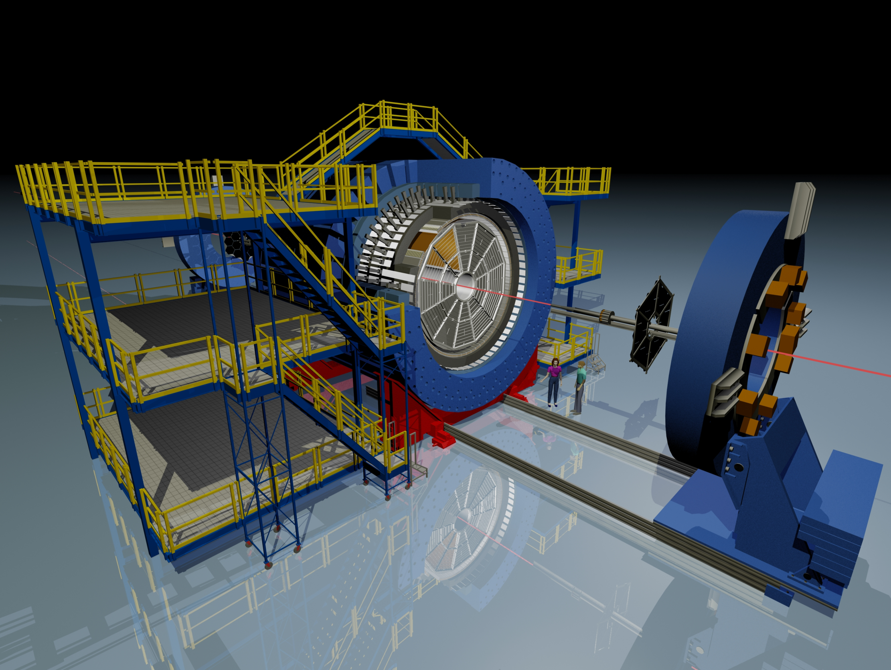
The Solenoidal Tracker At RHIC (STAR)
BEMC
Magnet
EEMC
TOF
TPC
BBC
VPD
TPC: |η| < 1 & 2π in azimuth
by Maria & Alex Schmah

Slide 4
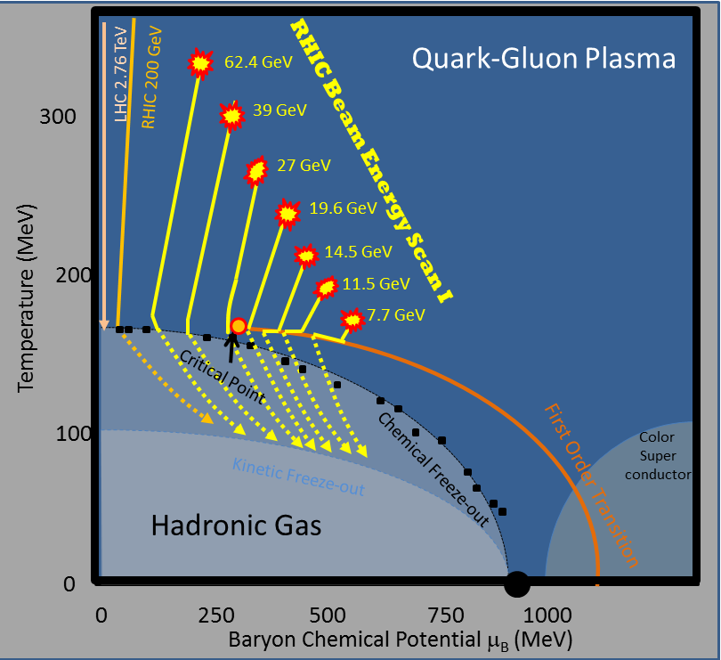
Beam Energy Scan
At what energy do key QGP formation signatures turn off?
Is there a critical point and if so where?
Is there evidence for a first order phase transition?
?

Slide 5
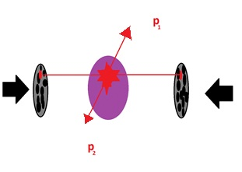
Motivation
2 suggested signatures of QGP formation are investigated
One measures v₃²{2}
The other looks for “high-p_{T}” suppression (Y(N_{part}))
These two techniques are distinct and complementary

Slide 6
Data
These data are from phase 1 of the BES at RHIC
Phase 2 of the BES will provide additional statistics and energies for $\sqrt{s_{NN}}<20GeV$
$\sqrt{s_{NN}}$(GeV) | μ_{B}(MeV) | Year | N_{event}(10⁶)
7.7 | 420 | 2010 | 4
11.5 | 315 | 2010 | 12
14.5 | 260 | 2014 | 20
19.6 | 205 | 2011 | 36
27 | 155 | 2011 | 70
39 | 115 | 2010 | 130
62.4 | 70 | 2010 | 67
200 | 20 | 2010 | 350
STAR Internal Note SN0598 (2014)

Slide 7
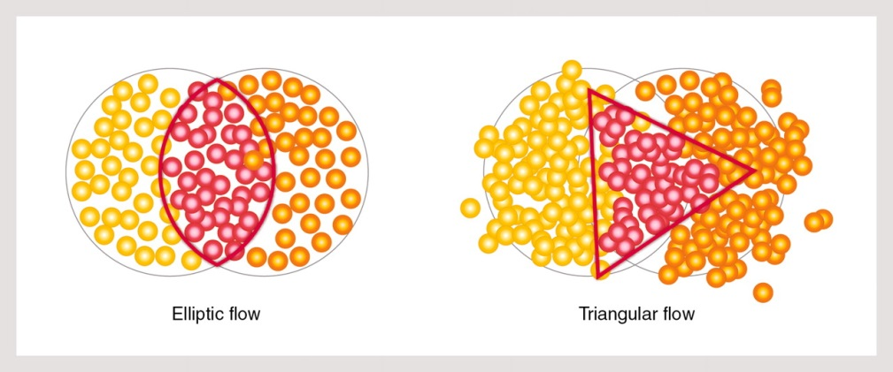
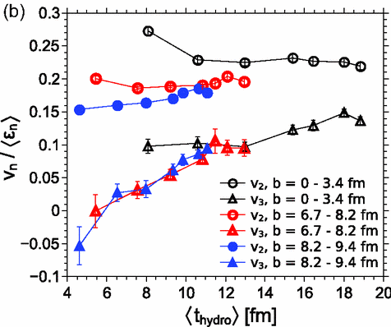
Signatures from the bulk (v₃²{2})
B. Jacak and B. Müller, Science 337 (2012) 310-314
Au+Au Hybrid Model
$$\frac{dN}{d(φ_{2}−φ_{1})}∝1+\sum_{n=1}^{∞}{2{v_{n}}^{2}cos⁡(n\left(φ_{2}−φ_{1}\right))}$$
Hybrid model shows v₃ as a signature for the formation of a low η/s partonic medium
J. Auvinen and H. Petersen, Phys. Rev. C 88, no. 6, 397 064908 (2013)
“shear viscosity suppresses the higher p_{T}-integrated v_{n} coefficients more strongly than v₂” – C. Chen et al., Phys.Rev. C 91 (2015) 2, 024908

Slide 8
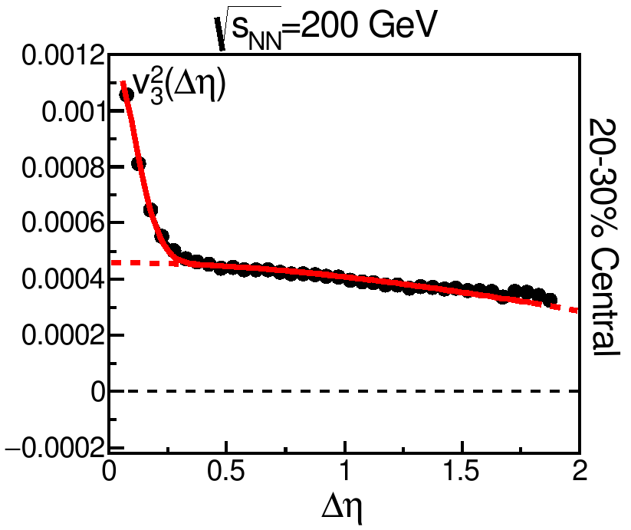
Extracting v₃²{2}
B. Jacak and B. Müller, Science 337 (2012) 310-314
Au+Au
h⁺+h⁻
$$\frac{dN}{d(φ_{2}−φ_{1})}∝1+\sum_{n=1}^{∞}{2{v_{n}}^{2}cos⁡(n\left(φ_{2}−φ_{1}\right))}$$
Corrected for detector acceptance and efficiency
The ∆η distribution is fit with 2 Gaussians and the broader Gaussian is used to extract $\left\langle {v_{3}}^{2}\left\{2\right\}\right\rangle$
The narrow Gaussian is dominated by HBT
See Liao SONG’s Talk
Tuesday 2:40
Correlations and Fluctuations IV

Slide 9
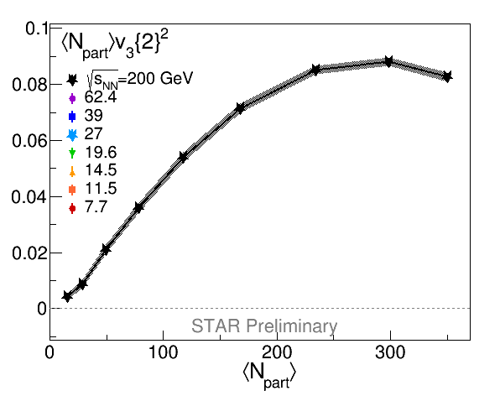
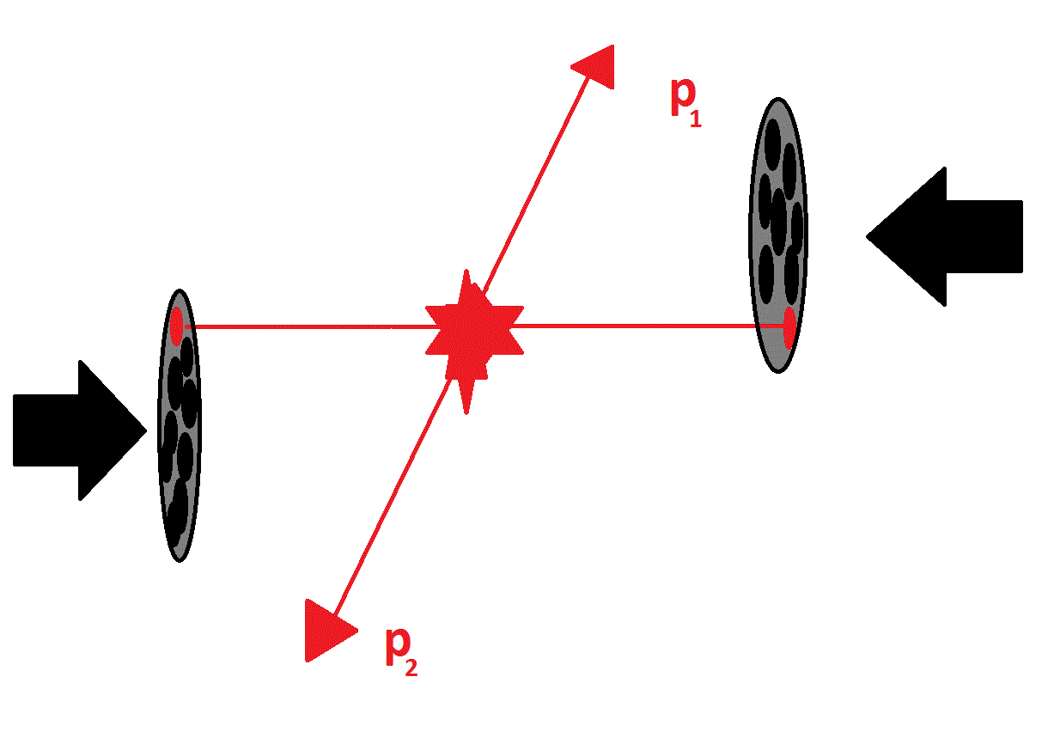
Results – N_{part} v₃²{2}
Au+Au
Scaled by N_{part} to counter the approximate 1/ N_{part} dependence one would expect from fluctuation driven v₃²{2}

Slide 10
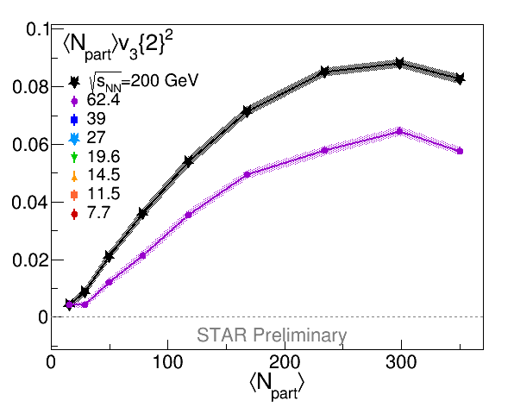
Results – N_{part} v₃²{2}
Au+Au
Scaled by N_{part} to counter the approximate 1/ N_{part} dependence one would expect from fluctuation driven v₃²{2}

Slide 11
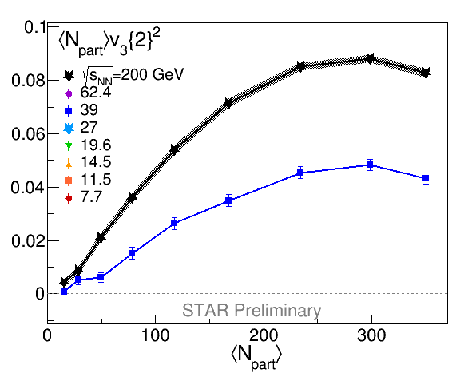
Results – N_{part} v₃²{2}
Au+Au
Scaled by N_{part} to counter the approximate 1/ N_{part} dependence one would expect from fluctuation driven v₃²{2}

Slide 12
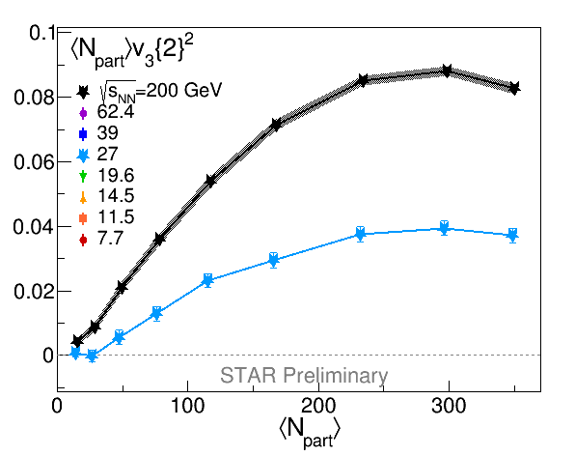
Results – N_{part} v₃²{2}
Au+Au
Scaled by N_{part} to counter the approximate 1/ N_{part} dependence one would expect from fluctuation driven v₃²{2}

Slide 13
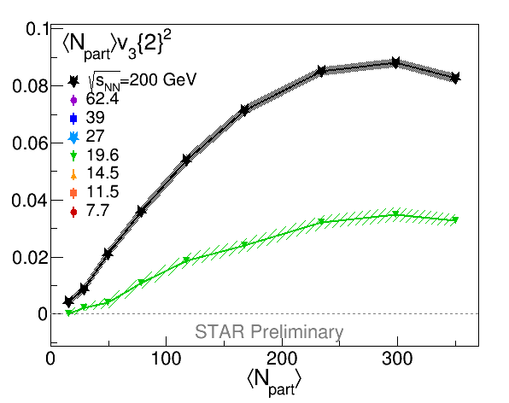
Results – N_{part} v₃²{2}
Au+Au
Scaled by N_{part} to counter the approximate 1/ N_{part} dependence one would expect from fluctuation driven v₃²{2}

Slide 14
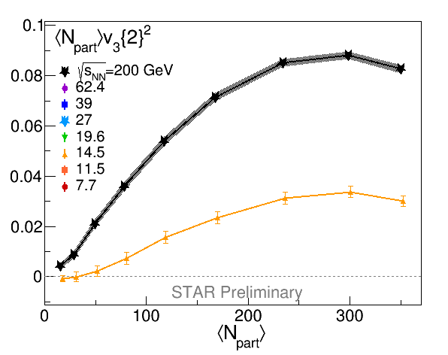
Results – N_{part} v₃²{2}
Au+Au
Scaled by N_{part} to counter the approximate 1/ N_{part} dependence one would expect from fluctuation driven v₃²{2}

Slide 15
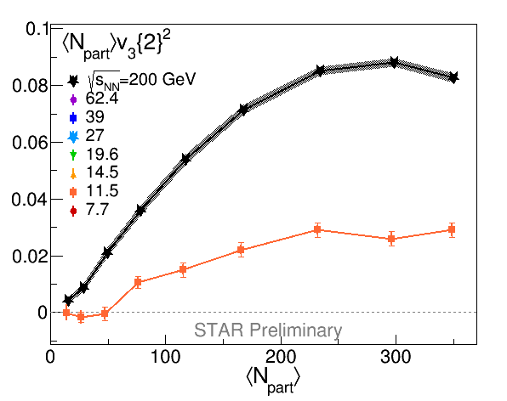
Results – N_{part} v₃²{2}
Au+Au
Scaled by N_{part} to counter the approximate 1/ N_{part} dependence one would expect from fluctuation driven v₃²{2}

Slide 16
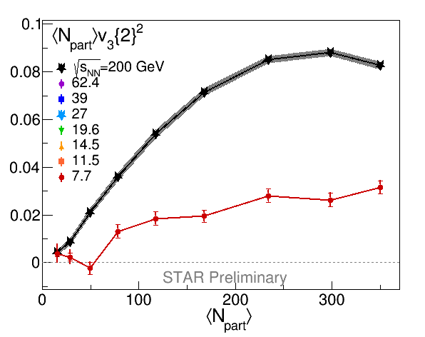
Results – N_{part} v₃²{2}
Au+Au
Scaled by N_{part} to counter the approximate 1/ N_{part} dependence one would expect from fluctuation driven v₃²{2}

Slide 17
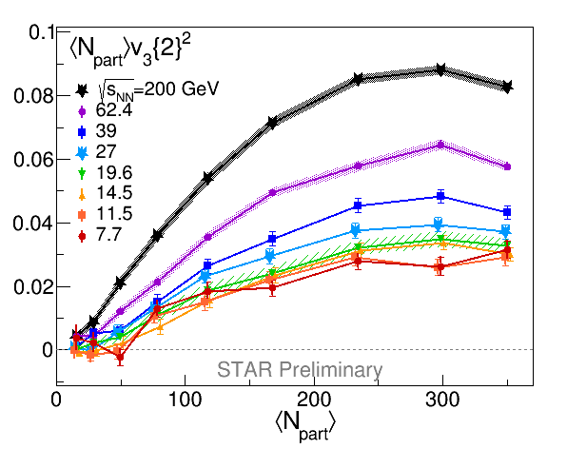
Results – N_{part} v₃²{2}
v₃²{2} is positive for data more central than 50-60% centralities, for all energies measured here
Hybrid UrQMD expectations suggest that these results are consistent with QGP formation, even in the lowest energy collisions at RHIC
Au+Au
Scaled by N_{part} to counter the approximate 1/ N_{part} dependence one would expect from fluctuation driven v₃²{2}

Slide 18
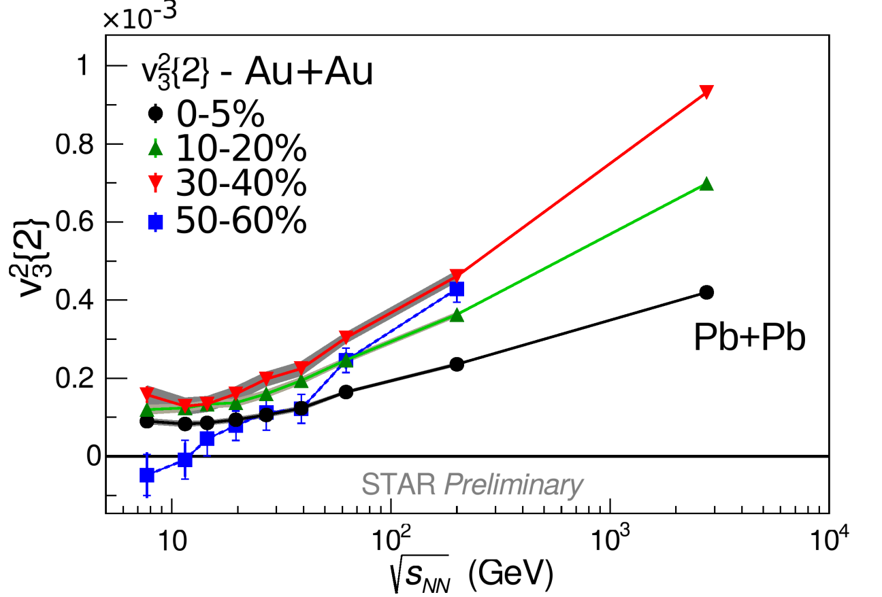
Results – v₃²{2}
v₃²{2} vanishes for the lowest energy peripheral data
This is consistent with the hybrid UrQMD model’s expectations for the turn-off of QGP formation
Au+Au
2.76 TeV data from ALICE,
Phys. Rev. Lett. 107, 032301 (2011)

Slide 19
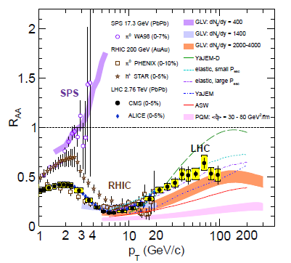
State of world’s R_{AA}
CMS: Eur. Phys. J. C 72 (2012) 1945
We use R_{CP} in the BES since we do not have a p+p reference

Slide 20
Suppression of high p_{T}
‘Suppression’ ≡ R_{CP} < 1
‘Quenching’ ≡ loss of energy for high momentum particles
Au+Au 200
high p_{T} charged hadrons are suppressed at $\sqrt{s_{NN}}$ = 200GeV
STAR: Phys. Rev. Lett. 91, 172302 (2003)

Slide 21
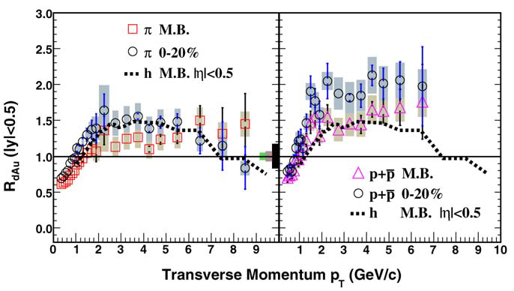
d+Au for Cold Nuclear Matter (CNM)
STAR: Physics Letters B 637 (2006) 161–169
The suppression observed at 200GeV is due to quenching
Protons
Au+Au 200
Pions
dAu200
STAR: Phys. Rev. Lett. 91, 172302 (2003)
The ‘Cronin Effect’ is the experimentally observed enhancement of spectra in p+A collisions relative to a p+p reference
PRL 68, 452 (1992) Straub

Slide 22
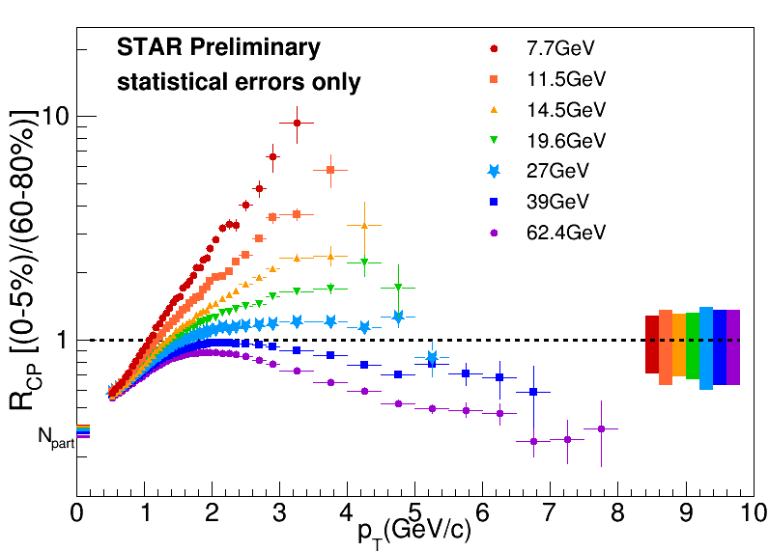
BES I Charged Hadron R_{CP}
Au+Au
NEW
Enhancement effects compete against suppression effects concealing the turn off of QGP formation at low $\sqrt{s_{NN}}$

Slide 23
Y(N_{part})
Y(N_{part}) takes a projection at high-p_{T} of the numerator from R_{CP} and investigates its centrality dependence
Au + Au
Peripheral
Y$\left(N_{part}\right)={\left(\frac{d^{2}N}{\left\langle N_{coll}\right\rangle dp_{T}dη}\right)}_{{high−p}_{T} bin}$
Au + Au
Central
This method should increase sensitivity to suppression
Provides possible evidence for where a QGP is formed
N_{coll} ≡ number of binary collisions (from Glauber MC)

Slide 24
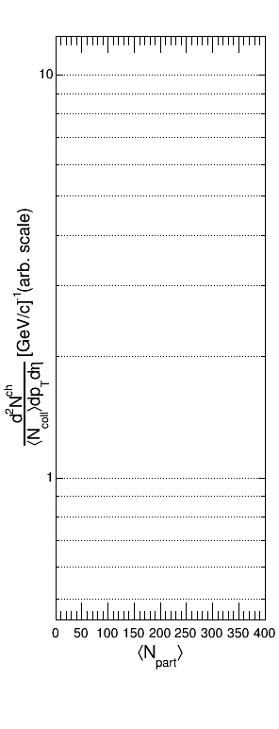
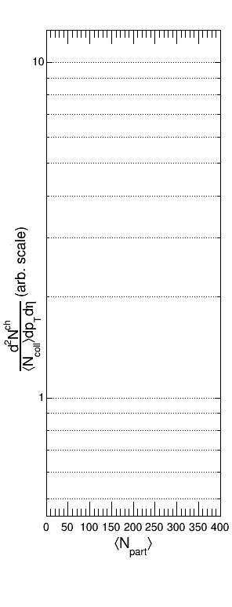
Y(N_{part})
If the “high-p_{T}” region scales with N_{coll} such that we can consider the Au+Au collision to be a linear superposition of p+p-like collisions then we would expect Y(N_{part}) to be flat at unity
Y$\left(N_{part}\right)={\left(\frac{d^{2}N}{N_{coll}dp_{T}dη}\right)}_{{high−p}_{T} bin}$

Slide 25
Y(N_{part})
If there are enhancement effects that grow stronger as you go more central then you would expect Y(N_{part}) to increase with N_{part}
Au + Au
Peripheral
Y$\left(N_{part}\right)={\left(\frac{d^{2}N}{N_{coll}dp_{T}dη}\right)}_{{high−p}_{T} bin}$

Slide 26
Y(N_{part})
If the enhancement effects grow stronger as you go more central and then saturate then you would expect:
Au + Au
Peripheral
Y$\left(N_{part}\right)={\left(\frac{d^{2}N}{N_{coll}dp_{T}dη}\right)}_{{high−p}_{T} bin}$

Slide 27
Y(N_{part})
Suppression that grows stronger as you go more central would give:
Au + Au
Peripheral
Y$\left(N_{part}\right)={\left(\frac{d^{2}N}{N_{coll}dp_{T}dη}\right)}_{{high−p}_{T} bin}$

Slide 28
Y(N_{part})
Enhancement and suppression effects compete against each other
Y(N_{part}) measures the net change in these as a function of centrality
If enhancement grows faster initially but suppression effects become more dominant as you go more central (or enhancement effects become weaker) then there will be a turnover in Y(N_{part})
The suppression is measured relative to a centrality that contains enhancement effects (Cronin, Radial Flow, etc.) rather than a p+p-like system
Au + Au
Peripheral
Y$\left(N_{part}\right)={\left(\frac{d^{2}N}{N_{coll}dp_{T}dη}\right)}_{{high−p}_{T} bin}$

Slide 29
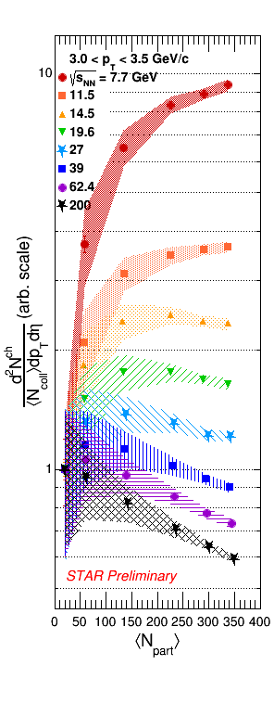
Y(N_{part}) 3.0 < p_{T} < 3.5 GeV/c
Most central data are suppressed (turnover) for $\sqrt{s_{NN}}$ ≥ 14.5 GeV
- This does not rule out the formation of a QGP at
lower energies than 14.5 GeV
7.7 and 11.5 GeV results increase monotonically
200 GeV results decrease monotonically
Au+Au
Error bands are correlated uncertainties

Slide 30
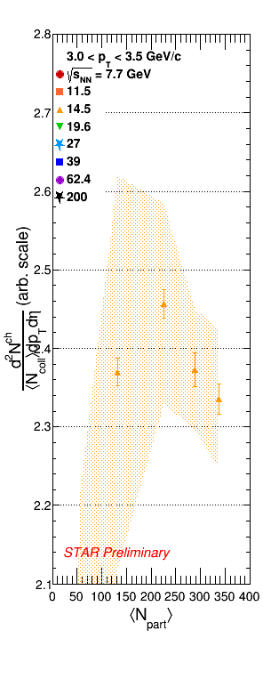
Y(N_{part}) 3.0 < p_{T} < 3.5 GeV/c
Zooming in on 14.5 GeV
Most central data are suppressed (turnover) for $\sqrt{s_{NN}}$ ≥ 14.5 GeV
- This does not rule out the formation of a QGP at
lower energies than 14.5 GeV
7.7 and 11.5 GeV results increase monotonically
200 GeV results decrease monotonically
Au+Au
Error bands are correlated uncertainties

Slide 31
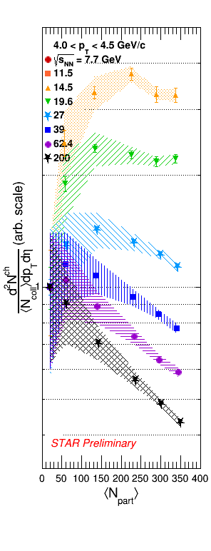
Y(N_{part}) 4.0 < p_{T} < 4.5 GeV/c
Most central data are suppressed for $\sqrt{s_{NN}}$ ≥ 14.5 GeV
This method is sensitive to charged hadron suppression to a lower energy than previous techniques
To prove the suppression is due to quenching, possible contributions from hadronic energy loss and impact parameter dependent nPDFs need further investigation
p+p and d+Au collisions for the BES will help
Au+Au

Slide 32
Conclusions
Suggested QGP signatures
Some models suggest v₃²{2} as a signature for the formation of a low η/s partonic medium
Suppression measured by Y(N_{part}) may be due to in-medium energy loss
Measurements
For sufficiently central collisions, v₃²{2} persists for $\sqrt{s_{NN}}$ ≥ 7.7 GeV and Y(N_{part}) exhibits relative suppression for $\sqrt{s_{NN}}$ ≥ 14.5 GeV
For lower energy peripheral collisions these signatures are turned off
Au+Au
Au+Au

Slide 33
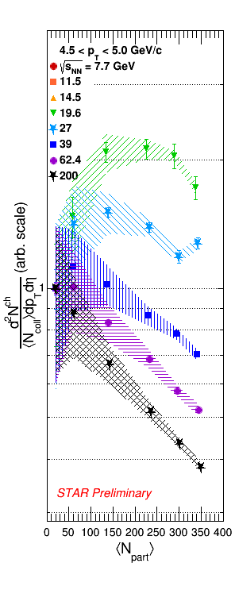
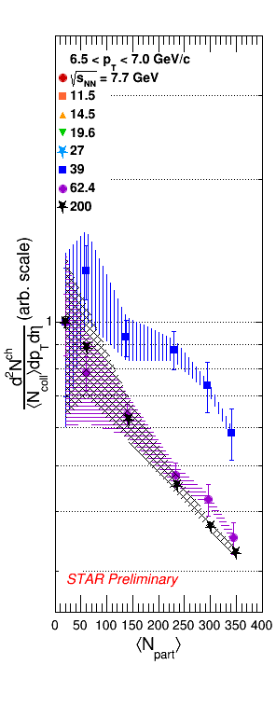
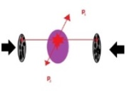
Backups
Au+Au
Au+Au
Au+Au

Slide 34
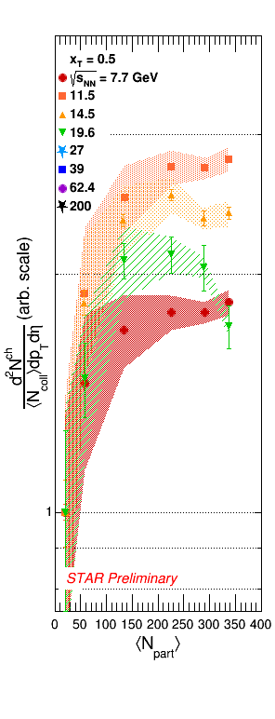
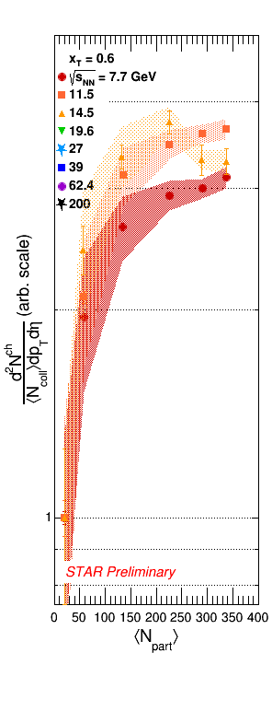
x_{T}
Au+Au
Au+Au
Au+Au

