Slide 1
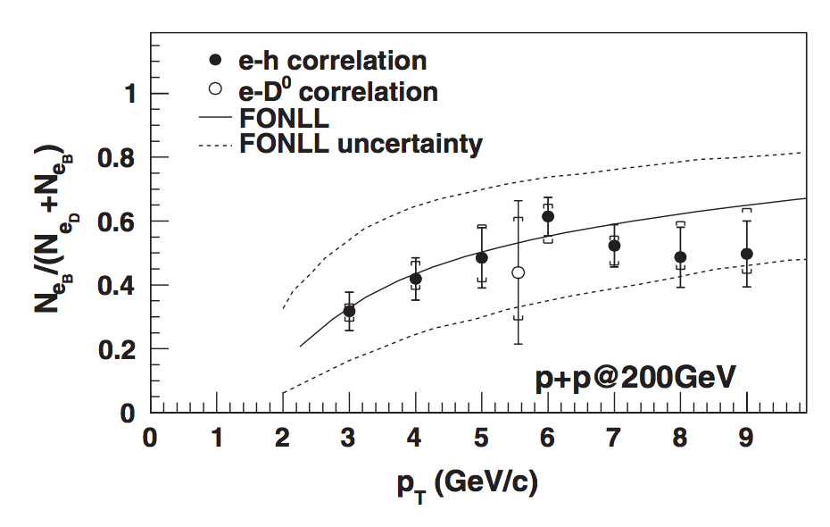
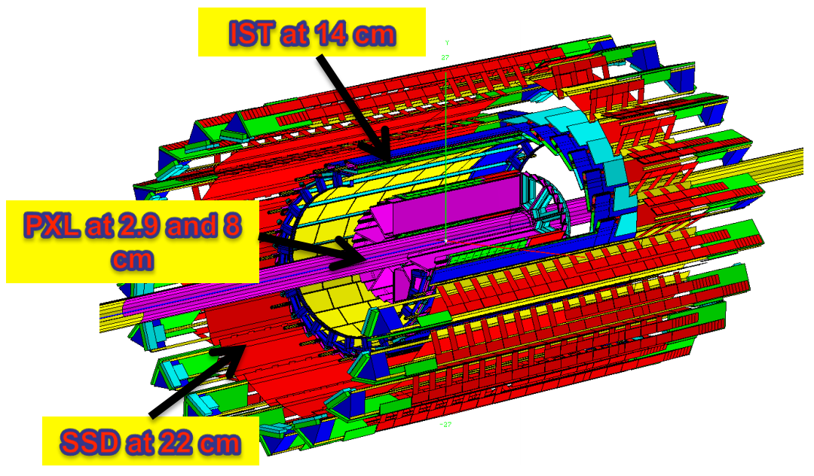
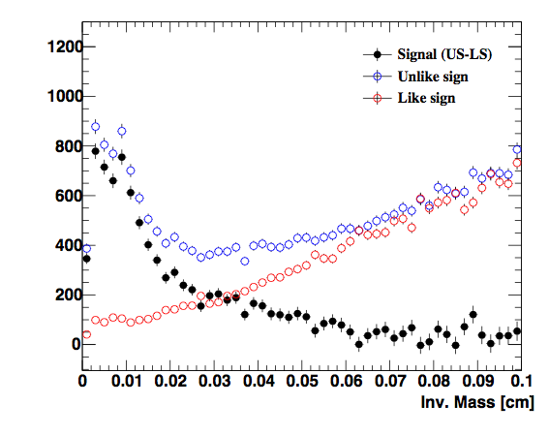
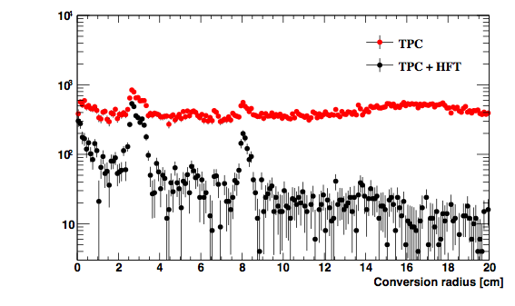
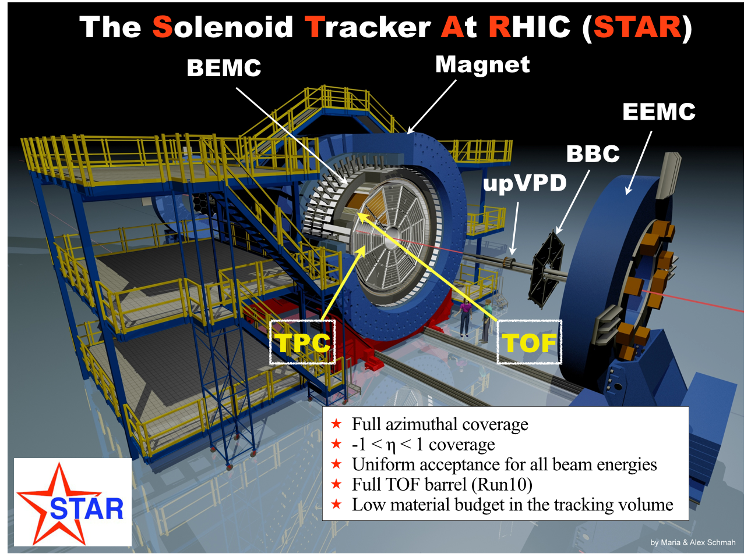
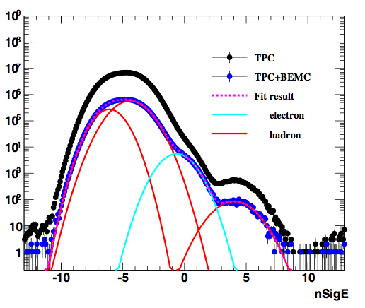
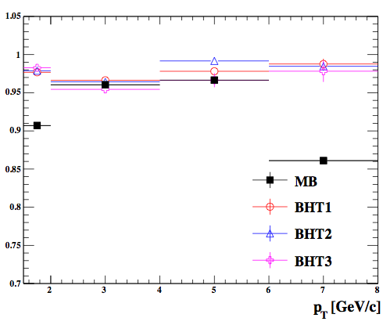
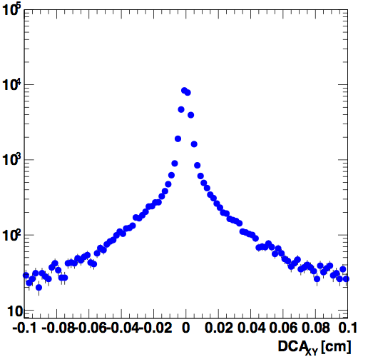
Measurements of Charm and Bottom Productions in Semi-leptonic Channels at STAR
KUNSU OH (Pusan National University) for the STAR Collaboration
Abstract
Heavy flavor quarks are suggested as excellent probes to study the strongly interacting Quark-Gluon Plasma (QGP) created in high-energy heavy-ion collisions. Measurements of Non-Photonic Electron (NPE) production from open heavy flavor hadron decays have revealed strong suppression at large transverse momentum in Au+Au collisions relative to p+p collisions at the Relativistic Heavy Ion Collider (RHIC). Such suppression has been attributed to energy losses of heavy flavor quarks within the QGP. Theoretical predictions that are able to describe existing NPE data suggest that bottom quarks lose less energy than charm quarks, but it varies among models how exactly they differ. Therefore it is important to experimentally constrain such model calculations, which can further improve our understanding of parton interactions with the QGP and the QGP properties. Electrons from bottom hadron decays can be statistically separated from charm hadron decay electrons by studying their impact parameter distributions. In this poster, we will present a first attempt to separately measure charm and bottom quark productions through semi-leptonic channels in Au+Au collisions at √sNN = 200 GeV at RHIC, utilizing the new Heavy Flavor Tracker of the STAR experiment.
Motivation
Analysis method
b hadron decay electrons have larger DCA value than c hadron decay electrons. → We can distinguish b and c using DCA distributions.
We can obtain DCA distributions for different electron sources in data and/or simulation, and fit the inclusive electron DCA distribution in data to these distributions.
gamma conversion electrons: data and simulation
pi0/eta Dalitz decay electrons: data and simulation
D⁰/D*/D± ... decay electrons: simulation
B⁰/B±... decay electrons: simulation
STAR PRL 105, 202301 (2010)
e⁺
ve
X
HF quarks are primarily produced in initial hard scattering, and are exposed to the evolution of the hot nuclear matter created at RHIC.
Using the HF as a probe to study properties of the QGP and their dependence on e.g. parton energy loss in medium, system size and collisional energy.
→ Theories predict for ΔE in medium : ΔEg > ΔElight quark > ΔEc > ΔEb (?)
→ Precise measurements of charm and bottom quark energy loss separately are crucial for understanding the heavy quark energy loss mechanism.
STAR published Nb→e/Nb,c→e ratio using e-h and e-D⁰ correlation in p+p 200 GeV.
secondary vertex
B⁰/B±/D⁰/D±…
primary vertex
DCA
Particle | c𝜏 (µm) | Mass (GeV/c²) | X → e (BR)
D⁰ | 123 | 1.865 | 0.0653
D⁺ | 312 | 1.868 | 0.160
B⁰ | 459 | 5.279 | 0.101
B⁺ | 491 | 5.279 | 0.108
J. Phys. G: Nucl. Part. Phys. 41 (2014) 025103
STAR and HFT detector
Photonic electrons
2.5 < pT < 4.0 GeV/c, |eta| < 0.7
Au+Au 200 GeV MB
2.5 < pT < 4.0 GeV/c, |eta| < 0.7
Au+Au 200 GeV MB
2 layers of silicon pixel (MAPS)
Light material budget : ~0.4% (0.6%) X0 inner (outer) layer
Excellent DCA resolution : ~30µm at pT > 1.5 GeV/c
2 layers of silicon strip detectors:
Fast readout, bridging TPC and PXL
Gamma conversion and pi0/eta Dalitz decay electrons can be reconstructed in data using e⁺e⁻ pairs with small invariant masses
HFT matching requirement (track hits inner and outer PXL layers) significantly reduces gamma conversion electron background.
Heavy Flavor Tracker (HFT) : enhance track DCA resolution, installed in 2014
Time Projection Chamber (TPC) : particle identification (dE/dx → nSigE : modified dE/dx for electron mean is 0 and sigma is 1) and tracking
Barrel ElectroMagnetic Calorimeter (BEMC) and Barrel Shower Maximum Detector (BSMD) : electron identification (e0 : highest tower energy deposit in the cluster)
STAR take ~1.2B Au+Au MinBias and ~0.4 nb⁻¹ BEMC triggered data at Run14 with HFT and we expect to increase the Au+Au statistics by a factor of 3 in Run16.
Simulation
Construct pseudo-data by adding DCA distribution for D→e, B→e and Dalitz decay electrons from fast simulations to obtain the inclusive electron DCA distribution, where D→e vs B→e ratio is from FONLL and assuming PHE/NPE ratio of 1.
Assume 3x10⁵ electron can- didates in 2 < pT < 4 GeV/c for Run14+Run16 sample, based on current data statistics. (~50% of Run14 data)
Extract B→e fraction
Fit the pseudo-data inclusive electron distribution by D→e, B→e and Dalitz electron template.
Repeat 1000 times the generation of pseudo-data, and D→e, B→e and Dalitz electron template fit.
Electron candidates
2.0 < pT < 4.0 GeV/c, |eta| < 0.7
Au+Au 200 GeV MB
Electron purity
Run14 Au+Au 200 GeV 541M MB (~50M BHT) events
Electron identification with TPC+BEMC(+BSMD)
BEMC : 0.8 < e0/p < 2.0
TPC : 0 < nSigE < 2.5 at 2.0 < pT < 4.0 GeV
Purity is higher than ~96%.
Inclusive electron DCA distribution
2.0 < pT < 4.0 GeV/c, |eta| < 0.7
Au+Au 200 GeV MB
Inclusive e
Summary and outlook
With the newly installed HFT, STAR can separately measure charm and bottom quark productions through semi-leptonic channels.
The measurement of Charm and Bottom production in semi-leptonic channel in Au+Au 200 GeV collisions is ongoing.
The STAR Collaboration: http://drupal.star.bnl.gov/STAR/presentations

