Slide 1
System-size and energy dependence of di-electron excess invariant-mass spectra at STAR
Shuai Yang (for the STAR Collaboration)
University of Science and Technology of China
Brookhaven National Laboratory
Quark Matter 2015
Kobe Fashion Mart, Kobe, Japan
September 27 – October 3, 2015

Slide 2
Outline
Motivation
STAR experiment
Electron Identification
Di-electron measurements
Di-electron mass spectra within STAR acceptance in U+U@193 GeV
Transverse momentum dependence
Centrality dependence
Energy and system-size dependence of acceptance corrected yield
AuAu@19.6, 27, 39, 62.4, 200 GeV
UU@193 GeV
Summary

Slide 3
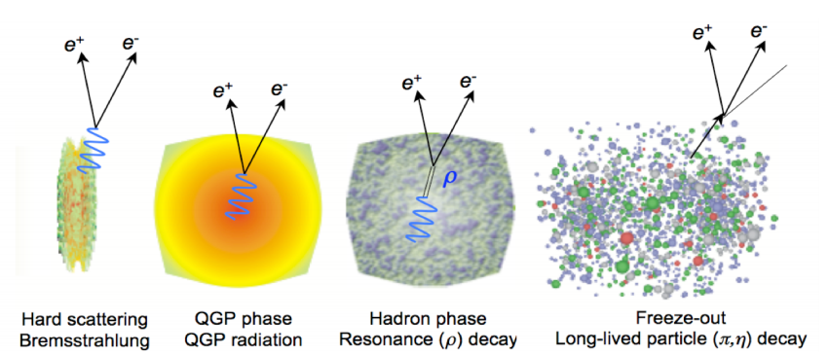
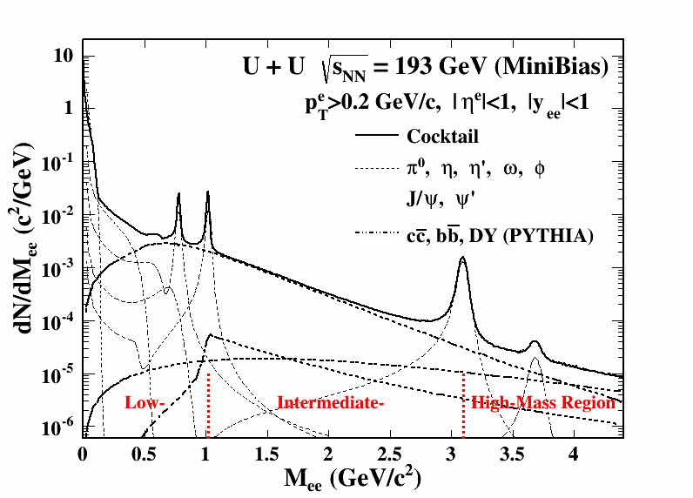
Di-lepton production
S. Bass
Di-leptons – penetrating probe
Do not suffer strong interactions
Bring direct information of the medium created in heavy ion collisions
Time
Different physics of interest
Low Mass Region (LMR, M_{ll} < M_{φ})
In-medium modifications of vector meson
Intermediate Mass Region (IMR, M_{φ} <M_{ll}<M_{J/ψ})
QGP thermal radiation
Semi-leptonic decays of correlated charm
High Mass Region (HMR, M_{J/ψ}<M_{ll})
Drell-Yan process
Heavy quarkonia

Slide 4
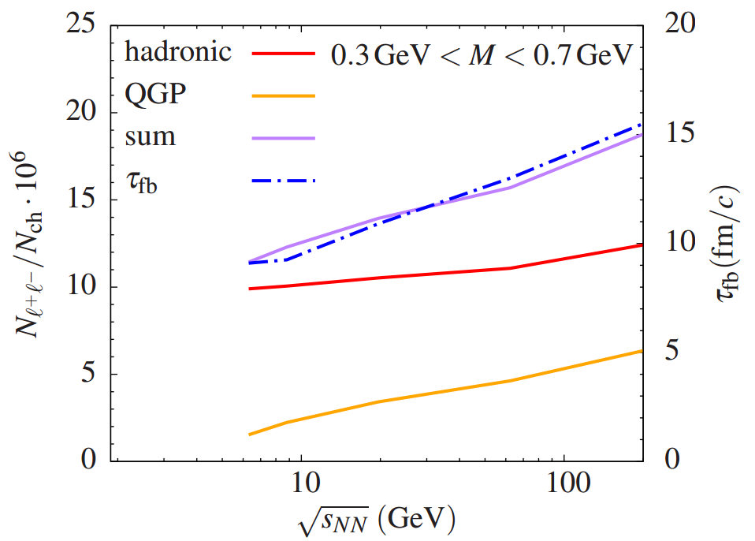
Di-electron physics @ STAR
UU@193 GeV
Energy density is higher by 20% than that in AuAu@200 GeV.
Longer medium life time?
Higher excess yield in the low mass region?
Beam Energy Scan Program
Systematically study energy
dependence of LMR excess
Systematically study the low
mass excess yield versus medium
life time.
D. Kikola, G. Odyniec, and R. Vogt, PRC 84 (2011) 054907
R. Rapp, H. van Hees,arXiv:1411.4612

Slide 5
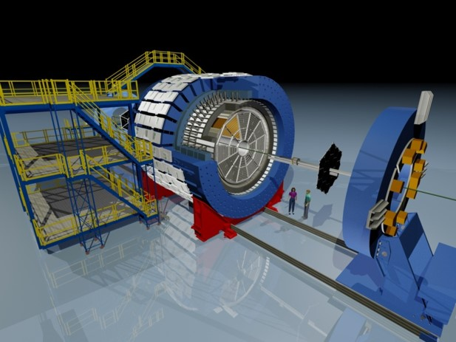
STAR detector
Time Projection Chamber
|η|<1, 0<φ<2π
Main detector: tracking, momenta, and energy loss
Time Of Flight
|η|<0.9, 0<φ<2π
Rejects slow hadrons, enables clean electron identification at p < 3 GeV/c
Time Projection Chamber
Time Of Flight

Slide 6
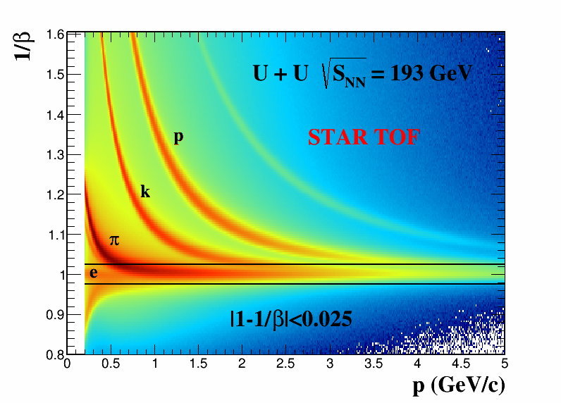
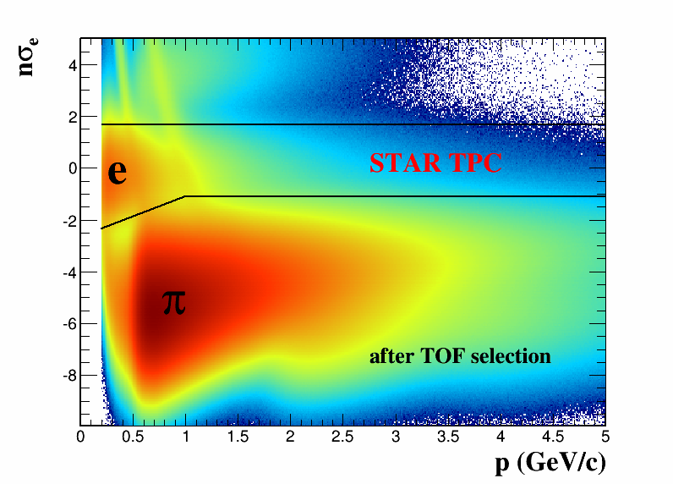
Electron identification
Clean electron identification with a combination of TPC and TOF
$$nσ_{e}= \frac{1}{R}log\frac{{(dE/dx)}_{measured}}{{(dE/dx)}_{electron}}$$

Slide 7
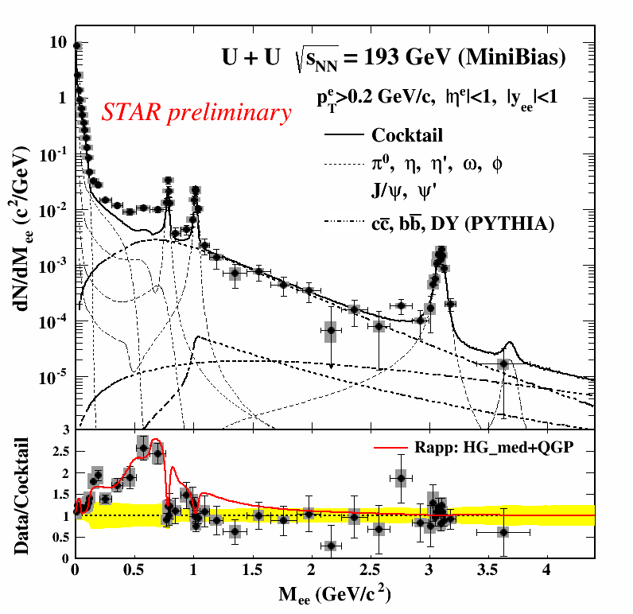
U+U @ 193 GeV results
Cocktail simulation: STAR, PRC 92 (2015) 024912
Significant enhancement w.r.t cocktail at ρ-like mass region (0.3-0.76 GeV/c²)
2.1±0.1(stat.)±0.2(sys.)±0.3 (cocktail)
The charm contribution to the total cocktail is significant in the ρ-like mass region (48.5%).
$σ_{c\overline{c}}=797 μb$, $σ_{b\overline{b}}=3.7 μb,$ $σ_{DY}=42 nb$
Compared with a theoretical model based on a broadened ρ spectral function [R. Rapp, Adv. High Energy Phys. 2013 (2013) 148253]
Model shows good agreement with data within uncertainty.

Slide 8
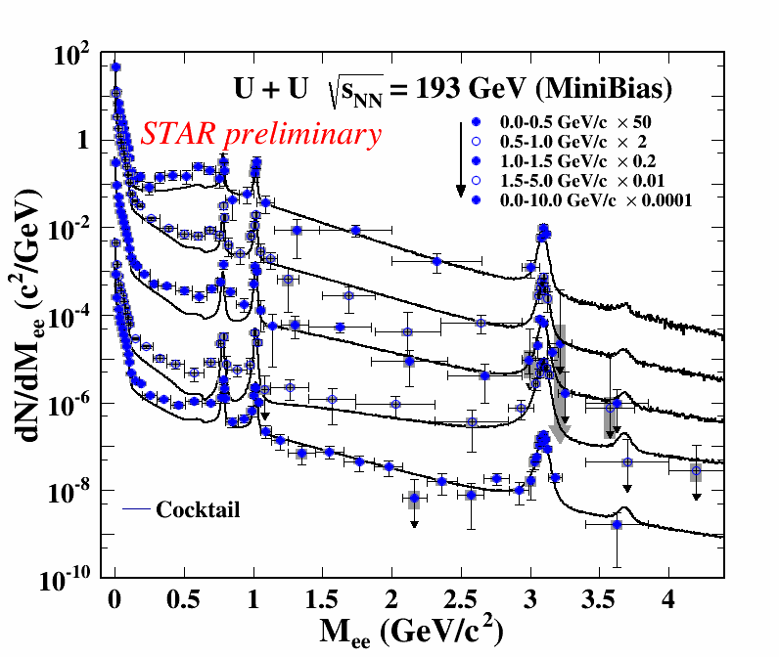
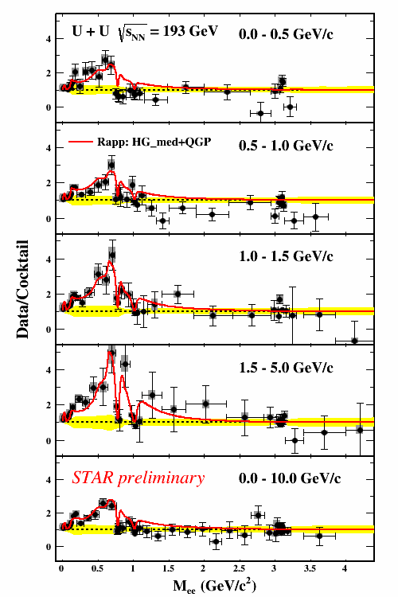
p_{T} dependence
p_{T} (GeV/c) | Yield/cocktail
0-0.5 | 2.2±0.2±0.5
0.5-1.0 | 1.8±0.2±0.3
1.0-1.5 | 2.7±0.3±0.5
1.5-5.0 | 3.1±0.4±0.8
Integrated mass region:
0.3-0.76 GeV/c²
Model calculation consistently describes the LMR excess in all p_{T} bins.

Slide 9
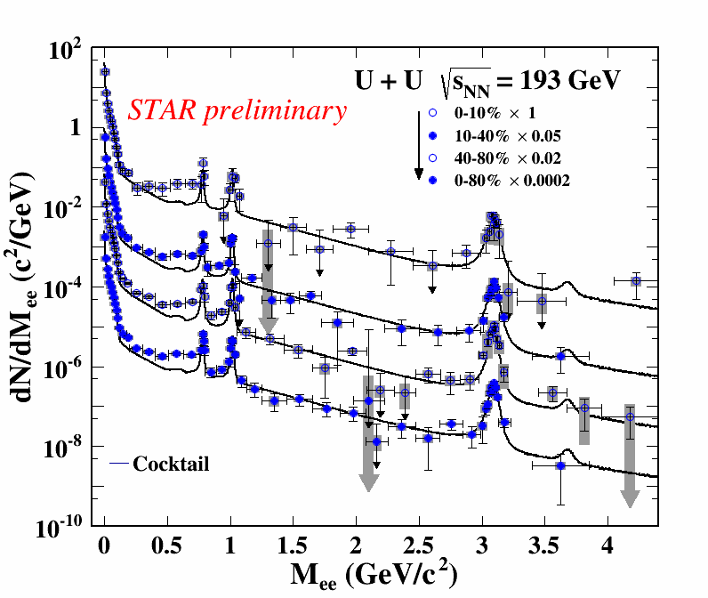
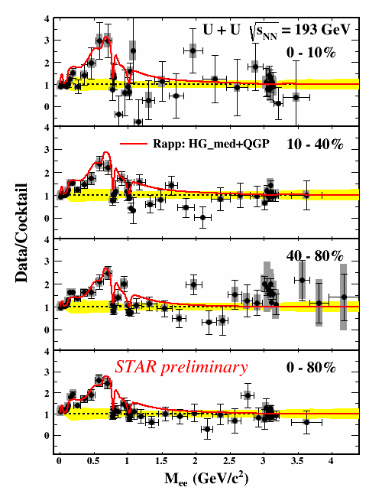
Centrality dependence
Centrality(%) | Yield/cocktail
0-10 | 2.2±0.3±0.3
10-40 | 1.9±0.1±0.2
40-80 | 1.9±0.1±0.2
0-80 | 2.1±0.1±0.2
Integrated mass region:
0.3-0.76 GeV/c²
Model calculation consistently describes the LMR excess in all centrality bins.

Slide 10
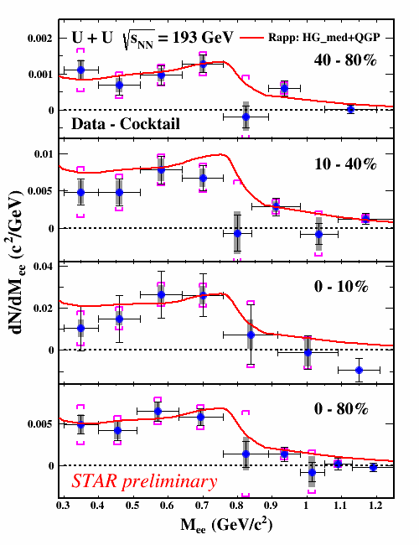
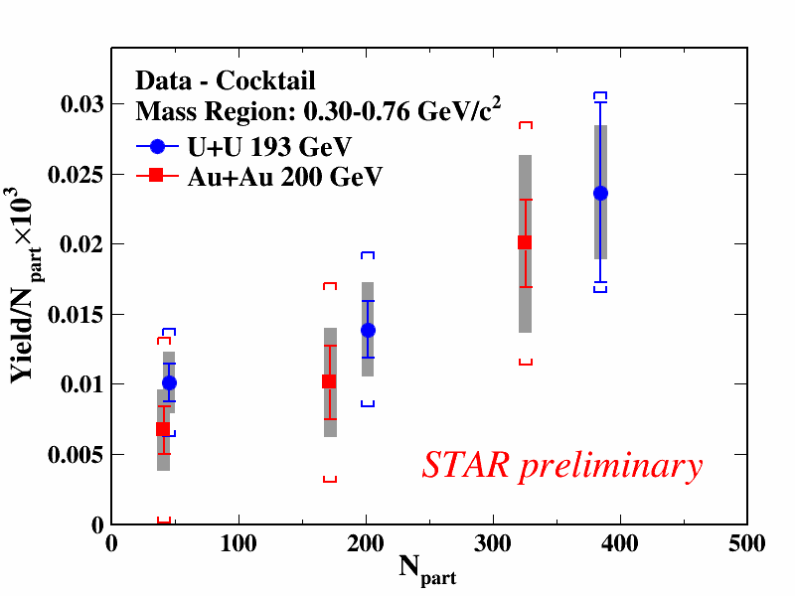
Excess spectrum and yield
AuAu@200 GeV: STAR, PRL 113 (2014) 022301
Excess yield in ρ-like mass region:
Increase faster than N_{part} scaling
Sensitive to medium dynamics

Slide 11
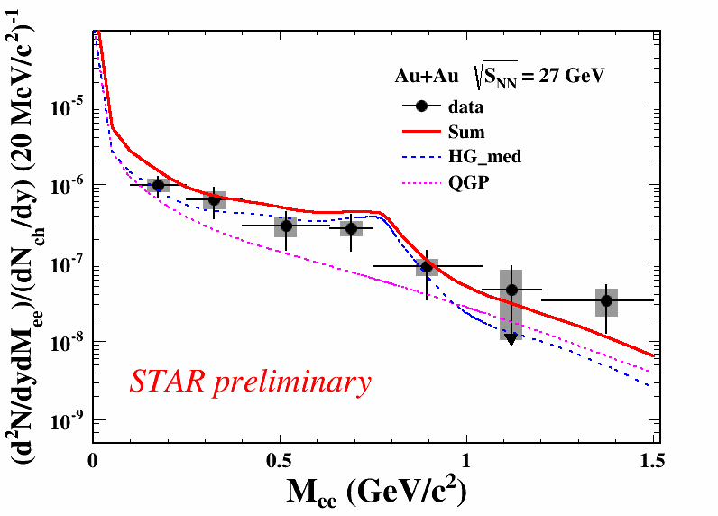
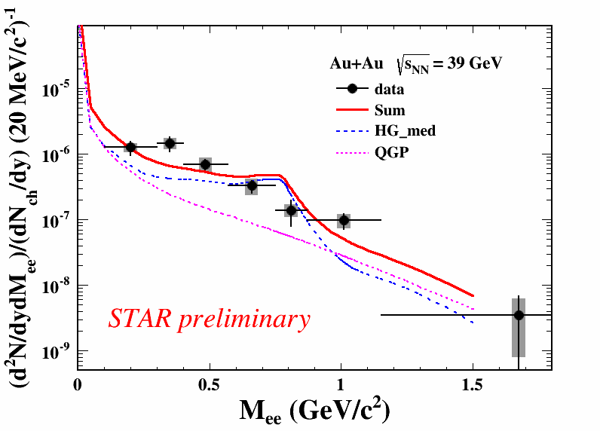
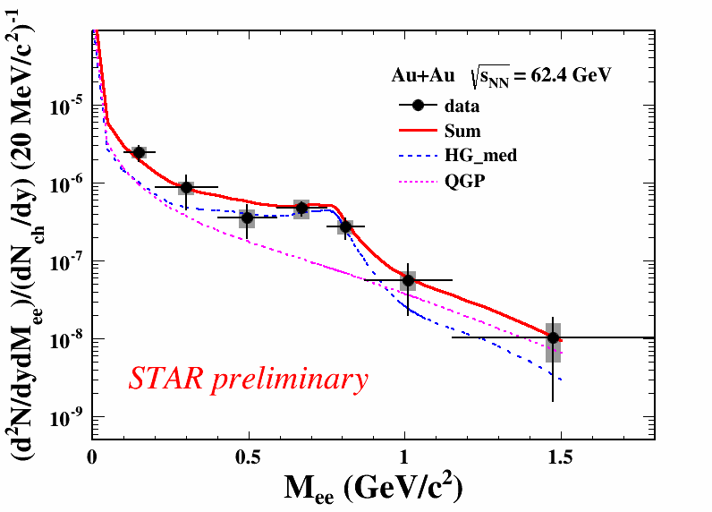
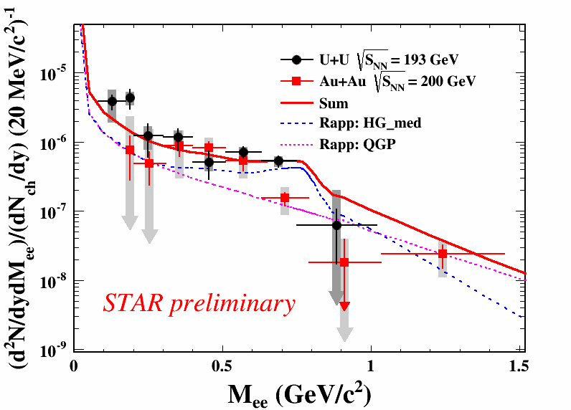
Acceptance corrected excess spectra
Beam Energy Scan I: 27, 39, 62.4 GeV
AuAu@200 GeV
UU@193 GeV
Theory:
R. Rapp, PRC 63 (2001) 054907
AuAu@200 GeV:
STAR, PLB 750 (2015) 64
Acceptance-corrected excess mass spectra are well described by a ρ broadened spectral function in various collision systems and energies.

Slide 12
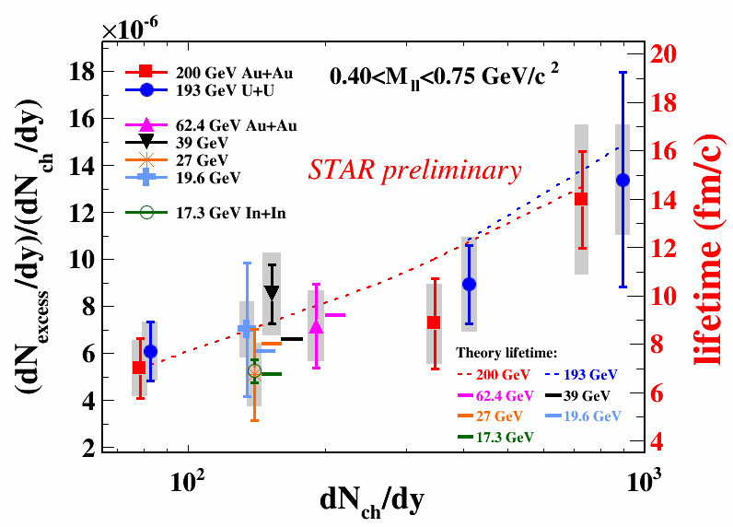
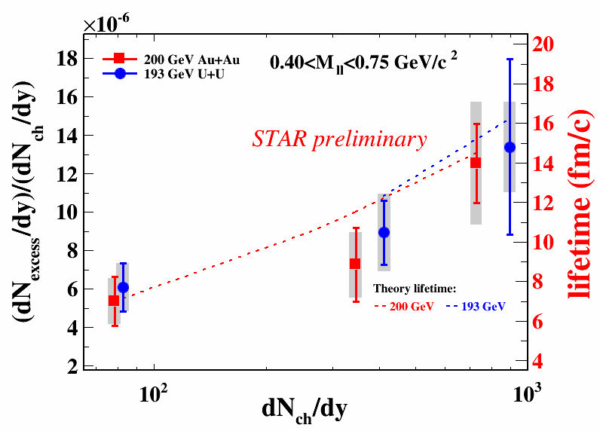
Energy and system-size dependence of integrated excess yield
AuAu@200 GeV, 19.6 GeV: STAR, PLB 750 (2015) 64
InIn@17.3 GeV: NA60, Eur. Phys. J. C 59 (2009) 607
The normalized excess yield in LMR is proportional to the medium life time (HG + QGP) for $\sqrt{S_{NN}}$ = 17.3-200 GeV
[R. Rapp, H. van Hees, arXiv:1411.4612]
Nearly constant total baryon density
Emission rate dominated around T_{c}
The normalized excess yields of UU@193GeV and AuAu@200GeV
Increase from peripheral to central collisions.
In central collisions are higher than those at lower energies.
Indicate longer medium lifetime in central UU@193GeV and AuAu@200GeV collisions.

Slide 13
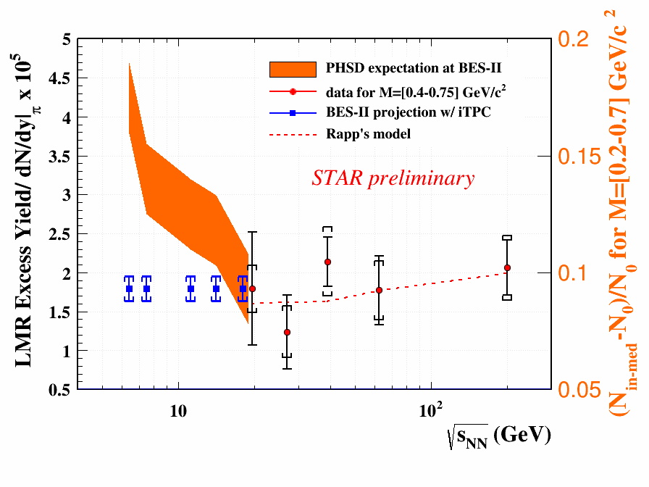
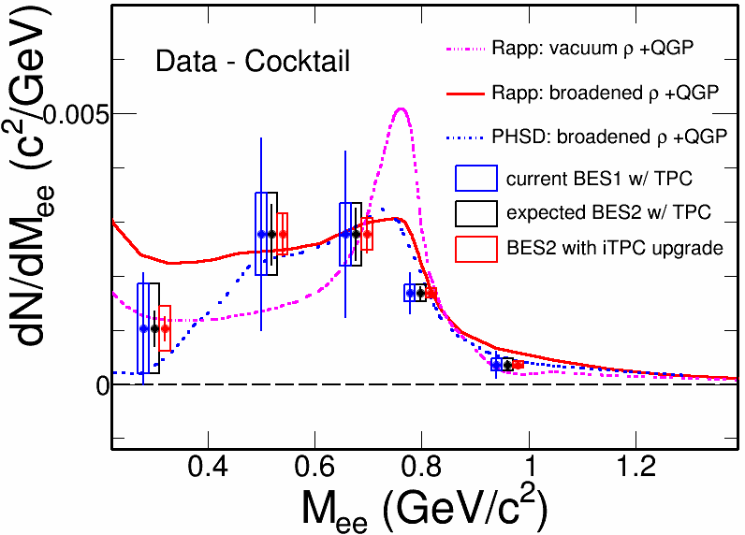
Di-electron measurements in Beam Energy Scan II
Systematically study di-electron continuum from $\sqrt{S_{NN}}$ = 7.7 – 19.6 GeV
Inner Time Projection Chamber (iTPC) upgrade: reduce systematic and statistical uncertainties
Distinguish models with different ρ-meson broadening mechanisms (Rapp’s method vs. PHSD)
Study the total baryon density effect on LMR excess yield in BESII

Slide 14
Summary
The di-electron production is systematically studied in UU@193 GeV for the first time.
The LMR excess at all collision systems can be consistently described by a ρ broadened spectral function scenario.
The excess yield in ρ-like mass region has a strong centrality dependence and increases faster than N_{part} scaling in UU@193 GeV and AuAu@200GeV.
The measurements indicate that the lifetime of medium created in central UU@193GeV and AuAu@200GeV collisions is longer than those in peripheral collisions and at lower energies.

Slide 15
Backup

Slide 16
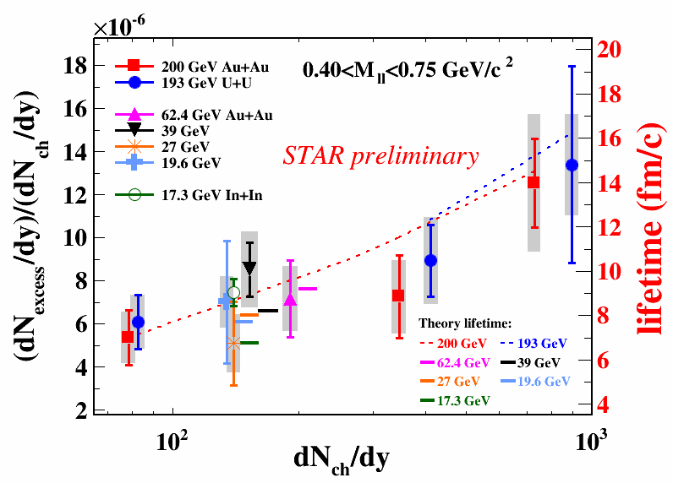
InIn@17.3 GeV: NA60, AIP Conf. Proc. 1322 (2010) 1

Slide 17
Theoretical temperature and lifetime
Collision Energy (GeV) | Temperature (MeV) | Lifetime (fm/c)
AuAu@19.6 | 227 | 7.7
AuAu@27 | 230 | 8.0
AuAu@39 | 237 | 8.2
AuAu@62.4 | 272 | 9.2
AuAu@200 | 328 | 10.5
UU@193 10-40% | 357 | 12.3
UU@193 0-10% | 392 | 16.2
[R. Rapp, Adv. High Energy Phys. 2013 (2013) 148253] ; (private communication)

