Slide 1
STAR Overview
courtesy Alex Schmah
Frank Geurts
(Rice University)
for the STAR Collaboration

Slide 2
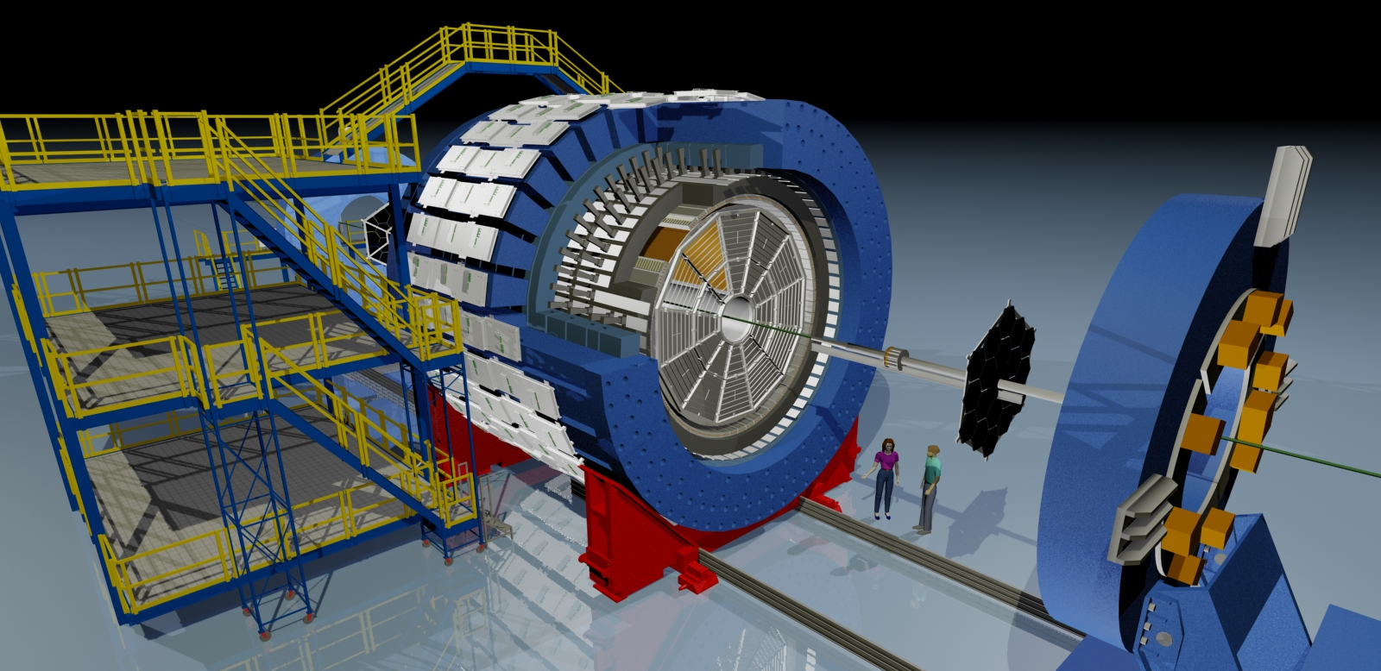
The Solenoidal Tracker at RHIC
Muon Telescope Detector
BEMC
TPC
Magnet
TOF
BBC
RHIC Runs 14 -16
STAR Heavy Flavor Program
HFT and MTD
Au+Au, p+p, p+Au @ √s_{NN}=200GeV
Heavy Flavor Tracker
VPD
Giacomo Contin (254)

Slide 3
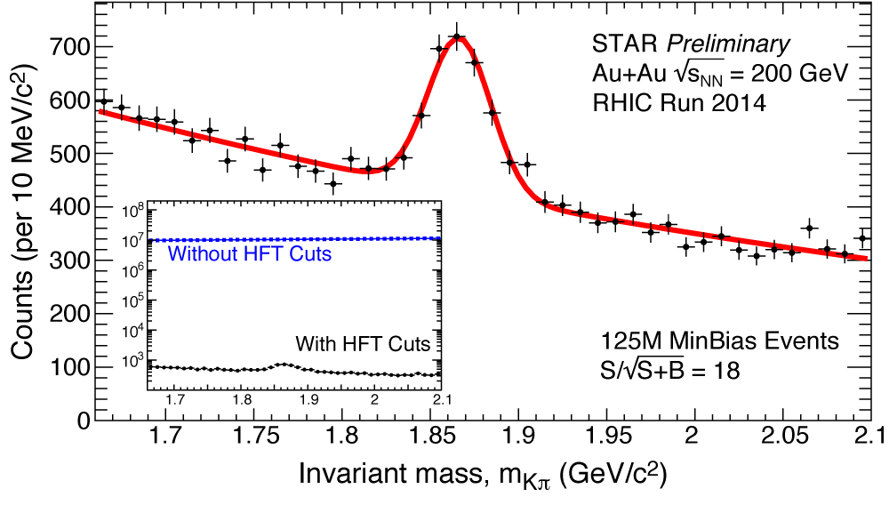
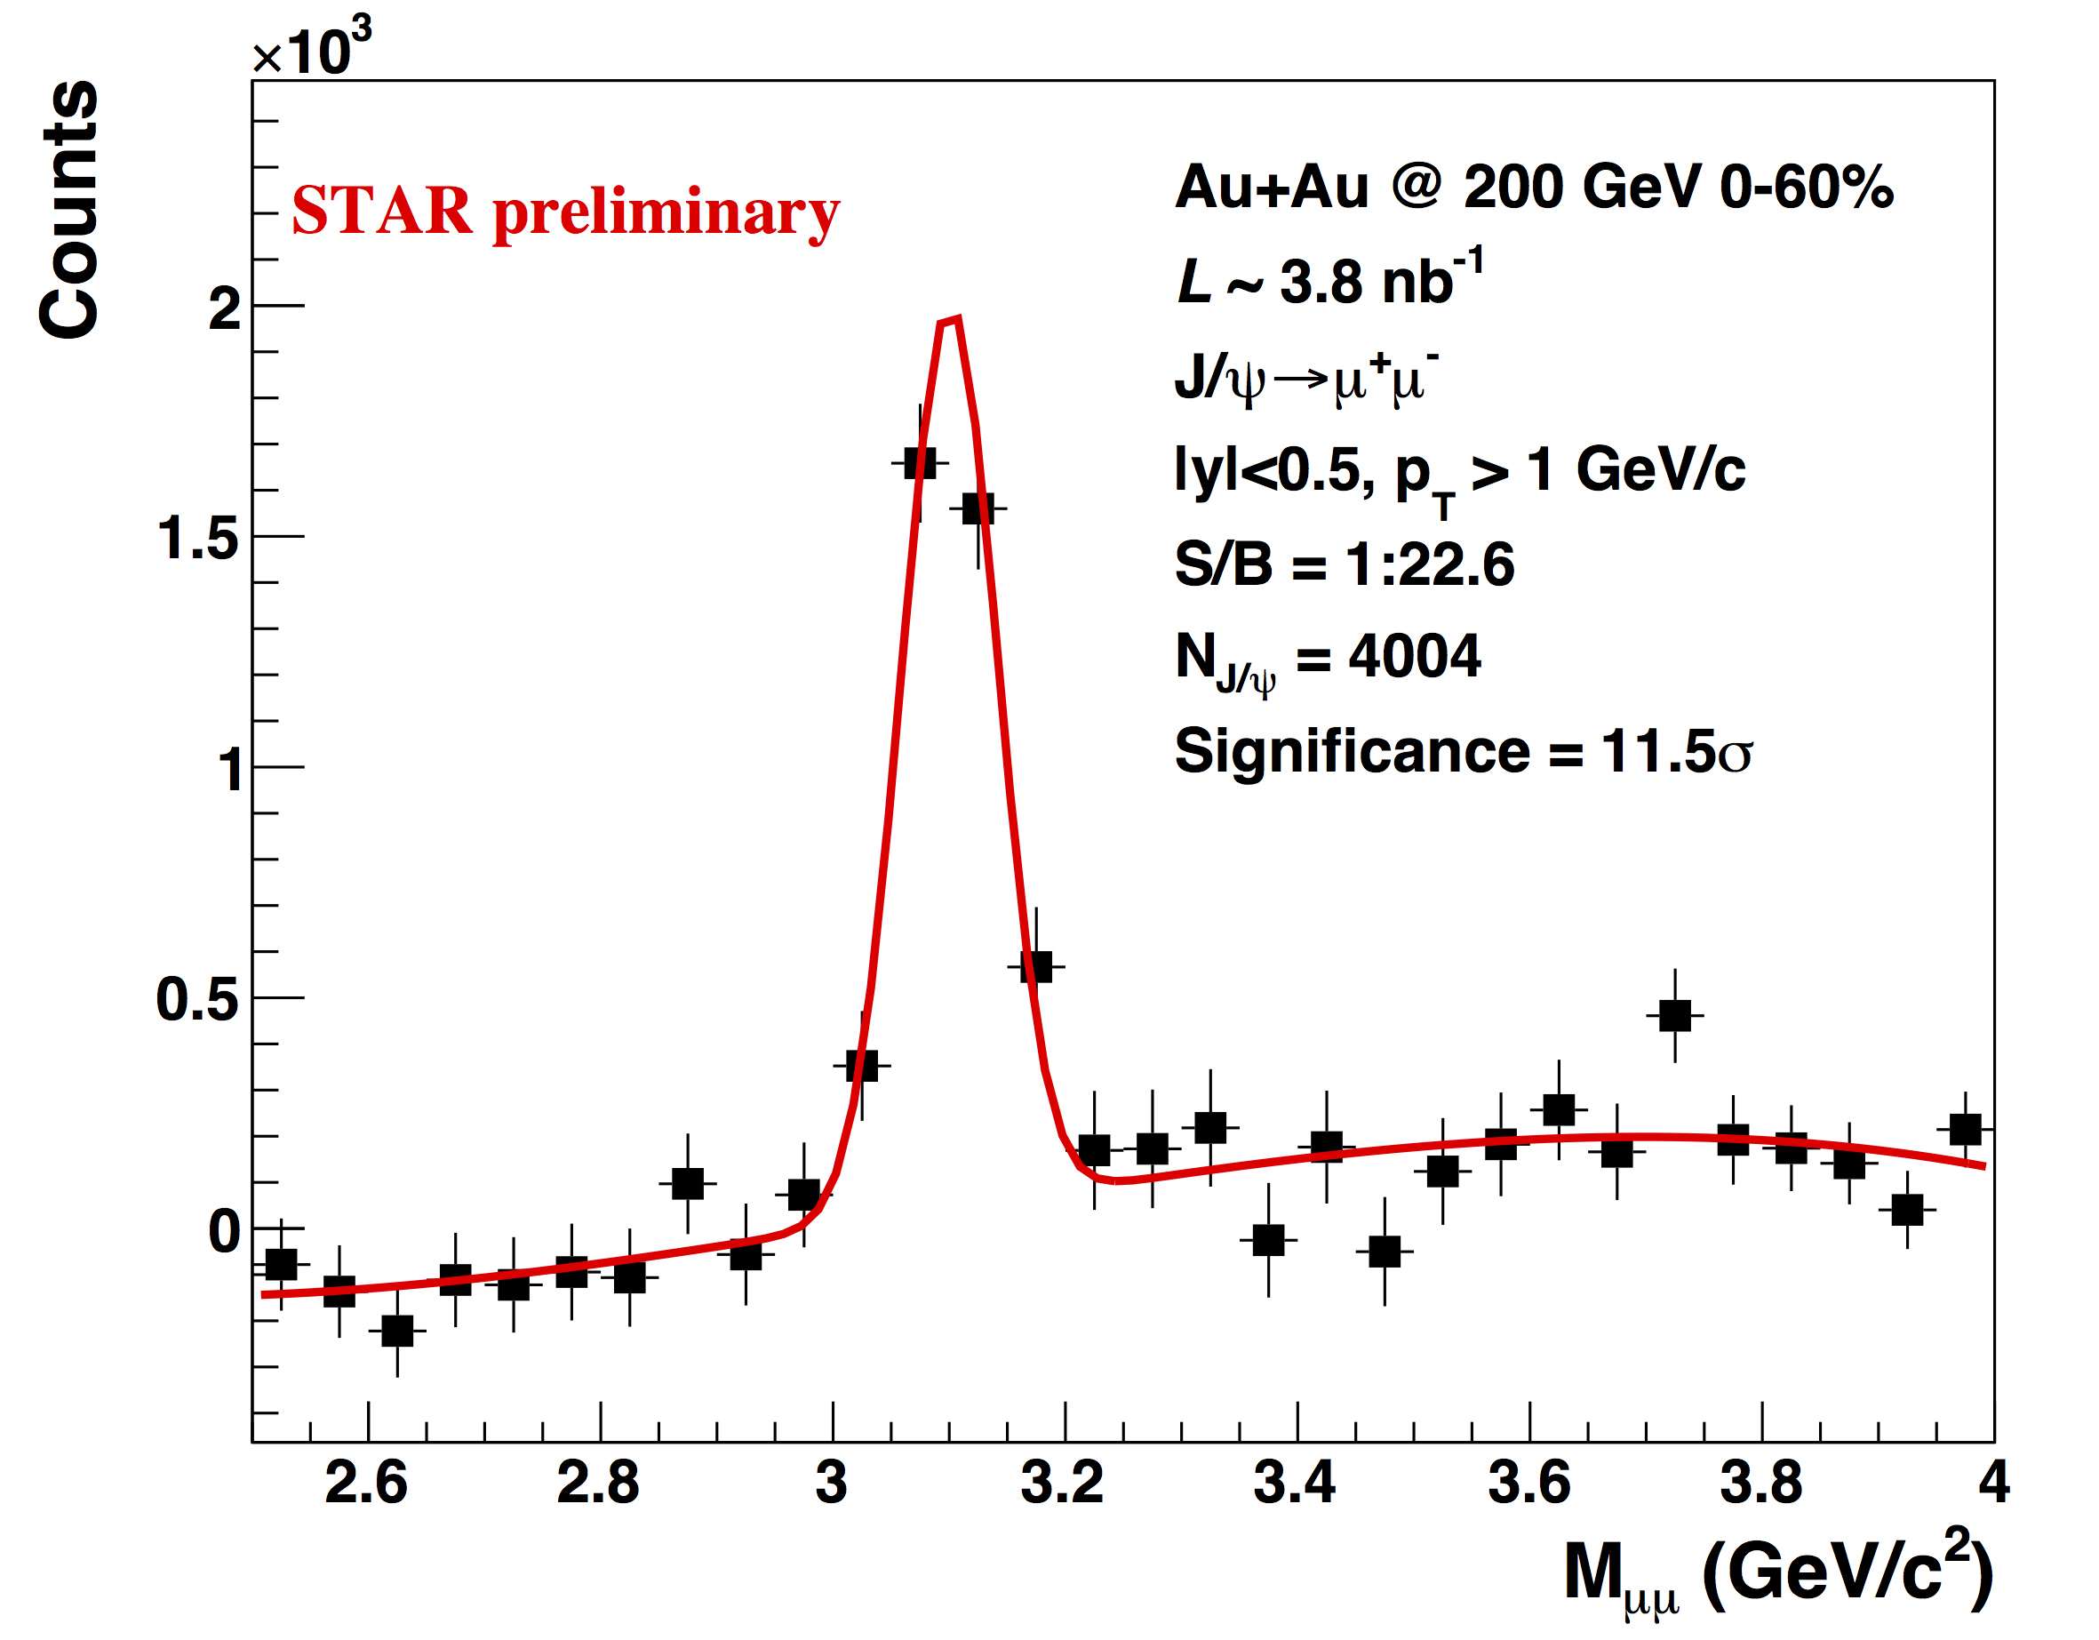
Heavy Flavors … first results from HFT and MTD!!
Thermalization and modification of charm at RHIC?
D⁰, D± elliptic flow -- Michael Lomnitz (493)
D⁰ nuclear modification factor – Guannan Xie (523)
Modification of charm in the medium: How about D_{S}± ? -- Md Nasim (221)
strangeness enhancement reflected in an enhanced R_{AA} compared to the other D’s?
effects of expected early freeze-out in a reduced elliptic flow?
Results from semi-leptonic channels – Xiaozhi Bai (496)
new p+p cross section measurements, R_{AA} in Au+Au and U+U
Quarkonia – suppression, a complicated story … – Rongrong Ma (274), Barbara Trzeciak (497)
measure J/ψ nuclear modification
disentangle production/regeneration mechanisms: J/ψ non-zero v₂ at low momentum
to the bottom of it: explore different Υ states
make sure to understand “the basics”: J/ψ and Υ production and polarization in p+p
Jets – study energy loss in the medium
Surface vs. volume emission – Nihar Sahoo (251)
compare medium effect for γ_{dir}-hadron and π⁰-hadron; we do not see less suppression for π⁰-h when compared to γ_{dir}-h. Push I_{AA} (z_{T}) measurements to lower z_{T}
Quantifying medium properties – Peter Jacobs (311)
recoil jets suggest less out-of-cone energy transport at RHIC than LHC
HFT
MTD

Slide 4
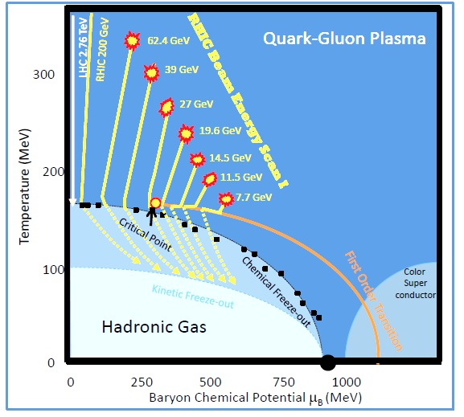
New Results for 14.5GeV :: fill in the large μ_{B} gap
Higher moments of net particle distributions: -- Jochen Thaeder (153)
new results for net-Q, net-K, and net-p; indications of non-monotonic behavior
v₁ for identified particles – Prashanth Shanmuganthan (398)
study the interplay between baryon transport and hydrodynamic expansion; can theory reproduce this?
The ridge, v₂², and v₃² from di-hadron correlations – Liao Song (258)
apparent non-monotonicity of v₃²/v₂² and v₃²/n_{ch} similar in shape to net-p dv₁/dy; 1st order phase transition?
Bulk properties vs. energy, centrality – Vipul Bairathi (492), Daniel Brandenburg (606), Chris Flores (320)
v₂, chemical & kinetic freeze-out
energy dependence of strange baryon-meson ratios
rapidity density measurements and the Dale plot
Hadron suppression and nuclear modification
centrality dependence of high-p_{T} suppression– Stephen Horvat (323)
identified particle R_{CP} – Daniel Brandenburg (606)
Chiral Symmetries
BES dielectron measurement – Shuai Yang (290)
acceptance corrected, life-time comparison: BES and U+U
Charge-dependent directed flow in Cu+Au – Takafumi Niida (263)
can asymmetric systems result in large initial electric fields?
relevant to test chiral-magnetic effect and waves.
√s_{NN}(GeV) | 7.7 | 11.5 | 14.5 | 19.6 | 27 | 39
μ_{B} (MeV) | 420 | 315 | 260 | 205 | 155 | 115

Slide 5
STAR Posters
… where you have all the time, and find all the experts!
Chiral Symmetries
Charge Asymmetry Correlations to Search for Chiral Magnetic Effect from BES (123)
Systematic searches for chiral magnetic effect and chiral vortical effect (948)
Beam Energy Results
Net-K results from BES (127)
Search for critical parton density fluctuations through baryon clustering (103)
Energy and centrality dependence of identified particle elliptic flow (833)
Beam Energy Dependence of Deuteron Prod. (130)
Production of light nuclei (105)
STAR Au+Au fixed target results (116)
Quarkonia
Non-Prompt J/ψ Measurements (626)
J/ψ polarization measurement in p+p collisions at 500 GeV (624)
Υ measurements in p+p collisions at 500 GeV (613)
Open Heavy Flavor
Two-particle correlation measurement of D⁰ meson elliptic anisotropy (521)
D_{S}± meson production in Au+Au collisions (569)
Λ_{C}⁺ baryon production in Au+Au collisions (555)
Measurements of heavy flavor electron production (567)
Measuring Charm and Bottom Productions in Semi-leptonic Channels (542)
Measurement of semileptonic decays of open heavy flavor hadrons in p+p and Au+Au (505)
Heavy Flavor Triggered Azimuthal Correlations in p+p at 500 GeV (533)
Jets & U+U
Characterizing the away-side jet, devoid of flow background, via 2-particle and 3-particle correlations (412)
Strangeness production in U+U (560)
Electrons from heavy flavor decays in central U+U (517)

Slide 6
STAR Future Plans Completing the RHIC Mission
charm
dilepton
sQGP properties
- QCD phase structure
- Critical Point
AA: B, Λ_{C}, jet, γ-jet, 3D correl.
p↑A: CNM, proton structure
2014 | 2015 | 2016 | 2017 | 2018 | 2019 | 2020 | 2021 | 2022 | 2023
HF-I, (e, μ), spin
BES-II
e-Cooling, iTPC, EPD
HF-II, p↑A
Forward tracking/calorimetry, HFT+, TPC speed-up
physics
iTPC proposal: drupal.star.bnl.gov/STAR/starnotes/public/sn0619
BES-II whitepaper: drupal.star.bnl.gov/STAR/starnotes/public/sn0598
Polarized p+p and p+A drupal.star.bnl.gov/STAR/starnotes/public/sn0605
upgrade

Slide 7
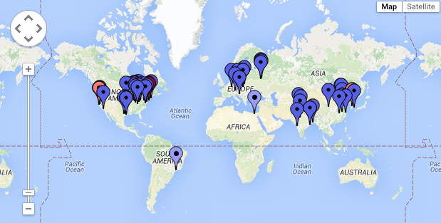
The STAR Collaboration
5 continents
11 countries
57 institutes
583 collaborators
ありがとう
http://www.star.bnl.gov/central/collaboration

Slide 8
STAR Speakers & Sessions
Monday
11:15a Daniel Brandenburg (606) – Open HF & Strangeness
2:30p Jochen Thaeder (153) – Correlations & Fluctuations I
3:10p Guannan Xie (523) – Open HF & Strangeness II
5:00p Takafumi Niida (263) – Initial State Physics & Approach to Equilibrium
Tuesday (AM)
9:00 Michael Lomnitz (493) – Collective Dynamics I
9:20 Prashanth Shanmuganthan (398) – Collective Dynamics
11:10 Md Nasim (221) – Open HF & Strangeness IV
11:30 Nihar Sahoo (251) – Jets & High p_{T} Hadrons III
11:30 Xiaozhi Bai (496) – Open HF & Strangeness IV
11:50 Chris Flores (320) – Collective Dynamics II
Tuesday (PM)
2:40p Liao Song (258) – Correlations & Fluctuations IV
3:00p Peter Jacobs (311) – Jets & High pT Hadrons IV
3:00p Giacomo Contin (254) – Future Exp. Fac., Upgr.
Wednesday
9:40a Vipul Bairathi (492)- Collective Dynamics III
9:40a Barbara Trzeciak (497) – Quarkonia III
10:50a Rongrong Ma (274) – Quarkonia IV
11:10a Shuai Yang (290) – Electromagnetic Probes II
11:50a Steven Horvat (323) – Baryon Rich QCD Matter
Thursday
11:30a Mustafa Mustafa (60) – Plenary II

