Slide 1





Measurements of Open Heavy Flavor
Production in Semi-leptonic Channels at STAR
Xiaozhi Bai^{1,2} (for the STAR Collaboration)
1 Central China Normal University
2 University of Illinois at Chicago

Slide 2
Outline
Motivation
STAR and Data Analysis
Non-Photonic Electron (NPE) Results
  NPE in p+p collisions at √s=200 GeV
  R_{AA} in Au+Au and U+U collisions
  Status of NPE analyses with the HFT
Summary and Outlook

Slide 3
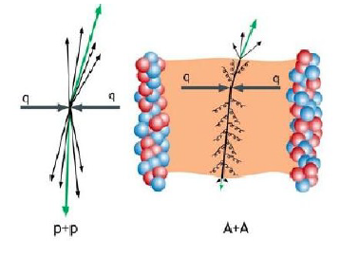
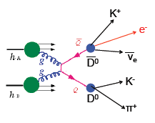
Motivation
Heavy Flavor Quarks
  Large masses, dominantly produced
  in hard scatterings in the early stage
  Excellent probe for studying the QGP
Non-Photonic Electrons (NPE)
  Produced from semi-leptonic decays
  of open heavy flavor hadrons
  A good proxy to measure heavy flavor
  quark production
  Can be triggered online with high eff.

Slide 4
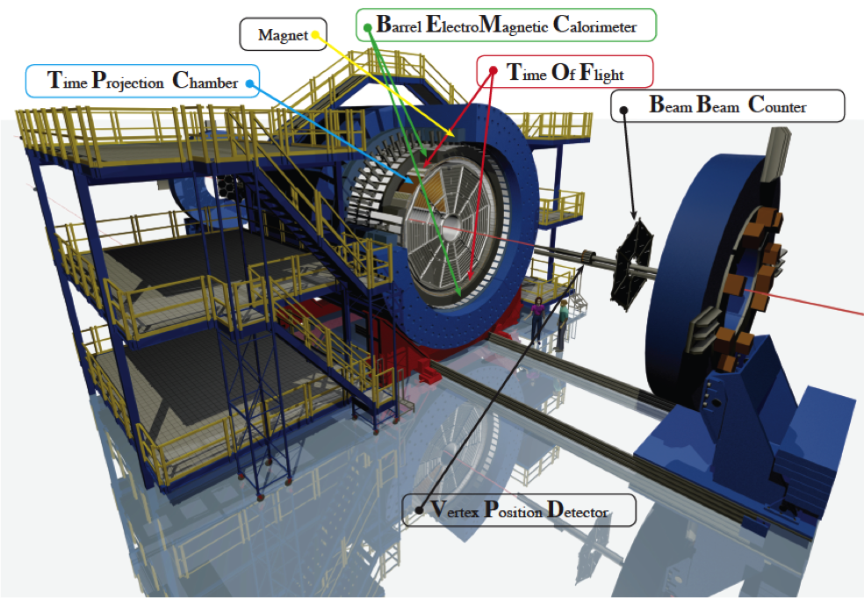
STAR Detector (2012)
Time Projection Chamber
|η|<1.1, 0≤ϕ<2π
tracking, momentum
electron ID through dE/dx
Time Of Flight
|η|<0.9, 0≤ϕ<2π
electron ID for p_{T}<1.5 GeV/c
Barrel EM Calorimeter
|η|<1, 0≤ϕ<2π
electron ID for p_{T} >1.5 GeV/c
high p_{T} electron online trigger
Vertex Position Detector
MinBias trigger

Slide 5
Data Analysis Procedure
Non-photonic electrons
from D/B hadron decays
γ conversion
π⁰ Dalitz decay
η Dalitz decay
Inclusive electrons
after electron ID
Photonic electrons
Partially reconstructed
though e⁺e⁻ pairs
Hadron contamination
Statistically subtracted
NPE yield after background correction:
purity: purity of inclusive electron sample
ε_{photonic}: photonic electron reco. efficiency
NPE invariant cross section:
p_{T} > 1.5 GeV/c
p_{T} < 1.5 GeV/c

Slide 6
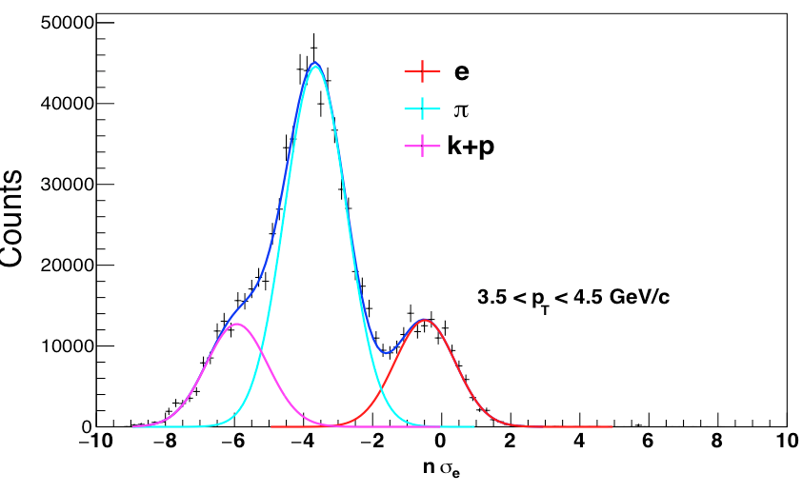
Data Analysis Procedure
dE/dx Distribution Fit for Purity
w/o dE/dx cut
-1<nσ_{e}<3

Slide 7
Data Analysis Procedure
dE/dx Distribution Fit for Purity
Photonic Electron Reconstruction
w/o dE/dx cut
-1<nσ_{e}<3
m_{ee} <0.24 GeV/c²

Slide 8
Data Analysis Procedure
dE/dx Distribution Fit for Purity
Photonic Electron Reconstruction
w/o dE/dx cut
-1<nσ_{e}<3
m_{ee} <0.24 GeV/c²
Purity and Photonic Electron Eff.

Slide 9
Data Analysis Procedure
dE/dx Distribution Fit for Purity
Photonic Electron Reconstruction
w/o dE/dx cut
-1<nσ_{e}<3
m_{ee} <0.24 GeV/c²
Purity and Photonic Electron Eff.
Electron Reconstruction Eff.

Slide 10
NPE in p+p@√s=200 GeV
[1] STAR Collaboration, PRD 83 (2011) 52006
[2] R.E. Nelson et al. PRC 87 (2013) 014908
            Extend the p_{T} coverage to lower and higher values than previous STAR measurements with significantly better precision; Results confirm and constrain FONLL calculations!
Poster 0505 by X. Bai and 0567 by S. Zhang

Slide 11
R_{AA} in Au+Au@√s_{NN}=200 GeV
            Significant suppression at p_{T}>4 GeV/c in the most central Au+Au collisions, and reduces gradually towards more peripheral collisions; Enhancement at low p_{T} across all centrality bins but with large systematic uncertainties.
Poster 0505 by X. Bai

Slide 12
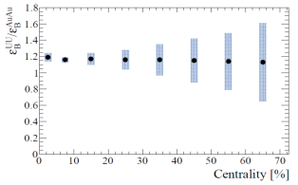
R_{AA} in U+U@√s_{NN}=193 GeV
Uranium nuclei have higher number of nucleons compared to gold nuclei.
By colliding uranium nuclei it is possible to achieve up to 20% larger energy density than Au+Au collisions[1].
            Larger suppression of non-photonic electrons in uranium collisions is expected in comparison to gold nuclei at the same centrality class.
[1]D. Kikola, G. Odyniec, R. Vogt, Phys. Rev. C 84, 054907 (2011)

Slide 13
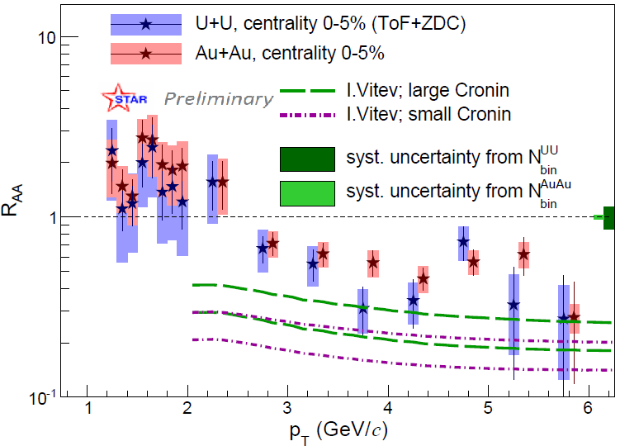
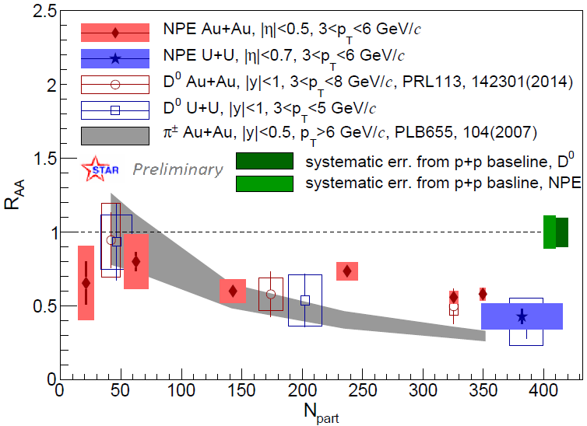
R_{AA} in U+U@√s_{NN}=193 GeV
U+U and AuAu use the same improved p+p reference
R_{AA} in the most central 0-5% U+U collisions systematically lower than that in 0-5% Au+Au collisions, but still consistent within uncertainties.
Poster 0517 by K. Gajdosova

Slide 14
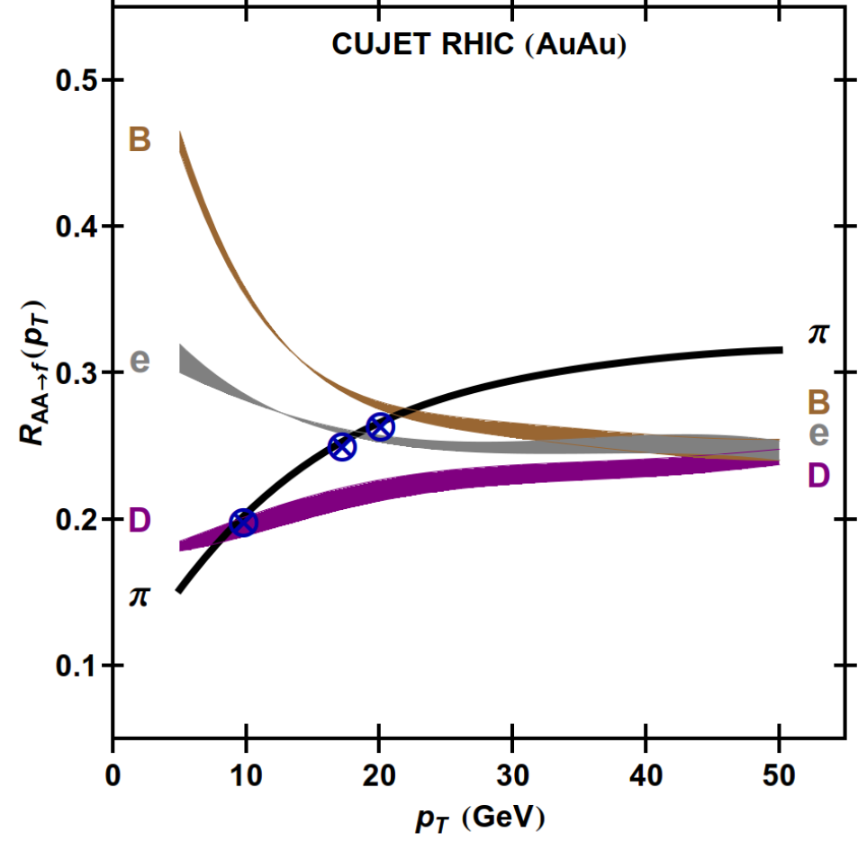
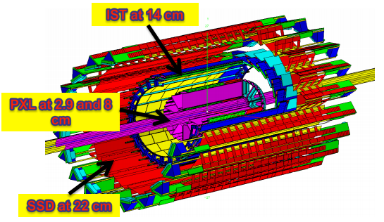
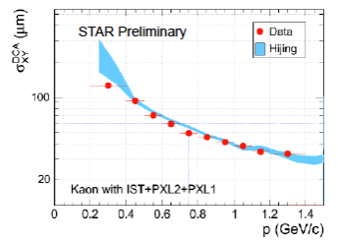
Separate e_{D} and e_{B} with HFT
A. Buzzatti and M. Gyulassy, 2012
δ(DCA) < 30μm @ p_{T} > 1.5 GeV/c
Precise measurements of charm and bottom quark production separately in heavy-ion collisions crucial for understanding parton energy loss mechanism. This becomes possible with the HFT.

Slide 15
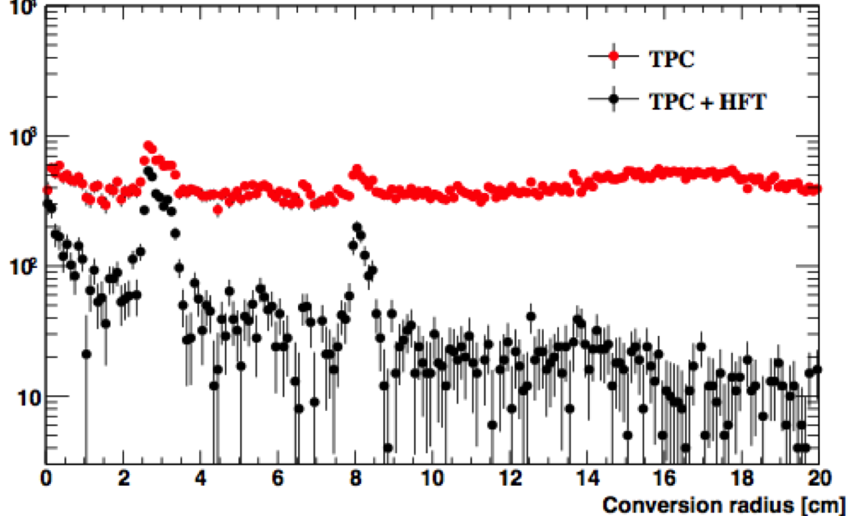
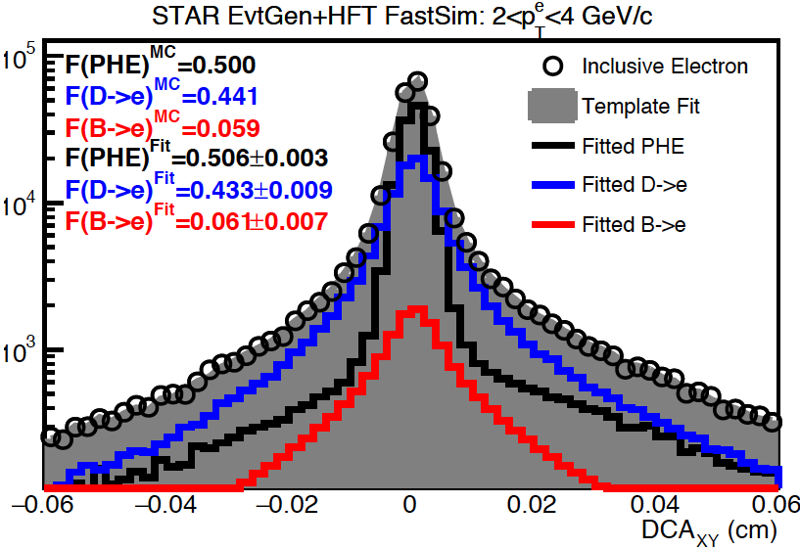
Simulation of e_{D} and e_{B} with HFT
Photon conversion background can be significantly suppressed by requiring hits in the the first HFT PXL layer.
Simulation with HFT for electrons decayed from D and B hadrons:
  DCA distributions for D and B decayed electrons, and photonic electrons (PHE) are obtained from fast simulation using real detector resolutions from data
  Pseudo data generated and fitted to D/B/PHE MC templates, with stat. uncertainty at p_{T}=2-4 GeV/c:
  δD/D~3%
  δB/B~12%
With full statistics of Run14+16 data, precise measurements are possible.
Au+Au 200 GeV Run14 MB
photonic electrons
Simulation
Poster 0542 by K. Oh

Slide 16
Summary and Outlook
            Production cross section in 200 GeV p+p collisions
              measured as a function of p_{T} over a broad p_{T} range 0.3-12 GeV/c with significantly improved precision than previous measurements
              confirm and constrain pQCD FONLL calculations
            R_{AA} in 200 GeV Au+Au collisions
              strong suppression for p_{T}>4 GeV/c in central collisions, less towards more peripheral collisions.
              Likely enhancement at low p_{T} in both central and peripheral collisions
            R_{AA} in 193 GeV 0-5% central U+U collisions
              systematically lower than those in 0-5% central Au+Au collision but consistent within uncertainties.
            Separate measurements for D and B decayed electrons
              become possible with the new HFT
              analysis with Run14 Au+Au data in progress
              precise results can be expected from STAR -> Stay tuned!

