Slide 1

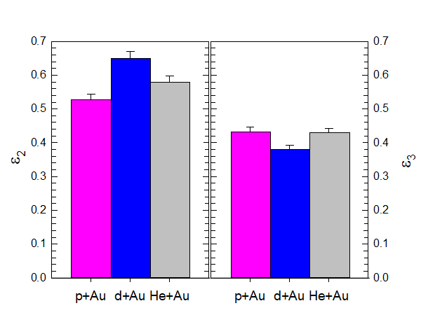
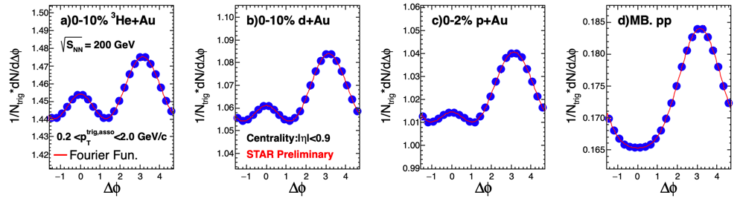
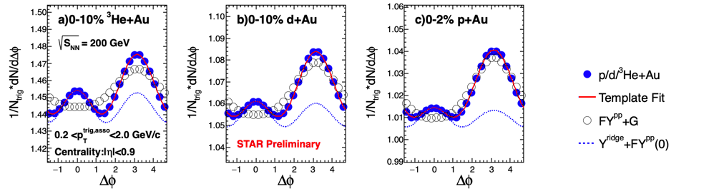

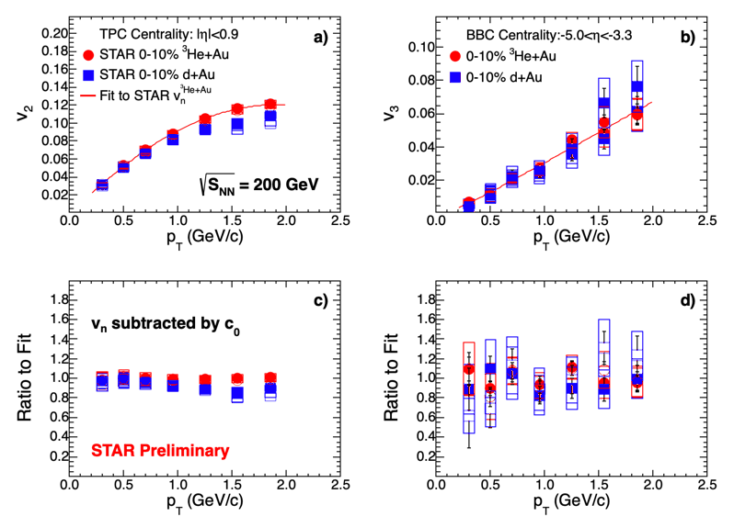
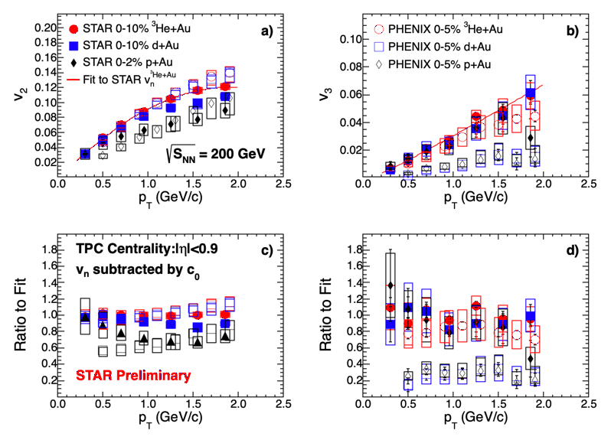
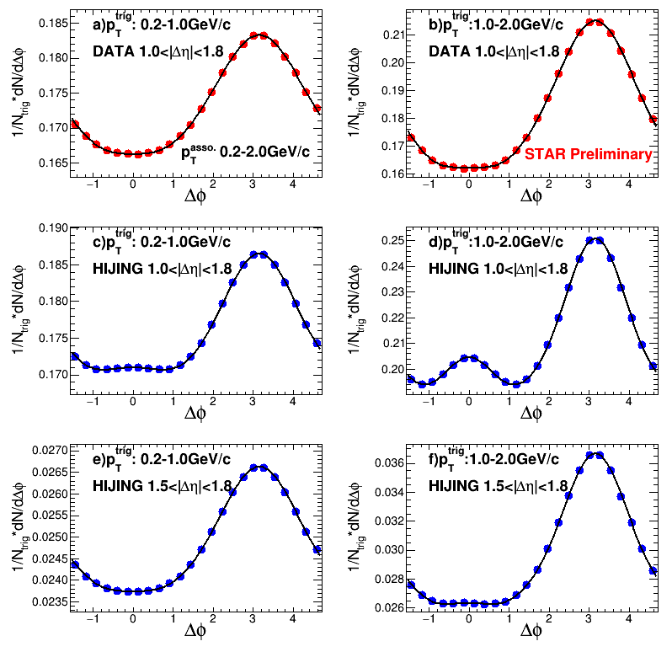
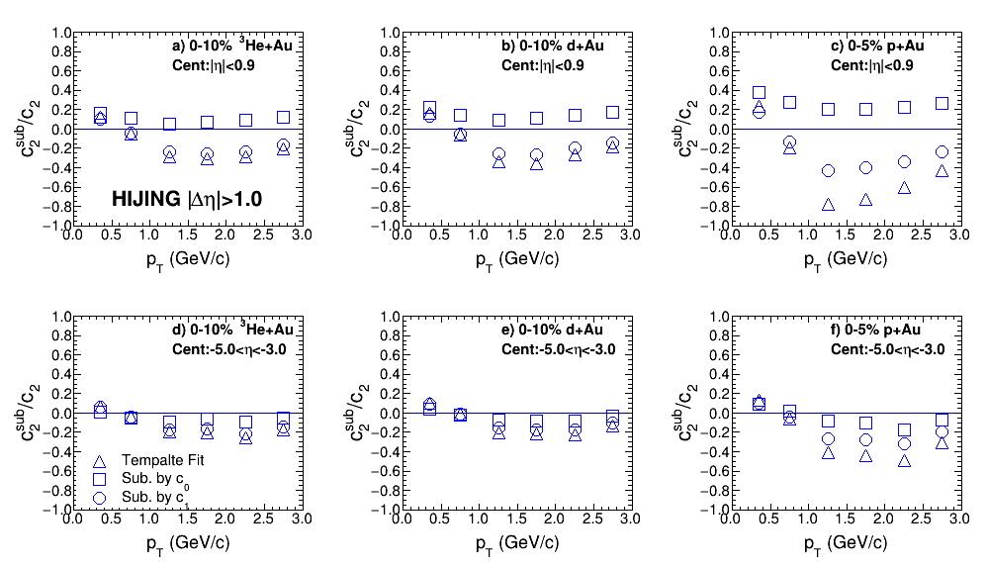
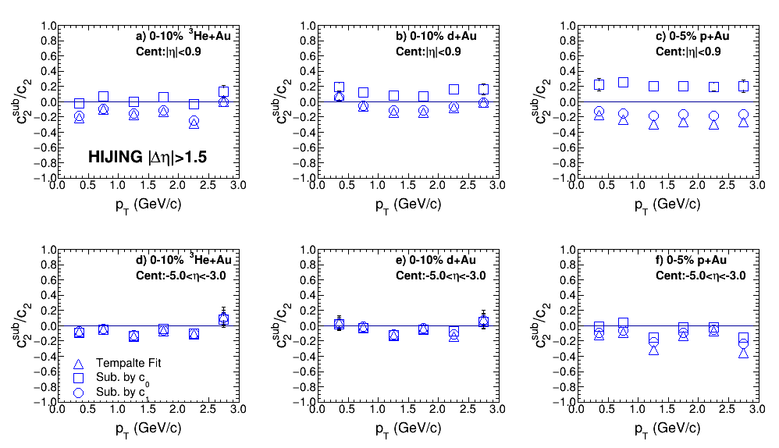
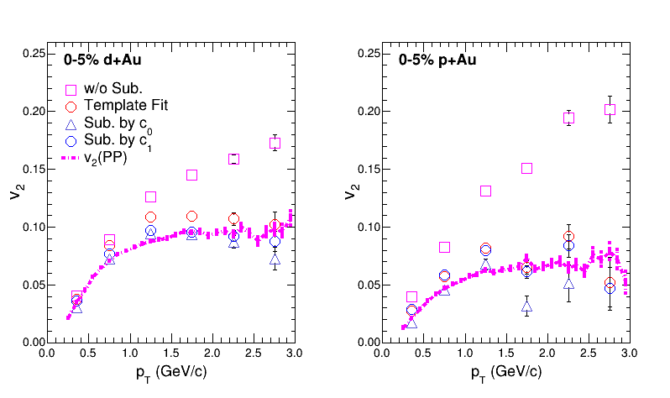
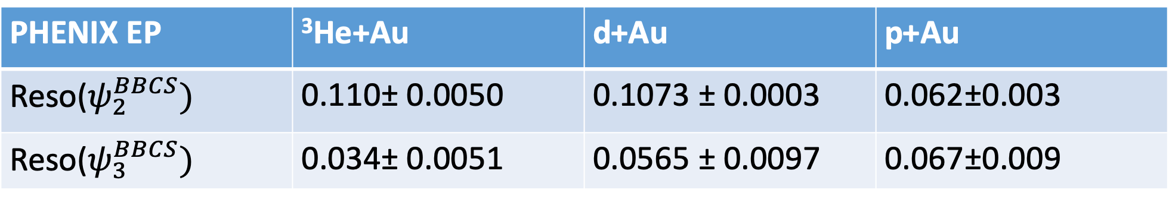
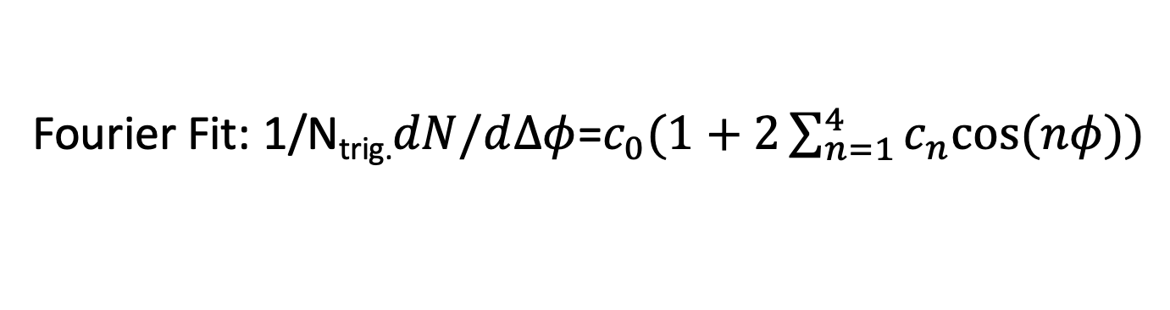
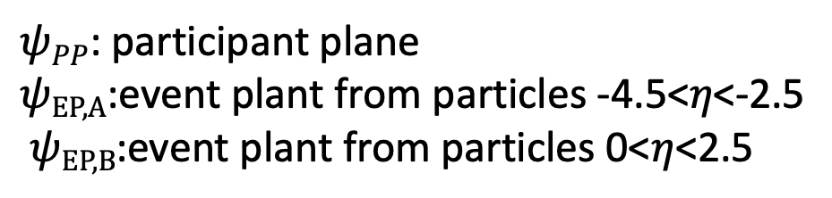
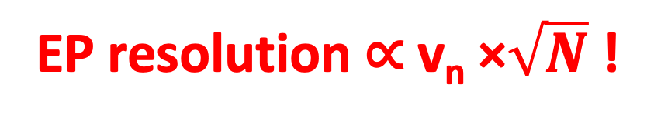

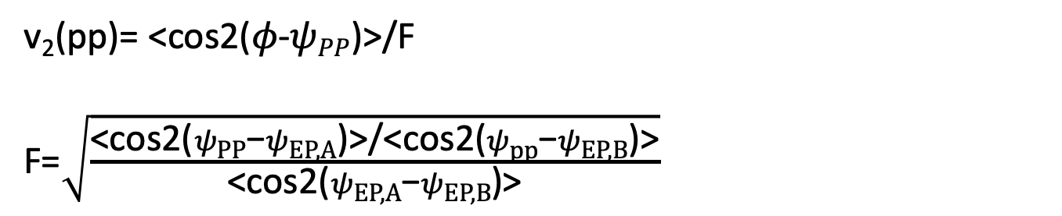
Measurements of v₂, v₃ in p+Au, d+Au and ³He+Au
collisions at 200 GeV from STAR
Shengli Huang for STAR Collaboration
Initial Geometry in Small System
Long-range Correlations and Three Subtraction Methods
Nucleon
Glauber
<𝛆₂>
<𝛆₃>
Fourier Fit: 1/N_{trig.}$dN/d∆φ$=$c_{0}(1+2\sum_{n=1}^{4}{c_{n}cos⁡(nφ)})$
Three Nonflow Subtraction Methods:
1. Sub. by c₀ (yield per trigger): $c_{n,sub}^{sys.}=c_{n}^{sys.}−{(c}_{0}^{pp}/c_{0}^{sys.}){×c}_{n}^{pp}$
2. Sub. by c₁:
$$c_{n,sub}^{sys.}=c_{n}^{sys.}−{(c}_{1}^{sys.}/c_{1}^{pp}){×c}_{n}^{pp}$$
3. Template Fit:
$Y_{templ.}($Δϕ) = F $Y_{pp}(\text{Δϕ}$) + $Y_{ridge}(\text{Δϕ}$)
Where
$Y_{ridge}(\text{Δϕ}$) =G$(1+2\sum_{n=2}^{4}{c_{n,sub}^{sys.}cos⁡(\text{n}\text{Δϕ}))}$
${ v}_{n,sub}^{sys.}=\sqrt{c_{n,sub}^{sys.}}$ ; n=2,3
Quark
Glauber
PHENIX EP | ³He+Au | d+Au | p+Au
Reso($ψ_{2}^{BBCS})$ | 0.110± 0.0050 | 0.1073 ± 0.0003 | 0.062±0.003
Reso($ψ_{3}^{BBCS})$ | 0.034± 0.0051 | 0.0565 ± 0.0097 | 0.067±0.009
Template Fit
ATLAS:PRL(116)172301
Nucleon vs. Quark Glauber
𝛆₃ shows large uncertainties
PHNEIX v₃ EP resolution and v₃ signal show different order
In pAu, PHENIX v₂ and v₃ EP resolution
are same!
PRC95,034910;nature physics 15, 214–220 (2019);
PRL115(2015)142301;PRC96.064905
EP resolution ∝ v_{n} ×$\sqrt{N}$ !
0.2<p_{T}^{trig,asso}<2.0GeV/c; Centrality: # of tracks in TPC |𝜂|<0.9
v_{n} Three subtraction methods
Comparing of different centrality definitions
Comparing with PHNEIX
Subtracted v₂ and v₃ in central p/d/³He+Au collisions at 200 GeV.
Three different subtraction methods show similar results
v₃(w/o sub.) will give a low Limit! Subtraction only increase signal.
v_{n} measured with centrality defined by BBC charge in Au-going direction (-5.0<𝜂<-3.3 ) is similar to that measured with centrality defined by number of TPC track (|𝜂|<0.9 )
STAR observes a similar v₃ in central p/d/³He+Au collisions at 200 GeV.
v₃ measured by STAR is similar to that of ³He+Au from PHENIX while a factor of 3~4 larger than that of p/d+Au
Closure test with HIJING
Nonflow in HIJING: |∆𝜂|>1.5
Nonflow in HIJING: : |∆𝜂|>1.0
HIJING shows a near-side peak for |∆𝜂|>1.0 while data doesn’t in pp@200GeV. Wider near-side jet in HIJING!
Results with |∆𝜂|>1.5 in HIJING is more closer to data and will give a more reasonable closure test
From study using |∆𝜂|>1.5 with centrality defined in |𝜂|<0.9 , three methods well estimate the nonflow contribution in d/³He+Au collision. For p+Au collision, the deviation is less than 20%. Since faction of nonflow is less 60% of c₂ in p+Au, it will give 12% uncertainties for nonflow subtraction
For centrality defined in -5.0<𝜂<3.0 , three methods well estimate the nonflow contribution in p/d/³He+Au collision.
Due to the near-side peak in HIJING, the c₁ and template methods both significantly over subtract the nonflow in pAu collision for centrality defined in |𝜂|<0.9. While c₀ method only 20% less subtract the nonflow.
In the real data, results from three methods are similar. It indicates that the closure testing in HIJING with |∆𝜂|>1.0 is not reliable for data!
Closure test with AMPT
Summary
By three different subtraction methods, v₂ and v₃ have been measured in central p+Au, d+Au and ³He+Au collisions as a functions of p_{T.} at 200 GeV
A closure test for nonflow subtraction has been studied with HIJING and AMPT model. Both indicate that the nonflow is well covered with these subtraction methods
A similar v₃ is observed for p/d/³He+Au collisions! It indicates that sub-nucleon fluctuations play an important role on the initial geometry of small system.
v₂(pp)= <cos2(𝜙-$ψPP$)>/F
F=$\sqrt{\frac{\text{<}\text{cos}\text{2(}ψ\text{PP}\text{−}ψ\text{EP}\text{,}\text{A}\text{)>/<}\text{cos}\text{2(}ψ\text{pp}\text{−}ψ\text{EP}\text{,}\text{B}\text{)>}}{\text{<}\text{cos}\text{2(}ψ\text{EP}\text{,}\text{A}\text{−}ψ\text{EP}\text{,}\text{B}\text{)>}}}$
From study using |∆𝜂|>1.0 with centrality defined in |𝜂|<0.9 , three methods well reproduce the flow measured by participant plane(v2(pp)) in 0–5% p/d+Au collision at 200 GeV.
$ψPP$: participant plane
$ψ\text{EP}\text{,}\text{A}$:event plant from particles -4.5<𝜂<-2.5
$ψ\text{EP}\text{,}\text{B}$:event plant from particles 0<𝜂<2.5

