Slide 1
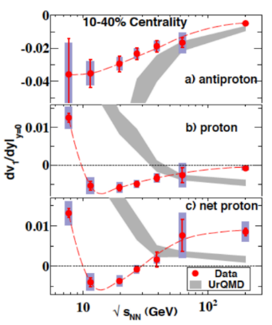
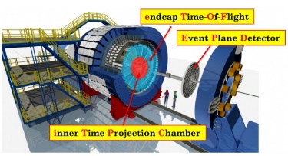
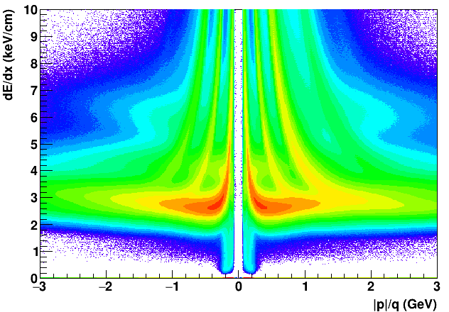
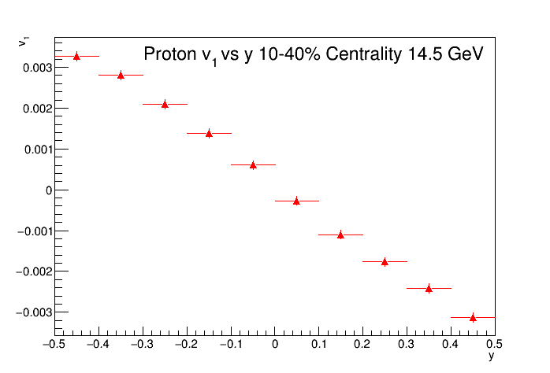
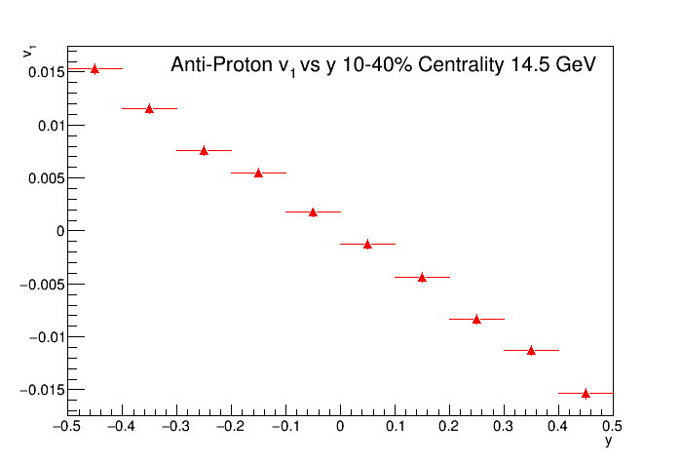
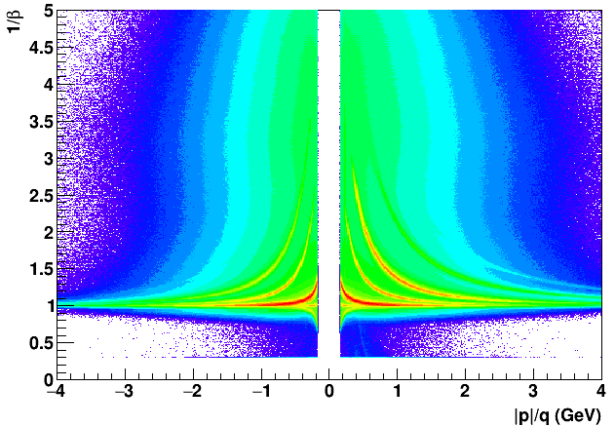
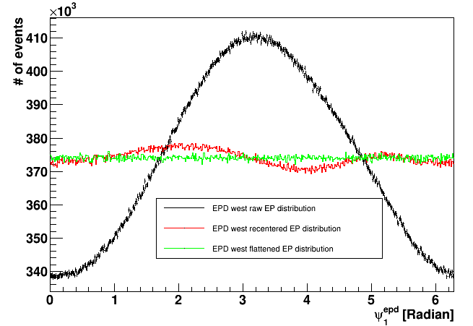
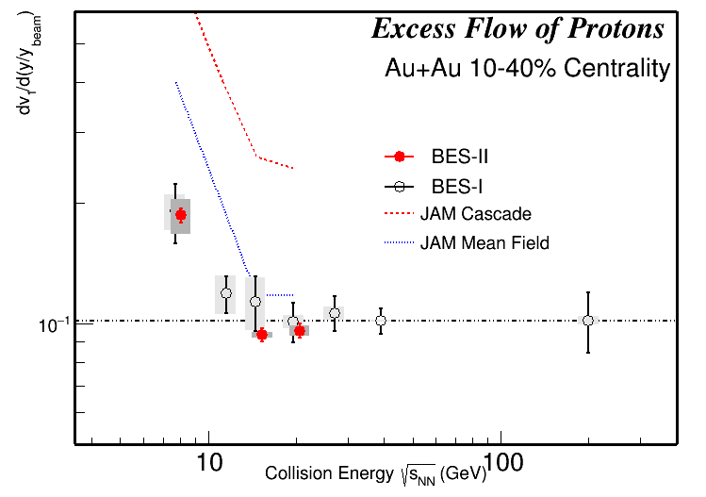
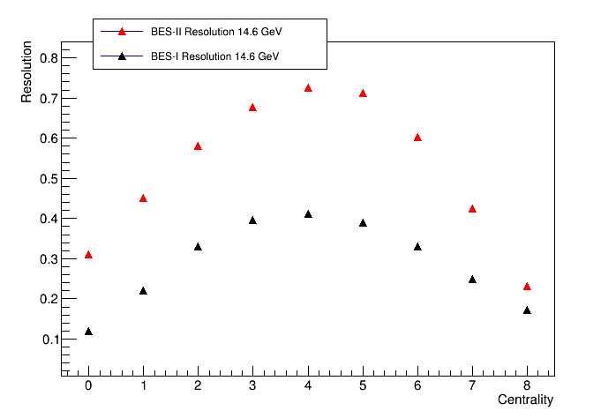
Directed Flow of Protons and Anti-Protons in RHIC Beam Energy Scan II
QM 2023
E. Duckworth (educkwor@kent.edu), Kent State University, for the STAR Collaboration
Abstract
Directed flow of particles is an important feature seen in heavy-ion collisions and is a sensitive probe of the equation of state (EoS) of the matter produced in the collisions. Model calculations have also predicted that directed flow could be a sensitive probe of the softening of EoS associated with a first order phase transition. Directed flow of protons and anti-protons are also of interest as they offer sensitivity to both the contributions from the transported quarks and also the medium generated component from the produced quarks. Measurements of proton and net-proton directed flow from BES-I have shown that there is a non-monotonous dependence on collision energy at mid-rapidity. We will present measurements of the directed flow of protons and antiprotons from 19.6, 14.6, and 7.7 GeV Au+Au collisions for 10-40% centrality, using high statistics BES-II data from the STAR experiment at RHIC. We will also present a decomposition of proton directed flow into a medium generated component and a component (v₁ excess) attributed to transported protons. The excess v₁ is found to show a simple scaling between collision energies of 200 GeV to ~10 GeV, but to break scaling below that. The new results have significantly reduced uncertainties and also allow differential measurements in centrality and transverse momentum. Measurements will be compared to different model calculations and implications to the understanding of the QCD phase structure and EoS of the medium will be discussed.
Motivation
dv₁/dy of net protons at mid-rapidity exhibits non-monotonic behavior as a function of collision energy.
$$v_{1,net}=\frac{\left(v_{1,p}−rv_{1\overline{p}}\right)}{1−r}$$
(r is the yield ratio of anti-protons to protons)
Alternatively, we can look at excess proton v₁ to better understand the origin of the proton v₁ and its beam energy dependence.
$$v_{1,excess}=\frac{\left(v_{1,p}−v_{1\overline{p}}\right)}{1−r}$$
Particle Identification
Protons and anti-protons were identified using both dE/dx and Time of Flight (TOF). Tracks with <dE/dx> less than 3 sigmas away from expected value, and a TOF measured mass of 0.8<m²<1.0 GeV were identified as protons.
Event Plane
The event plane is measured by the Event Plane Detector (EPD) based on number of Minimally Ionizing Particles (nMIP). The Event plane was recentered and flattened to correct for detector biases causing non uniform distributions of the event plane.
The Event plane resolution was greatly improved from BES-I to BES-II. This allows for a more accurate v₁ measurement.
Proton and Anti-Proton V₁ measurements at 14.6 GeV
Proton v₁ vs y 10-40% Centrality 14.6 GeV
0.4<P_{T}<3.0 GeV
Systematics not shown
STAR Preliminary
Anti-Proton v₁ vs y 10-40% Centrality 14.6 GeV
0.4<P_{T}<3.0 GeV
Systematics not shown
STAR Preliminary
Summary
Excess v₁ scales with beam rapidity from 200 GeV down to at least 14.6 GeV. The JAM Mean Field Model seems to qualitatively describe the behavior more accurately than JAM Cascade. The JAM Mean Field is close to data at 14.6 and 19.6 GeV, but cannot simultaneously reproduce the result at 7.7 GeV. Extending to lower energies, there is clear breaking of scaling at or above 7.7 GeV with the BES-II dataset analysis, indication change in medium and collision dynamics at 7.7 GeV.
References
J. Adams et al., Nucl. Instrum. Meth. A 968 (2020) 163970
A. Poskanzer & S. Voloshin, Phys. Rev. C 58 (1998) 1671
STAR Collaboration, Phys. Rev. Lett. 120 (2018) 62301
Voloshin, Sergei A. Phys Rev C.55.1630
RMF EoS, Κ = 380 MeV, Y. Nara et al. Phys. Rev. C 100, 054902 (2019)
STAR Preliminary
Supported in part by the
The STAR Collaboration https://drupal.star.bnl.gov/STAR/presentations

