Slide 1


Identified Light and Strange Hadron Spectra at = 14.5 GeV and Systematic Study of Baryon/Meson Effect at Intermediate Transverse Momentum with STAR at RHIC BES I
Daniel Brandenburg
Rice University
For the STAR collaboration

Slide 2
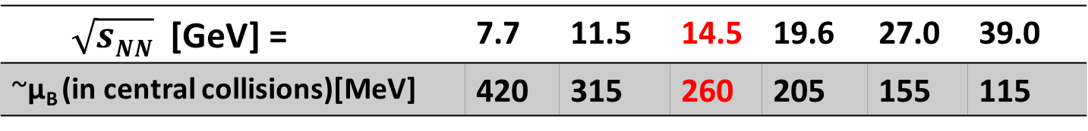
RHIC Beam Energy Scan (BES) Phase I
BES Phase I - Au+Au collisions at 7.7, 11.5, 14.5, 19.6, 27.0, and 39.0 GeV
  Search for Conjectured QCD critical point
  Search for 1st order phase transition
  Search for the onset of key QGP signatures
= 14.5 GeV
  Important measurement in the relatively large μ_{B} gap between 11.5 and 19.6 GeV
?
$\sqrt{sNN}$ [GeV] = | 7.7 | 11.5 | 14.5 | 19.6 | 27.0 | 39.0
~μ_{B} (in central collisions)[MeV] | 420 | 315 | 260 | 205 | 155 | 115
J. Cleymans, H. Oeschler, K. Redlich, and S. Wheaton, Phys. Rev. C73 (2006) 034905

Slide 3
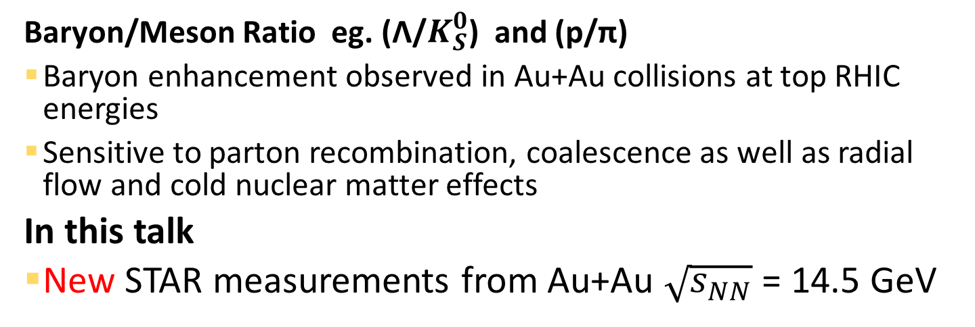
Onset of QGP Signatures
Nuclear Modification Factor R_{CP}
High p_{T} suppression R_{CP} < 1.0
  Strong suppression observed in inclusive charged hadrons at top RHIC energies.
  Attributed to energy loss in QGP
Enhancement R_{CP} > 1.0
  Cold nuclear matter effects and radial flow.
Baryon/Meson Ratio eg. (Λ/$K_{S}^{0}$) and (p/π)
Baryon enhancement observed in Au+Au collisions at top RHIC energies
Sensitive to parton recombination, coalescence as well as radial flow and cold nuclear matter effects
In this talk
New STAR measurements from Au+Au $\sqrt{s_{NN}}$ = 14.5 GeV

Slide 4
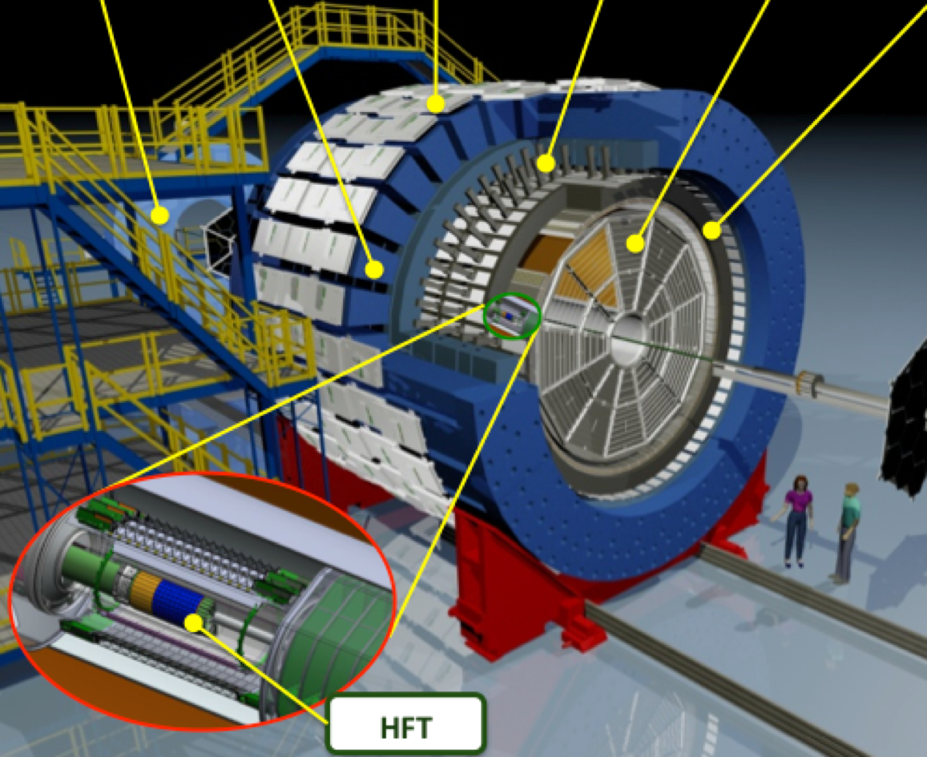
STAR Detector
EEMC
Magnet
MTD
BEMC
TPC
TOF
Time Projection Chamber (TPC)
Charged Particle Tracking
Momentum reconstruction
Particle identification from ionization energy loss (dE/dx)
Pseudorapidity coverage |η| < 1.0
Time Of Flight (TOF) Detector
Particle identification 1/β
Pseudorapidity coverage |η| < 0.9
VPD
BBC
VPD and BBC detectors are used to trigger minimum bias collisions

Slide 5
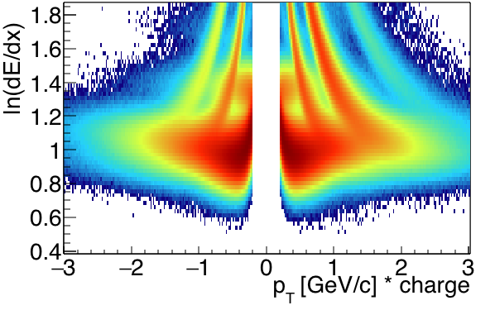
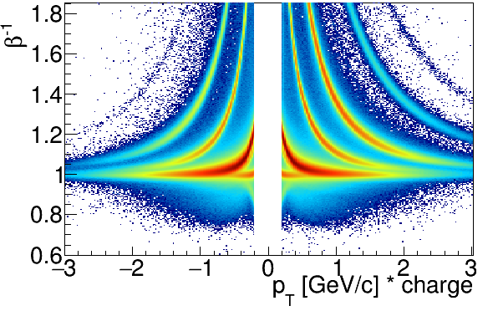


Particle Identification @ STAR
TPC
Au+Au $\sqrt{s_{NN}}$=14.5 GeV
TOF
Au+Au $\sqrt{s_{NN}}$=14.5 GeV
STAR Preliminary

Slide 6
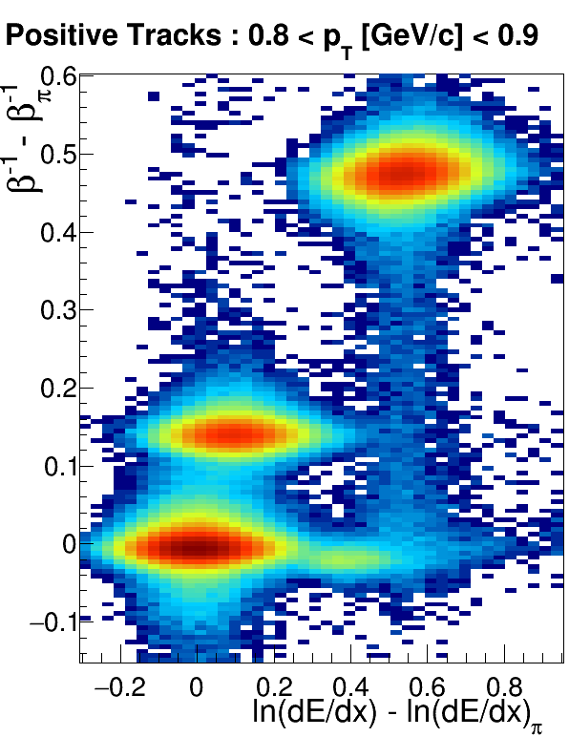

Particle Identification @ STAR
TPC
ln
ln(dE/dx)_{π} =
ideal dE/dx for pion from Bichsel
p
Au+Au $\sqrt{s_{NN}}$=14.5 GeV
TOF
K
Expected
π
e
Au+Au $\sqrt{s_{NN}}$=14.5 GeV
Au+Au $\sqrt{s_{NN}}$=14.5 GeV
STAR Preliminary

Slide 7
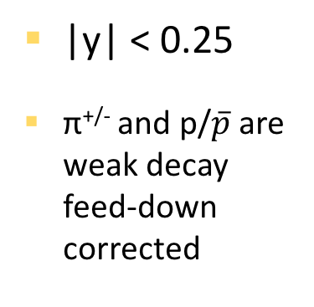
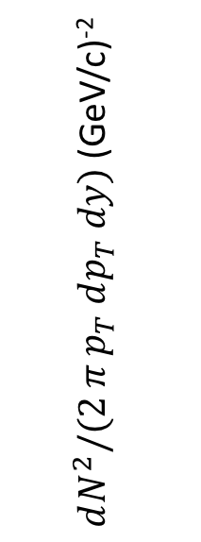
Light Hadron Spectra @ Au+Au =14.5 GeV
Centrality :
STAR Preliminary
STAR Preliminary
$dN^{2}/(2 π p_{T} dp_{T} dy)$ (GeV/c)⁻²
|y| < 0.25
π^{+/-} and p/$\overline{p}$ are weak decay feed-down corrected
STAR Preliminary
STAR Preliminary
Notes:
Light

Slide 8
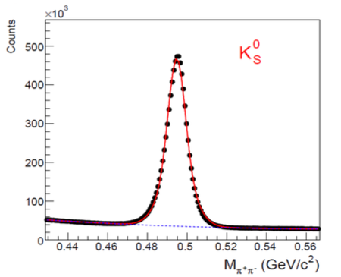
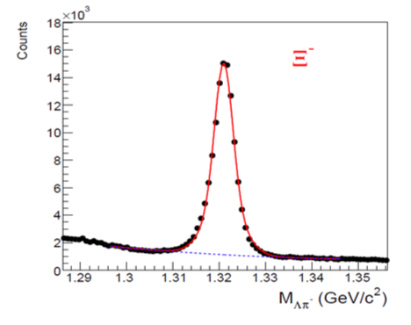
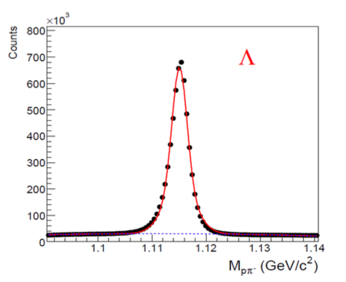
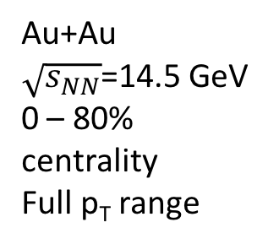
Topological Particle Identification
  Reconstruct secondary vertex from charged decay products
  Use topological cuts
  Extract yield by fitting to invariant mass peak
Au+Au
$\sqrt{s_{NN}}$=14.5 GeV
0 – 80% centrality
Full p_{T} range

Slide 9
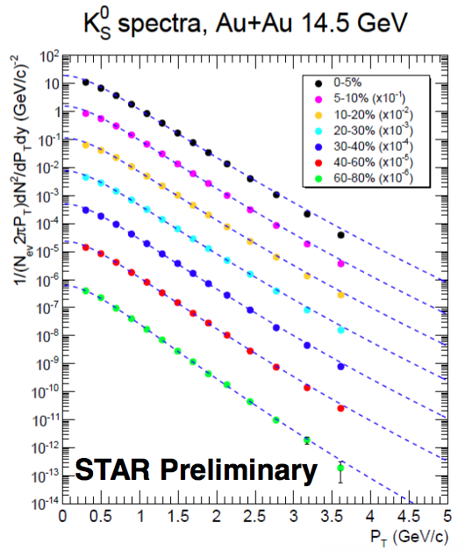
Strange Hadron Spectra @Au+Au = 14.5 GeV
Statistical Uncertainties only
|y| < 0.5
Fit with Levy function

Slide 10
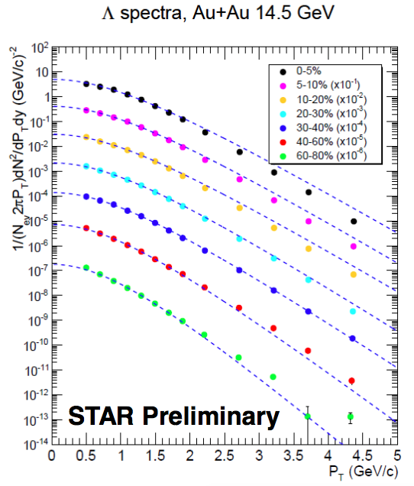
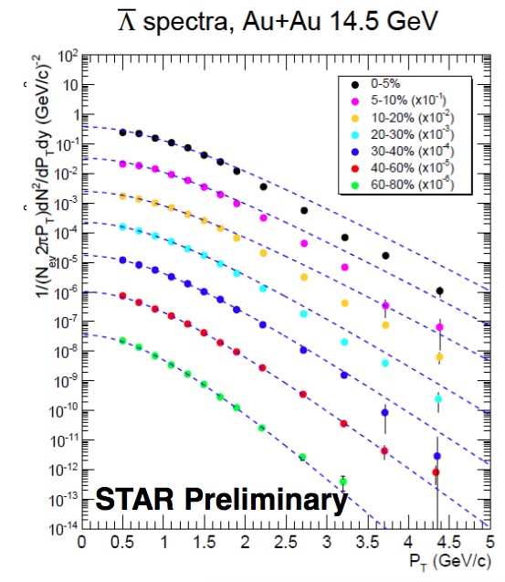
Strange Hadron Spectra @Au+Au = 14.5 GeV
Statistical Uncertainties only
|y| < 0.5
Λ spectra are weak decay feed-down corrected
Fit with Boltzmann function

Slide 11
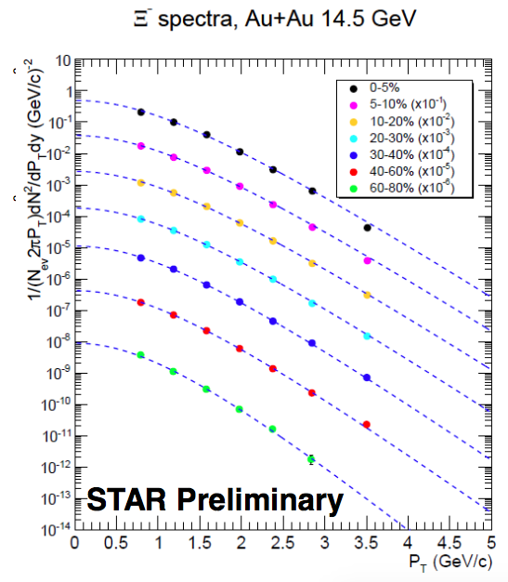
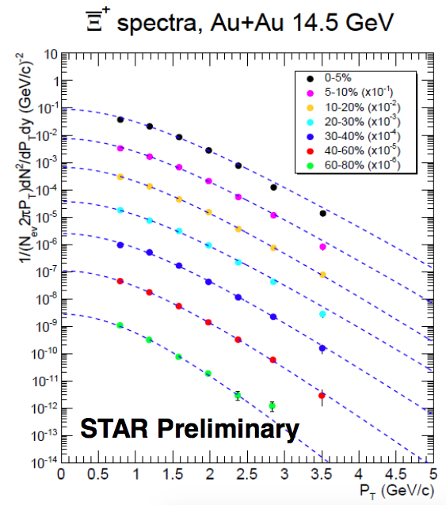
Strange Hadron Spectra @Au+Au = 14.5 GeV
Statistical Uncertainties only
|y| < 0.5
Fit with Boltzmann function

Slide 12
Nuclear Modification Factor R_{CP} (0-5%)/(60-80%)@ Au+Au $\sqrt{s_{NN}}$ = 14.5
STAR Preliminary
STAR Preliminary
R_{CP} (0-5%) / ( 60-80% )
STAR Preliminary
systematic uncertainty on
STAR Preliminary
Enhancement observed for protons
Pions around unity for p_{T}>2.0 GeV/c
Stat. uncertainties – vertical bars
Syst. uncertainties - vertical boxes
Bin width – horizontal box size

Slide 13
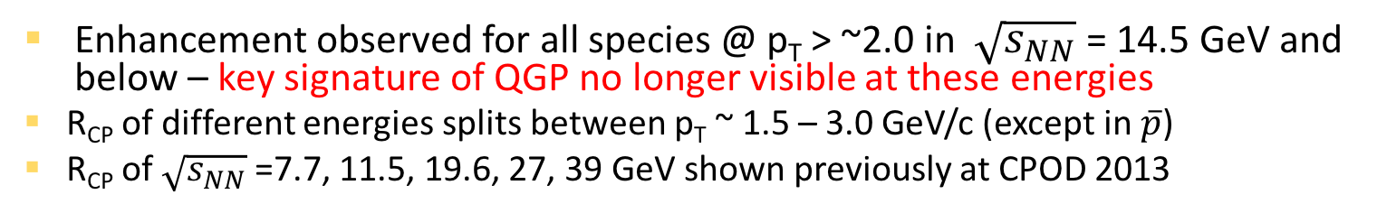
Nuclear Modification Factor R_{CP} (0-5%)/(60-80%)@ BES I Energies
STAR Preliminary
STAR Preliminary
R_{CP} (0-5%) / ( 60-80% )
STAR Preliminary
STAR Preliminary
Enhancement observed for all species @ p_{T} > ~2.0 in $\sqrt{s_{NN}}$ = 14.5 GeV and below – key signature of QGP no longer visible at these energies
R_{CP} of different energies splits between p_{T} ~ 1.5 – 3.0 GeV/c (except in $\overline{p}$)
R_{CP} of $\sqrt{s_{NN}}$ =7.7, 11.5, 19.6, 27, 39 GeV shown previously at CPOD 2013

Slide 14
Strange Hadron R_{CP} (0-5%)/(40-60%)@ BES I Energies
Statistical Uncertainty Only
R_{CP} (0-5%) / ( 40-60% )
STAR Preliminary
STAR Preliminary
STAR Preliminary
STAR Preliminary
STAR Preliminary
STAR Preliminary
Ω R_{CP} in 19.6 and 27 GeV : (0-10%) / (40-60%)
For = 14.5 GeV and below:
R_{CP} is greater than or equal to 1 for p_{T} > ~1.5 GeV/c
R_{CP} particle type dependence becomes less significant
Specifically baryon vs. meson difference at intermediate p_{T} becomes less pronounced

Slide 15
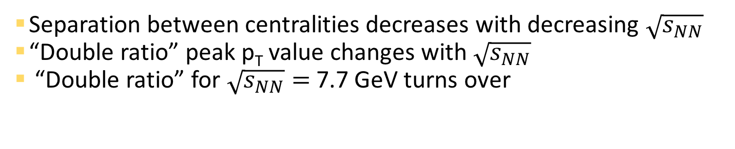
Baryon/Meson Ratio : p/π⁺ @ BES I
Separation between centralities decreases with decreasing $\sqrt{s_{NN}}$
“Double ratio” peak p_{T} value changes with $\sqrt{s_{NN}}$
“Double ratio” for $\sqrt{s_{NN}}=$7.7 GeV turns over
(0-5%) Central (Red)
(60-80%) Peripheral (Yellow)
Au+Au
STAR Preliminary
STAR Preliminary
STAR Preliminary
STAR
Preliminary
STAR Preliminary
STAR Preliminary
STAR Preliminary
STAR Preliminary

Slide 16
Baryon/Meson Ratio : p/π⁺ @ BES I
Separation between centralities decreases with decreasing $\sqrt{s_{NN}}$
“Double ratio” peak p_{T} value changes with $\sqrt{s_{NN}}$
“Double ratio” for $\sqrt{s_{NN}}=$7.7 GeV turns over
(0-5%) Central (Red)
(60-80%) Peripheral (Yellow)
Au+Au
STAR Preliminary
STAR Preliminary
STAR Preliminary
STAR
Preliminary
STAR Preliminary
STAR Preliminary
STAR Preliminary
STAR Preliminary

Slide 17

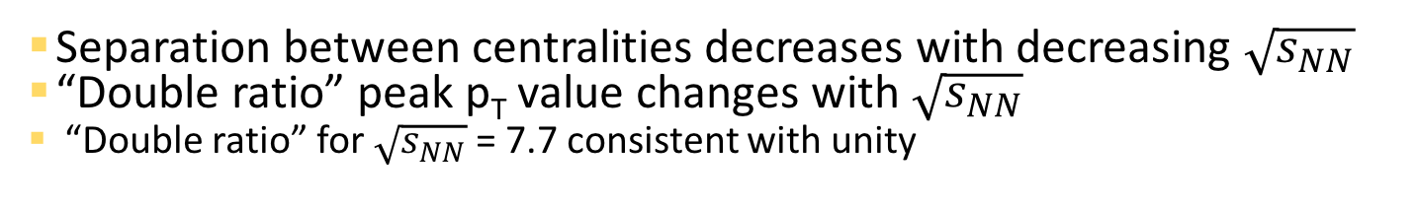
Baryon/Meson Ratio : Λ/$K_{s}^{0}$ @ BES I
Separation between centralities decreases with decreasing $\sqrt{s_{NN}}$
“Double ratio” peak p_{T} value changes with $\sqrt{s_{NN}}$
“Double ratio” for $\sqrt{s_{NN}}$ = 7.7 consistent with unity
(0-5%) Central (Red)
(40-60%) Peripheral (Dark Blue)
Statistical Uncertainty Only
Au+Au
STAR Preliminary
STAR Preliminary
STAR Preliminary
STAR Preliminary
STAR Preliminary
STAR Preliminary
STAR Preliminary
STAR Preliminary

Slide 18
Baryon/Meson Ratio : Λ/$K_{s}^{0}$ @ BES I
Separation between centralities decreases with decreasing $\sqrt{s_{NN}}$
“Double ratio” peak p_{T} value changes with $\sqrt{s_{NN}}$
“Double ratio” for $\sqrt{s_{NN}}$ = 7.7 consistent with unity
(0-5%) Central (Red)
(40-60%) Peripheral (Dark Blue)
Statistical Uncertainty Only
Au+Au
STAR Preliminary
STAR Preliminary
STAR Preliminary
STAR Preliminary
STAR Preliminary
STAR Preliminary
STAR Preliminary
STAR Preliminary

Slide 19
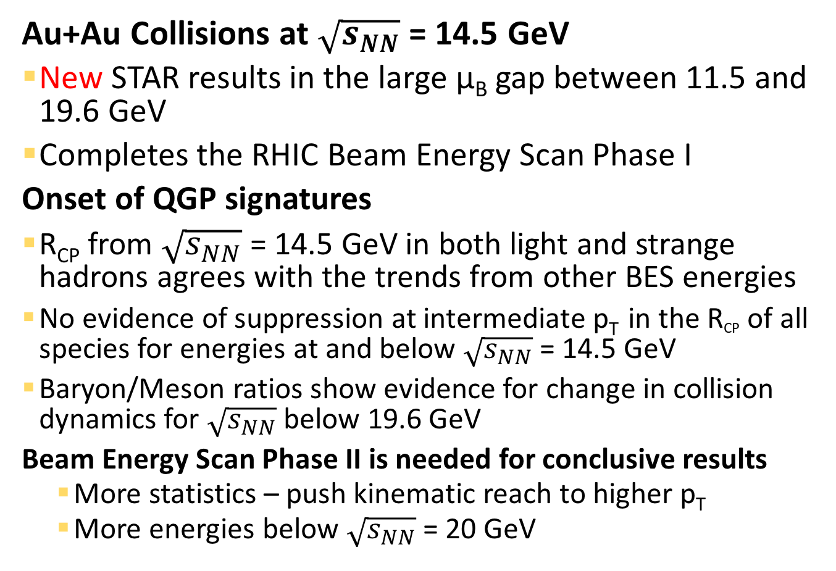
Conclusions
Au+Au Collisions at $\sqrt{s_{NN}}$ = 14.5 GeV
New STAR results in the large μ_{B} gap between 11.5 and 19.6 GeV
Completes the RHIC Beam Energy Scan Phase I
Onset of QGP signatures
R_{CP} from $\sqrt{s_{NN}}$ = 14.5 GeV in both light and strange hadrons agrees with the trends from other BES energies
No evidence of suppression at intermediate p_{T} in the R_{CP} of all species for energies at and below $\sqrt{s_{NN}}$ = 14.5 GeV
Baryon/Meson ratios show evidence for change in collision dynamics for $\sqrt{s_{NN}}$ below 19.6 GeV
Beam Energy Scan Phase II is needed for conclusive results
  More statistics – push kinematic reach to higher p_{T}
  More energies below $\sqrt{s_{NN}}$ = 20 GeV

Slide 20
THANK YOU

Slide 21
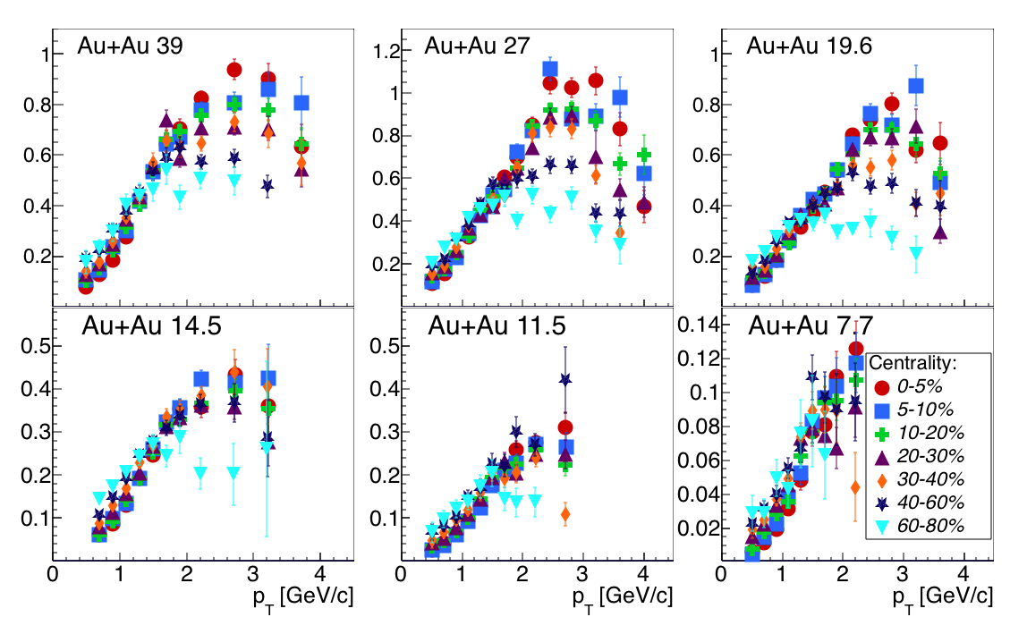



Baryon/Meson Ratio : $\overline{Λ}$/$K_{s}^{0}$ @ BES I
(0-5%) Central (Red)
(40-60%) Peripheral (Dark Blue)
Statistical Uncertainty Only
Au+Au
STAR Preliminary
$$\overline{Λ}/K_{s}^{0}$$
STAR Preliminary
STAR Preliminary
STAR Preliminary
$$\overline{Λ}/K_{s}^{0}$$
STAR Preliminary
STAR Preliminary
STAR Preliminary

Slide 22
Baryon/Meson Ratio p-bar/π⁻ @ BES I
Most Central (Red)
Most Peripheral (Yellow)
STAR Preliminary
STAR Preliminary
STAR Preliminary
STAR Preliminary
STAR Preliminary
STAR Preliminary
STAR Preliminary

Slide 23
π⁺⁽⁻⁾, K⁺⁽⁻⁾, and (anti-)proton particle identification
Extract yields by simultaneously fitting the dE/dx and 1/β distributions.
Combined TPC + TOF for a single p_{T} bin
STAR Preliminary
Project 1/β
Proton
π
K
p
Project
dE/dx
Kaon
π
STAR Preliminary
p
Pion
electrons
K
STAR Preliminary
Grey bands show +/- 2σ around each particle peak
The pion and kaon peaks are merged in dE/dx but are still well separated in 1/β
The black band is the total fit result

